Slide 1


A little Programming:

Slide 2
A little Programming:
User defined function example:
Compute the intensities of the Planck distribution
Let the user input a Temperature
Let the user input start and endpoint. Assume it is in nm
Careful here. Make sure wavelength units are consistent with the other constants.

Slide 3
A little Programming:
Hints:
Have the user set the wavenumber range and generate a sequence from it:
The “wavenumber axis”
nut <- seq(from=nut.min, to=nut.max, length.out=2500)

Slide 4
che302r library
First install the che302r library:
install.packages("remotes") # package to install R stuff from GitHub
library(devtools) # load remotes
install_github("npetraco/che302r") # install our che302r library

Slide 5
che302r library
Quick tour of the che302r library:
library(che302r)
# Some pre-defined constants:
h # Planck's const
hb # Reduced Planck's const
cl # Speed of light
kB # Boltzmann's const
# What other constants are currently in che302r?:
?constants
# Check out current help for anything in the library:

Slide 6
Coding Example
# This is a function to plot the Plank distribution as a
# function of wavenumber.
pplanck.distribution.nutilde <- function(nut.min, nut.max, Temp) {
#Make a nu-tilde (nut) axis. This is the x-axis.
nut <- seq(from=nut.min, to=nut.max, length.out=2500)
#Planck's dist as a function of nu-tilde (nut). This is the
#y-axis.
rho <- 2*h*(cl^2)*(nut^3) * (1/(exp((h*cl*nut)/(kB*Temp))-1))
#Make the plot.
plot(nut, rho, typ="l", xlab="nu-tilde (m^-1)", ylab="Intensity",
main="Planck's distribution")
}

Slide 7
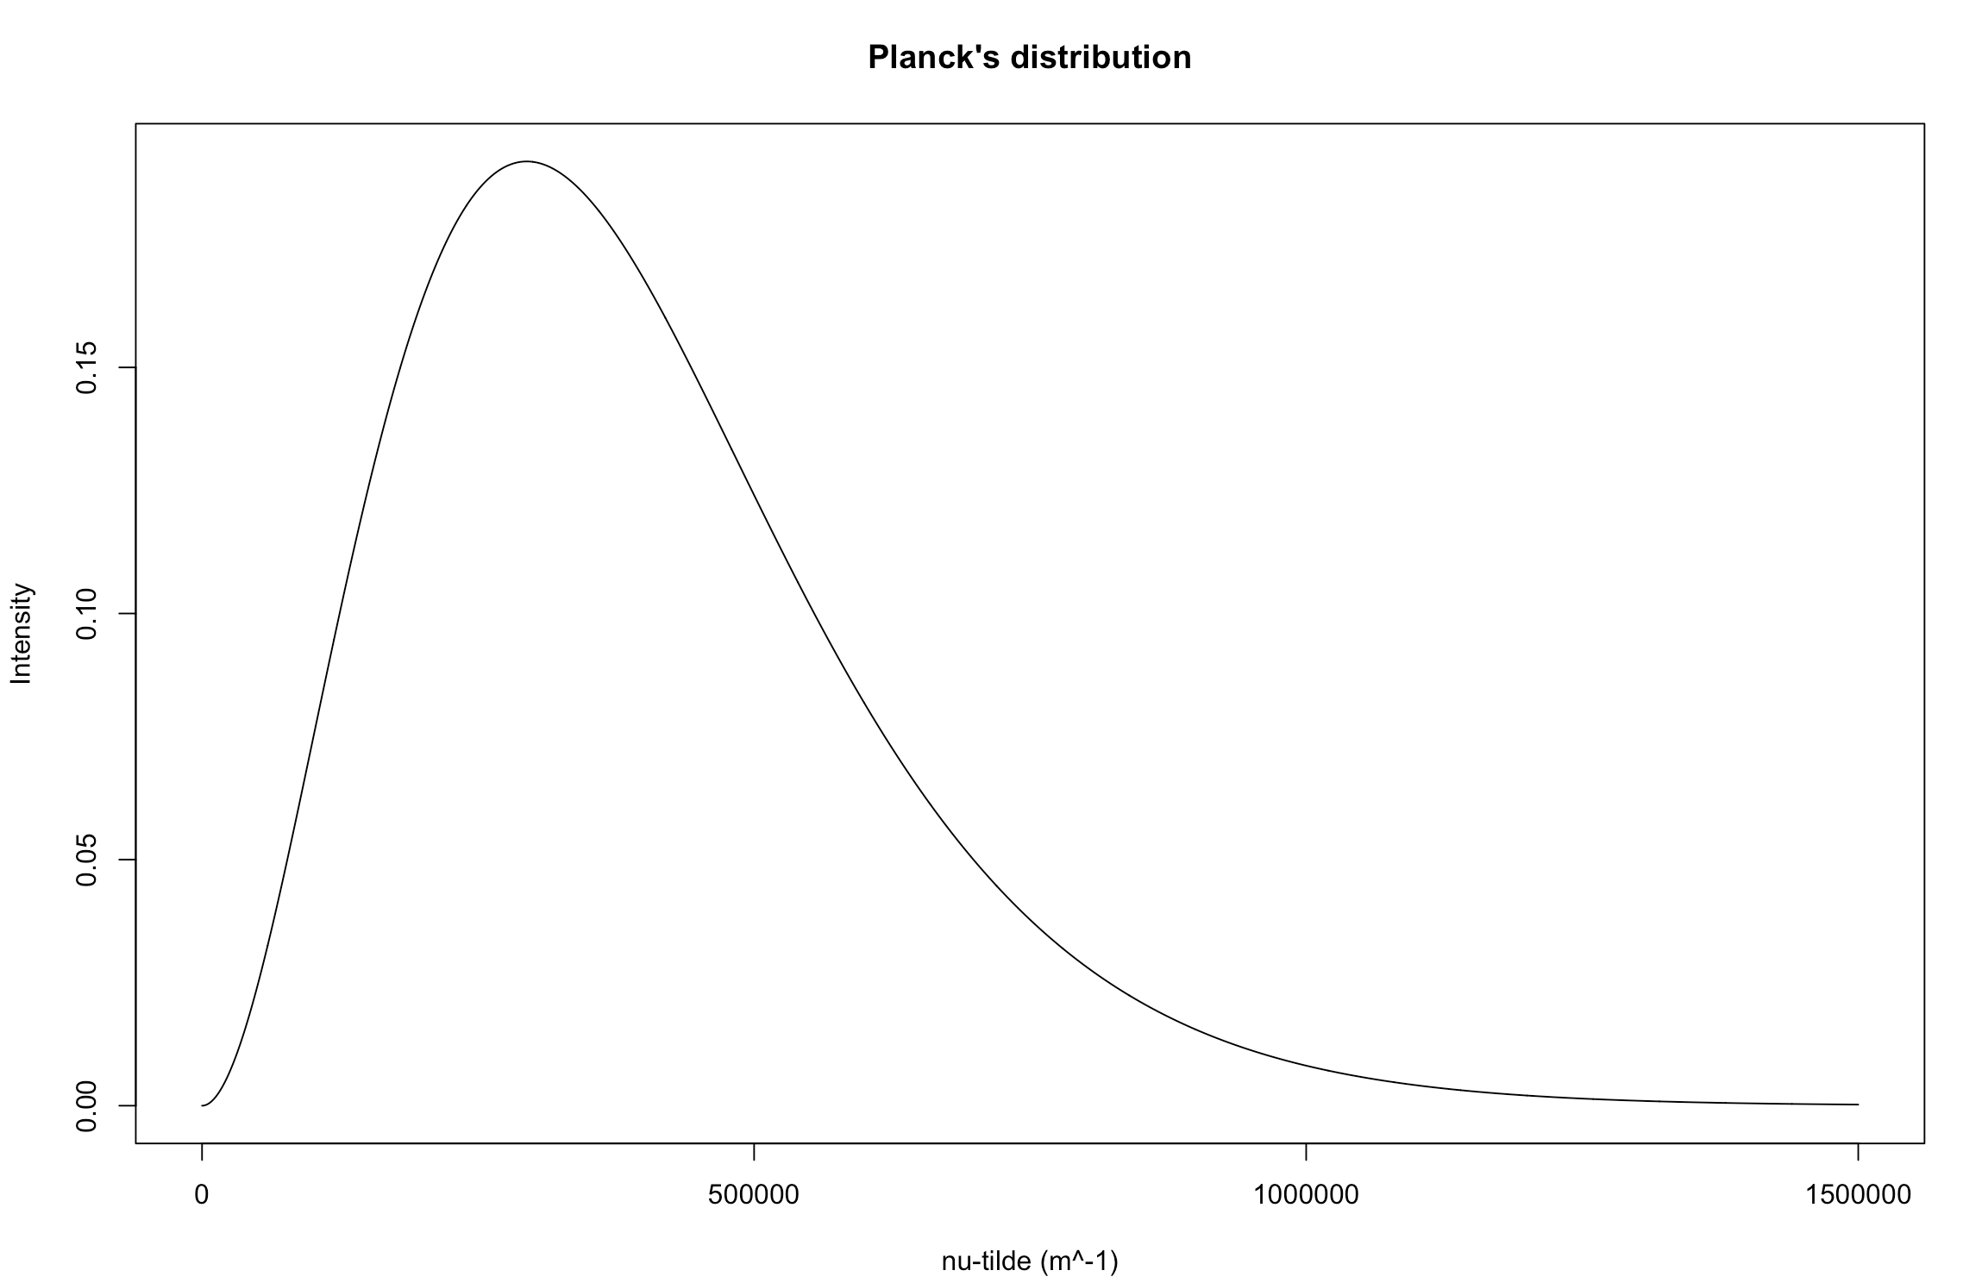
#Now USE the function planck.distribution.nutilde below:
pplanck.distribution.nutilde(0.1,1500000,1500)

