Slide 1
Quantum Theory I
An Overview

Slide 2
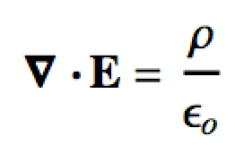
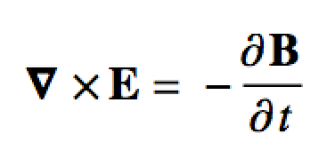
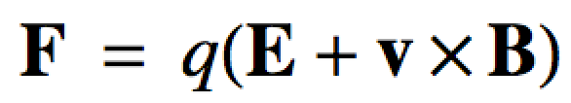
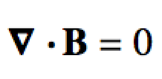
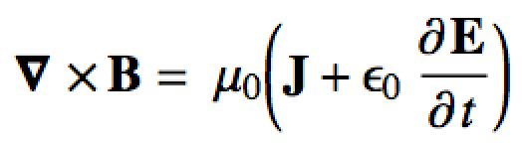
Introduction
The development of classical physics (based on Newton’s laws) culminated in James Clerk Maxwell’s equations:
Maxwell’s equations cannot however:
…explain the constant speed of light
…reproduce the black-body distribution

Slide 3
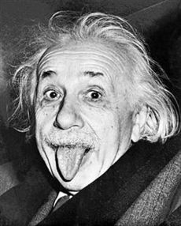
Introduction
The constant speed of light lead to Einstein’s special theory of relativity
We won’t need to use relativity directly for the spectroscopies we study
E = mc²
The explanation of the black body distribution was much more profound!
So what’s a black body…?

Slide 4

Black Body Radiation
Think of electro-magnetic (e-m) radiation as a “wave”
Wave energy frequency
Lower freq. (longer wavelength) = lower energy
Higher freq. (shorter wavelength) = higher energy

Slide 5
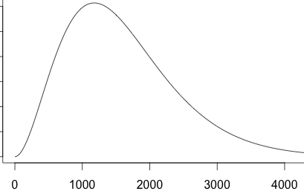
Black Body Radiation
Black body: An (idealized) absorber and emitter of e-m radiation at all frequencies
Absorbs, so is “hot” (not 0 K)
Emits an amount (intensity) of e-m at all frequencies
Absorb
Emit

Slide 6
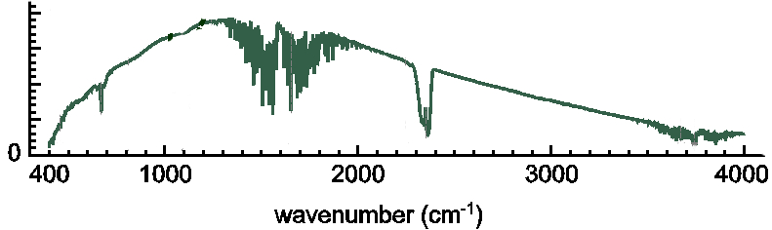
Black Body Radiation
Theoretical black bodies don’t exist…
BUT… pretty much anything that can absorb and emit a wide range of e-m radiation will approximately behave as a black body!
Ideal BB
@ 600K
Nernst element in an FT-IR
Pretty much anything then is an approximate black body
Light bulbs and electric kitchen stoves are good examples

Slide 7
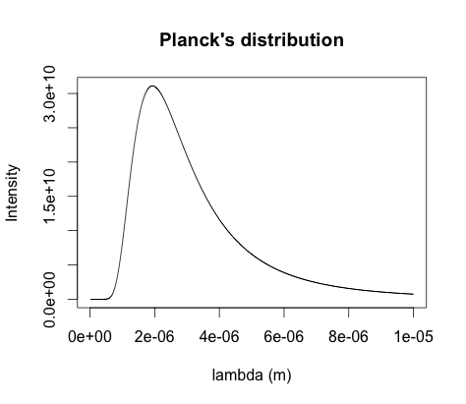
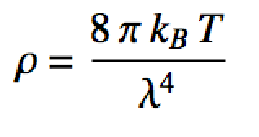
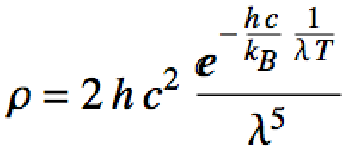
Black Body Radiation
Maxwell’s equations/Classical mechanics could not model the BB curve in its entirety
Rayleigh-Jeans eq.
ρ (Intensity)
Wein’s eq.
λ (wavelength)

Slide 8
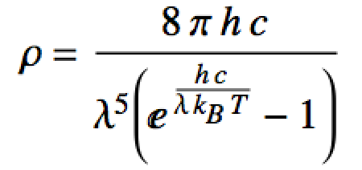
Black Body Radiation
Using Rayleigh-Jeans (theory), Wein (empirical) and assuming energy is discrete (quantized) Max Planck modeled the whole curve!
We’ll get a better idea where this is from after particle in a box
Planck distribution
ρ (Intensity)
λ (wavelength)

Slide 9
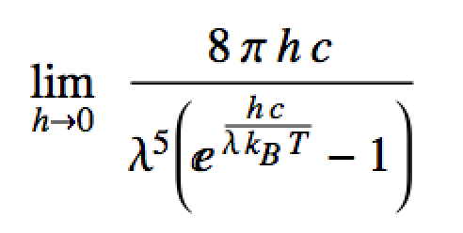
Planck’s Constant
Planck’s constant is the “fudge factor” that turns classical mechanics into quantum mechanics
h = 6.626 ×10⁻³⁴ J s Planck’s constant
Small BUT not = 0!
What happens to ρ as h ➔ 0??

Slide 10
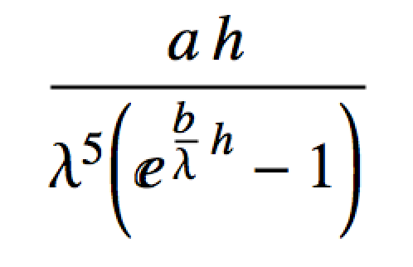

Planck’s Constant
Planck’s distribution is like:
Limit as h ➔ 0 ??

Slide 11
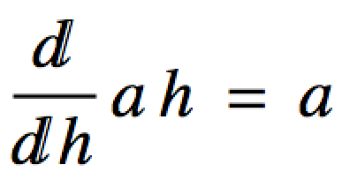
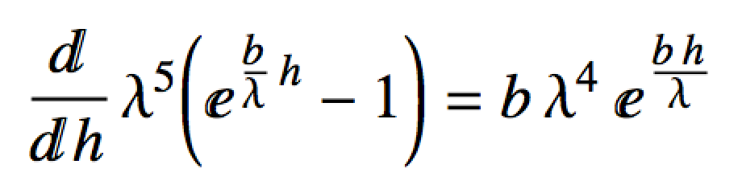
Planck’s Constant
Use L’Hopital’s Rule!
Derivative of the numerator
Derivative of the denominator

Slide 12
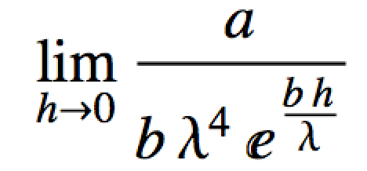
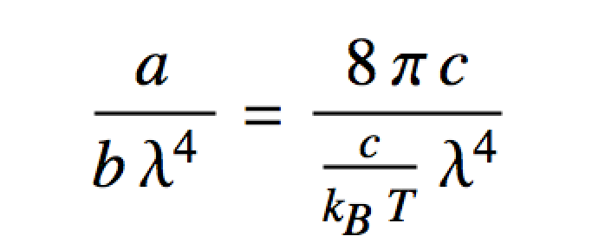
Planck’s Constant
Use L’Hopital’s Rule!
Rayleigh-Jeans eq.
Derived entirely from classical mechanics!

Slide 13
Handy Constants and Symbols To Know
h = 6.626 ×10⁻³⁴ J s Planck’s constant
ħ = 1.055 ×10⁻³⁴ J s Reduced Planck’s constant
k_{B} = 1.381 ×10⁻²³ J/K Boltzmann’s constant
c = 2.998 ×10⁸ m/s speed of light in a vacuum
λ = wavelength
ν = frequency

