Slide 1
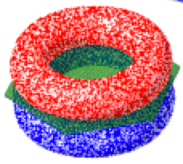
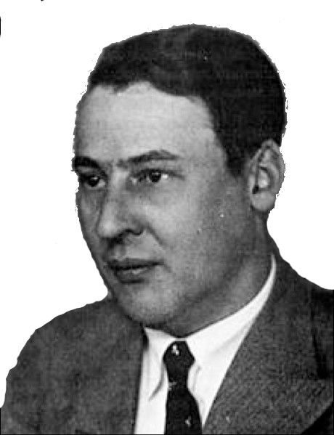
Qualitative Molecular Orbitals on a Computer

Slide 2
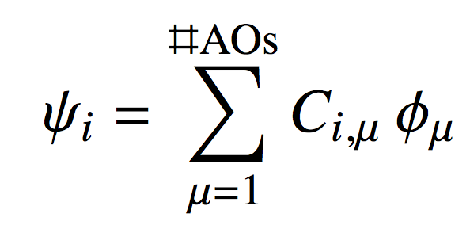
The Molecular Orbital Model
In lecture we learned that molecular orbitals are a “mixing together” of all the atomic orbitals of all the atoms making us a molecule
Mathematically, the “mixing recipe” is LCAO:
An MO
AOs

Slide 3
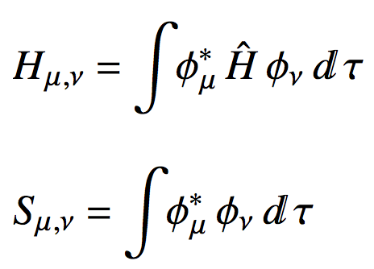
The Molecular Orbital Model
To visualize MOs we must determine the MO coefficients C_{i,μ}
We get them from the matrix form of the Schrodinger equation: HC = SCE
We then need the matrix elements for H and S

Slide 4
The Huckel Molecular Orbital Model
These are not easy integrals to evaluate!
Also, task is even harder if there are a lot of AOs
We’ll make a seemingly drastic approximation:
Only p_{z} orbitals on “heavy” atoms (i.e.not H)
Only one valence e- on each “heavy” atom
We’ll “guess” the value of the Hamiltonian and overlap integrals we’ll need.

Slide 5
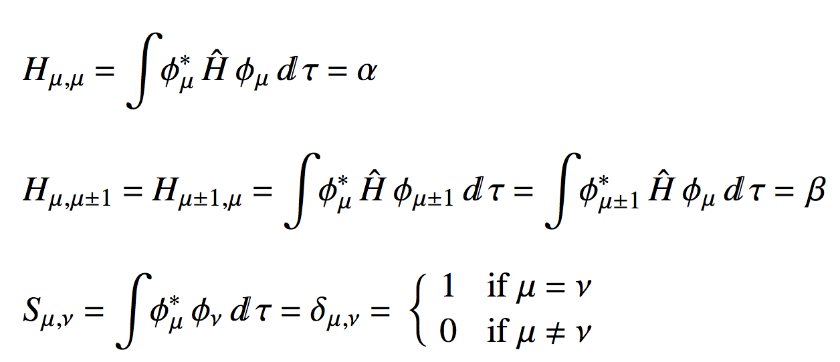
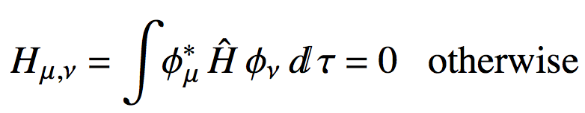
The Huckel Molecular Orbital Model
The “Huckel integrals” are:

Slide 6
The Huckel Molecular Orbital Model
The values of α and β (this is going to be VERY sophisticated)
α = 0
β = -1
φ₁
φ₂
φ₃
φ₄
φ₅
φ₆
φ₁
α
β
0
0
0
0
−1
β
−1
φ₂
β
α
β
0
0
0
−1
0
−1
H =
φ₃
0
β
α
0
0
−1
0
β
−1
φ₄
0
0
β
α
−1
0
β
0
−1
φ₅
β
α
0
0
0
−1
0
β
−1
φ₆
β
0
0
0
−1
α
β
0
−1

Slide 7
The Huckel Molecular Orbital Model
The Huckel overlap matrix is only ever going to look something like this:
φ₁
φ₂
φ₃
φ₄
φ₅
φ₆
φ₁
1
0
0
0
0
0
φ₂
0
1
0
0
0
0
S =
φ₃
0
0
1
0
0
0
φ₄
0
0
0
1
0
0
φ₅
0
0
0
0
1
0
φ₆
0
0
0
0
0
1
This is the equivalent to 1 for matrices

Slide 8
The Molecular Orbital Model
So to “solve” HC = SCE in Huckel theory, all we really need to do is “solve” HC = CE
“Solving” HC = CE means diagonalizing H
C eigenvectors of H
E eigenvalues of H
In R use eigen(H) to diagonalize!

Slide 9
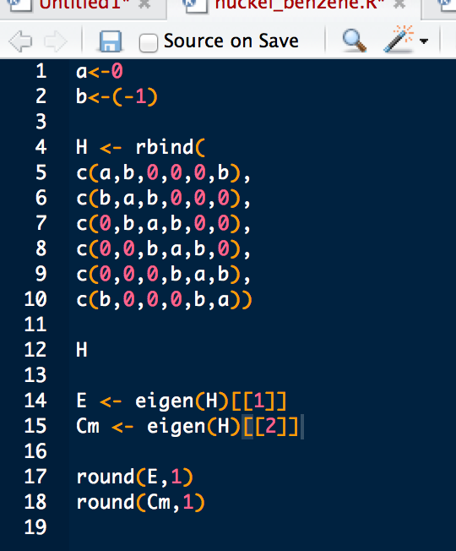
In RStudio
Define α and β
Define H for your molecule
Note how we rbind rows of H together
Get the eigenvects/vals
Make your output a little easier to read

Slide 10
The Molecular Orbital Model
Write down the Huckel Hamiltonian for:
Get the C matricies for each molecule, sketch the MOs and MO energy diagram

Slide 11
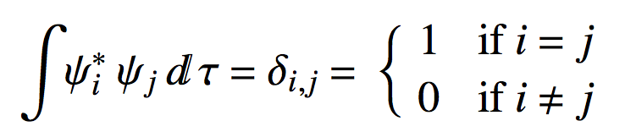
The Molecular Orbital Model
MOs, just like AOs should be orthonormal:
The columns of the C matrix play the role of MO wave functions
To check the orthonormality of the MOs we got, matrix multiply the C matrix by its inverse:
C^{T}C = 1
In R this is how we the above: t(Cm)%*%Cm

