Slide 1


A little Programming:

Slide 2
A little Programming:
User defined function example:
Compute the intensities of the Planck distribution
Let the user input a Temperature
Let the user input endpoint. Assume it is in nm
Careful here. Make sure wavelength units are consistent with the other constants.
What is the “easiest” thing to do??

Slide 3
A little Programming:
Hints:
Have the user set the wavenumber range and generate a sequence from it:
The “wavenumber axis”
nut <- seq(from=nut.min, to=nut.max, length.out=2500)

Slide 4
# Define Constants:
h <- 6.626068e(-34) # Planck's const
cl <- 299792458 # Speed of light
kB <- 1.3806503e(-23) # Boltzmann's const
# This is a function to plot the Plank distribution as a
# function of wavenumber.
planck.distribution.nutilde <- function(nut.min, nut.max, Temp) {
#Make a nu-tilde (nut) axis. This is the x-axis.
nut <- seq(from=nut.min, to=nut.max, length.out=2500)
#Planck's dist as a function of nu-tilde (nut). This is the
#y-axis.
rho <- 2*h*(cl^2)*(nut^3) * (1/(exp((h*cl*nut)/(kB*Temp))-1))
#Make the plot.
plot(nut, rho, typ="l", xlab="nu-tilde (m^-1)", ylab="Intensity”,
main="Planck's distribution”)
}

Slide 5
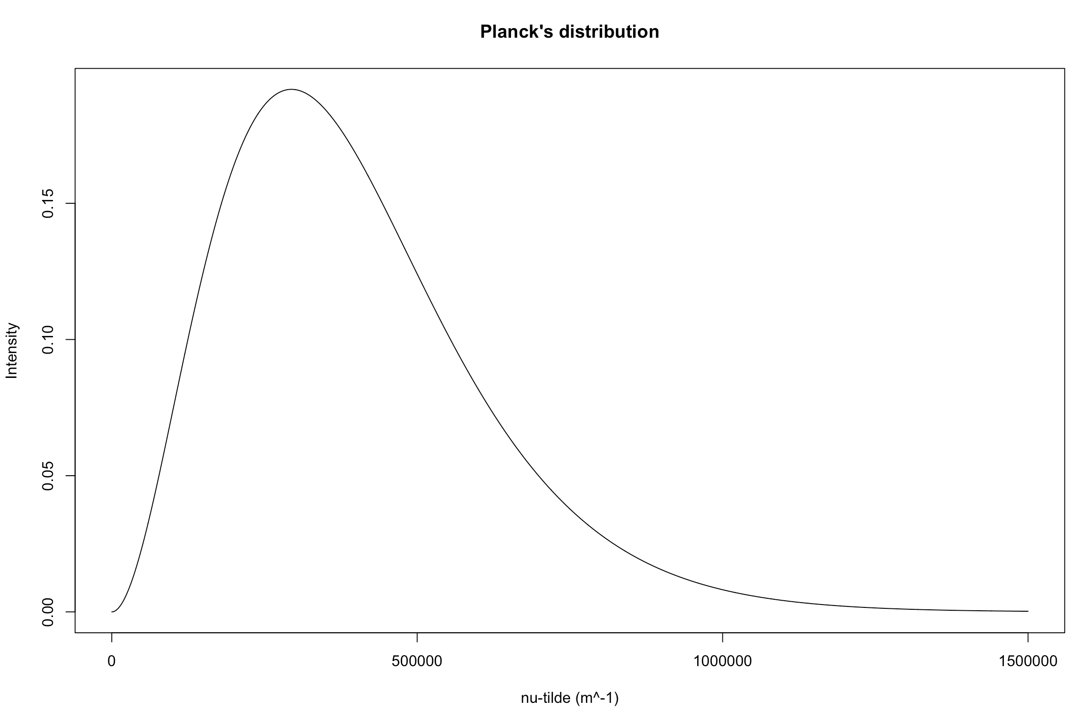
#Now USE the function planck.distribution.nutilde below:
planck.distribution.nutilde(0.1,1500000,1500)

