Slide 1
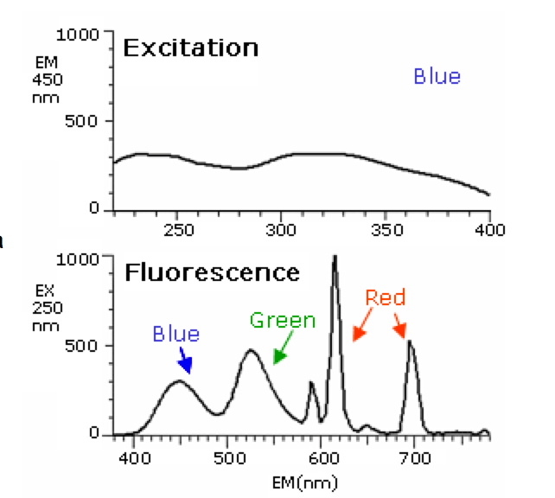
Electronic Spectroscopy
Hitachi-HiTec

Slide 2
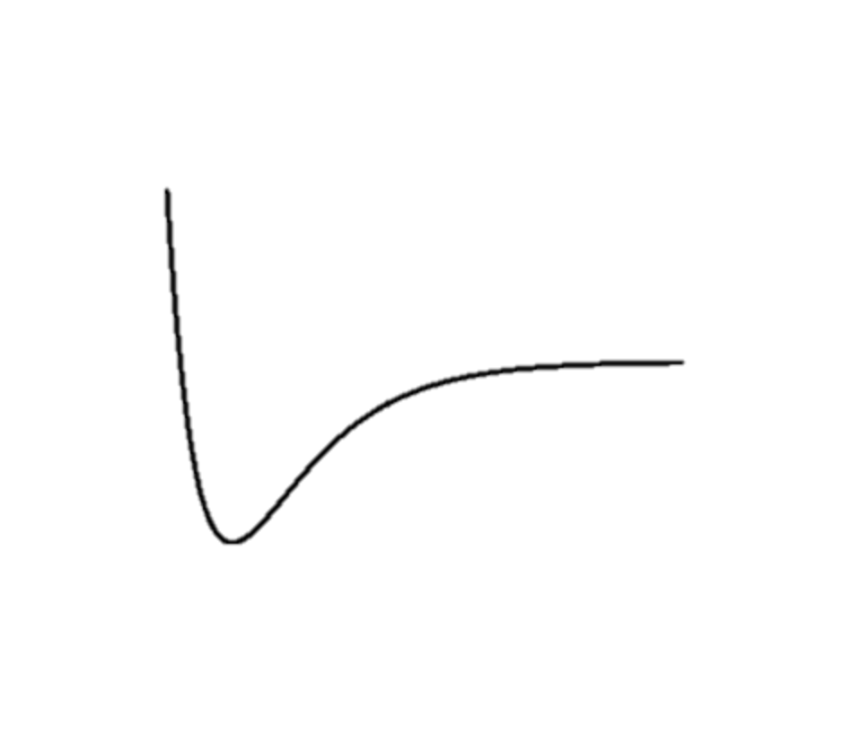
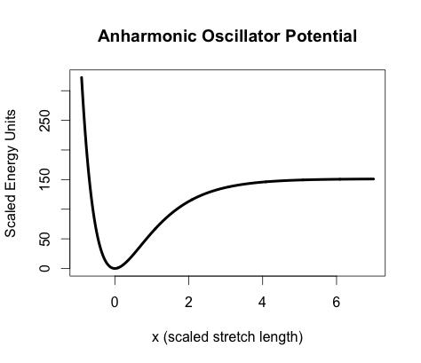
Electronic Excitation Model
~
A
Radiationless decay (vibrational relaxation)
γ
Fluorescence (Fast radiative decay)
Internal conversion (Slowish non-radiative decay)
~
Excitation
(Absorption)
X
γ

Slide 3
Electronic Excitation Model
Radiationless decay (vibrational relaxation)
~
A
~
a
Intersystem crossing
Phosphorescence (Slow radiative decay)
~
Intersystem crossing (Slow non-radiative decay)
Excitation
γ
X
γ

Slide 4
Franck-Condon Principle
The intensities of observed peaks in UV-Vis spectra depend on the overlap between the initial and final vibronic states
Eh Overlap-Weak Peaks
Good Overlap-Strong Peaks
~
~
A
A
~
~
X
X

Slide 5
Fluorescence Spectra
Excite mostly in the UV
Hitachi-HiTec
A Plasma Display Panel Fluorescence Spectrum

Slide 6
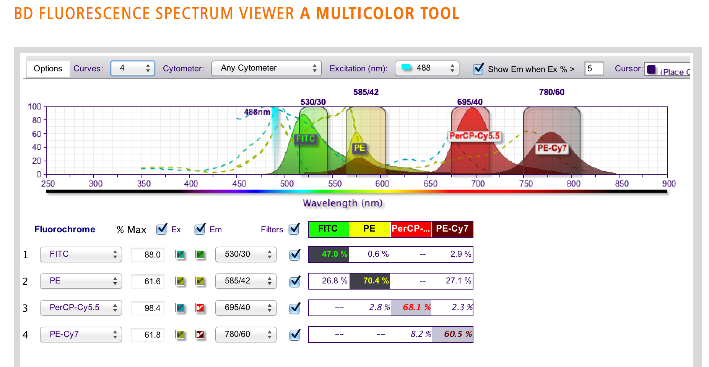
Fluorescence Spectra
A neat fluorescence spectrum tool for assorted fluoro-cores:
http://www.bdbiosciences.com/ca/research/multicolor/spectrum_viewer/index.jsp

Slide 7
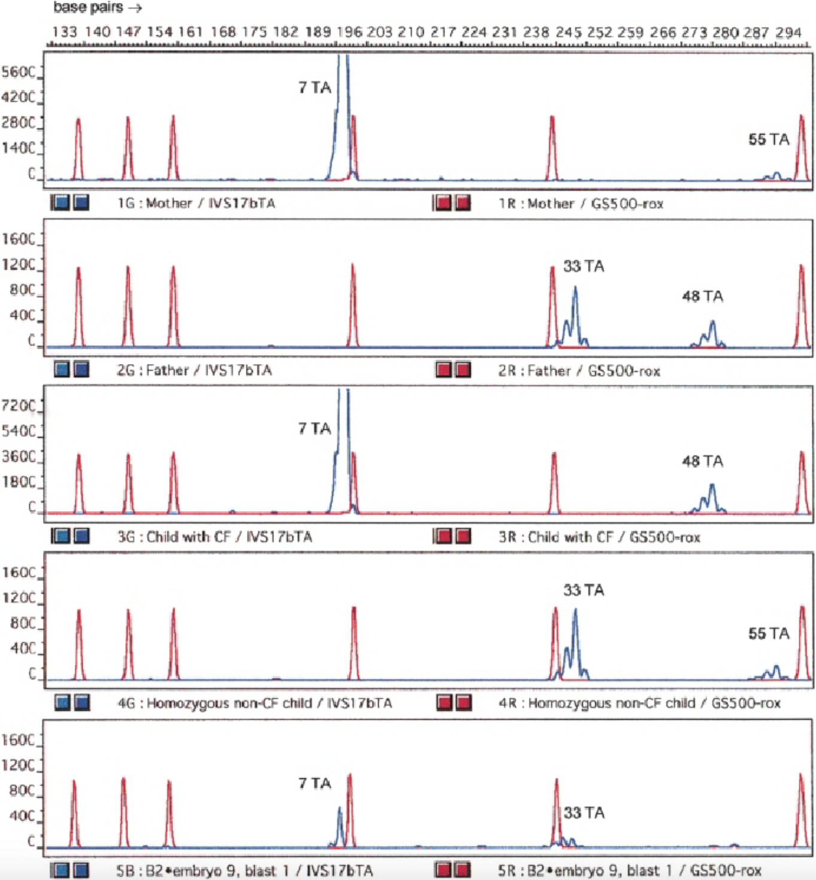
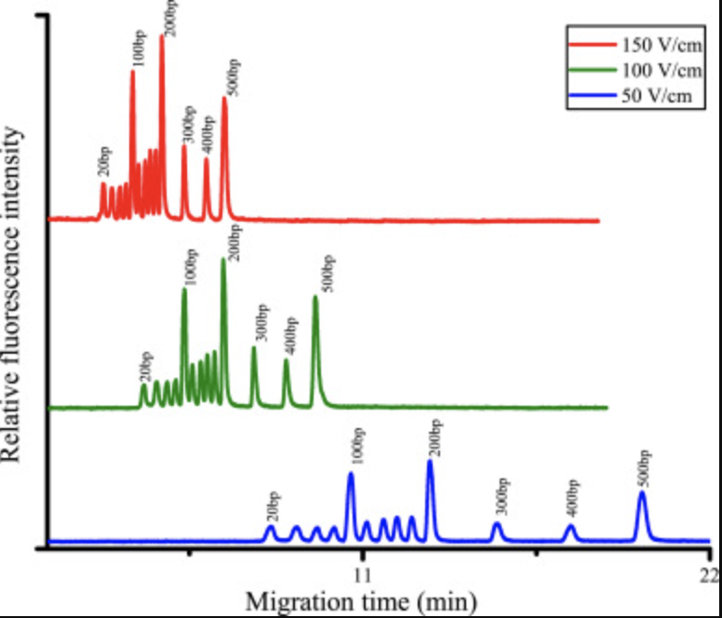
PCR/Capillary Electrophoresis
Wang et al. 2021
Eftedal et al. 2001
DNA Profiles are (many) UV-Vis (Fluorescence) spectra!

