Slide 1
Quantum Theory II
An Overview

Slide 2
A Couple of More Clues
Photoelectric Effect: Light wave behave like particles!
Light shines on metal
Classical predictions:
Electrons (e-) should “wiggle” with same frequency as light.
More intense the light, the more e- should oscillate and get kicked out.

Slide 3
A Couple of More Clues
Photoelectric Effect
But, … e- flux is experimentally seen to be independent of light intensity
e- flux only depends on characteristic frequencies of light
KE_{e-} = hν - Φ
γ
If E_{γ} = Φ = hν₀
e-
KE_{e-} = ½ m_{e-}v²
E_{γ} = hν
Φ is characteristic of the metal
Work Function
Metal Surface
What if KE_{e-} is negative??

Slide 4
A Couple of More Clues
Photoelectric Effect
What is v_{e-}?
Φ_{Ag} = 4.73 eV
λ = 0.1 nm
m_{e-} = 9.109 × 10⁻³¹kg
γ
e-
1 eV = 1.602 × 10⁻¹⁹J
Ag

Slide 5

library(che302r)
Phi <- 4.73 # Work function in eV
lambda <- 0.1e-9 # Photon wavelength
me <- 9.1093837015e-31 # Mass e-
PhiJ <- Phi * 1.602177e-19 # Convert to J
Eph <- h * cl/lambda
ve <- sqrt(2*(Eph - PhiJ)/me)
ve

Slide 6
A Couple of More Clues
Double Slit Experiment: Particles behave like waves!
e- have mass and were thought to be corpuscular!
But,…firing e- at a slits:
Produces an interference pattern!
e- e- e- e-

Slide 7
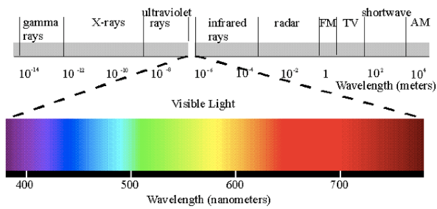
A Couple of More Clues
The Electromagnetic Spectrum: Light has different names in different wavelength (frequency) regions

Slide 8

A Couple of More Clues
Atomic Spectra: When atomic gasses are excited with an electrical discharge:
See discrete “lines” of color, not a rainbow!
Discrete colors mean only discrete energies at specific frequencies are emitted!
Visible Hydrogen Emission Lines

Slide 9
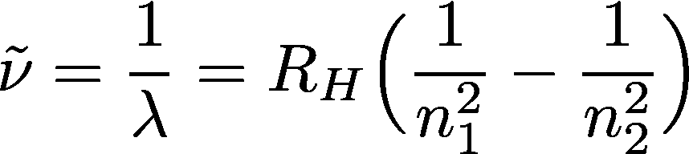
A Couple of More Clues
Hydrogen Atomic Spectra
There are “lines” in other parts of the e-m spectrum:
Lyman UV
Balmer Visible
Paschen near-IR
Bracket IR
Rydberg eq. predicts all these spectra
Rydberg const. = 109625 cm⁻¹
“Quantum numbers”
n₁, n₂ = {1, 2, 3, …}
n₂, > n₁
Line “energy” in cm⁻¹
Line wavelength in cm

Slide 10
A Couple of More Clues
Hydrogen Atomic Spectra
Determine an expression for n₂ in terms of n₁ and the excitation wavenumber.
What does n₂ tell you?

Slide 11
Example
The electron of a hydrogen atom is excited into a higher energy level from a lower energy level. A short time later the electron relaxes down to the n_{lo} = 3 energy level, releasing a photon with a an energy of 1.8147 × 10⁻¹⁹J.
Compute the quantum number of the energy level the electron relaxes from, n_{hi}
Compute the wavelength of the released photon. What region of the spectrum is it in?

Slide 12
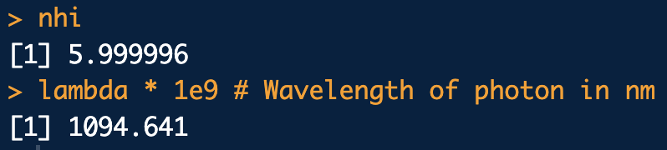
library(che302r)
Eph <- 1.8147e-19
RH.joules <- 2.177641e-18 # Rydberg const in Joules
nhi <- sqrt( 1/( 1/(nlo^2) - (Eph/RH.joules) ) )
nhi
lambda <- h * cl/Eph
lambda * 1e9 # Wavelength of photon in nm

Slide 13
Some Handy Equations Before
We Move On
KNOW THESE!
E = hν one quantum of energy
*This is the most important equation for the course.
c = νλ convert bet. freq. and wavelength
E = hc/λ
ω = 2 π ν convert bet. “angular” freq. and “linear” wavelength

Slide 14
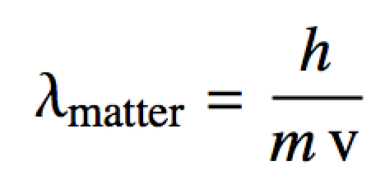
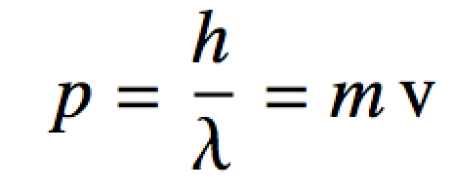
De Broglie and Wave-Particle Duality
Inspired by Einstein’s particle like description of photons in the photoelectric effect
De Broglie extended this “wave-particle” idea to matter
Waves have particle properties (Einstein)
Particles have wave properties (De Broglie)
Summarized as:
De Broglie equations

Slide 15

Example
On average, electrons in a neon light travel at about 1 × 10⁶m/s. Compute the wavelength of these electrons.
library(che302r)
m.electron <- 9.109384e-31
v.electron <- 1e6
lambda <- h/(m.electron * v.electron)
lambda

Slide 16

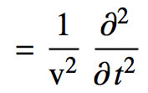
The Schrodinger Equation
This is the second most important equation for the course:
Start with the classical wave equation:
Use separation of variables trick and replace:
u(x,t) = ψ(x) cos(ω t)

Slide 17
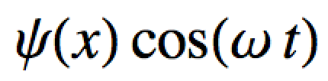
The Schrodinger Equation
This is the second most important equation for the course:
Substitute u(x,t) = ψ(x) cos(ω t):

Slide 18
The Schrodinger Equation
This is the second most important equation for the course:
Rearrange:
What does this derivative work out to be??

Slide 19
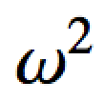
The Schrodinger Equation
This is the second most important equation for the course:
After doing the time derivative:
-

Slide 20
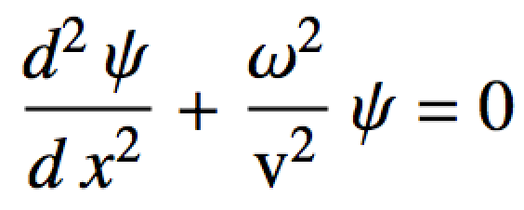
The Schrodinger Equation
This is the second most important equation for the course:
Divide out the cos(ω t)’s:
-
…and rearrange a bit:

Slide 21
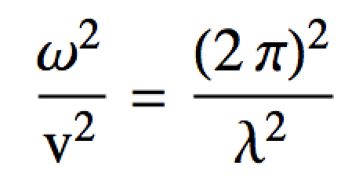
The Schrodinger Equation
This is the second most important equation for the course:
Note ω = 2 π ν
Guess: v = ν λ (…like c = ν λ)
So:
Now let’s focus on the wavelength term

Slide 22
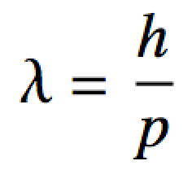
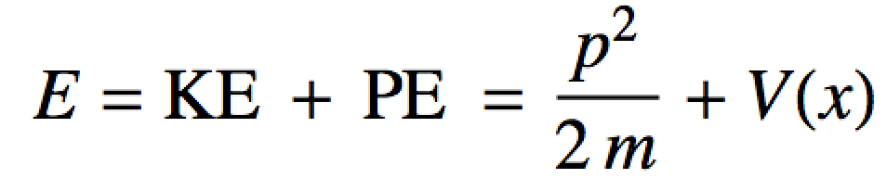
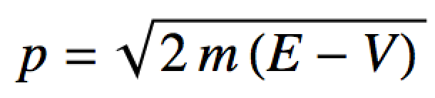
The Schrodinger Equation
This is the second most important equation for the course:
Look at the De Broglie eq:
We can use a general energy expression to find a substitute for p:
Rearranging:

Slide 23
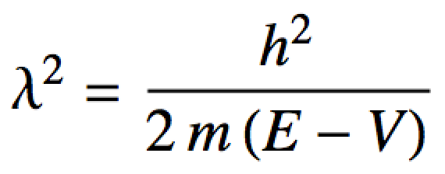
The Schrodinger Equation
This is the second most important equation for the course:
2
2
Substituting into
2

Slide 24
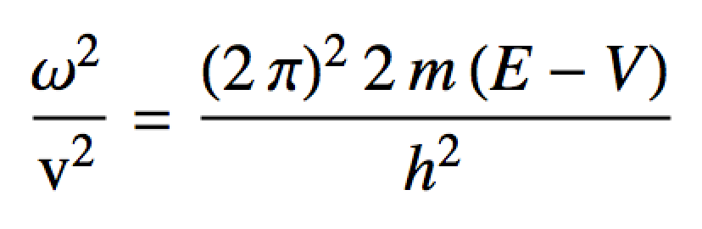
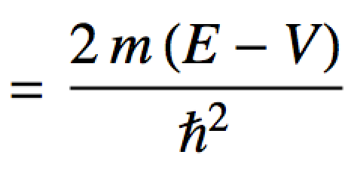
The Schrodinger Equation
This is the second most important equation for the course:
Substituting into

Slide 25
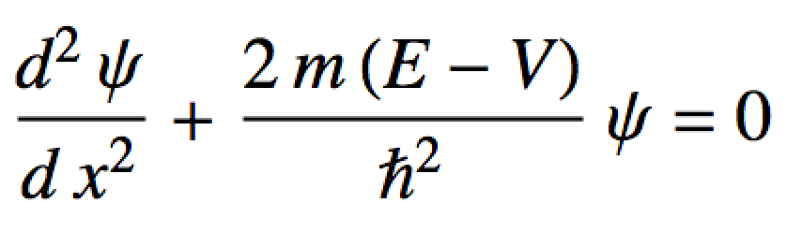
The Schrodinger Equation
This is the second most important equation for the course:
Substituting into the wave eq.

Slide 26

The Schrodinger Equation
This is the second most important equation for the course: The Schrodinger Equation!
Kind of looks like:
c not necessarily a constant

Slide 27
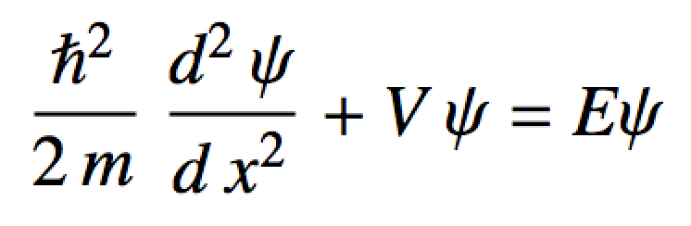
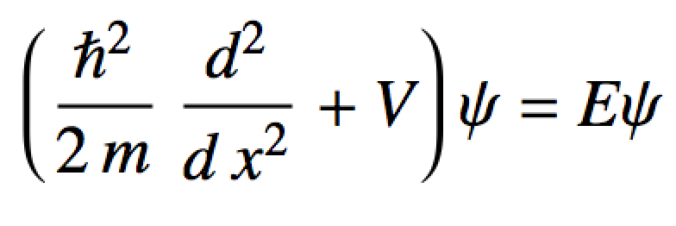
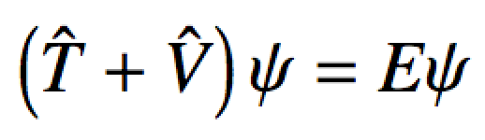
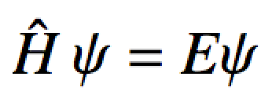
The Schrodinger Equation
Usually we rearrange it like this:
Energy “operator”
KE “operator”
PE “operator”
The Schrodinger Equation

