Slide 1
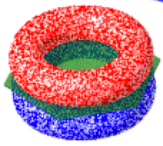
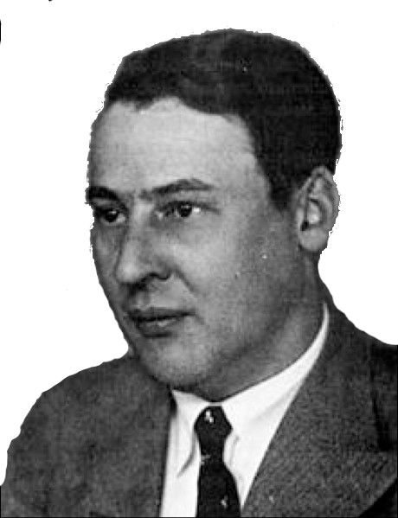
Qualitative Molecular Orbitals on a Computer

Slide 2
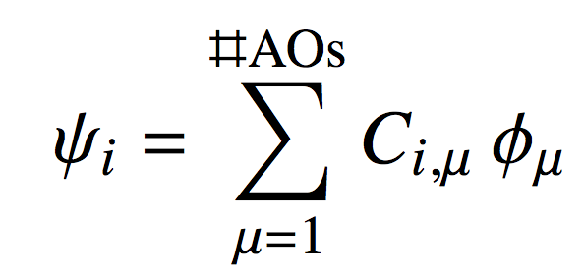
The Molecular Orbital Model
In lecture we learned that molecular orbitals are a “mixing together” of all the atomic orbitals of all the atoms making us a molecule
Mathematically, the “mixing recipe” is LCAO:
An MO
AOs

Slide 3
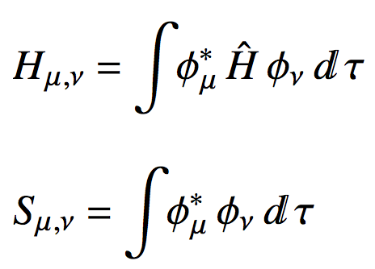
The Molecular Orbital Model
To visualize MOs we must determine the MO coefficients C_{i,μ}
We get them from the matrix form of the Schrodinger equation: HC = SCE
We then need the matrix elements for H and S

Slide 4
The Huckel Molecular Orbital Model
These are not easy integrals to evaluate!
Also, task is even harder if there are a lot of AOs
We’ll make a seemingly drastic approximation:
Only p_{z} orbitals on “heavy” atoms (i.e.not H)
Only one valence e- on each “heavy” atom
We’ll “guess” the value of the Hamiltonian and overlap integrals we’ll need.

Slide 5
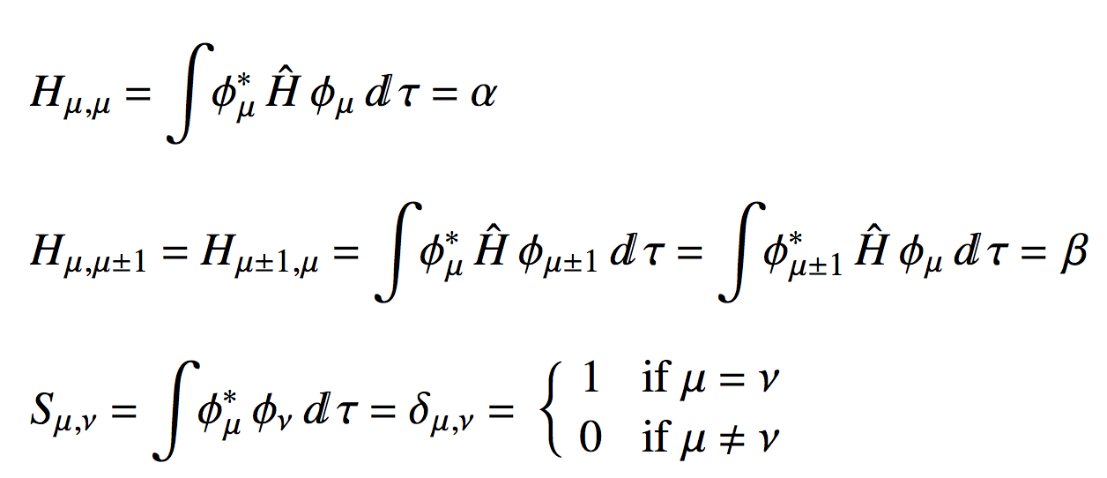
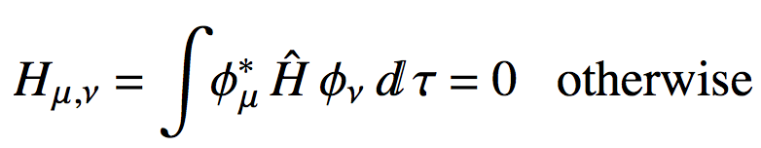
The Huckel Molecular Orbital Model
The “Huckel integrals” are:

Slide 6
The Huckel Molecular Orbital Model
The values of α and β
α = 0
β = -1
(this H is for benzene)
φ₁
φ₂
φ₃
φ₄
φ₅
φ₆
φ₁
α
β
0
0
0
0
−1
β
−1
φ₂
β
α
β
0
0
0
−1
0
−1
H =
φ₃
0
β
α
0
0
−1
0
β
−1
φ₄
0
0
β
α
−1
0
β
0
−1
φ₅
β
α
0
0
0
−1
0
β
−1
φ₆
β
0
0
0
−1
α
β
0
−1

Slide 7
The Huckel Molecular Orbital Model
The Huckel overlap matrix is only ever going to look something like this:
φ₁
φ₂
φ₃
φ₄
φ₅
φ₆
φ₁
1
0
0
0
0
0
φ₂
0
1
0
0
0
0
S =
φ₃
0
0
1
0
0
0
φ₄
0
0
0
1
0
0
φ₅
0
0
0
0
1
0
φ₆
0
0
0
0
0
1
This is the equivalent to 1 for matrices

Slide 8
The Molecular Orbital Model
So to “solve” HC = SCE in Huckel theory, all we really need to do is “solve” HC = CE
“Solving” HC = CE means diagonalizing H
C eigenvectors of H
E eigenvalues of H
In R use eigen(H) to diagonalize!

Slide 9
In RStudio
a<-0
b<-(-1)
H <- rbind(
c(a,b,0,0,0,b),
c(b,a,b,0,0,0),
c(0,b,a,b,0,0),
c(0,0,b,a,b,0),
c(0,0,0,b,a,b),
c(b,0,0,0,b,a))
H
es <- eigen(H)
E <- es$values
Cm <- es$vectors
round(E,1)
round(Cm,1)
Define α and β
Define H for your molecule
Note how we rbind rows of H together
Get the eigenvects/vals
Make your output a little easier to read

Slide 10
The Molecular Orbital Model
Write down the Huckel Hamiltonian for:
Get the C matricies for each molecule, sketch the MOs and MO energy diagram

Slide 11
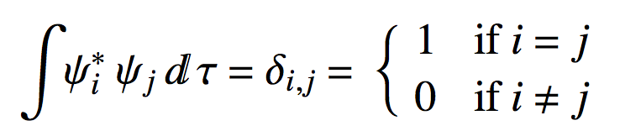
The Molecular Orbital Model
MOs, just like AOs should be orthonormal:
The columns of the C matrix play the role of MO wave functions
To check the orthonormality of the MOs we got, matrix multiply the C matrix by its inverse:
C^{T}C = 1
In R this is how we the above: t(Cm)%*%Cm

Slide 12
The Molecular Orbital Model
Huckel Energy of the molecule can be computed by adding up the energies of the MOs multiplied by how many electrons are in them:
Energy (eigenvalue) of MO i
Number of e- in MO i
Sum is over occupied MOs

Slide 13
The Molecular Orbital Model
Lets take a look at cyclopentene to illustrate:
a<-0
b<-(-1)
H <- rbind(
c(a,b,0,0,b),
c(b,a,b,0,0),
c(0,b,a,b,0),
c(0,0,b,a,b),
c(b,0,0,b,a))
es <- eigen(H)
E <- es$values
Cm <- es$vectors
round(E,1) # MO energies
1
5
2
4
3

Slide 14
The Molecular Orbital Model
For example the Huckel Energy of molecular system below is:
Energy Diagram
1
5
2
1.6
4
3
E
-0.6
-2
= -5.8
nocc <- c(1,2,2) # e- occupations in the MOs
Ehuckel <- sum(nocc * E[3:5])
Ehuckel

Slide 15
The Molecular Orbital Model
Huckel bond order gives an idea of the “strength” of the “bond” between any two atoms:
coefficient for AO μ, MO i
Number of e- in MO i
Sum is over occupied MOs
In R this is how we the above: Cocc%*%(nocc*t(Cocc)

Slide 16
The Molecular Orbital Model
Huckel bond order gives an idea of the “strength” of the “bond” between any two atoms:
1
# Occupied MO coef matrix for cyclopentene:
Cocc <- Cm[,3:5]
Cocc
# Occupancy of the occupied orbitals
# (ground state), cyclopentene:
nocc <- c(1,2,2)
# Huckel Bond order matrix (AO x AO):
O <- Cocc %*% (nocc*t(Cocc))
round(O,2)
5
2
4
3
[,1] [,2] [,3] [,4] [,5]
[1,] 0.80 0.52 0.08 0.08 0.52
[2,] 0.52 1.16 0.75 -0.15 -0.29
[3,] 0.08 0.75 0.94 0.39 -0.15
[4,] 0.08 -0.15 0.39 0.94 0.75
[5,] 0.52 -0.29 -0.15 0.75 1.16

