Slide 1

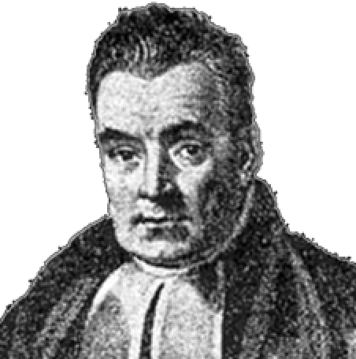
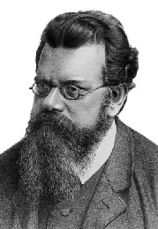
Weights of Evidence and Their Relationship to Statistical Mechanics

Slide 2
Background
In 2009 a report was released by the National Academy of Science which outlined “challenges facing the forensic science community” and outlined pathways for advancement
One suggestion that arose in several areas was the application of more statistical analyses to the subdisciplines of forensic science.
A copious literature existed at that point (starting from about 1977) which advocated for computing the statistical “weight of evidence” in case work
Dubbed “the Bayesian Framework” or later “the Logical Framework”
This approach has a deep connection to statistical physics

Slide 3
The “Logical (Bayesian) Framework” in F.S.
Notation now common in forensic science ^{Aitken, Taroni}:
H_{p} = the prosecution’s hypothesis
H_{d} = the defences’ hypothesis
E = any evidence (we’ll use D for data later)
I = any background information
Odd’s form of Bayes’ Rule:
Posterior odds in favour of
prosecution’s hypothesis
Likelihood Ratio
Prior odds in favour of
prosecution’s hypothesis

Slide 4
The “Logical (Bayesian) Framework” in F.S.
The likelihood ratio has largely come to be the main quantity of interest in their literature:
A measure of how much “weight” or “support” the “evidence” gives to one hypothesis relative to the other
Here, H_{p} relative to H_{d}
Major Players: Evett, Aitken, Taroni, Champod, Buckelton
Influenced by Dennis Lindley

Slide 5
The “Logical (Bayesian) Framework” in F.S.
Likelihood ratio ranges from 0 to infinity
Points of interest on the LR scale:
LR = 0 means evidence TOTALLY DOES NOT SUPPORT H_{p} in favour of H_{d}
LR = 1 means evidence does not support either hypothesis more strongly
LR = ∞ means evidence TOTALLY SUPPORTS H_{p} in favour of H_{d}

Slide 6
The “Logical (Bayesian) Framework” in F.S.
A standard verbal scale of LR “weight of evidence” IS IN NO WAY, SHAPE OR FORM, SETTLED IN THE STATISTICS LITERATURE!
A popular verbal scale is due to Jefferys, pp.432 (in here too) but there are others
READ British R v. T footwear case!, Ref. 1, Ref. 2

Slide 7
Preliminaries
In science, hypotheses are formed to explain data.
A formal relationship between data (D) and a hypothesis (H) that (potentially) explains the data can be formulated through Bayes’ Theorem:

Slide 8
Preliminaries
Let’s say we have two competing hypotheses (H_{p}, H_{d}) that can explain some observed data:

Slide 9
Preliminaries
Which hypothesis is more probable given the observed data?
To answer this, take the ratio of the two Bayes’ theorems:
Weight of evidence: A measure of how much “weight” or “support” observed data (i.e. “evidence”) gives to one hypothesis relative to the other^{Jeffereys, Turing, Good}

Slide 10
Hypothesis Models of Data
p(D|H_{p}) and p(D|H_{d}) are clearly important.
So how do we get them??!!
In practice, H_{p} and H_{d} are probabilistic models seeking to explain observed data D (the “evidence”)
Probabilistic models are formulated in terms of probability functions (e.g. Pr’s, pmf’s, pdf’s etc.) which have parameters, θ

Slide 11
Hypothesis Models of Data
Model parameters are also obtained from Bayes’ theorem:
This is our quantity of interest
Now that we’ve gotten into some detail, we see what p(D|H_{i}) really is, and it’s a problem…

Slide 12
Marginal Likelihood and Sums over States
The denominator of (any) Bayes’ theorem can be found from the law of total probability:
with
In our specific case/notation, it’s written:
A sum of values over a defined partition − ger. Zustandssumme
Colloquially called a “sum over states”
In probability theory, this specific zustandssumme is called marginalization
p(D|H_{i}) is called (among other thing) a marginal likelihood

Slide 13
Marginal Likelihood and Sums over States
Summary so far:
Marginal likelihood: likelihood of observing the data given the hypothesis (model, theory) is true
expected likelihood
(Bayes) evidence
a zustandssumme (a sum over states), Z_{i}
a Bayes’ theorem normalization constant
Some other names for a marginal likelihood
Each term in the weight of evidence is a marginal likelihood (and thus a sum over states):

Slide 14
Bayes Factors
More trivia:
These integrals (or sums) are often intractable (impossible or nearly impossible to evaluate)
Intractability comes from the high dimensionality of the integral or a gigantic number of terms in the sums (combinatorial explosion)
If we can evaluate these integrals, the weight of evidence is called a Bayes factor (BF)
No uncertainty other than that from estimating the integral by numerical/monte carlo methods
BFs can be very model dependent however, especially due to the prior terms p(θ_{i}|H_{i})
Computing marginal likelihood and BFs routinely is still an active area of research

Slide 15
Likelihood Ratios
More trivia:
Usually, the integrals are replaced with formulas/parameter point estimates, in which case the weight of evidence is called a likelihood ratio
LRs are subject to sampling uncertainty when parameters are estimated
LRs are subject to modelling uncertainty
LRs are by far the most common weight of evidence computed but issues of appropriateness, modelling, meaning and uncertainty are hotly debated.

Slide 16
Partition Functions
Prior to general statistical analysis becoming widely popular, physicists in statistical mechanics had been dealing with how to evaluate big sums over states:
Partition function: a sum over states. Notorious to find in general….
Energy as a function of quantum numbers n
Boltzmann distribution:
Probability of observing system in a state with quantum numbers n

Slide 17
Evaluating Partition Functions
Partition functions are sums over states just like marginal likelihoods
Reason why marginal likelihoods are also called partition functions and often denoted as Z:
All are partition functions
etc.…

Slide 18
Evaluating Partition Functions
Just like marginal likelihoods, partition functions are exceptionally difficult to determine in general
Known in physics for over a hundred years (cf. Boltzmann papers)
Most techniques to approximate general sums over states originally came from physics and made their way into general statistics:
Umbrella Sampling
Annealed importance sampling
Bridge sampling
Thermodynamic integration
Nested sampling
Wang-Landau sampling
Belief propagation*
Some modern methods for approximating partition functions/marginal likelihoods
Most based on fancy random sampling
None are easy to implement for production (i.e. not black box buttons)
None universally applicable

Slide 19
Actually Computing Bayes Factors
and Likelihood Ratios…
Regardless of philosophies about BFs/LRs:
…try to compute and work with them for practical situations of interest.
Do they deliver any value to you; helping to get closer to the “truth” or discern a clearer “scientific story”?
Note: Always be cognizant and “up-front” about the assumptions, strengths and weaknesses of your calculations.
Until recently (~1995, early 2000s??) BFs are almost all impossible to compute for realistic models of practical interest
This is probably the reason why they are not actually applied widely in the Bayesian community despite their pedigree as “logical”
LRs are typically easier to compute than BFs but are far more arbitrary/uncertain for assorted reasons…(cf. Lund and Iyer, arXiv ver.)

