Slide 1
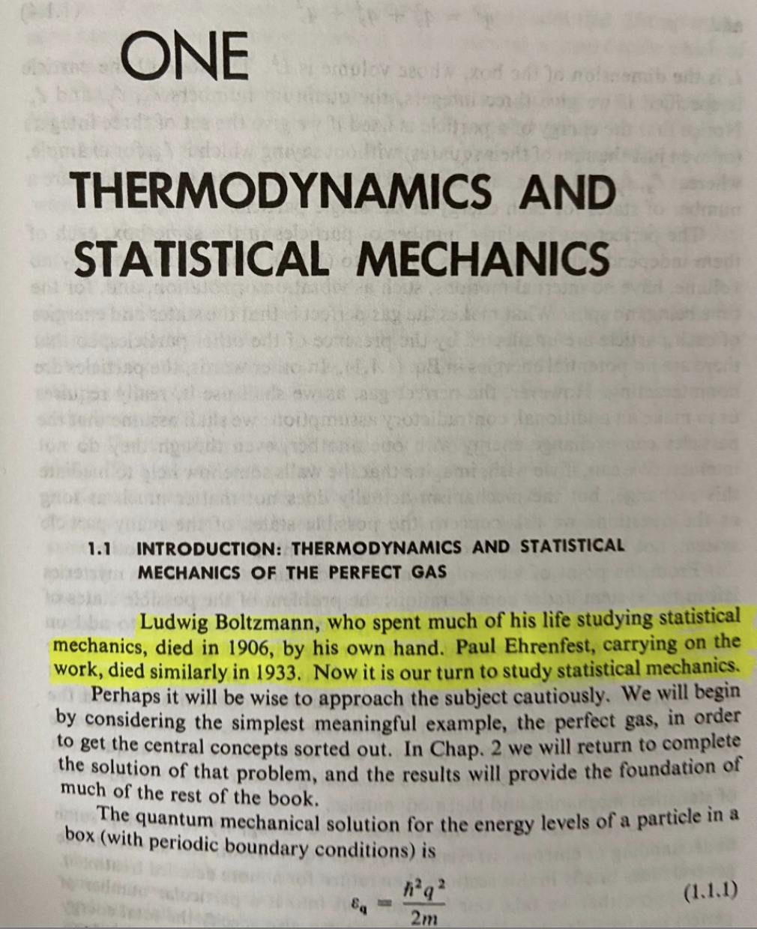
Introduction to Statistical Mechanics
-DL Goodstein, States of Matter, ISBN-10: 048664927X 🤔

Slide 2
Review
The Boltzmann distribution tells us the probability of finding a system to be in a state characterized by the set of quantum numbers κ :
Energy as a function of quantum numbers κ
Temperature of the system
Probability of observing system in a state with quantum numbers κ
Partition function (normalization constant). This can be a big headache to find….

Slide 3
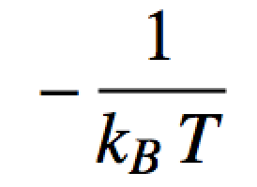
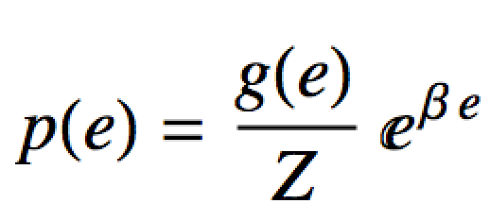
Boltzmann distribution
This form of the Boltzmann distribution isn’t too useful to us because:
We don’t really know Z (yet)
For “normal” temperatures (e.g. room temp), the total number of wave functions reachable, J is HUGE and the e_{j} are super close together (essentially “un-quantized”)
Instead we’ll use this form of Boltzmann’s distribution (Boltzmann’s density):
Degeneracy for energy e
Probability density of energy e

Slide 4
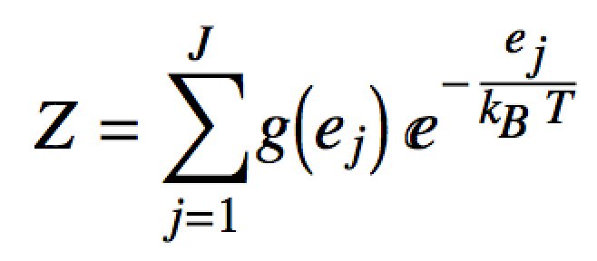
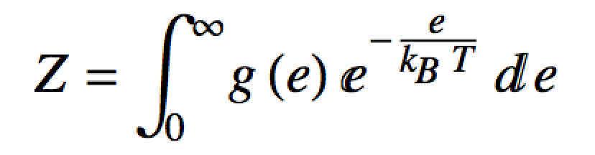
Boltzmann distribution
In theory, we can find Z with:
Usually impossible to use this directly
Instead lets note that for a big box and lots of particles, the e_{i} are very close together:
The degeneracy term, g(e) can be found in k-space

Slide 5
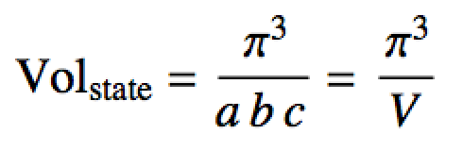
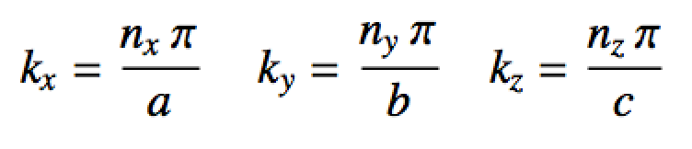
k-space
For particle in a 3D box:
π/b
A state in k-space
k_{y}
π/a
π/c
k_{x}
k_{z}
Quantum numbers n_{x}, n_{y} and n_{z} define a point in k-space
Points in k-space are discrete
“Distance” in k-space is inverse length

Slide 6
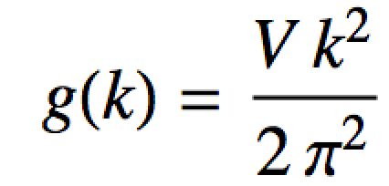
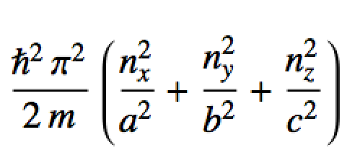
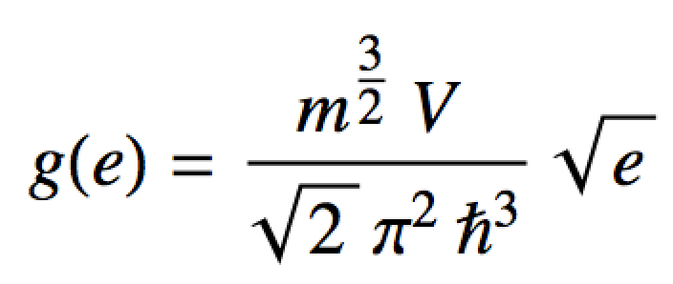
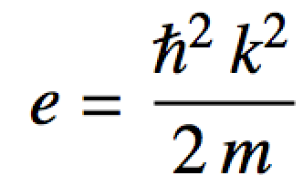
k-space
We can determine g(e) by using the “volume” (the number of states) of a shell in k-space.
Volume in k-space has units of m⁻³ = m_{k}³
A state in k-space
k_{y}
Units:
states/m_{k}
k_{x}
From particle in a box energy formula:
k_{z}
Units:
states/J
Energy degeneracy in a box of particles

Slide 7
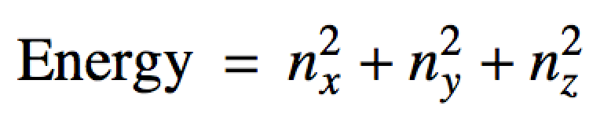
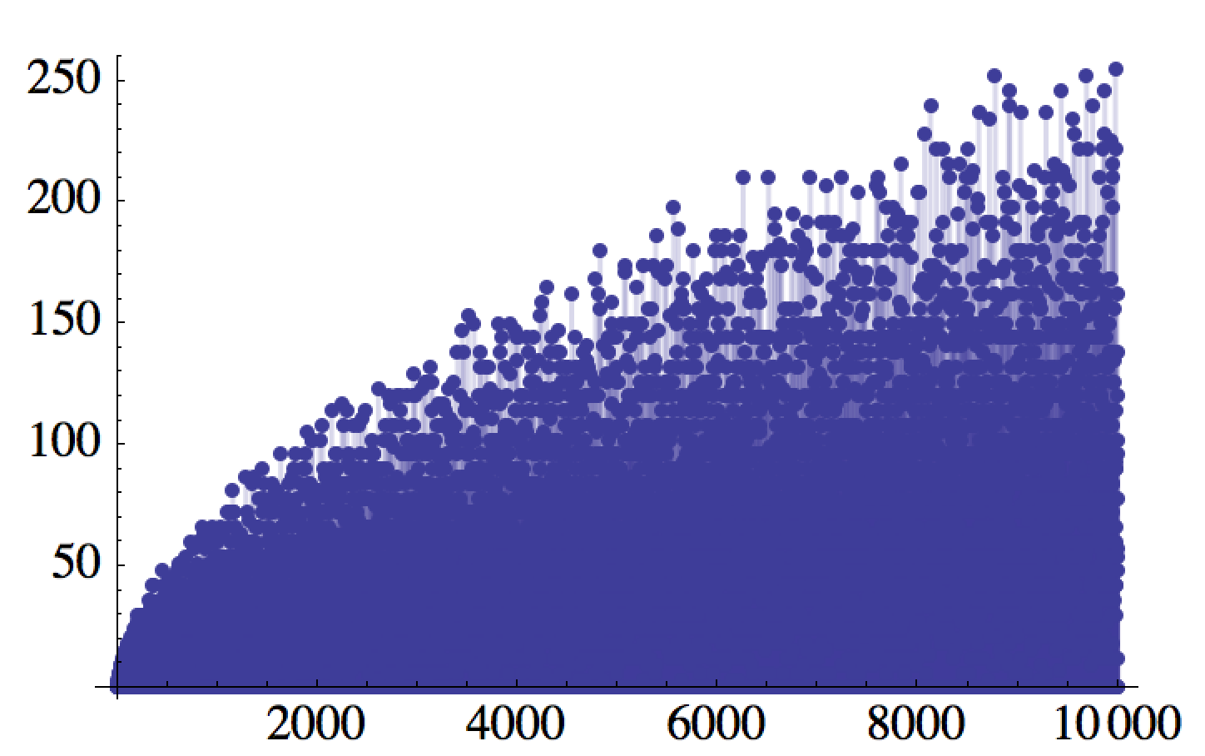
Another Look at Energy Degeneracy in the Box
From the PIAB unit, solving the Diophantine equation:
# of states
Energy

Slide 8
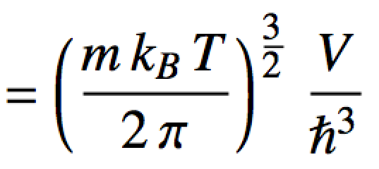
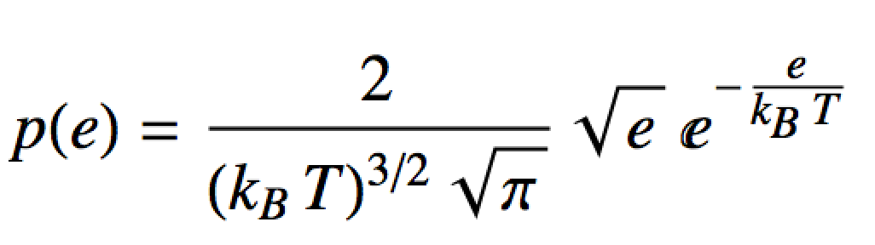
Maxwell-Boltzmann distribution
Using g(e) to get Z:
Finally substituting in p(e):
Maxwell-Boltzmann “Distribution” for distinguishable particles in a box

Slide 9
Maxwell-Boltzmann distribution
What does this probability density like like?
Draw a particle from the box. What energy is it most likely to have?
(k_{B}T)³ p(E) (scaled density)
Past how much energy do you not expect to find too many particles?
x = E/(k_{B}T) (scaled energy)

Slide 10
3D Box/Degeneracy problem
Consider a 3D box (side length 1 dm) filled with 1 mol of HCl gas (36.46 g/mol) at 273 K.
Compute the log of the partition function.
Assuming the HCl molecules occupy P.I.A.B. states, approximately how many states are available up to an energy of 1k_{B}T at 273K. Hint: Compute
Do it symbolically first. Log the result, plug in and then “e” back. That is better form.
Compute the probability of reaching into the box and pulling out an HCl molecule of energy between 0 J and 1k_{B}T at 273K. Hint: Compute

Slide 11
3D Box/Degeneracy problem
a.
kB <- 1.38064852e-23
hb <- 1.054571817e-34
Na <- 6.02214076e23
m <- 36.46 * 1/Na * 1/1000 # convert g/mol -> kg/molec
Temp <- 273
Vol <- 1 * (1/10)^3 # convert dm^3 -> m^3
# Z just by plugging in to the formula:
Z.dont.do.it.this.way <- (m*kB*Temp/(2*pi))^(3/2) * Vol/hb^3
Z.dont.do.it.this.way
# Z by computing with logs. Usually do it this way:
logZ <- (3/2) * (log(m) + log(kB) + log(Temp) - log(2*pi)) + log(Vol) - 3* log(hb)
exp(logZ) # More stable. Do it this way
Z ~ 10²⁹

Slide 12
3D Box/Degeneracy problem
b.
g[e_] := (m^(3/2) V)/(Sqrt[2] Pi^2 hb^3) Sqrt[e];
Integrate[g[e], {e, 0, kB T}]
kB <- 1.38064852e-23
hb <- 1.054571817e-34
Na <- 6.02214076e23
m <- 36.46 * 1/Na * 1/1000 # convert g/mol -> kg/molec
Temp <- 273
Vol <- 1 * (1/10)^3 # convert dm^3 -> m^3
# int g(e) just by plugging in to the formula:
num.states <- sqrt(2) * m^(3/2) * Vol * (Temp * kB)^(3/2) / (3*pi^2*hb^3)
num.states
# g(e) by computing with logs. Usually do it this way. More numerically stable to use logs:
log.ns <- (1/2)*log(2) + (3/2)*log(m) + log(Vol) + (3/2)*(log(Temp) + log(kB)) - log(3*pi^2) - 3*log(hb)
exp(log.ns)
~ 10²⁹ states are available under these conditions
…just a coincidence the magnitude is the same as Z

Slide 13
3D Box/Degeneracy problem
c.

Slide 14
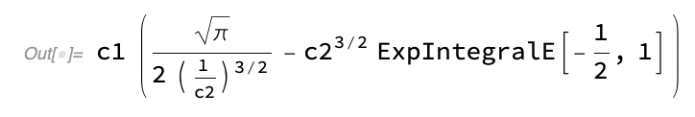
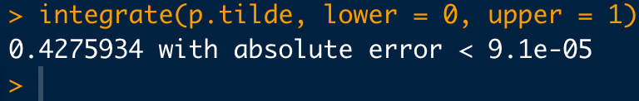
3D Box/Degeneracy problem
c.
X
(*Definite integral: c_1\int_0^{c_2}\sqrt{x}\ e^{-\frac{x}{c_2}}\ dx *)
c1*Integrate[Sqrt[x] Exp[-x/c2], {x, 0, c2}]
# Do the integral numerically with a substation in R instead:
# Substitute x = e/(kB T):
p.tilde <- function(x){
val <- 2/sqrt(pi) * sqrt(x) * exp(-x)
return(val)
}
xx <- seq(0, 6, length.out=1000)
plot(xx,p.tilde(xx), typ="l")
integrate(p.tilde, lower = 0, upper = 1)

Slide 15
Why belabour the point?
We often want to compare “models” (hypotheses) in science.
A way to do this quantitatively is:
“Weight of the evidence” is a ratio of normalization constants.
To see, consider
Bayes’ Theorem
for the models:
So:
The point:
We just saw how hard these can be to calculate, even for our “easy” cases with lots of theory behind them…

Slide 16
The “Bayesian Framework”
Notation now common in forensic science ^{Aitken, Taroni}:
H_{p} = the prosecution’s hypothesis
H_{d} = the defences’ hypothesis
E = any evidence
I = any background information
Odd’s form of Bayes’ Rule:
{
{
{
Posterior odds in favour of
prosecution’s hypothesis
Likelihood Ratio
Prior odds in favour of
prosecution’s hypothesis

Slide 17
The “Bayesian Framework”
The likelihood ratio has largely come to be the main quantity of interest in their literature:
A measure of how much “weight” or “support” the “evidence” gives to one hypothesis relative to the other
Here, H_{p} relative to H_{d}
Major Players: Evett, Aitken, Taroni, Champod, Buckelton
Influenced by Dennis Lindley

Slide 18
The “Bayesian Framework”
Likelihood ratio ranges from 0 to infinity
Points of interest on the LR scale:
LR = 0 means evidence TOTALLY DOES NOT SUPPORT H_{p} in favour of H_{d}
LR = 1 means evidence does not support either hypothesis more strongly
LR = ∞ means evidence TOTALLY SUPPORTS H_{p} in favour of H_{d}

Slide 19
The “Bayesian Framework”
A standard verbal scale of LR “weight of evidence” IS IN NO WAY, SHAPE OR FORM, SETTLED IN THE STATISTICS LITERATURE!
A popular verbal scale is due to Jefferys but there are others
READ British R v. T footwear case!

Slide 20
Actually Computing Bayes Factors
and Likelihood Ratios…
Regardless of your philosophies about BFs/LRs:
…try to compute and work with them for practical situations of interest.
Do they deliver any value to you; helping to get closer to the “truth” or discern a clearer “scientific story”?
Note: Always be cognizant and “up-front” about the assumptions, strengths and weaknesses of your calculations.
Until recently (~2004??) BFs are almost all impossible to compute for realistic models of practical interest
This is probably the real reason why they are unpopular^{(whisper…)} in the Bayesian community
LRs are typically easier to compute than BFs but are far more arbitrary for assorted reasons…

Slide 21
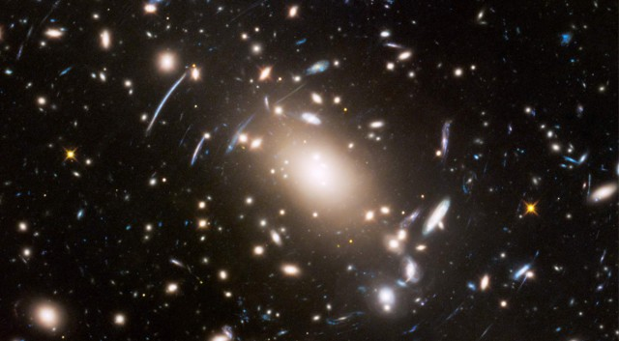
Actually Computing Bayes Factors
and Likelihood Ratios…
Well, for a parametric Bayes model:
So:
The point:
These are almost always high dimensional integrals and notoriously hard to compute!
Nested sampling (2004): a method that can do it for the widest array of practical models so far…
Gravitational lensing: Hubble Space Telescope

