Slide 1
Classical Waves
Calculus/Differential Equations Refresher

Slide 2
Introduction
Quantum Mechanics is the basis of ALL spectroscopies we use in forensic science
QM build on idea that matter has both wave AND particle properties
Most of the math we use in this course is from the language of waves

Slide 3
Classical Waves
u(x, t) = Amplitude of the wave at position x and time t
u
u(x₁,t₁)
x₁=1.15
x
u
u(x₁,t₁)
u(x₁,t₂)
x₁=1.15
x

Slide 4
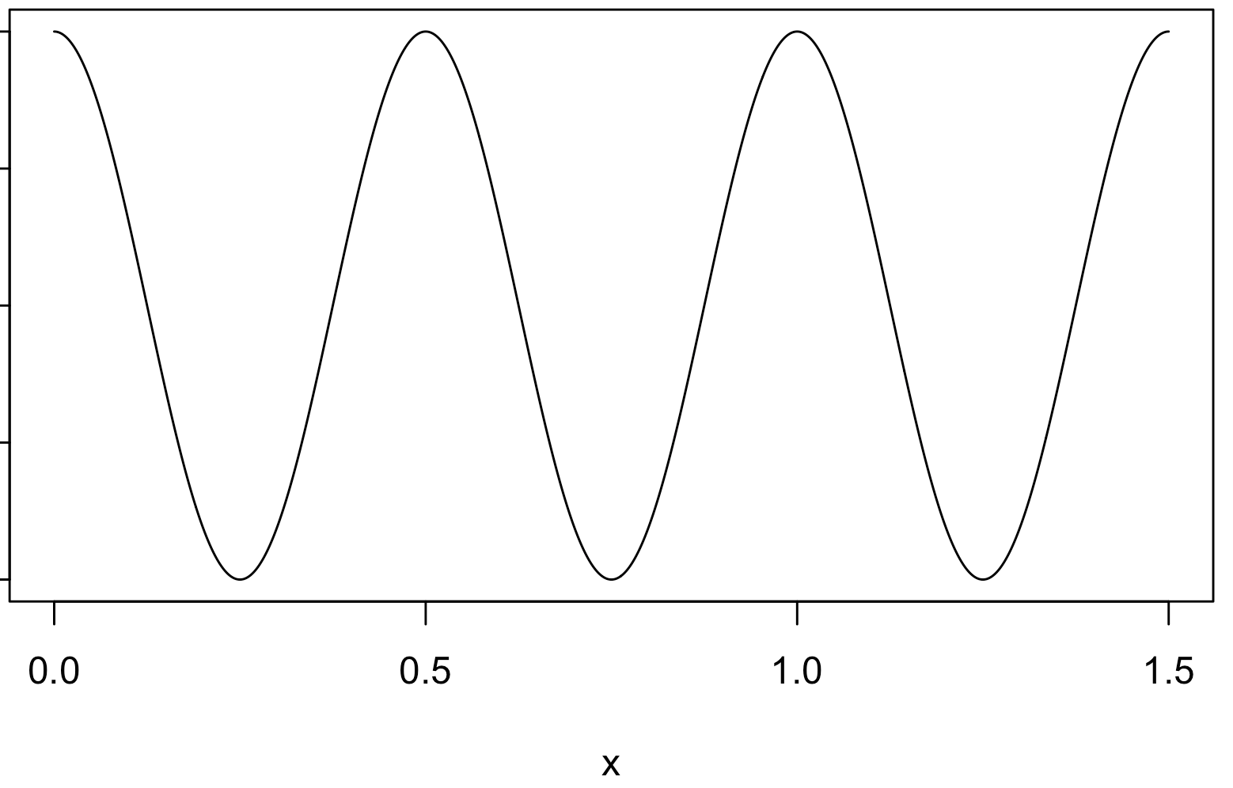
Classical Waves
Wavelength: distance for one wave cycle to complete (λ, length units)
Frequency: number of wave cycles in a reference time or distance (ν, cycles/time unit; , cycles/length unit)
λ = 0.5 length unit
wavelength
(spatial) frequency
(wavenumber)
= 2 cycles/length unit

Slide 5
Classical Waves
Boundary conditions:
u(0,t) = 0
u(l,t) = 0
Means: The wave is tied down at both ends!
u(x)-axis
x = 0
x = l
x-axis

Slide 6
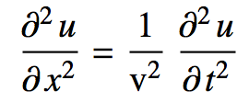
Classical Wave Equation
It is known that a “classical” wave is governed by the equation:
partial derivatives
squared speed of the wave

Slide 7

Classical Wave Equation
Solving this partial differential equation is easier than you think! (Will be a theme of the course…)
Separate variables:
function of position
function of position
This assumes that position and time are independent and do not influence each other (a reasonable assumption)

Slide 8

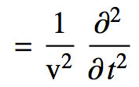
Classical Wave Equation
Now let’s just plug and chug:

Slide 9

Classical Wave Equation
Now let’s just plug and chug:
Substitute for u

Slide 10

Classical Wave Equation
Now let’s just plug and chug:
Make a bit easier to look at

Slide 11
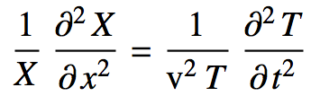
Classical Wave Equation
Now let’s just plug and chug:
Rearrange according to who the derivative affects

Slide 12
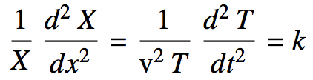
Classical Wave Equation
Now let’s just plug and chug:
Clean up the notation and set equal to a constant
Since they are equal, they must be equal to the same constant
“Clever” choice for the constant
Really just regular old derivatives

Slide 13
Classical Wave Equation
Now separate into two equations:

Slide 14
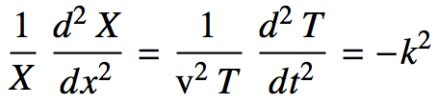
Classical Wave Equation
Now separate into two equations:

Slide 15
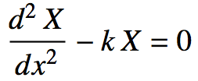
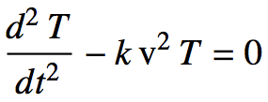
Classical Wave Equation
Now separate into two equations:
And rearrange into standard form

Slide 16
Classical Wave Equation
These are just (the same!) standard differential equations with known solutions
Second order linear homogenous diff. eq. with constant coefficients
In general:
Ours:
with c = -k

Slide 17

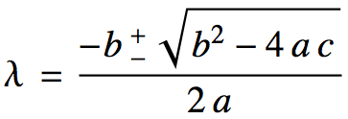
Classical Wave Equation
We will see this diff. eq. A LOT in the course:
Let’s take the time to solve it right
Set up and solve the corresponding characteristic equation:
It’s just the quadratic equation! Solution is the quadratic formula!

Slide 18

Classical Wave Equation
Case 1: The discriminant
λ is real, 2 roots
roots
Solution:
constants

Slide 19

Classical Wave Equation
Case 2: The discriminant
λ is real, but repeated
Solution:

Slide 20

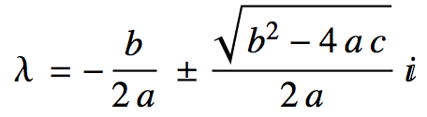

Classical Wave Equation
Case 3: The discriminant
λ is complex. MOST IMPORTANT CASE

Slide 21
Classical Wave Equation
Case 3: The discriminant
λ is complex. MOST IMPORTANT CASE
Solution:
Euler’s Formula

Slide 22
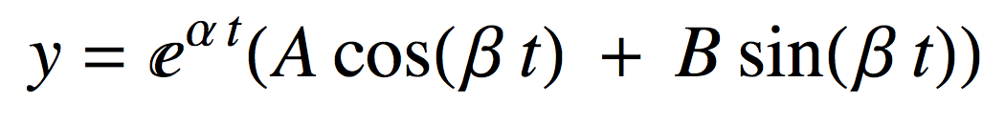
Classical Wave Equation
Case 3: The discriminant
Using Euler’s Formula and rearranging:
Solution:
In physics, β is the “angular frequency” and usually denoted:
“linear frequency”

Slide 23
Classical Wave Equation
Case 3: The discriminant
Using Euler’s Formula and rearranging:
Solution:
In physics, β is the “angular frequency” and usually denoted:
“linear frequency”

Slide 24

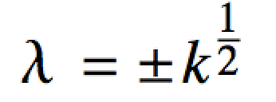
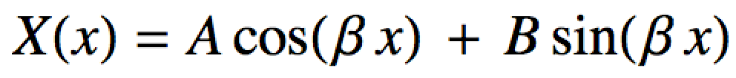
Classical Wave Equation
Back to where we were:
a = 1, b = 0, c = -k
x(0) = 0, x(l) = 0
If k > 0 or k = 0 (case 1 or 2) then X(x) = 0
Therefore k must be < 0
Solution:
Waves!!

Slide 25
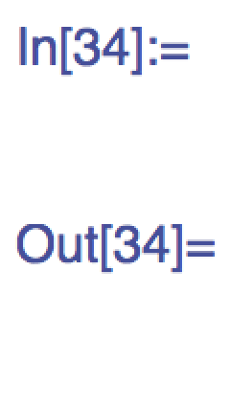
Classical Wave Equation
Or we could do this whole lecture in one line of Mathematica or Maple
DSolve[X''[x] + c X[x] == 0, X[x], x]

Slide 26
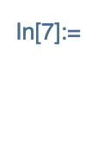

Classical Wave Equation
We can also check the solution with computer algebra systems:
?
X = c1 Cos[Sqrt[c] x] + c2 Sin[Sqrt[c] x];
D[X, {x, 2}] + c X // FullSimplify

