Slide 1
Vibrational Spectroscopy
Bend
O
H
H

Slide 2
Diatomic Molecules
So far we have studied vibrational spectroscopy in the form of harmonic and anharmonic oscillators.
Technically these models only apply to diatomic molecules
We will still use them as tools to make analogies for the vibrational behaviour of bigger molecules
The vib. spectra of diatomics are not very useful for forensic applications
They are usually gasses
The is only one peak!

Slide 3
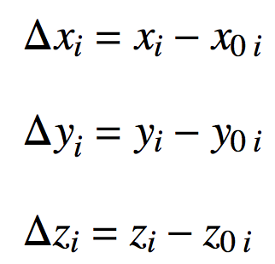
Polyatomic Molecules
The potential energy function for polyatomics is really complicated!
Function of 3N coordinates
N = #of atoms. i = {1,2,3,…,N}
3 is for the atomic “displacements” in x, y and z:
Atomic coordinate displacements
“Equilibrium” (lowest energy) position of each atom

Slide 4
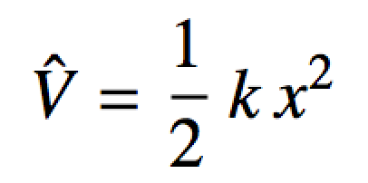
Polyatomic Molecules
Analogy with a diatomic:
V
x₀ = “equilibrium bond length”
x = spring stretch distance

Slide 5
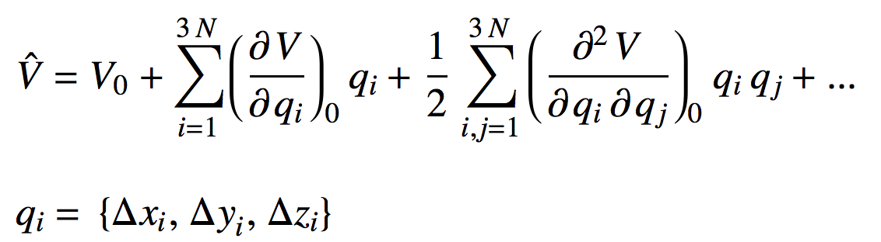
Polyatomic Molecules
The potential energy function for polyatomics is really complicated!
0
0
0
Set = 0
Slopes at bottom of potential well = 0
Harmonic terms
Anharmonic terms. Assume displacements small so these = 0

Slide 6
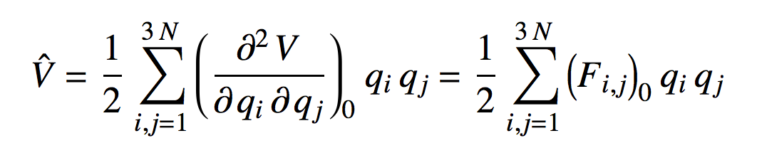
Polyatomic Molecules
Well, to good approximation potential energy function for polyatomics isn’t too bad:
PE is (approx.) a sum of coupled harmonic oscillators, like connected bed springs!
Forces (force constants) to displace each atom “a little bit” around each of their equilibrium positions

Slide 7
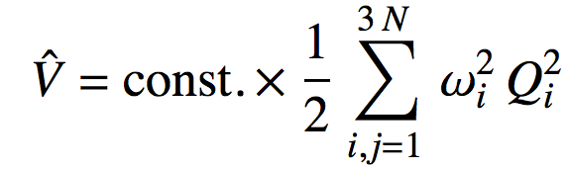
Polyatomic Molecules
Can go a little further by finding sums of displacements that “don’t feel each other”
The independent vibrations are called normal coordinates, Q_{i}
Normal coordinates “decouple” the harmonic oscillators:

Slide 8
Normal Coordinates
For linear molecules there are always 5 normal coordinates = 0
For non-linear molecules there are always 6 normal coordinates = 0
These correspond to translations and rotations!
They are not vibrations!
For linear molecules there are 3N-5 vibrations
For non-linear molecules there are always 3N-6 vibrations

Slide 9
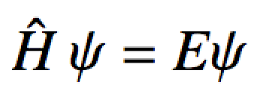
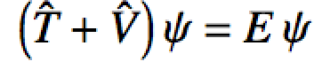
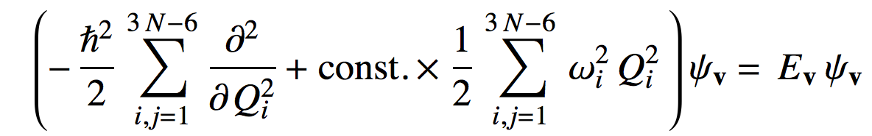

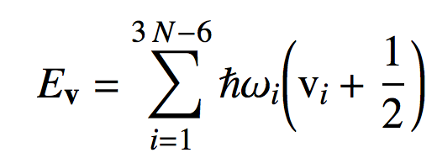
Vibrational Schrodinger Equation
Insert the operators
This is just a bunch of harmonic oscillator SEs
Energy:
# of quanta in normal mode i
(approx) vibrational frequencies!

Slide 10
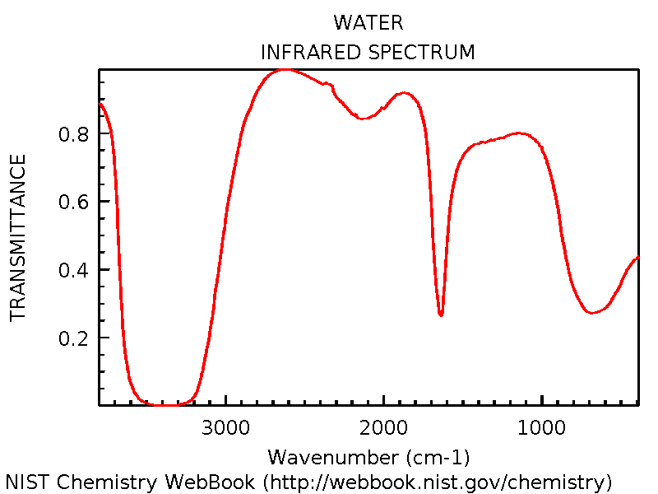
Vibrational Spectrum
The collection of ω_{i} is called the (harmonic) vibrational spectrum of the molecule!
This is what we (basically) see in FT-IR for molecules with IR active normal modes (vibrations)
H₂O: 3 normal modes, all IR active
Stuff not accounted for by harmonic model
1 normal mode
2 more normal modes overlapped here

Slide 11
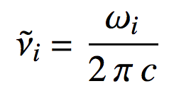
Vibrational Spectrum
What do the (approx) normal modes look like?
Here theory helps us a lot. Modern quantum chemistry programs can easily spit out the F_{i,j} force constants, F
Called the (mass weighted) Hessian matrix
F is 3N×3N
x₁, y₁, z₁, …, x_{N}, y_{N}, z_{N} by x₁, y₁, z₁, …, x_{N}, y_{N}, z_{N}
Diagonalizing F gives:
Q Eigenvectors. What the normal modes look like!
Λ Eigenvalues. Square root of these are the ω_{i}
Q^{T}FQ = Λ
In wavenumbers

Slide 12
Vibrational Spectrum
What do the (approx) normal modes look like?
Approximate Hessian for H₂O:
 | O1x | O1y | O1z | H2x | H2y | H2z | H3x | H3y | H3z
O1x | 0.0347 | -0.0068 | 0.0000 | -0.0115 | 0.0038 | 0.0000 | -0.1269 | 0.0232 | 0.0000
O1y | -0.0068 | 0.0389 | 0.0000 | -0.0121 | -0.1352 | 0.0000 | 0.0391 | -0.0197 | 0.0000
O1z | 0.0000 | 0.0000 | 0.0000 | 0.0000 | 0.0000 | 0.0000 | 0.0000 | 0.0000 | 0.0000
H2x | -0.0115 | -0.0121 | 0.0000 | 0.0500 | -0.0051 | 0.0000 | -0.0041 | 0.0531 | 0.0000
H2y | 0.0038 | -0.1352 | 0.0000 | -0.0051 | 0.5557 | 0.0000 | -0.0103 | -0.0172 | 0.0000
H2z | 0.0000 | 0.0000 | 0.0000 | 0.0000 | 0.0000 | 0.0000 | 0.0000 | 0.0000 | 0.0000
H3x | -0.1269 | 0.0391 | 0.0000 | -0.0041 | -0.0103 | 0.0000 | 0.5098 | -0.1454 | 0.0000
H3y | 0.0232 | -0.0197 | 0.0000 | 0.0531 | -0.0172 | 0.0000 | -0.1454 | 0.0958 | 0.0000
H3z | 0.0000 | 0.0000 | 0.0000 | 0.0000 | 0.0000 | 0.0000 | 0.0000 | 0.0000 | 0.0000
F =

Slide 13
Vibrational Spectrum
What do the (approx) normal modes look like?
Diagonalizing F we get the 3N-6 = 3 normal modes that correspond to non-zero eigenvalues:
Λ
(in cm⁻¹)
 | 3998 | 3894 | 1677
O1x | 0.16 | -0.16 | 0.22
O1y | -0.22 | -0.12 | 0.16
O1z | 0 | 0 | 0
H2x | 0.02 | -0.03 | -0.68
H2y | 0.68 | 0.69 | 0.01
H2z | 0 | 0 | 0
H3x | -0.66 | 0.65 | -0.19
H3y | 0.18 | -0.23 | -0.65
H3z | 0 | 0 | 0
Q =

Slide 14
Vibrational Spectrum
Actually looking at Q to sketch the vibrations is a little difficult…. Best left to a computer.
For H₂O:
Symmetric Stretch
 | 3998
O1x | 0.16
O1y | -0.22
O1z | 0
H2x | 0.02
H2y | 0.68
H2z | 0
H3x | -0.66
H3y | 0.18
H3z | 0
Bend
O
O
H
 | 3894
O1x | -0.16
O1y | -0.12
O1z | 0
H2x | -0.03
H2y | 0.69
H2z | 0
H3x | 0.65
H3y | -0.23
H3z | 0
H
H
 | 1677
O1x | 0.22
O1y | 0.16
O1z | 0
H2x | -0.68
H2y | 0.01
H2z | 0
H3x | -0.19
H3y | -0.65
H3z | 0
H
O
H
H
Asymmetric Stretch

Slide 15
Vibrational Spectrum
 | 3894
O1x | -0.16
O1y | -0.12
O1z | 0
H2x | -0.03
H2y | 0.69
H2z | 0
H3x | 0.65
H3y | -0.23
H3z | 0
O
H
H

Slide 16
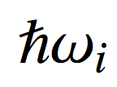
Mechanisms of Vibration
Typical fundamental vibrations of normal modes (v_{i} = 0 ➔ v_{i} = 1) have energies in the chunk of the infrared region:
400 cm⁻¹ – 4,000 cm⁻¹
v_{i} = 1
γ
is absorbed by the mode
V
v_{i} = 0
Normal mode Q_{i}

Slide 17
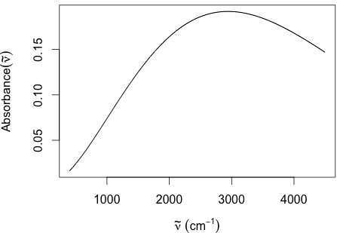
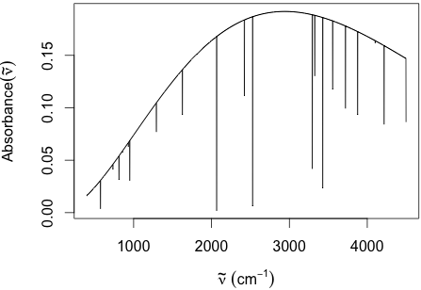
Mechanisms of Vibration
Typical fundamental vibrations of normal modes (v_{i} = 0 ➔ v_{i} = 1) have energies in the chunk of the infrared region:
400 cm⁻¹ – 4,000 cm⁻¹
Sample
Source spectrum
Spectrum reaching the detector

Slide 18
Mechanisms of Vibration
Raman Vibrational Scattering
Somewhere into the rainbow
Inelastic scattering:
Stokes
Elastic (Rayleigh) scattering:
Florescence
Inelastic scattering:
Anti-Stokes
v_{i} = 2
v_{i} = 2
v_{i} = 2
e-
v_{i} = 1
v_{i} = 1
v_{i} = 1
e-
e-
v_{i} = 0

Slide 19
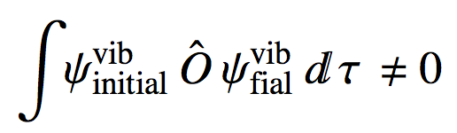
Active Vibrational Modes
The “irreducible” vibrations of a molecule are its normal modes
In order for a vibrational mode to show up in a spectrum:
IR active modes: vibration changes dipole moment of the molecule
Raman active modes: vibration changes the polarizability (squishiness) the molecule
Dipole moment op. for IR
Polarizability op. for Raman

Slide 20
Active Vibrational Modes
If molecule has a “center of symmetry” it has no common IR and Raman active nodes
Cl
OH
Cl
H
C
C
C
H
Cl
Cl
Cl
Has center of symmetry
Has no common IR and Raman active modes
Has no center of symmetry
Has some common IR and Raman active modes

Slide 21
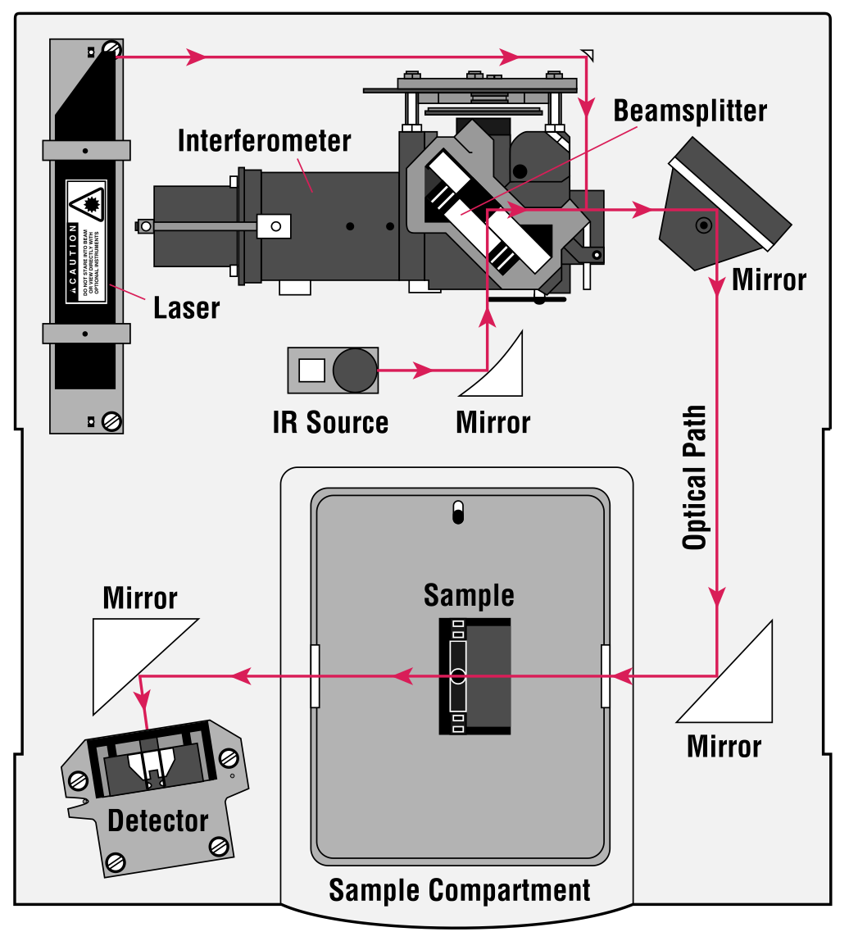
Infrared Vibrational Spectrocscopy
Vibrational spectroscopy in forensic science is done experimentally!
Most common modern method is Fourier Transform Infrared (FT-IR) spectroscopy
We’re going to focus on this part
Thermo-Nicolet

Slide 22
The Michelson Interferometer
Fixed mirror
Movable mirror
Beam spliter
δ-axis
Incoming wave
δ₀=0
δ_{min}
δ_{max}

Slide 23
The Michelson Interferometer
Fixed mirror
recombine
split
Movable mirror
Incoming wave
Path lengths equal
Recombine in-phase

Slide 24
The Michelson Interferometer
Fixed mirror
recombine
split
Movable mirror
Incoming wave
Path lengths NOT equal
Recombine out-of-phase

Slide 25
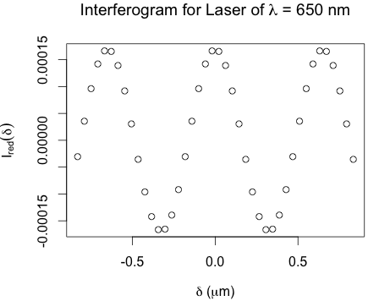
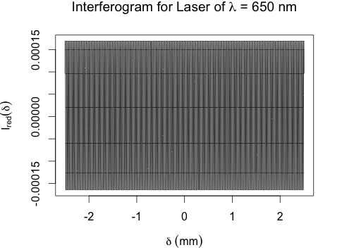
The Michelson Interferometer
What does an Michelson interferometer do to source light with 1 wavelength component?
This is what the detector records:
Zooming in

Slide 26
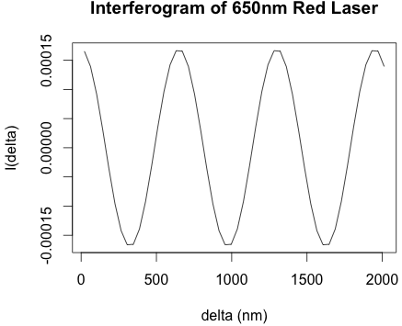
The Michelson Interferometer
What does an Michelson interferometer do to source light with 1 wavelength component?
This is what the detector records:
One complete cycle at δ = λ
Zooming in
650 nm
Trick: A laser can give us the mirror position, δ, very accurately!

Slide 27
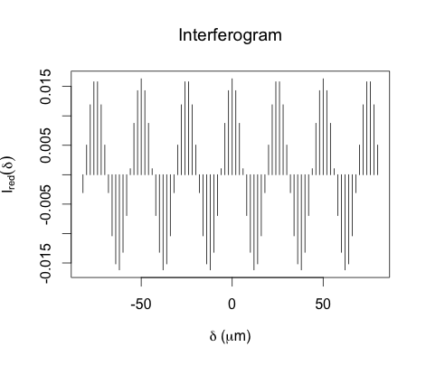
Interferograms
What does an Michelson interferometer do to source light with 1 wavenumber component?
This is what the detector records (zoomed in):

Slide 28
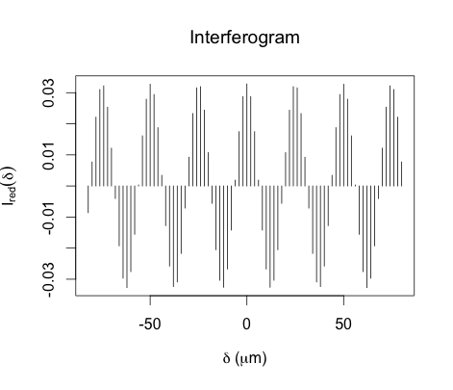
Interferograms
What does an Michelson interferometer do to source light with 2 wavenumber components?
This is what the detector records (zoomed in):

Slide 29
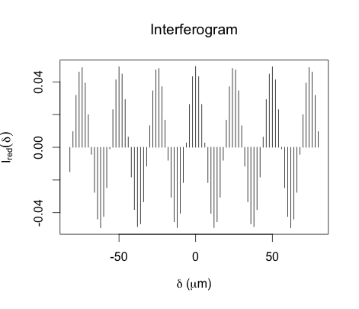
Interferograms
What does an Michelson interferometer do to source light with 3 wavenumber components?
This is what the detector records (zoomed in):

Slide 30
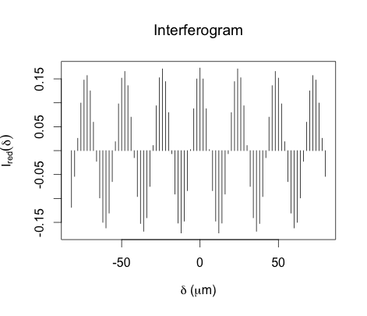
Interferograms
What does an Michelson interferometer do to source light with 10 wavenumber components?
This is what the detector records (zoomed in):

Slide 31
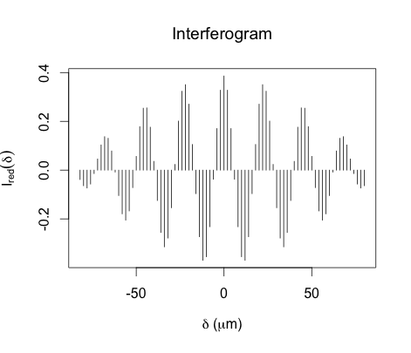
Interferograms
What does an Michelson interferometer do to source light with 20 wavenumber components?
This is what the detector records (zoomed in):

Slide 32
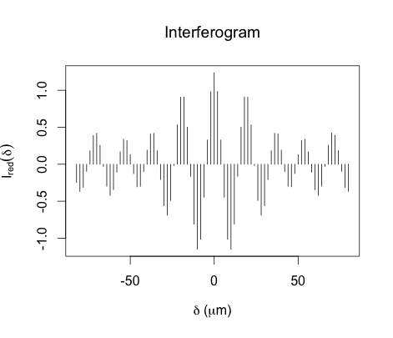
Interferograms
What does an Michelson interferometer do to source light with 50 wavenumber components?
This is what the detector records (zoomed in):

Slide 33
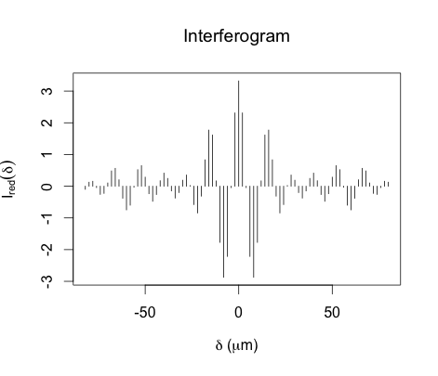
Interferograms
What does an Michelson interferometer do to source light with 100 wavenumber components?
This is what the detector records (zoomed in):

Slide 34
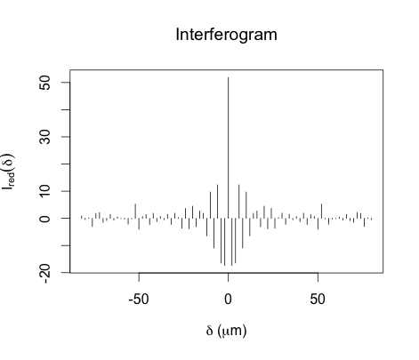
Interferograms
What does an Michelson interferometer do to source light with 500 wavenumber components?
This is what the detector records (zoomed in):

Slide 35
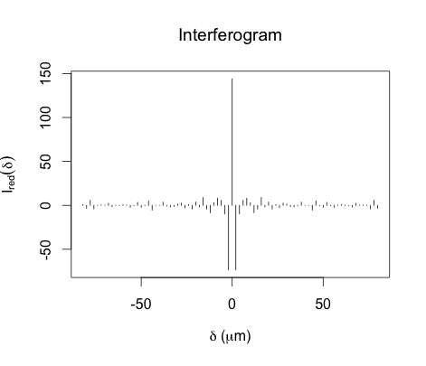
Interferograms
What does an Michelson interferometer do to source light with 1000 wavenumber components?
This is what the detector records (zoomed in):

Slide 36
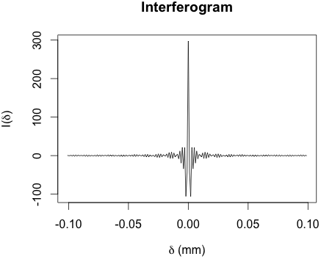

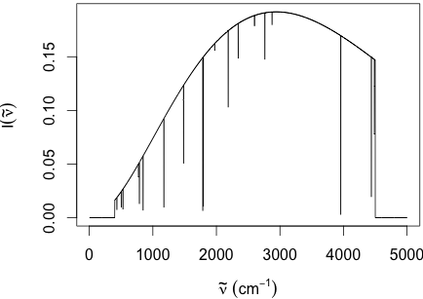
FT-IR Vibrational Spectroscopy
Source spectrum
Absorbance spectrum
Sample
FFT

Slide 37
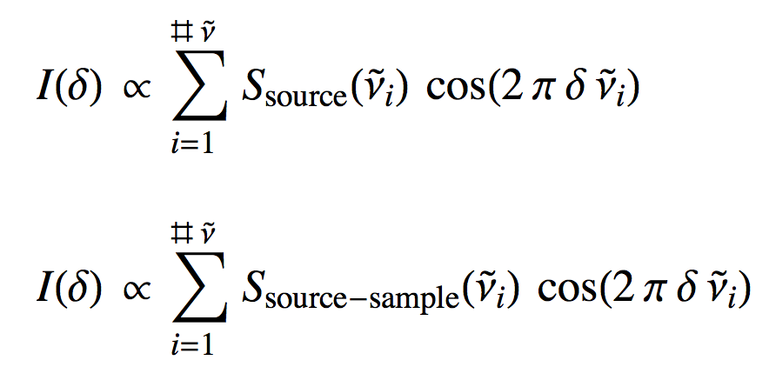
Fourier Transform of the Interferogram
We now know that the interferogram is a sum of waves:
One wave for each cm⁻¹ in the source spectrum: multiplex
Some of the multiplexed information in the source’s interferogram is absorbed by the sample’s vibrations
Whole vibrational spectrum is recorded in a sweep of the interferometer’s mirror!

Slide 38
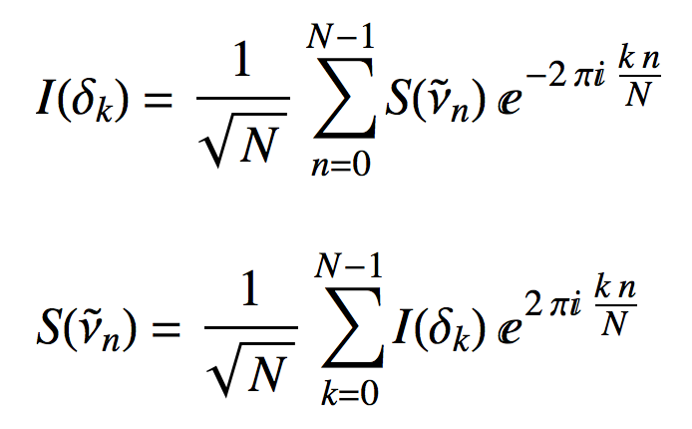
Fourier Transform of the Interferogram
How do we untangle the interferogram to see which parts of the spectrum got absorbed?
A little fancier version of the interferogram’s equation is:
Here is our IR spectrum inside
To get it out, invert the equation with a Fourier transform:

Slide 39
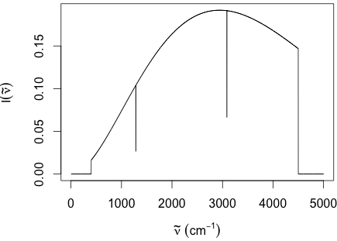

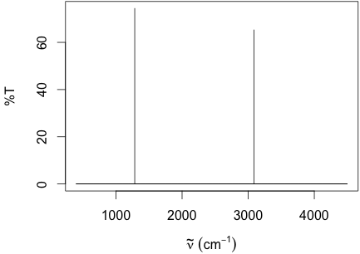
FT-IR Vibrational Spectroscopy
Simulation for IR-active modes of CH₄

