Slide 1
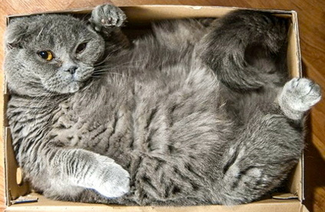
Particle In A Box

Slide 2
Dimensions
Let’s get some terminology straight first:
Normally when we think of a “box”, we mean a 3D box:
y
3 dimensions
x
z

Slide 3
Dimensions
Let’s get some terminology straight first:
We can have a 2D and 1D box too:
1D “box”
a line
2D “box”
a plane
y
x
x

Slide 4
Particle in a 1D box
Let’s start with a 1D “Box”
To be a “box” we have to have “walls”
V = ∞
V = ∞
Length of the box is l
x-axis
0
l

Slide 5
Particle in a 1D box
1D “Box
V = ∞
V = ∞
Inside the box
V = 0
x-axis
0
l
Put in the box a particle of mass m

Slide 6
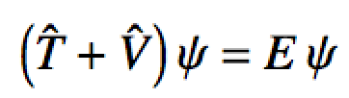
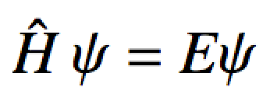
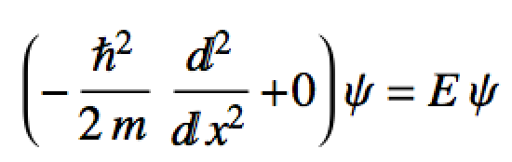
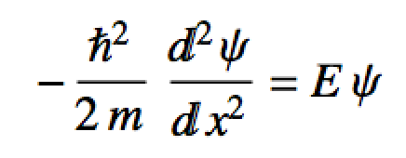
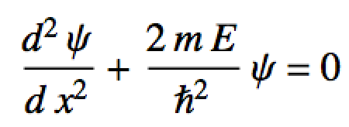

Particle in a 1D box
1D “Box”
The Schrodinger equation:
V = ∞
For P.I.A.B:
V = ∞
Rearrange a little:
This is just:
x-axis
0
l
Particle of mass m

Slide 7

Particle in a 1D box
We know the solution for :
Boundary conditions: ψ (0) = 0, ψ(l) = 0
General solution: ψ (x) = A cos(βx) + B sin(βx)
First boundary condition knocks out this term:
0
x-axis
0
l

Slide 8
Particle in a 1D box
We know the solution for :
Boundary conditions: ψ (0) = 0, ψ(l) = 0
Solution: ψ (x) = B sin(β x)
ψ (l) = B sin(β l) = 0
sin( ) = 0 every π units
=> β l = n π
n = {1,2,3,…} are quantum numbers!
x-axis
0
l

Slide 9
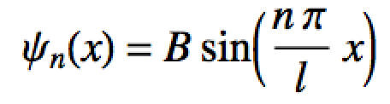
Particle in a 1D box
We know the solution for :
Boundary conditions: ψ (0) = 0, ψ(l) = 0
Solution:
We still have one more constant to worry about…
x-axis
0
l

Slide 10
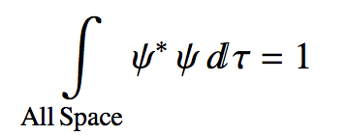
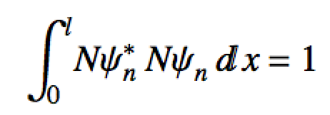
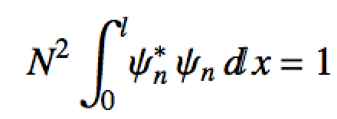
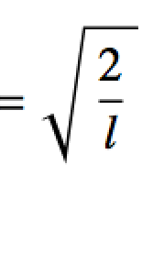
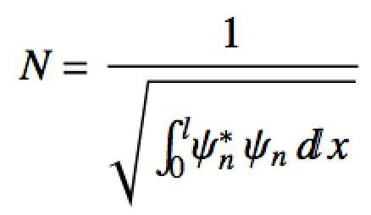
Particle in a 1D box
Solution:
Use normalization condition to get B = N:
PIAB normalization constant

Slide 11
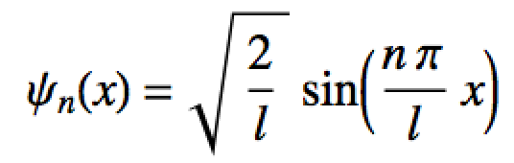
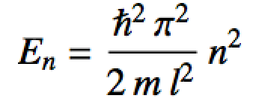
Particle in a 1D box
Solution for 1D P.I.A.B.:
n = {1,2,3,…}
PIAB eigenfunctions
PIAB eigenvalues
Quantum numbers label the state
n = 1, lowest quantum number called the ground state

Slide 12
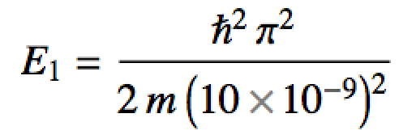
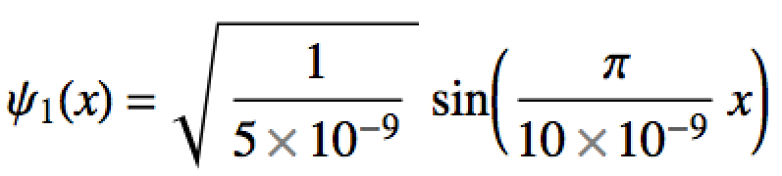
Particle in a 1D box
Quantum numbers label the state
n = 1, lowest quantum number called the ground state
ψ² = probability density for the ground state

Slide 13
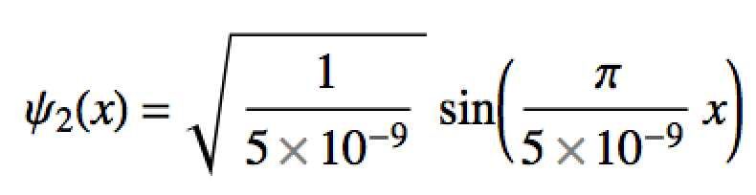
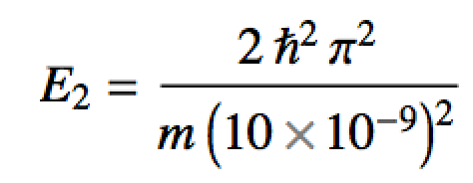
Particle in a 1D box
Quantum numbers label the state
n = 2, first excited state
ψ² = probability density for the first excited state

Slide 14
Particle in a 1D box
A closer look at this probability density
n = 2, first excited state
one particle but (sort of) at two places at once
particle will never be found here at the node

Slide 15
Particle in a 1D box
Quantum numbers label the state
n = 3, second excited state

Slide 16
Particle in a 1D box
Quantum numbers label the state
n = 4, third excited state

Slide 17
Particle in a 1D box
For Particle in a box:
# nodes = n – 1
Energy increases as n²
…
n = 7
Particle in a 1D box is a model for UV-Vis spectroscopy
Single electron atoms have a similar energetic structure
Large conjugated organic molecules have a similar energetic structure as well
n = 6
n = 5
E_{n} in units of
n = 4
n = 3
n = 2
n = 1

Slide 18
Particle in a 3D box
We will skip 2D boxes for now
Not much different than 3D and we use 3D as a model more often
b
0 ≤ y ≤ b
y
a
x
0 ≤ x ≤ a
z
0 ≤ z ≤ c
c

Slide 19
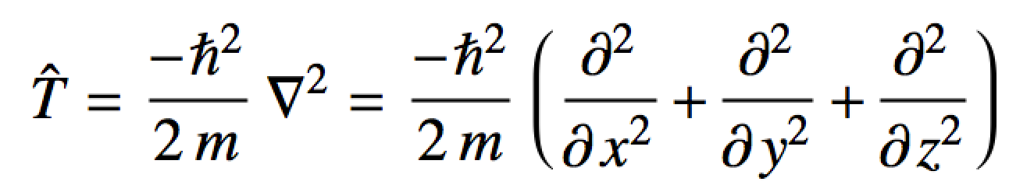
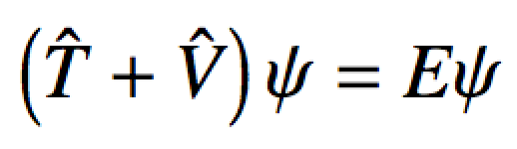
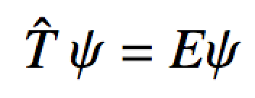
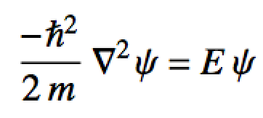
Particle in a 3D box
Inside the box V = 0
Outside the box V= ∞
KE operator in 3D:
Now just set up the Schrodinger equation:
0
Schrodinger eq for particle in 3D box

Slide 20

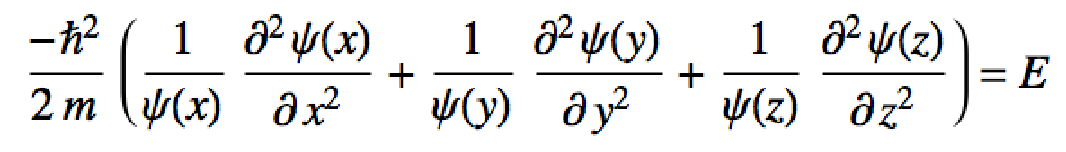
Particle in a 3D box
Assuming x, y and z motion is independent, we can use separation of variables:
Substituting:
Dividing through by:

Slide 21
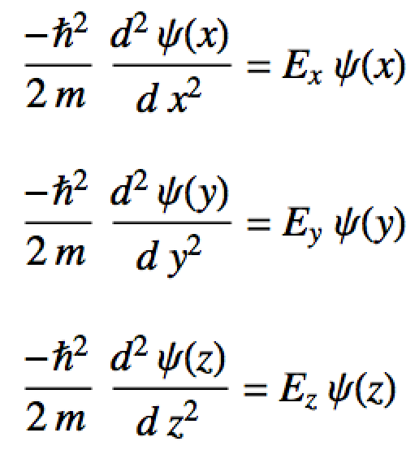
Particle in a 3D box
This is just 3 Schrodinger eqs in one!
One for x
One for y
One for z
These are just for 1D particles in a box and we have solved them already!

Slide 22
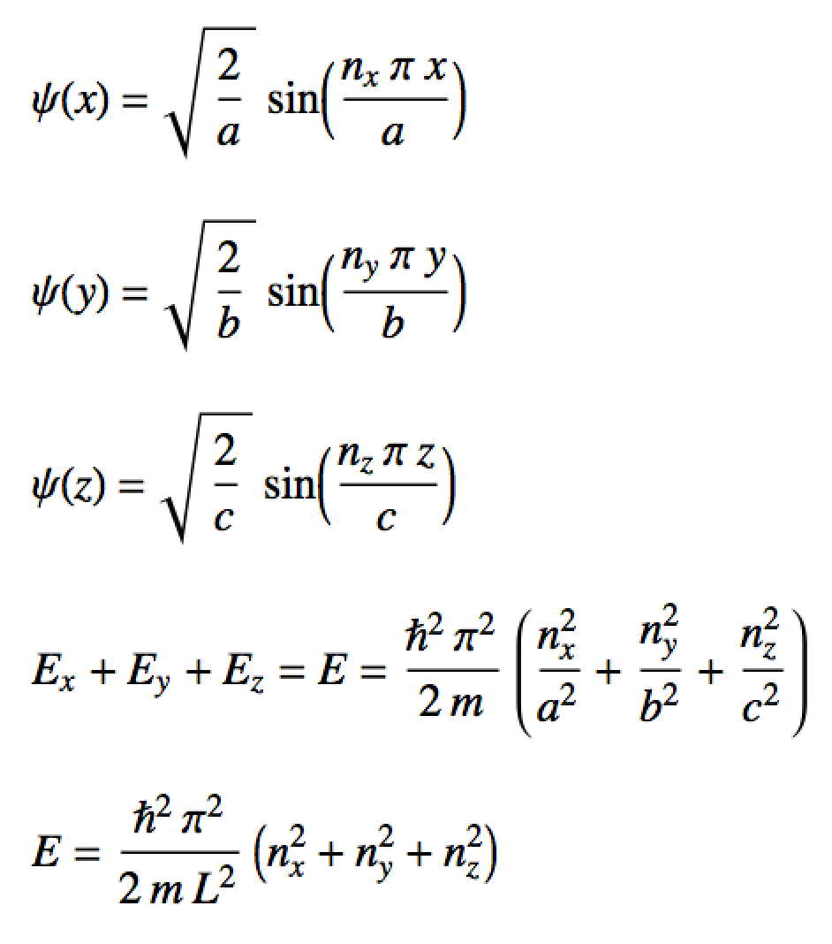
Particle in a 3D box
Wave functions and energies for particle in a 3D box:
n_{x} = {1,2,3,…}
n_{y} = {1,2,3,…}
eigenfunctions
n_{z} = {1,2,3,…}
eigenvalues
eigenvalues if a = b = c = L

Slide 23
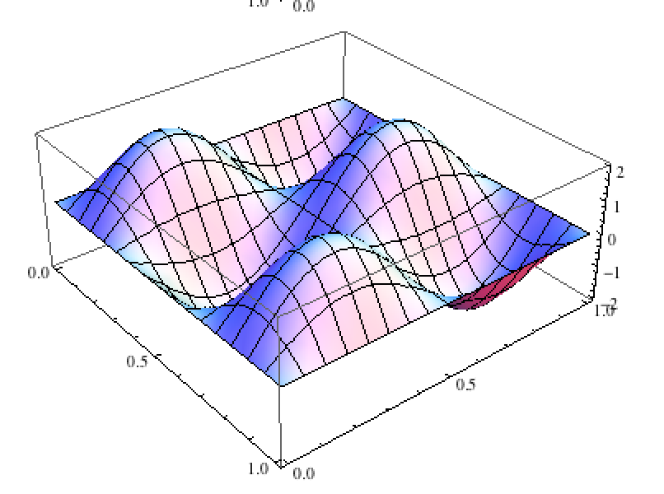
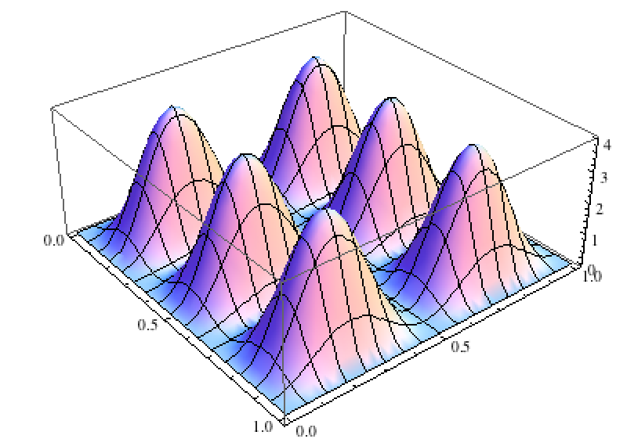
Particle in a 2D/3D box
Particle in a 2D box is exactly the same analysis, just ignore z.
What do all these wave functions look like?
ψ_{nx=3,ny=2}(x,y)
|ψ_{nx=3,ny=2}|²
2D box wave function/density examples

Slide 24
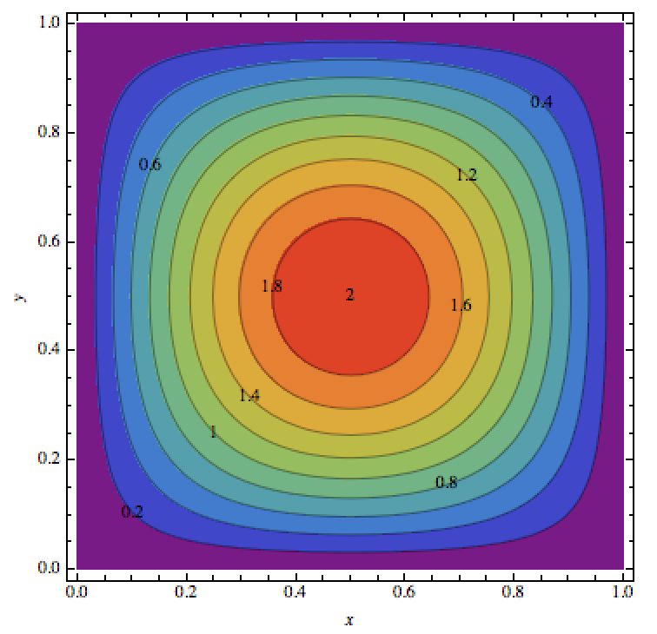
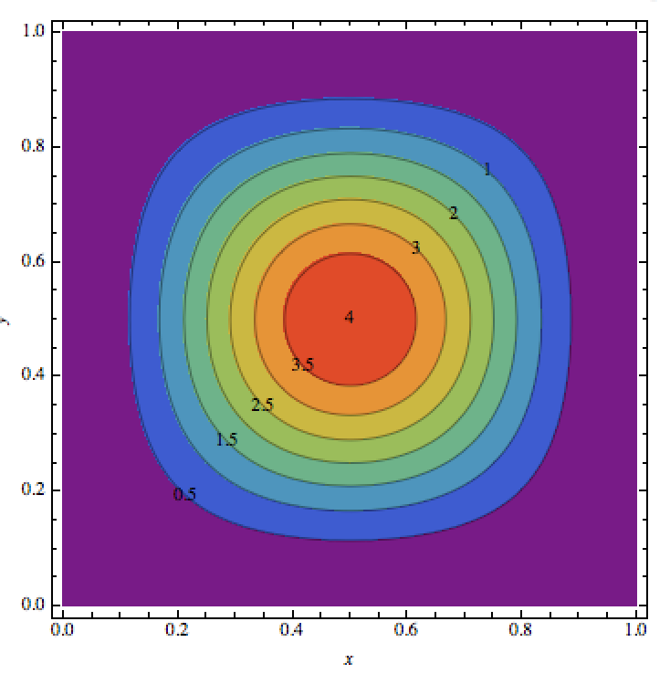
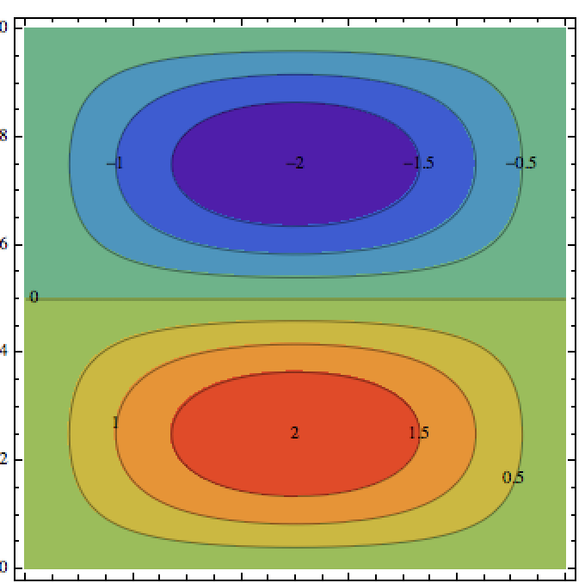
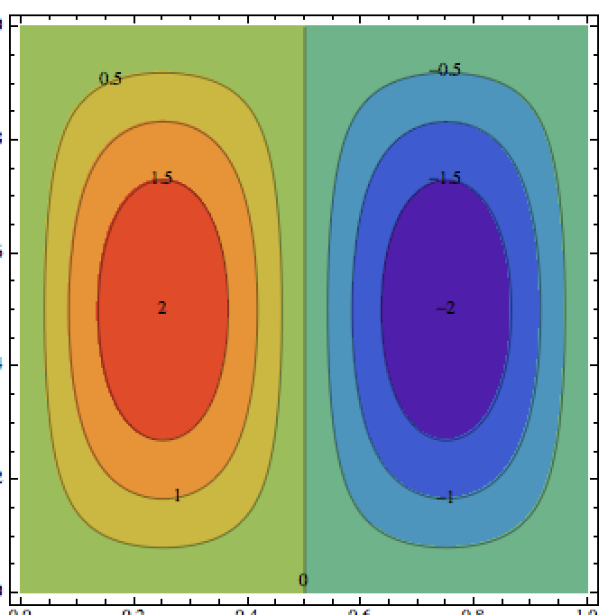
Particle in a 2D/3D box
Particle in a 2D box, wave function contours
ψ
|ψ|²
n_{x} = 1, n_{y} = 1
These two have the
same energy!
ψ
ψ
n_{x} = 1, n_{y} = 2
n_{x} = 2, n_{y} = 1
2D box wave function/density contour examples

Slide 25
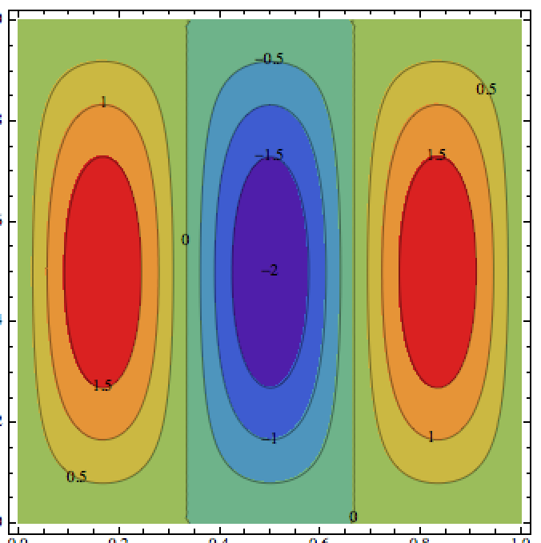
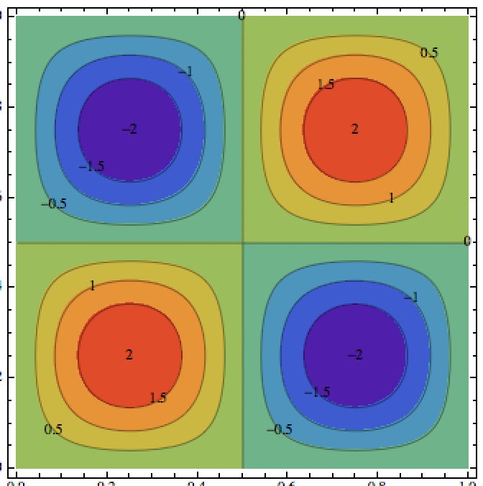
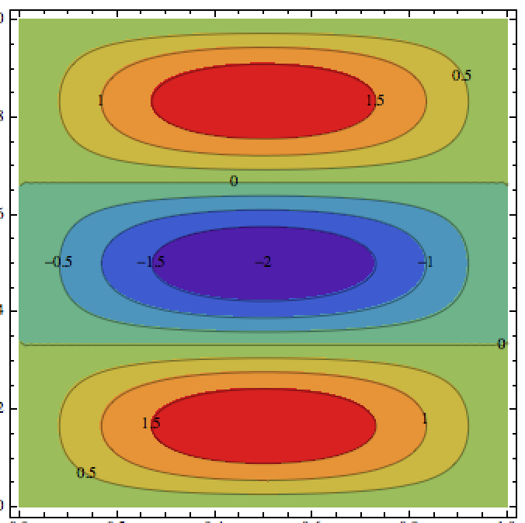
Particle in a 2D/3D box
Particle in a 2D box, wave function contours
ψ
ψ
ψ
n_{x} = 3, n_{y} = 1
n_{x} = 2, n_{y} = 2
n_{x} = 1, n_{y} = 3
Wave functions with different quantum numbers but the same energy are called degenerate
2D box wave function contour examples

Slide 26
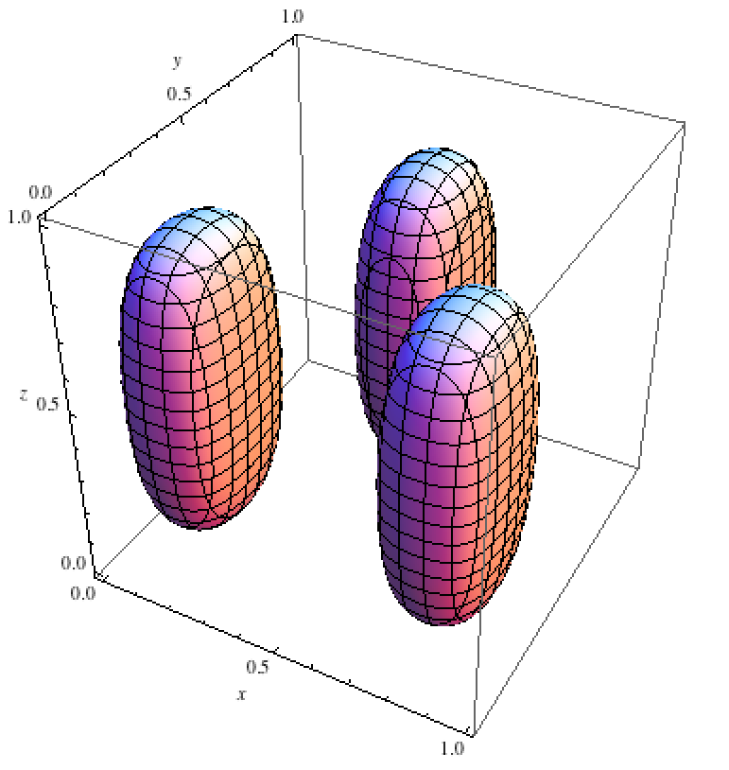
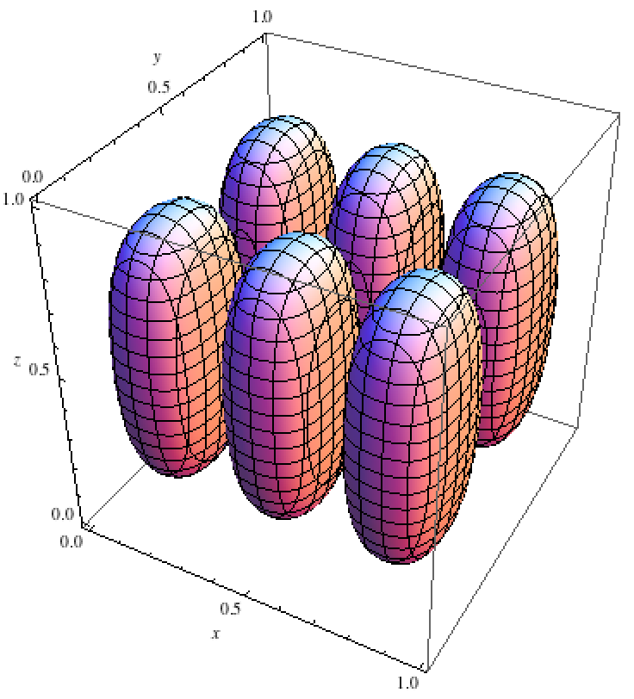
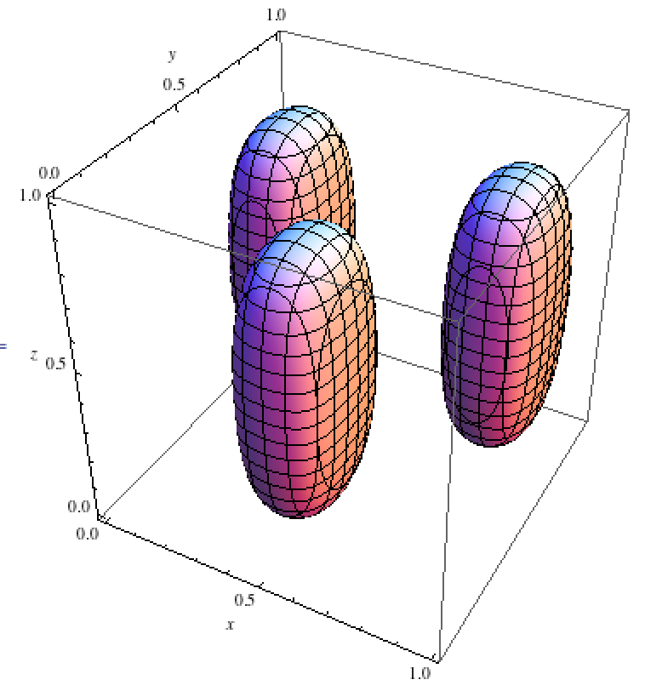
Particle in a 2D/3D box
3D box wave function contour plots:
ψ_{nx=3,ny=2,nz=1}(x,y,z) = 0.84
|ψ_{nx=3,ny=2,nz=1}|² = 0.7
3D box wave function/density examples

Slide 27
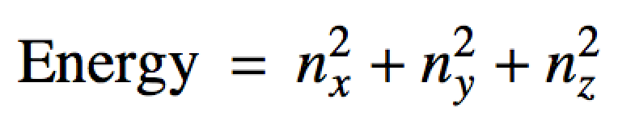
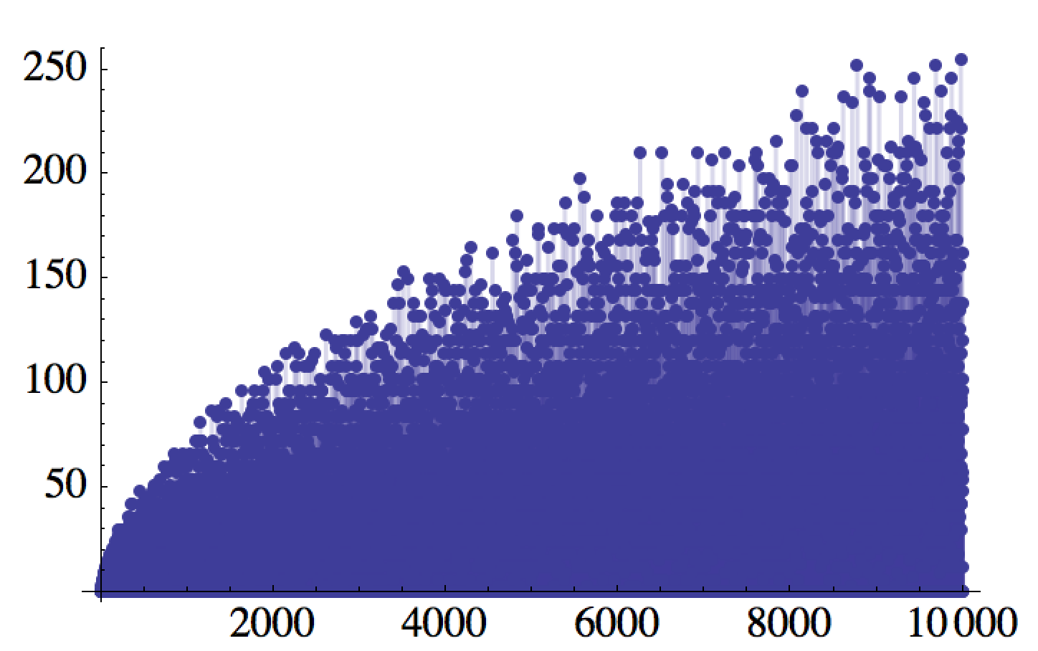
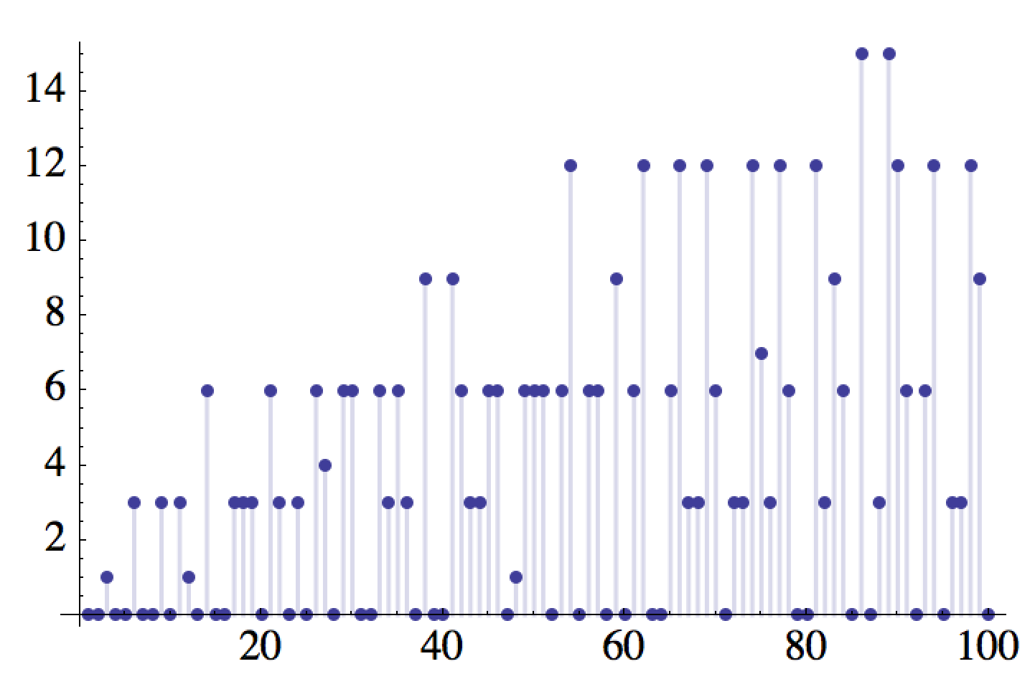
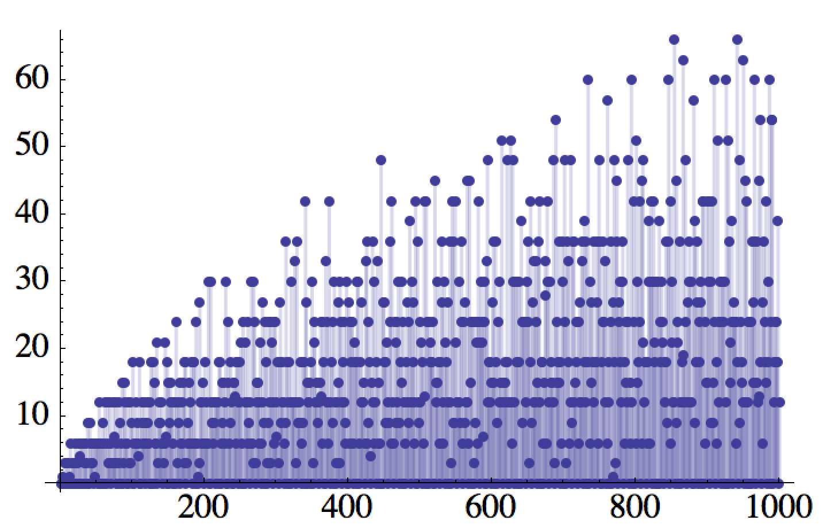
Particle in a 3D box degeneracy
The degeneracy of 3D box wave functions grows quickly.
Degenerate energy levels in a 3D cube satisfy a Diophantine equation:
With Energy in units of
# of states
Concept called the density of states
Energy

