Slide 1

Solving the Schrodinger Equation on a Computer with the Numerov Procedure

Slide 2
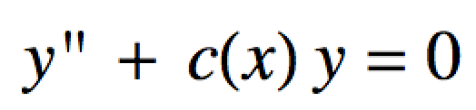
Numerov Procedure
The Numerov algorithm can be used to solve diff. eqs of the form:
It’s important to us since our Schrodinger equations have this form.

Slide 3
Numerov Procedure
The algorithm “solves” the diff. eq iteratively as it works its way across the x-axis
Choose a potential energy function V(x)
Our choices are:
“box” for particle in a box
“harmonic” for harmonic oscillator
“anharmonic” for anharmonic oscillator
“radial” for hydrogen-like radial wave functions

Slide 4
Numerov Procedure
Guess an initial value for the energy E.
Set up an x-axis:
Choose an increment dx as well as an xmin and xmax.
xmin and xmax should span a distance where the wave function will be mostly non-zero
It helps to look at a graph of your V(x) to figure out about what xmin and xmax should be for a given guess E.

Slide 5
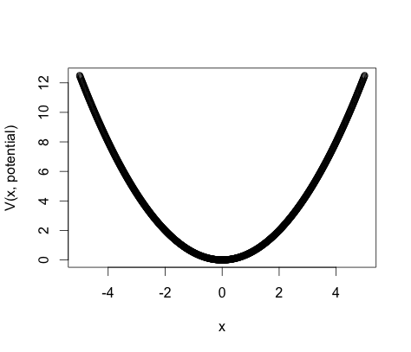
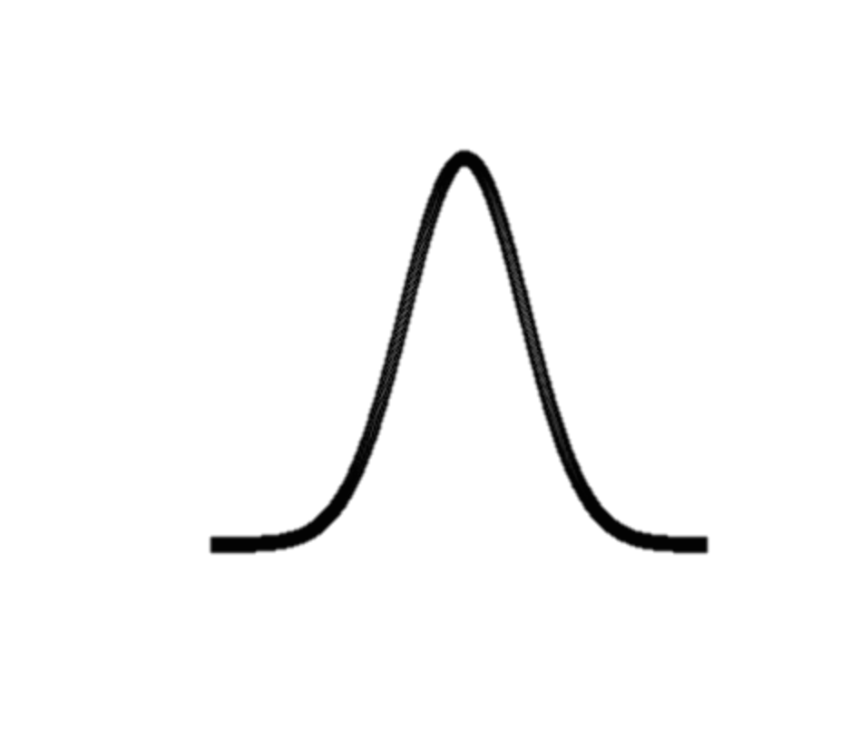
Numerov Procedure
ψ₀
Wave function tails should be around here
Say we guess an energy, E in this neighborhood
Guess xmin and xmax at least around here

Slide 6
Numerov Procedure
Input the desired number of nodes in ψ(x).
This gives the state.
Need to know the first two solution points ψ(x₁) and ψ(x₂)
We always make ψ(x₁) and ψ(x₂) ≈ 0 because of the boundary conditions
Once we have ψ(x₁), ψ(x₂), V(x) and a guess for E the algorithm can compute a ψ(x).
We check that ψ(x) has the requested number of nodes and that ψ(xmax) ≈ 0
If not, guess another E and repeat.

Slide 7
che302r library
The Numerov algorithm is programmed in the library che302r
There a two functions in che302r we will use to start out with:
numerov.procedure(xaxis, dxaxis, PE.function.name,
nodes.in.state, E.guess, num.iterations,
delay.time)
approx.normalize(wf.info, plotQ=FALSE)
We will use these functions in the Numerov-control_script.R script
To use these functions we must first install and then load the che302r library

Slide 8
che302r library
First install the che302r library:
install.packages("devtools") # package to install R stuff from GitHub
library(devtools) # load devtools
install_github("npetraco/che302r") # install our che302r library

Slide 9
Numerov-control_script.R:
Now load and use the che302r library in the Numerov control script:
library(che302r)
# Domain (x-axis):
dx <- 0.01 # Increment on x-axis
x.min <- (0) # Start of x-axis. Well into (left) classically forbidden region
x.max <- 10 # End of x-axis. Well into the (right) classically forbidden region
x <- seq(from=x.min,to=x.max,by=dx) # x-axis
# Potential energy function
# Your choices are "box", "harmonic", "anharmonic":
Potential <- "box"
plot(x,V(x,potential))
# Numerov's procedure:
state <- 0 # State you want, starting from 0. It is an integer:
# 0,1,2,3,...etc. I.E., number of nodes
Guess.Energy <- (0) # Initial guess for energy of the state
max.iter <- 40
psi.info <- numerov.procedure(x,dx,potential,state,Guess.Energy,max.iter,delay.time=0.00)
# Approximately Normalize Psi:
Npsi.info <- approx.normalize(psi.info,plotQ=FALSE)

Slide 10
che302r library
The output of both numerov.procedure and approx.normalize is a two-column matrix:
Column 1 is the x-axis used to compute the wave function
Column 2 is the computed wavefunction values
Using psi.info, how could you plot the wave function?
How could you plot the normalized wave function?

