Slide 1
Quantum Springs

Slide 2
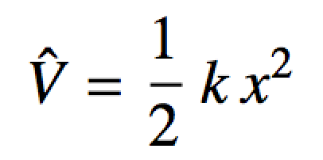
Harmonic Oscillator
Our next model is the quantum mechanics version of a spring:
Serves as a good model of a vibrating (diatomic) molecule
The simplest model is a harmonic oscillator:

Slide 3
Harmonic Oscillator
What does this potential mean?
Let’s take a look at a plot:
V
x₀ = “equilibrium bond length”
x = spring stretch distance

Slide 4
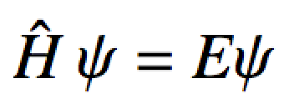
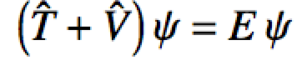
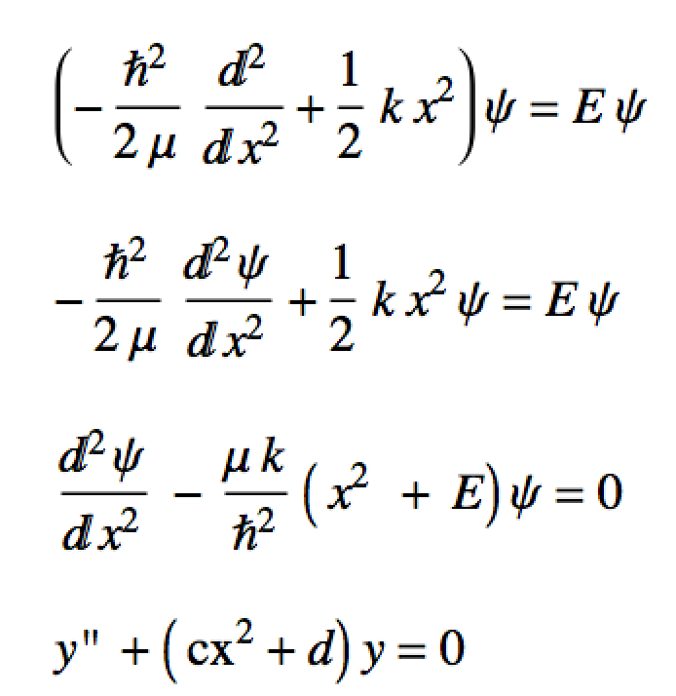
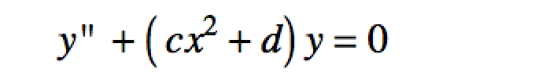
Harmonic oscillator
Let’s do the usual set up:
The Schrodinger equation:
Insert the operators
Rearrange a little
This is a linear second order homogeneous diff. eq., BUT with non-constant coefficients…
A pain to solve by hand, so we’ll do it numerically on the computer!

Slide 5
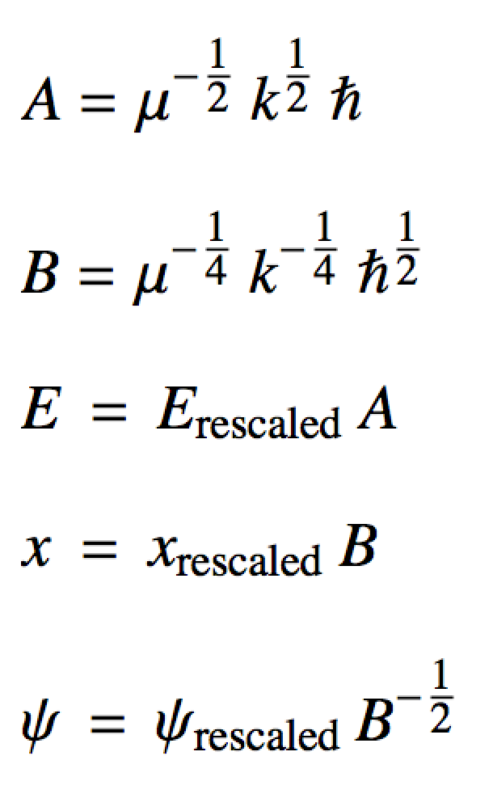
Numerov technique
Just as a matter of note, we have to use rescaled x, ψ, and E for the numerical solution algorithm we’ll use: the Numerov technique.
Get spit out of the Numerov alg.
Scaling coefficients

Slide 6
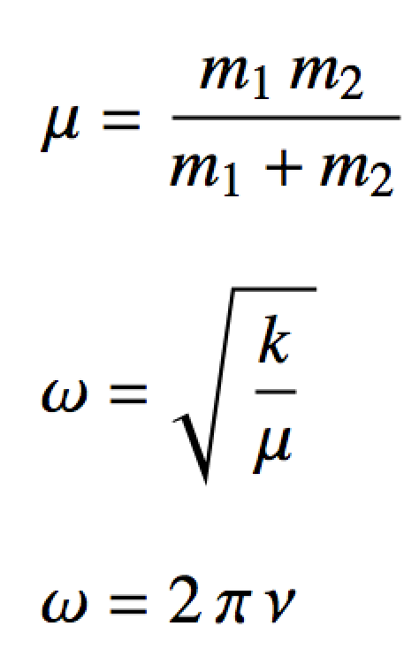
Numerov technique
μ is the “reduced mass”:
m₁
m₂
k is the “spring constant”
Measures “stiffness” of the bond
With the spring constant and reduced mass we can obtain fundamental vibrational frequencies

Slide 7
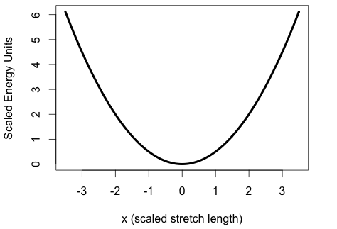
Solve the Harmonic Oscillator

Slide 8
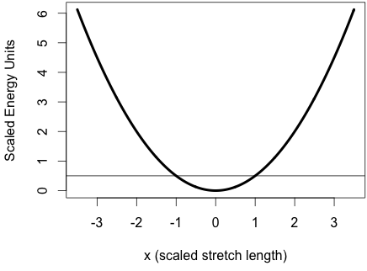
Solve the Harmonic Oscillator
E_{v = 0}

Slide 9

Solve the Harmonic Oscillator
E_{v = 1}
E_{v = 0}

Slide 10

Solve the Harmonic Oscillator
E_{v = 2}
E_{v = 1}
E_{v = 0}

Slide 11
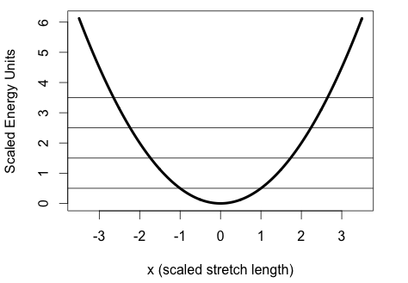
Solve the Harmonic Oscillator
E_{v = 3}
E_{v = 2}
E_{v = 1}
E_{v = 0}

Slide 12
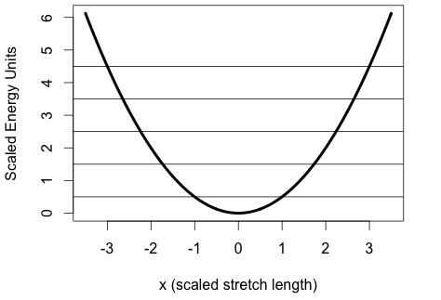
Solve the Harmonic Oscillator
E_{v = 4}
E_{v = 3}
E_{v = 2}
E_{v = 1}
E_{v = 0}

Slide 13
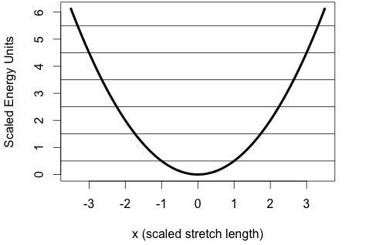
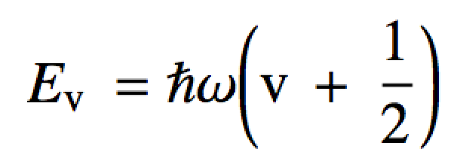
Solve the Harmonic Oscillator
E_{v = 5}
ΔE = ħω
E_{v = 4}
ΔE = ħω
E_{v = 3}
ΔE = ħω
E_{v = 2}
ΔE = ħω
E_{v = 1}
ΔE = ħω
E_{v = 0}
v = {0, 1, 2, 3, …}

Slide 14
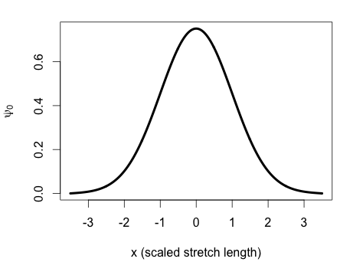
Solve the Harmonic Oscillator
Ground State

Slide 15
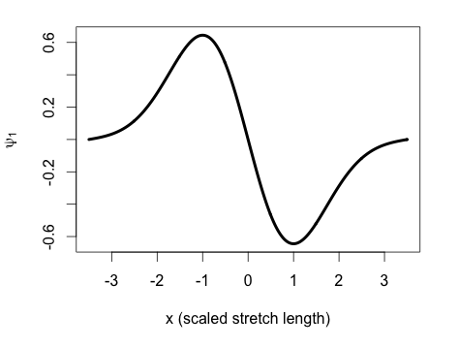
Solve the Harmonic Oscillator
First Excited State

Slide 16
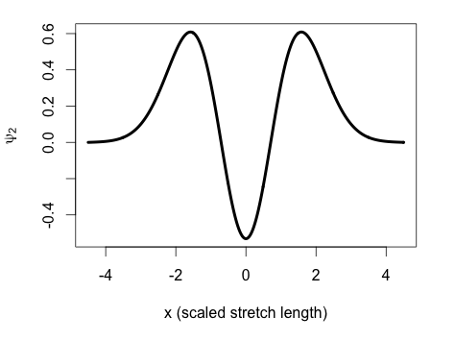
Solve the Harmonic Oscillator
Second Excited State

Slide 17
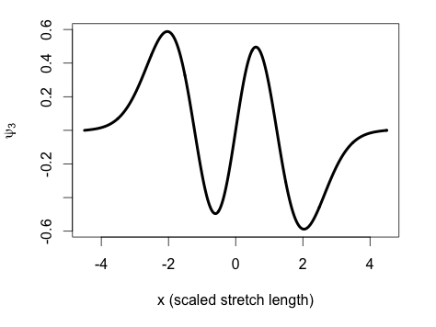
Solve the Harmonic Oscillator
Third Excited State

Slide 18
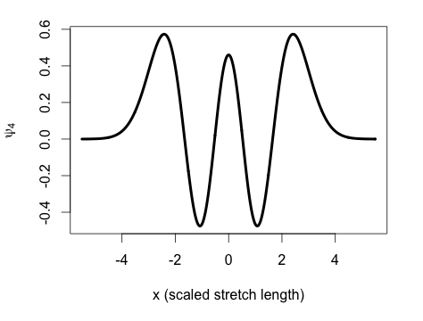
Solve the Harmonic Oscillator
Fourth Excited State

Slide 19
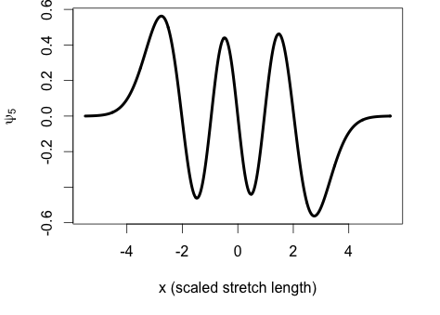
Solve the Harmonic Oscillator
# nodes, harmonic oscillator = v
Fifth Excited State

Slide 20
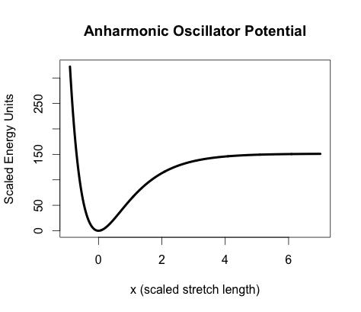
Anharmonic Oscillator
Real bonds break if they are stretched enough.
Harmonic oscillator does not account for this!
A more realistic potential should look like:
Energetic asymptote

Slide 21
Anharmonic Oscillator
Unfortunately the exact equation for anharmonic V(x) contains an infinite number of terms
We will use a close approximation which has a closed form: the Morse potential

Slide 22
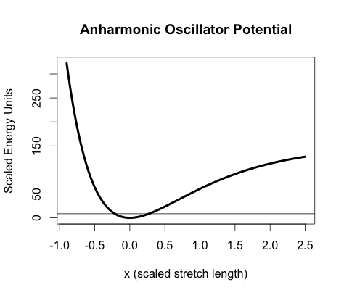
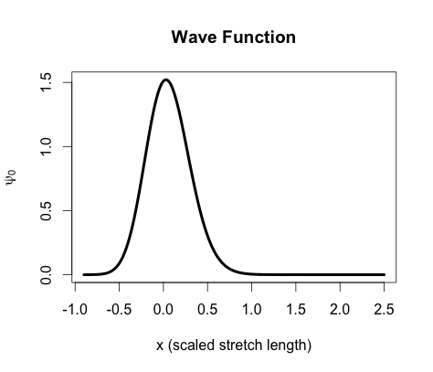
Anharmonic Oscillator
Ground State
Wave function dies off quickly when it gets past the potential walls
# nodes, anharmonic oscillator = v

Slide 23
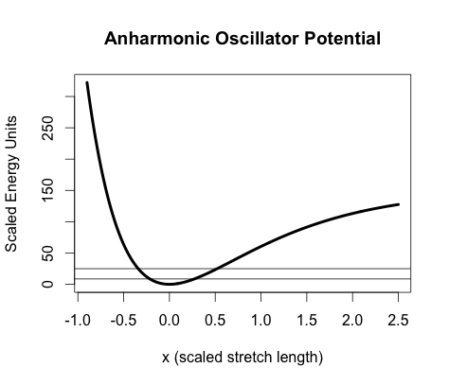
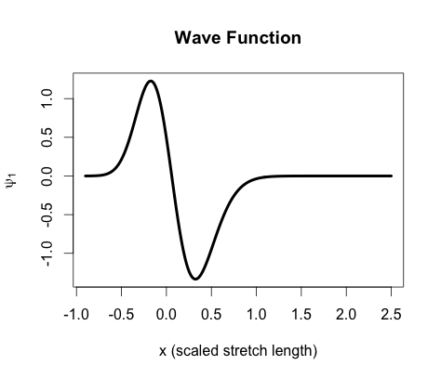
Anharmonic Oscillator
First Excited State
Note how anharmonic wave functions are asymmetric

Slide 24
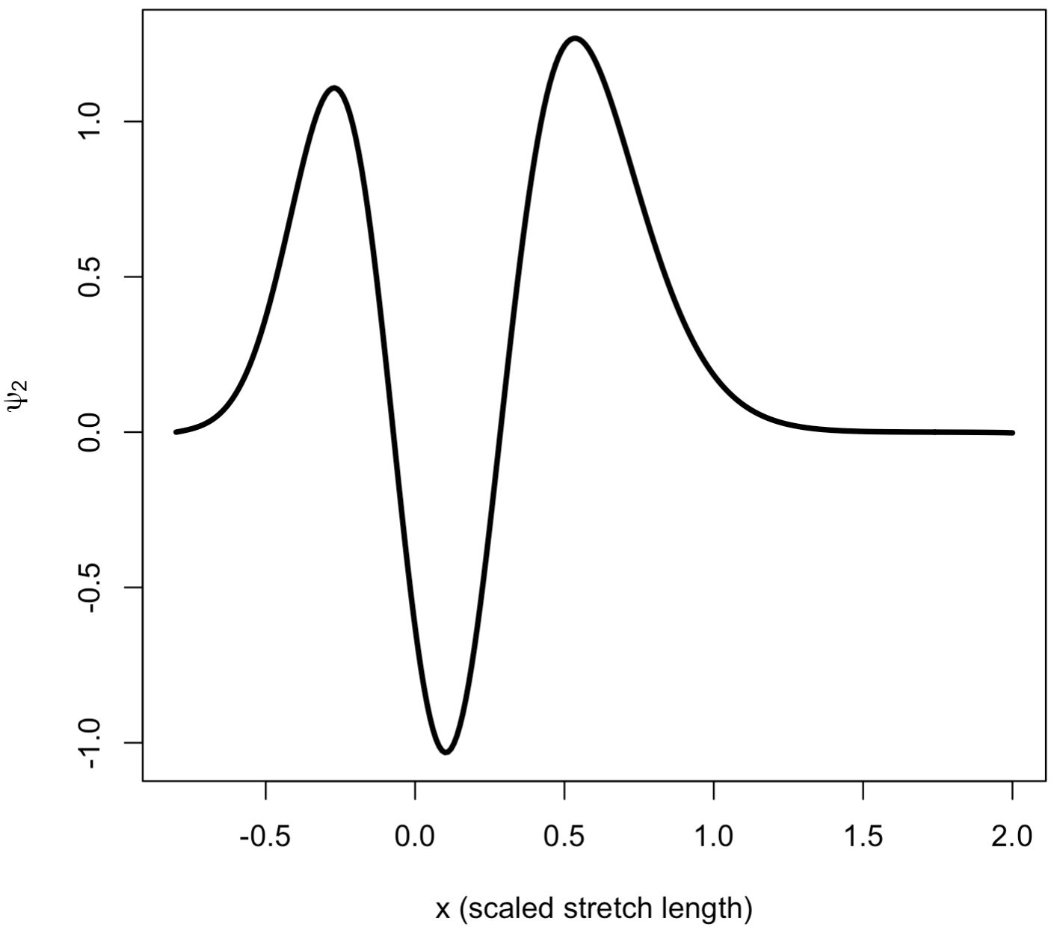
Anharmonic Oscillator
Second Excited State

Slide 25
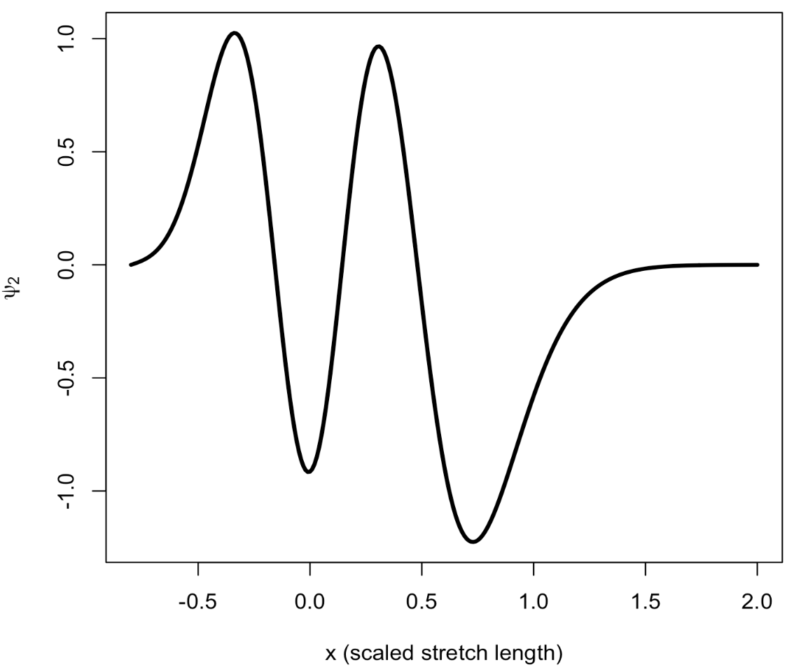
Anharmonic Oscillator
Third Excited State

Slide 26
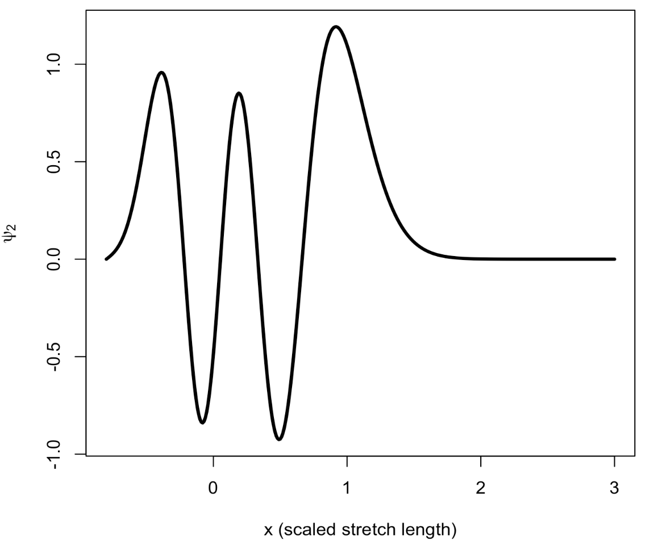
Anharmonic Oscillator
Fourth Excited State

Slide 27
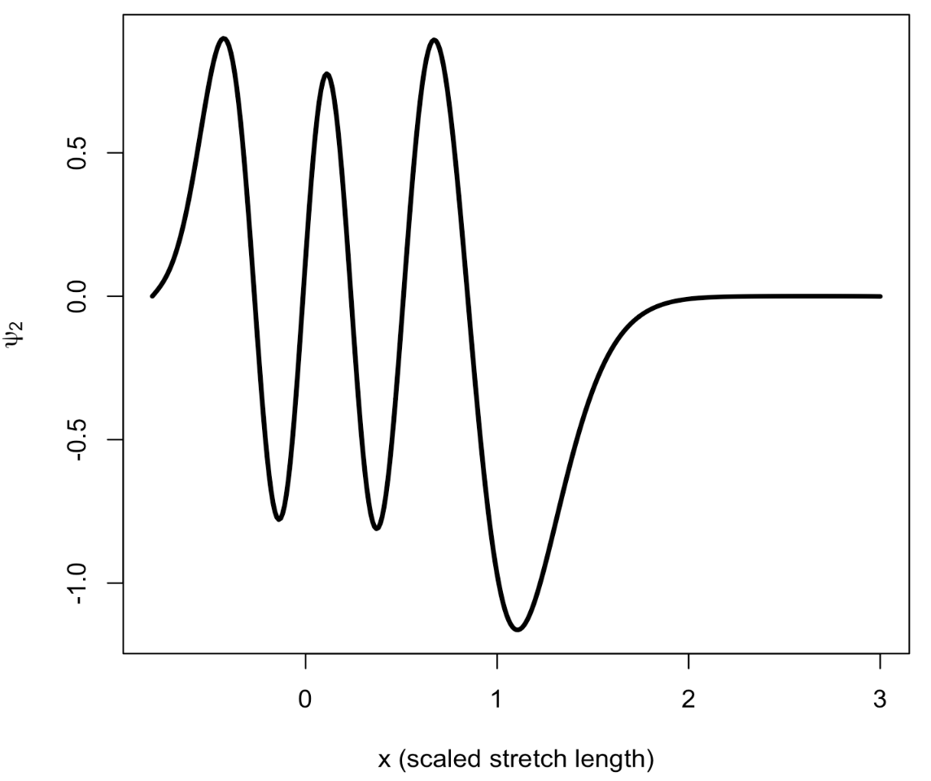
Anharmonic Oscillator
Fifth Excited State

Slide 28
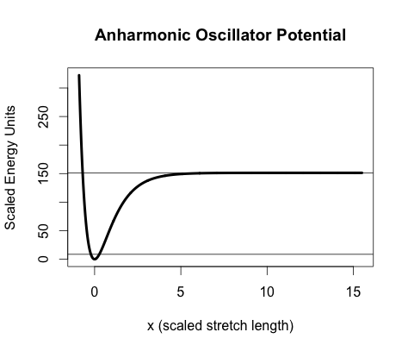
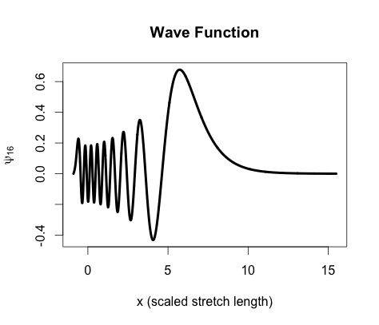
Anharmonic Oscillator
High enough energy: bond almost broken…
What happens when the energy approaches the top of the potential well?

Slide 29
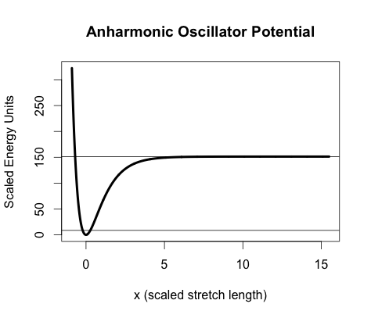
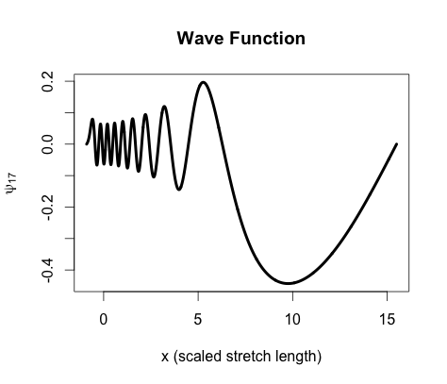
Anharmonic Oscillator
Energetic asymptote
D₀ = bond energy
Bond breaks!

Slide 30
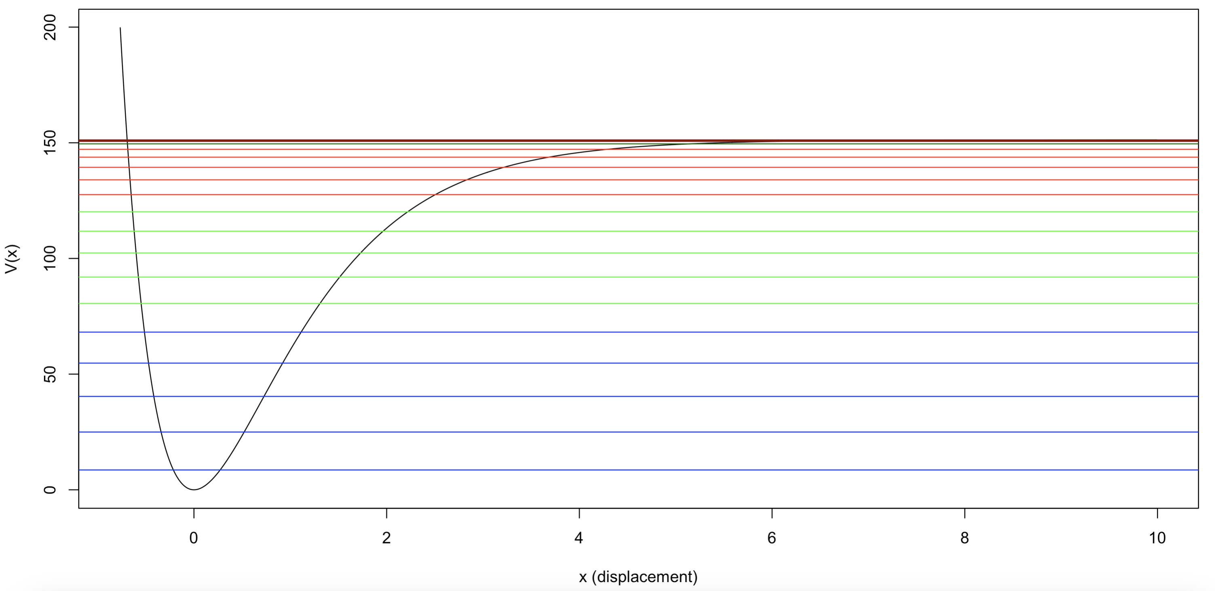
Anharmonic Oscillator
Energetic asymptote
As energy increases toward the asymptote, eigenvalues of the anharmonic oscillator get closer and closer

Slide 31
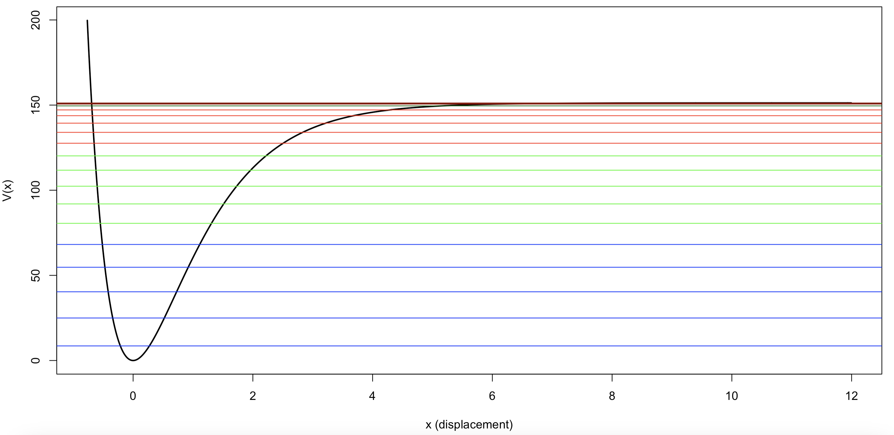
Anharmonic Oscillator

Slide 32
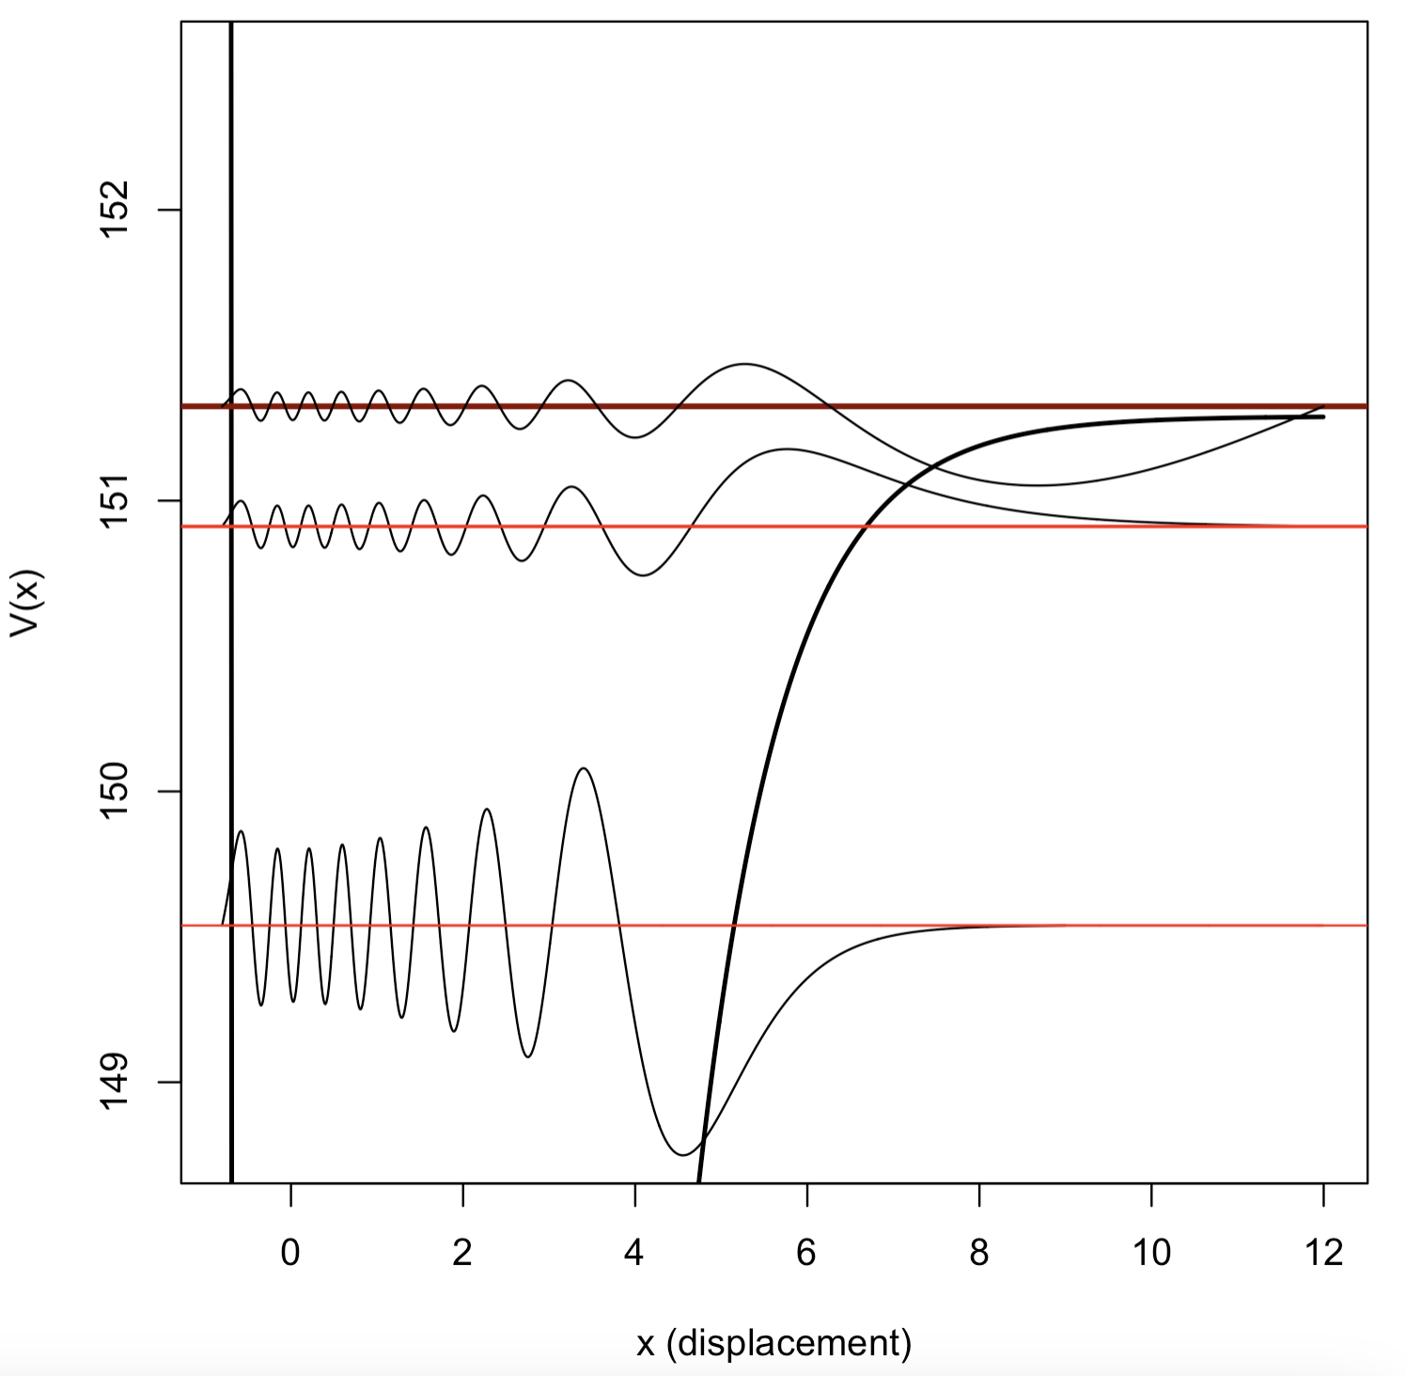
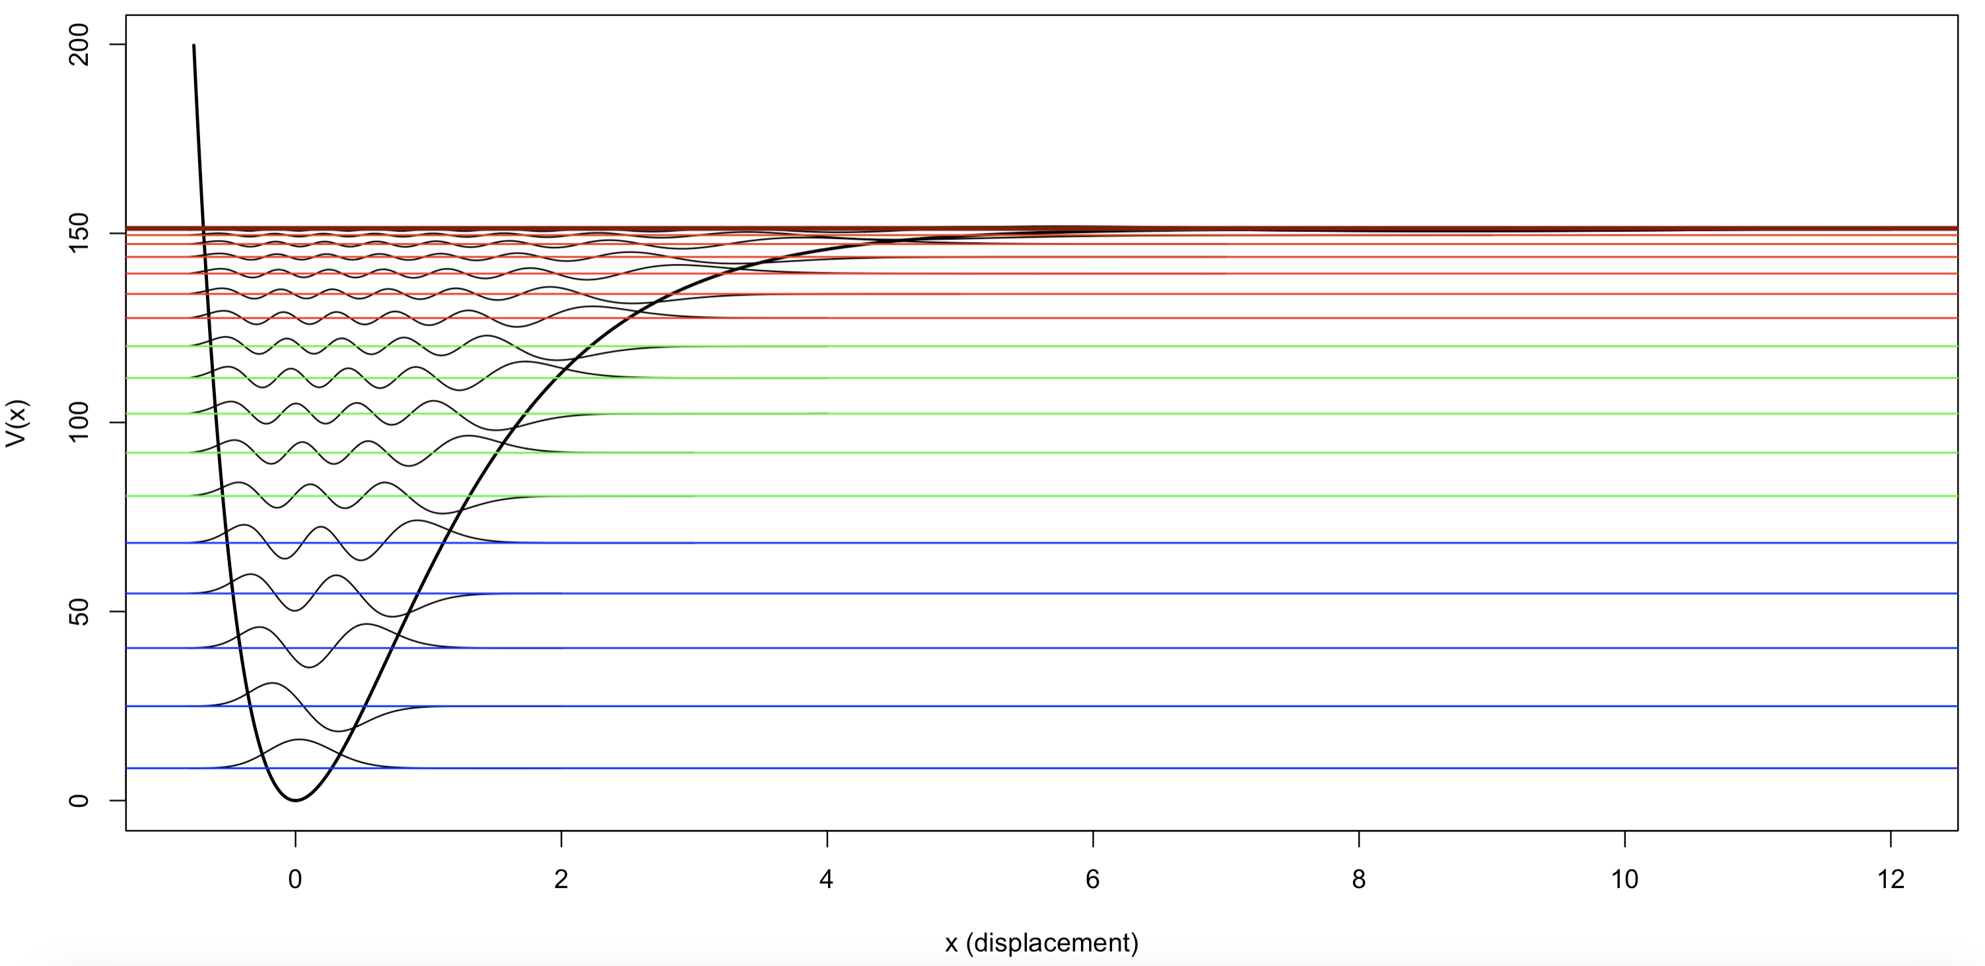
Anharmonic Oscillator

Slide 33
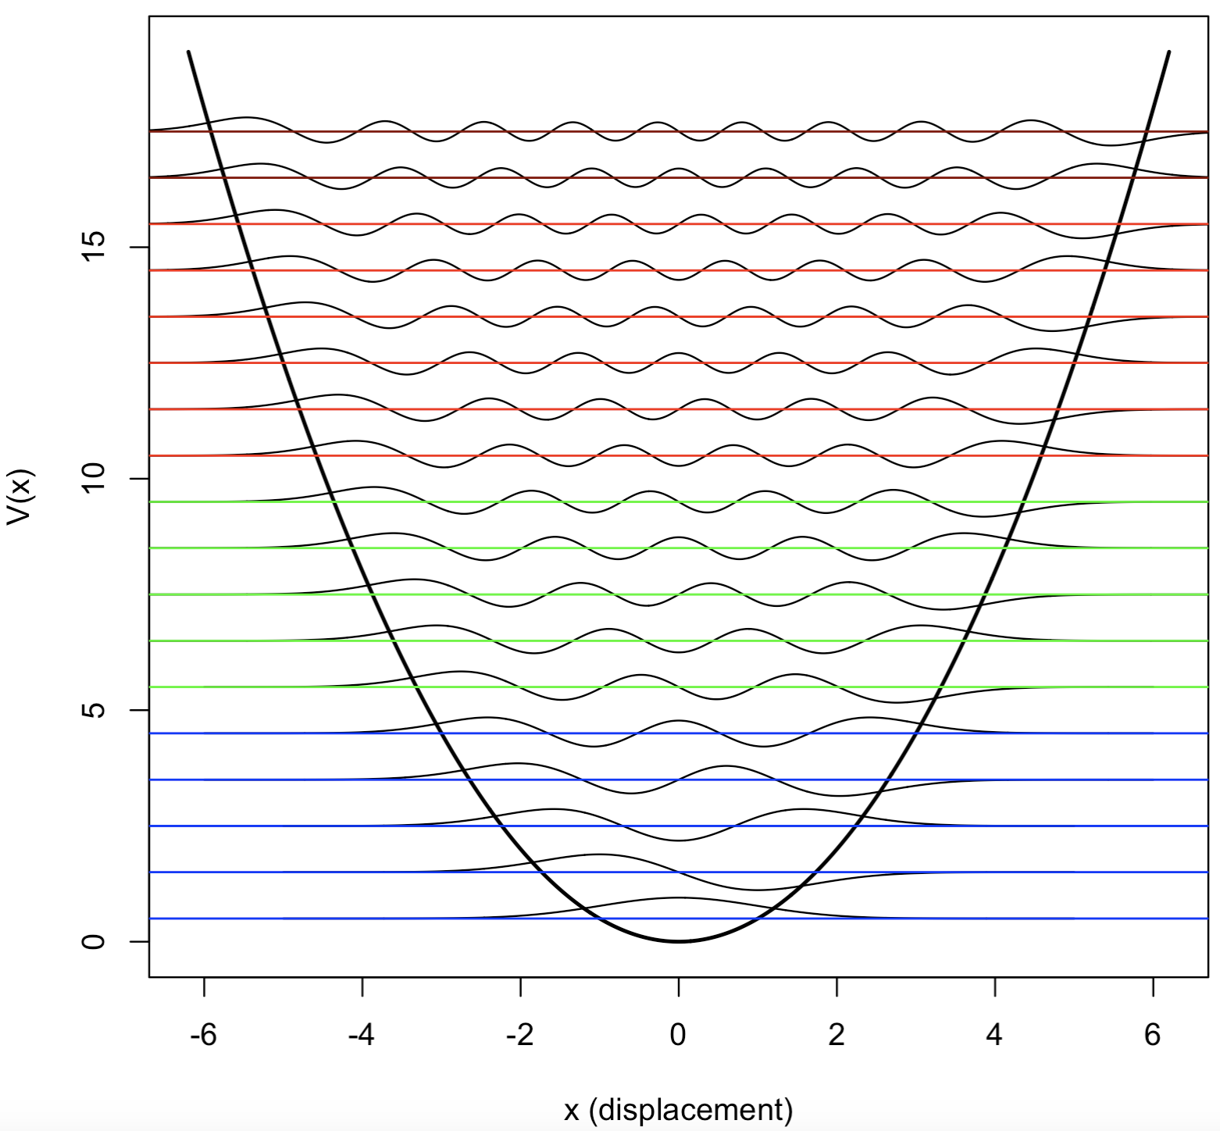
Comparison
Bond breaks
Harmonic Oscillator
Anharmonic Oscillator

