Slide 1

Solving the Schrodinger Equation on a Computer with the Numerov Procedure

Slide 2
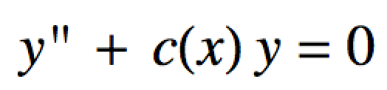
Numerov Procedure
The Numerov algorithm can be used to solve diff. eqs of the form:
It’s important to us since our Schrodinger equations have this form.

Slide 3
Numerov Procedure
The algorithm “solves” the diff. eq iteratively as it works its way across the x-axis
Choose a potential energy function V(x)
Our choices are:
“box” for particle in a box
“harmonic” for harmonic oscillator
“anharmonic” for anharmonic oscillator
“radial” for hydrogen-like radial wave functions

Slide 4
Numerov Procedure
Guess an initial value for the energy E.
Set up an x-axis:
Choose an increment dx as well as an x.min and x.max.
x.min and x.max should span a distance where the wave function will be mostly non-zero
It helps to look at a graph of your V(x) to figure out about what x.min and x.max should be for a given guess E.
More on this later…

Slide 5
Numerov Procedure
Input the desired number of nodes in ψ(x).
This gives the state.
Need to know the first two solution points ψ(x₁) and ψ(x₂)
We always make ψ(x₁) and ψ(x₂) ≈ 0 because of the boundary conditions
Once we have ψ(x₁), ψ(x₂), V(x) and a guess for E the algorithm can compute a ψ(x).
We check that ψ(x) has the requested number of nodes and that ψ(xmax) ≈ 0
If not, guess another E and repeat.

Slide 6
Numerov Procedure
dx
x_{min} = x₁
…, x_{i}, …
x_{max}

Slide 7
Numerov Procedure
x_{min} = x₁
…, x_{i}, …
x_{max}

Slide 8
Numerov Procedure
x_{min} = x₁
…, x_{i}, …
x_{max}

Slide 9
Numerov Procedure
x_{min} = x₁
…, x_{i}, …
x_{max}

Slide 10
Numerov Procedure
x_{min} = x₁
…, x_{i}, …
x_{max}

Slide 11
Numerov Procedure
x_{min} = x₁
…, x_{i}, …
x_{max}

Slide 12
Numerov Procedure
x_{min} = x₁
…, x_{i}, …
x_{max}

Slide 13
Numerov Procedure
x_{min} = x₁
…, x_{i}, …
x_{max}

Slide 14
Numerov Procedure
x_{min} = x₁
…, x_{i}, …
x_{max}

Slide 15
Numerov Procedure
x_{min} = x₁
…, x_{i}, …
x_{max}

Slide 16
Numerov Procedure
x_{min} = x₁
…, x_{i}, …
x_{max}

Slide 17
Numerov Procedure
x_{min} = x₁
…, x_{i}, …
x_{max}
After this process we hope:
ψ(x_{max}) ≈ 0
No guarantee that this happens right away
The # of nodes = the state number
Repeat (iterate) this process several times (usually between 40-80 times), adjusting* each time, until this happens.
and ψ(x) of last iteration are the solutions (energy eigenvalue and wave function)
Notes:
Connect the dots, draw in wf on board and label psi(x)

Slide 18
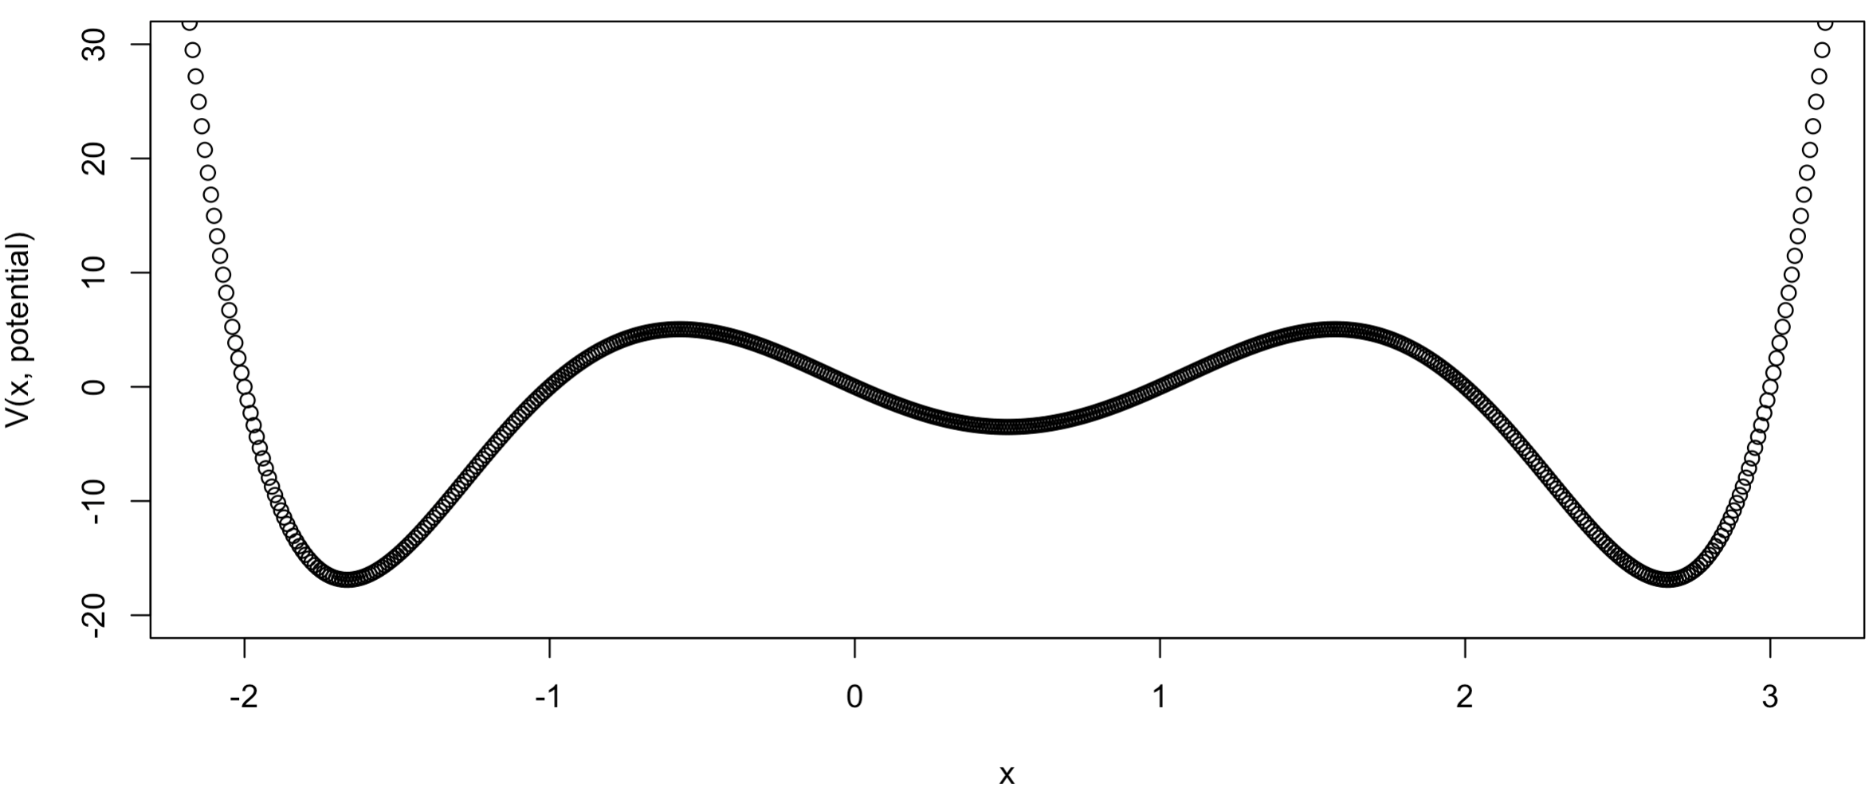
Guessing Good x.min and x.max
Say we guess an energy, E in neighborhood of -10
Guess x.min and x.max at least around here

Slide 19
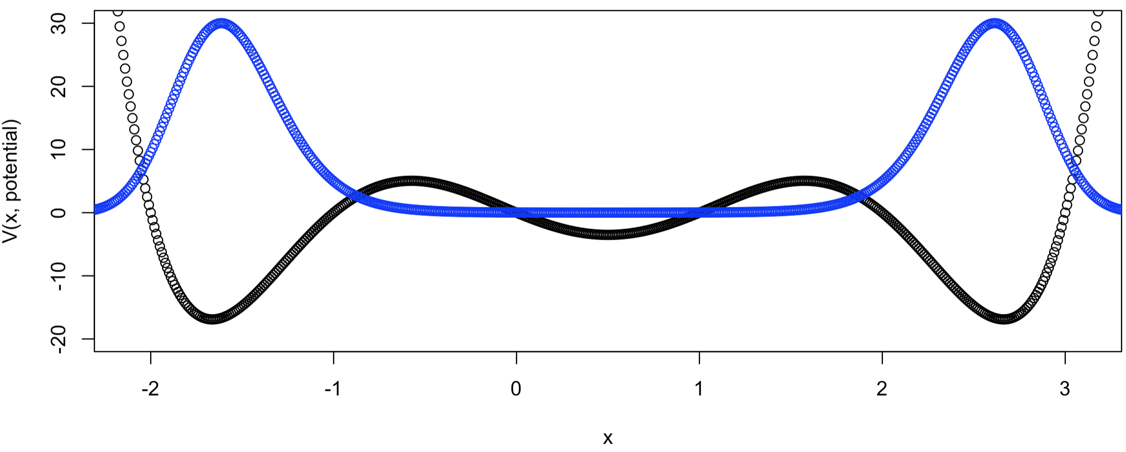
Guessing Good x.min and x.max
ψ(x)
Wavefunction solution superimposed on top of potential energy function

Slide 20
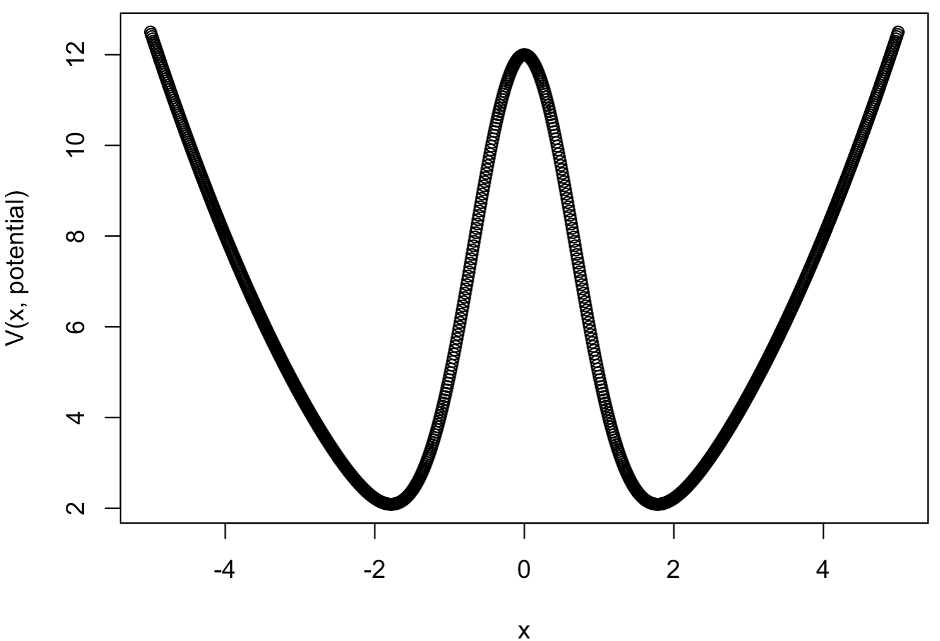
Guessing Good x.min and x.max
What are good x.min and x.max values to use with a guess energy of 6 for this potential energy function?:

Slide 21
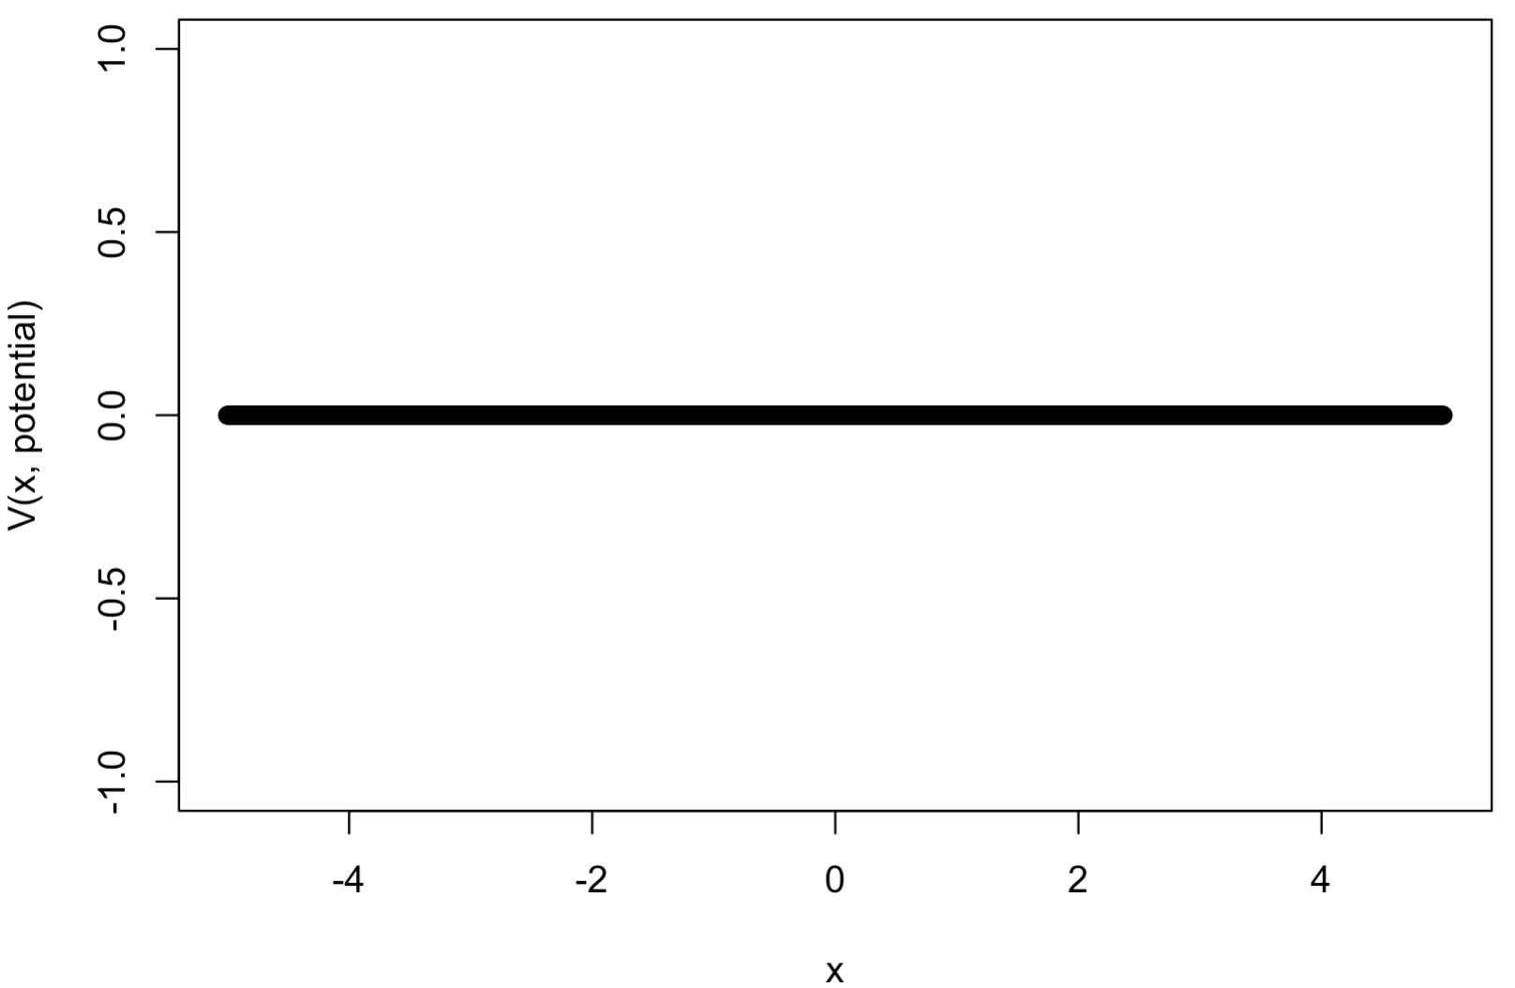
Guessing Good x.min and x.max
What are good x.min and x.max values to use with a guess energy of 2 for this potential energy function? Does the value of the guess energy matter in this case?:

Slide 22
che302r library
The Numerov algorithm is programmed in the library che302r
There a two functions in che302r we will use to start out with:
numerov.procedure(xaxis, dxaxis, PE.function.name,
nodes.in.state, E.guess, num.iterations,
delay.time)
approx.normalize(wf.info, plotQ=FALSE)
We will use these functions in the Numerov-control_script.R script
To use these functions we must first install and then load the che302r library

Slide 23
Numerov-control_script.R:
Now load and use the che302r library in the Numerov control script:
library(che302r)
# Domain (x-axis):
dx <- 0.01 # Increment on x-axis
x.min <- (0) # Start of x-axis. Well into (left) classically forbidden region
x.max <- 10 # End of x-axis. Well into the (right) classically forbidden region
x <- seq(from=x.min,to=x.max,by=dx) # x-axis
# Potential energy function
# Your choices are "box", "harmonic", "anharmonic":
Potential <- "box"
plot(x,V(x,potential))
# Numerov's procedure:
state <- 0 # State you want, starting from 0. It is an integer:
# 0,1,2,3,...etc. I.E., number of nodes
Guess.Energy <- (0) # Initial guess for energy of the state
max.iter <- 40
psi.info <- numerov.procedure(x,dx,potential,state,Guess.Energy,max.iter,delay.time=0.00)
# Approximately Normalize Psi:
Npsi.info <- approx.normalize(psi.info,plotQ=FALSE)

Slide 24
che302r library
The output of both numerov.procedure and approx.normalize is a two-column matrix:
Column 1 is the x-axis used to compute the wave function
Column 2 is the computed wave function values
Using psi.info, how could you plot the wave function?
How could you plot the normalized wave function?

