Slide 1
Quantum Theory II
An Overview

Slide 2

Diffraction and Interference of Waves
Light definitely behaves like this^{Young}
diffraction: waves bend around obstacles
incoming waves
wiki
interference: waves add constructively and destructively to produce a pattern

Slide 3
A Couple of More Clues
Photoelectric Effect: But light waves also behave like particles^{Einstein}!
Light shines on metal
Classical predictions:
Electrons (e-) should “wiggle” with same frequency as light.
More intense the light, the more e- should oscillate and get kicked out.

Slide 4
A Couple of More Clues
Photoelectric Effect
But, … e- flux is experimentally seen to be independent of light intensity
e- flux only depends on characteristic frequencies of light
KE_{e-} = hν - Φ
γ
If E_{γ} = Φ = hν₀
e-
KE_{e-} = ½ m_{e-}v²
E_{γ} = hν
Φ is characteristic of the metal
Work Function
Metal Surface
What if KE_{e-} is negative??

Slide 5
A Couple of More Clues
Photoelectric Effect
What is v_{e-}?
Φ_{Ag} = 4.73 eV
λ = 0.1 nm
m_{e-} = 9.109 × 10⁻³¹kg
γ
e-
1 eV = 1.602 × 10⁻¹⁹J
Ag

Slide 6

library(che302r)
Phi <- 4.73 # Work function in eV
lambda <- 0.1e-9 # Photon wavelength
me <- 9.1093837015e-31 # Mass e-
PhiJ <- Phi * 1.602177e-19 # Convert to J
Eph <- h * cl/lambda
ve <- sqrt(2*(Eph - PhiJ)/me)
ve

Slide 7
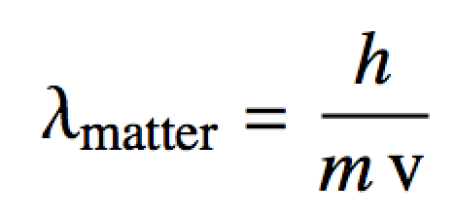
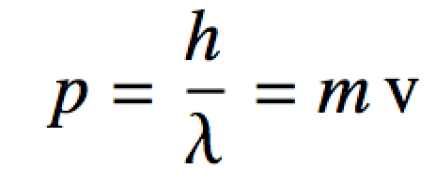
De Broglie and Wave-Particle Duality
Inspired by Einstein’s particle like description of photons in the photoelectric effect
De Broglie extended this “wave-particle” idea to matter
Waves have particle properties (Einstein)
Particles have wave properties (De Broglie)
Summarized as:
De Broglie equations

Slide 8

Example
On average, electrons in a neon light travel at about 1 × 10⁶m/s. Compute the wavelength of these electrons.
library(che302r)
m.electron <- 9.109384e-31
v.electron <- 1e6
lambda <- h/(m.electron * v.electron)
lambda

Slide 9
A Couple of More Clues
Double Slit Experiment: Confirmation: particles behave like waves!
e- have mass and were thought to be corpuscular!
Firing e- at a wall with two slits you’d expect:
e- e- e- e-

Slide 10

A Couple of More Clues
Double Slit Experiment: Confirmation: particles behave like waves^{Davisson,Germer}!
e- have mass and were thought to be corpuscular!
But,…firing e- at a wall with two slits:
Produces an interference pattern!
e- e- e- e-
MATLAB

Slide 11
Diffraction and Interference (con’t)
Fringes of interference pattern (minima) for a double slit occur for θ_{fringe} which satisfy the Bragg equation:
Bragg equation
a
…
slit width
2
incoming quantum “particles” (γ, e-, etc…)
d
1
θ
0
-1
-2
distance between slits
…
The interference pattern itself is a probability density function!:
double slit intensity
Notes:
Cf. https://phys.libretexts.org/Bookshelves/University_Physics/University_Physics_(OpenStax)/University_Physics_III_-_Optics_and_Modern_Physics_(OpenStax)/04%3A_Diffraction/4.04%3A_Double-Slit_Diffraction
Cf. http://www.physicsbootcamp.org/section-intensity-in-diffraction-pattern-light.html
Cf. http://www.physicsbootcamp.org/section-diffraction-through-a-double-slit-light.html

Slide 12
Example
The third fringe of an interference pattern formed by a beam of particles traveling through a double slit mask appears at 3.1º to incidence. If the slits are 1Å apart, compute:
a. the wavelength in nm of the particles
b. the energy of the particles (mks units!)
c. the momentum of the particles (mks units!)
d. If the average speed of particles in the beam is one million miles/hr
compute the average particle mass (mks units!).

Slide 13
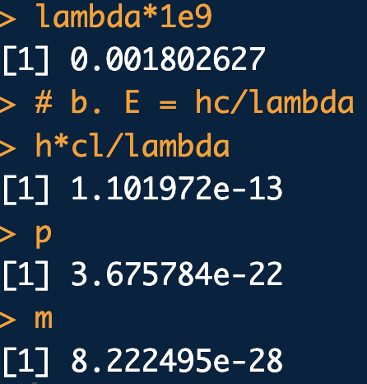
library(che302r)
n <- 3
d <- 1e-10
theta <- 3.1 * pi/180
# a. n lambda = d sin(theta)
lambda <- d*sin(theta)/n
lambda
lambda*1e9
# b. E = hc/lambda
h*cl/lambda
# c. p = h/lambda
p <- h/lambda
p
# d. p = mv
v <- 447040
m <- p/v
m

Slide 14
Example
For closely spaced slits (small d, i.e. single slit), interference pattern equation can be written as:
with
single slit intensity
Maxima of the peaks (not entirely obviously) occur at:
a. Plot from -6π to 6π
b. Visually locate the roots of
c. Actually find the first five positive roots of this equation
using your choice of software
d. Compute the θ’s corresponding to these roots assuming
Which roots will work and which wont?
Notes:
Cf. http://www.physicsbootcamp.org/section-intensity-in-diffraction-pattern-light.html

Slide 15
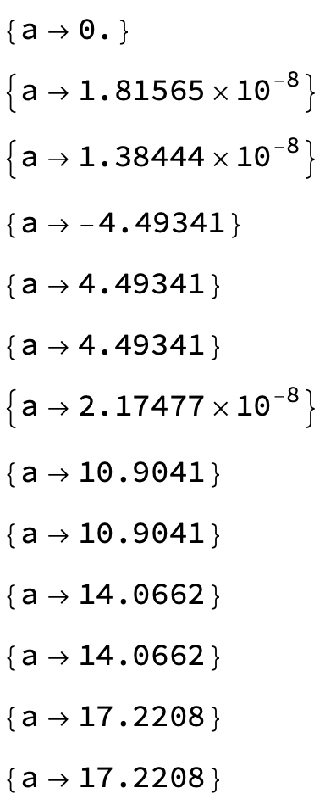
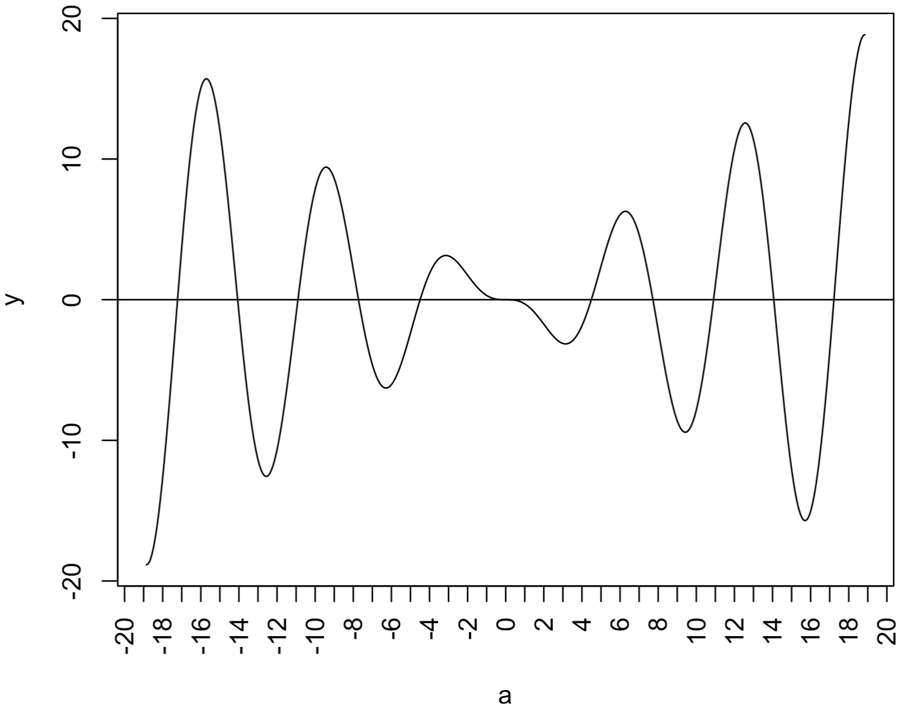
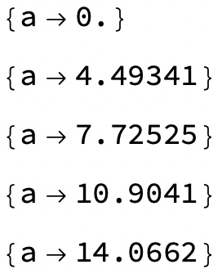
# a., b.:
a <- seq(from=-6*pi, to=6*pi, length.out=1000) # alpha axis
y <- a*cos(a) - sin(a) # plug in alpha's
plot(a,y, typ="l", xaxt="n") # Plot but turn off x-ticks
axis(1, at = seq(-20, 20, by = 5), las=2) # Put in custom x-ticks
abline(a=0,b=0) # Put in x=0 for reference
abline(v=4.5) # Check out root-ish vals
(*c.*)
f = a Cos[a] - Sin[a];
(*Try a bunch of starting values near roots:*)
FindRoot[f, {a, 0}] // Print;
FindRoot[f, {a, 1}] // Print;
FindRoot[f, {a, 2}] // Print;
FindRoot[f, {a, 3}] // Print; (*Weird)
FindRoot[f, {a, 4}] // Print;
FindRoot[f, {a, 5}] // Print;
FindRoot[f, {a, 6}] // Print; (*Weird*)
FindRoot[f, {a, 10}] // Print;
FindRoot[f, {a, 11}] // Print;
FindRoot[f, {a, 14}] // Print;
FindRoot[f, {a, 15}] // Print;
FindRoot[f, {a, 16}] // Print;
FindRoot[f, {a, 17}] // Print;
FindRoot[f, {a, 0}] // Print;
FindRoot[f, {a, 4.5}] // Print;
FindRoot[f, {a, 8}] // Print;
FindRoot[f, {a, 11}] // Print;
FindRoot[f, {a, 14}] // Print;

Slide 16

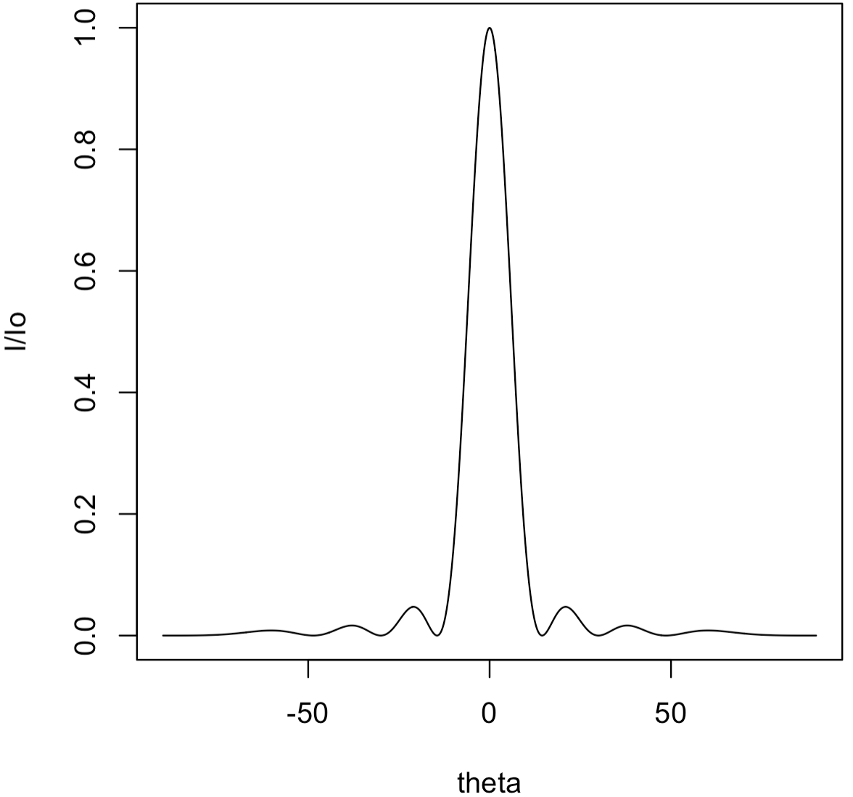
d*. Compute the θ’s corresponding to these roots assuming
Which roots will work and which wont?
# Compute theta's where max's occur:
roots <- c(0,4.49341,7.72525,10.9041)
asin(roots/(4*pi)) * 180/pi # theta's
# See four max's??
theta <- seq(from=-pi/2, to=pi/2, length.out=1000)
alp <- 4*pi*sin(theta)
IIo <- (sin(alp)/alp)^2
plot(theta * 180/pi, IIo, typ="l", xlab="theta", ylab="I/Io")
Indeed! Four max’s!
if slit width

Slide 17
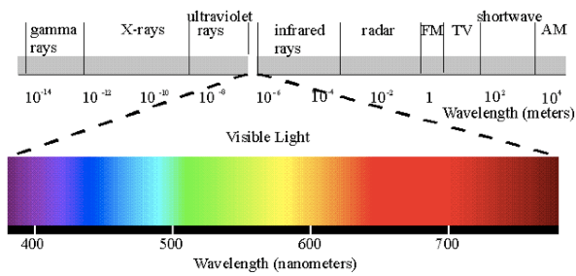
A Couple of More Clues
The Electromagnetic Spectrum: Light has different names in different wavelength (frequency) regions

Slide 18

A Couple of More Clues
Atomic Spectra: When atomic gasses are excited with an electrical discharge:
See discrete “lines” of color, not a rainbow!
Discrete colors mean only discrete energies at specific frequencies are emitted!
Visible Hydrogen Emission Lines

Slide 19
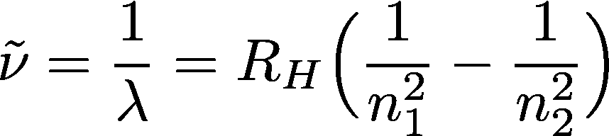
A Couple of More Clues
Hydrogen Atomic Spectra
There are “lines” in other parts of the e-m spectrum:
Lyman UV
Balmer Visible
Paschen near-IR
Bracket IR
Rydberg eq. predicts all these spectra
Rydberg const. ≈ 109678 cm⁻¹
“Quantum numbers”
n₁, n₂ = {1, 2, 3, …}
n₂, > n₁
Line “energy” in cm⁻¹
Line wavelength in cm

Slide 20
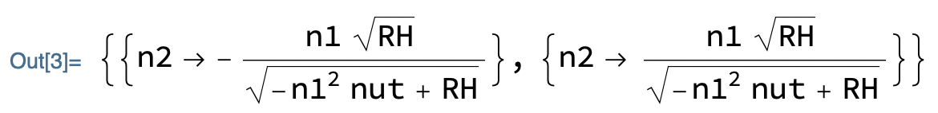
A Couple of More Clues
Hydrogen Atomic Spectra
Determine an expression for n₂ in terms of n₁ and the excitation wavenumber.
What does n₂ tell you?
Solve[nut == RH (1/n1^2 - 1/n2^2), n2]

Slide 21
Example
The electron of a hydrogen atom is excited into a higher energy level from a lower energy level. A short time later the electron relaxes down to the n_{lo} = 3 energy level, releasing a photon with a an energy of 1.8147 × 10⁻¹⁹J.
Compute the quantum number of the energy level the electron relaxes from, n_{hi}
Compute the wavelength of the released photon. What region of the spectrum is it in?

Slide 22
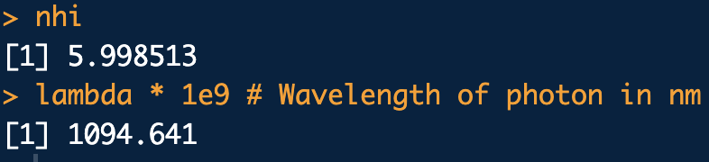
library(che302r)
nlo <- 3
Eph <- 1.8147e-19
RH.joules <- 2.178e-18 # Rydberg const in Joules
nhi <- sqrt( 1/( 1/(nlo^2) - (Eph/RH.joules) ) )
nhi
lambda <- h * cl/Eph
lambda * 1e9 # Wavelength of photon in nm

Slide 23
Some Handy Equations Before
We Move On
KNOW THESE!
E = hν one quantum of energy
*This is the most important equation for the course.
c = νλ convert bet. freq. and wavelength
E = hc/λ
ω = 2 π ν convert bet. “angular” freq. and “linear” wavelength

Slide 24

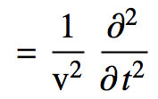
The Schrodinger Equation
This is the second most important equation for the course:
Start with the classical wave equation:
Use separation of variables trick and replace:
u(x,t) = ψ(x) cos(ω t)

Slide 25
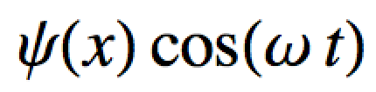
The Schrodinger Equation
This is the second most important equation for the course:
Substitute u(x,t) = ψ(x) cos(ω t):

Slide 26
The Schrodinger Equation
This is the second most important equation for the course:
Rearrange:
What does this derivative work out to be??

Slide 27
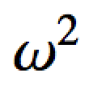
The Schrodinger Equation
This is the second most important equation for the course:
After doing the time derivative:
-

Slide 28
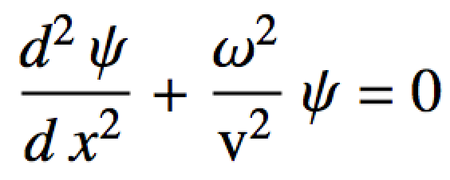
The Schrodinger Equation
This is the second most important equation for the course:
Divide out the cos(ω t)’s:
-
…and rearrange a bit:

Slide 29
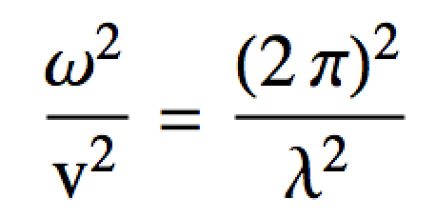
The Schrodinger Equation
This is the second most important equation for the course:
Note ω = 2 π ν
Guess: v = ν λ (like c = ν λ)
So:
Now let’s focus on the wavelength term

Slide 30
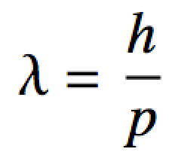
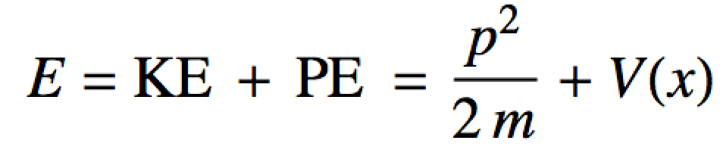
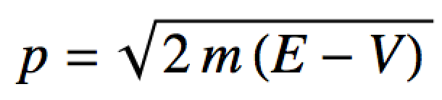
The Schrodinger Equation
This is the second most important equation for the course:
Look at the De Broglie eq:
We can use a general energy expression to find a substitute for p:
Rearranging:

Slide 31
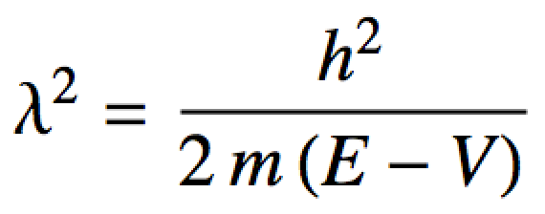
The Schrodinger Equation
This is the second most important equation for the course:
2
2
Substituting into
2

Slide 32
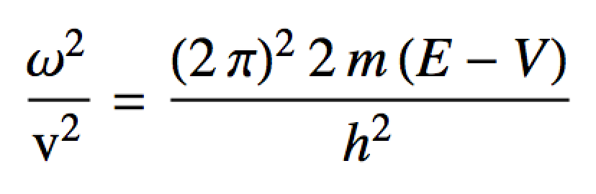
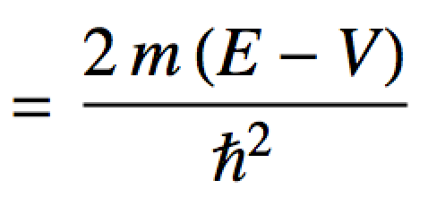
The Schrodinger Equation
This is the second most important equation for the course:
Substituting into

Slide 33
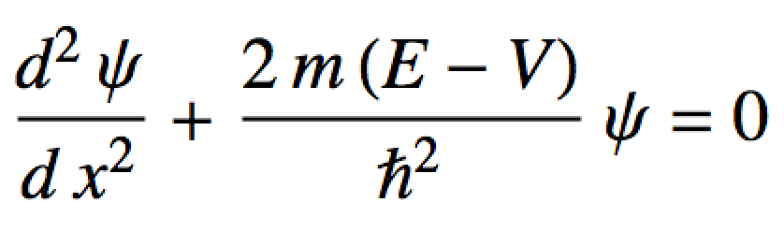
The Schrodinger Equation
This is the second most important equation for the course:
Substituting into the wave eq.

Slide 34

The Schrodinger Equation
This is the second most important equation for the course: The Schrodinger Equation!
Kind of looks like:
c not necessarily a constant

Slide 35
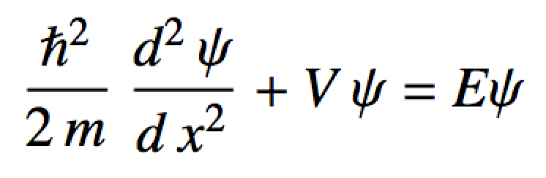
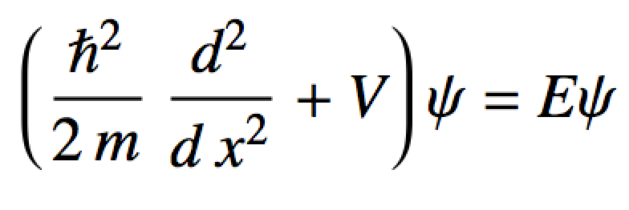
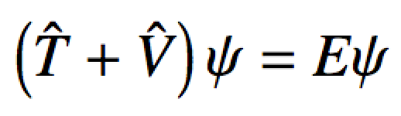
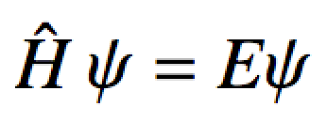
The Schrodinger Equation
Usually we rearrange it like this:
Energy “operator”
KE “operator”
PE “operator”
The Schrodinger Equation

