Slide 1
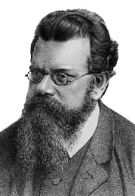
A Box of Particles

Slide 2
Dimensions
We studied a single particle in a box
What happens if we have a box full of particles??
We get a model of a gas
The box is 3D
The particles bounce around, but do not stick together or repel
Each particle behaves like a particle in a box
y
x
z

Slide 3
Microstates and Macrostates
Each of the particles can be in any number of wave functions at any instant
Which particle is in which state is called a microstate
e_{i} means particle is in particle in a box state i and has energy e_{i}
e₅
e₃
e₄
y
e₂
e₂
e₈
e₁
e₅
e₂
x
e₂
z
e₄
e₁
e₈

Slide 4
Microstates and Macrostates
Another representation at the same instant: Count up the number of particles in each wave function.
Called a occupation number vector, configuration or a macrostate
n_{i} is the number of particles in state (wave function) i
e₅
e₃
e₄
y
e₂
n = {2 4 1 2 2 0 0 2 …}
e₂
e₈
e₁
e₅
e.g. there are 2 particles in 4th (3rd excited state) particle in a box wave functions
e₂
… means that there are many more wave functions available, but they are empty
x
e₂
z
e₄
e₁
e₈

Slide 5
Most Probable Macrostate
As the particles bounce around they are constantly exchanging energy
The microstate is constantly changing
y
x
z

Slide 6
Most Probable Macrostate
As the particles bounce around they are constantly exchanging energy
The microstate is constantly changing
Which microstate is most likely??
e₃
e₅
e₁₀
Assume any microstate is just as likely as any other: “The principle of a priori probability”
e₈
y
e₇
e₃
e₁
e₂
But, … if all the microstates are equally likely, we can figure out which macrostate is most likely!
e₂
x
e₃
e₁
z
e₈
e₁

Slide 7
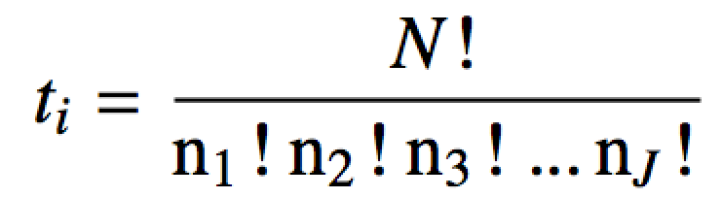
Most Probable Macrostate
The most probable macrostate is the configuration that can occur the most number of ways
There are J wave functions available to to all the particles
The number of ways to achieve a macrostate with N total particles:
Plug in the occupation number vector
# ways to arrange particle energies and get macrostate i
Read: n₃ particles have wave function 3
-or-
# number of microstates corresponding to macrostate i

Slide 8
Most Probable Macrostate
Which macrostate is more probable: {3,2,8,0,0,1,0,0} or {3,3,7,0,0,1,0,0} or {2,4,1,2,2,0,1,2}??
= 180,180
= 480,480
= 227,026,800
Macrostate 3 is (way) more probable. There are more ways to get it (i.e. corresponds to more microstates).

Slide 9
Most Probable Macrostate
Which ever macrostate has the most number of microstates is most probable
Find the maximum of t_{i} (macrostate with the most microstates) given the constraints
The total energy E, remains constant
The total number of particles N, remains constant
The number of microstates accessible to the particles increases as temperature T increases

Slide 10
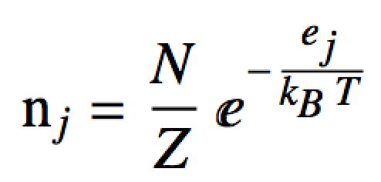
The Boltzmann Distribution
The macrostate with the most microstates (given the E, N, and T constraints) occurs when the n_{j} equal:
Energy of the wave function j
Total number of particles in the box
Temperature of the box is T
Boltzmann factor
Number of particles with wave function j (i.e. in single particle state j)
Normalization constant (partition function) so that n_{j}/N can be interpreted as the probability that n_{j} particles have energy e_{j}

Slide 11
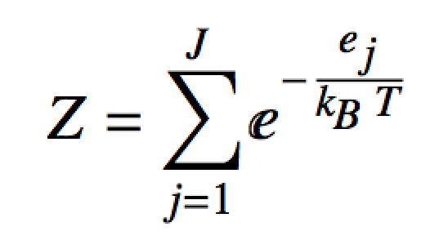
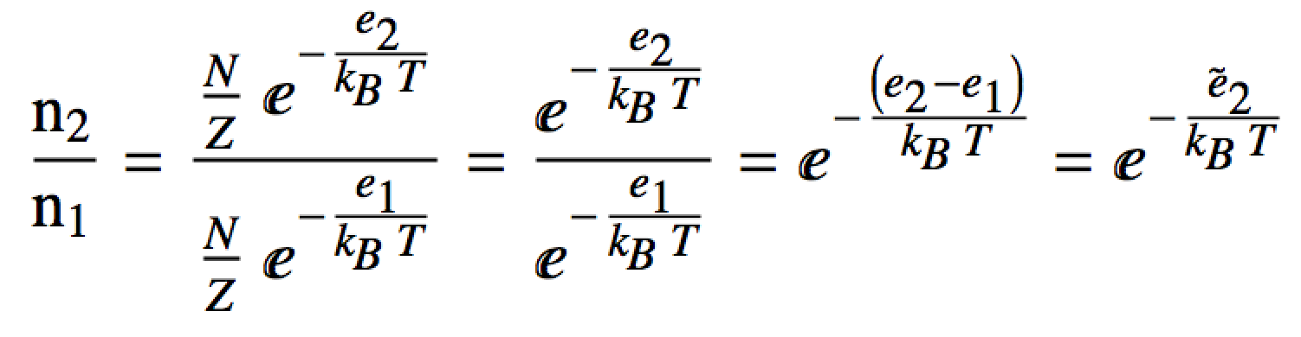
Partition Function
The partition function Z can be interpreted as how the total number of particles are “partitioned” amongst all the energies e_{i}
Huh?
Look at the ratio of particles in the first excited state to particles in the ground state:
# particles in first excited state
# particles in ground state

Slide 12
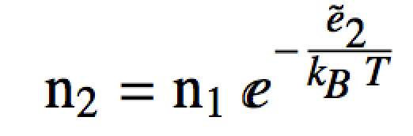
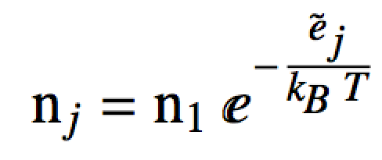
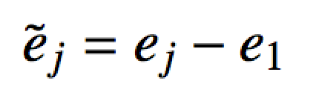
Partition Function
Thus the particles in the first excited state are a fraction of the particles in the ground state:
# particles in first excited state
# particles in the ground state
fraction (relative Boltzmann factor)
We would find the same thing for the number of particles in the other excited states:
state j’s energy relative to the ground state
where
# of particles in state j is a fraction of the number of particles in the ground state

Slide 13
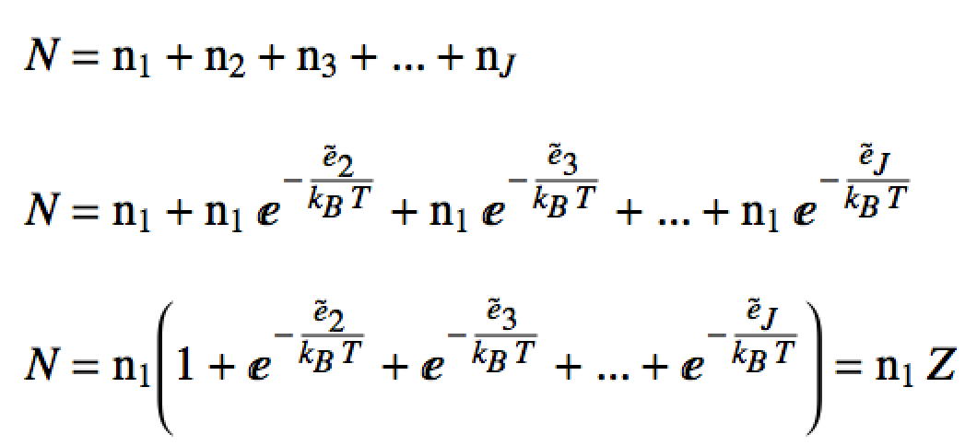
Partition Function
We can write the total particle number, N “partitioned out” amongst the energy levels in this way:
Total particle number
Substitute
~
Factor out n₁
This is just the partition function (scaled by a constant)!
Note:

Slide 14
Example
Consider a 1D box of length 50 μm at 77K containing 2.3 mols of neutrino particles (m_{neutrino}=1.78×10⁻³⁷ kg). This system is constructed such that only the first 4 “particle in a box” (P.I.A.B.) states are available to be occupied by the particles.
What is the value of the (scaled) partition function with respect to the ground state Z? What about Z?
What are the most likely number of neutrinos in each P.I.A.B. state (i.e. the most likely macrostate)? Mols of neutrinos?
What is the probability of finding a neutrino in each state?
~

Slide 15
Example
library(che302r)
# Energy of a particle mass m in box state i when the box length is L:
en <- function(i, m, L) {
(hb^2 * pi^2)/(2*m*L^2) * i^2
}
# Boltzmann factor for particle at energy ei and temperature Temp:
bf <- function(ei, Temp) {
exp(-ei/(kB*Temp))
}
num.states <- 4 # Number of PIAB states
L.box <- 50e-6 # Box length
m.particle <- 1.78e-37 # Mass of particle(s)
TT <- 77 # Temperature
N <- 2.3*N.A # Total number of particles
# PIAB energies:
e <- en(1:num.states, m = m.particle, L = L.box)
e
# Compute the scaled partition function, Z-tilde:
# PIAB energies relative to PIAB state 1:
e.tilde <- e-e[1]
e.tilde

Slide 16


# Boltzmann factors relative to PIAB state 1:
bfs.tilde <- bf(e.tilde, Temp = TT)
bfs.tilde
# a. Sum to get Z-tilde:
Z.tilde <- sum(bfs.tilde)
Z.tilde
# a. Compute partition function, Z:
# Boltzmann factors for each PIAB state:
bfs <- bf(e, Temp = TT)
bfs
# a. Sum of the Boltzmann factors is the partition function
Z <- sum(bfs)
Z
# b. Most likely number of particles in each P.I.A.B. state (most likely
# macrostate):
n <- N/Z * bfs
n
# c. Most likely number of mols of particles in each P.I.A.B. state:
n/N.A
# d. Probability of finding a particle in each state:
n/N
sum(n/N) # Check: Sum pf probabilities == 1??

