Slide 1
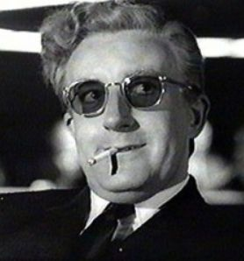
The Hydrogen Atom

Slide 2
Model
The “orbitals” we know from general chemistry are wave functions of “hydrogen-like” atoms
Hydrogen-like: any atom, but it has only one electron
Atomic charge Z can be anything in other words
If we can understand atomic orbitals, we can use them to:
Build up molecules
Understand electronic spectroscopy

Slide 3
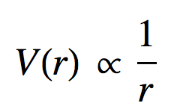
Hydrogen-Like Atom
an electron
r
the nucleus is at the origin
electron is “confined” to the atom by a “spherically symmetric” potential

Slide 4
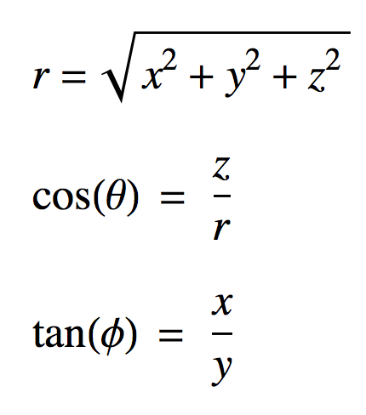
Spherical Polar Coordinates
It’s easier to study this “planetary like” model in terms of spherically polar coords. (r, θ, φ) than Cartesian coords. (x, y, z)
z
θ can vary form 0 to π
φ can vary form 0 to 2 π
θ
r
r can vary from 0 to ∞
y
Cartesians to polar
φ
polar to Cartesians
x
x = r sin(θ) cos(φ)
y = r sin(θ) sin(φ)
z = r cos(θ)

Slide 5
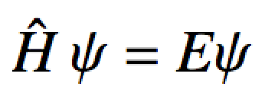
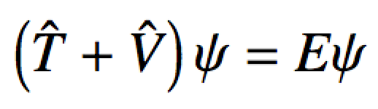
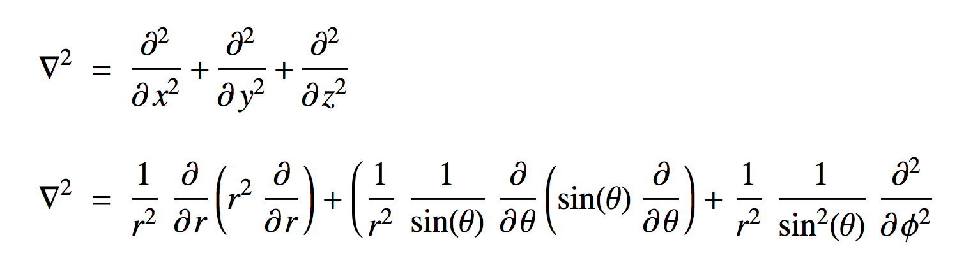
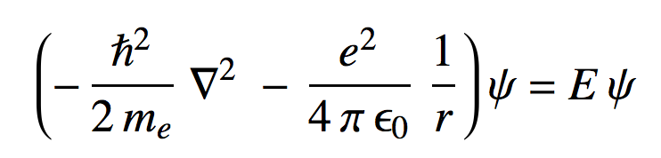
Hydrogen Atom
The Schrodinger equation for the Hydrogen atom:

Slide 6
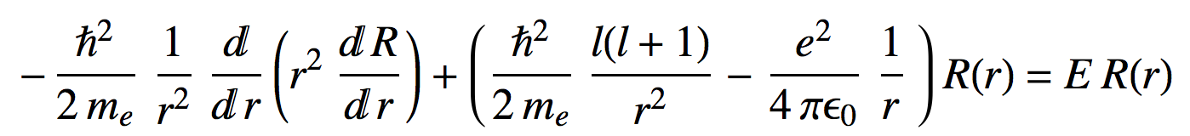
Hydrogen Atom
The Schrodinger equation for the Hydrogen atom:
Luckily this splits up by separation of variables:
For the Radial part of the Schrodinger equation:
Gives R_{n,l}(r)

Slide 7
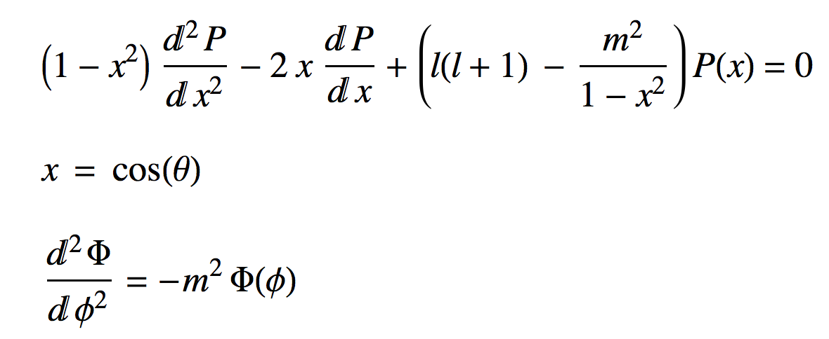
Hydrogen Atom
For the Angular parts of the Schrodinger equation:
Gives Θ_{l,m}(θ)
Gives Φ_{m}(φ)
Quantum number rules for hydrogen atom:
n = 1, 2, 3, 4, …
l = 0, 1, 2, 3, …, n-1
m = -l, …, 0, …, l

Slide 8
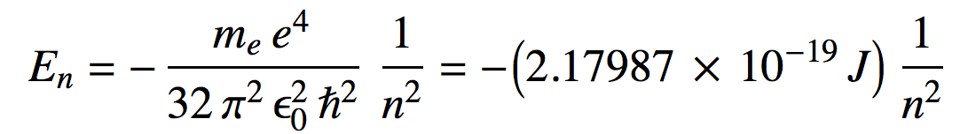
Hydrogen Energies
Summary
Energies:
Rydberg constant R_{H} in J
Energies only depend on principle quantum number n
Orbital energy degeneracies:
For every n, there are n-1 values of l
For every value of l the are 2l+1 values of m_{l}

Slide 9
Orbital Energies
…
3s
3p
3d
0
-1
0
1
-2
-1
0
1
2
2s
2p
0
-1
0
1
Orbital Energy in units of R_{H} (J)
R_{H}
1s
0

Slide 10
Hydrogen Orbitals
Summary
Wave functions: ψ_{n,l,m}(r,θ,φ) = R_{n,l}(r) Y_{l,m}(θ,φ) are called orbitals
Orthogonalized modified associated Laguerre functions
Spherical harmonic functions
We used a Numerov solution to get these
Tells what happens “inside” the orbital
There are n-l-1 radial nodes
We “Monte Carlo sampled” their probability density to look at them
Text book pictures of orbitals (i.e. the outer shells)
There are l angular nodes

Slide 11
R_{n,l}(r)
n = 1
l = 0
R_{1,0}(r)
r²|R_{1,0}|²

Slide 12
R_{n,l}(r)
n = 2
l = 0
R_{2,0}(r)
r²|R_{2,0}|²

Slide 13
R_{n,l}(r)
n = 2
l = 1
R_{2,1}(r)
r²|R_{2,1}|²

Slide 14
R_{n,l}(r)
n = 3
l = 0
R_{3,0}(r)
r²|R_{3,0}|²

Slide 15
R_{n,l}(r)
n = 3
l = 1
R_{3,1}(r)
r²|R_{3,1}|²

Slide 16
R_{n,l}(r)
n = 3
l = 2
R_{3,2}(r)
r²|R_{3,2}|²

Slide 17
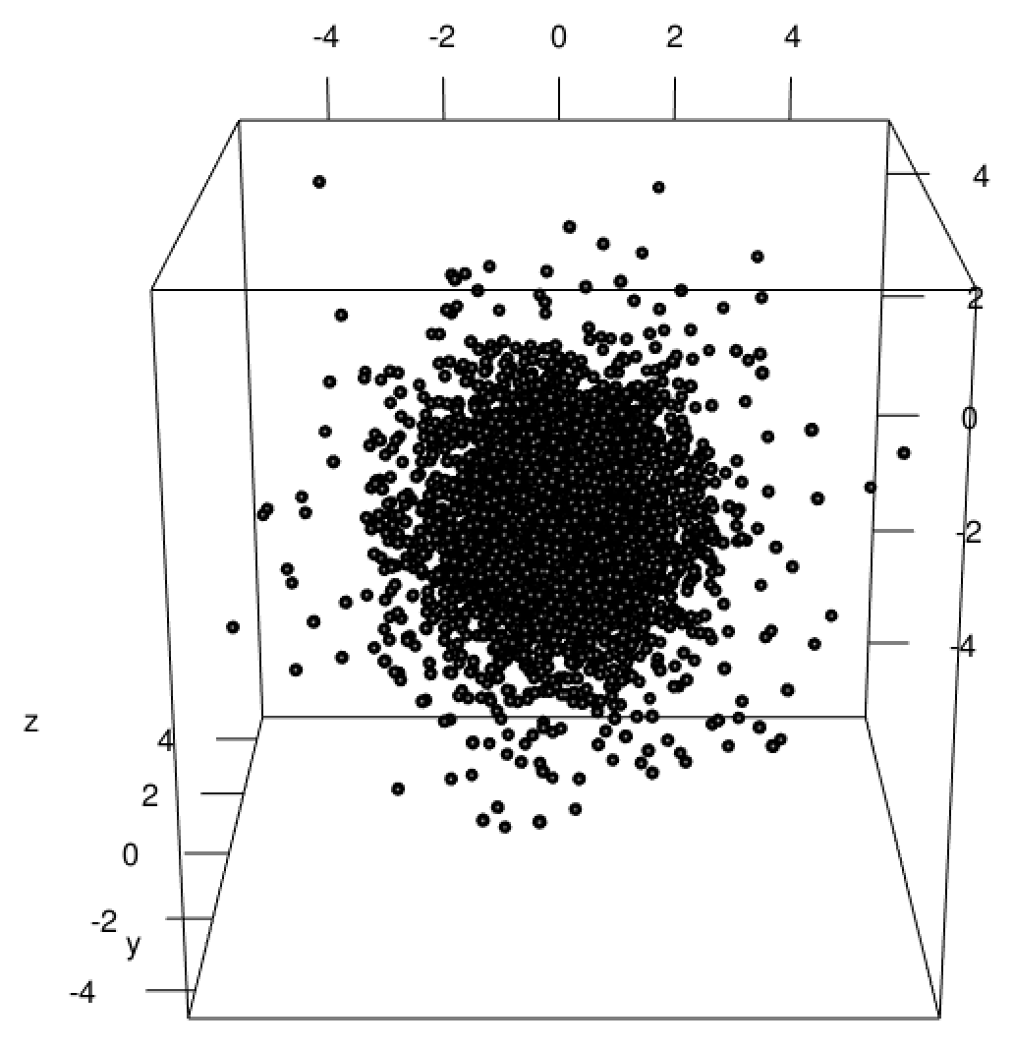
Sampled Orbital Probability Densities

Slide 18
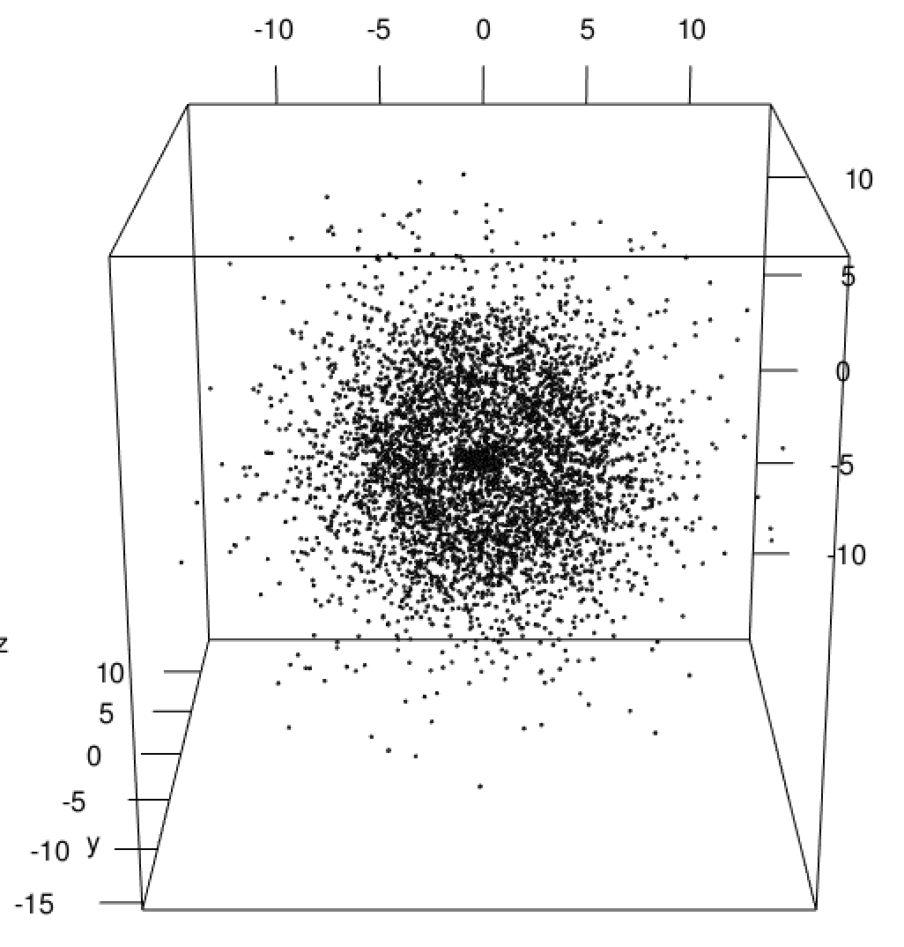
Sampled Orbital Probability Densities

Slide 19
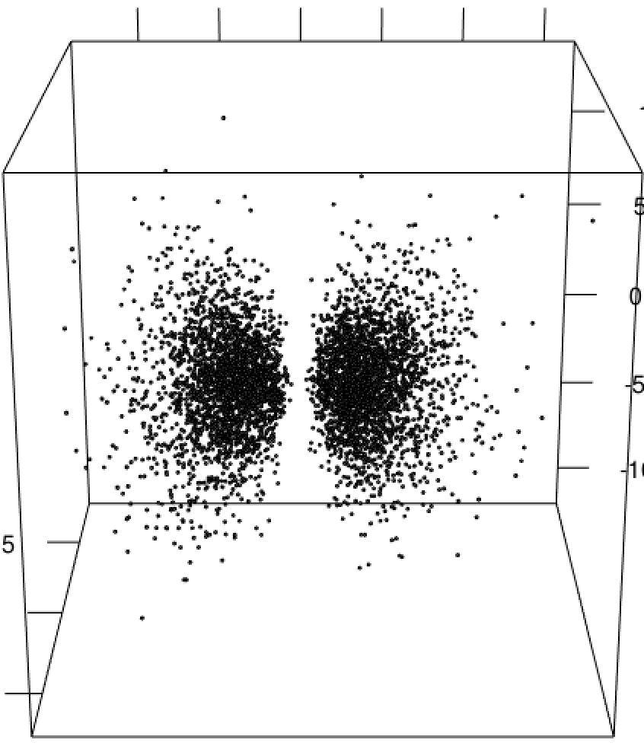
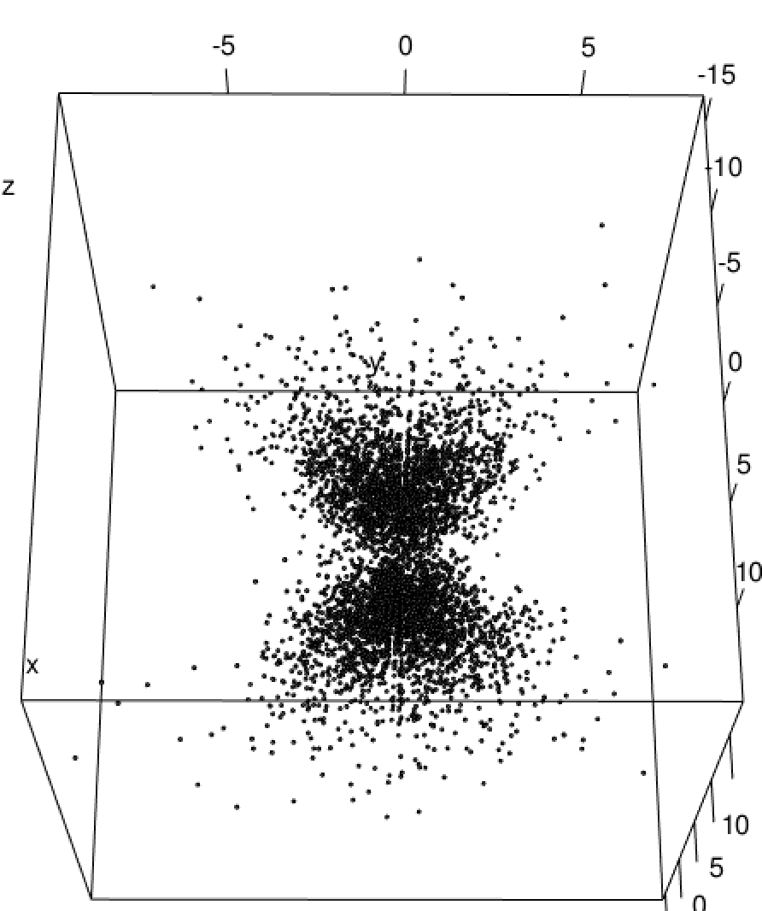
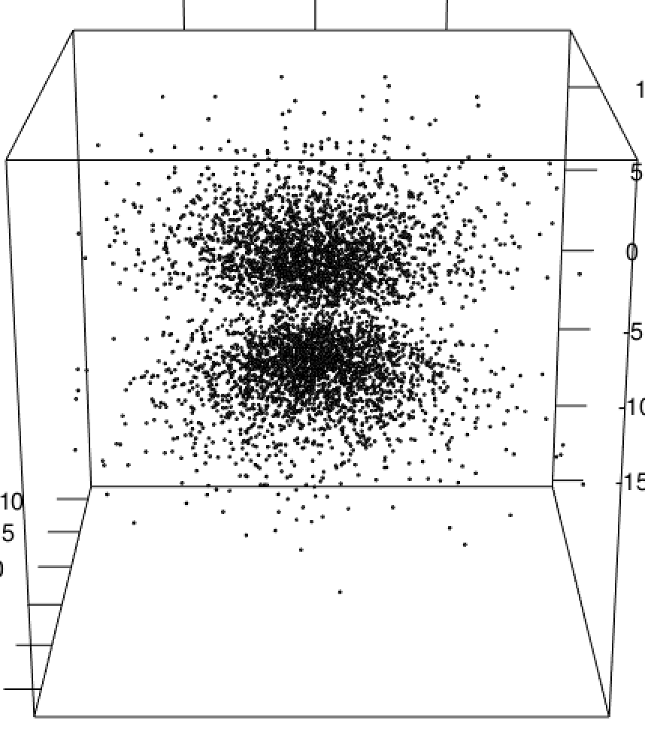
Sampled Orbital Probability Densities

Slide 20
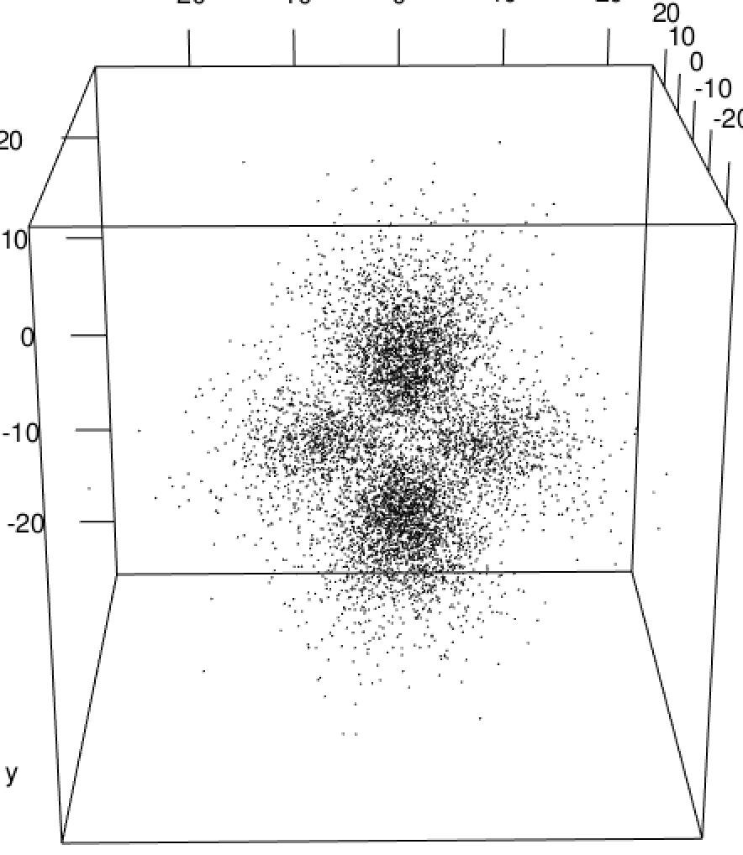
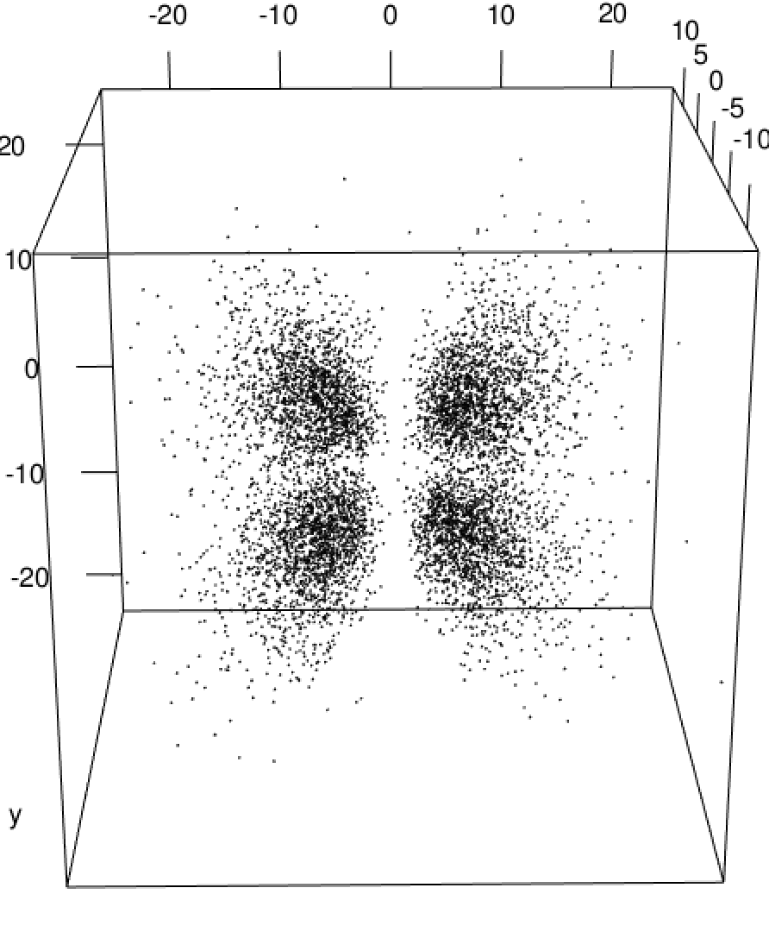
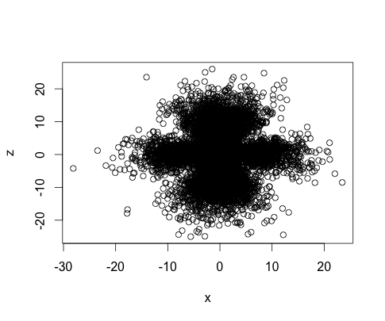
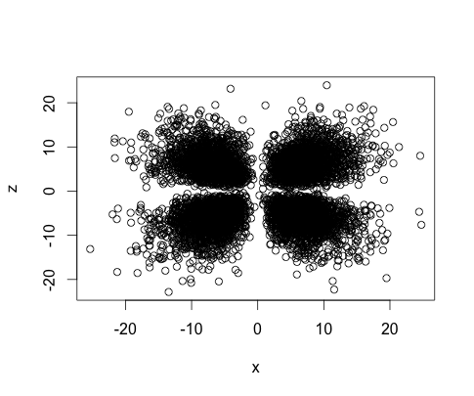
Sampled Orbital Probability Densities

Slide 21
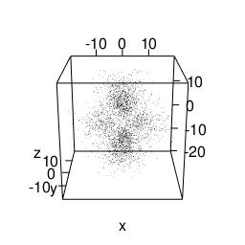
Sampled Orbital Probability Densities

