Slide 1
Quantum Theory I
An Overview

Slide 2
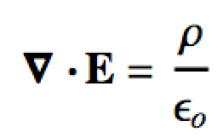
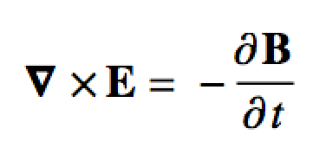

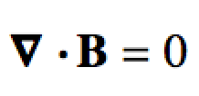
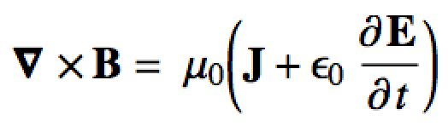
Introduction
The development of classical physics (based on Newton’s laws) culminated in James Clerk Maxwell’s equations:
Maxwell’s equations cannot however:
…explain the constant speed of light
…reproduce the black-body distribution

Slide 3
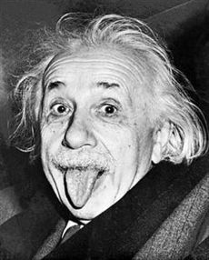
Introduction
The constant speed of light lead to Einstein’s special theory of relativity
We won’t need to use relativity directly for the spectroscopies we study
E = mc²
The explanation of the black body distribution was much more profound!
So what’s a black body…?

Slide 4

Black Body Radiation
Think of electro-magnetic (e-m) radiation as a “wave”
Wave energy frequency
Lower freq. (longer wavelength) = lower energy
Higher freq. (shorter wavelength) = higher energy

Slide 5
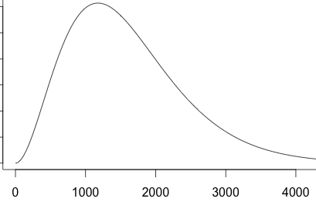
Black Body Radiation
Black body: An (idealized) absorber and emitter of e-m radiation at all frequencies
Absorbs, so is “hot” (not 0 K)
Emits an amount (intensity) of e-m at all frequencies
Absorb
Emit

Slide 6
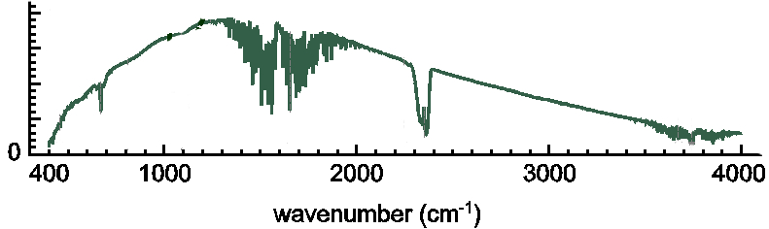
Black Body Radiation
Theoretical black bodies don’t exist…
BUT… pretty much anything that can absorb and emit a wide range of e-m radiation will approximately behave as a black body!
Ideal BB
@ 600K
Nernst element in an FT-IR
Pretty much anything then is an approximate black body
Light bulbs and electric kitchen stoves are good examples

Slide 7
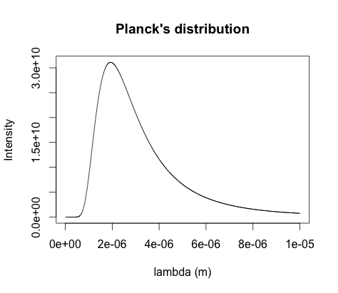
Black Body Radiation
Maxwell’s equations/Classical mechanics could not model the BB curve in its entirety
Rayleigh-Jeans eq.
ρ (Intensity)
Wein’s eq.
λ (wavelength)

Slide 8
Black Body Radiation
Using Rayleigh-Jeans (theory), Wein (empirical) and assuming energy is discrete (quantized) Max Planck modeled the whole curve!
We’ll get a better idea where this is from after particle in a box
Planck distribution
ρ (Intensity)
λ (wavelength)

Slide 9
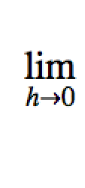
Planck’s Constant
Planck’s constant is the “fudge factor” that turns classical mechanics into quantum mechanics
h = 6.626 ×10⁻³⁴ J s Planck’s constant
Small BUT not = 0!
What happens to ρ as h ➔ 0??

Slide 10
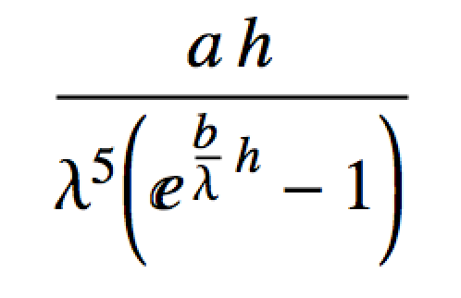

Planck’s Constant
Planck’s distribution is like:
Limit as h ➔ 0 ??

Slide 11
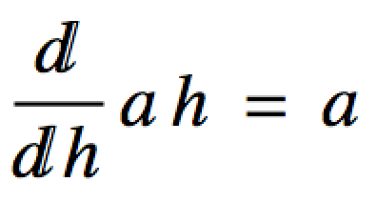
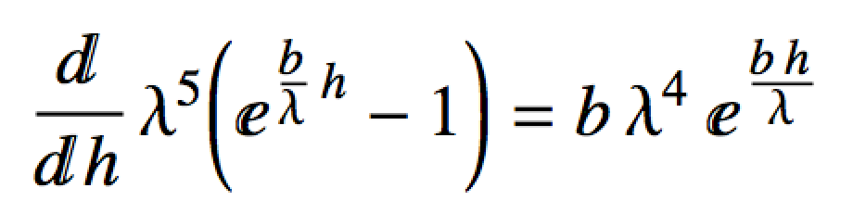
Planck’s Constant
Use L’Hopital’s Rule!
Derivative of the numerator
Derivative of the denominator

Slide 12
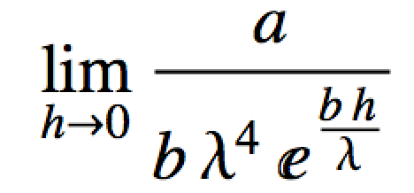
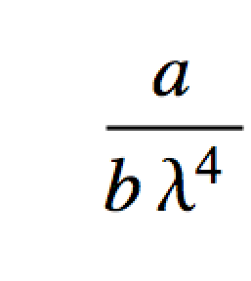
Planck’s Constant
Use L’Hopital’s Rule!
Rayleigh-Jeans eq.
Derived entirely from classical mechanics!

Slide 13
Handy Constants and Symbols To Know
h = 6.626 ×10⁻³⁴ J s Planck’s constant
ħ = 1.055 ×10⁻³⁴ J s Reduced Planck’s constant
k_{B} = 1.381 ×10⁻²³ J/K Boltzmann’s constant
c = 2.998 ×10⁸ m/s speed of light in a vacuum
λ = wavelength
ν = (time) frequency
ν = (spatial) frequency, wavenumber
~

Slide 14
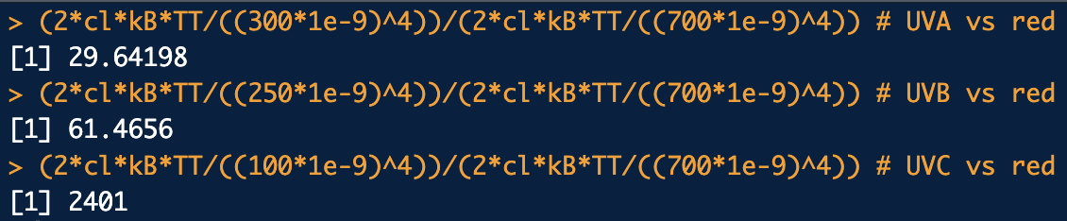
Example
According to the Rayleigh-Jeans eq., how many times more intense should the emitted radiation intensity be at λ = 300nm (in the UVA), 250nm (in the UVB) and 100nm (in the UVC) vs. λ = 700nm (red)? The thing emitting radiation is at T = 2000K.
library(che302r)
# Rayleigh-Jeans. Really starts to blow up in the UV:
TT <- 2000
(2*cl*kB*TT/((300*1e-9)^4))/(2*cl*kB*TT/((700*1e-9)^4)) # UVA vs red
(2*cl*kB*TT/((250*1e-9)^4))/(2*cl*kB*TT/((700*1e-9)^4)) # UVB vs red
(2*cl*kB*TT/((100*1e-9)^4))/(2*cl*kB*TT/((700*1e-9)^4)) # UVC vs red
lam.ax <- seq(from=250, 830, length.out=1000) # lambda in nm
rho <- 2*cl*kB*TT/((lam.ax*1e-9)^4)
plot(lam.ax, rho, xlab="lambda")

Slide 15
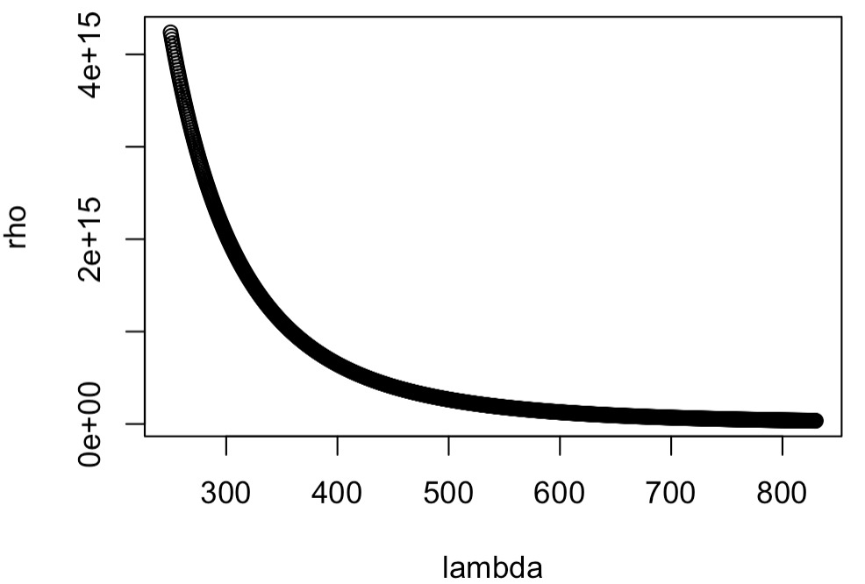

Slide 16
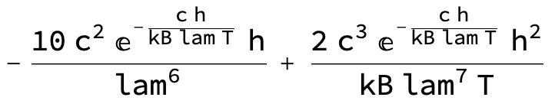
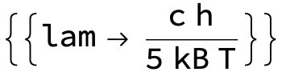
Example
According to Wein’s eq., at any temperature T, λ_{max} occurs at:
proof:
rho = 2 h c^2/lam^5 Exp[h c/(lam kB T)]^-1;
drho = D[rho, lam]
Wein’s displacement law
Solve[drho == 0, lam]
What are the steps involved for getting the above from Wein’s eq.?
What is λ_{max} for T = 5K, 50K, 500K, 5000K? Units too!
What does λ_{max} appear to be doing as temperature increases?
Notes:
rho = 2 h c^2/lam^5 Exp[h c/(lam kB T)]^-1;
df = D[f, lam];
Solve[df == 0, lam]

Slide 17

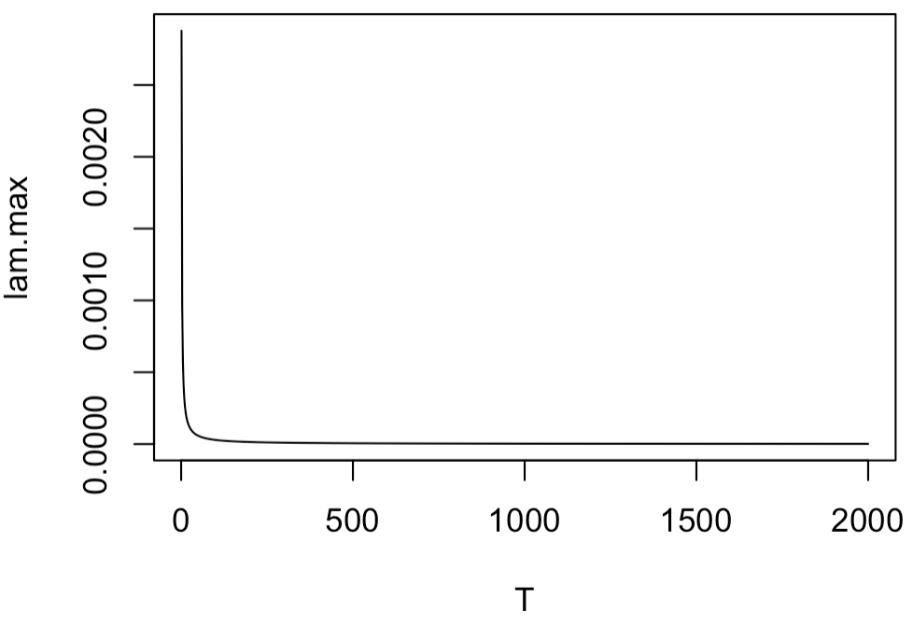
library(che302r)
b <- (h * cl)/(5 * kB)
Ts <- c(5, 50, 500, 5000)
# Wein's "displacement" law:
b/Ts * 1e9 # lambda units: nm
# Plot Wein's "displacement" law:
Tax <- seq(from=1, to=2000, length.out=1000)
lam.max <- b/Tax
plot(Tax, lam.max, typ="l", xlab="T")

