Slide 1

Postulates of Quantum Mechanics

Slide 2
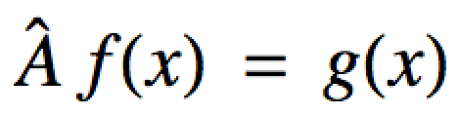
The Fundamental Rules of Our Game
Any measurement we can make with an experiment corresponds to a mathematical “operator”
Operator: A mathematical machine that “acts on” a function and produces a new function:
We say A-hat “acts on” f
And produces a new function g
An operator.
We put “hats” (circumflexes) over them

Slide 3
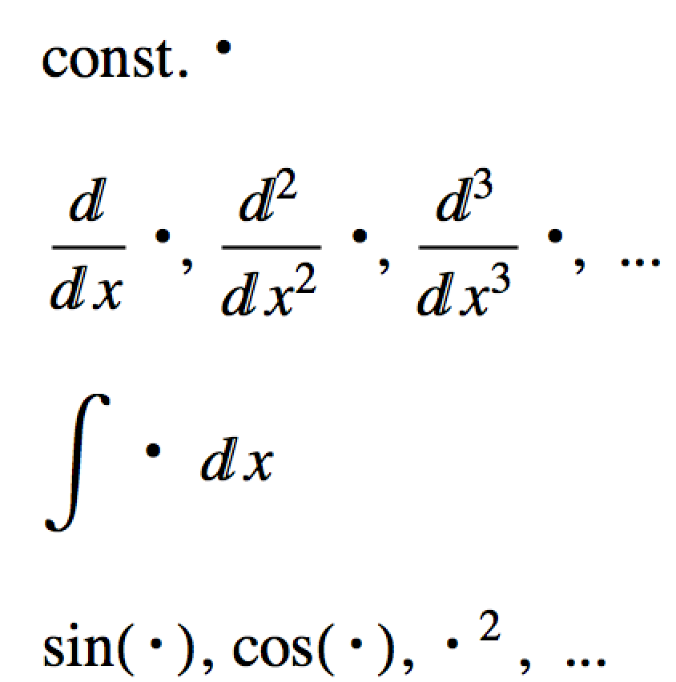
The Fundamental Rules of Our Game
Some operators we are already familiar with:
Multiply by a constant
Derivatives
Integrals
Functions themselves

Slide 4
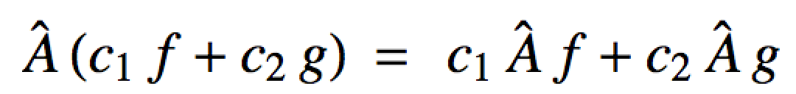
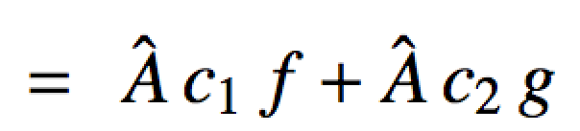
The Fundamental Rules of Our Game
Operators in quantum mechanics are “linear”:
Operators are distributive
Constants can be pulled out

Slide 5
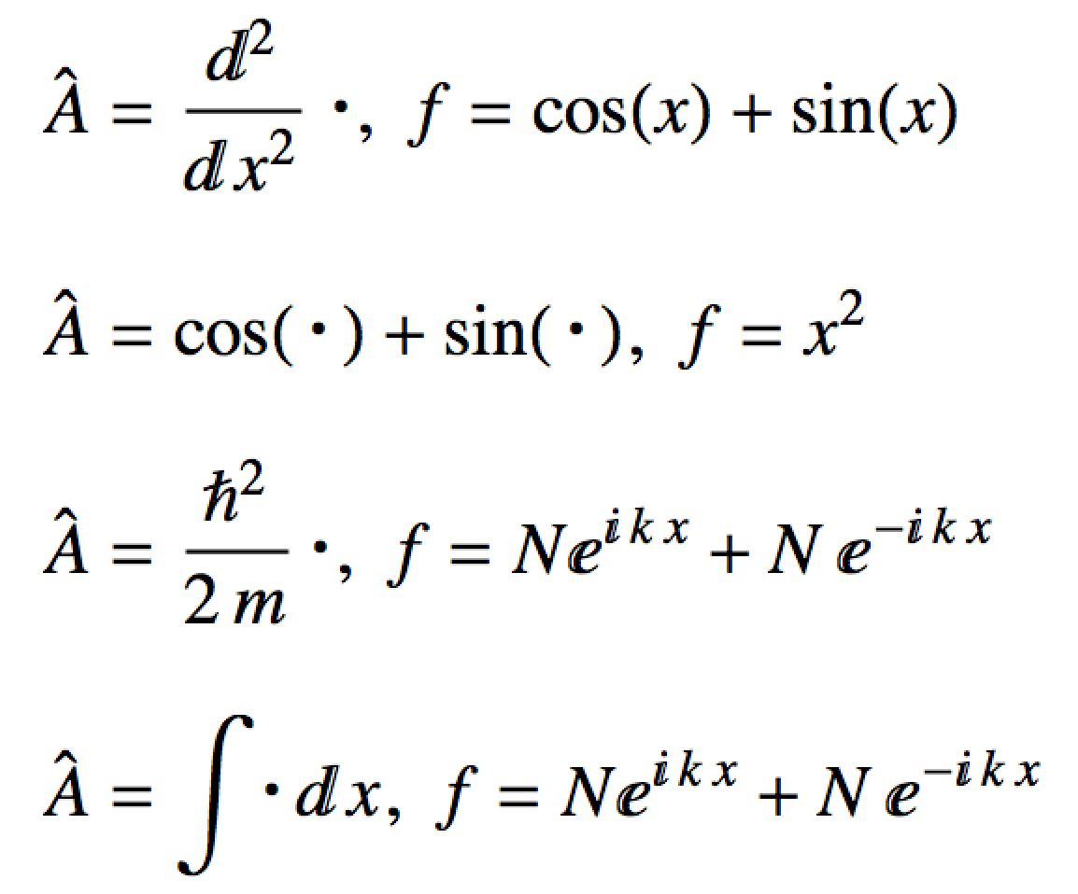

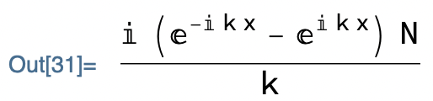
The Fundamental Rules of Our Game
What are the actions of the operators on the functions? Are they linear operators?
f = Cos[x] + Sin[x];
D[f, {x, 2}]
a.
b.
c.
f = N Exp[I k x] + N Exp[-I k x];
Integrate[f, x]
d.

Slide 6
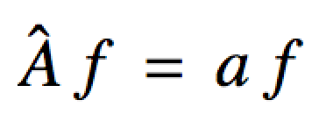
The Fundamental Rules of Our Game
Eigen-system: When an operator acts on a function and produces the same function multiplied by a constant:
Multiplied by a constant
Act A on f
Get f back
f is an eigenfunction or eigenvector
a is an eigenvalue (a constant!)

Slide 7
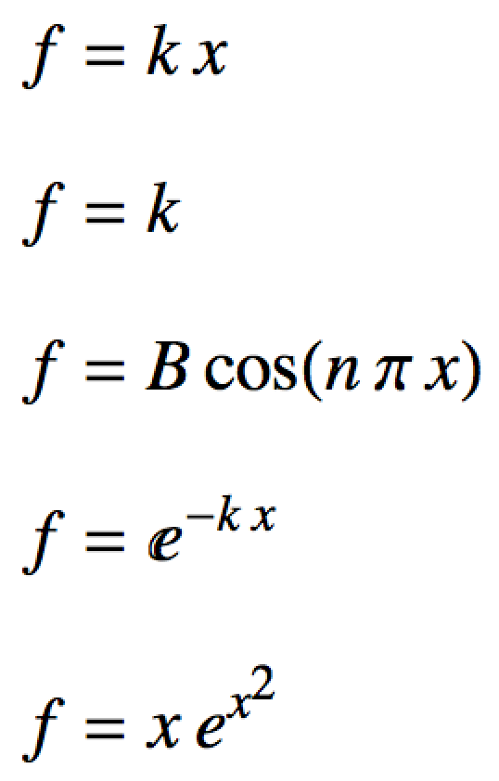
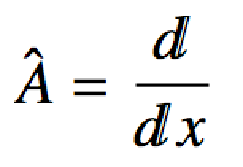


The Fundamental Rules of Our Game
Are these eigen-systems? If so, what are the eigenfunctions and eigenvalues?
f = B Cos[n Pi x];
D[f, x]
f = x Exp[x^2];
D[f, x]

Slide 8
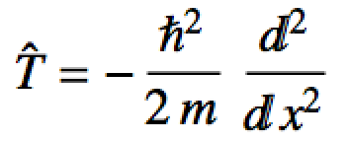
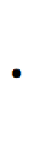
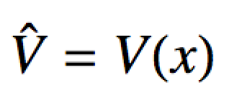
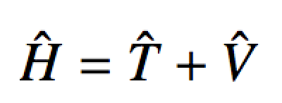
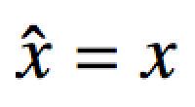
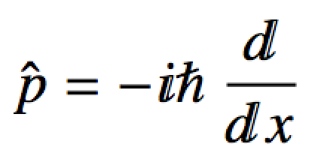
The Fundamental Rules of Our Game
Postulates of Quantum Mechanics
Every observable (measurable quantity) corresponds to a linear operator
Energy (Kinetic, Potential and Total)
Position
Momentum
The Hamiltonian

Slide 9
The Fundamental Rules of Our Game
Postulates of Quantum Mechanics
All that can be known about a physical system (i.e. its state) is encoded in its wave function
Wave functions, ψ(x) are also called state functions
ψ is not a physical entity!!
ψ² dx represents “a little bit” of probability
ψ² = |ψ|² ⁼ψ∗ψ
is a probability density
This is physical, i.e. we can measure it

Slide 10
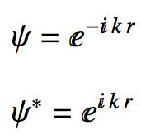
The Fundamental Rules of Our Game
Postulates of Quantum Mechanics
All that can be known about a physical system (i.e. its state) is encoded in its wave function
ψ∗ means conjugate
E.g.

Slide 11
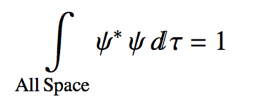
The Fundamental Rules of Our Game
Postulates of Quantum Mechanics
All that can be known about a physical system (i.e. its state) is encoded in its wave function
Sum of all the little bits of probability “over all space” = 1
This is called the normalization condition
We say the wave function must be normalized

Slide 12
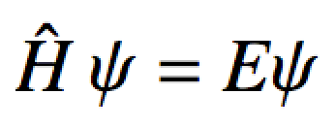
The Fundamental Rules of Our Game
Postulates of Quantum Mechanics
Every observable satisfies an eigen-system.
Physical observables are eigenvalues of their operators
The eigen-system we are MOST interested in:
The Schrodinger Equation
We are interested in eigenfunctions of the Hamiltonian, whose eigenvalues are energies
Spectra are made up of energies!

Slide 13
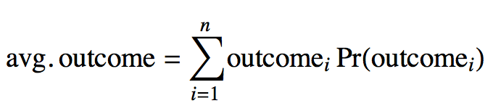
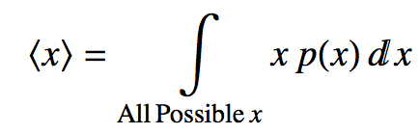
The Fundamental Rules of Our Game
Postulates of Quantum Mechanics
Besides being eigenvalues of some eigen-system, observables are also average values
From statistics an average value is:
Discrete outcomes, like rolling dice
Continuous outcomes, like body weights

Slide 14
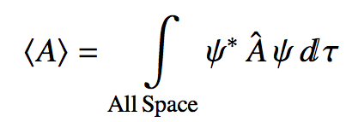
The Fundamental Rules of Our Game
Postulates of Quantum Mechanics
Besides being eigenvalues of some eigen-system, observables are also average values
Generalization of average value of observables for quantum mechanics:

Slide 15
The Fundamental Rules of Our Game
Say we have a physical system with a wave function:
Is it an eigenfunction of ?
Is it an eigenfunction of ?
Is it an eigenfunction of ?

Slide 16
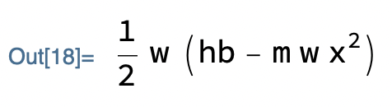


f = ((m w)/(Pi hb))^(1/4) Exp[-(m w x^2)/(2 hb)];
Tf = -hb^2/(2 m) D[f, {x, 2}];
Tf/f // FullSimplify
Divide ψ₀ out from the result and see if you’re just left with just constants
Vf = (1/2 m w^2 x^2) f;
Vf/f // FullSimplify
So:
Hf = Tf + Vf;
Hf/f // FullSimplify

Slide 17
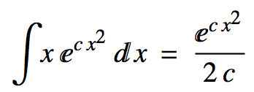
The Fundamental Rules of Our Game
Say we have a physical system with a wave function:
What is the average value of position for an object defined by this system?
To work it out completely by hand you’ll need the integral:

Slide 18
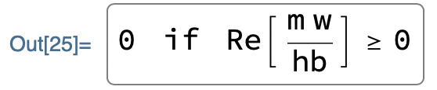
f = ((m w)/(Pi hb))^(1/4) Exp[-(m w x^2)/(2 hb)];
Integrate[x f^2, {x, -Infinity, Infinity}]

Slide 19
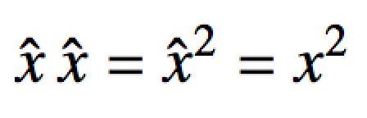
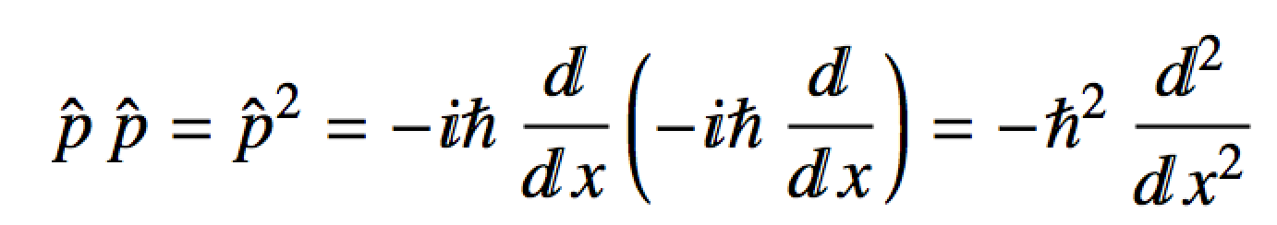
Uncertainty
We can find average values for any operator
This includes products of operators:
E.g.

Slide 20
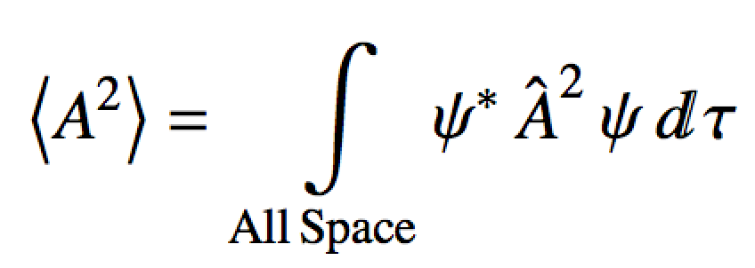
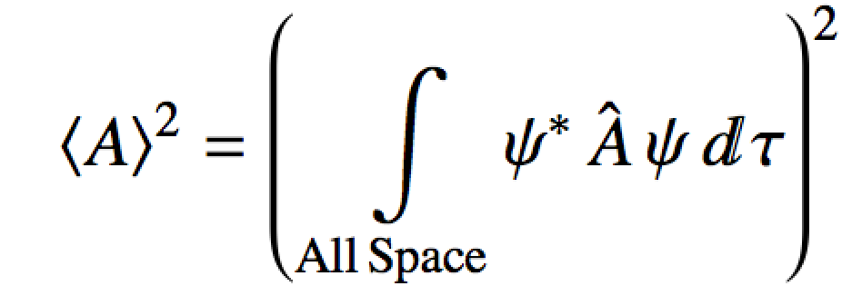
Uncertainty
We can find average values for any operator
Average value of A-squared operator
Average value of A operator, squared

Slide 21
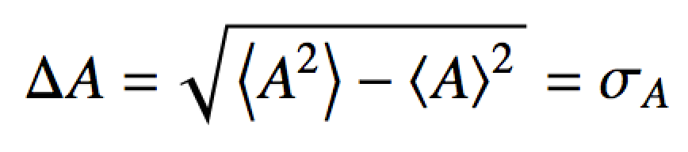
Uncertainty
The standard deviation (spread) in the values we’d measure is:
In physics, we call standard deviation: uncertainty
Statisticians are still arguing with each other about the definition of uncertainty…
Reality is that there are alternative definitions.

Slide 22
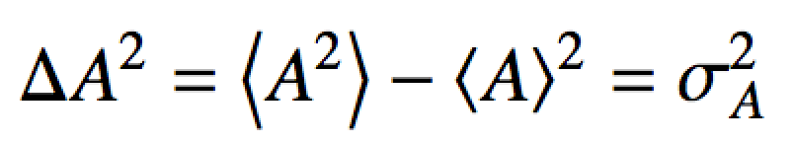
Uncertainty
In statistics you learn about an alternative measure of spread, variance:
Both definitions of standard deviation and variance are identical to what you learned in statistics.

Slide 23

Uncertainty
Uncertainty holds a special status in quantum mechanics
Heisenberg uncertainty relation: It is impossible to simultaneously measure “conjugate” observables to arbitrarily small precision.
= 0, Observables are independent
(their operators commute)
≠ 0, Observables are conjugate
(their operators do not commute)
commutator

Slide 24
Uncertainty
Uncertainty holds a special status in quantum mechanics
Heisenberg uncertainty relation for position and momentum:
It is impossible to simultaneously measure position and momentum to arbitrarily small precision.
Position and momentum operators do not commute. Their Heisenberg uncertainty relation is:

Slide 25
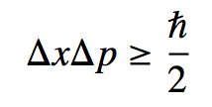
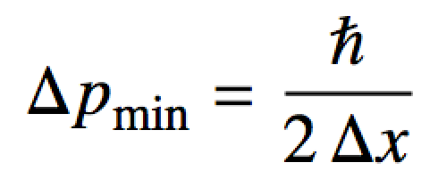
Uncertainty
If the uncertainty in one of the conjugate observations is known from experiment, the minimum uncertainty in the other is:
Swap out for an = sign

Slide 26
Uncertainty
If the uncertainty in one of the conjugate observations is known from experiment, the minimum uncertainty in the other is:
min
Experimentally, determine uncertainty in one of the observables
Solve for minimum uncertainty in the other

Slide 27

Uncertainty
Compute the minimum uncertainty with which the position of an e- may be measured if the standard deviation in the measurement of its speed is found to be ± 6 μm/s
library(che302r)
m.electron <- 9.109384e-31
Dv <- 6e-6 # uncertainty in speed
Dx.min <- hb/(2*m.electron*Dv)
Dx.min # minimum uncertainty in position

