Slide 1
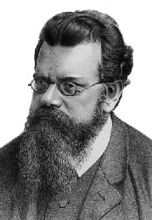
A Box of Particles

Slide 2
Dimensions
We studied a single particle in a box
What happens if we have a box full of particles??
We get a model of a gas
The box is 3D
The particles bounce around, but do not stick together or repel
Each particle behaves like a particle in a box
y
x
z

Slide 3
Microstates and Macrostates
Each of the particles can be in any number of wave functions at any instant
Which particle is in which state is called a microstate
e_{i} means particle is in particle in a box state i and has energy e_{i}
e₅
e₃
e₄
y
e₂
e₂
e₈
e₁
e₅
e₂
x
e₂
z
e₄
e₁
e₈

Slide 4
Microstates and Macrostates
Another representation at the same instant: Count up the number of particles in each wave function.
Called a occupation number vector, configuration or a macrostate
n_{i} is the number of particles in state (wave function) i
e₅
e₃
e₄
y
e₂
n = {2 4 1 2 2 0 0 2 …}
e₂
e₈
e₁
e₅
e.g. there are 2 particles in 4th (3rd excited state) particle in a box wave functions
e₂
… means that there are many more wave functions available, but they are empty
x
e₂
z
e₄
e₁
e₈

Slide 5
Most Probable Macrostate
As the particles bounce around they are constantly exchanging energy
The microstate is constantly changing
Which microstate is most likely??
e₃
e₅
e₁₀
Assume any microstate is just as likely as any other: “The principle of a priori probability”
e₈
y
e₇
e₃
e₁
e₂
But, … if all the microstates are equally likely, we can figure out which macrostate is most likely!
e₂
e₃
x
e₁
z
e₈
e₁

Slide 6
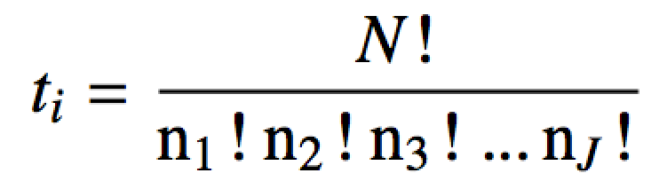
Most Probable Macrostate
The most probable macrostate is the configuration that can occur the most number of ways
There are J wave functions available to to all the particles
The number of ways to achieve a macrostate with N total particles:
Plug in the occupation number vector
# ways to arrange particle energies and get macrostate i
Read: n₃ particles have wave function 3
-or-
# number of microstates corresponding to macrostate i

Slide 7
Most Probable Macrostate
Which macrostate is more probable: {3,2,8,0,0,1,0,0} or {3,3,7,0,0,1,0,0} or {2,4,1,2,2,0,1,2}??
= 180,180
= 480,480
= 227,026,800
Macrostate 3 is (way) more probable. There are more ways to get it (i.e. corresponds to more microstates).

Slide 8
Most Probable Macrostate
Which ever macrostate has the most number of microstates is most probable
Find the maximum of t_{i} (macrostate with the most microstates) given the constraints
The total energy E, remains constant
The total number of particles N, remains constant
The number of microstates accessible to the particles increases as temperature T increases

Slide 9
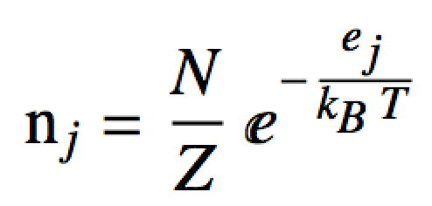
The Boltzmann Distribution
The macrostate with the most microstates (given the E, N, and T constraints) occurs when the n_{j} equal:
Energy of the wave function j
Total number of particles in the box
Temperature of the box is T
Number of particles with wave function j (i.e. in single particle state j)
Normalization constant (partition function) so that n_{j}/N can be interpreted as the probability that n_{j} particles have energy e_{j}

Slide 10
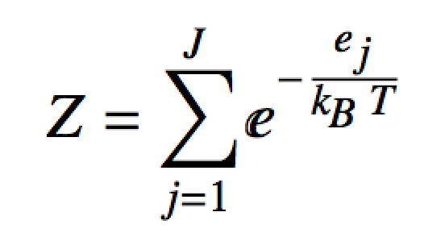
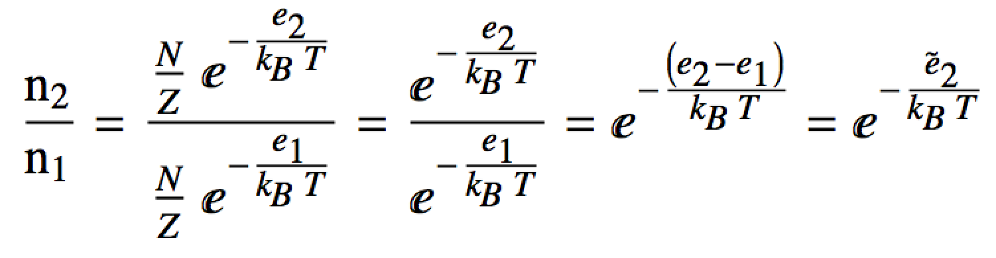
Partition Function
The partition function Z can be interpreted as how the total number of particles are “partitioned” amongst all the energies e_{i}
Huh?
Look at the ratio of particles in the first excited state to particles in the ground state:
# particles in first excited state
# particles in ground state

Slide 11
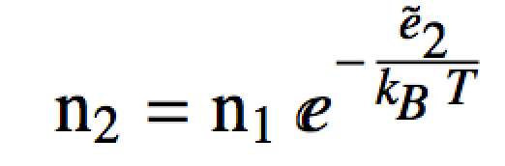
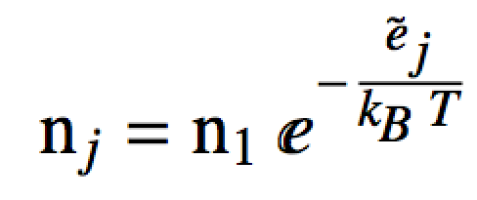
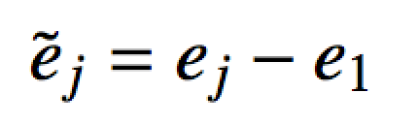
Partition Function
Thus the particles in the first excited state are a fraction of the particles in the ground state:
# particles in first excited state
# particles in the ground state
fraction
We would find the same thing for the number of particles in the other excited states:
state j’s energy relative to the ground state
where
# of particles in state j is a fraction of the number of particles in the ground state

Slide 12
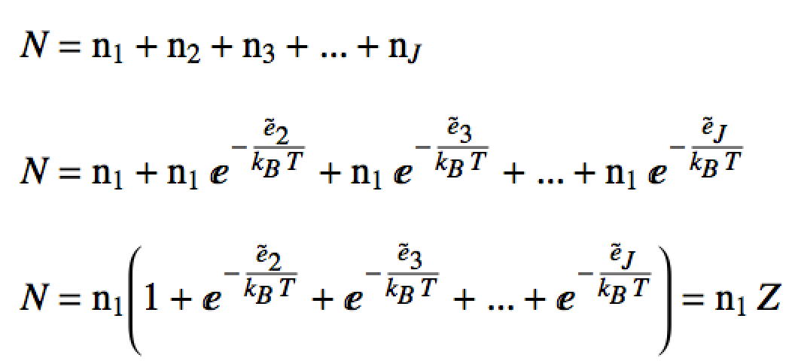
Partition Function
We can write the total particle number, N “partitioned out” amongst the energy levels in this way:
Total particle number
Substitute
~
Factor out n₁
This is just the partition function (scaled by a constant)!
Note:

Slide 13
Partition Function
Consider a 1D box of length 50 μm at 77K containing 2.3 mols of neutrino particles (m_{neutrino}=1.78×10⁻³⁷ kg). This system is constructed such that only the first 4 “particle in a box” (P.I.A.B.) states are available to be occupied by the particles.
What is the value of the (scaled) partition function with respect to the ground state Z? What about Z?
What are the most likely number of neutrinos in each P.I.A.B. state? Mols of neutrinos?
What is the most likely macrostate?
What is the probability of finding a neutrino in each state?
~

Slide 14
Partition Function

Slide 15
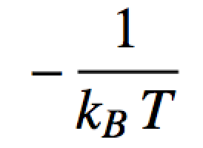
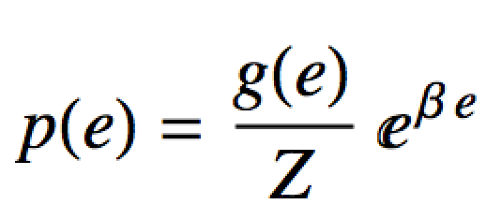
Boltzmann distribution
This form of the Boltzmann distribution isn’t too useful to us because:
We don’t really know Z (yet)
For “normal” temperatures (e.g. room temp), the total number of wave functions reachable, J is HUGE and the e_{j} are super close together (essentially “un-quantized”)
Instead we’ll use this form of Boltzmann’s distribution (Boltzmann’s density):
Degeneracy for energy e
Probability density of energy e

Slide 16
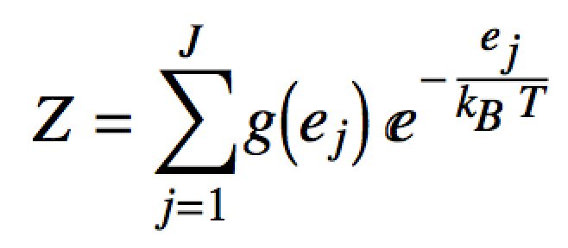
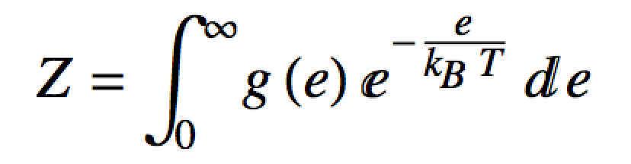
Boltzmann distribution
In theory, we can find Z with:
Usually impossible to use this directly
Instead lets note that for a big box and lots of particles, the e_{i} are very close together:
The degeneracy term, g(e) can be found in k-space

Slide 17
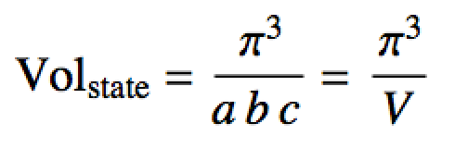
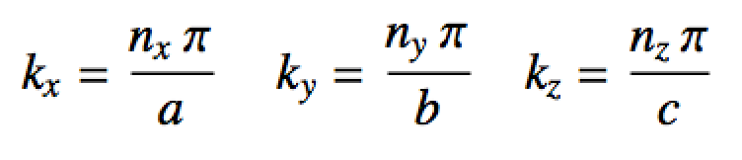
k-space
For particle in a 3D box:
π/b
A state in k-space
k_{y}
π/a
π/c
k_{x}
k_{z}
Quantum numbers n_{x}, n_{y} and n_{z} define a point in k-space
Points in k-space are discrete
“Distance” in k-space is inverse length

Slide 18
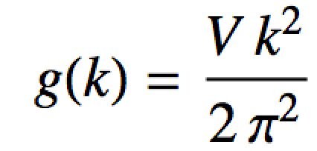
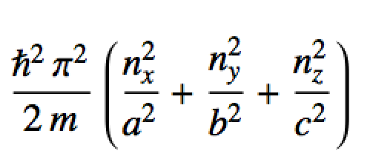
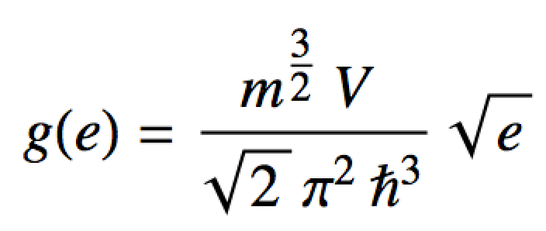
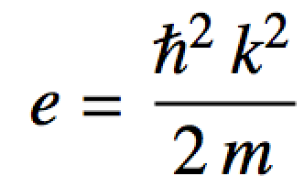
k-space
We can determine g(e) by using the “volume” (the number of states) of a shell in k-space.
Volume in k-space has units of m⁻³ = m_{k}³
A state in k-space
k_{y}
Units:
states/m_{k}
k_{x}
From particle in a box energy formula:
k_{z}
Units:
states/J
Energy degeneracy in a box of particles

Slide 19
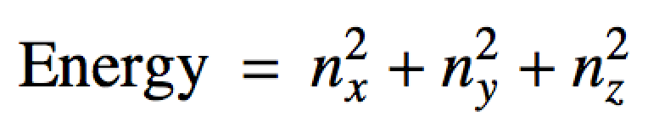
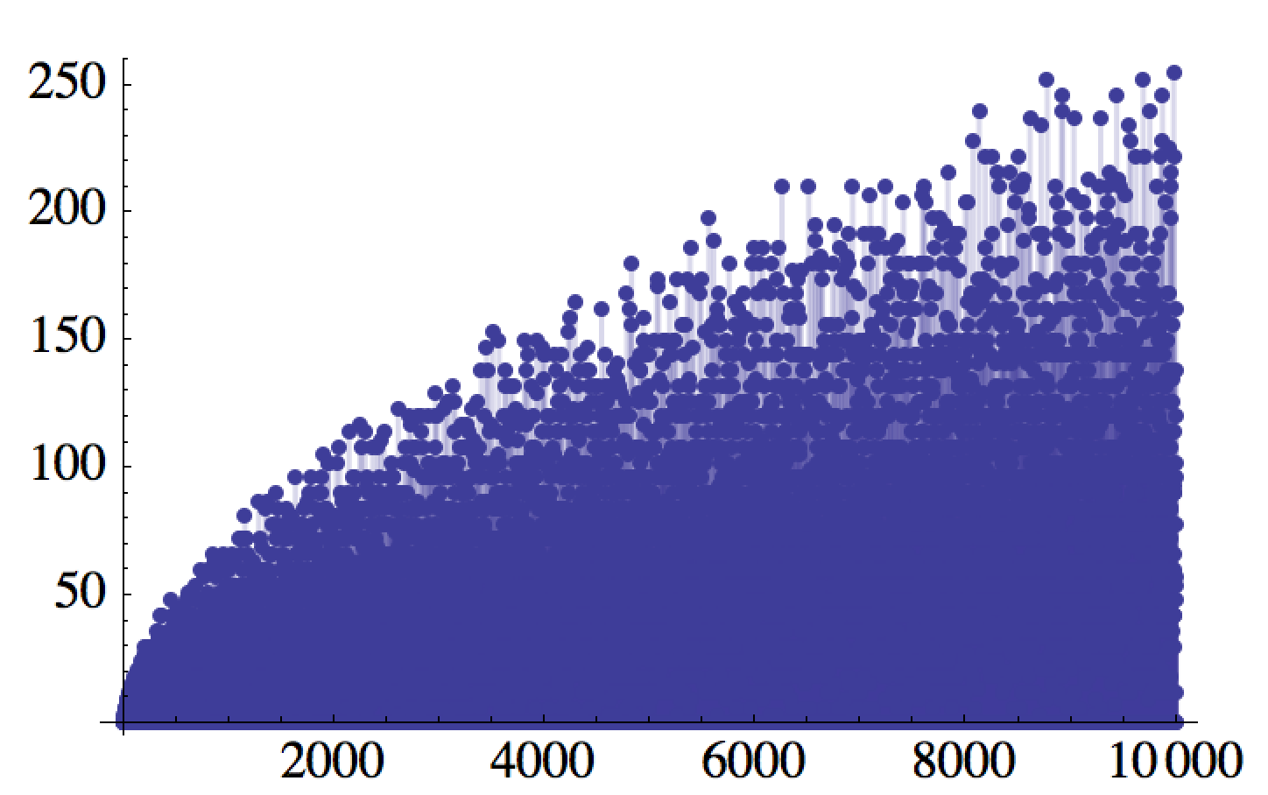
Another Look at Energy Degeneracy in the Box
From the last unit, solving the Diophantine equation:
# of states
Energy

Slide 20
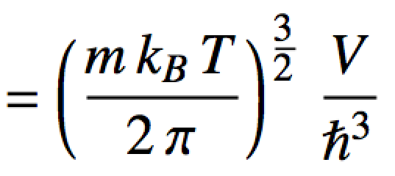
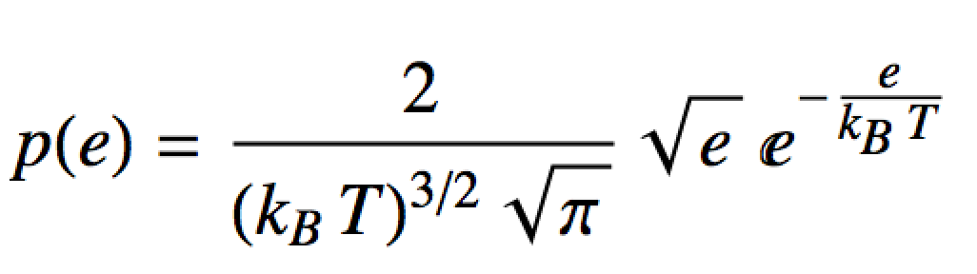
Maxwell-Boltzmann distribution
Using g(e) to get Z:
Finally substituting in p(e):
Maxwell-Boltzmann “Distribution” for distinguishable particles in a box

Slide 21
Maxwell-Boltzmann distribution
What does this probability density like like?
Draw a particle from the box. What energy is it most likely to have?
(k_{B}T)³ p(E) (scaled density)
Past how much energy do you not expect to find too many particles?
x = E/(k_{B}T) (scaled energy)

Slide 22
3D Box/Degeneracy problem
Consider a 3D box (side length 1 dm) filled with 1 mol of HCl gas (36.46 g/mol) at 273 K.
Compute the log of the partition function.
Assuming the HCl molecules occupy P.I.A.B. states, approximately how many states are available up to an energy of 1k_{B}T at 273K. Hint: Compute
Do it symbolically first. Log the result, plug in and then “e” back. That is better form.
Compute the probability of reaching into the box and pulling out an HCl molecule of energy between 0 J and 1k_{B}T at 273K. Hint: Compute

Slide 23
3D Box/Degeneracy problem
a.
kB <- 1.38064852e-23
hb <- 1.054571817e-34
Na <- 6.02214076e23
m <- 36.46 * 1/Na * 1/1000 # convert g/mol -> kg/molec
Temp <- 273
Vol <- 1 * (1/10)^3 # convert dm^3 -> m^3
# Z just by plugging in to the formula:
Z.dont.do.it.this.way <- (m*kB*Temp/(2*pi))^(3/2) * Vol/hb^3
Z.dont.do.it.this.way
# Z by computing with logs. Usually do it this way:
logZ <- (3/2) * (log(m) + log(kB) + log(Temp) - log(2*pi)) + log(Vol) - 3* log(hb)
exp(logZ) # More stable. Do it this way
Z ~ 10²⁹

Slide 24
3D Box/Degeneracy problem
b.
g[e_] := (m^(3/2) V)/(Sqrt[2] Pi^2 hb^3) Sqrt[e];
Integrate[g[e], {e, 0, kB T}]
kB <- 1.38064852e-23
hb <- 1.054571817e-34
Na <- 6.02214076e23
m <- 36.46 * 1/Na * 1/1000 # convert g/mol -> kg/molec
Temp <- 273
Vol <- 1 * (1/10)^3 # convert dm^3 -> m^3
# int g(e) just by plugging in to the formula:
num.states <- sqrt(2) * m^(3/2) * Vol * (Temp * kB)^(3/2) / (3*pi^2*hb^3)
num.states
# g(e) by computing with logs. Usually do it this way. More numerically stable to use logs:
log.ns <- (1/2)*log(2) + (3/2)*log(m) + log(Vol) + (3/2)*(log(Temp) + log(kB)) - log(3*pi^2) - 3*log(hb)
exp(log.ns)
~ 10²⁹ states are available under these conditions
…just a coincidence the magnitude is the same as Z

Slide 25
3D Box/Degeneracy problem
c.

Slide 26
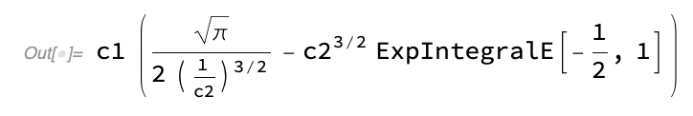
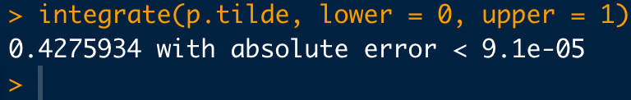
3D Box/Degeneracy problem
c.
X
(*Definite integral: c_1\int_0^{c_2}\sqrt{x}\ e^{-\frac{x}{c_2}}\ dx *)
c1*Integrate[Sqrt[x] Exp[-x/c2], {x, 0, c2}]
# Do the integral numerically with a substation in R instead:
# Substitute x = e/(kB T):
p.tilde <- function(x){
val <- 2/sqrt(pi) * sqrt(x) * exp(-x)
return(val)
}
xx <- seq(0, 6, length.out=1000)
plot(xx,p.tilde(xx), typ="l")
integrate(p.tilde, lower = 0, upper = 1)

Slide 27
Why belabor the point?
We often want to compare “models” (hypotheses) in science.
A way to do this quantitatively is:
“Weight of the evidence” is a ratio of normalization constants.
To see, consider
Bayes’ Theorem
for the models:
So:
The point:
We just saw how hard these can be to calculate, even for our “easy” cases with lots of theory behind them…

