Slide 1
Great background material for Markov Random Fields from which the Notes below are derived:
Chapters 4 and 20 Koller and Friedman:
Probabilistic Graphical Models: Principles and Techniques
Gould Notes:
https://users.cecs.anu.edu.au/~sgould/papers/part1-MLSS-2011.pdf
**UGM (Schmidt):
https://www.cs.ubc.ca/~schmidtm/Software/UGM.html
**CRF: Port of UGM for R (Wu):
https://cran.r-project.org/web/packages/CRF/index.html
Murphy Chapter 19:
https://www.cs.ubc.ca/~murphyk/MLbook/pml-print3-ch19.pdf
Kschischang et al.:
Factor Graphs and the Sum-Product Algorithm, IEEE Transactions on Information Theory Volume: 47, Issue: 2, pp 498-519, 2001:
https://vision.unipv.it/IA2/Factor%20graphs%20and%20the%20sum-product%20algorithm.pdf

Slide 2
My little add on R package to do some stuff in these Notes can be found at:
To install in R, run the lines:
https://github.com/npetraco/CRFutil
# First install remotes and some packages now only available on Bioconductor
install.packages("remotes")
install.packages("BiocManager")
BiocManager::install("graph", force = TRUE)
BiocManager::install("Rgraphviz", force = TRUE)
BiocManager::install("RBGL", force = TRUE)
# Turn on remotes and install CRFutil2 from github
# CRFutil2 should automatically install CRF and gRbase:
library(remotes)
install_github("npetraco/CRFutil2")
# Test and see if the CRFutil2 library loads. No error messages
# is a sign of success. Don't worry about any warning messages.
library(CRFutil2)
Note: CRFutil is meant to be pedagogical, not fast…

Slide 3
Table of Contents
Markov Random Fields: Theory and Computation - 4
Maximum Likelihood Approximation for MRF Parameters - XX
Maximum Pseudolikelihood Approximation for MRF Parameters - XX
Multilevel Logistic Regression to Determine MRF Parameters - XX
Log-linear approach to for MRF Parameters - XX
Message passing and belief propagation - XX
XX

Slide 4
Markov Random Field Notes
A Little Theory and Lots of Computation

Slide 5
For some joint probability distribution over a set of variables* , Pr(X):
The dependencies between the X_{i} can be represented as a graph.
An example for a 5-variable distribution Pr(A,B,C,D,E)
A
A 5-variable PMF with dependencies represented by an undirected graph (Markov Random Field or Markov Network)
E
B
D
C
*We’ll assume variables are discrete unless stated otherwise

Slide 6
Parameterize this distribution using unary potentials for each node and pair-wise potentials between each pair of connected nodes*
For the example Pr(A,B,C,D,E) this amounts to replacing the undirected graph with a factor graph
*We’ll assume all MRFs in these notes are parameterized this way unless otherwise stated
Ψ_{A}
A
Ψ_{AE}
Ψ_{AB}
E
B
Ψ_{E}
Ψ_{BE}
Ψ_{B}
Ψ_{AD}
Ψ_{DE}
Ψ_{AC}
Ψ_{BC}
Ψ_{BD}
D
C
Ψ_{D}
Ψ_{BD}
Ψ_{C}

Slide 7
The Ψ_{i} and Ψ_{ij} are factors or potentials. They are functions representable in table form which hold (usually) un-normalized quantities which contribute to the probability distribution:
Ψ_{i} are called unary or node potentials and Ψ_{ij} are called pair or edge potentials.
Edge potentials are known as transfer matrices in statistical physics
Z is the normalization constant called the partition function
For the example Pr(A,B,C,D,E):

Slide 8
It will be convenient to actually parameterize the probability distribution in terms of negative logarithms of the potentials:
Making an analogy with physics, log potentials are like energies associated with particles in a many-body system
ψ_{i}: Energies of the particle at node i to be in its various possible states.
In the Ising model of a magnet, the particle is an electron and its possible states are +1 (“spin up”) and -1 (“spin down”) so:

Slide 9
Making an analogy with physics, negative-log potentials are like energies associated with particles in a many-body system (con’t)
ψ_{ij}: Energies between particles at node i and j which directly feel each other.
In the Ising model:
For these reasons we’ll refer to log potentials as one-body (node) and two-body (edge) energies

Slide 10
The variable X_{i} are discrete but can take on any number of states (levels) s_{i}
Ising-like model: Two possible states: {s₁, s₂}
Potts-like model: More than two possible states {s₁, s₂, …, s_{m}}
To computationally operational-ize these ideas, it is convenient to define a “feature function”
w is a vector of weights for each state
I is a vector function which acts like a switch; indicator function
I selects out the weight for the state X_{i} = s_{Xi}
In physics, feature functions are related to spinors which have a deep mathematical theory

Slide 11
As an example, let’s say:
Then:
For the Ising model in physics it’s a little different:
Which leads to feature functions:

Slide 12
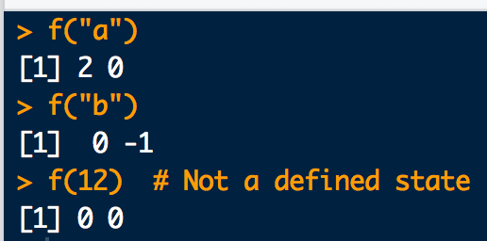
Here is how you can implement feature functions in R:
# Make up some state labels:
s1 <- "a"
s2 <- "b"
# Define a weight vector:
w <- c(2,-1)
# Define feature function:
f <- function(y){ w * as.numeric(c((y==s1),(y==s2))) }
# Try it out:
f("a")
f("b")
# What happens for an undefined state?
f(12)
scr1.R

Slide 13
There is also CRFutil2 built-in feature functions for convenience:
ff0.R
ff0_C.cpp
ff1_C.cpp
ff2_C.cpp
library(CRFutil2)
# Make up some state labels:
s1 <- "a"
s2 <- "b"
# Define a weight vector:
w <- c(2,-1)
# A feature function built into CRFutil2:
ff0(st = "b", ss.dim = 2, w.vec = w, st.vec = c(s1,s2))
scr2.R

Slide 14
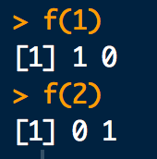
We usually define the feature function this way to work with CRF output:
# State labels used by CRF:
s1 <- 1
s2 <- 2
# Define feature function. State weights are implicitly 1:
f <- function(y){ as.numeric(c((y==s1),(y==s2))) }
# Try it out:
f(1)
f(2)
scr3.R
Compare with example two-slides ago

Slide 15
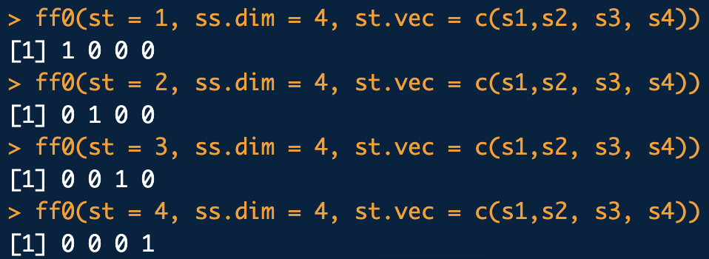
Feature function for a Potts-like model is the same idea:
library(CRFutil2)
# Define 4 state labels for a Potts-like model:
s1 <- 1
s2 <- 2
s3 <- 3
s4 <- 4
# Try it out:
ff0(st = 1, ss.dim = 4, st.vec = c(s1, s2, s3, s4))
ff0(st = 2, ss.dim = 4, st.vec = c(s1, s2, s3, s4))
ff0(st = 3, ss.dim = 4, st.vec = c(s1, s2, s3, s4))
ff0(st = 4, ss.dim = 4, st.vec = c(s1, s2, s3, s4))
scr4.R

Slide 16
Using feature functions, we can write node and edge energies in convenient matrix-vector form(s):
node energies
is called the node i weight vector:
If w = id(m) (all ones vector) then has entries numerically equivalent to node i energies

Slide 17
Using feature functions, we can write node and edge energies in convenient matrix-vector form(s):
edge energies
is called the edge ij weight matrix:
If w = id(m) (all ones vector) then has entries numerically equivalent to edge ij energies
Feature functions play a role similar to spin-orbital one-body basis functions familiar from many-body theory.

Slide 18
For the models considered here, there will only be 2 states at each node. Also, each state has weight 1. That is:
Thus, the node and edge weights are:
The corresponding node and edge energies in table form are:

Slide 19
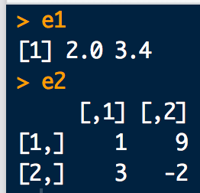
Here is how one and two-body energy calculations can be implemented in R:
library(CRFutil2)
# Consider an Ising-like model with:
tau <- c(2, 3.4) # node weights
omega <- rbind( # edge weights
c(1,9),
c(3,-2)
)
# one-body energies:
e1 <- c(ff0(1) %*% tau , ff0(2) %*% tau)
e1
# two-body energies
e2 <- rbind(
c(ff0(1) %*% omega %*% ff0(1), ff0(1) %*% omega %*% ff0(2)),
c(ff0(2) %*% omega %*% ff0(1), ff0(2) %*% omega %*% ff0(2))
)
e2
scr5.R

Slide 20
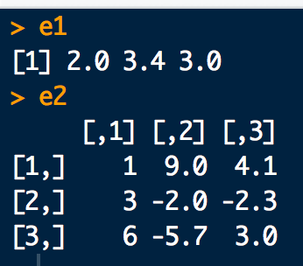
Again, for a Potts-like model things are pretty similar:
#Consider an Potts-like model with node/edge weights:
tau <- c(2, 3.4, 3)
omega <- rbind(
c(1, 9, 4.1),
c(3, -2, -2.3),
c(6, -5.7, 3 )
)
# Define states and feature function:
s1 <- 1
s2 <- 2
s3 <- 3
f <- function(y){ as.numeric(c((y==s1),(y==s2),(y==s3))) }
# one-body energies:
e1 <- c(ff0(1, ss.dim = 3) %*% tau, ff0(2, ss.dim = 3) %*% tau, ff0(3, ss.dim = 3) %*% tau)
e1
# two body energies
e2 <- rbind(
c(ff0(1,3) %*% omega %*% ff0(1,3), ff0(1,3) %*% omega %*% ff0(2,3), ff0(1,3) %*% omega %*% ff0(3,3)),
c(ff0(2,3) %*% omega %*% ff0(1,3), ff0(2,3) %*% omega %*% ff0(2,3), ff0(2,3) %*% omega %*% ff0(3,3)),
c(ff0(3,3) %*% omega %*% ff0(1,3), ff0(3,3) %*% omega %*% ff0(2,3), ff0(3,3) %*% omega %*% ff0(3,3))
)
e2
scr6.R

