Slide 1

A Little Bit of Probability 4
A Long Example

Slide 2
Example
76% of the light aircraft that disappear while in flight in a certain country are subsequently discovered (D). Of the aircraft that are discovered, 60% have an emergency locator (L), whereas 86% of the aircraft not discovered (D’) do not have such a locator (L’). Suppose a light aircraft has disappeared.
What is Pr(D’)?
What is Pr(L’|D)?
What is Pr(L|D’)?
What is Pr(L ∩ D)?
What is Pr(L ∩ D’)?
What is Pr(L)?
If the plane has an emergency locator, what is the probability it will not be discovered?
If the aircraft doesn’t have an emergency locator, what is the probability it will be discovered?

Slide 3
Example
76% of the light aircraft that disappear while in flight in a certain country are subsequently discovered (D). Of the aircraft that are discovered, 60% have an emergency locator (L), whereas 86% of the aircraft not discovered (D’) do not have such a locator (L’). Suppose a light aircraft has disappeared.
What is Pr(D’)?
What is Pr(L’|D)?
What is Pr(L|D’)?
What is Pr(L ∩ D)?
What is Pr(L ∩ D’)?
What is Pr(L)?
If the plane has an emergency locator, what is the probability it will not be discovered?
If the aircraft doesn’t have an emergency locator, what is the probability it will be discovered?

Slide 4
# Data from the question:
D <- 0.76
L.given.D <- 0.6
Ln.given.Dn <- 0.86
#a. Pr(D')
Dn <- 1-D
Dn
#b. Pr(L'|D) = 1 - Pr(L|D)
Ln.given.D <- 1 - L.given.D
Ln.given.D
#c. Pr(L|D')
L.given.Dn <- 1 - Ln.given.Dn
L.given.Dn
#d. Pr(L and D) = Pr(L|D) Pr(D)
L.and.D <- L.given.D * D
L.and.D
#e. Pr(L and D')
L.and.Dn <- L.given.Dn * Dn
L.and.Dn
#f. Pr(L) = Pr(L|D)Pr(D) + Pr(L|D')Pr(D')
L <- L.given.D * D + L.given.Dn * Dn
L
#g. Pr(D'|L) = Pr(L|D')Pr(D')/Pr(L)
Dn.given.L <- (L.given.Dn*Dn)/(L)
Dn.given.L
#h. Pr(D|L') = Pr(L'|D)Pr(D)/Pr(L')
D.given.Ln <- (Ln.given.D*D)/(1-L)
D.given.Ln
Notes:
REPLACE WITH HAND CALC

Slide 5
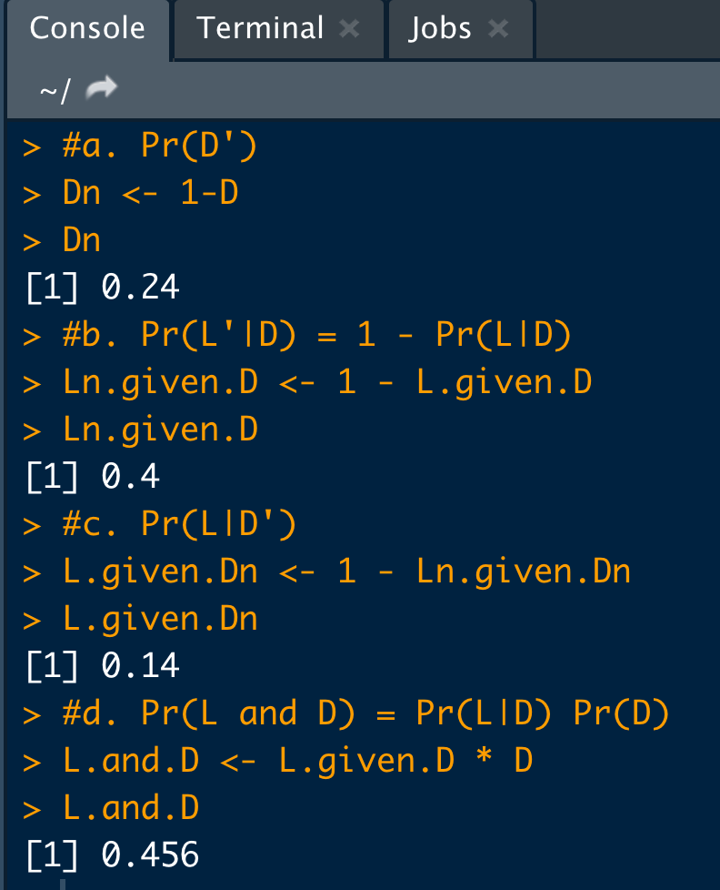
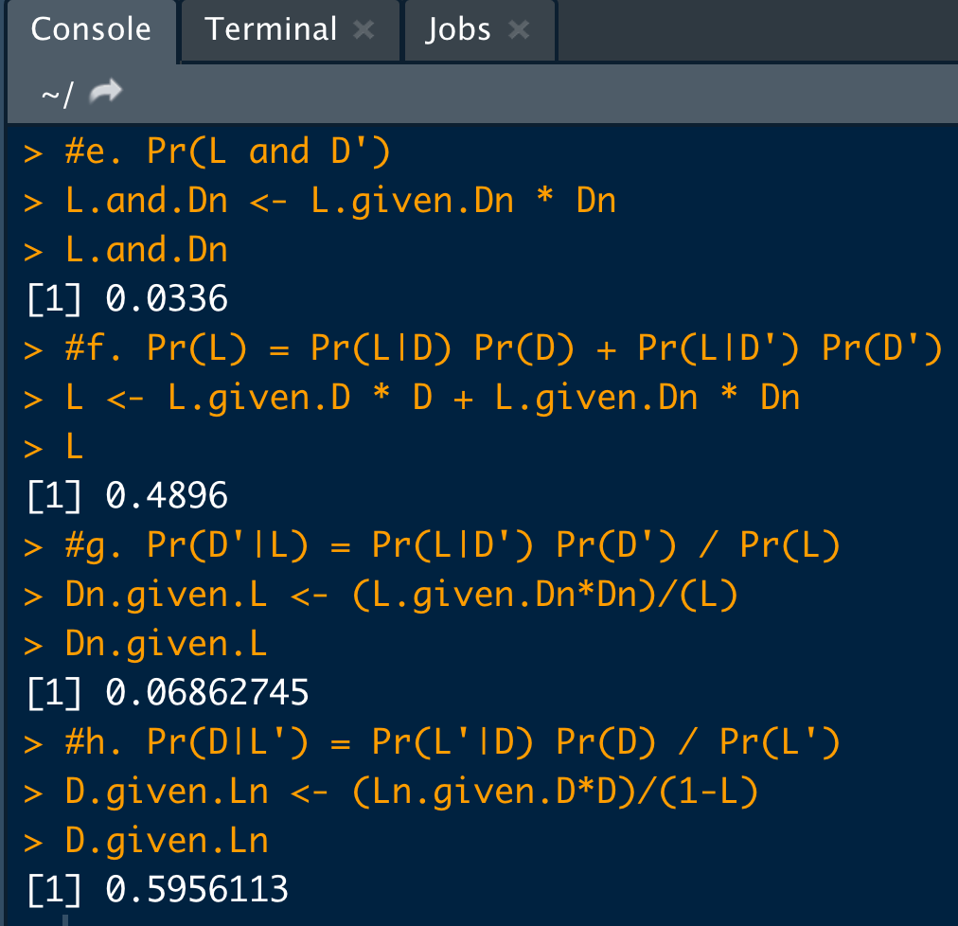
Answers:

