Slide 1

Important Probability Distributions 1
Permutations and Combinations

Slide 2
Handy Counting Formulas
When various outcomes of an experiment are equally likely computing probabilities reduces to a counting problem
Say we have two experiments, each with a set of outcomes:
Experiment 1 has m outcomes
Experiment 2 has n outcomes
The total number of outcomes that can occur for both experiments is m×n

Slide 3
Handy Counting Formulas
When various outcomes of an experiment are equally likely computing probabilities reduces to a counting problem
Say now we have k-experiments with the following number of outcomes:
Experiment 1 has n₁ outcomes
Experiment 2 has n₂ outcomes
…
Experiment k has n_{k} outcomes
The total number of outcomes that can occur for all experiments is (the counting principle):
Total number of outcomes = n₁n₂…n_{k}

Slide 4
Handy Counting Formulas
How many ways are there to select r distinct items from a group of n distinct items?
Permutations: If the order of selection is important
Combinations: If the order of selection is irrelevant

Slide 5
Handy Counting Formulas
How many ways are there to arrange n distinct items into k-groups (partitions), each with n_{i} items
Partitions: Grouping items into sets where order doesn’t matter
multinomial-coefficient
Note:

Slide 6
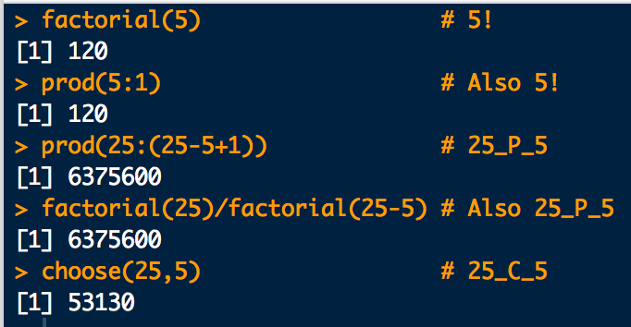
This is how we do permutation and combinations in R:
factorial(5) # 5!
prod(5:1) # Also 5!
# nPr is prod(n:(n-r+1))
prod(25:(25-5+1)) #25_P_5
# nPr is also factorial(n)/factorial(n-r)
factorial(25)/factorial(25-5)
# nCr os choose(n,r)
choose(25,5)
And this is what we get:

