Slide 1

Important Probability Distributions 2
Discrete Data:
Probability Mass Functions and Cumulative Mass Distributions

Slide 2
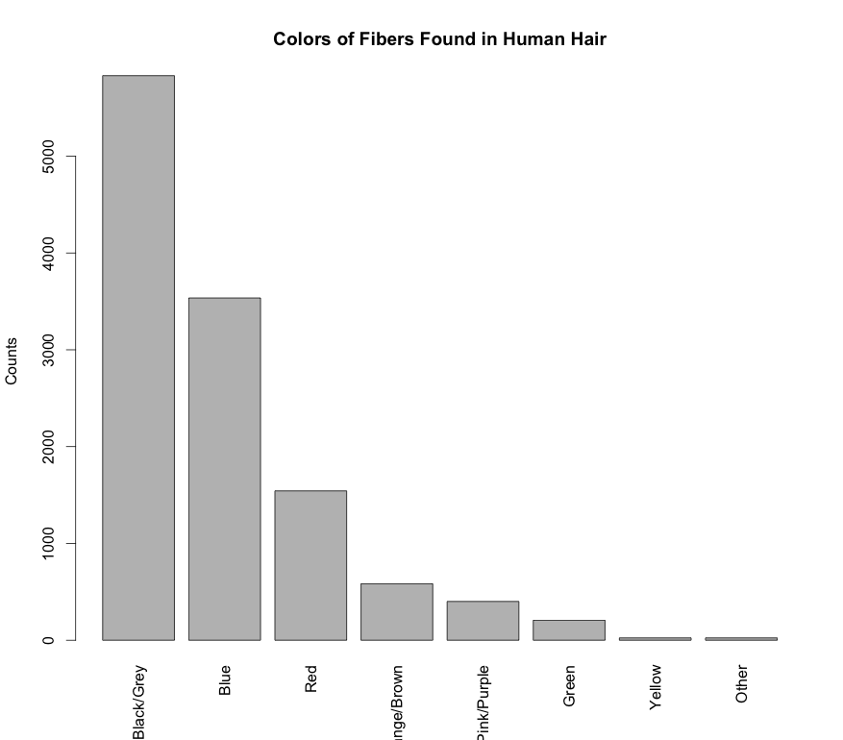
Probability Mass Function
Probability over a discrete set of outcomes is described by a probability mass function (PMF)
A PMF can be represented as a table or displayed as a histogram
Fiber Color | Probability
Black/Grey | 0.48
Blue | 0.291
Red | 0.127
Orange/Brown | 0.048
Pink/Purple | 0.033
Green | 0.017
Yellow | 0.002
Other | 0.002
Data from dafs: fiber.color.df

Slide 3
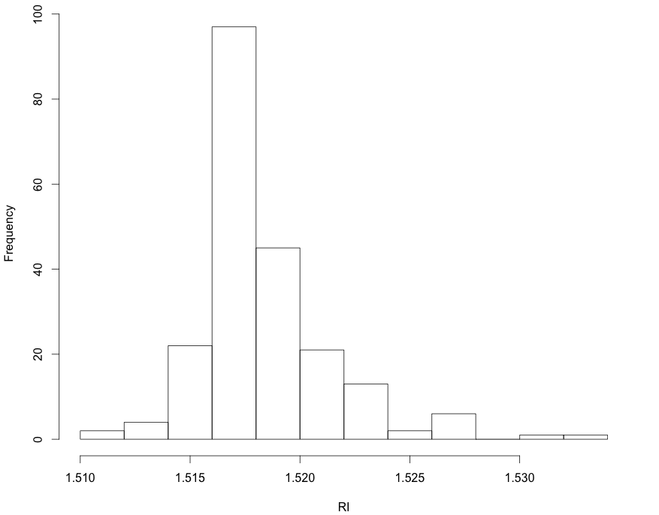
Example: Probability Mass Function For Some Glass RI
x <- read.csv("https://raw.githubusercontent.com/npetraco/MAT301/master/R/data/Glass.csv")
RI <- x[,1]
hist(RI, xlab="RI", main="Refractive Index of Glass Fragments")
Continuous data treated as if it were discrete
Data from mlbench: Glass.df

Slide 4
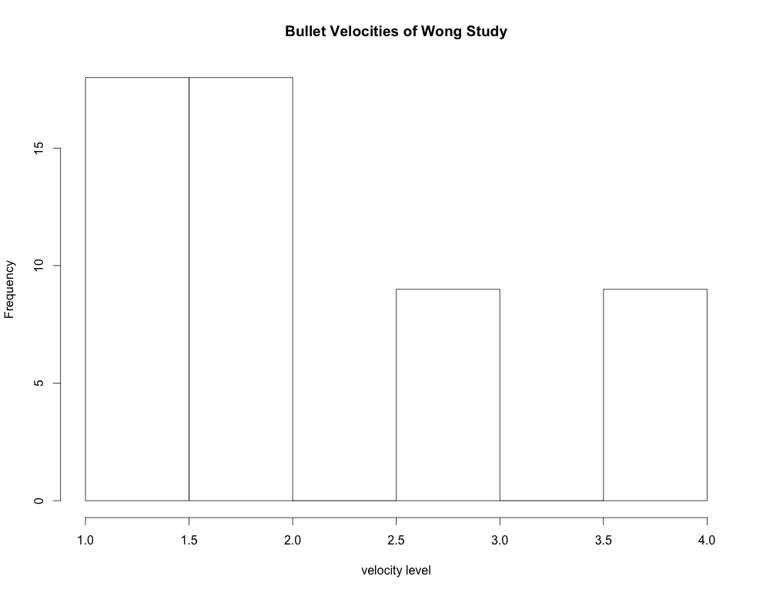
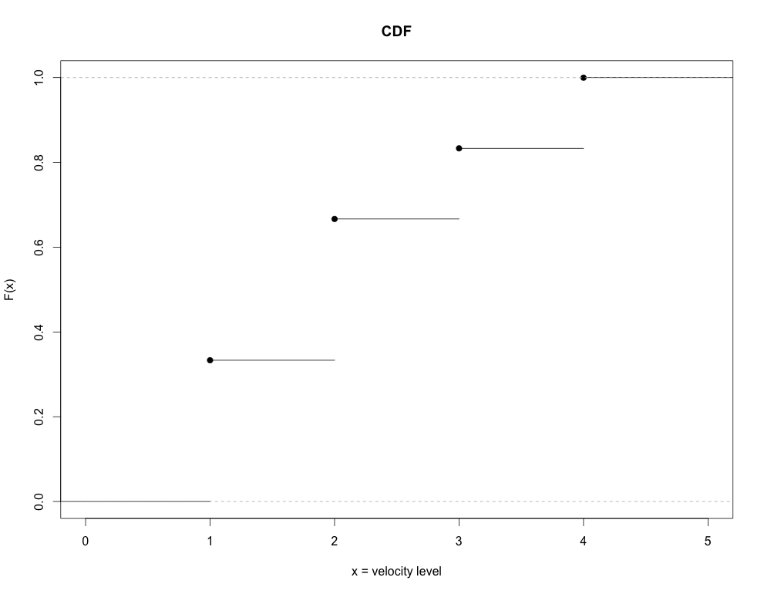
Cumulative Distribution Function
A function that gives the probability that a random variable is less than or equal to a specified value is a cumulative (mass) distribution function (CDF):
Varies between 0 and 1
CDFs for discrete RVs are step functions

Slide 5
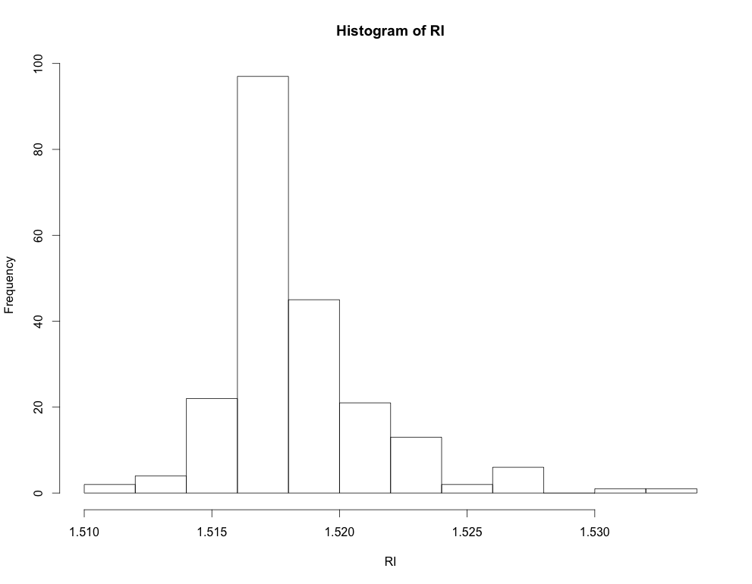
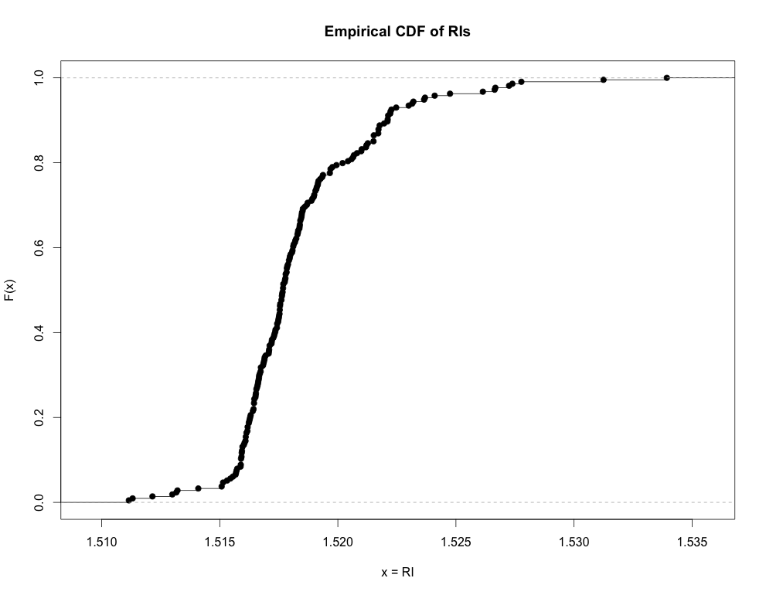
Cumulative (Mass) Distribution Function
The same mathematical machinery can be used compute a CDF for a histogram of any data type:
ordinal-discrete (previous slide)
artificially ordered nominal-discrete
*continuous treated as if it were discrete (empirical CDF)
Fx <- ecdf(RI)
plot(Fx, ylab="F(x)", xlab="x=RI",
main="Empirical CDF of RIs")

Slide 6
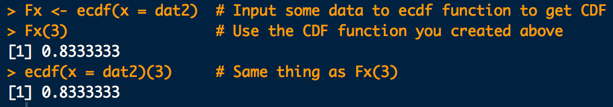
Cumulative Distribution Function
In R we can compute the empirical CDF, F(x) like this:
dat <- c(
1,1,1,1,1,1,1,1,1,1,1,1,1,1,1,1,1,1,
2,2,2,2,2,2,2,2,2,2,2,2,2,2,2,2,2,2,
3,3,3,3,3,3,3,3,3,
4,4,4,4,4,4,4,4,4
)
Fx <- ecdf(dat)
Fx(3)
ecdf(dat)(3)
Don’t name anything “F” in R.
F(x = 3)
Pr(X ≤ 3)

Slide 7
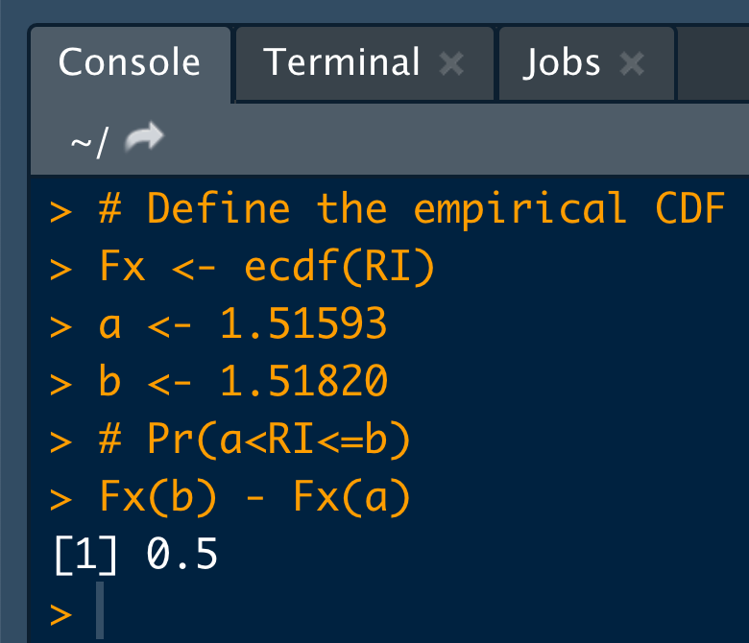
Cumulative Distribution Function
Use the CDF to compute the probability that a RV will lay between two specified values such that:
# Define the empirical CDF:
Fx <- ecdf(RI)
a <- 1.51593
b <- 1.51820
# Pr(a<RI<=b)
Fx(b) - Fx(a)
F(b)
Some interpretations:
There is a 50% chance an RI in this data is between 1.51593 and 1.51820
50% of the RIs in this data set are between 1.51593 and 1.51820
0.5
F(a)
a
b

