Slide 1

Important Probability Distributions 3
Discrete Data:
Discrete Moments and Expectation Values

Slide 2
Discrete Moments and Expectation Values
Moments are handy numerical values that can systematically help to describe distribution location and shape properties.
m^{th}-order moments are found by taking the expectation value of an RV raised to the m^{th}-power:

Slide 3
Moments and Expectation Values
1st-order moment:
Number of times outcome x_{i} occurs
Total number of experiments
average value of X

Slide 4
Moments and Expectation Values
1st-order moment:
location descriptor
mean
average value of X
1st-order moment for a parameter g(X) on X:
average value of parameter g

Slide 5
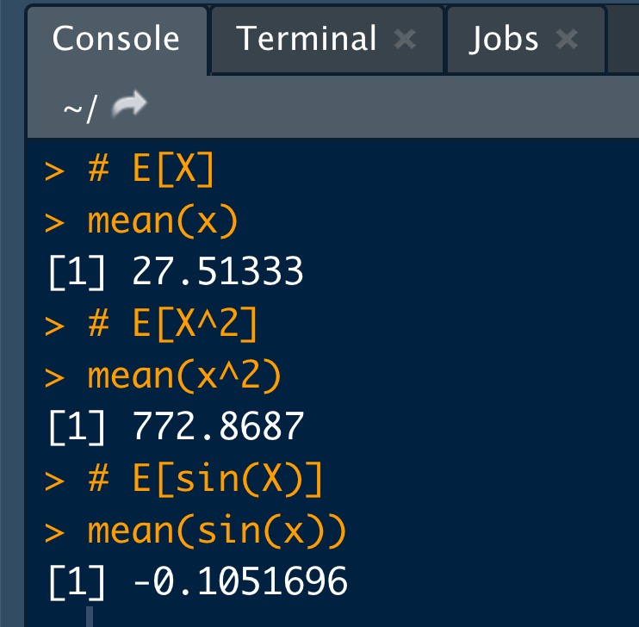
Example: Computing Discrete Moments
Compute discrete E[X], E[X²] and E[sin(X)] for the data below:
27.5, 34.3, 30.1, 29.9, 23.0, 21.8, 25.9, 25.7, 31.2, 26.6,
30.4, 31.2, 29.4, 23.4, 27.3, 25.2, 21.5, 34.6, 20.3, 29.8,
30.1, 27.8, 24.1, 28.8, 29.7, 25.2, 34.1, 32.0, 20.8, 23.7
# Some data:
x <- c(27.5, 34.3, 30.1, 29.9, 23.0, 21.8, 25.9, 25.7, 31.2, 26.6,
30.4, 31.2, 29.4, 23.4, 27.3, 25.2, 21.5, 34.6, 20.3, 29.8,
30.1, 27.8, 24.1, 28.8, 29.7, 25.2, 34.1, 32.0, 20.8, 23.7)
# E[X]
mean(x)
# E[X^2]
mean(x^2)
# E[sin(X)]
mean(sin(x))

Slide 6
Moments and Expectation Values
2nd-order moments:
Second order moment. Not that interesting…
but…
Second order central moment.
It can be shown that
Population standard deviation
spread descriptor

Slide 7
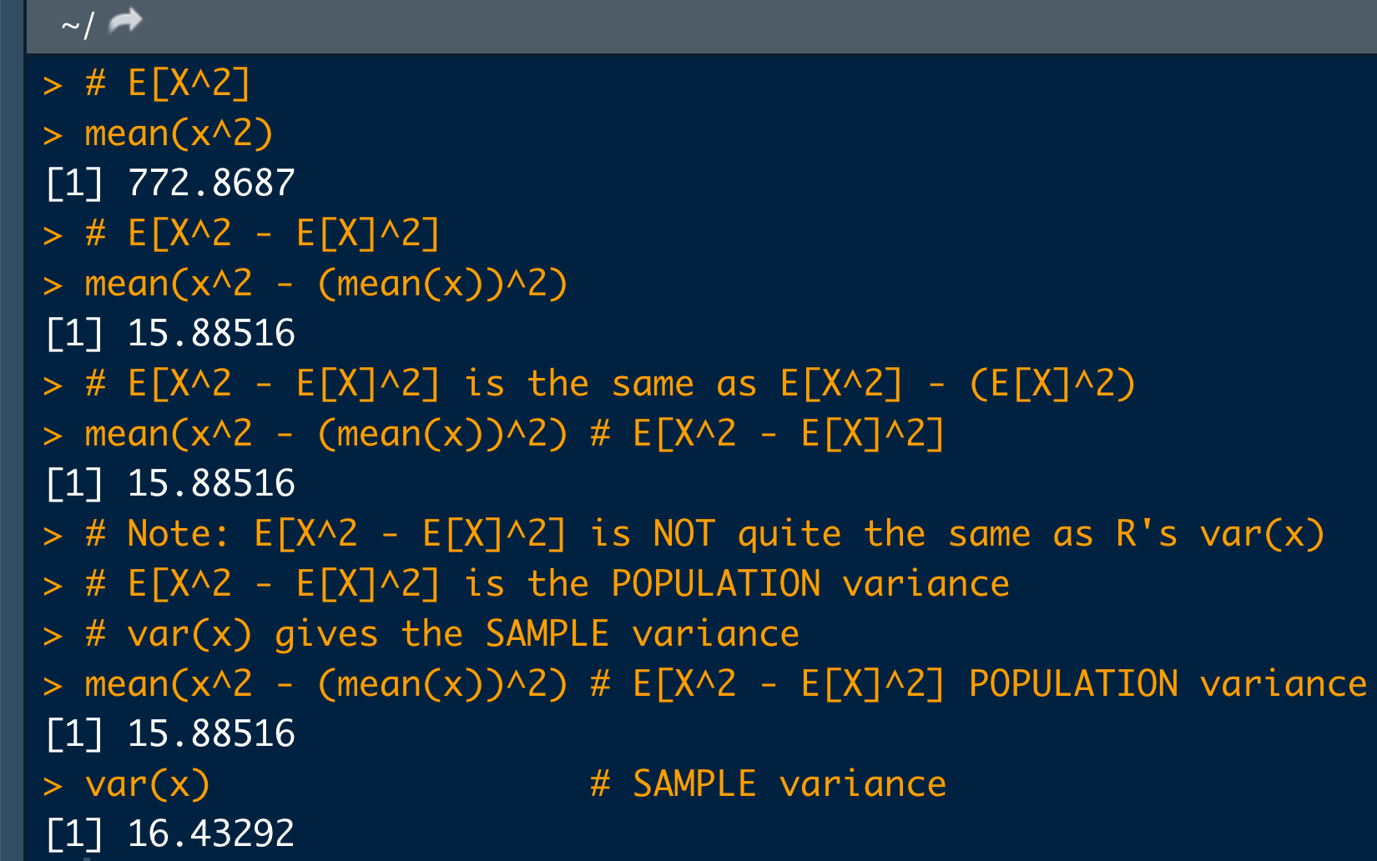
Example: Computing Discrete Second Order Moments
Compute discrete second order moment E[X²] and E[X² – (E[X])²] for the data below:
27.5, 34.3, 30.1, 29.9, 23.0, 21.8, 25.9, 25.7, 31.2, 26.6,
30.4, 31.2, 29.4, 23.4, 27.3, 25.2, 21.5, 34.6, 20.3, 29.8,
30.1, 27.8, 24.1, 28.8, 29.7, 25.2, 34.1, 32.0, 20.8, 23.7
x <- c(27.5, 34.3, 30.1, 29.9, 23.0, 21.8, 25.9, 25.7, 31.2, 26.6,
30.4, 31.2, 29.4, 23.4, 27.3, 25.2, 21.5, 34.6, 20.3, 29.8,
30.1, 27.8, 24.1, 28.8, 29.7, 25.2, 34.1, 32.0, 20.8, 23.7)
# E[X^2] (We did this one already)
mean(x^2)
# E[X^2 - E[X]^2]
mean(x^2 - (mean(x))^2)
# E[X^2 - E[X]^2] is the same as E[X^2] - (E[X]^2)
mean(x^2 - (mean(x))^2) # E[X^2 - E[X]^2]
mean(x^2) - (mean(x))^2 # E[X^2] - (E[X]^2)
# Note: E[X^2 - E[X]^2] is NOT quite the same as R's var(x)
# E[X^2 - E[X]^2] is the POPULATION variance
# var(x) gives the SAMPLE variance
mean(x^2 - (mean(x))^2) # E[X^2 - E[X]^2] POPULATION variance
var(x) # SAMPLE variance

Slide 8
Moments and Expectation Values
Higher-order moments measure other distribution shape properties:
3rd order: “skewness”
4th order: “kurtosis” (pointy-ness/flat-ness)
no skew
leptokurtic
left skew
right skew
platykurtic

