Slide 1
Interval Estimation 2
Computing Confidence Intervals

Slide 2
Confidence Intervals
So how do we compute a (1 − α)×100% confidence interval given a set of data??
Conceptually, if we are trying to estimate a parameter θ with some estimator we have to know something about the sampling distribution of the estimator
For large IID samples, one can show that is approximately normal:
Approx. sampling dist. of an estimator (large IID sample assumed)

Slide 3
Confidence Intervals
To explicitly take sample size, n, into account (and thus be more conservative), instead use the student-T distribution:
Approx. sampling dist. of an estimator (IID sample of size n)
We will use the Student-T assumption for the sampling distribution by default

Slide 4
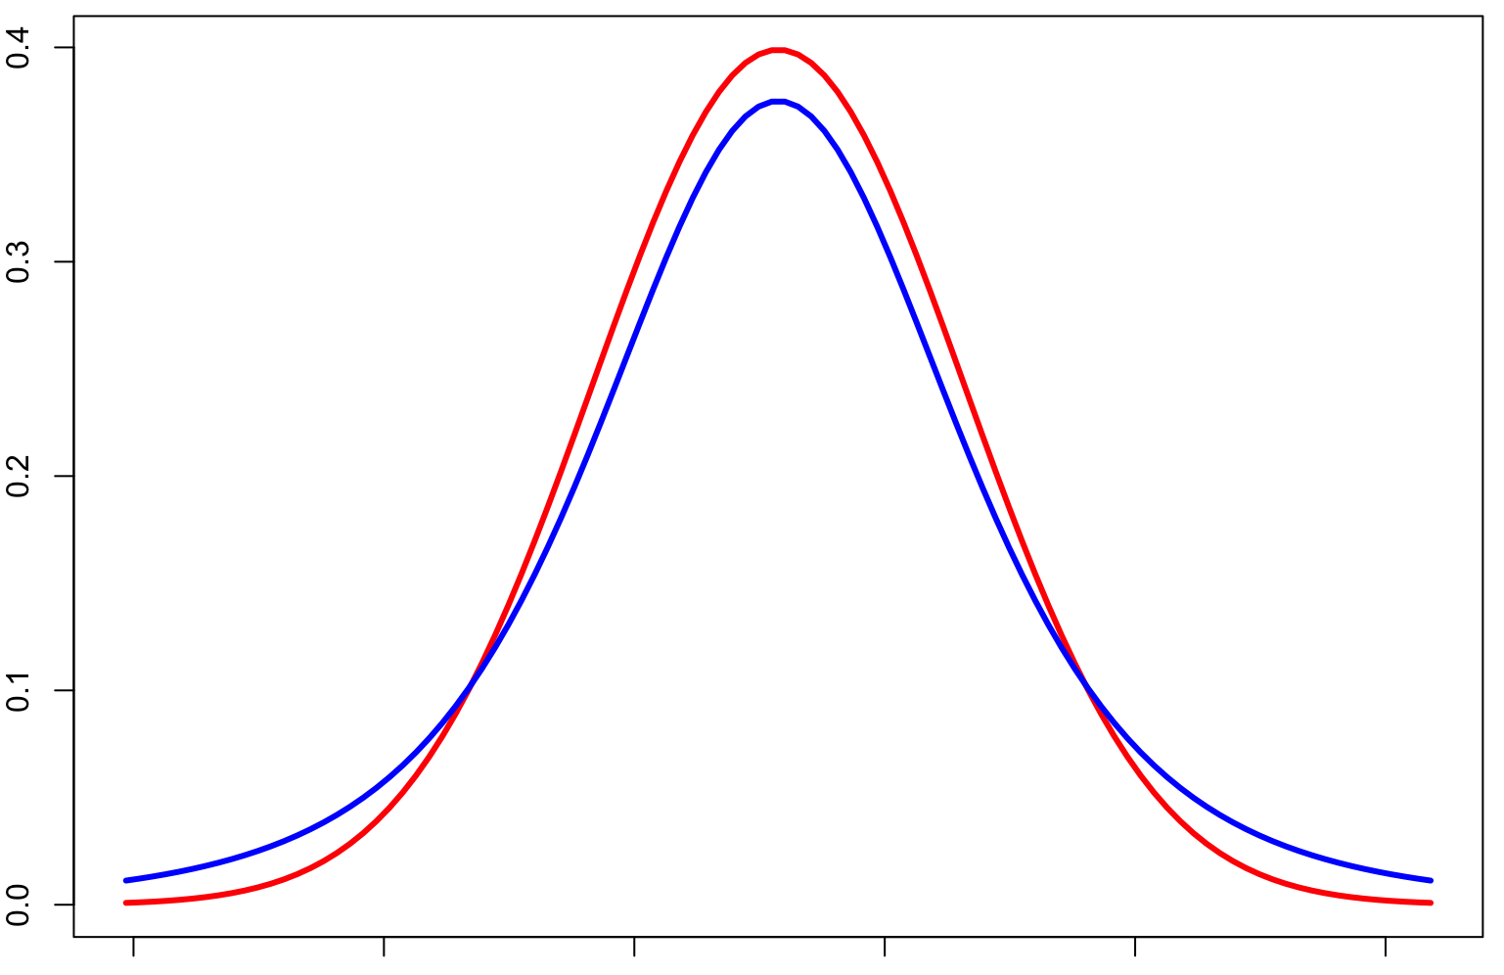
Intuition: Student-t vs Normal Sampling Dists
Normal distribution
Student-t distribution
Fatter in the tails

Slide 5
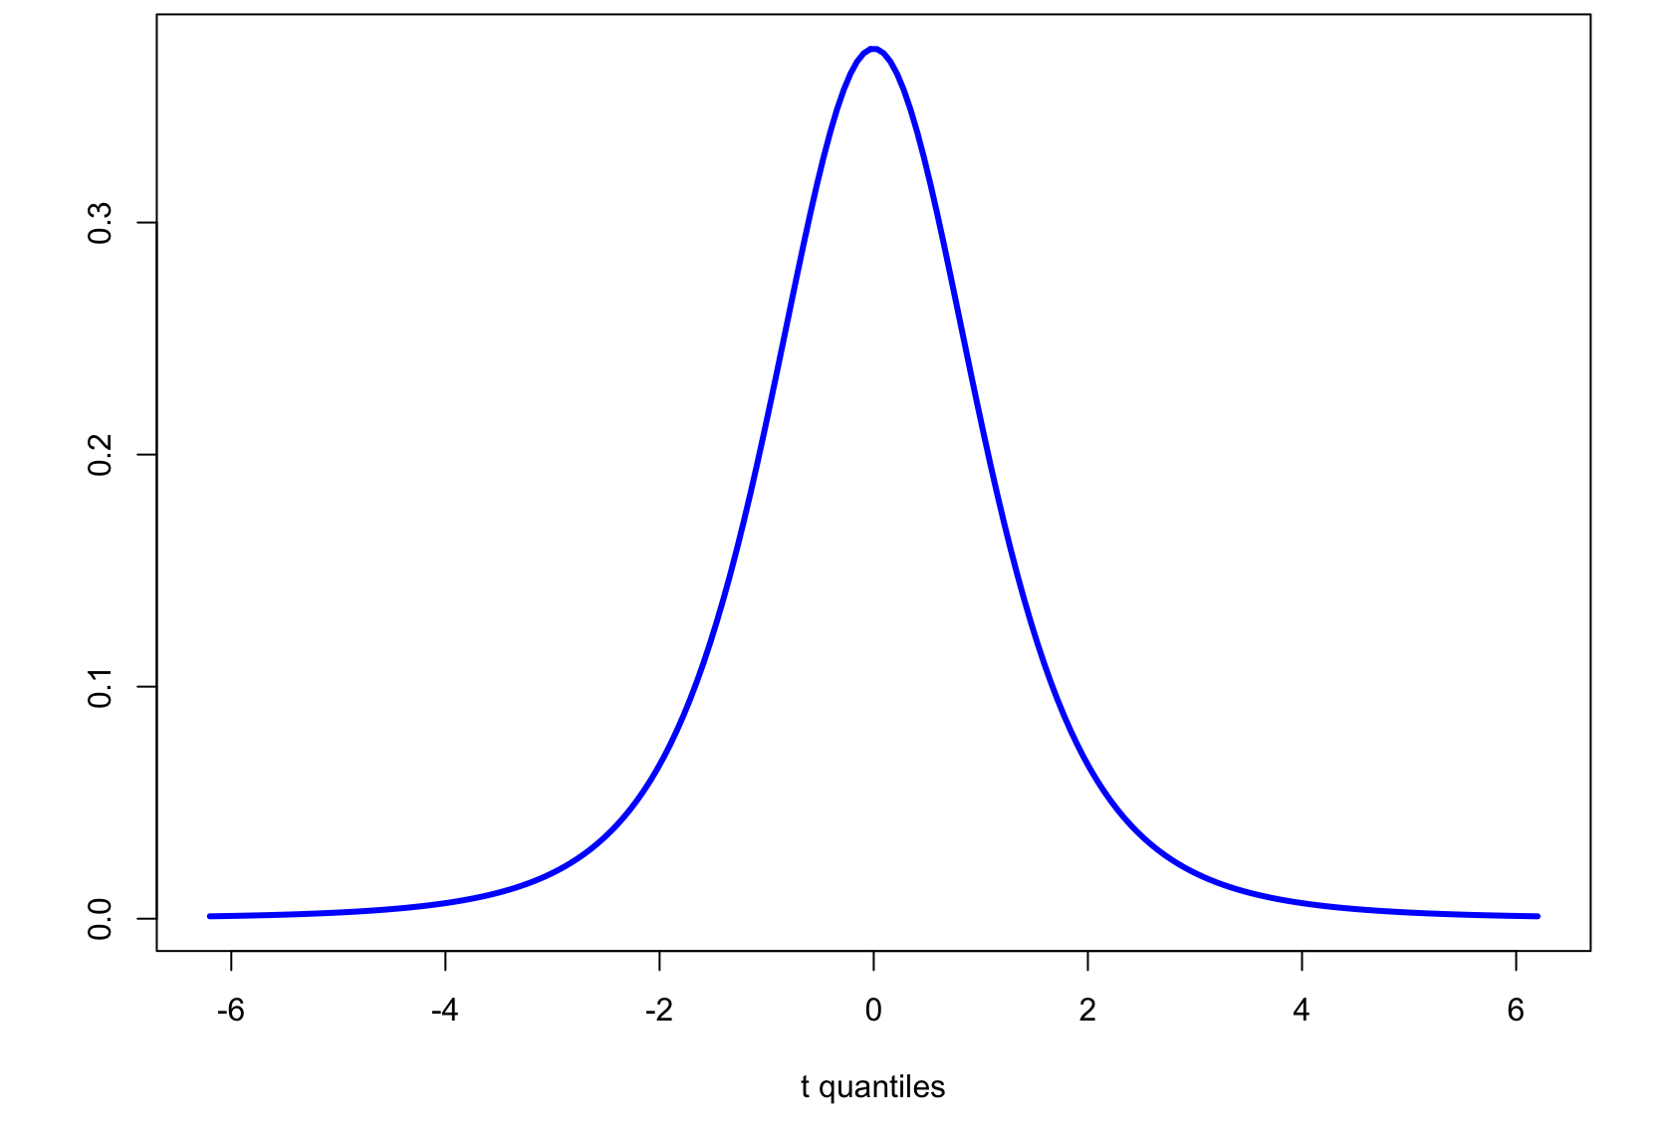
Intuition: Student-t and t_{c}
Student-t PDF, d.f. = 3
Area =
0.99
Area =
0.95
-5.84
5.84
-3.18
3.18
t_{c} = 3.18 for (two-sided) 95% confidence
t_{c} = 5.84 for (two-sided) 99% confidence

Slide 6
Confidence Intervals
Construction of a CI for a mean depends on:
Sample size n
Mean estimate
Estimated standard error for the mean
Level of confidence 1-α
α is significance level
Use α to compute t_{c}-value
(1-α)×100% CI for population mean using a sample average and standard error is:

Slide 7
Example: Confidence Intervals
Compute a 99% two sided confidence interval for the the RI of a glass shard using this sample set:
Fragment # | Fragment nD
1 | 1.52005
2 | 1.52003
3 | 1.52001
4 | 1.52004
5 | 1.52000
6 | 1.52001
7 | 1.52008
8 | 1.52011
9 | 1.52008
10 | 1.52008
11 | 1.52008
?

Slide 8
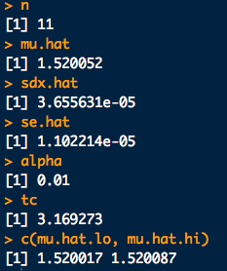
Example: Confidence Intervals
# Data
x <- c(1.52005,1.52003,1.52001,1.52004,1.52000,1.52001,
1.52008,1.52011,1.52008,1.52008,1.52008)
n <- length(x)
# Estimate of parameter:
mu.hat <- mean(x)
# Standard deviation of the data
sdx.hat <- sd(x)
# Standard error of the mean estimate
se.hat <- sd(x)/sqrt(n)
# Compute tc for given sample size and chosen confidence level
conf <- 0.99
alpha <- 1-conf
tc <- qt(1 - alpha/2, df = n-1)
# Put the CI together:
mu.hat.lo <- mu.hat - tc*se.hat
mu.hat.hi <- mu.hat + tc*se.hat
c(mu.hat.lo, mu.hat.hi)

Slide 9
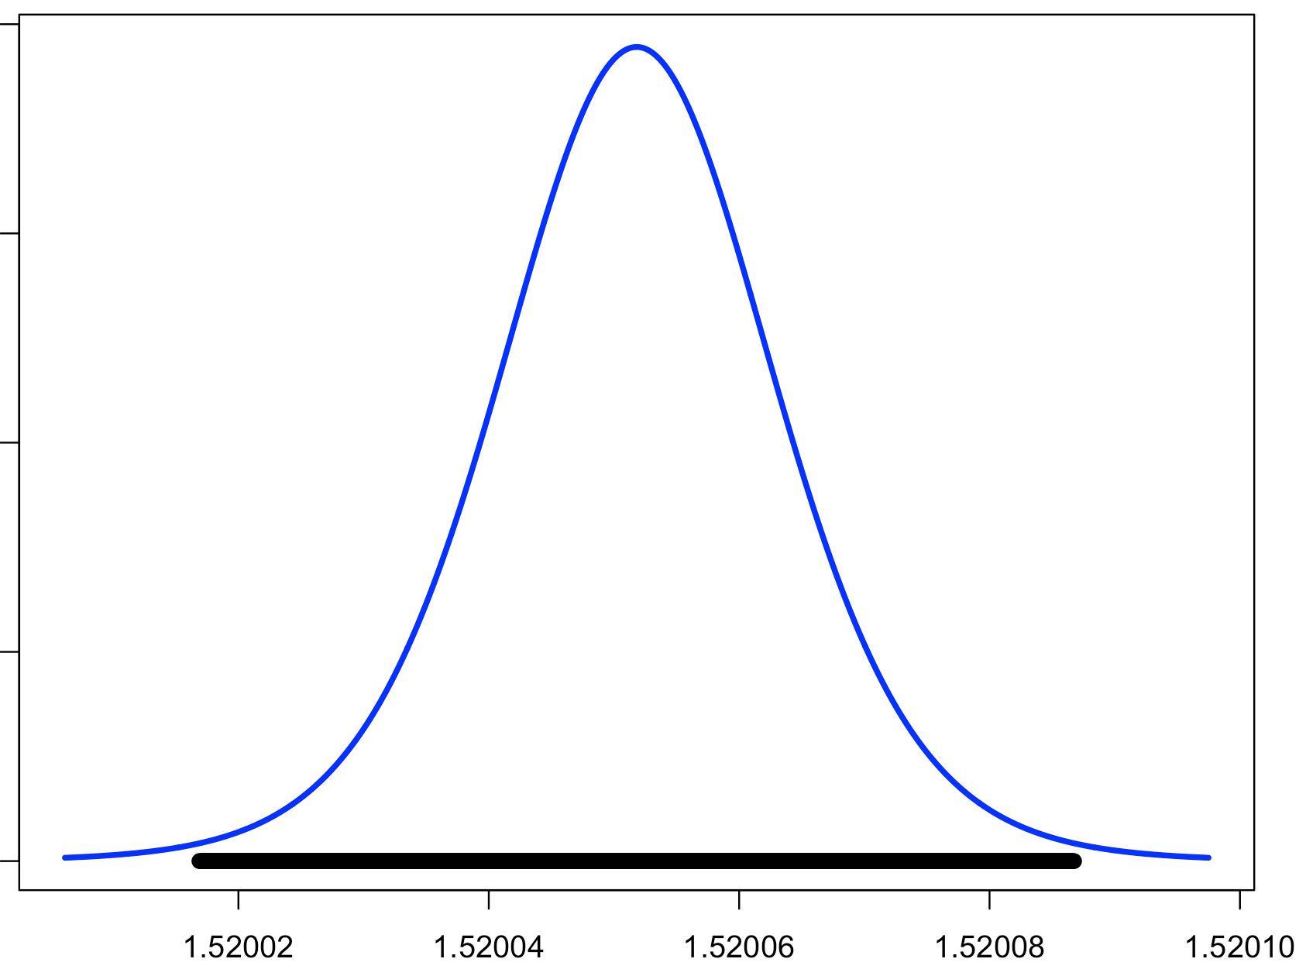
Example: Confidence Intervals
Approx. Sampling
Distribution for Mean
1.520017
99% Confidence
1.520087

Slide 10
Example: Confidence Intervals
Compute a 99% two sided confidence interval for the the RI of a glass shard using this sample set:
Fragment # | Fragment nD
1 | 1.52005
2 | 1.52003
3 | 1.52001
4 | 1.52004
5 | 1.52000
6 | 1.52001
7 | 1.52008
8 | 1.52011
9 | 1.52008
10 | 1.52008
11 | 1.52008
Putting this together:
[1.520052 - (3.17)(0.00001), 1.520052 + (3.17)(0.00001)]
99% CI for sample = [1.520017, 1.520087]

Slide 11
Another Exercise
A suspect, one Mr. B. Mayhew is captured by law enforcement officials in possession of many mini-Ziploc baggies containing what is determined to be very pure, dry methamphetamine. The forensic lab’s analytical balances are reliable to 4-decimal places. The baggies are emptied and collected into one mass of crystals. 10 mass measurements are taken (units g):
49.9996, 49.9994, 49.9993, 49.9996, 49.9995, 49.9995, 49.9995, 49.9994, 49.9995, 49.9994
Compute the one-sided 95% CI for the lower bound on the mean mass
Compute the one-sided 95% CI for the upper bound on the mean mass
Sketch pictures of where these CIs would appear on the approximate sampling distribution for the meth’s mass

Slide 12
# Data for Mr. Mayhew's seizure:
x <- c(49.9996,49.9994,49.9993,49.9996,49.9995,
49.9995,49.9995,49.9994,49.9995,49.9994)
n <- length(x)
# a. **One-sided lower bound. The assumed "upper limit" is Infinity
# Estimate of mean:
mu.hat <- mean(x)
# Estimate of the standard deviation of the data
sdx.hat <- sd(x)
# Standard error of the mean estimate
se.hat <- sd(x)/sqrt(n)
# Compute tc for given sample size and chosen confidence level
conf <- 0.95
alpha <- 1-conf
tc <- qt(1 - alpha, df = n-1) # **This is the big change.
# Now we don't split the alpha between the tails.
# For the lower bound we put all the alpha on
# the lower tail. Therefore -tc!
# Put the One-sided lower bound CI together:
mu.hat.lo <- mu.hat - tc*se.hat
c(mu.hat.lo, Inf)
# b. **One-sided upper bound. The assumed "lower limit" is -Infinity
# Everything is the same except now we put all the alpha in the upper tail.
mu.hat.hi <- mu.hat + tc*se.hat
c(-Inf, mu.hat.hi)

Slide 13
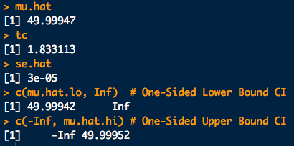
Another Exercise

Slide 14
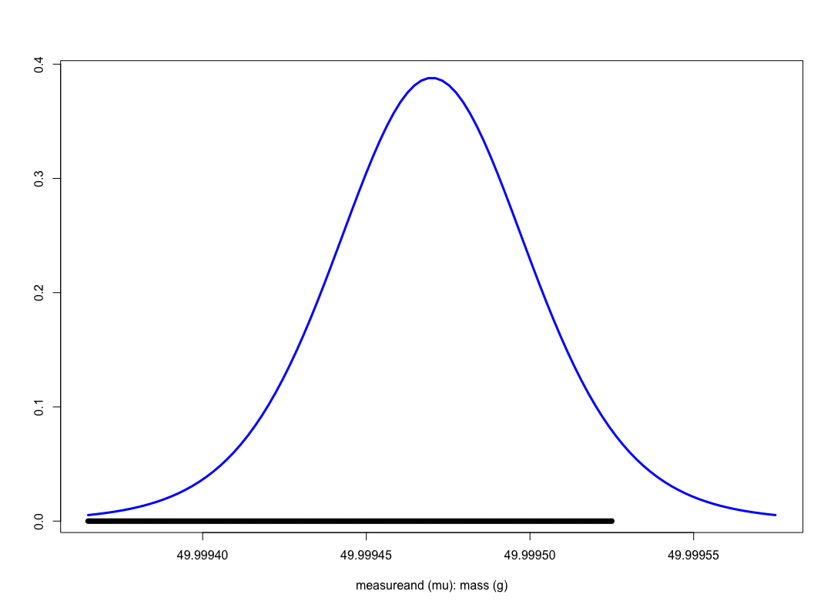
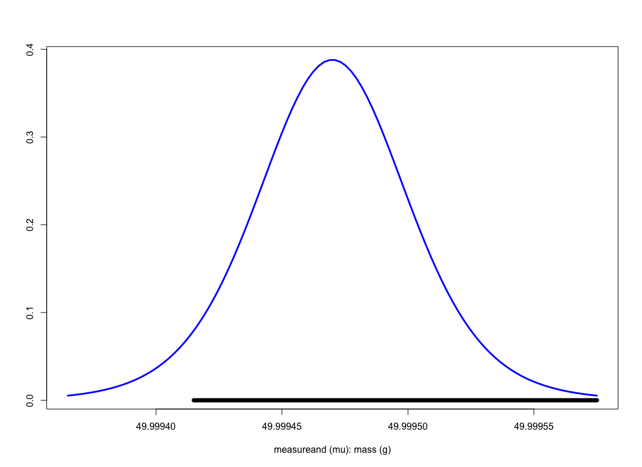
Another Exercise
49.99952
49.99942
95% Confidence
95% Confidence
One sided, upper bound
One sided, lower bound

