Slide 1
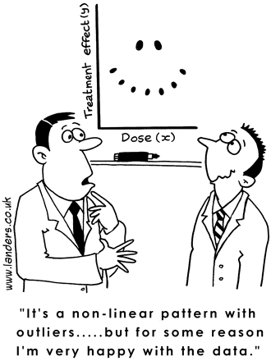
Linear Regression 1
Definitions and Theory

Slide 2
Basic Linear Regression
Remember the equation of a line:
As scientists, we find it an irresistible temptation to put a straight line though something that looks like it needs one…
How do we do this in a principled, systematic way??

Slide 3
Basic Linear Regression
Simple univariate linear model:
response variable
error
explanatory or predictor
variable
intercept
regression coefficients
In simple linear regression, error is assumed to be normally distributed with mean 0 and sd σ
Estimated from the data

Slide 4
Basic Linear Regression
y
x

