Slide 1
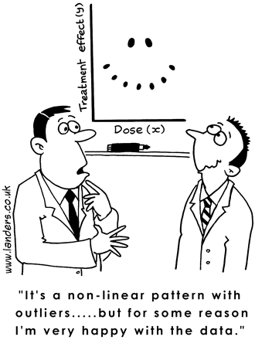
Linear Regression 2
Basic Fit Workflow

Slide 2
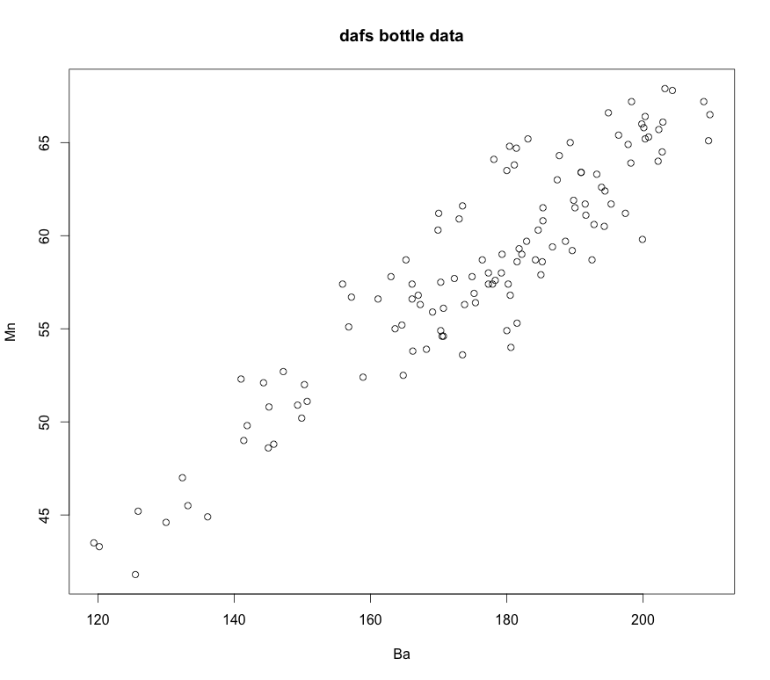
Basic Linear Regression

Slide 3
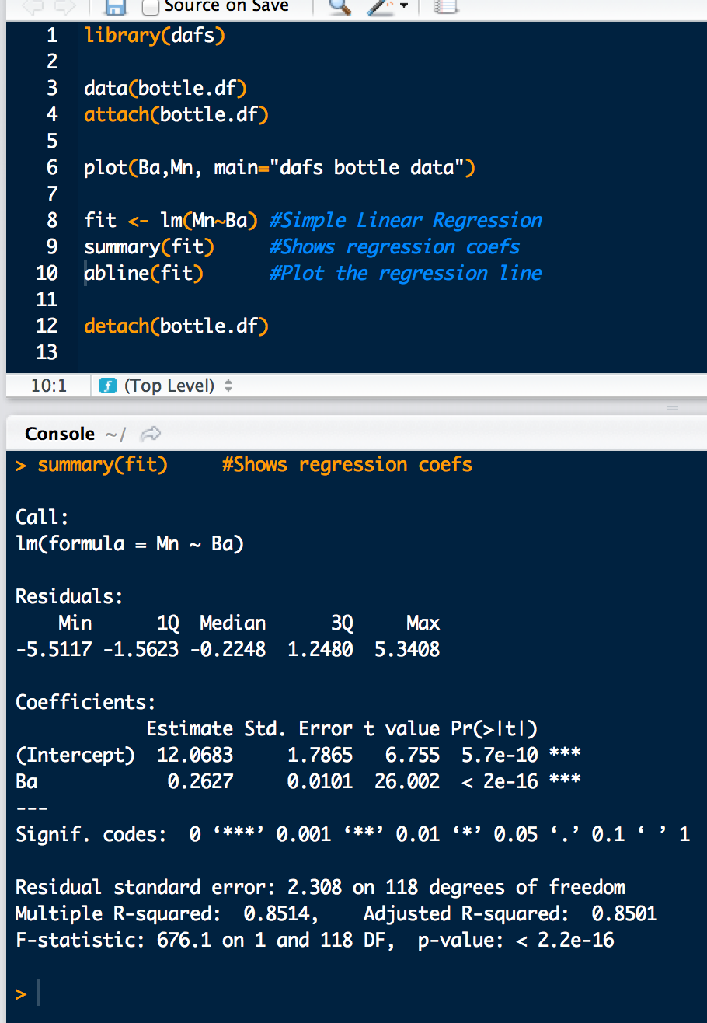
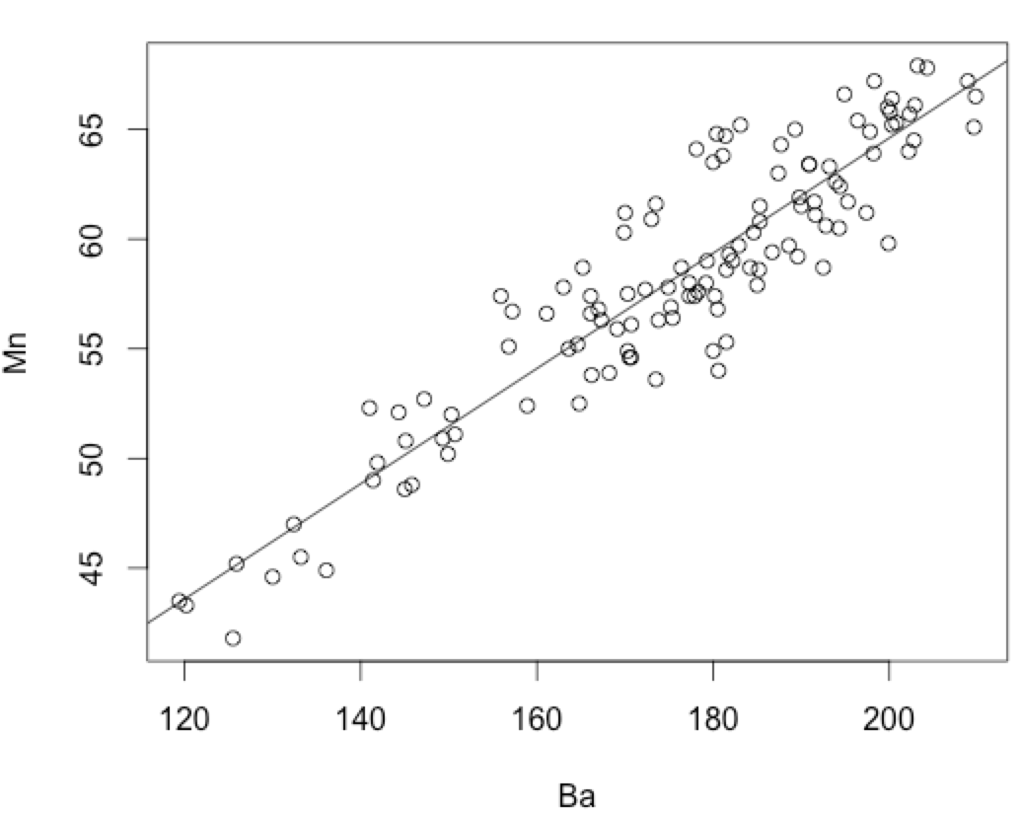
Basic Linear Regression
is significant =>keep it!
is significant =>keep it!

Slide 4
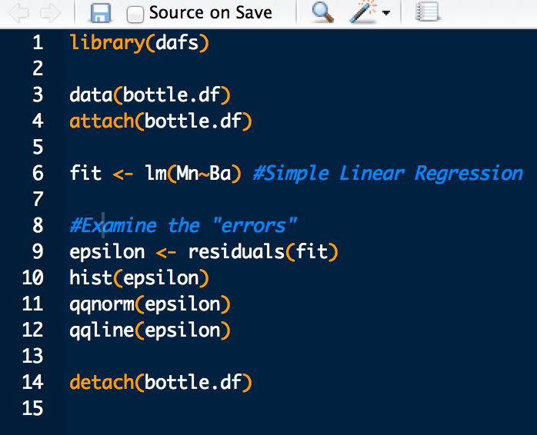
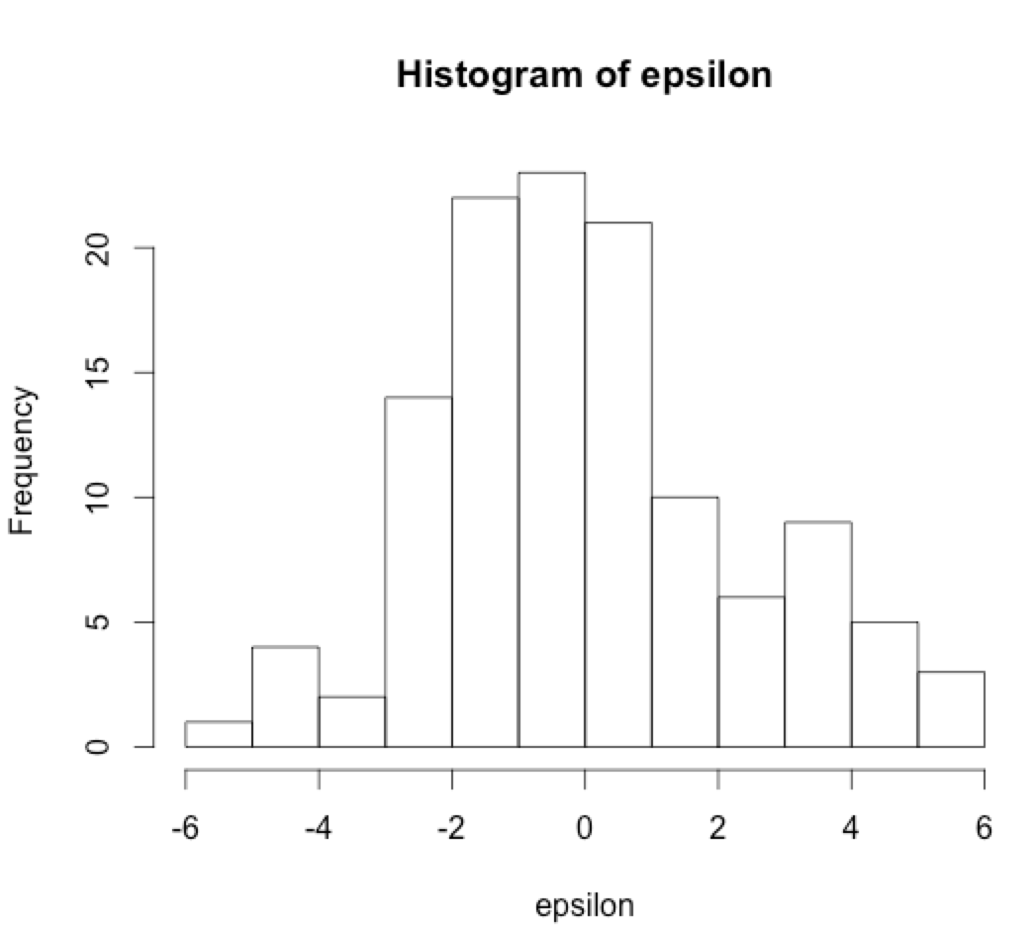
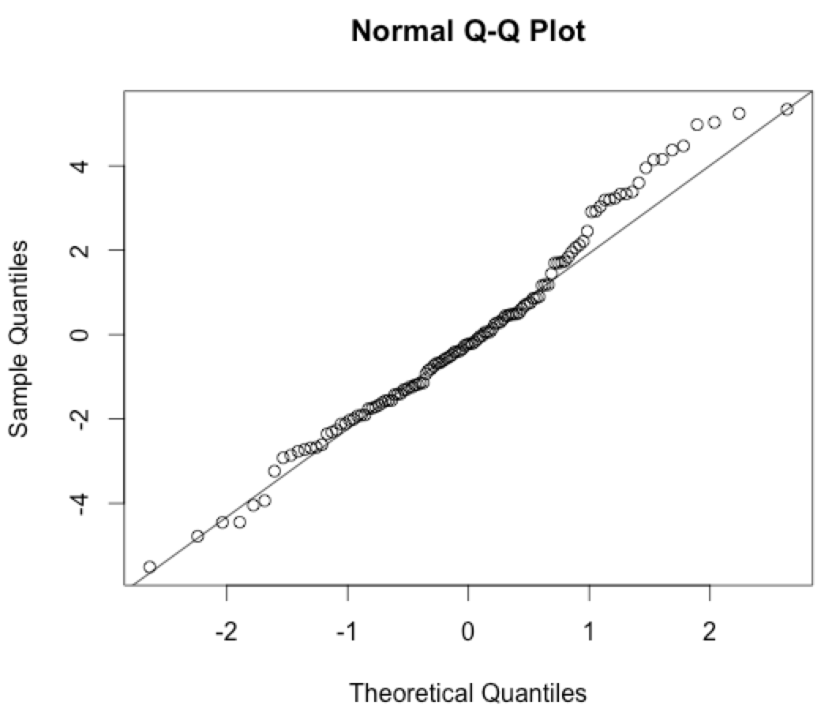
Basic Linear Regression
Look Gaussian?
Most of these fall in the line?

