Slide 1

Estimation 5: The Bootstrap

Slide 2
The Bootstrap
The Bootstrap is a technique to approximate a parameter’s sampling distribution.
Makes no assumption about the shape of the distribution
e.g. Doesn’t assume it’s a bell curve
Technique works for most parameters
Works well even with small-ish data sample sizes
Requires a computer to carry out

Slide 3
The Bootstrap
(Non-parametric) Bootstrapping starts with a single sample of data x of size n:
and re-samples (“bootstraps”) it many times, B
For each “bootstrap sample”, x*, compute your statistic of interest θ*
The collection of B θ*’s is the “bootstrap approximation” for the sampling distribution of θ.

Slide 4
Example
Consider the measurements of the length of a gun barrel (in):
18.449, 18.468, 18.431, 18.390, 18.450,
18.426, 18.401, 18.438, 18.431, 18.417
Find a bootstrap approximation for the sampling distribution of the mean
Find a bootstrap approximation for the sampling distribution of the median
Find a bootstrap approximation for the sampling distribution of the measurement standard deviation
Compute the bootstrap point estimates for the parameters and their standard errors

Slide 5
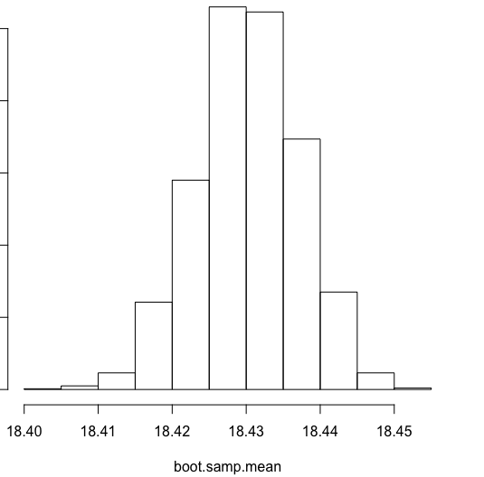
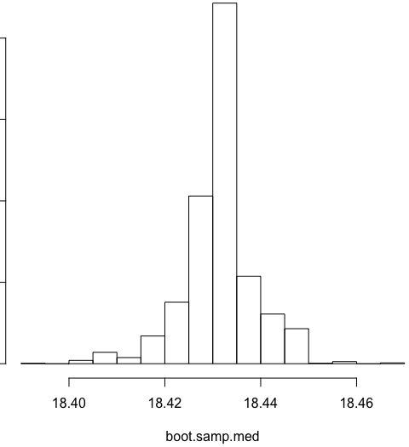
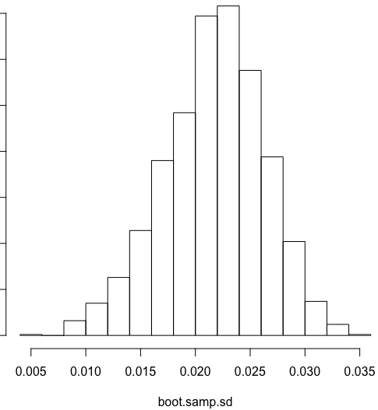
Example
# Length measurements (in):
x <- c(18.449, 18.468, 18.431, 18.390, 18.450,
18.426, 18.401, 18.438, 18.431, 18.417)
n <- length(x)
B <- 2000 # Do this many bootstrap iterations
# a.
boot.samp.mean <- sapply(1:B, function(xx){mean(sample(x, size = n, replace = T))})
hist(boot.samp.mean)
# b.
boot.samp.med <- sapply(1:B, function(xx){median(sample(x, size = n, replace = T))})
hist(boot.samp.med)
# c.
boot.samp.sd <- sapply(1:B, function(xx){sd(sample(x, size = n, replace = T))})
hist(boot.samp.sd)

Slide 6
The Bootstrap
The set of B bootstrap replications is an approximate sampling distribution for so:
Average all the together to get the bootstrap based point estimate for θ :
Compute the unbiased s.d. over all the to get the bootstrap based standard error estimate for :

Slide 7
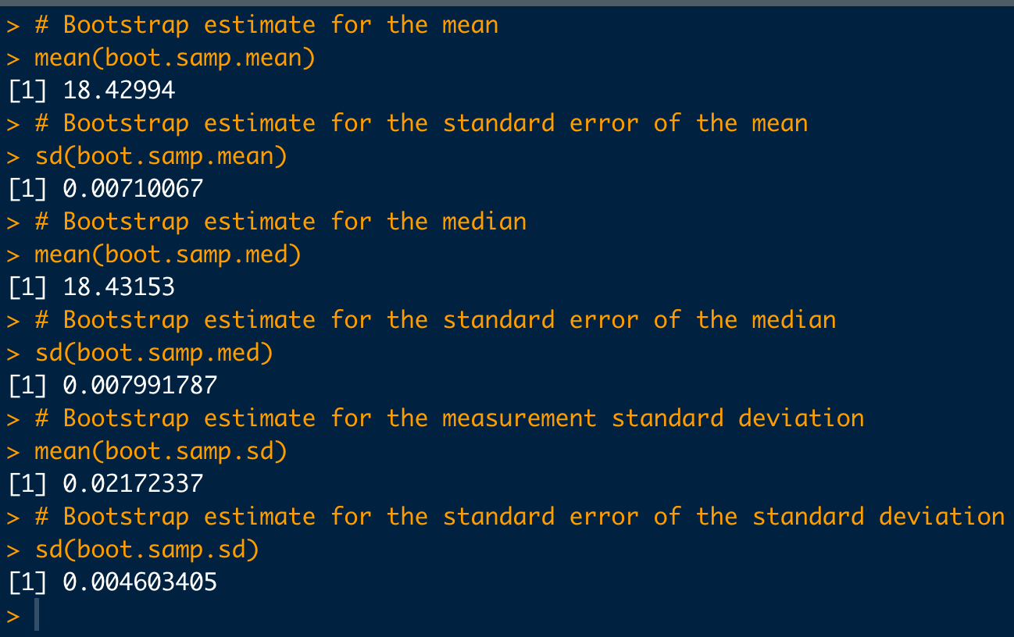
Example (con’t)
# d.
# Bootstrap estimate for the mean
mean(boot.samp.mean)
# Bootstrap estimate for the standard error of the mean
sd(boot.samp.mean)
# Bootstrap estimate for the median
mean(boot.samp.med)
# Bootstrap estimate for the standard error of the median
sd(boot.samp.med)
# Bootstrap estimate for the measurement standard deviation
mean(boot.samp.sd)
# Bootstrap estimate for the standard error of the standard
# deviation
sd(boot.samp.sd)

