Slide 1

Estimation

Slide 2

We Don’t Know Anything For Sure
PMFs and PDFs tell us about what to expect from data when we measure it, including how “uncertain” we are about our measurements but…
PMFs and PDFs depend on parameters that we don’t know.
All we really have is data…
We can’t make much use of PMFs or PDFs without values for their parameters, so what can we do??
Learn to read crystal balls??
The Telegraph 2009

Slide 3
We Don’t Know Anything For Sure
In the absence of having a functioning crystal ball, we can take two routes:
Assume the parameters are actual numbers that are fixed and exist, we just don’t know them
Leverage data we can actually measure to infer what their values may be as “best” we can
This is called frequentist inference, and comprises the most common approach.
Assume the parameters r.v.s just like data.
Assume a “prior” dist. which represents your “beliefs” about the parameters before you’ve seen data. Combine that with data to get “updated beliefs” about the parameters.
This is called Bayesian inference, and is generally much more difficult to carry out.

Slide 4
Parameter Estimation Methods
Estimator are functions of a sample of data, so they are properly called statistics. They are known as point estimates.
Think of f as an “algorithm” to approximate θ.
What choices of algorithms do we have to estimate θ ?
There are many…
Method of Moments
Maximum Likelihood Estimators
The plug-in principle
Bootstrapping
Bayes estimators

Slide 5
Maximum Likelihood Estimators
Say your data X_{i} follows some distribution with parameters θ:
Next say you get an independent and identically distributed (IID) sample of size n. The log likelihood of your sample is:
The θ which gives the maximum log likelihood is the “maximum likelihood estimator”:

Slide 6
Maximum Likelihood Estimators
Sometimes we can get closed form formulas for MLEs.
Luckily, one of the few times this happens is for the normal distribution:
MLE for mean of Gaussian data:
The sample average
MLE for sd of Gaussian data:

Slide 7
Maximum Likelihood Estimators
Sometimes we can get closed form formulas for MLEs.
For Bernoulli/Binomial distributed data and sample size n:
MLE for proportion:
For Poisson distributed data of sample size n:
MLE for mean counts:

Slide 8
Sampling Distributions
Because estimators are based on random samples, they are random variates just like data!
Estimators have distributions called sampling distributions
Say are interested in mean Mn mass contained in bullets manufactured at a particular factory
Lets use the average mass of Mn in a sample (of size n) to estimate the population mean mass:
What might the distribution of
look like if we take 1000 samples of
size 10 over the course of a week?

Slide 9
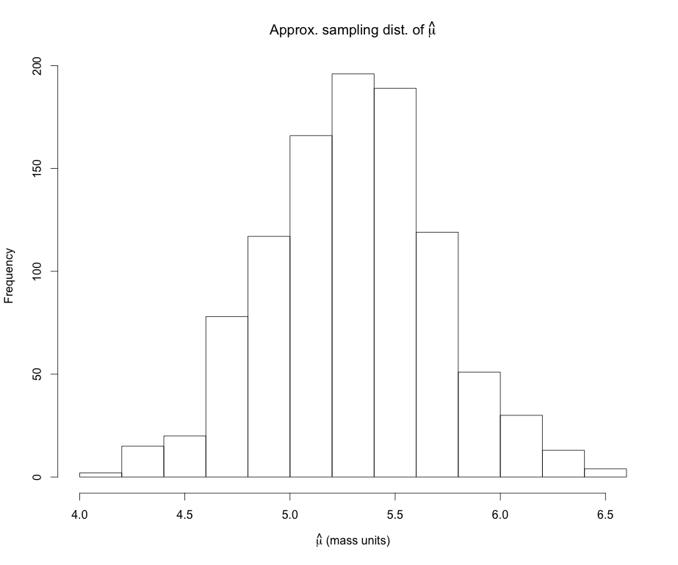
Sampling Distributions
Important features of an estimator’s sampling distribution:
(Approximate) sampling distribution of
Sampling dist mean:
Sample size, n = 10 bullets
Number of samples = 1000
Sampling dist s.d.:

Slide 10
Sampling Distributions
Uncertainty in the estimate can be represented as standard deviation for the sampling distribution:
is called the standard error of the estimator
Important case: The are good reasons to believe* that many typical laboratory measurements, X (e.g. mass) are approximately normally distributed with mean μ and s.d. σ
Then the average measurement in a sample of size n, is also normally distributed, mean μ but s.d.
Sampling distribution of an IID sample average

Slide 11
Sampling Distributions
Important case (con’t): Thus the uncertainty (standard error) in the sample average is:
This is important because a lot of what we do in science is take an average of measurements we make in the lab!
Since we usually don’t know σ_{X}, we estimate the standard error of the sample average by plugging in

Slide 12
Sampling Distributions
So, to recap, estimators for a parameter θ have:
A mean:
A s.d.
Called standard error. Can itself be estimated with plug-ins.
Ideally we want this to be as small as possible.
If
is called an unbiased estimator for θ
The bias for an estimator is thus:
Note: Depending on the situation, bias is not necessarily a bad thing…

Slide 13
Handy Unbiased Estimators
An unbiased estimator of the mean that we always use is:
Same as MLE estimate
An unbiased estimator of the variance (which we will typically use as a variance estimator) is:
Different from MLE estimate

Slide 14
Handy Unbiased Estimators
An unbiased estimator for a proportion is:
Heads, Success, etc, …
An unbiased estimator of the standard error of p is:

Slide 15
Example
The length of a shotgun barrel is measured with a ruler four times (units: in):
18.438, 18.440, 18.468, 18.437
Compute:
What is the measurand?
The sample mean:
The sample sd:
The estimated standard error of the mean:
Estimate the %relative standard measurement uncertainty^{GUM}
Sketch and label the approximate sampling distribution with the with the measureand’s estimate and standard uncertainty.

Slide 16
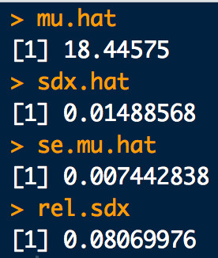
Example
# Data(Input values^GUM):
x <- c(18.438, 18.440, 18.468, 18.437)
# b. Sample average (measurand estimate^GUM):
mu.hat <- mean(x)
# c. Sample SD (standard measurement uncertainty^GUM):
sdx.hat <- sd(x)
# d. SE of sample average (measurand standard uncertainty^GUM):
se.mu.hat <- sd(x)/sqrt(4)
#e. %Relative SD (%Relative standard measurement uncertainty^GUM):
rel.sdx <- sdx.hat/mu.hat * 100

Slide 17
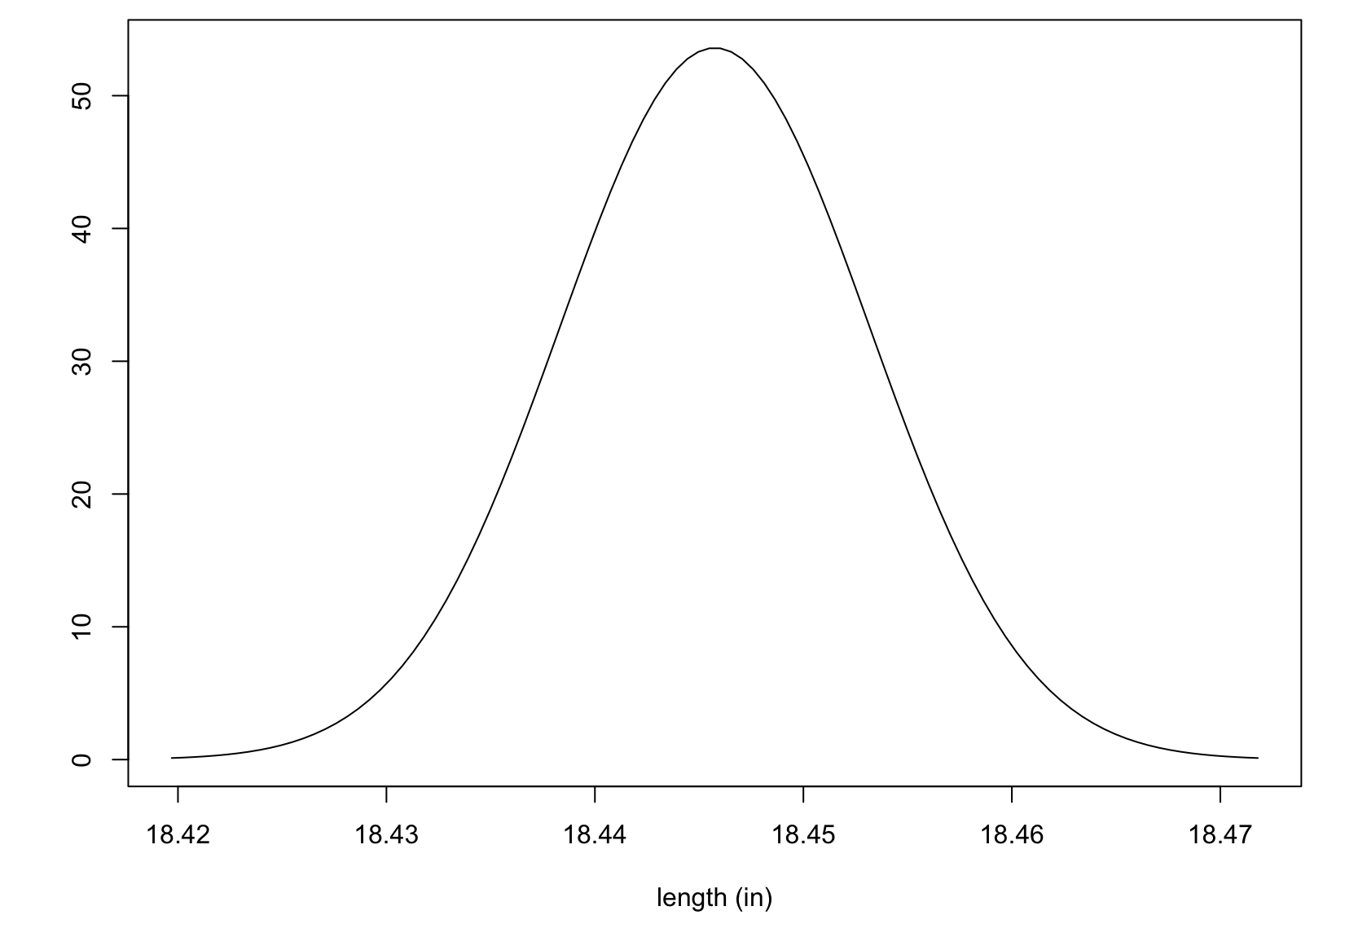
Example
Measurand’s (barrel length) approximate sampling distribution
f.
= 18.446 in
= ±0.007 in

Slide 18
The Bootstrap
Reality in lab work:
Sample sizes are often small
Parameters we may want estimates for don’t have a known or convenient sampling distribution
Reality in the 21st century:
Computers are powerful, cheap and plentiful!
The bootstrap is a computer based simulation method that can be used to estimate virtually any parameter along with a measure of its accuracy^{Efron}
Assumes nothing about the underlying data except that it is IID
Tends to give good estimates even for small sample sizes
Both handy properties for forensic applications

Slide 19
The Bootstrap
(Non-parametric) Bootstrapping starts with a sample of data x of size n:
and re-samples (“bootstraps”) it many times, B
For each “bootstrap sample”, x*, compute your statistic of interest θ*
The collection of B θ*’s is the “bootstrap approximation” for the sampling distribution of θ.

Slide 20
Example
Consider the measurements of the length of a gun barrel (in):
18.449, 18.468, 18.431, 18.390, 18.450,
18.426, 18.401, 18.438, 18.431, 18.417
Find a bootstrap approximation for the sampling distribution of the mean
Find a bootstrap approximation for the sampling distribution of the median
Find a bootstrap approximation for the sampling distribution of the measurement standard deviation

Slide 21
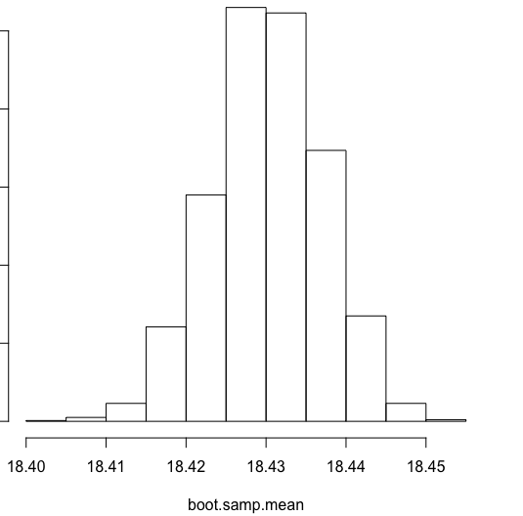
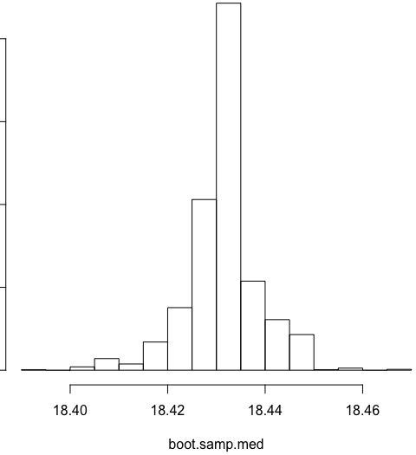
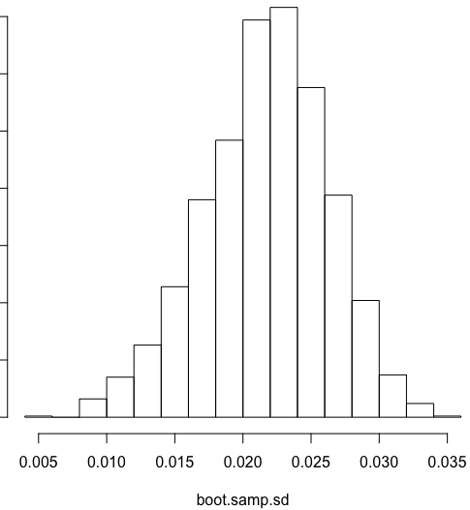
Example
# Length measurements (in):
x <- c(18.449, 18.468, 18.431, 18.390, 18.450,
18.426, 18.401, 18.438, 18.431, 18.417)
n <- length(x)
B <- 2000 # Do this many bootstrap iterations
boot.samp.mean <- sapply(1:B, function(xx){mean(sample(x, size = n, replace = T))})
hist(boot.samp.mean)
boot.samp.med <- sapply(1:B, function(xx){median(sample(x, size = n, replace = T))})
hist(boot.samp.med)
boot.samp.sd <- sapply(1:B, function(xx){sd(sample(x, size = n, replace = T))})
hist(boot.samp.sd)

Slide 22
The Bootstrap
The set of B bootstrap replications is an approximate sampling distribution for so:
Average all the together to get the bootstrap based point estimate for θ :
Compute the unbiased s.d. over all the to get the bootstrap based standard error estimate for :

Slide 23
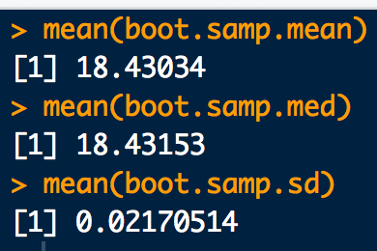
Example (con’t)
# Bootstrap estimate for the mean
mean(boot.samp.mean)
# Bootstrap estimate for the median
mean(boot.samp.med)
# Bootstrap estimate for the measurement standard deviation
mean(boot.samp.sd)

Slide 24
Example: Bootstrapping Fail
How would our last bootstrap algorithm be different for estimating the standard error of a sample max over a uniform distribution?
We will simulate some fake data from a uniform distribution with known min = 1 and known max = 3. The sample size will be n = 15.
1.891304, 2.909405, 1.417487, 1.386373, 1.070313, 1.031299, 2.010315, 2.537558, 1.424424, 2.286100, 1.385528, 1.608154, 1.102906, 2.753568, 1.010469

Slide 25
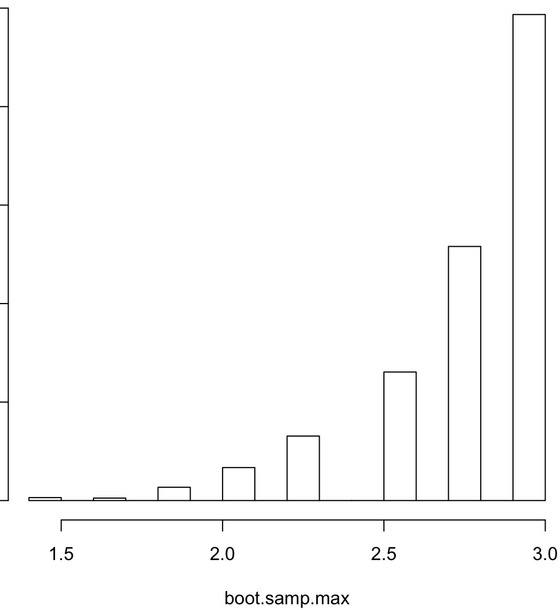

Example: Bootstrapping Fail
# Bootstrap fail:
x <- c(1.891304, 2.909405, 1.417487, 1.386373, 1.070313, 1.031299, 2.010315,
2.537558, 1.424424, 2.286100, 1.385528, 1.608154, 1.102906, 2.753568,
1.010469)
boot.samp.max <- sapply(1:B, function(i){max(sample(x, size = n, replace = T))})
hist(boot.samp.max)
If the histogram of bootstrap replications looks like this, the bootstrap didn’t work! Don’t use it!!

Slide 26
The Bootstrap Bias Correction
Bias is also an measure of estimator accuracy that typically comes up when comparing data produced by a methodology to a reference standard:
Mean of the sampling dist. For the estimator of θ.
If we have a reference standard (i.e. a CRM) we can plug it in here
If the bootstrap must be used to estimate θ (e.g. the sampling dist. of is unknown), and θ is available then just plug in for
θ known!

Slide 27

Example: Bias with the bootstrap and known
A CRM solution of 150ng/mL Oxycodone in blood is used to assess the bias of a Laboratory’s SOP for concentration determination. 15 assay runs are conducted under the same conditions with the following data recorded (ng/mL):
117.7, 97.6, 147.4, 139.6, 135.5, 130.8, 141.0, 137.6, 115.0, 134.0, 122.3, 148.0, 121.6, 132.5, 119.8
Compute the MLE, unbiased and bootstrap estimates for:
average concentration
s.d. concentration
s.e. of the average concentration
bias

Slide 28
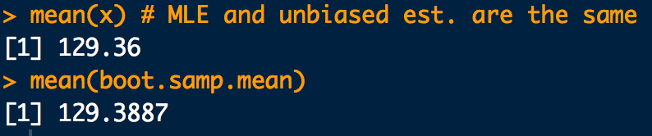
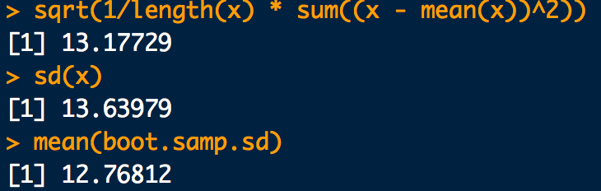
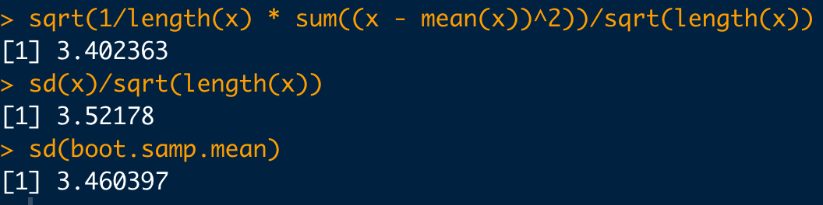

Example: Bias with the bootstrap and known
x <- c(117.7, 97.6, 147.4, 139.6, 135.5, 130.8, 141.0,
137.6, 115.0, 134.0, 122.3, 148.0, 121.6, 132.5, 119.8)
n <- length(x)
B <- 2000
#a. MLE, unbiased and bootstrap estimates for average concentration
mean(x) # MLE and unbiased est. are the same
boot.samp.mean <- sapply(1:B, function(i){mean(sample(x, size = n, replace = T))})
mean(boot.samp.mean)
#b. MLE, unbiased and bootstrap estimates for s.d. concentration
sqrt(1/length(x) * sum((x - mean(x))^2))
sd(x)
boot.samp.sd <- sapply(1:B, function(i){sd(sample(x, size = n, replace = T))})
mean(boot.samp.sd)
#c. MLE, unbiased and bootstrap estimates for s.e. of the average concentration
# Thanks for the fix HelenJ!
sqrt(1/length(x) * sum((x - mean(x))^2))/sqrt(length(x))
sd(x)/sqrt(length(x))
sd(boot.samp.mean)
#d. Bootstrap estimates for bias
mean(boot.samp.mean) - 150

