Slide 1
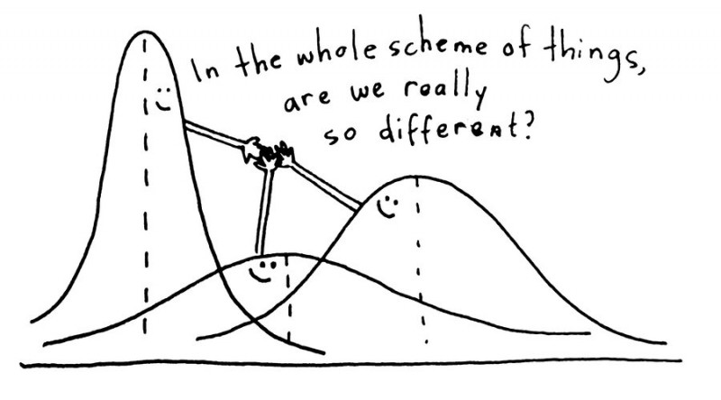
Analysis of Variance 1
Credit: https://www.questionpro.com/blog/anova-testing/
Definitions and Theory

Slide 2
Analysis of Variance
Standard hypothesis testing is great for comparing parameter estimates for one or two samples, θ₁ and θ₂.
What is we have more than two statistics to compare?
Use “one-way” analysis of variance (ANOVA)
Note that the statistics to be compared must all be of the same type
Usually the statistics we want to “compare” in the sciences are averages between different treatments

Slide 3
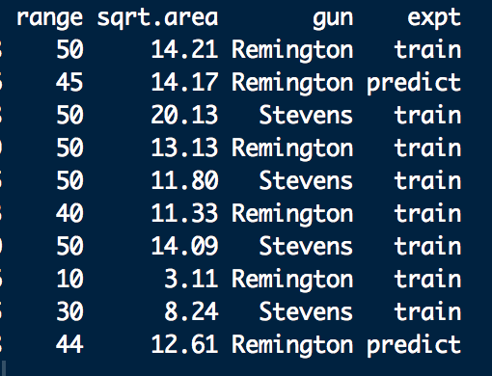
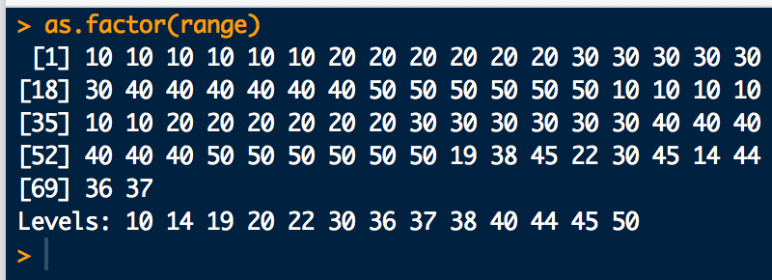
Analysis of Variance
Experiment: understand how inputs (explanatory variables) affect outputs (responses)
Treatments: the input variables.
Typically, discrete factors with a finite number of levels
dafs shotgun.df
“gun” is a factor with levels: Remington
Stevens
“range” is a factor with levels:

Slide 4
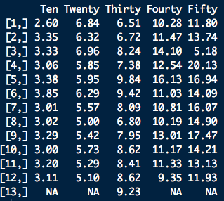

Analysis of Variance
“range” is the treatment
Index is i, column number in this case
# replicates per treatment is 12 or 13
Index is j, row number in this case
we’ll want to see if these are “statistically” the same or if there is evidence that they are different

Slide 5
Analysis of Variance
H₀ for “means” ANOVA
The treatment means being compared are not statistically different at the (1-α)×100% level of confidence
H_{a} for “means” ANOVA
At least one of the treatment means being compared is statically distinct from the others.
ANOVA computes an F-statistic from the data
The F-statistic is the ratio of the mean “variation” between samples (MSB), to the mean “variation” within samples, (MSW)

Slide 6
Analysis of Variance: Calculation
A nice way to organize the calculations is with an ANOVA table:
Sources | Degrees of Freedom | Sum Squares | Mean Sum Squares | F-statistic | p-value
Treatments | k-1 | SSB | MSB = SSB/(k-1) | F = MSB/MSW | 1 - pf(F, k-1, n-k)
Error | n-k | SSW | MSW = SSW/(n-k)
Total | n-1 | SST

