Slide 1
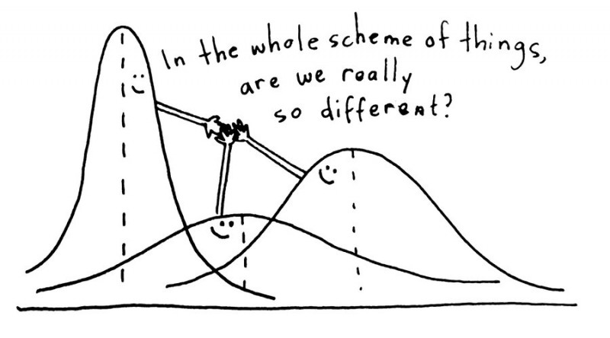
Analysis of Variance 3
Credit: https://www.questionpro.com/blog/anova-testing/
Post Hoc Testing

Slide 2
Post Hoc Testing
If ANOVA returns a significant result, it makes sense to ask which means may be statistically different than the rest.
A way to accomplish this is to do pair-wise hypothesis tests on all pairs of treatment averages to see if the Null (μ_{A}-μ_{B} = 0) may be rejected.
The problem is, using regular t-tests the probability of falsely rejecting the Null is α.
For n-treatments there are _{n}C₂ pair-wise t-tests to perform, so the our level of confidence in _{n}C₂ simultaneous t-tests is at-least:
For 5-treatments, our overall confidence in all 10, 95% confidence t-tests would only be (at-least):

Slide 3
Post Hoc Testing
We could compensate for the problem by performing each t-test at the 1-α/_{n}C₂ confidence level. (the Bonferroni correction)
This typically leads to unreasonable false negative reject rate
Something else we could do is use a test statistic which compensates well for the fact that we are doing simultaneous hypothesis tests (Tukey HSD)
p-values can be obtained with ptukey(q^{Tukey}, k, n-k), but TukeyHSD packages up the whole calculation in an easy to use function.

Slide 4
Another Tukey HSD Example
# Here is the GSR experiment data again. Lets reload the data first
y <- c(
2.60,3.35,3.33,3.06,3.38,3.85,3.01,3.02,3.29,3.00,3.20,3.11,
6.84,6.32,6.96,5.85,5.95,6.29,5.57,5.00,5.42,5.73,5.29,5.10,
6.51,6.72,8.24,7.38,9.84,9.42,8.09,6.80,7.95,8.62,8.41,8.62,9.23,
10.28,11.47,14.10,12.54,16.13,11.03,10.81,10.19,13.01,11.17,11.33,9.35,
11.80,13.74, 5.18,20.13,16.94,14.09,16.07,14.90,17.47,14.21,13.13,11.93
)
# Treatment labels for each data point
lbl.treat <- c(
10, 10, 10, 10, 10, 10, 10, 10, 10, 10, 10, 10,
20, 20, 20, 20, 20, 20, 20, 20, 20, 20, 20, 20,
30, 30, 30, 30, 30, 30, 30, 30, 30, 30, 30, 30, 30,
40, 40, 40, 40, 40, 40, 40, 40, 40, 40, 40, 40,
50, 50, 50, 50, 50, 50, 50, 50, 50, 50, 50, 50
)
# Do the ANOVA first:
fit <- aov(y ~ as.factor(lbl.treat))
summary(fit)

Slide 5
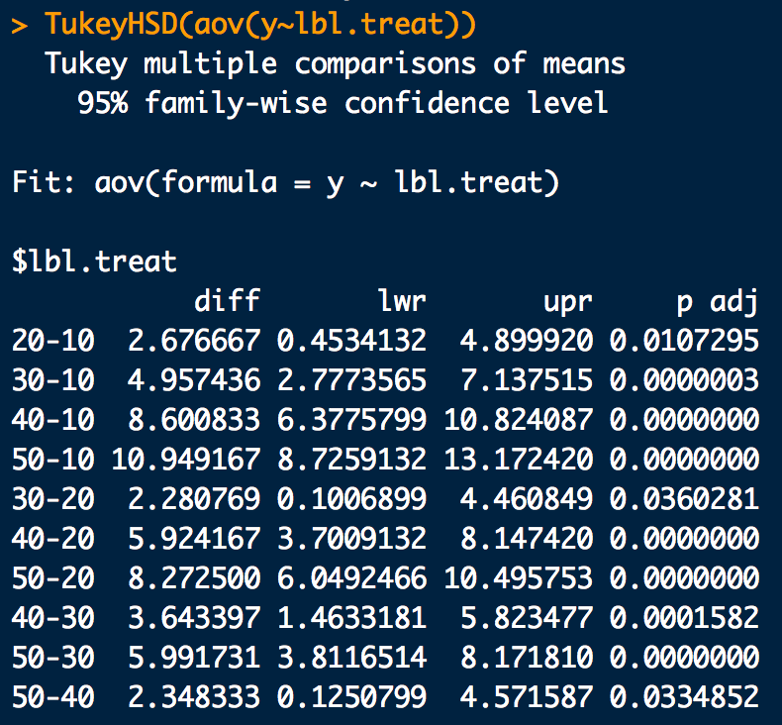
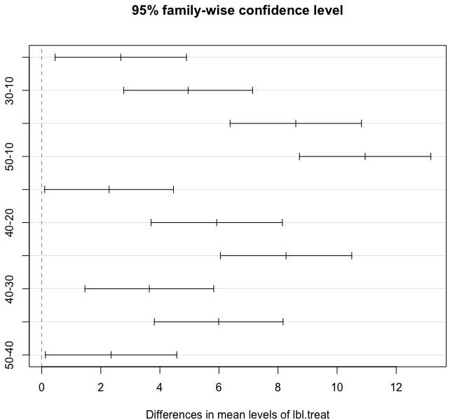
Another Tukey HSD Example
# Find a significant result from ANOVA? Do a Tukey HSD:
fit.tukey <- TukeyHSD(fit)
fit.tukey # Tukey test outputs
plot(fit.tukey) # Graphical version

