Slide 1
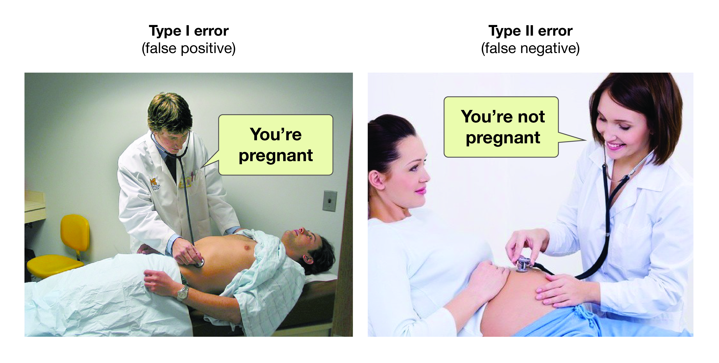
Hypothesis Testing 1
https://opentextbc.ca/researchmethods/
Definitions and Theory

Slide 2
The Basic Idea of Hypothesis Testing
A private tox lab is contracted to check an agency’s employees blood levels for Heroin.
The agency has a policy that if a mean level greater than 3 nM are detected the employee is subject to summary dismissal and potential prosecution.
Because estimates for the mean concentration can vary from sample to sample, we want to be 95% confident
After extensive QC (quality control), the agency establishes that the sample size should be 20 and that an acceptable specification for the uncertainty in the concentration determination is σ_{X} = 0.5 nM.
Question: Assuming the (mean) concentration of Heroin in an employee’s blood is less than or equal to 3 nM, can we detect evidence in a sample to reject this assumption?
Mathematically: Assume H₀: μ ≤ 3 nM
Is there evidence in a sample to reject this hypothesis?

Slide 3
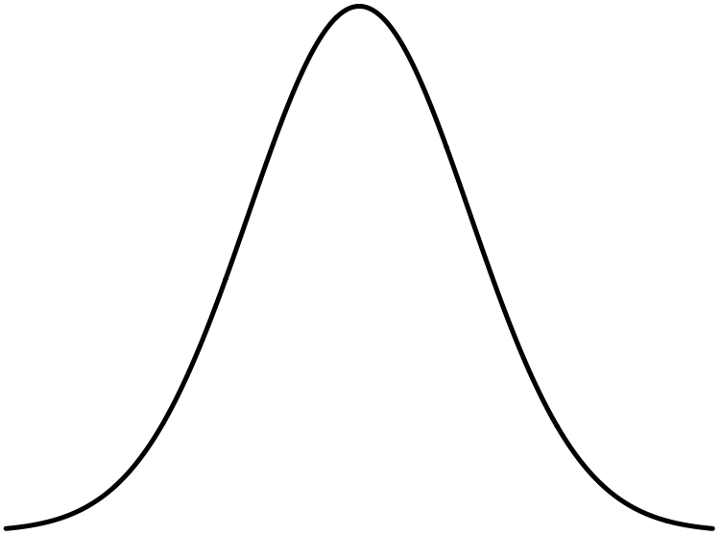
The Basic Idea of Hypothesis Testing
Sampling distribution for a known mean μ and known sd σ_{μ}= is:
Area from -∞ to 1.6 σ_{μ} is 95%
So: IF the mean conc is really less than 3 nM, then we could (95%) plausibly measure it up to here
Obtain a sample:
Measure the conc. 20 times
95% right-CI for H₀: μ ≤ 3 nM
1.6 σ_{μ}
Compute sample average:
μ = 3 nM
Is the employee in trouble????

Slide 4
Hypothesis Testing
A hypothesis is an assumption about a parameter.
Form a hypothesis about the parameter
H₀, the null hypothesis: What we are “assuming” about the parameter. Typically:
Identify the alternative hypothesis, H_{a}
What we want to “prove”
Not really prove, but “reject the Null in favor of”

Slide 5
Hypothesis Testing
So there are two outcomes for a hypothesis test:
“Cannot Reject” H₀ or
“Reject” H₀ in favor of H_{a}
The outcome is quoted at a state level of confidence: (1-α)×100%
The procedure uses the sampling distribution of the parameter as the Null to see if the value of (i.e. the value you measure) is “unlikely” if the Null is true.
“Unlikely” is measured by a p-value for

Slide 6
Hypothesis Testing
Sampling distribution for
The “Null distribution”
p-value is this area.
If p-value is > α, it’s “big”: Don’t reject H₀
It’s “big”, so is “likely” if the Null is true
If p-value is < α, it’s “small”: Reject H₀ in favor of H_{a}
p-value is this area.
It’s “small”, so is “unlikely” if the Null is true.
Get a data set and compute . It falls here.
Get a data set and compute . It falls here.
We will use t.test() and prop.test() to take care of the whole process

Slide 7
Hypothesis Testing
Hypothesis testing can go wrong:
1-β is called test’s power
 | H₀ is really true | H₀ is really false
Test rejects H₀ | Type I error. Probability is α | OK
Test accepts H₀ | OK | Type II error. Probability is β

