Slide 1
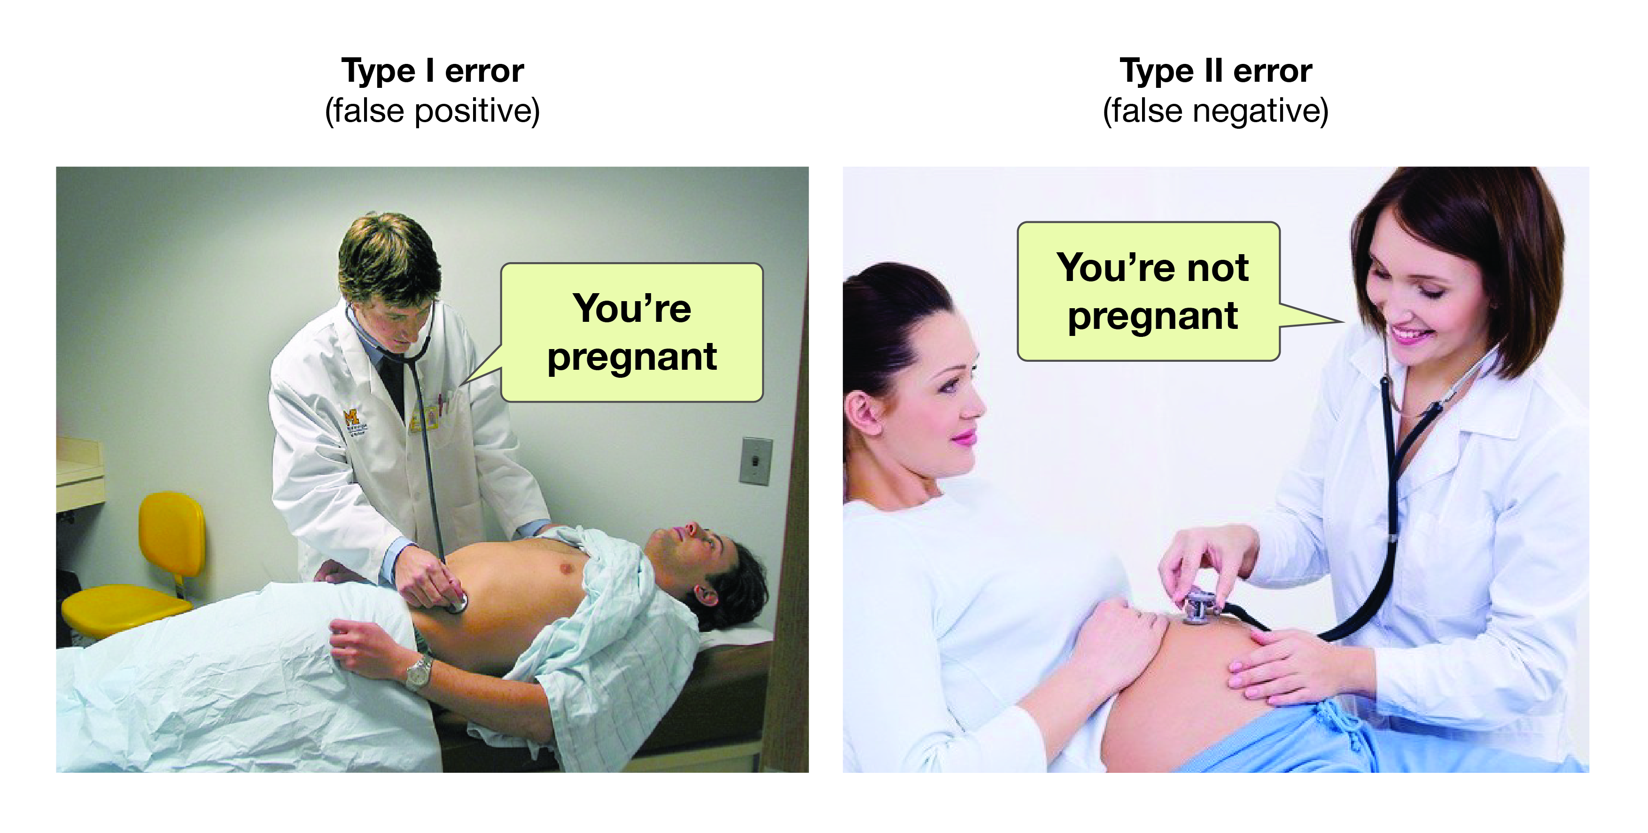
Hypothesis Testing 2
https://opentextbc.ca/researchmethods/
One Sample Hypothesis Test for Mean

Slide 2
Example: One Sample Hypothesis Testing for the Mean
Consider again the case of Mr. B. Mayhew with seizure mass (in grams) measurements of:
49.9996, 49.9994, 49.9993, 49.9996, 49.9995, 49.9995,49.9995, 49.9994, 49.9995, 49.9994
Do a 95% confidence hypothesis test to test if μ_{mass} ≠ 50.000g (H_{a}).
Do a 95% confidence hypothesis test to test if μ_{mass} < 50.000g (H_{a}).
Do a 95% confidence hypothesis test to test if μ_{mass} > 50.000g (H_{a}).

Slide 3
Example: One Sample Hypothesis Testing for the Mean
# Question of interest: Is the mean mass == 50.000g ?
x <- c(49.9996,49.9994,49.9993,49.9996,49.9995,49.9995,49.9995,49.9994,49.9995,49.9994)
mean(x)
# NULL HYPOTHESIS: mu == 50.000g
# ALTERNATIVE HYPOTHESIS: mu != 50.000g
t.test(x, alternative = "two.sided", mu = 50.000, conf.level = 0.95)
# The meaning of the output for t.test:
# Can we REJECT the NULL HYPOTHESIS? => Is there evidence that the mean mass is not equal to 50.000g?
# p-value = 2.704e-08
#
# So p < 0.05. REJECT the NULL HYPOTHESIS. The data is "unlikely" under the null.
# Another interperitation: If the Null were true, we wouldn't see data like this too often.
# BUT: We CANNOT SAY that the data is more likely under the Alternative hypothesis.
# 95 percent confidence interval:
# 49.99940 49.99954
# This means: given your sample, a set of plausible values for the mean is [49.99940 49.99954], with 95% "plausibility”
Η₀: μ_{mass} = 50.000g
Η_{a}: μ_{mass} ≠ 50.000g

Slide 4
Example: One Sample Hypothesis Testing for the Mean
# Question of interest: Is there evidence that the mean mass is less than 50.000g ?
x <- c(49.9996,49.9994,49.9993,49.9996,49.9995,49.9995,49.9995,49.9994,49.9995,49.9994)
mean(x)
# NULL HYPOTHESIS: mu >= 50.000g
# ALTERNATIVE HYPOTHESIS: mu < 50.000g
t.test(x, alternative = "less", mu = 50.000, conf.level = 0.95)
# The meaning of the output for t.test:
# Can we REJECT the NULL HYPOTHESIS? => Is there evidence that the mean mass is less than 50.000g?
# p-value = 1.352e-08
# So p < 0.05. REJECT the NULL HYPOTHESIS. The data is "unlikely" under the null.
# Another interperitation: If the Null were true, we wouldn't see data like this too often.
# BUT: We CANNOT SAY that the data is more likely under the Alternative hypothesis.
# 95 percent confidence interval:
# -Inf 49.99952
# This means: given your sample, the GREATEST value the mean could be is 49.99952, with 95% "plausibility"
Η₀: μ_{mass} ≥ 50.000g
Η_{a}: μ_{mass} < 50.000g

Slide 5
Example: One Sample Hypothesis Testing for the Mean
# Question of interest: Is there evidence that the mean mass is greater than or equal to 50.000g ?
x <- c(49.9996,49.9994,49.9993,49.9996,49.9995,49.9995,49.9995,49.9994,49.9995,49.9994)
mean(x)
# NULL HYPOTHESIS: mu <= 50.000g Assumes the opposite of what you seek evidence for.
# ALTERNATIVE HYPOTHESIS: mu > 50.000g
t.test(x, alternative = "greater", mu = 50.000, conf.level = 0.95)
# The meaning of the output for t.test:
# Can we REJECT the NULL HYPOTHESIS? => Is there evidence that the mean mass is greater than 50.000g?
# p-value = 1 (Wow!)
# So p is not < 0.05. CANNOT REJECT the NULL HYPOTHESIS. The data is "likely" under the null.
# Another interperitation: If the Null were true, we would see data like this often.
# 95 percent confidence interval:
# 49.99942 Inf
# This means: given your sample, the LEAST value the mean could be is 49.99942, with 95% "plausibility”
Η₀: μ_{mass} ≤ 50.000g
Η_{a}: μ_{mass} > 50.000g

