Slide 1
Interval Estimation 4
Bootstrap Confidence Intervals

Slide 2
Bootstrap Confidence Intervals
So how do we compute a (1 − α)×100% confidence interval given a set of data??
For any parameter, you can try to obtain bootstrap based CIs
For a sample of size n:
Obtain a bootstrap sampling distribution for θ: boot.reps
Find the (1 − α)×100% empirical percentiles:
quantile(boot.reps, probs=c(a/2, 1-a/2))
Two sided
quantile(boot.reps, probs=c(a))
One sided, lower bound
quantile(boot.reps, probs=c(1-a))
One sided, upper bound

Slide 3
Example: Bootstrap Confidence Intervals
Consider again the case of Mr. B. Mayhew with seizure mass measurements of:
49.9996g
49.9994g
49.9993g
49.9996g
49.9995g
49.9995g
49.9995g
49.9994g
49.9995g
49.9994g
Compute the mean mass estimate via the bootstrap.
What is your bootstrap standard error estimate for the estimated mean?
Compute the two-sided 99% CI for the mean mass via the bootstrap.
Compute the one-sided lower bound 99% CI for the mean mass via the bootstrap.
Compute the one-sided upper bound 99% CI for the mean mass via the bootstrap.

Slide 4
Example: Bootstrap Confidence Intervals
# The data:
x <- c(49.9996,49.9994,49.9993,49.9996,49.9995,49.9995,49.9995,49.9994,49.9995,49.9994)
n <- length(x) # Sample size
# Approximate sampling distribution of the mean via the bootstrap:
B <- 2000
boot.samp <- sapply(1:B, function(xx){mean(sample(x, size = n, replace = T))})
hist(boot.samp)
# a. Boostrap estimate of the mean:
mean(boot.samp)
# b. Bootstrap estimate of the standard error of the mean
sd(boot.samp)
# c. Two-sided 99% CI for the mean mass via the bootstrap:
conf <- 0.99
a <- 1 - conf
quantile(boot.samp, probs=c(a/2, 1-a/2))
# One-sided lower bound 99% CI for the mean mass via the bootstrap.
conf <- 0.99
a <- 1 - conf
quantile(boot.samp, probs=c(a))
# One-sided lower bound 99% CI for the mean mass via the bootstrap.
conf <- 0.99
a <- 1 - conf
quantile(boot.samp, probs=c(1 - a))

Slide 5
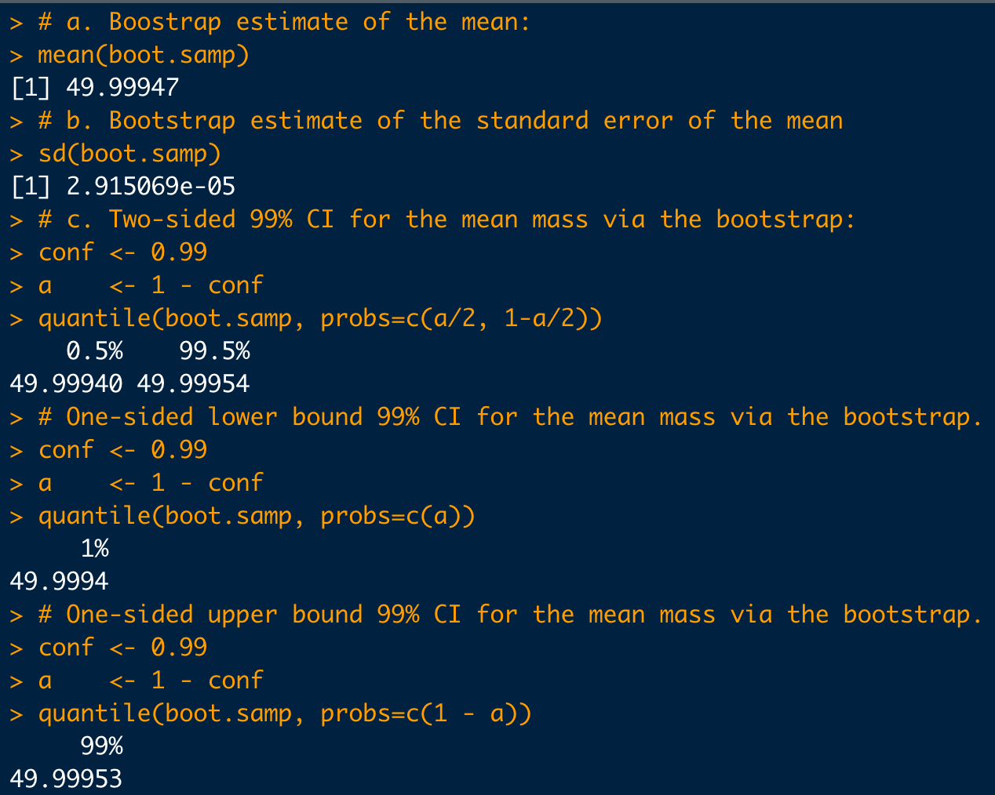
Example: Bootstrap Confidence Intervals

