Slide 1

Summarizing Data
Osborn

Slide 2
Measures of Central Tendency
Given a sample from some population:
What is a good “summary” value which well describes the sample?
We will look at:
Average (arithmetic mean)
Median
Mode
For reference see (available on-line):
“The Dynamic Character of Disguised Behaviour for Text-based, Mixed and Stylized Signatures”
LA Mohammed, B Found, M Caligiuri and D Rogers
J Forensic Sci 56(1),S136-S141 (2011)

Slide 3
Histogram Points of Interest
Velocity for the first segment of genuine signatures in (soon to be classic) Mohammed et al. study.
What is a good summary number?
“Central Tendency”
How spread out is the data?

Slide 4
Measures of Central Tendency
Arithmetic sample mean (average):
The sum of data divided by number of observations:
intuitive formula
fancy formula

Slide 5

Measures of Central Tendency
Example from L.A.M. study:
Compute the average absolute size of segment 1 for the genuine signature of subject 2:
Subj. 2; Gen; Seg. 1 | Absolute Size (cm)
1 | 0.0548
2 | 0.2951
3 | 0.1026
4 | 0.1005
5 | 0.2491
6 | 0.1287
7 | 0.0496
8 | 0.2299
9 | 0.256
10 | 0.0538
x <- c(0.0548,0.2951,0.1026,0.1005,0.2491,
0.1287,0.0496,0.2299,0.256,0.0538)
mean(x)

Slide 6
Measures of Central Tendency
Example:
More useful: Consider again Absolute Average Velocity for Genuine Signatures across all writers in the LAM study:
92 subjects × 10 measurements/subject = 920 velocity measurements
Average Absolute Average Velocity:

Slide 7
Measures of Central Tendency
Sample median:
Ordering the n pieces of data from smallest value to largest value, the median is the “middle value”:
If n is odd, median is largest data point.
If n is even, median is average of and largest data points.

Slide 8

Measures of Central Tendency
Example from L.A.M. study:
Compute the median absolute size of segment 1 for the genuine signature of subject 2:
Subj. 2; Gen; Seg. 1 | Absolute Size (cm)
1 | 0.0548
2 | 0.2951
3 | 0.1026
4 | 0.1005
5 | 0.2491
6 | 0.1287
7 | 0.0496
8 | 0.2299
9 | 0.256
10 | 0.0538
Ordered
0.0496 0.0538 0.0548 0.1005 0.1026 0.1287 0.2299 0.2491 0.2560 0.2951

Slide 9
Measures of Central Tendency
Example:
Median of Average Absolute Velocity for Genuine Signatures, LAM:
Avg

Slide 10


Measures of Central Tendency
Sample mode:
Needs careful definition but basically:
The data value that occurs the most
Tabulate the data and see which value(s) occur the most:
Sample:
mode

Slide 11
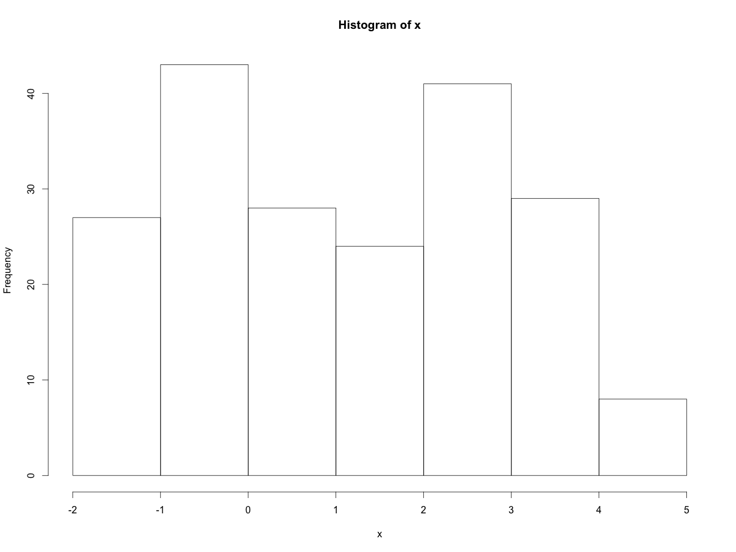
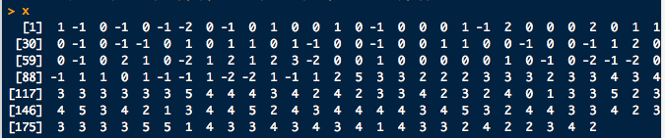

Measures of Central Tendency
Sample mode:
Computing modes can get tricky if there are more than one (multi-modal)
Sample:
modes…

Slide 12
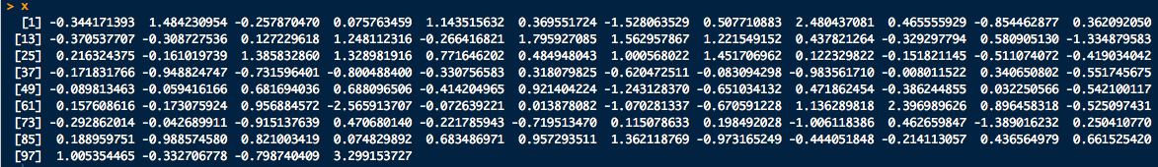
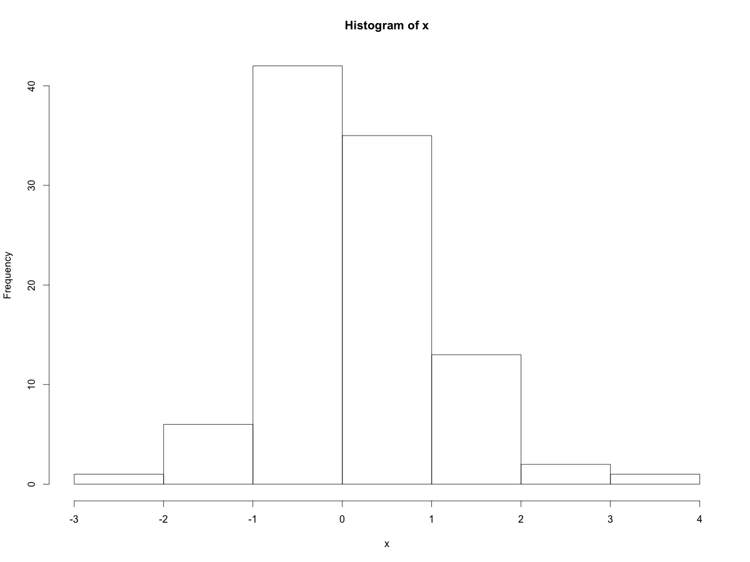
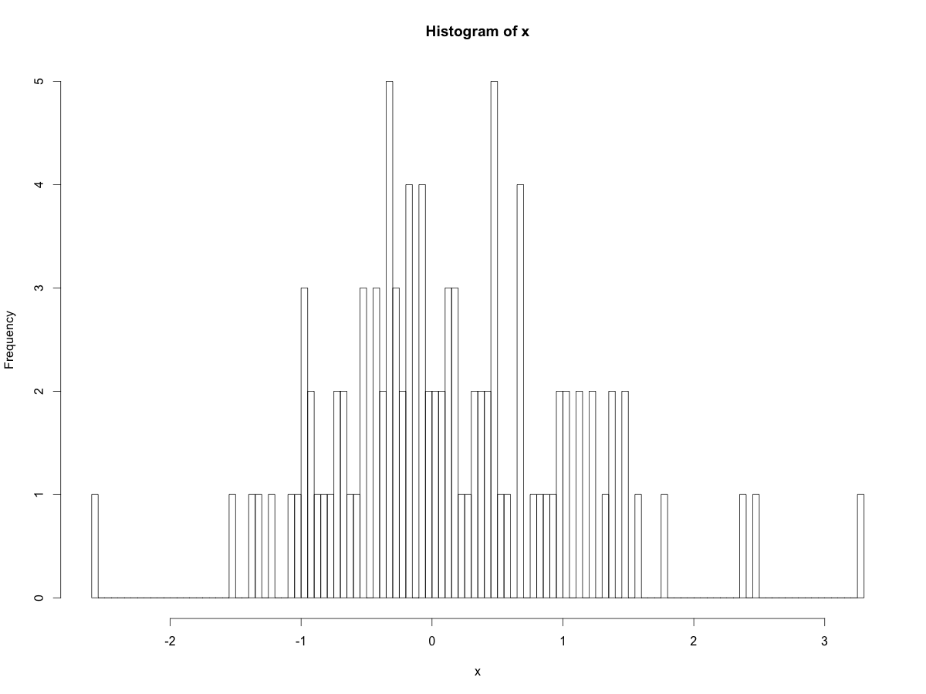
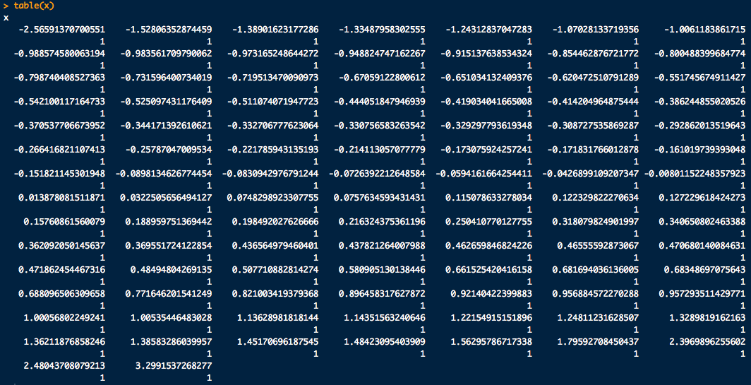
Measures of Central Tendency
Sample mode:
What’s the mode here?
Sample:

Slide 13
Measures of Central Tendency
Sample mode:
Mode of Average Absolute Velocity for Genuine Signatures, LAM:
mode = 9.2541
Med
Avg

Slide 14
Measures of Central Tendency
Some trivia:
Modes
Mean
Nice and symmetric:
Mean = Median = Mode

Slide 15
Measures of Data Spread
Sample variance:
(Almost) the average of squared deviations from the sample mean.
there are n data points
sample mean
data point i
Standard deviation is
The sample average and standard dev. are the most common measures of central tendency and spread
Sample average and standard dev have the same units

Slide 16
Measures of Data Spread
Standard deviation is “instructive” to do by hand a few times:
Compute the standard deviation of the following blood alcohol volumes assayed in 10 samples of 10 μL of blood drawn from a drunk driving suspect:
7.97 nL, 7.80 nL, 7.79 nL, 8.12 nL, 8.12 nL, 8.22 nL, 8.03 nL, 7.97 nL, 7.88 nL, 8.08 nL
To prevent writers cramp:
sd(c(7.97, 7.80, 7.79, 8.12, 8.12, 8.22, 8.03, 7.97, 7.88, 8.08))

Slide 17
Uncertainty
Current national effort to standardize procedures, quantification of uncertainty and conclusions used in Forensic Science and Digital Forensics
Efforts WILL EFFECT YOU
Two major bodies currently writing draft policy:
The National Commission on Forensic Science (NCFS)
http://www.justice.gov/ncfs
National Institute of Standards and Technology, Organization of Scientific Area Committees for Forensic Sciences (OSAC)
http://www.nist.gov/forensics/osac.cfm
So get to know whatever “uncertainty” is…

Slide 18
Uncertainty
The “Guide to the expression of uncertainty in measurement” (GUM) is a document developed by the Joint Committee for Guides in Metrology (JCGM) and published by the International Standards Organization (ISO):
Describes a generally accepted set of rules and methods to evaluate uncertainty in measurement.
http://www.bipm.org/en/publications/guides/gum.html
Uncertainty is defined as a parameter, associated with the result of a measurement, that characterizes the dispersion of the values that could reasonably be attributed to the measurand (JCGM 100:2008, sect 2.2.3)
very frequentist…
NOTE 2 Uncertainty of measurement comprises, in general, many components. Some of these components may be evaluated from the statistical distribution of the results of series of measurements and can be characterized by experimental standard deviations. The other components, which also can be characterized by standard deviations, are evaluated from assumed probability distributions based on experience or other information.
very Bayesian…

Slide 19
Measures of Data Spread
Sample range:
The difference between the largest and smallest value in the sample
Very sensitive to outliers (extreme observations)
Percentiles:
The p^{th} percentile data value, x, means that p-percent of the data are smaller than or equal to x.
Median = 50th percentile

Slide 20
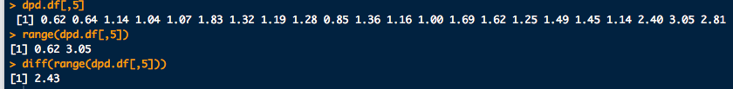
Measures of Data Spread
What is the sample range of deoxypyridinoline conc?
0.62 0.64 1.14 1.04 1.07 1.83 1.32 1.19 1.28 0.85 1.36 1.16 1.00 1.69 1.62 1.25 1.49 1.45 1.14 2.40 3.05 2.81
# Dr. James Curran's dafs (http://www.stat.auckland.ac.nz/~curran)
# dpd.df <- read.csv(file.choose())
library(dafs)
data(dpd.df) # Deoxypyridinoline data
range(dpd.df[,5]) # Look at column 5 for Deoxypyridinoline
# concentration and get its range
diff(range(dpd.df[,5])) # Range as defined in the notes

Slide 21
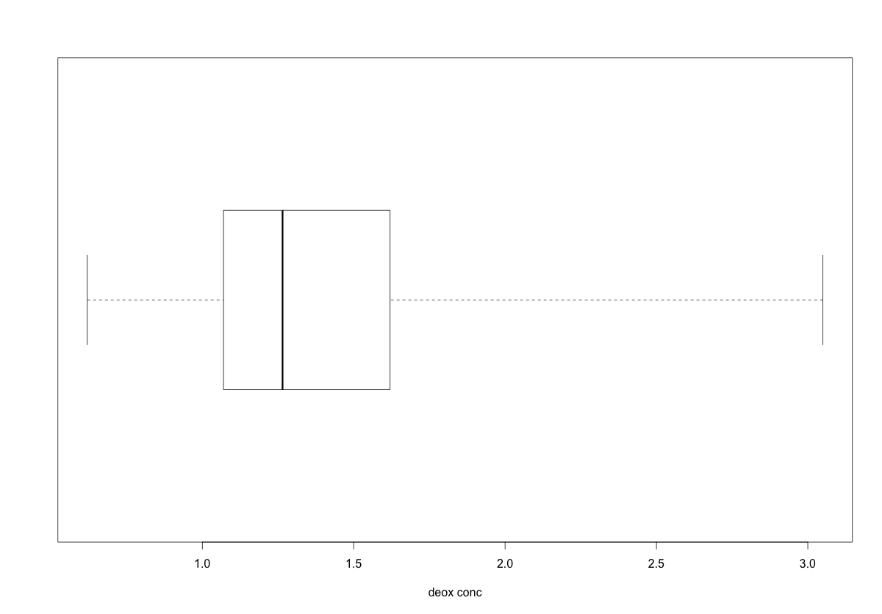
Measures of Data Spread
Box-and-whisker plot again for reference
Deoxypyridinoline conc?
0.62 0.64 1.14 1.04 1.07 1.83 1.32 1.19 1.28 0.85 1.36 1.16 1.00 1.69 1.62 1.25 1.49 1.45 1.14 2.40 3.05 2.81
range
25th-%tile
1st-quartile
median
50th-%tile
75th-%tile
3rd-quartile
# Box and whiskers plots:
boxplot(dpd.df[,5], horizontal = T, range = 0, xlab = "Deoxypyridinoline conc.”)
summary(dpd.df[,5]) # Common summary statistics

Slide 22
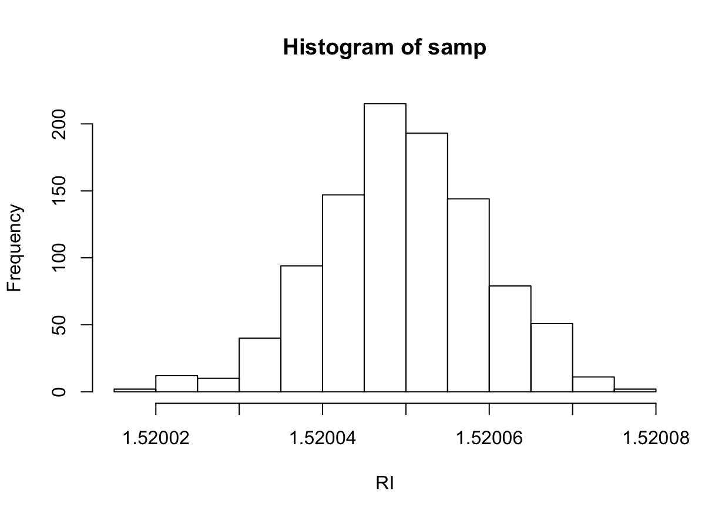
Measures of Data Spread
First 99% of the data is up to here
First 1% of the data is uo to here
99th-%tile
1st-%tile
1.520024
1.520071

Slide 23
Measures of Data Spread
# Finding quantiles:
# First lets get some (fake) data:
samp <- rnorm(1000, mean = 1.52005, sd = 0.00001)
hist(samp, xlab="RI")
# 1% and 99% quantiles of the data
quantile(samp, probs = c(0.01, 0.99))

Slide 24
Measures of Data Spread
Sample relative standard deviation:
Ratio of standard dev to the average
Also called coefficient of variation
Data quality-outliers:
Rule of thumb, if :
x_{i} > 75th-%tile + γ×(75th-%tile - 25th-%tile)
x_{i} < 25th-%tile + γ×(75th-%tile - 25th-%tile)
x_{i} outlier for γ = 1.5
x_{i} extreme outlier for γ = 3

Slide 25

Measures of Data Spread
Deoxypyridinoline conc.
%RSD?
Which data might be outliers?
0.62 0.64 1.14 1.04 1.07 1.83 1.32 1.19 1.28 0.85 1.36 1.16 1.00 1.69 1.62 1.25 1.49 1.45 1.14 2.40 3.05 2.81

