Slide 1
Interval Estimation
We are interested in methods that produce an interval:
Given the assumptions of the methods are satisfied, the interval covers the true value of the parameter with (approximate) probability at least 1 – α.
Common interval methods for:
Confidence intervals
Prediction intervals
Tolerance intervals
Credibility/Probability intervals (Bayesian)

Slide 2
Confidence Intervals
θ is a parameter we are interested in and assume we don’t know its true value.
e.g. a mean, a sd, a proportion, etc.
Consider an experiment that will collect a sample of data.
Then BEFORE we collect the data, we can devise procedure such that:
Estimates we will get from the sample we have yet to collect

Slide 3
Confidence Intervals
In order to get actual numerical values for and we perform the experiment and plug in the data
The outcomes for this experiment are:
Under the frequentist definition, probabilities (other than 0 or 1) only exist for outcomes of experiments that haven’t happened yet.

Slide 4
Confidence Intervals
Once the data is collected we cannot say that θ is in the specific, realized interval with probability greater than or equal to 1-α
The “probability” of the outcome is now: 0 (outcome did not happen) or 1 (outcome did happen).
This is true even if you don’t know what the outcome was.
For realized CIs something happened. We just can’t tell what the outcome was if we don’t know the true value of θ.
What we could say is: “considering the data we’ve collected is a set of plausible values for θ ”.
But that’s a mouthful, so let’s make up a new word: confidence

Slide 5
Confidence Intervals
Caution: The method produces an interval that covers the true value with a probability of (1- α)×100%
IT IS NOT CORRECT to say that any given CI has a (1- α)×100% probability of containing the true value.
confidence is not probability
Take a sample.
Compute a CI.
Here 90% of the
CIs contain the
true value of the
parameter
Graphical representation of
90% CIs is for a parameter:
true value
of parameter

Slide 6
Confidence Intervals
So how do we compute a (1 − α)×100% confidence interval given a set of data??
Conceptually, if we are trying to estimate a parameter θ with some estimator we have to know something about the sampling distribution of the estimator
For large IID samples, one can show that is approximately normal:
Approx. sampling dist. of an estimator (large IID sample assumed)

Slide 7
Confidence Intervals
To explicitly take sample size, n, into account (and thus be more conservative), instead use the student-T distribution:
Approx. sampling dist. of an estimator (IID sample of size n)
We will use the Student-T assumption for the sampling distribution by default

Slide 8
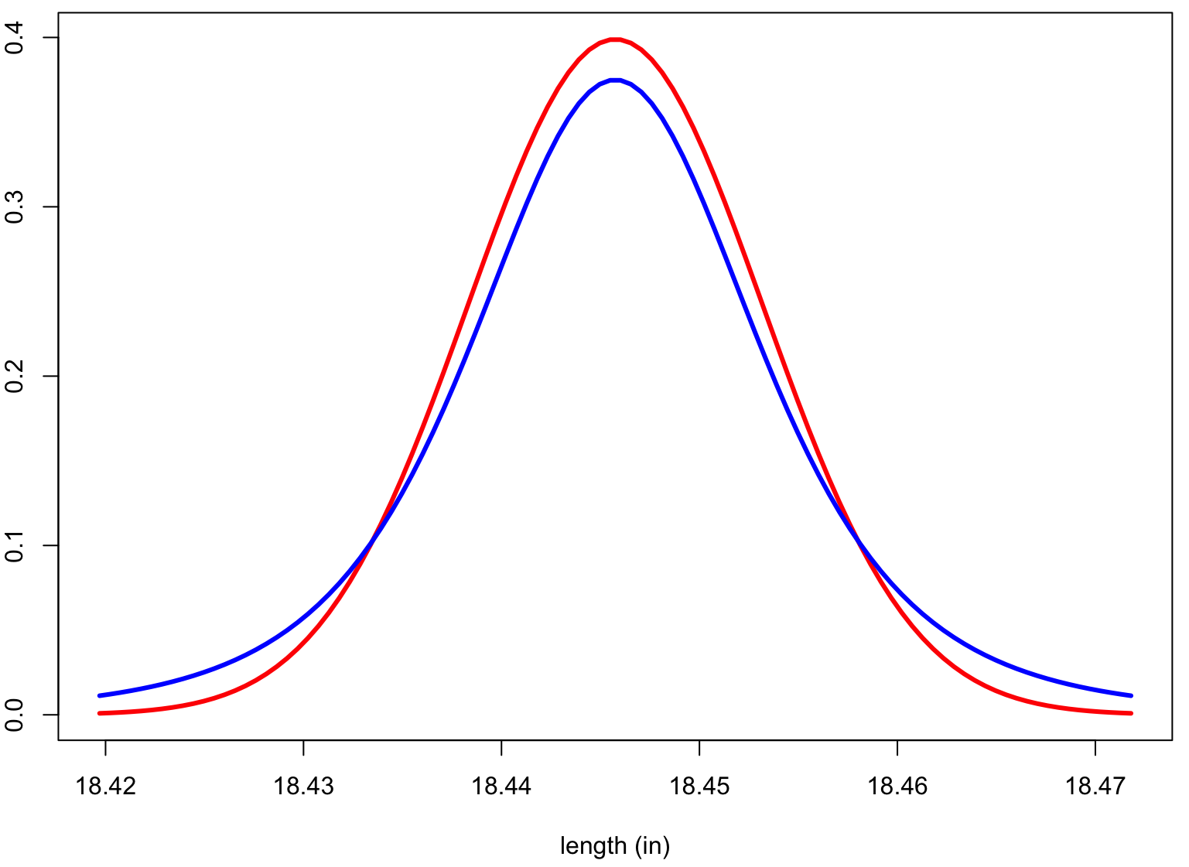
Intuition: Student-t and t_{c}
Measurand’s (barrel length) approximate sampling distribution
Normal distribution
Student-t distribution
Fatter in the tails

Slide 9
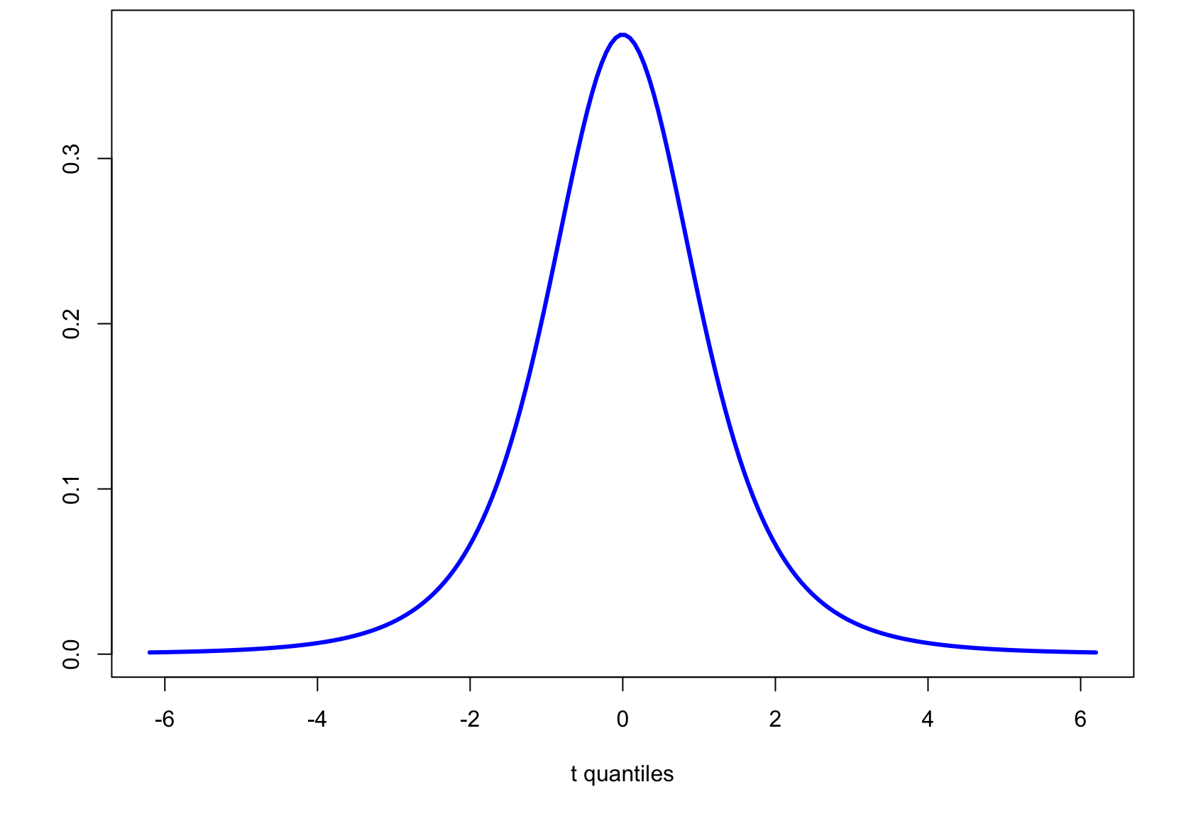
Intuition: Student-t and t_{c}
Student-t PDF, d.f. = 3
Area =
0.99
Area =
0.95
-5.84
5.84
-3.18
3.18
t_{c} = 3.18 for (two-sided) 95% confidence
t_{c} = 5.84 for (two-sided) 99% confidence

Slide 10
Confidence Intervals
Construction of a CI for a mean depends on:
Sample size n
Standard error for the mean
Level of confidence 1-α
α is significance level
Use α to compute t_{c}-value
(1-α)×100% CI for population mean using a sample average and standard error is:

Slide 11
Example: Confidence Intervals
Compute a 99% two sided confidence interval for the the RI of a glass shard using this sample set:
Fragment # | Fragment nD
1 | 1.52005
2 | 1.52003
3 | 1.52001
4 | 1.52004
5 | 1.52000
6 | 1.52001
7 | 1.52008
8 | 1.52011
9 | 1.52008
10 | 1.52008
11 | 1.52008
?

Slide 12
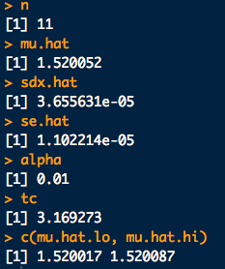
Example: Confidence Intervals
# Data (input quantities^GUM)
x <- c(1.52005,1.52003,1.52001,1.52004,1.52000,1.52001,1.52008,1.52011,1.52008,1.52008,1.52008)
n <- length(x)
# Estimate of measurand^GUM:
mu.hat <- mean(x)
# Standard uncertainty of the input quantities^GUM
sdx.hat <- sd(x)
# Standard uncertainty of the measurand^GUM
se.hat <- sd(x)/sqrt(n)
# Compute tc for given sample size and chosen confidence level
conf <- 0.99
alpha <- 1-conf
tc <- qt(1 - alpha/2, df = n-1)
# Put the CI together:
mu.hat.lo <- mu.hat - tc*se.hat
mu.hat.hi <- mu.hat + tc*se.hat
c(mu.hat.lo, mu.hat.hi)

Slide 13
Example: Confidence Intervals
Compute a 99% two sided confidence interval for the the RI of a glass shard using this sample set:
Fragment # | Fragment nD
1 | 1.52005
2 | 1.52003
3 | 1.52001
4 | 1.52004
5 | 1.52000
6 | 1.52001
7 | 1.52008
8 | 1.52011
9 | 1.52008
10 | 1.52008
11 | 1.52008
Putting this together:
[1.520052 - (3.17)(0.00001), 1.520052 + (3.17)(0.00001)]
99% CI for sample = [1.52002, 1.52009]

Slide 14
Another Exercise
A suspect, one Mr. B. Mayhew is captured by law enforcement officials in possession of many mini-Ziploc baggies containing what is determined to be very pure, dry methamphetamine. The forensic lab’s analytical balances are reliable to 4-decimal places. The baggies are emptied and collected into one mass of crystals. 10 mass measurements are taken (units g):
49.9996, 49.9994, 49.9993, 49.9996, 49.9995, 49.9995, 49.9995, 49.9994, 49.9995, 49.9994
Compute the one-sided 95% CI for the lower bound on the mean mass
Compute the one-sided 95% CI for the upper bound on the mean mass
Sketch pictures of where these CIs would appear on the approximate sampling distribution for the meth’s mass

Slide 15
# Input quantities^GUM for some of Mr. Mayhew's seizure:
x <- c(49.9996,49.9994,49.9993,49.9996,49.9995,
49.9995,49.9995,49.9994,49.9995,49.9994)
n <- length(x)
# a. **One-sided lower bound. The assumed "upper limit" is Infinity
# Estimate of measurand^GUM:
mu.hat <- mean(x)
# Standard uncertainty of the input quantities^GUM
sdx.hat <- sd(x)
# Standard uncertainty of the measurand^GUM
se.hat <- sd(x)/sqrt(n)
# Compute tc for given sample size and chosen confidence level
conf <- 0.95
alpha <- 1-conf
tc <- qt(1 - alpha, df = n-1) # **This is the big change.
# Now we don't split the alpha between the tails.
# For the lower bound we put all the alpha on
# the lower tail. Therefore -tc!
# Put the One-sided lower bound CI together:
mu.hat.lo <- mu.hat - tc*se.hat
c(mu.hat.lo, Inf)
# b. **One-sided upper bound. The assumed "lower limit" is -Infinity
# Everything is the same except now we put all the alpha in the upper tail.
mu.hat.hi <- mu.hat + tc*se.hat
c(-Inf, mu.hat.hi)

Slide 16
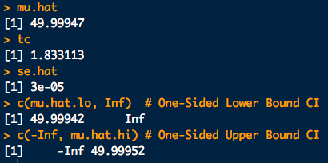
Another Exercise

Slide 17
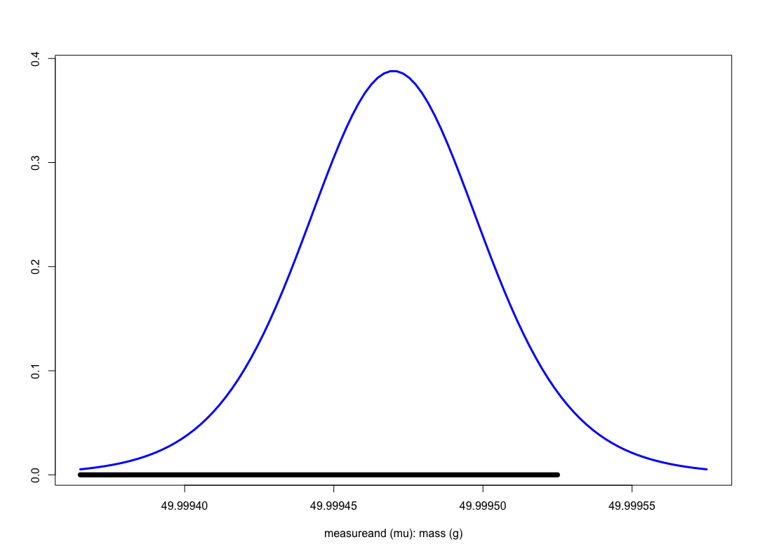
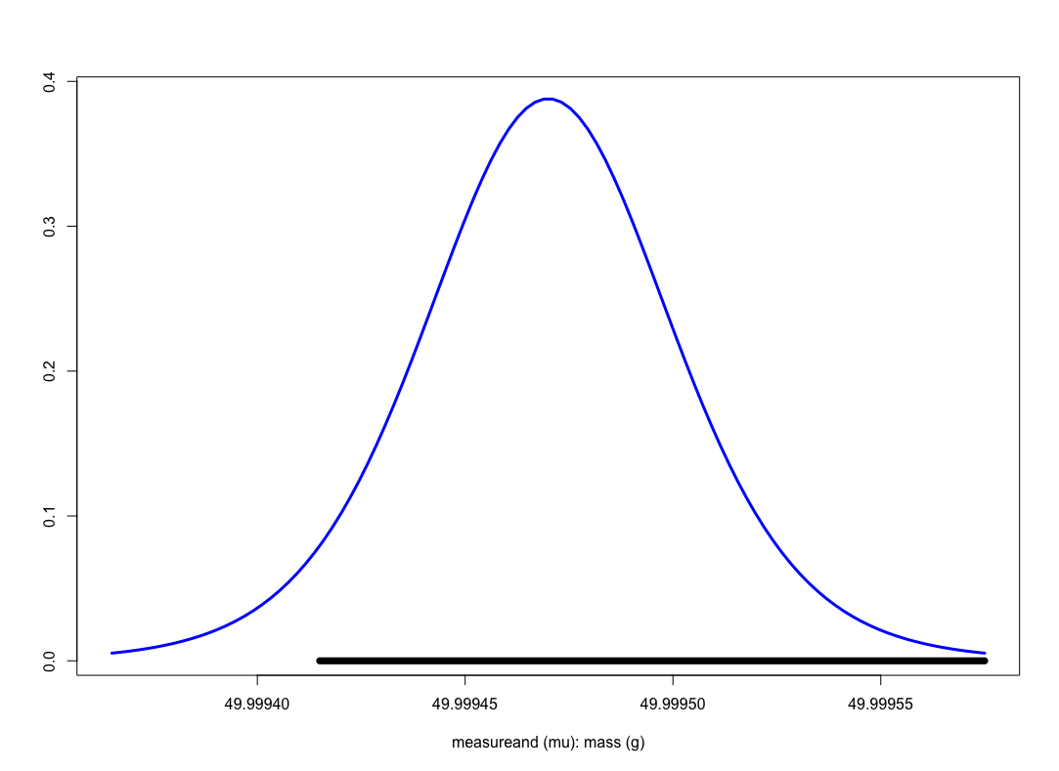
Another Exercise
One sided, upper bound
One sided, lower bound

Slide 18
Equation Catalogue: Confidence Intervals
So how do we compute a (1 − α)×100% confidence interval given a set of data??
Case 1a: (1 − α)×100% CIs for the mean μ :
Large sample n (at least 30), sd σ_{X} known:
Two sided
One sided, lower bound
One sided, upper bound
N(0,1) quantiles qnorm(1-a/2) or qnorm(1-a)

Slide 19
Equation Catalogue: Confidence Intervals
So how do we compute a (1 − α)×100% confidence interval given a set of data??
Case 1b: (1 − α)×100% CIs for the mean μ :
Large sample n (at least 30), sd σ_{X} unknown:
Two sided
One sided, lower bound
One sided, upper bound

Slide 20
Equation Catalogue: Confidence Intervals
So how do we compute a (1 − α)×100% confidence interval given a set of data??
Case 1c: (1 − α)×100% CIs for the mean μ :
Small sample n, sd σ_{X} unknown:
Two sided
One sided, lower bound
One sided, upper bound
Student-t(n-1) quantiles qt(1-a/2,df=n-1) or qt(1-a,df=n-1)

Slide 21
Equation Catalogue: Confidence Intervals
So how do we compute a (1 − α)×100% confidence interval given a set of data??
Case 2a: (1 − α)×100% CIs for a proportion p :
Large sample n (at least 30), p not too close to 0 or 1:
Two sided
One sided, lower bound
One sided, upper bound
Remember:

Slide 22
Equation Catalogue: Confidence Intervals
So how do we compute a (1 − α)×100% confidence interval given a set of data??
Case 2b: (1 − α)×100% CIs for a proportion p :
Small sample n and/or p close to 0/1:
Define^{Agresti, Coull}:
Two sided

Slide 23
Example: Confidence Intervals
Saunders, Davis and Buscaglia define random match probability (RMP) in handwriting analysis as “[T]he chance of randomly selecting two individuals from some relevant population and then randomly selecting two writing samples, one from each individual’s available body of handwriting, that are declared to ‘‘match’’ on the basis of the chosen comparison procedure.”
Say a suspect is apprehended in an a case and is alleged to have written a threatening letter. A database search yields 100 “best matching” individuals (one writing sample each). Assume this serves as a sample from a “relevant population”. It is known that none were actually produced by the suspect with the exception of the writing sample they produced. Each item in the sample compared to the others (n = 4950 comparisons) and two pairs are found to “match”. The estimated RMP is thus 2/4950 = 0.0004.
Compute the estimated two sided CI (neglecting correlations) for this RMP at the 95% level of confidence.

Slide 24
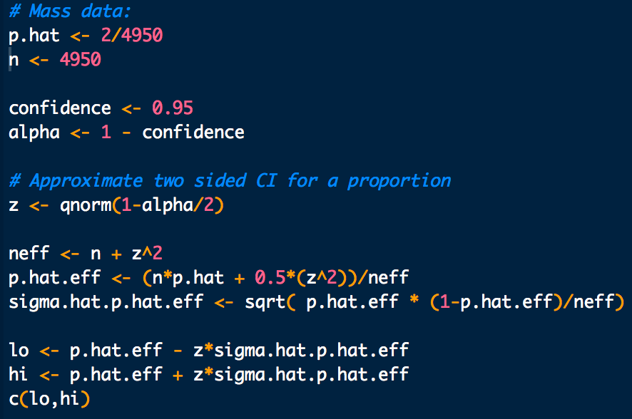

Example: Confidence Intervals

Slide 25
Confidence Intervals
So how do we compute a (1 − α)×100% confidence interval given a set of data??
Case 3: (1 − α)×100% CIs for a Poisson mean counts λ:
Large sample n (at least 30):
Two sided

Slide 26
Bootstrap Confidence Intervals
So how do we compute a (1 − α)×100% confidence interval given a set of data??
For any parameter, you can try to obtain bootstrap based CIs
For a sample of size n:
Obtain a bootstrap sampling distribution for θ: boot.reps
Find the (1 − α)×100% empirical percentiles:
quantile(boot.reps, probs=c(a/2, 1-a/2))
Two sided
quantile(boot.reps, probs=c(a))
One sided, lower bound
quantile(boot.reps, probs=c(1-a))
One sided, upper bound

Slide 27
Example: Bootstrap Confidence Intervals
Consider again the case of Mr. B. Mayhew with seizure mass measurements of:
49.9996g
49.9994g
49.9993g
49.9996g
49.9995g
49.9995g
49.9995g
49.9994g
49.9995g
49.9994g
Compute the 99% CI for the mean mass via the bootstrap.
What is your bootstrap standard error estimate for the estimated mean?
Approximately, with what level of confidence can you report the mean measurement is equal to or exceeds 50.0000g?

Slide 28
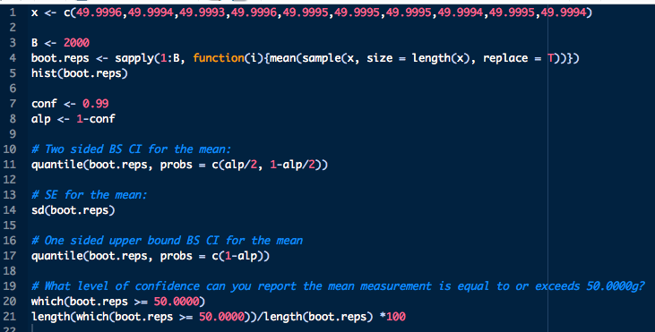
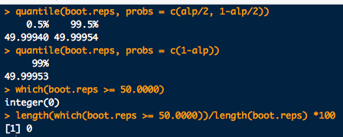
Example: Bootstrap Confidence Intervals
Look at what happens by just demanding a little more precision:

