Slide 1
Graphical Models in Brief

Slide 2
Directed Graphs
A
B
Word equivalents:
The outcome of A influences the outcome of B
A influences B
A “causes” B
A effects B
Knowledge of A is relevant for my belief about B
Called a Bayesian Network

Slide 3
PMF Equivalents and Common Graph Motifs
A
The probability of A:
“node”
A node represents a probability table:
 |  | Pr(A)
A: | yes | 0.29
 | maybe | 0.10
 | no | 0.61
A
=
A prior (unconditional) “node”

Slide 4
PMF Equivalents and Common Graph Motifs
A
B
Graph defines two probability tables:
 |  | Pr(A)
A: | yes | 0.29
 | maybe | 0.10
 | no | 0.61
A
=
Pr(B|A) |  | A:
 |  | yes | maybe | no
B: | low | 0.28 | 0.81 | 0
 | medium | 0.03 | 0.18 | 0.76
 | high | 0.69 | 0.1 | 0.24
B
=

Slide 5
PMF Equivalents and Common Graph Motifs
A
B
C
How many table do we need to represent Pr(A, B, C)?

Slide 6
PMF Equivalents and Common Graph Motifs
Note:
A
B
A
B
The “causal” direction is not uniquely defined.
We can choose it to be intuitive or convenient

Slide 7
PMF Equivalents and Common Graph Motifs
A
C
B
B
A
C

Slide 8
PMF Equivalents and Common Graph Motifs
A
B
C
A
B
Cycles NOT ALLOWED!
C

Slide 9
Directed Graphs
Hypothesis: not directly observable or only observable at high cost
Data: information that reveals something about the state of a hypothesis
Hypothesis
Data
Typical
Hypothesis
Hypothesis
Typical
Hypothesis
Data
Not Typical

Slide 10
Directed Graphs
It helps me to remember:
Disease
Symptoms
Typical

Slide 11
PMF Equivalents and common graph motifs
In general, for a graph consisting of nodes in the set:
The joint PMF is (product/chain rule):
Parent nodes of A_{i}
This equation defined the Bayesian Network DAG

Slide 12
Example: Monty Hall Problem
In the “Let’s Make a Deal” game show, a version of the Choose a Door game is (Monty himself pointed out that there are many variations depending on what his mood was):
You are given the choice of three doors:
Behind one door the real prize, a car.
Behind the others, goats or other gag prizes.
You pick a door, say No. 1. The host (who knows what's behind the doors) opens another door, say No. 3, which has a goat. He then says to you, “Do you want to switch to door No. 2?”
Question: Is it to your advantage to switch your choice?

Slide 13
Example: Monty Hall Problem
Nodes:
P = Prize is behind door #
C = Your choice of door #
M = Monty’s choice of door #
Prize is
Behind
Door #
Your Choice
of Door #:
Joint PMF for the scenario:
Monty Hall
Chooses
Door #:
What are the dependencies between the nodes?
Your choice of door affects Monty’s choice of door
The door the prize is behind affects Monty’s choice of door
Your choice of door is not affected by anything in this scenario
The door the prize is behind is not affected by anything in this scenario

Slide 14
Example: Monty Hall Problem
Task: Marginalize nodes
Knowing the probability table of each node, compute all marginal probabilities:
Marginals of prior nodes are just their tables.
Prize is
Behind
Door #
Your Choice
of Door #:
Monty Hall
Chooses
Door #:
Marginals of conditional nodes generally requires software:
Graph theoretic operations
Some form of Pearl’s “Message Passing Algorithm”

Slide 15
Example: Monty Hall Problem
 |  | Pr(P)
Prize is Behind Door #: | door 1 | 0.333
 | door 2 | 0.333
 | door 3 | 0.333
 |  | Pr(C)
Your Choice of Door #: | door 1 | 0.333
 | door 2 | 0.333
 | door 3 | 0.333
Prize is
Behind
Door #
Your Choice
of Door #:
Monty Hall
Chooses
Door #:
Pr(M|P,C) | Prize is Behind Door #: | door 1 | door 1 | door 1 | door 2 | door 2 | door 2 | door 3 | door 3 | door 3
 | Your Choice of Door #: | door 1 | door 2 | door 3 | door 1 | door 2 | door 3 | door 1 | door 2 | door 3
Monty Hall Chooses Door #: | door 1 | 0 | 0 | 0 | 0 | 0.5 | 1 | 0 | 1 | 0.5
 | door 2 | 0.5 | 0 | 1 | 0 | 0 | 0 | 1 | 0 | 0.5
 | door 3 | 0.5 | 1 | 0 | 1 | 0.5 | 0 | 0 | 0 | 0

Slide 16
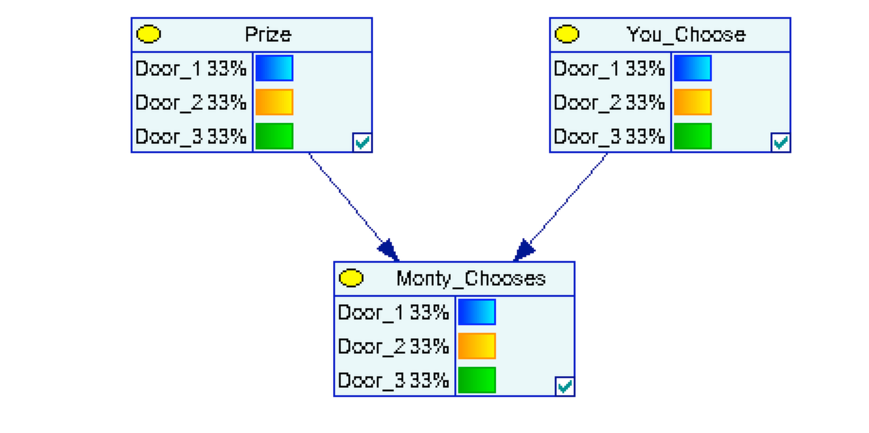
Example: Monty Hall Problem
 |  | Pr(P)
Prize is Behind Door #: | door 1 | 0.333
 | door 2 | 0.333
 | door 3 | 0.333
 |  | Pr(C)
Your Choice of Door #: | door 1 | 0.333
 | door 2 | 0.333
 | door 3 | 0.333
Prize is
Behind
Door #
Your Choice
of Door #:
Monty Hall
Chooses
Door #:
Pr(M|P,C) | Prize is Behind Door #: | door 1 | door 1 | door 1 | door 2 | door 2 | door 2 | door 3 | door 3 | door 3
 | Your Choice of Door #: | door 1 | door 2 | door 3 | door 1 | door 2 | door 3 | door 1 | door 2 | door 3
Monty Hall Chooses Door #: | door 1 | 0 | 0 | 0 | 0 | 0.5 | 1 | 0 | 1 | 0.5
 | door 2 | 0.5 | 0 | 1 | 0 | 0 | 0 | 1 | 0 | 0.5
 | door 3 | 0.5 | 1 | 0 | 1 | 0.5 | 0 | 0 | 0 | 0

Slide 17
Example: Monty Hall Problem
Task: Update marginals of nodes after data is collected
After introducing “evidence” or “observations” how are our beliefs about the states of the other nodes changed?
Prize is
Behind
Door #
Your Choice
of Door #:
door #1
Monty Hall
Chooses
Door #:
door #3

Slide 18
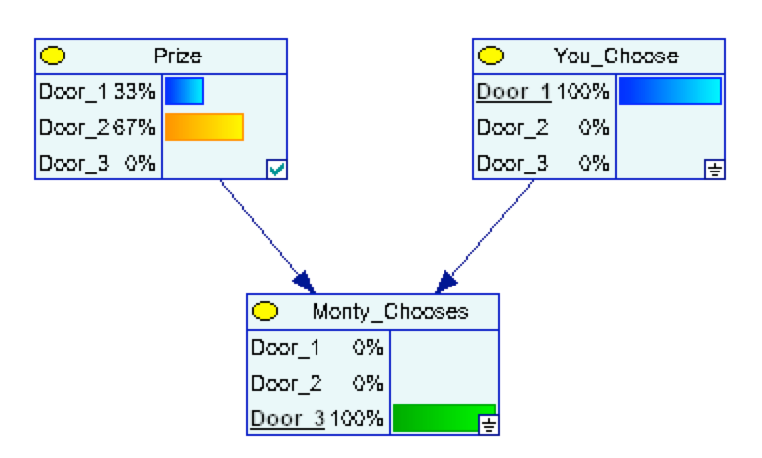
Example: Monty Hall Problem
Updated beliefs about which door to pick
door #1
door #3

Slide 19
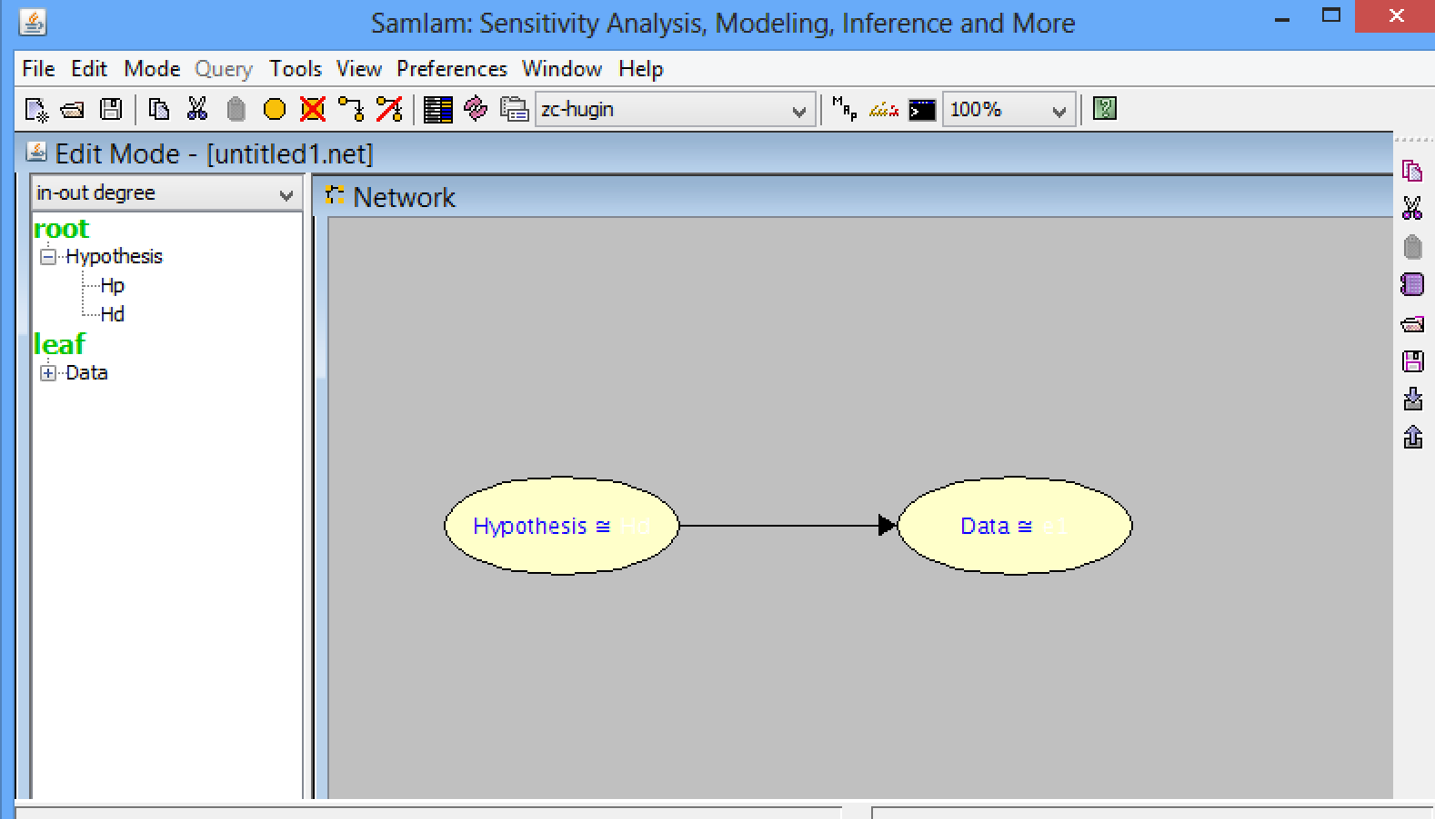
Software: SamIam
Draw dependency arrows
Compute marginals/updates
Draw nodes

Slide 20
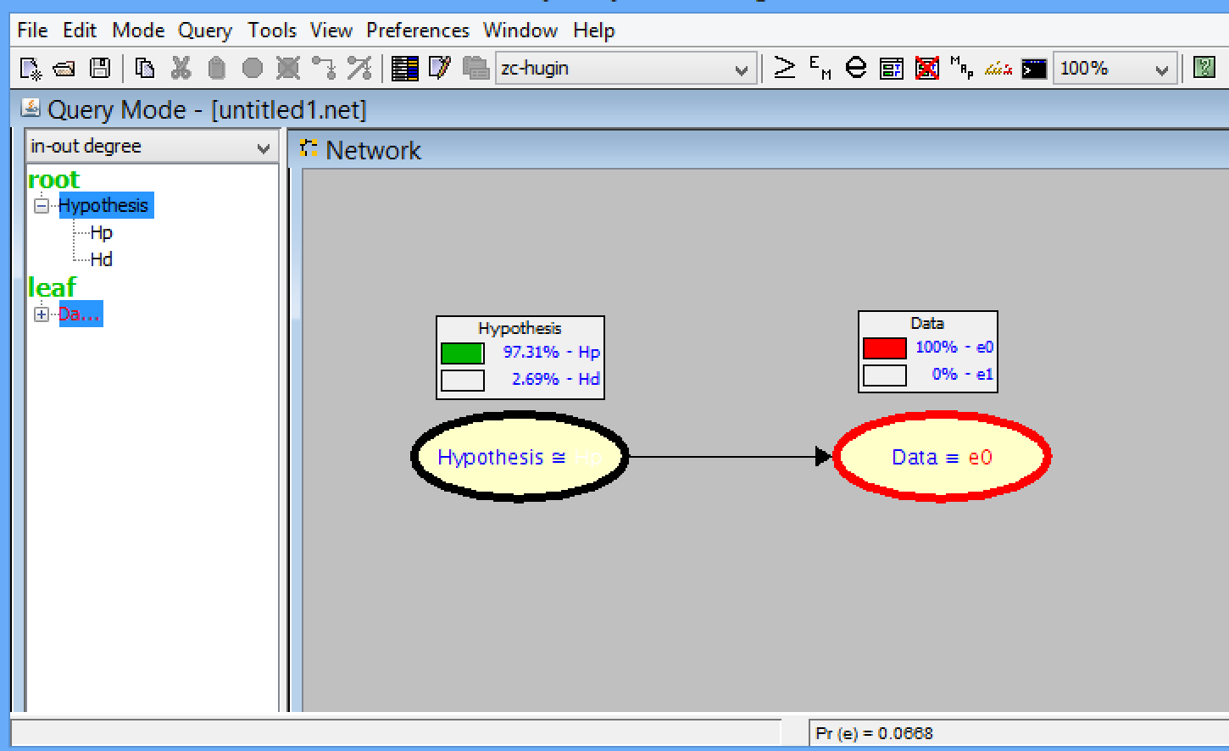
Software: SamIam
Enter evidence by clicking on observed states
Switch back to edit mode
Switch on node histograms

Slide 21
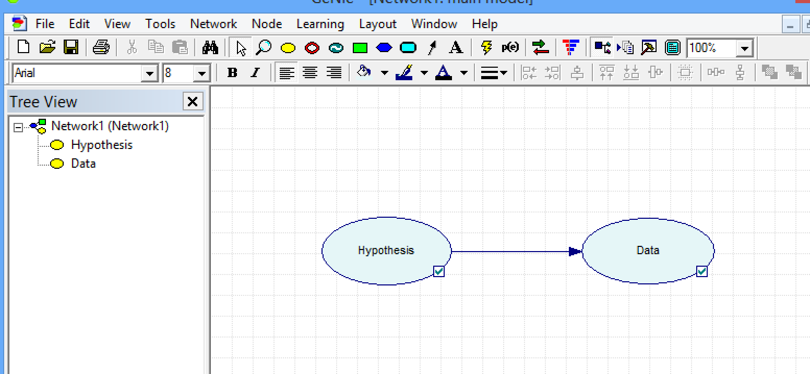
Software: GeNIe
Draw nodes
Draw dependency arrows
Compute marginals/updates

Slide 22
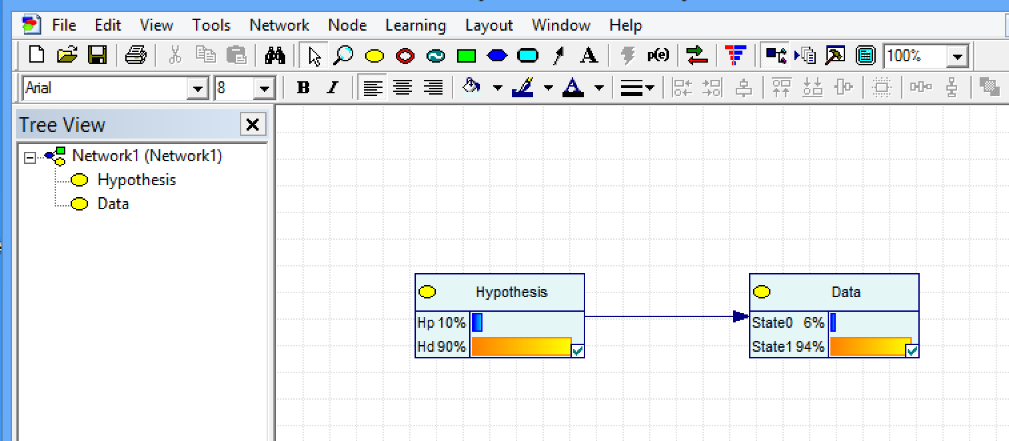
Software: GeNIe
Switch on node histograms
Toggle update immediately
Enter evidence by clicking on observed states

