Slide 1

A Little Bit of Probability

Slide 2
Sample Spaces
Sample space:
The set of possible outcomes or answers for a experiment or question.
Experiment: Flip a two sided coin
Question: When will the next financial crash be?
Ω = {2018, 2019, 2020, ….}

Slide 3
Sample Spaces
Sample space:
Standard lingo:
We will always stick with the term “experiment” to refer to anything in which the outcome(s) are uncertain.
Applies to outcomes we both can and cannot specify a frequency for.

Slide 4
Sample Spaces
Outcomes can be continuous or discrete
Discrete: Nominal (categories)
Experiment: Did he do it?
Discrete: Ordinal (orderable somehow)
Experiment: How many arsons will there be in my neighbourhood this year?

Slide 5
Sample Spaces
Outcomes can be continuous or discrete
Continuous: Any values in the real numbers,
What is the mass of scheduled drugs seized in a box of 15,000 glassine envelopes?
What is the concentration of cocaine in a suspects blood?

Slide 6
Sample Spaces
A subset of a sample space is an event:
 | Roll 1 | 1 | 2 | 3 | 4 | 5 | 6
Roll 2 | 1 | 2 | 3 | 4 | 5 | 6 | 7
 | 2 | 3 | 4 | 5 | 6 | 7 | 8
 | 3 | 4 | 5 | 6 | 7 | 8 | 9
 | 4 | 5 | 6 | 7 | 8 | 9 | 10
 | 5 | 6 | 7 | 8 | 9 | 10 | 11
 | 6 | 7 | 8 | 9 | 10 | 11 | 12
E = Sum of rolls is 6 or 7
E

Slide 7
Sample Spaces
The complement to the event:
Everything not in the event
E’
E

Slide 8
Sample Spaces
A simple event is an event containing a single outcome.
A compound event consists of more than one outcome.
When the experiment is performed, if the outcome that occurs is in event E then we say E occurs.

Slide 9
Some More Set Theory Language
Venn diagram: A pictorial representation of combinations of sets making use of circles and rectangles.
Empty set: The set containing no outcomes.
The null set ∅ or { }.
Union: A ∪ B occurs if A occurs, B occurs or both A and B occur.
A
A ∪ B
B
also

Slide 10
Some More Set Theory Language
Intersection: A ∩ B occurs if both A and B occur.
A
A ∩ B
B
also
Disjoint: A and B are disjoint or mutually exclusive if they have no outcomes in common, i.e. if A ∩ B = ∅.
A
B

Slide 11
Kolmogorov Axioms of Probability
To the probabilities of outcomes/events of an experiment must obey the axioms:
Axiom 1: For any event A, Pr(A) ≥ 0
Axiom 2: Pr(Ω) = 1
Axiom 3: For a collection of mutually exclusive events, A₁, A₂, …, A_{n}
Everything else in probability theory can be deduced starting with these axioms

Slide 12
Handy Consequences of Kolmogorov Axioms
Important consequences:
A probability function assigns a probability to any event A such that:
A partition of the sample space means:
In words: The A_{i}’s chop up the sample space into non-overlapping (i.e. mutually exclusive) pieces.

Slide 13
Handy Consequences of Kolmogorov Axioms
Important consequences:
Probability of a complement
Probability of nothing in the sample space

Slide 14
Handy Consequences of Kolmogorov Axioms
Important consequences:
Probability of a union of non-disjoint events
In words: The probability of A or B is the probability of A plus the probability of B minus the probability of A and B
Don’t count the probabilities of A and B twice if there is overlap between the events

Slide 15
Handy Consequences of Kolmogorov Axioms
DeMorgan’s Laws
DeMorgan Law 1
DeMorgan Law 2

Slide 16
Example
Sally got shot by some purp(s).
Let A = Alice shot Sally. Pr(A) = 0.49
Let B = Bill shot Sally. Pr(B) = 0.54
Draw a Venn diagram for this scenario assuming A and B are not mutually exclusive. What would that mean?
Compute
Compute
Compute
Compute

Slide 17
Example
It isn’t necessary to use R for this question. All you need for most probability problems is a calculator.
# Data from the question:
A <- 0.49
B <- 0.54
# Pr(A')
An <- 1 - A
An
# Pr(A union B) = Pr(A) + Pr(B) - Pr(A intersect B)
AandB <- ((A+B) - 1)
AandB
AorB <- A + B - AandB
AorB
# Pr(A' and B') = Pr( (A or B)' )
1-AorB
# Pr(A' or B') = Pr( (A and B)' )
1 - AandB

Slide 18
Conditional Probability
Suppose we have two events A and B, but now, we know B has occurred.
What can we say about the probability of A given B has occurred?
The information given in B excludes some outcomes of A.
What outcomes do A and B have in common?

Slide 19
Conditional Probability
Conditional probability:
The probability of A given B
The proportion of A and B in B
Conditional operator | “word flags”:
if, given, of the
Pr(A)
Note consequence:
Pr(B)

Slide 20
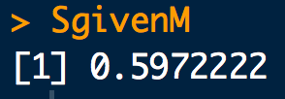
Example
In a large soil database 72% of the of the samples contain mica and 43% mica and schist. Assuming the database reflective of a relevant population, what is the probability that a randomly selected soil sample (from the same population) that contains mica also contains schist?
# Data from the question:
M <- 0.72
MandS <- 0.43
SgivenM <- MandS/M
SgivenM

Slide 21
Example with Probability Tables
Consider two variables, A and B, that can co-occur. A has two states and B has three states. The probabilities of A and B can be listed in a table:
 | b₁ | b₂ | b₃
a₁ | 0.16 | 0.12 | 0.12
a₂ | 0.24 | 0.28 | 0.08
If the Probabilities for B alone are:
 | b₁ | b₂ | b₃
 | 0.4 | 0.4 | 0.2
Compute:
Compute:
Compute:

Slide 22
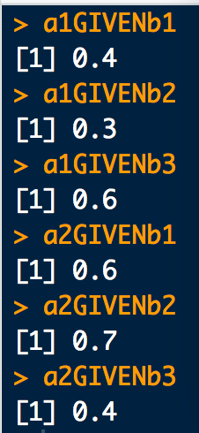
# Pr(A and B):
a1ANDb1 <- 0.16
a1ANDb2 <- 0.12
a1ANDb3 <- 0.12
a2ANDb1 <- 0.24
a2ANDb2 <- 0.28
a2ANDb3 <- 0.08
# Pr(B):
b1 <- 0.4
b2 <- 0.4
b3 <- 0.2
# Pr(A|B):
a1GIVENb1 <- a1ANDb1/b1
a1GIVENb2 <- a1ANDb2/b2
a1GIVENb3 <- a1ANDb3/b3
a2GIVENb1 <- a2ANDb1/b1
a2GIVENb2 <- a2ANDb2/b2
a2GIVENb3 <- a2ANDb3/b3
a1GIVENb1
a1GIVENb2
a1GIVENb3
a2GIVENb1
a2GIVENb2
a2GIVENb3

Slide 23
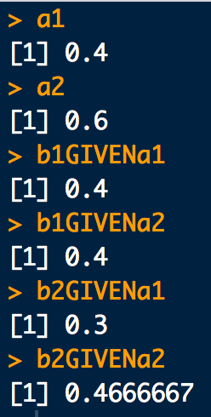
# Pr(A):
a1 <- a1ANDb1 + a1ANDb2+ a1ANDb3
a2 <- a2ANDb1 + a2ANDb2+ a2ANDb3
a1
a2
# Pr(B|A)
b1GIVENa1 <- a1ANDb1/a1
b1GIVENa2 <- a2ANDb1/a2
b2GIVENa1 <- a1ANDb2/a1
b2GIVENa2 <- a2ANDb2/a2
b1GIVENa1
b1GIVENa2
b2GIVENa1
b2GIVENa2

Slide 24
Multiplication Rule
Another important consequence of conditional probability is the multiplication rule:

Slide 25
Example
Using the information from the large soil database:
72% of the of the samples contain mica
43% contain mica and schist.
100% contain mica or schist
a. Compute:
b. Next, set up probability tables for the above and re-compute.
Hint: what are the states for the random variates mica and schist?
Another hint: Write out all the tables and fill in the easy stuff first.

Slide 26
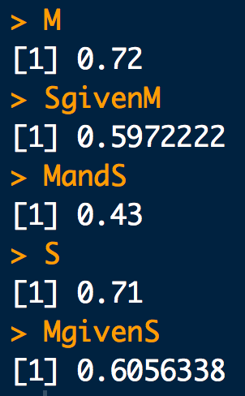
Example
a.
# Data from the question:
M <- 0.72 # Schist
MandS <- 0.43 # Mica and Schist
# Pr(M)
M
# Pr(S|M) = Pr(SandM)/Pr(M)
SgivenM <- MandS/M
SgivenM
# Pr(S and M) = Pr(M and S)
MandS
# Pr(S) = Pr(S or M) + Pr(S and M) - Pr(M)
S <- 1 + 0.43 - 0.72
S
# Pr(M|S) = Pr(M and S)/Pr(S)
MgivenS <- 0.43/S
MgivenS

Slide 27


# Data from the question:
M <- 0.72 # Schist
MandS <- 0.43 # Mica and Schist
MorS <- 1 # Mica or Schist
#----------------
# Table for Pr(M)
#----------------
# M
M
# M'
Mn <- 1-M
Mn
#----------------
# Table for Pr(S)
#----------------
# S = SorM + SandM - M: "or-rule”: pr non-disjoint events
S <- MorS + MandS - M
S
# S' = 1-S
Sn <- 1-S
Sn
b.

Slide 28
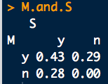
#-----------------------
# Table for Pr(M and S)
#-----------------------
# M and S
MandS
# M' and S' = (M or S)': DeMorgan Law 1
MnandSn <- 1 - MorS
MnandSn
# M' and S:
# Since M | S = (M and S)/S
# (M' | S) = 1 - (M | S)
# (M' | S) = (M' and S)/S
# then M' and S = (1 - (M|S)) * S
MnandS <- (1 - (MandS/S))*S
MnandS
# M and S'
MandSn <- 1 - MandS - MnandS - MnandSn
MandSn
# Format as probability table we can use with gRain table ops:
M.and.S <- rbind(
c(MandS, MandSn ),
c(MnandS, MnandSn)
)
rownames(M.and.S) <- c("y","n")
colnames(M.and.S) <- c("y","n")
# Rows name FIRST then Columns name!
names(dimnames(M.and.S)) <- c("M","S")
M.and.S
b.
(con’t)

Slide 29
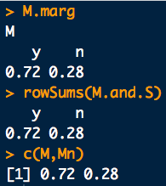
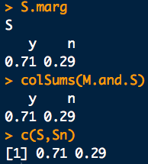
b.
(con’t)
library(gRain) # Use gRain table ops:
#--------------------------------------
# Lets Check marginal tables M and S
#--------------------------------------
# Pr(M):
M.marg <- tableMargin(M.and.S, margin = "M")
M.marg
rowSums(M.and.S) # Same as above?? Should be!
c(M,Mn) # Same as above?? Should be!
# Pr(S):
S.marg <- tableMargin(M.and.S, margin = "S")
S.marg
colSums(M.and.S) # Same as above?? Should be!
c(S,Sn) # Same as above?? Should be!

Slide 30
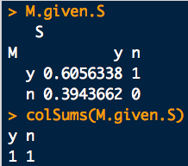
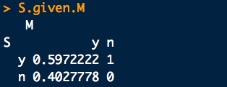
b. (con’t)
library(gRain) # Use gRain table ops:
#-----------------------
# Table for Pr(M | S)
#-----------------------
# (M | S) = (M and S)/S
M.given.S <- t(tableDiv(M.and.S, S.marg))
M.given.S
colSums(M.given.S) # All 1s? Should be!
#-----------------------
# Table for Pr(S | M)
#-----------------------
# Use Bayes theorem:
# (S | M) = ((M | S) * S)/M
S.given.M <- t(tableDiv(tableMult(M.given.S,S.marg), M.marg))
S.given.M
t(tableDiv(M.and.S, M.marg)) # Same as above? Should be!
colSums(S.given.M) # All 1s? Should be!
tabCondProb(M.and.S, cond = "M") # We can do this too!

Slide 31
Example
Consider a scenario proposed by Kwan et al.ª:
A pirated file could have been copied from a seized USB drive, which was found at the scene of crime, to a laptop seized from a suspect at apprehended at another location (H).
Pr(C = Yes) = 0.33
Pr(C = No) = 0.33
Pr(C = Uncertain) = 0.33
The “last modified” time of the file on the laptop could equal that of the file on the USB is the evidence (E). E has the same outcomes as C. Consider the conditional probability table
Pr(E|C) | C = Yes | C = No | C = Unc
E = Yes | 0.85 | 0.05 | 0
E = No | 0.15 | 0.95 | 0
E = Unc | 0 | 0 | 1
What is the prob. that the “last mod” time on the USB is the same as the file on the laptop (E=yes) and the pirated file was not copied (C=No) from the seized laptop?
ªhttp://i.cs.hku.hk/cisc/forensics/papers/BayesianNetwork.pdf

Slide 32
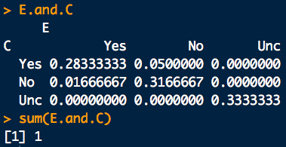
library(gRain) # Use gRain table ops:
# Format E | C as probability table we can use
# with gRain table ops:
E.given.C <- rbind(
c(0.85, 0.05, 0.00),
c(0.15, 0.95, 0.00),
c(0.00, 0.00, 1.00)
)
rownames(E.given.C) <- c("Yes","No", "Unc")
colnames(E.given.C) <- c("Yes","No", "Unc")
# Rows name FIRST then Columns name!
names(dimnames(E.given.C)) <- c("E","C")
E.given.C
# C: For a prior table, things are a little different:
C <- array(c(1/3, 1/3, 1/3), c(3))
C
names(C) <- c("Yes","No", "Unc")
names(dimnames(C)) <- c("C")
# (E and C) = (E | C) * C
E.and.C <- tableMult(E.given.C, C)
E.and.C
sum(E.and.C) # Sum to 1? It should!

Slide 33
Example: The Birthday Problemª
Say you meet two people at a party. What is the probability they have the same birthday?
An equivalent, but a little easier question to answer:
Say you meet two people at a party. What is the probability that they have different birthdays? Call this question B2.
If their birthdays are different then, out of 365 days, the other person’s birthday will be one of 364 possibilities. So:
ªFrom “A Modern Intro. To Prob. and Stat. Understanding Why and How”. Dekking et al.

Slide 34
Example: The Birthday Problem
Ok. So then what is the probability that you meet two people who don’t have the same birthday (B2) and a third person who doesn’t have the same birthday as one of the first two (call that A3).
This new probability B3 is the intersection of B2 and A3:
Conditional probability can help us with Pr(B3):

Slide 35
Example: The Birthday Problem
We already know Pr(B2). We just need Pr(A3|B2)
Following our reasoning to get B2, out of 365 days, the other person’s birthday cannot be two of the of 365 possibilities. So:
The probability that you meet a third person who doesn’t have the same birthday as either of the first two (A3), given the first two people you meet don’t have the same birthday:
Putting everything together for Pr(B3):

Slide 36
Example: The Birthday Problem
If we keep going with this, we’d find the pattern:
The probability that n people in a room all have different birthdays.

Slide 37
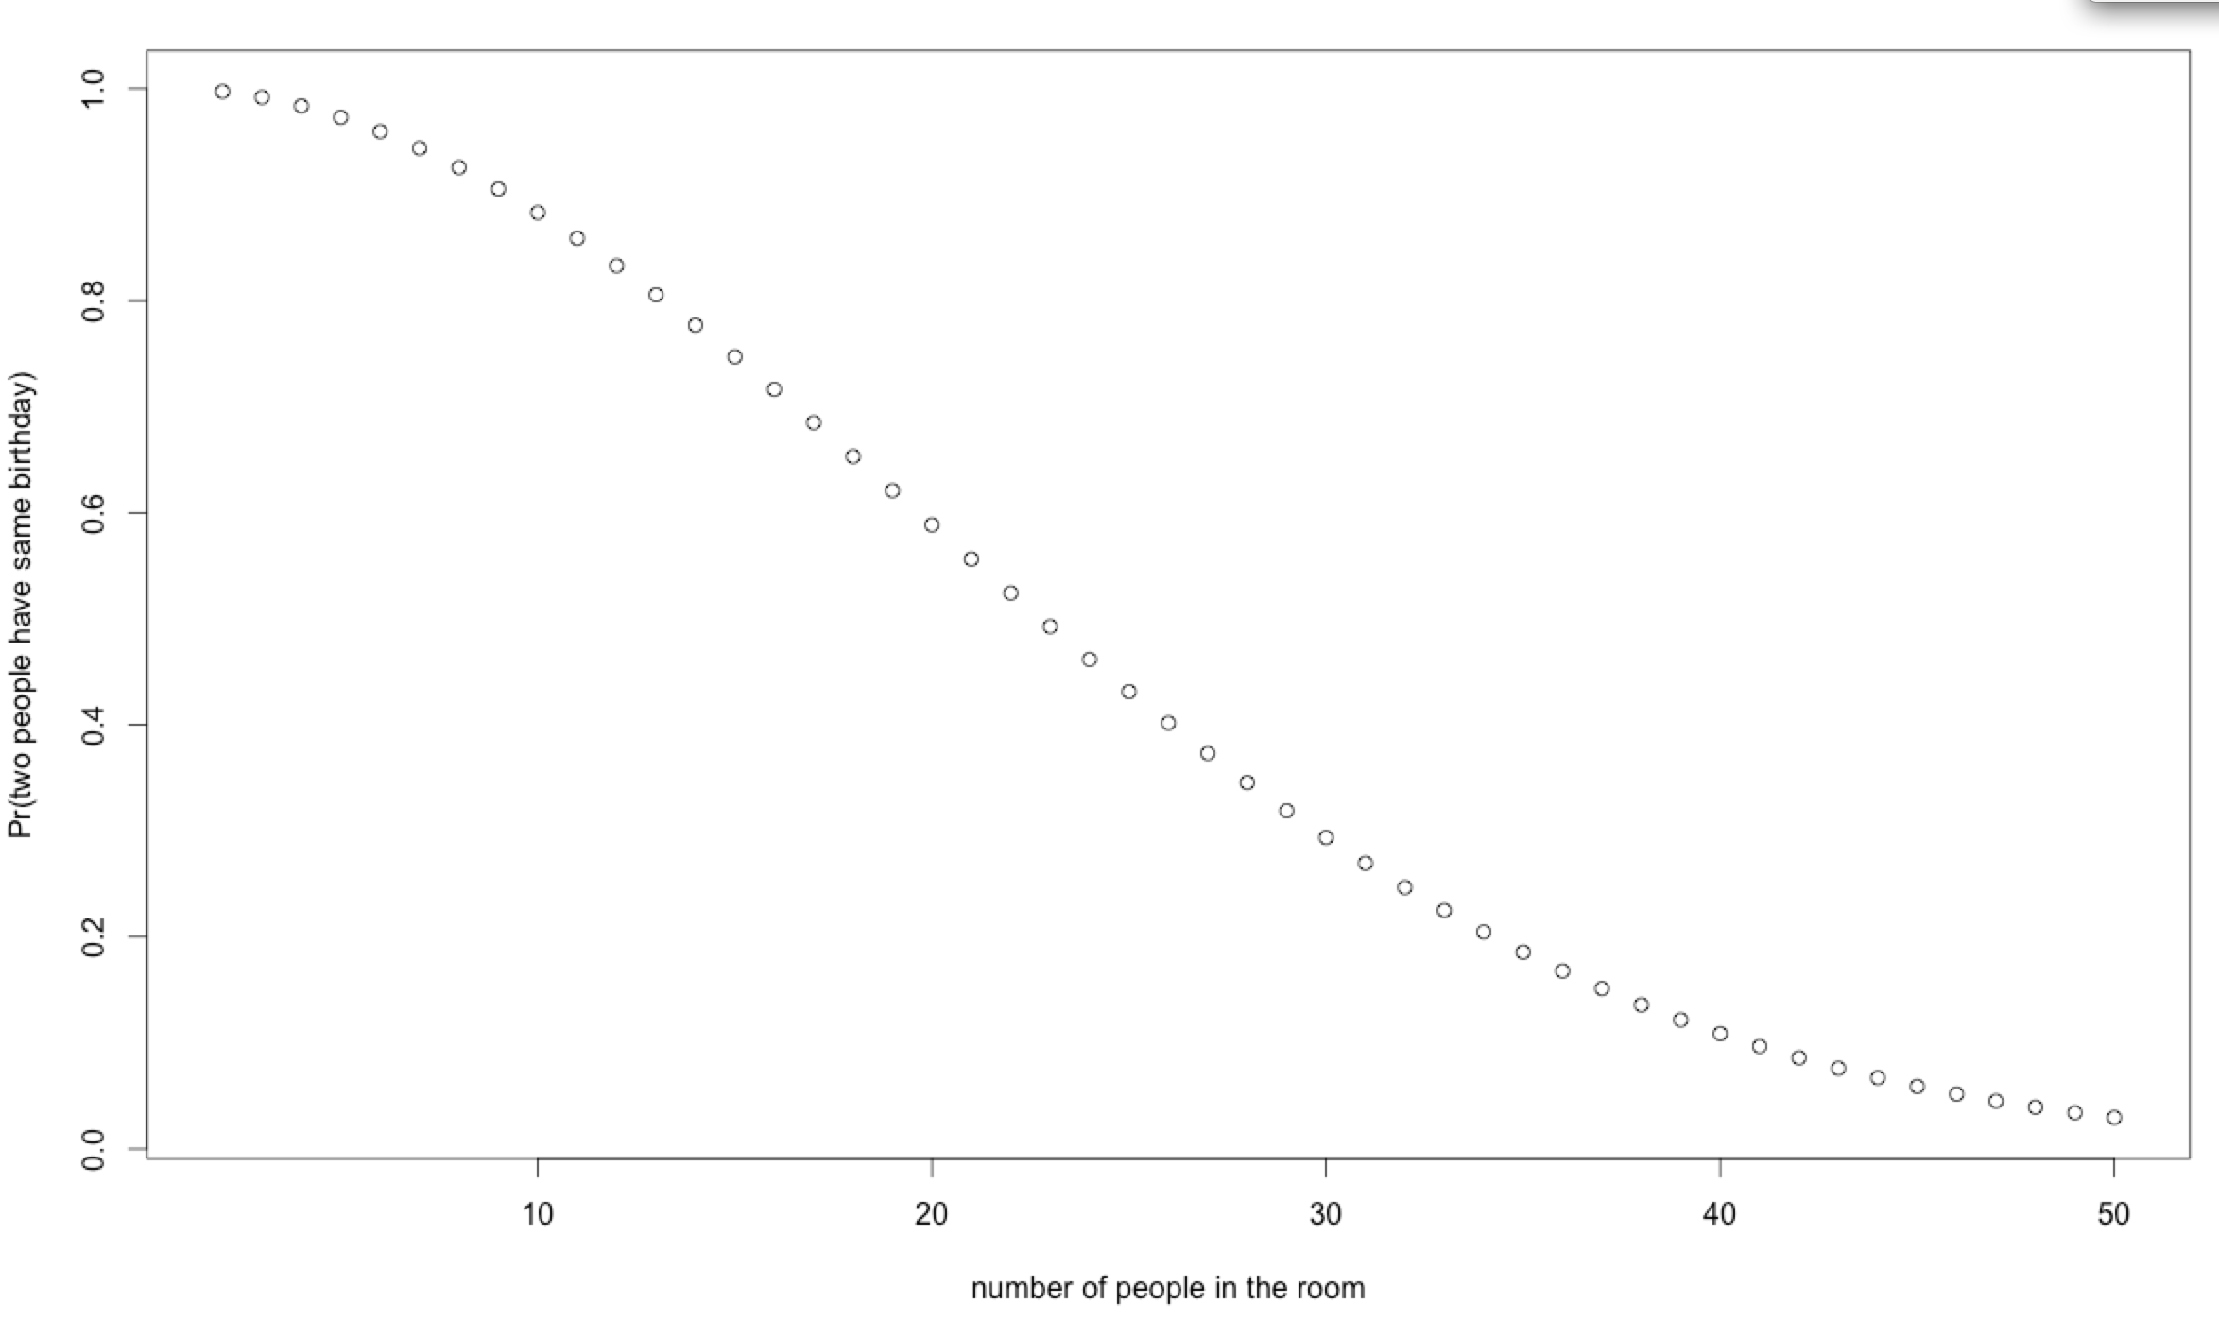
Example: The Birthday Problem
Graph of Pr(B_{n}) = The probability that in room with n-people, none share the same birthday:

Slide 38
The Birthday Problem and Simple Databases
Why do we care about the birthday problem in the forensic sciences?
Say you have a database containing n-observations of evidence
e.g. n-DNA profile from unrelated individuals.
Furthermore, say you estimate that the chance two randomly selected observations “match” is p.
i.e. the pair-wise random match probability (RMP) between two observations of evidence is estimated to be p.
The probability that the database contains at least one “matching” observation by random chance is:
pbirthday(n, classes = 1/p, coincident = 2)
Assuming a RMP of p, the probability that a database of size n contains at least one matching pair of observations is pbirthday in R:

Slide 39
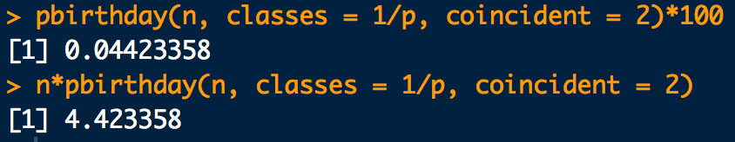
# Quoted odds of a random match:
O <- 1/(113e9)
# Corresponding RMP:
p <- O/(O+1)
p
# Database size:
n <- 10000
# (%) Probability of finding a random matching pair
pbirthday(n, classes = 1/p, coincident = 2)*100
# Number of random matching pairs one expect to
# find in the database:
n*pbirthday(n, classes = 1/p, coincident = 2)

Slide 40
The Birthday Problem and Simple Databases
Lets say we built a “research sized” database of 1000 tire tread marks from 1000 different tiresª. You’ve chosen a similarity metric to compute a “match” score between all unique pairs of tread marks. For a certain match/no-match cut-off score you find your system has a false match rate of 0.01%^{b}.
If you apply this system to a new database of 100 tread marks from different tires what is the probability that at least one “match” will be made by random chance?
# Pair-wise search of a database match problem:
fmr <- 0.0001
pbirthday(100, classes = 1/fmr, coincident = 2)
ªThis might not sound like much but it’s a lot of work!
^{b}This is pretty decent performance.

Slide 41
The Law of Total Probability
Suppose a sample space can be partitioned into a set of disjoint events B_{i} such that
B₁
B₄
B₃
A
B₂

Slide 42
The Law of Total Probability
Suppose a sample space can be partitioned into a set of disjoint events B_{i} such that
The probability of an arbitrary event A in Ω can be written as:
Law of total probability

Slide 43
Example: A medical test
Professor Shenkin LOVES hamburgers. But he’s also a hypochondriac. He thinks he is infected with “Mad Cow Disease” (MCD), so he gets himself tested (T).
The true positive rate of the test is: Pr(T⁺ | MCD⁺) = 0.7
The false positive rate of the test is: Pr(T⁺ | MCD⁻) = 0.1
The background prevalence of MCD in the yummy cow population is: Pr(MCD⁺) = 0.02
What is the probability that Prof. Shenkin tests positive for MCD, Pr(T⁺)?

Slide 44
Example: A medical test
# Data from the question:
Tp.given.MCDp <- 0.7
Tp.given.MCDm <- 0.1
MCDp <- 0.02
# Pr(T+) = Pr(T+ | MCD+) Pr(MCD+) + Pr(T+ | MCD-) Pr(MCD-)
Tp.given.MCDp * MCDp + Tp.given.MCDm * (1-MCDp)

Slide 45
There’s more than one way to condition:
Bayes’ Theorem
Intersection commutes:
So:
But from the multiplication rule we know:
So:
Bayes’ Theorem

Slide 46
Bayes’ Theorem
A slightly more general form for Bayes’ Theorem:
Suppose a sample space can be partitioned into a set of disjoint events B_{i} such that

Slide 47
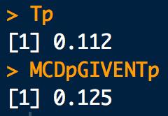
Example: A medical test again…
Suppose Professor Shenkin is positive for MCD. What is the probability that he truly has MCD, Pr(MCD⁺| T⁺)?
# Data from the question:
Tp.given.MCDp <- 0.7
Tp.given.MCDm <- 0.1
MCDp <- 0.02
# Pr(T+) = Pr(T+ | MCD+) Pr(MCD+) + Pr(T+ | MCD-) Pr(MCD-)
Tp.given.MCDp * MCDp + Tp.given.MCDm * (1-MCDp)
Tp
# Pr(MCD+ | T+) = Pr(T+ | MCD+) Pr(MCD+) / Pr(T+)
(Tp.given.MCDp * MCDp)/Tp

Slide 48
Statistical Independence
If A is independent of B then the probability of A is not affected by knowledge of B.
If A and B are statistically independent if:
If A and B do not satisfy the above they are statistically dependent

Slide 49
Example
76% of the light aircraft that disappear while in flight in a certain country are subsequently discovered (D). Of the aircraft that are discovered, 60% have an emergency locator (L), whereas 86% of the aircraft not discovered (D’) do not have such a locator (L’). Suppose a light aircraft has disappeared.
What is Pr(D’)?
What is Pr(L’|D)?
What is Pr(L|D’)?
What is Pr(L ∩ D)?
What is Pr(L ∩ D’)?
What is Pr(L)?
If the plane has an emergency locator, what is the probability it will not be discovered?
If the aircraft doesn’t have an emergency locator, what is the probability it will be discovered?

Slide 50
Example
76% of the light aircraft that disappear while in flight in a certain country are subsequently discovered (D). Of the aircraft that are discovered, 60% have an emergency locator (L), whereas 86% of the aircraft not discovered (D’) do not have such a locator (L’). Suppose a light aircraft has disappeared.
What is Pr(D’)?
What is Pr(L’|D)?
What is Pr(L|D’)?
What is Pr(L ∩ D)?
What is Pr(L ∩ D’)?
What is Pr(L)?
If the plane has an emergency locator, what is the probability it will not be discovered?
If the aircraft doesn’t have an emergency locator, what is the probability it will be discovered?

Slide 51
# Data from the question:
D <- 0.76
L.given.D <- 0.6
Ln.given.Dn <- 0.86
# Pr(D')
Dn <- 1-D
Dn
# Pr(L'|D) = 1 - Pr(L|D)
Ln.given.D <- 1 - L.given.D
Ln.given.D
# Pr(L|D')
L.given.Dn <- 1 - Ln.given.Dn
L.given.Dn
# Pr(L and D) = Pr(L|D) Pr(D)
L.and.D <- L.given.D * D
L.and.D
# Pr(L and D')
L.and.Dn <- L.given.Dn * Dn
L.and.Dn
# Pr(L) = Pr(L|D)Pr(D) + Pr(L|D')Pr(D')
L <- L.given.D * D + L.given.Dn * Dn
L
# Pr(D'|L) = Pr(L|D')Pr(D')/Pr(L)
Dn.given.L <- (L.given.Dn*Dn)/(L)
Dn.given.L
# Pr(D|L') = Pr(L'|D)Pr(D)/Pr(L')
D.given.Ln <- (Ln.given.D*D)/(1-L)
D.given.Ln

Slide 52
Example: People vs. Collins
A infamous example of the abuse of independence assumptions and the “Prosecutors Fallacy” is the People vs. Collins case in 1968. Eyewitness evidence in a robbery case was:
Black male with beard BMB.
Jury instructed to assume Pr(BMB) = 0.1
Male had moustache (MM).
Jury instructed to assume Pr(MM) = 0.25
White female with ponytail (WFP).
Jury instructed to assume Pr(WFP) = 0.1
Woman had blond hair (WB)
Jury instructed to assume Pr(WB) = 0.333
Getaway car was yellow (YC).
Jury instructed to assume Pr(YC) = 0.1
Jury instructed to assume an interracial couple is unlikely (IRC)
Jury instructed to assume Pr(IRC) = 0.001

Slide 53
Example: People vs. Collins
The defendants had all these characteristics. Prosecutor then suggests that the probability that another randomly selected couple (H_{d}) would have all of these characteristics (E) is:
ABUSE OF INDEPENDENCE!!!
The Prosecutor then concluded that the chance the defendants were innocent, Pr(H_{d}|E) was ≈ 1 × 10⁻⁸
Pr(H_{d}|E) = Pr(E|H_{d})
Prosecutors Fallacy.
NOT TRUE IN GENERAL!!!
Also called the fallacy of the reversed conditional

