Slide 1


Credit: David Pilkey, Prof. Poopypants
Introduction and Tutorial for

Slide 2

Why ?
R is not a black box!
Codes available for review; totally transparent!
R maintained by a professional group of statisticians, and computational scientists
From very simple to state-of-the-art procedures available
Very good graphics for exhibits and papers
R is extensible (it is a full scripting language)
Coding/syntax similar to Python and MATLAB
Easy to link to C/C++ routines

Slide 3
Why ?
Where to get information on R :
R: http://www.r-project.org/
Just need the base
RStudio: http://rstudio.org/
A great IDE for R
Work on all platforms
Sometimes slows down performance…
CRAN: http://cran.r-project.org/
Library repository for R
Click on Search on the left of the website to search for package/info on packages

Slide 4
Finding our way around R/RStudio
Script Window
Command Line

Slide 5
Handy Commands:
Basic Input and Output
Numeric input
x <- 4
variables:
store
information
Assignment operator
x <- “text goes in quotes”
Text (character) input

Slide 6
Handy Commands:
Get help on an R command:
If you know the name: ?command name
?plot brings up html on plot command
If you don’t know the name:
Use Google (my favorite)
??key word

Slide 7
Handy Commands:
R is driven by functions:
func(arguement1, argument2)
function name
input to function goes in parenthesis
function returns something; gets dumped into x
x <- func(arg1, arg2)

Slide 8
Using R functions: Example
Say we have a vector of some data. Let’s enter it into R:
-2π, -1.5π, …, 2π
# Enter in the vector of data:
dat <- c(-2*pi, -1.5*pi, -1*pi, -0.5*pi, 0, 0.5*pi, 1*pi,
1.5*pi, 2*pi)
c() is the “collect” function
Compute the sin() of each of your data points:
# Example of USING a function:
out <- sin(dat)
out

Slide 9
Plots: Look at your data
We will visualize our results as much as possible. Let’s make some basic plots!
Plot cosine from -5π to 2.8π, and use 100 data points
Handy R function we’ll use all the time
# seq generates a sequence:
x <- seq(from= -5*pi, to= 2.8*pi, length.out = 100)
y <- cos(x)
plot(x, y, type=“l”)
Defines “x-axis”
Extra argument to connect the points
Defines “y-axis”

Slide 10
How to Load Spreadsheets of Data:
Input from Excel
Save spreadsheet as a CSV file
Use read.csv function
Needs the path to the file
Mac e.g.:
"/Users/npetraco/latex/papers/data.csv”
Windows e.g.:
“C:\Users\npetraco\latex\papers\data.csv”
“C:\\Users\\npetraco\\latex\\papers\\data.csv”

Slide 11
How to Load Spreadsheets of Data:
Load a CSV file that is on your (mine actually…) Desktop. The file is called bigdata.csv and I made it in Excel:
This brings up the choose file menu instead
# Load the spreadsheet:
dat <- read.csv("/Users/npetraco/Desktop/bigdata.csv")
# We could also do this:
#dat <- read.csv(file.choose())
# Extract column 1
x <- dat[,1]
# Extract column 2
y <- dat[,2]
# Plot the data:
plot(x,y)

Slide 12
More Handy Commands:
Matrices: X
X[,1] returns column 1 of matrix X
X[3,] returns row 3 of matrix X
Handy functions for data frames and matrices:
dim, nrow, ncol, rbind, cbind
User defined functions syntax:
func.name <- function(arguements) {
do something
return(output)
}
To use it: func.name(values)

Slide 13
More Handy R Commands:
# Enter some data in a Matrix:
X <- rbind(
c(0.99, 0.92, 0.84, 0.39, 0.36),
c(0.87, 0.73, 0.80, 0.76, 0.87),
c(0.50, 0.11, 0.14, 0.43, 0.62),
c(0.08, 0.41, 0.68, 0.49, 0.02)
)
# What happens when we execute each of these line?:
X
X[1,3]
X[2,]
X[,1]
X[5,]
X[5]

Slide 14
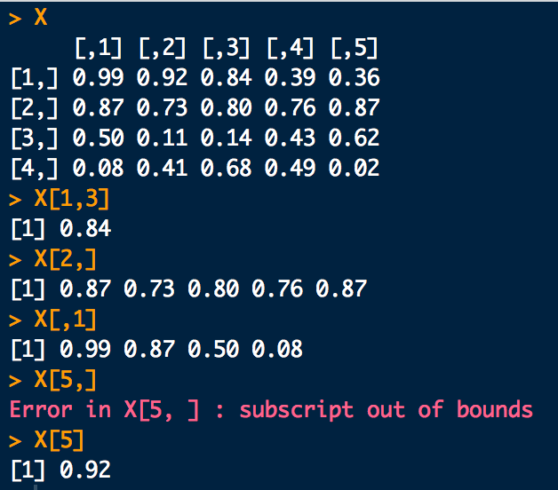
More Handy R Commands:

Slide 15
Brief example: Best fit line
# Data: GC-Ethanol from Daniel Azevedo
AreaRatio <- c(0.1716393,0.2905149,0.5521852,0.8684159,1.046752,1.279638)
Concentration <- c(0.05,0.1,0.2,0.3,0.4,0.5)
# Scatter plot:
plot(Concentration, AreaRatio)
# Best fit line:
fit <- lm(AreaRatio ~ Concentration)
# Plot the line on the scatter plot:
abline(fit)

Slide 16
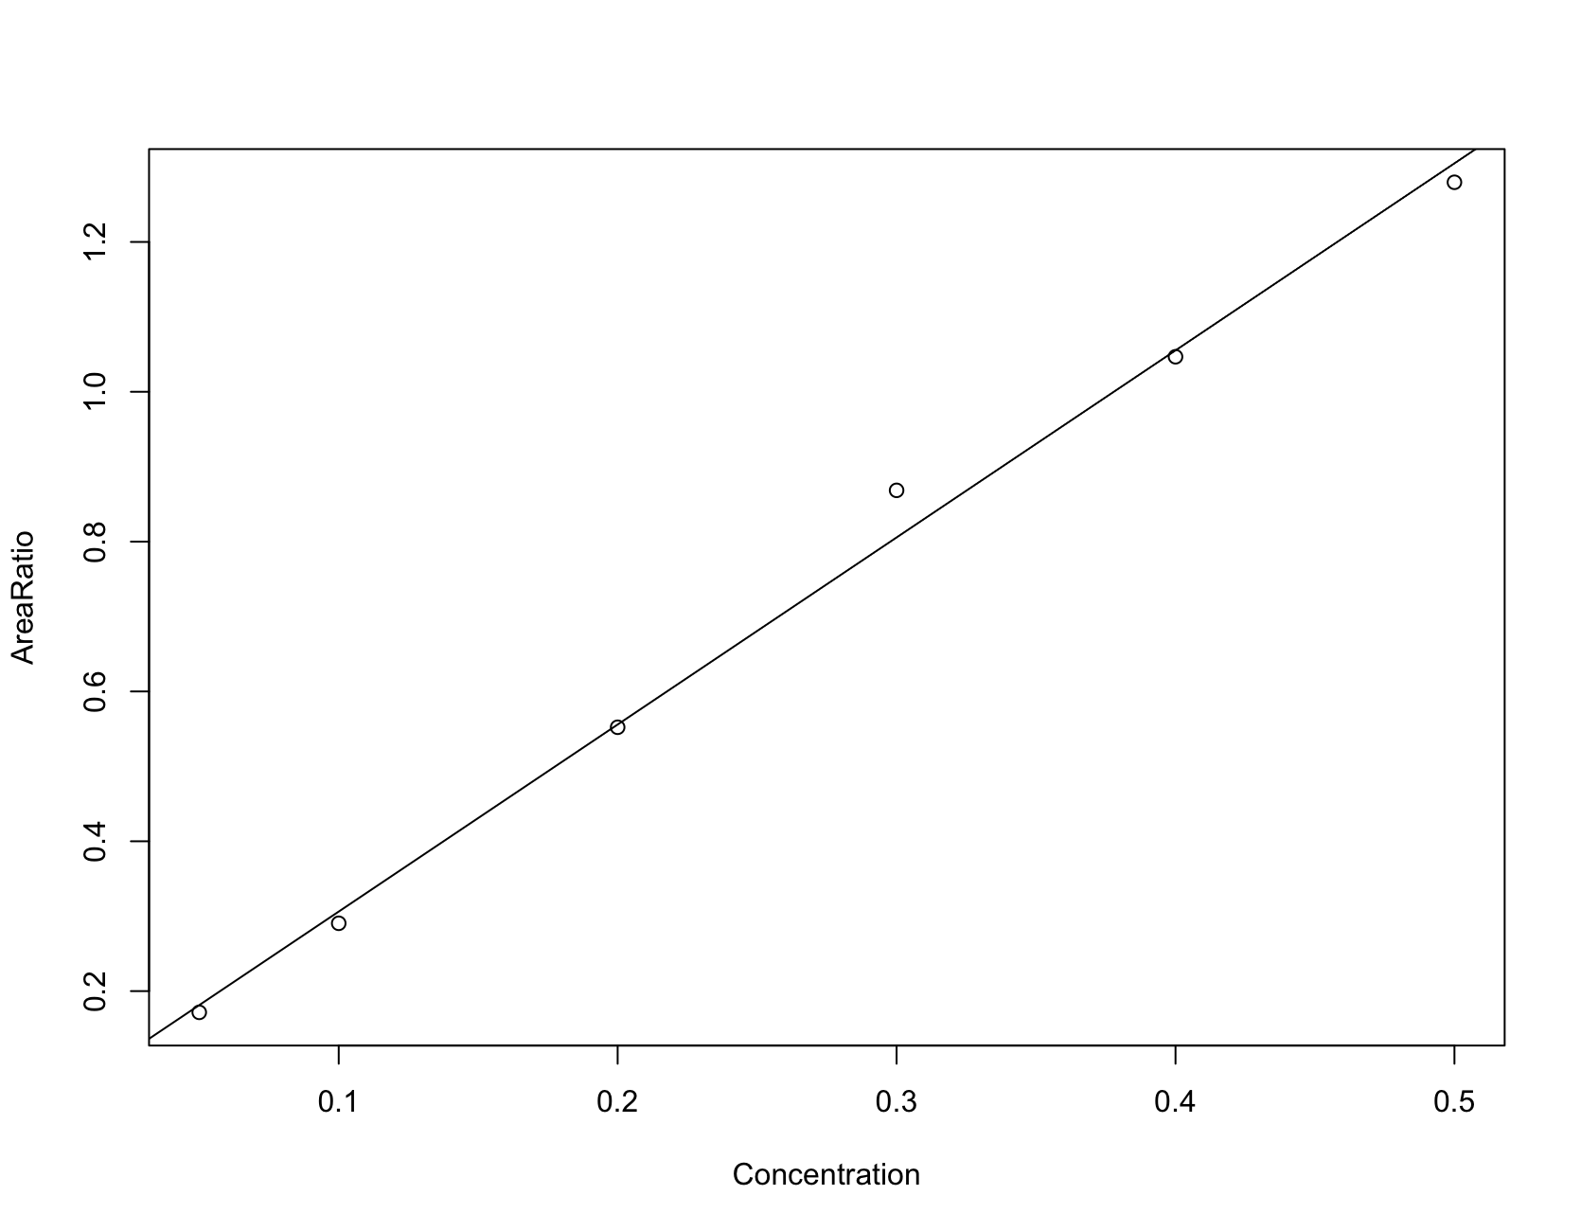
Brief example: Best fit line

Slide 17
R commands not to forget
<- (assignment or “gets”)
? (to get help with a command)
: (range operator)
c (“collect”)
sample
seq (generate a sequence)
plot
library
install.packages (to install libraries you don’t have)
For matrices and vectors: x[,3] vs. x[3,] vs. x[,] vs. x[3,3] vs. x[] vs. x[1:3] etc…

Slide 18

Graphing and Summarizing Data
Osborn

Slide 19
First Thing: Look at your Data
Some Handy Graphics

Slide 20
First Thing: Look at your Data
Scatter plots: plot any two variables against each other

Slide 21
First Thing: Look at your Data
Loading data from a spread sheet and scatter plots:
In R:
# Load Glass data from spread sheet. This was originally collected by the FSS:
# glass.dat <- read.csv("/Users/npetraco/latex/talks/CADOJ_17/Notes/data/Glass.csv", header = T)
glass.dat <- read.csv(file.choose(), header = T)
glass.dat
head(glass.dat)
# Scatter Plot:
plot(glass.dat[,4], glass.dat[,6])

Slide 22
First Thing: Look at your Data
Pairs plots: do many scatter plots at once

Slide 23
First Thing: Look at your Data
Gasoline data:

Slide 24
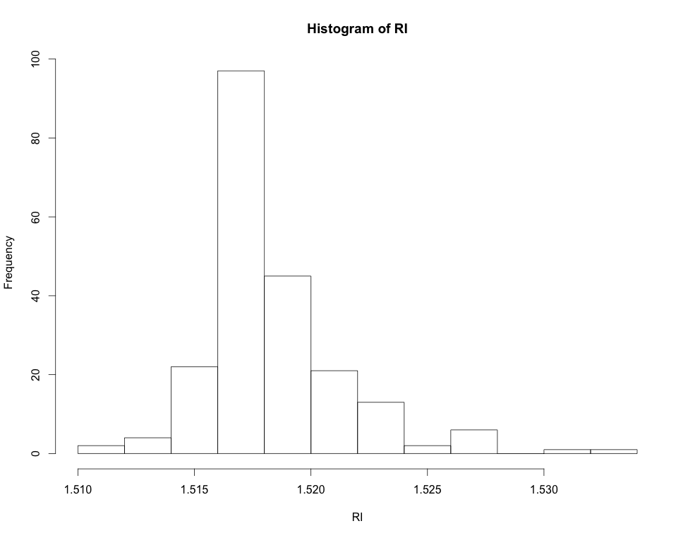
First Thing: Look at your Data
Histograms: “bin” a variable and plot frequencies

Slide 25
First Thing: Look at your Data
Histograms: “bin” a variable and plot frequencies
Each bar is a “bin” that contains a number of data points: counts

Slide 26
First Thing: Look at your Data
Histograms: counts in each bin:
library(mlbench) # Load a library containing some data
data(Glass) # Load Glass data set
Glass # Take a look at Glass
head(Glass) # Just look at the top of Glass
RI <- Glass[,1] # Pull out the RIs. They are in column 1
hist(RI) # Make a histogram for the RIs
In R:

Slide 27
First Thing: Look at your Data
Box and Whiskers plots:
range
possible
outliers
possible
outliers
25th-%tile
1st-quartile
median
50th-%tile
75th-%tile
3rd-quartile
RI

Slide 28
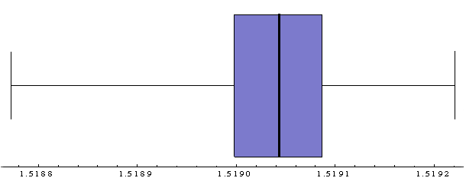
Visualizing Data
Note the relationship:

Slide 29
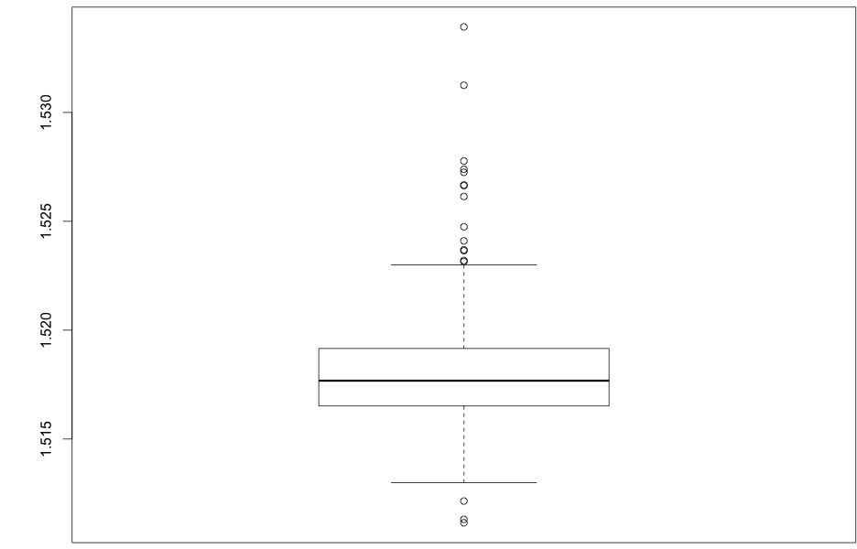
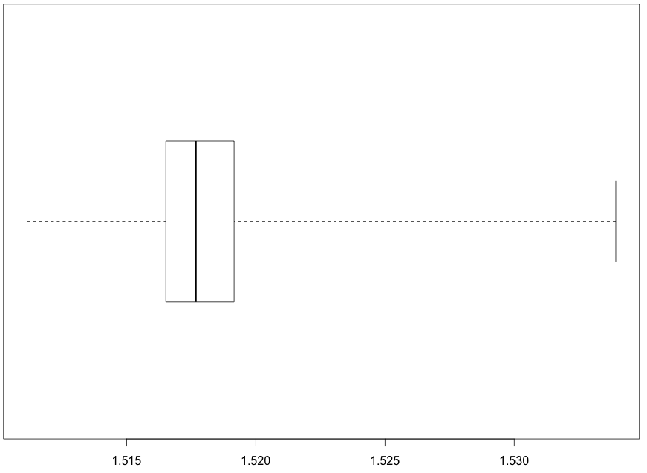
First Thing: Look at your Data
Box-and-whiskers:
# Box and whiskers plots
boxplot(RI)
boxplot(RI, horizontal = T, range = 0)
In R:
Result:

Slide 30
Next: Numbers to Summarize Data
Some Descriptive Statistics

Slide 31
Measures of Central Tendency
Given a sample from some population:
What is a good “summary” value which well describes the sample?
We will look at:
Average (arithmetic mean)
Median
Mode
For reference see (available on-line):
“The Dynamic Character of Disguised Behaviour for Text-based, Mixed and Stylized Signatures”
LA Mohammed, B Found, M Caligiuri and D Rogers
J Forensic Sci 56(1),S136-S141 (2011)

Slide 32
Histogram Points of Interest
Velocity for the first segment of genuine signatures in (soon to be classic) Mohammed et al. study.
What is a good summary number?
“Central Tendency”
How spread out is the data?

Slide 33
Measures of Central Tendency
Arithmetic sample mean (average):
The sum of data divided by number of observations:
intuitive formula
fancy formula

Slide 34
Measures of Central Tendency
Example from L.A.M. study:
Compute the average absolute size of segment 1 for the genuine signature of subject 2:
Subj. 2; Gen; Seg. 1 | Absolute Size (cm)
1 | 0.0548
2 | 0.2951
3 | 0.1026
4 | 0.1005
5 | 0.2491
6 | 0.1287
7 | 0.0496
8 | 0.2299
9 | 0.256
10 | 0.0538

Slide 35
Measures of Central Tendency
Example:
More useful: Consider again Absolute Average Velocity for Genuine Signatures across all writers in the LAM study:
92 subjects × 10 measurements/subject = 920 velocity measurements
Average Absolute Average Velocity:

Slide 36
Measures of Central Tendency
Sample median:
Ordering the n pieces of data from smallest value to largest value, the median is the “middle value”:
If n is odd, median is largest data point.
If n is even, median is average of and largest data points.

Slide 37
Measures of Central Tendency
Example from L.A.M. study:
Compute the median absolute size of segment 1 for the genuine signature of subject 2:
Subj. 2; Gen; Seg. 1 | Absolute Size (cm)
1 | 0.0548
2 | 0.2951
3 | 0.1026
4 | 0.1005
5 | 0.2491
6 | 0.1287
7 | 0.0496
8 | 0.2299
9 | 0.256
10 | 0.0538
Ordered
0.0496 0.0538 0.0548 0.1005 0.1026 0.1287 0.2299 0.2491 0.2560 0.2951

Slide 38
Measures of Central Tendency
Example:
Median of Average Absolute Velocity for Genuine Signatures, LAM:
Avg

Slide 39

Measures of Central Tendency
Load up LAM_study_mod.csv
# A nice set of plotting tools:
library(lattice)
# A realistic and complex data set commonly encountered in practice:
# Collected by Linton Mohammed http://www.qdexams.com/
dat <- read.csv("/Users/npetraco/latex/papers/linton_handwriting/LAM_study_mod.csv",header=TRUE)
# A trick to refer to columns directly by name instead of indices...
attach(dat)
names(dat)
levels(Subject)
levels(Condition)
# Pluck out some data to take a closer look at:
samp.of.data <- dat[which(Condition=="GEN" & Segment==1), ]
colnames(samp.of.data)
AvgAbsVelocity <- samp.of.data[,9]
length(AvgAbsVelocity)
histogram(AvgAbsVelocity)
# Mean and median of sample:
mean(AvgAbsVelocity)
median(AvgAbsVelocity)

Slide 40


Measures of Central Tendency
Sample mode:
Needs careful definition but basically:
The data value that occurs the most
Tabulate the data and see which value(s) occur the most:
Sample:
mode

Slide 41
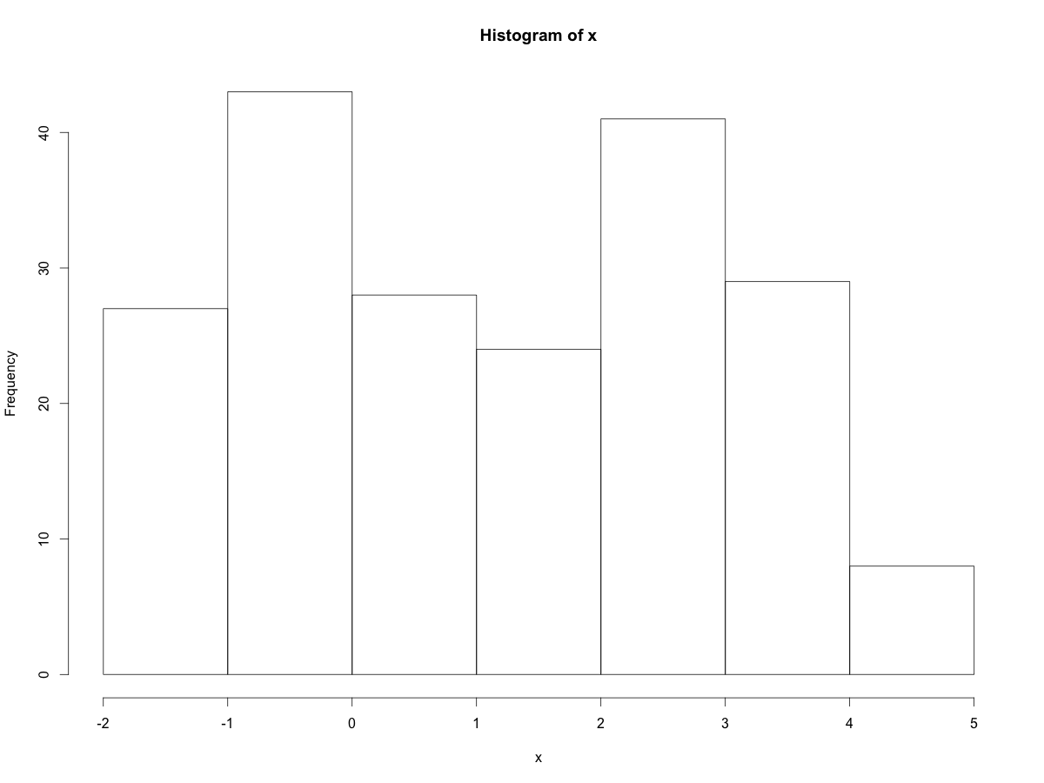
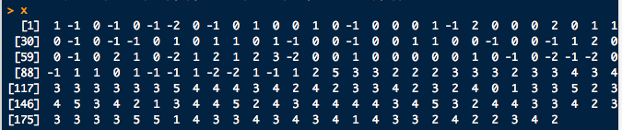

Measures of Central Tendency
Sample mode:
Computing modes can get tricky if there are more than one (multi-modal)
Sample:
modes…

Slide 42
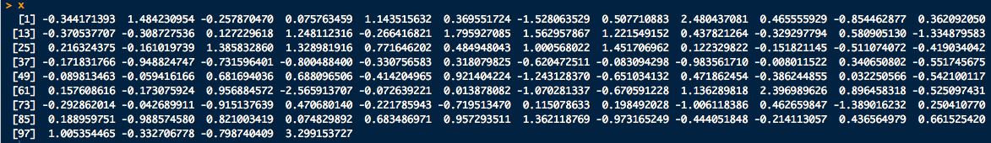
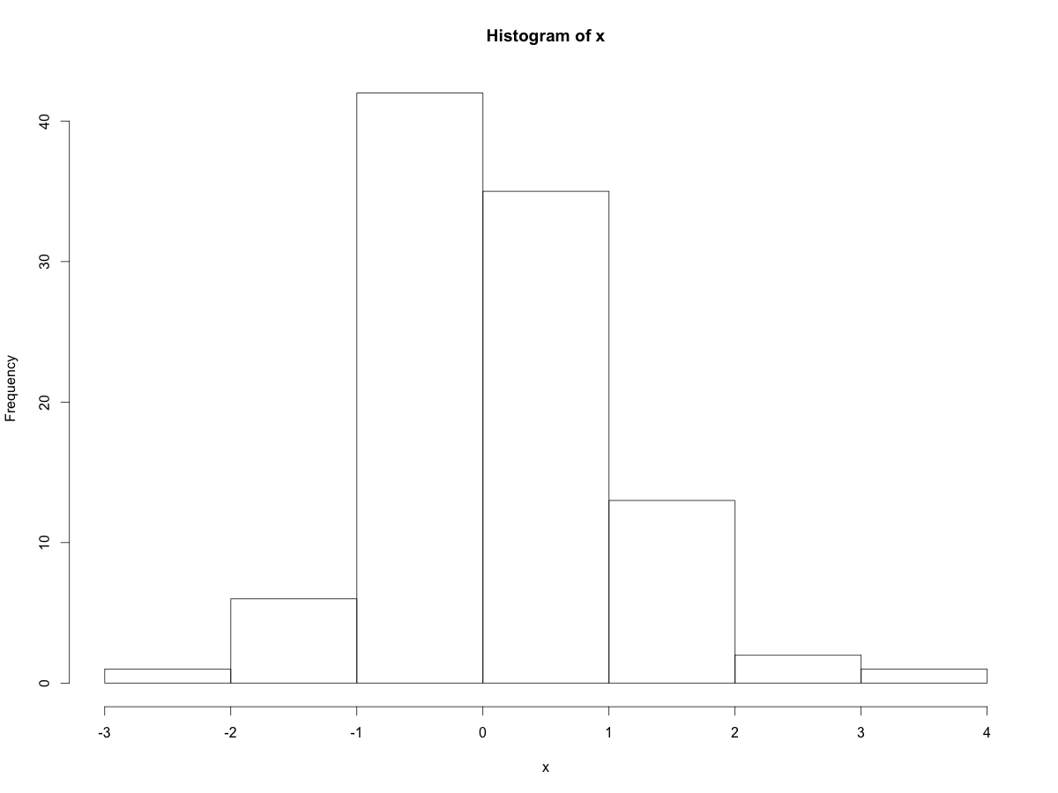
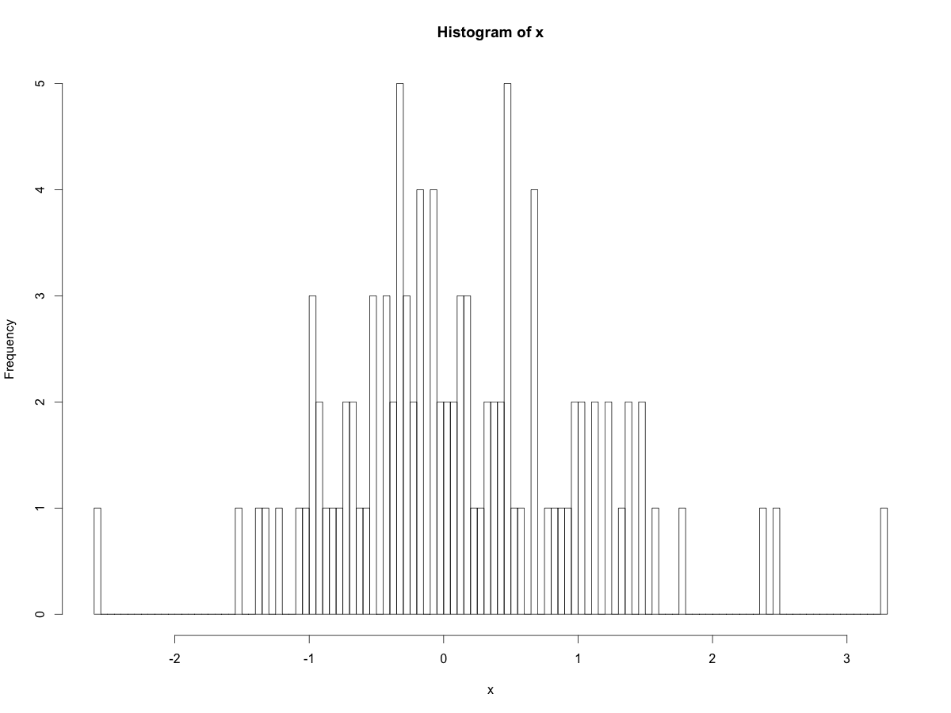
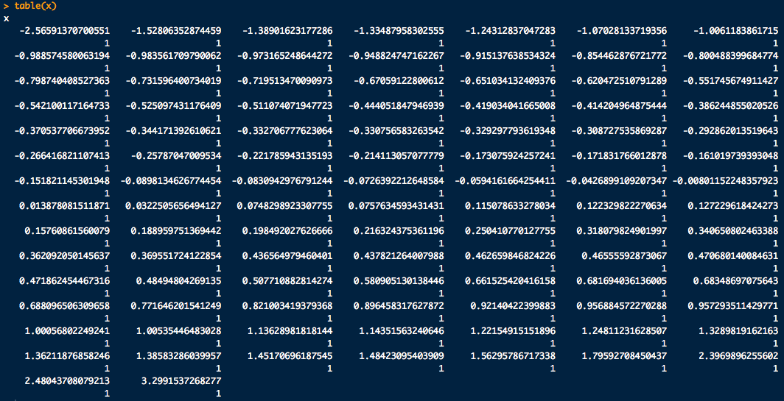
Measures of Central Tendency
Sample mode:
What’s the mode here?
Sample:

Slide 43
Measures of Central Tendency
Sample mode:
Mode of Average Absolute Velocity for Genuine Signatures, LAM:
# Mode: (kind of.... AVOID!):
AvgAbsVelocity[rev(order(table(AvgAbsVelocity)))[1]]
mode = 9.2541
Med
Avg

Slide 44
Measures of Central Tendency
Some trivia:
Modes
Mean
Nice and symmetric:
Mean = Median = Mode

Slide 45
Measures of Data Spread
Sample variance:
(Almost) the average of squared deviations from the sample mean.
there are n data points
sample mean
data point i
Standard deviation is
The sample average and standard dev. are the most common measures of central tendency and spread
Sample average and standard dev have the same units

Slide 46
Measures of Data Spread
Standard deviation is “instructive” to do by hand a few times:
Compute the standard deviation of the following blood alcohol volumes assayed in 10 samples of 10 μL of blood drawn from a drunk driving suspect (units: nL):
7.97, 7.80, 7.79, 8.12, 8.12, 8.22, 8.03, 7.97, 7.88, 8.08
To prevent writers cramp:
sd(c(7.97, 7.80, 7.79, 8.12, 8.12, 8.22, 8.03, 7.97, 7.88, 8.08))

Slide 47
Measures of Data Spread
Sample range:
The difference between the largest and smallest value in the sample
Very sensitive to outliers (extreme observations)
Percentiles:
The p^{th} percentile data value, x, means that p-percent of the data are smaller than or equal to x.
Median = 50th percentile

Slide 48
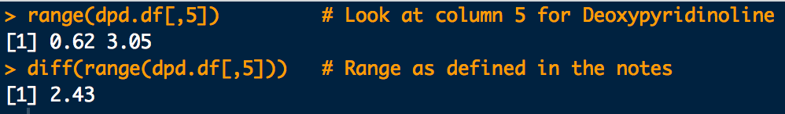
Measures of Data Spread
What is the sample range of deoxypyridinoline conc?
0.62, 0.64, 1.14, 1.04, 1.07, 1.83, 1.32, 1.19, 1.28, 0.85, 1.36, 1.16, 1.00, 1.69, 1.62, 1.25, 1.49, 1.45, 1.14, 2.40, 3.05, 2.81
# Dr. James Curran's dafs (http://www.stat.auckland.ac.nz/~curran)
# dpd.df <- read.csv(file.choose())
library(dafs)
data(dpd.df) # Deoxypyridinoline data
range(dpd.df[,5]) # Look at column 5 for Deoxypyridinoline
# concentration and get its range
diff(range(dpd.df[,5])) # Range as defined in the notes

Slide 49
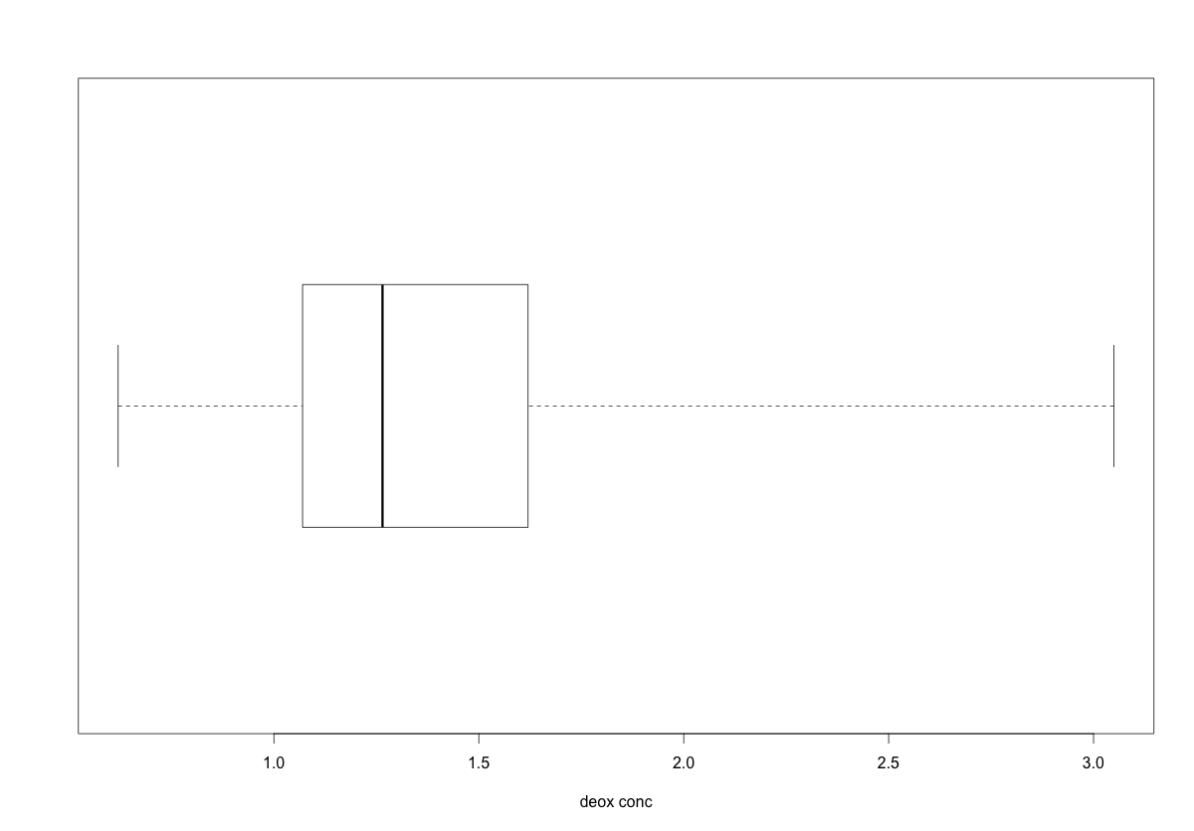
Measures of Data Spread
Box-and-whisker plot again for reference
Deoxypyridinoline conc?
0.62, 0.64, 1.14, 1.04, 1.07, 1.83, 1.32, 1.19, 1.28, 0.85, 1.36, 1.16, 1.00, 1.69, 1.62, 1.25, 1.49, 1.45, 1.14, 2.40, 3.05, 2.81
range
25th-%tile
1st-quartile
median
50th-%tile
75th-%tile
3rd-quartile
# Box and whiskers plots:
boxplot(dpd.df[,5], horizontal = T, range = 0, xlab = "Deoxypyridinoline conc.”)
summary(dpd.df[,5]) # Common summary statistics

Slide 50
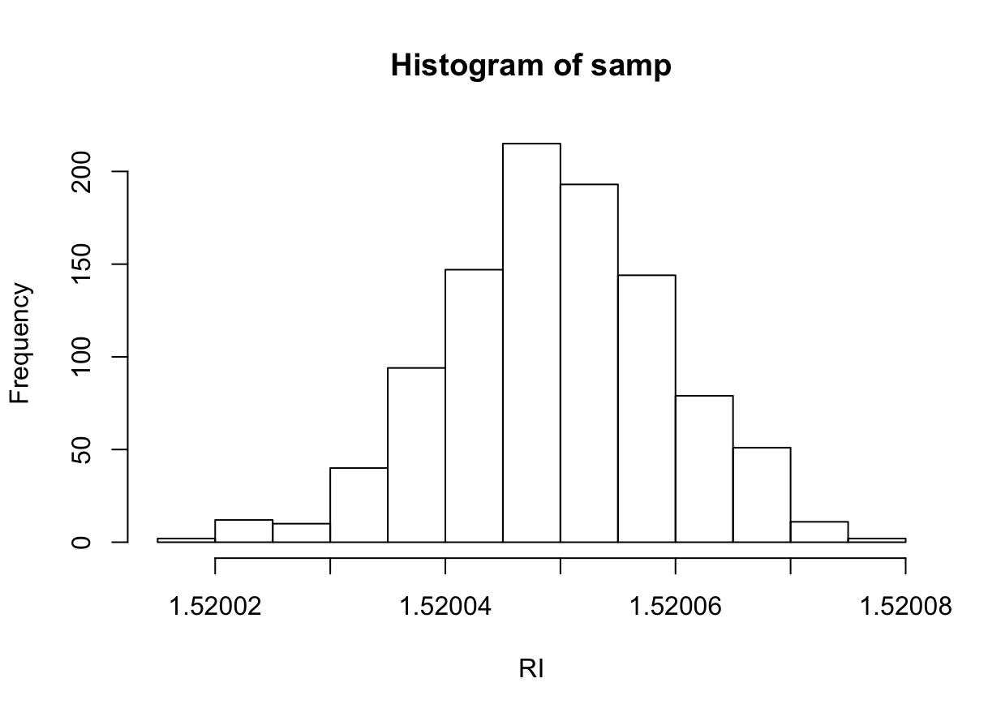
Measures of Data Spread
First 99% of the data is up to here
First 1% of the data is uo to here
99th-%tile
1st-%tile
1.520024
1.520071

Slide 51
Measures of Data Spread
# Finding quantiles:
# First lets get some (fake) data:
samp <- rnorm(1000, mean = 1.52005, sd = 0.00001)
hist(samp, xlab="RI")
# 1% and 99% quantiles of the data
quantile(samp, probs = c(0.01, 0.99))

