Slide 1
Regression

Slide 2
Basic Linear Regression
Remember the equation of a line:
As scientists, we find it an irresistible temptation to put a straight line though something that looks like it needs one…
How do we do this in a principled, systematic way??

Slide 3
Basic Linear Regression
Simple univariate linear model:
response variable
error
explanatory or predictor
variable
intercept
regression coefficients
In simple linear regression, error is assumed to be normally distributed with mean 0 and sd σ
Estimated from the data

Slide 4
Basic Linear Regression
y
x

Slide 5
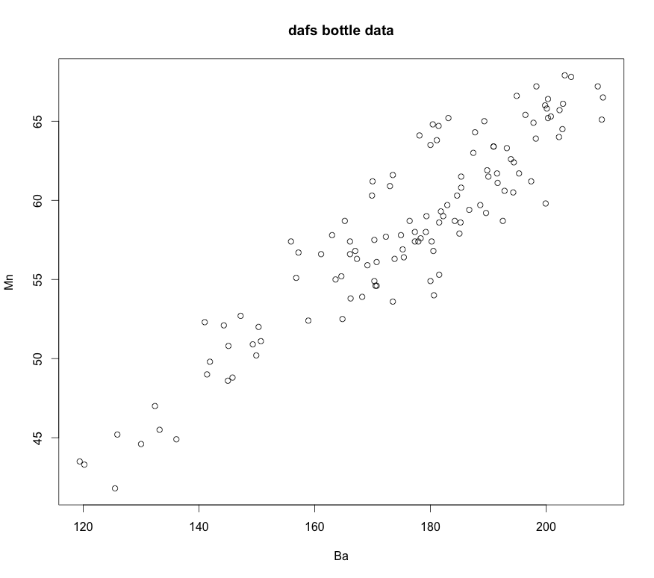
Basic Linear Regression

Slide 6
Basic Bayesian Linear Regression
Frequentist formulation
A Bayesian formulation
Likelihood
Data model
Priors

Slide 7
Basic Bayesian Linear Regression
data {
int<lower=0> N;
vector[N] x;
vector[N] y;
int<lower=0> Nnew;
vector[Nnew] xnew;
}
parameters {
real alpha;
real<lower=0> beta;
real<lower=0> sigma;
}
model {
// Priors on regression coef, intercept and noise
alpha ~ cauchy(0,1);
beta ~ cauchy(0,5);
sigma ~ normal(0,1);
// Likelihood (vectorized form)
y ~ normal(alpha + beta * x, sigma);
}
generated quantities {
vector[Nnew] mu_pred;
vector[Nnew] y_tilde;
// The average responses predicted by the model
mu_pred = alpha + beta * xnew;
// Future responses predicted by the model
for (i in 1:Nnew){
y_tilde[i] = normal_rng(mu_pred[i], sigma);
}
}
Stan model

Slide 8
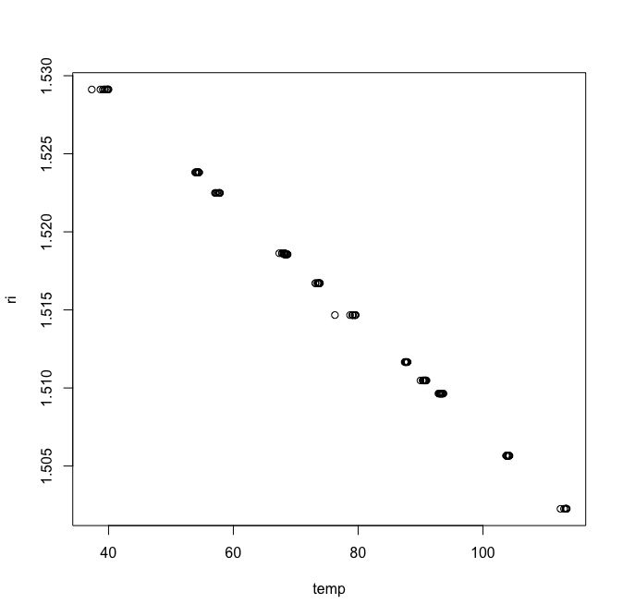
Example
Consider the oil temperature data vs. refractive indices from dafs:

Slide 9
Example
Fit a calibration line to this data assuming the Bayesian model:
Data model
Priors

Slide 10
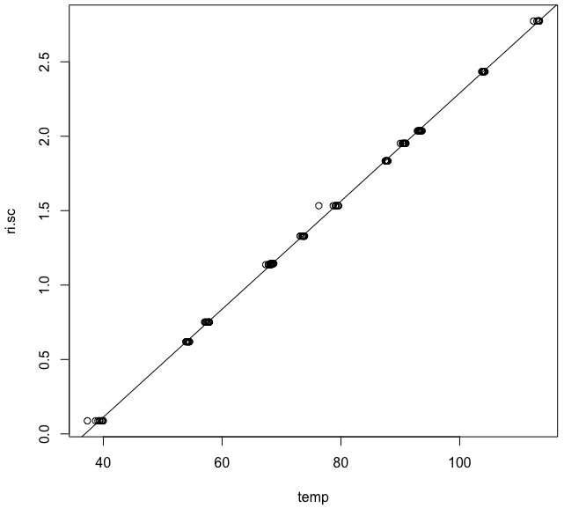

Example
library(rstan)
library(dafs)
# Load up the plot data:
data("ri.calibration.df")
temp <- ri.calibration.df[,3] # Temperatures
ri <- ri.calibration.df[,2] # RIs
ri.sc <- (1.53 - ri)*100 # Re-Scale y-axis
plot(temp, ri)
plot(temp, ri.sc)
# Standard MLE linear regression:
mle.fit <- lm(ri.sc ~ temp)
summary(mle.fit)
abline(mle.fit)

Slide 11
Example
# Bayesian linear regression with Stan:
# Make up a set of temperature values on
# which to make RI predictions
temp.new <- seq(min(temp), max(temp), length.out = 100)
n <- length(temp)
n.new <- length(temp.new)
dat <- list(N = n,
x = temp,
y = ri.sc,
Nnew = n.new,
xnew = temp.new
)
# Compile and run the model:
stan.c <-"
data {
int<lower=0> N;
vector[N] x;
vector[N] y;
int<lower=0> Nnew;
vector[Nnew] xnew;
}
parameters {
real alpha;
real beta;
real<lower=0> sigma;
}
model {
alpha ~ cauchy(0,1);
beta ~ cauchy(0,5);
sigma ~ normal(0,1);
y ~ normal(alpha + beta * x, sigma);
}
generated quantities {
vector[Nnew] mu_pred;
vector[Nnew] y_tilde;
mu_pred = alpha + beta * xnew;
for (i in 1:Nnew){
y_tilde[i] = normal_rng(mu_pred[i], sigma);
}
}”

Slide 12
Example
#rstan_options(auto_write = TRUE)
#options(mc.cores = parallel::detectCores())
# Compile and run the model
model.c <- stanc(model_code = stan.c, model_name = 'model1')
sm <- stan_model(stanc_ret = model.c, verbose = T)
#bayes.fit <- sampling(sm, data = dat, iter=10000, thin = 1, chains = 4)
bayes.fit <- sampling(sm, data = dat, iter=50000, thin = 10, chains = 4, control = list(adapt_delta = 0.9))
bayes.fit
# Examine the sampling output in more detail:
alpha <- extract(bayes.fit,"alpha")[[1]]
plot(alpha, typ="l", main="Trace")
hist(alpha, bre=80, probability = T)
acf(alpha)
mean(alpha)
median(alpha)
beta <- extract(bayes.fit,"beta")[[1]]
plot(beta, typ="l", main="Trace")
hist(beta, bre=80, probability = T)
acf(beta)
mean(beta)
median(beta)
sigma <- extract(bayes.fit,"sigma")[[1]]
plot(sigma, typ="l", main="Trace")
hist(sigma, bre=80, probability = T)
acf(sigma)
mean(sigma)
median(sigma)
Checks

Slide 13
Example
# -------All lines fit from posterior parameters-------
plot(temp, ri.sc)
abline(a = median(alpha), b = median(beta), col="green")
for(i in 2:length(beta)) {
abline(alpha[i],beta[i], col="green")
}
# -------Confidence bounds-------
plot(temp, ri.sc)
mu.pred <- extract(bayes.fit,"mu_pred")[[1]]
cred.bounds <-array(NA, c(length(temp.new), 4))
prob <- 0.95
eps <- 1 - prob
for(i in 1:length(temp.new)) {
cred.bounds[i,] <- c(min(mu.pred[,i]), max(mu.pred[,i]), quantile(mu.pred[,i], probs = c(eps/2, 1-eps/2)))
}
# Max extent:
lines(temp.new, cred.bounds[,1])
lines(temp.new, cred.bounds[,2])
# Probability bounds:
lines(temp.new, cred.bounds[,3], col="red")
lines(temp.new, cred.bounds[,4], col="red")
Plot confidence bounds

Slide 14
Example
# -------Prediction bounds-------
y.pred <- extract(bayes.fit,"y_tilde")[[1]]
pred.bounds <-array(NA, c(length(temp.new), 4))
prob <- 0.95
eps <- 1 - prob
for(i in 1:length(temp.new)) {
pred.bounds[i,] <- c(min(y.pred[,i]), max(y.pred[,i]), quantile(y.pred[,i], probs = c(eps/2, 1-eps/2)))
}
plot(temp, ri.sc)
abline(a = median(alpha), b = median(beta), col="green")
# Max extent:
lines(temp.new, pred.bounds[,1])
lines(temp.new, pred.bounds[,2])
# Probability bounds:
lines(temp.new, pred.bounds[,3], col="red")
lines(temp.new, pred.bounds[,4], col="red")
Plot prediction bounds

