Slide 1

Important Probability Distributions

Slide 2
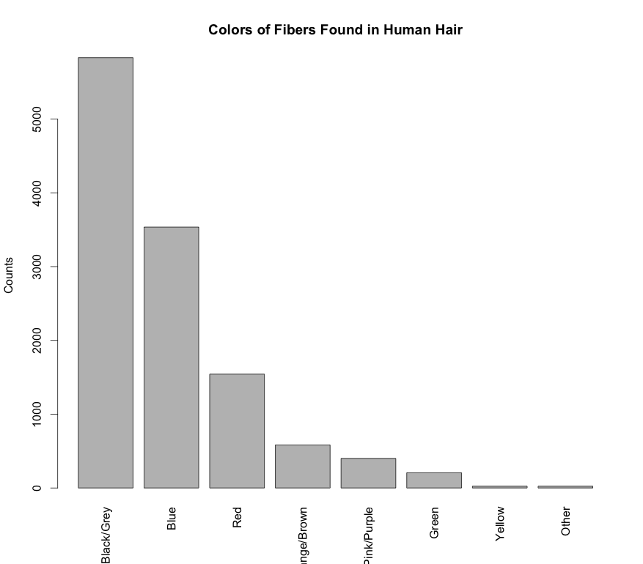
Probability Mass Function
Probability over a discrete set of outcomes is described by a probability mass function (PMF)
A PMF can be represented as a table or displayed as a histogram
Fiber Color | Probability
Black/Grey | 0.48
Blue | 0.291
Red | 0.127
Orange/Brown | 0.048
Pink/Purple | 0.033
Green | 0.017
Yellow | 0.002
Other | 0.002
library(dafs)
data("fiber.color.df")
table(fiber.color.df)
barplot(fiber.color.df[,3], names.arg = fiber.color.df[,1],
las=3, ylab = "Counts", xlab="",
main="Colors of Fibers Found in Human Hair")

Slide 3
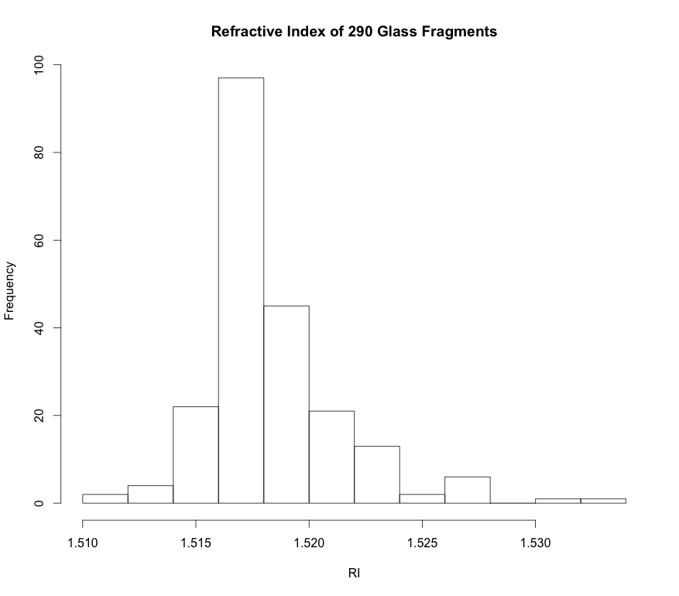
Example: Probability Mass Function For Some Glass RI
library(dafs)
data(Glass)
hist(Glass[,1], xlab="RI", main="Refractive Index of 290 Glass Fragments")
Continuous data treated as if it were discrete

Slide 4
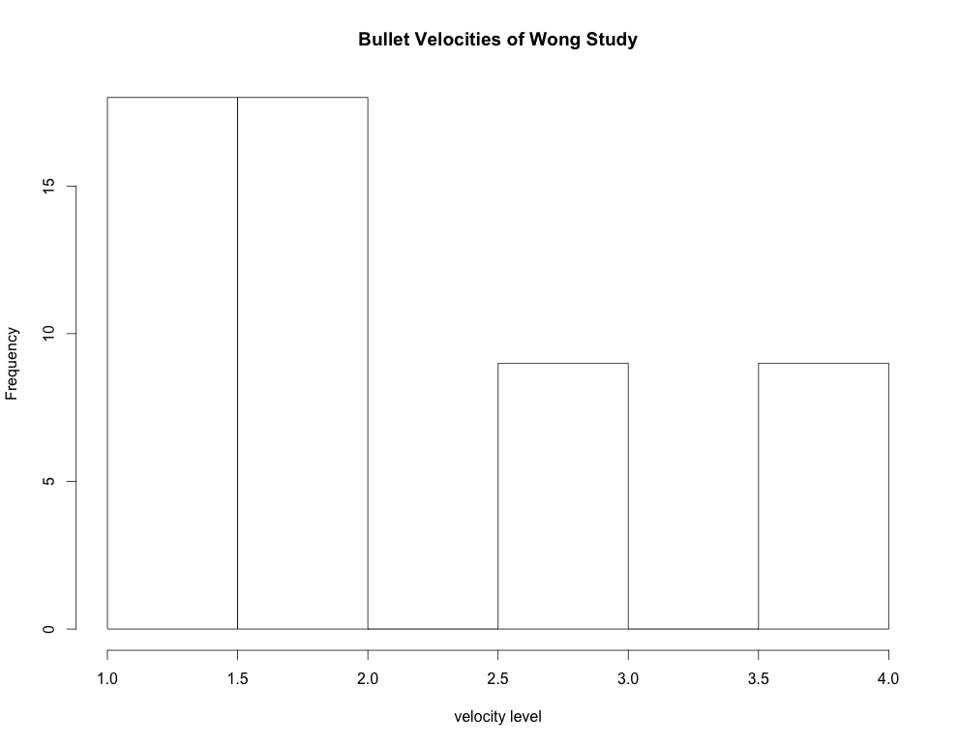
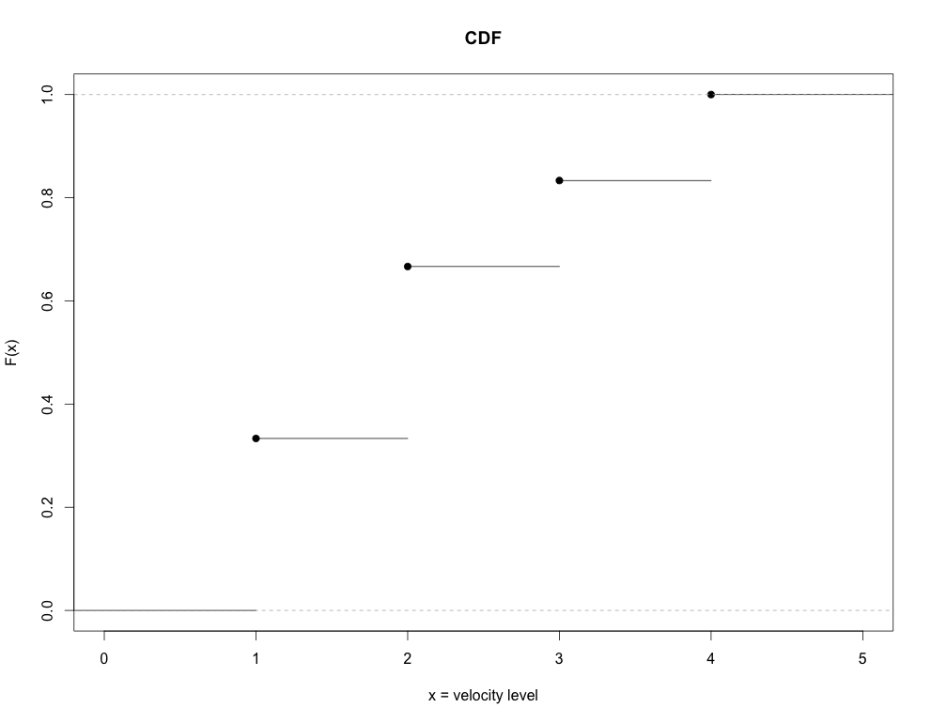
Cumulative Distribution Function
A function that gives the probability that a random variable is less than or equal to a specified value is a cumulative distribution function (CDF):
Varies between 0 and 1
CDFs for discrete RVs are step functions

Slide 5
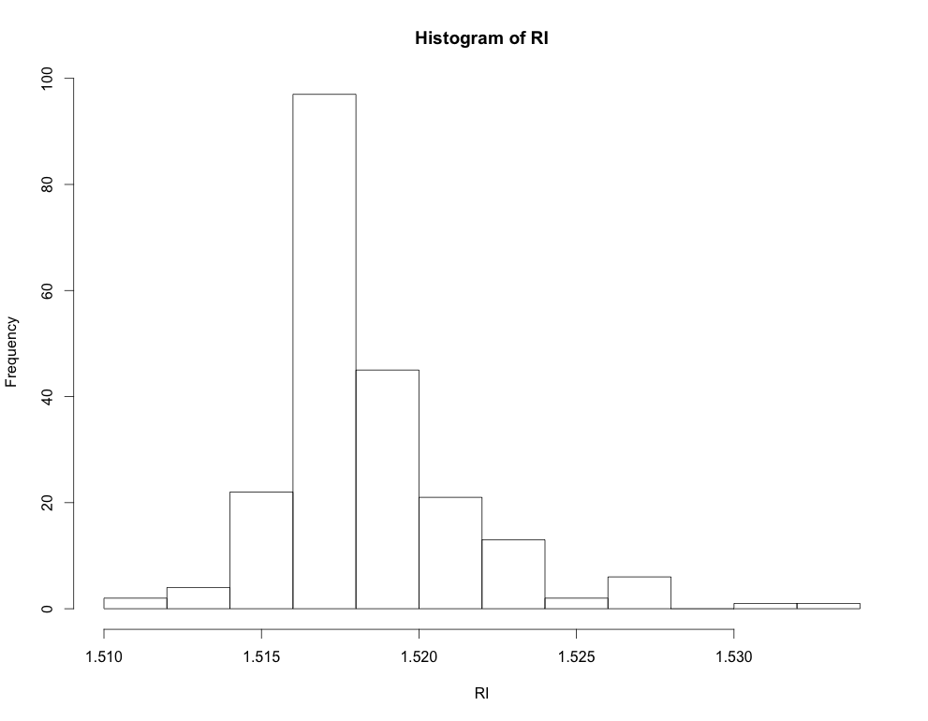
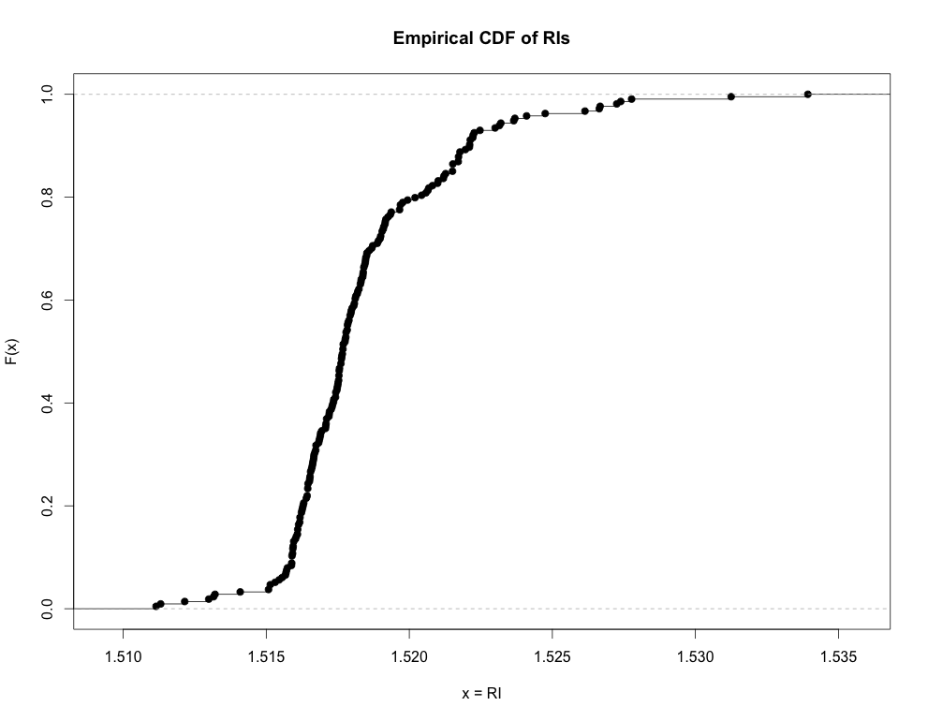
Cumulative Distribution Function
The same mathematical machinery can be used compute a CDF for a histogram of any data type:
ordinal-discrete (previous slide)
artificially ordered nominal-discrete
*continuous treated as if it were discrete (empirical CDF)
library(mlbench)
data(Glass)
RI <- Glass[,1]
hist(RI)
plot(ecdf(RI), ylab="F(x)", xlab="x=RI", main="Empirical CDF of RIs")

Slide 6
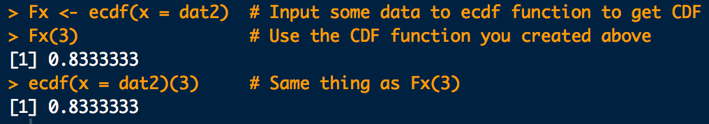
Cumulative Distribution Function
In R we can compute the empirical CDF, F(x) like this:
dat <- c(
1,1,1,1,1,1,1,1,1,1,1,1,1,1,1,1,1,1,
2,2,2,2,2,2,2,2,2,2,2,2,2,2,2,2,2,2,
3,3,3,3,3,3,3,3,3,
4,4,4,4,4,4,4,4,4
)
Fx <- ecdf(dat)
Fx(3)
ecdf(dat)(3)
Don’t name anything “F” in R.
F(x = 3)
Pr(X ≤ 3)

Slide 7
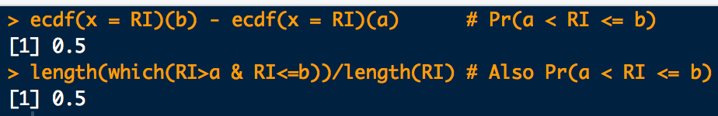
Cumulative Distribution Function
Use the CDF to compute the probability that a RV will lay between two specified values such that:
a <- 1.51593
b <- 1.51820
# Pr(a<RI<=b)
ecdf(x = RI)(b) - ecdf(x = RI)(a)
# Also Pr(a<RI<=b)
length(which(RI > a & RI <= b))/length(RI)
F(b)
F(a)
a
b

Slide 8
Moments and Expectation Values
Moments are handy numerical values that can systematically help to describe distribution location and shape properties.
m^{th}-order moments are found by taking the expectation value of an RV raised to the m^{th}-power:

Slide 9
Moments and Expectation Values
1st-order moment:
Number of times outcome x_{i} occurs
Total number of experiments
average value of X

Slide 10
Moments and Expectation Values
1st-order moment:
location descriptor
mean
average value of X
1st-order moment for a parameter g(X) on X:
average value of parameter g

Slide 11
Moments and Expectation Values
2nd-order moments:
Second order moment. Not that interesting…
but…
Second order central moment.
It can be shown that
Population standard deviation
spread descriptor

Slide 12
Moments and Expectation Values
Higher-order moments measure other distribution shape properties:
3rd order: “skewness”
4th order: “kurtosis” (pointy-ness/flat-ness)
no skew
leptokurtic
left skew
right skew
platykurtic

Slide 13
Bernoulli Distribution
Bernoulli PMF: “Coin Flipping” distribution
Probability of a “Heads” (success) is p
Probability of a “Tails” (fail) is 1 − p

Slide 14
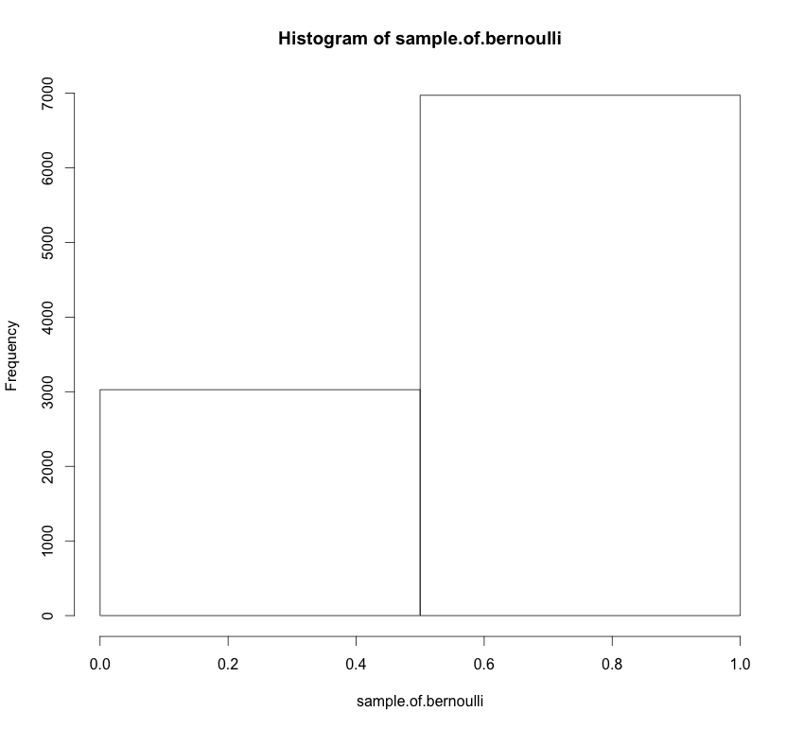
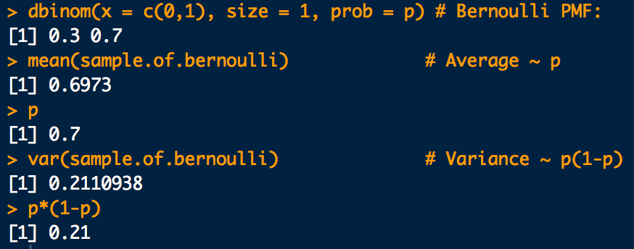
Bernoulli Distribution
Mean:
Variance:
p <- 0.7 # Probability of a "Heads" (a success)
bernoulli.pmf <- dbinom(x = 1:0, size = 1, prob = p)
plot(1:0,bernoulli.pmf, typ="h", main="Bernoulli PMF",xlab="x (heads=1, tails=0)",ylab="Pr(X)")
# A sample of 10,000 "coin flips”:
sample.of.bernoulli <- rbinom(10000, size = 1, prob = p)
hist(sample.of.bernoulli, xlim=c(0,1), xlab="x (heads=1, tails=0)", bre=2)
mean(sample.of.bernoulli) # Average ~ np
var(sample.of.bernoulli) # Variance ~ np(1-p)

Slide 15
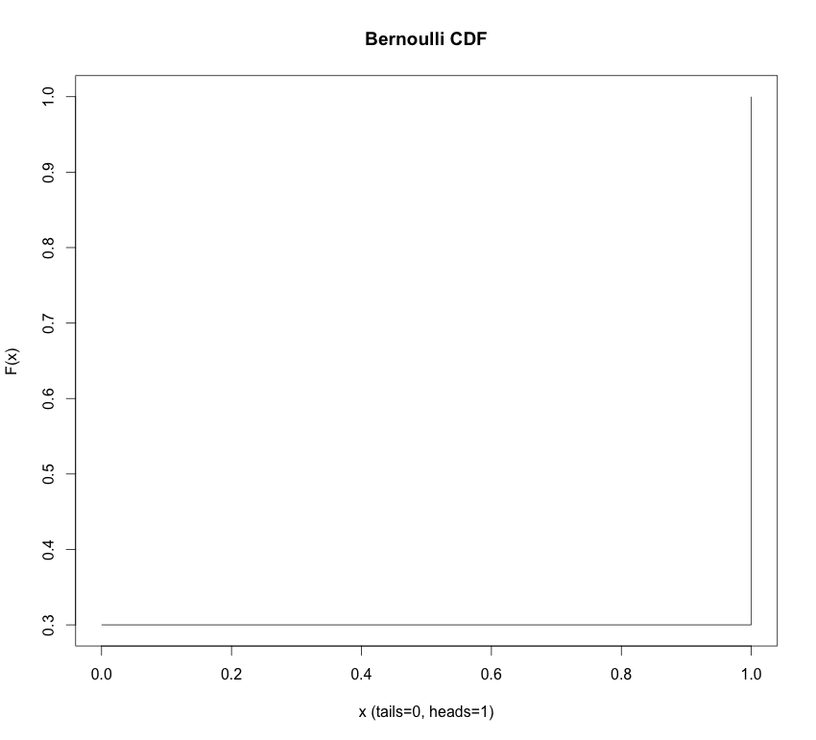
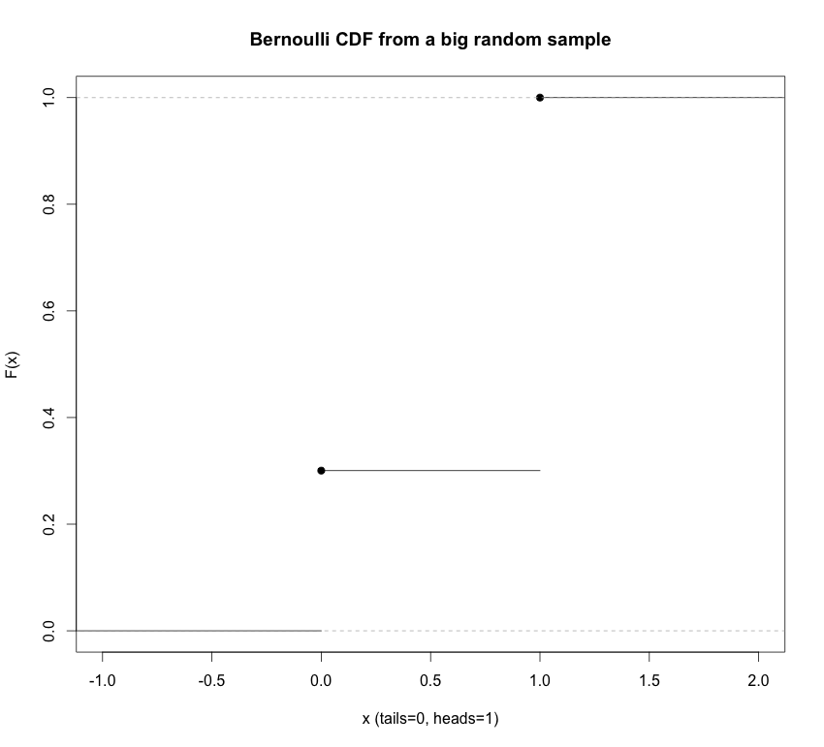
Bernoulli Distribution
Cumulative distribution function (CDF):
# Plot the Cumulative Distribution Function: This one is not that interesting
# since there are only two possibilities for what X can be ("heads"/"tails")
bernoulli.cdf <- pbinom(q = 0:1, size = 1, prob = p)
plot(0:1, bernoulli.cdf, typ="s", main="Bernoulli CDF",xlab="x (tails=0, heads=1)",ylab="F(x)")
# Make a prettier CDF plot by getting a big random sample
# and plotting the empirical CDF for it:
sample.of.bernoulli <- rbinom(100000, size = 1, prob = p)
plot(ecdf(sample.of.bernoulli), main="Bernoulli CDF from a big random sample",xlab="x (tails=0, heads=1)",ylab="F(x)")

Slide 16
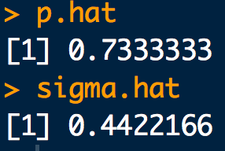
Example
Website access requests on a certain server are detected at the rising edge of the system clock with a period of 100ns. The following 3μs sequence of access requests are observed:
1, 0, 1, 1, 1, 1, 0, 0, 1, 1, 1, 1, 0, 1, 1, 1, 0, 0, 1, 0, 1, 1, 1, 1, 1, 0, 1, 1, 1, 1
Assuming the requests are independent, what is the approximate probability that a request is made within a clock cycle? What is the approximate uncertainty in this probability?
x <- c(1, 0, 1, 1, 1, 1, 0, 0, 1, 1, 1, 1, 0, 1, 1, 1, 0, 0, 1, 0, 1, 1, 1, 1, 1, 0, 1, 1, 1, 1)
p.hat <- sum(x)/length(x)
p.hat
sigma.hat <- sqrt(p.hat*(1-p.hat))
sigma.hat

Slide 17
Binomial Distribution
Binomial PMF: Number of “heads” (successes) in n flips
Number of “Heads” (successes) is x
Probability of a “Heads” is p
Number of flips (“Bernoulli trials”) is n

Slide 18
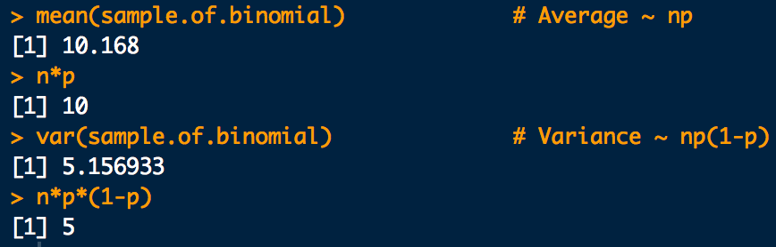
Binomial Distribution
Mean:
Variance:
p <- 0.5 # Probability of a "Heads" (a success)
n <- 20
binomial.pmf <- dbinom(x = 0:20, size = n, prob = p)
plot(0:20,binomial.pmf, typ="h", main="Binomial PMF",xlab="#-heads (x)",ylab="Pr(X)")
# A sample of 1,000 trials of n-"coin flips". Each trial counts
#the number of "heads" in n-tosses:
sample.of.binomial <- rbinom(1000, size = n, prob = p)
hist(sample.of.binomial, xlim=c(0,20),xlab="#-heads (x)")
mean(sample.of.binomial) # Average ~ np
var(sample.of.binomial) # Variance ~ np(1-p)

Slide 19
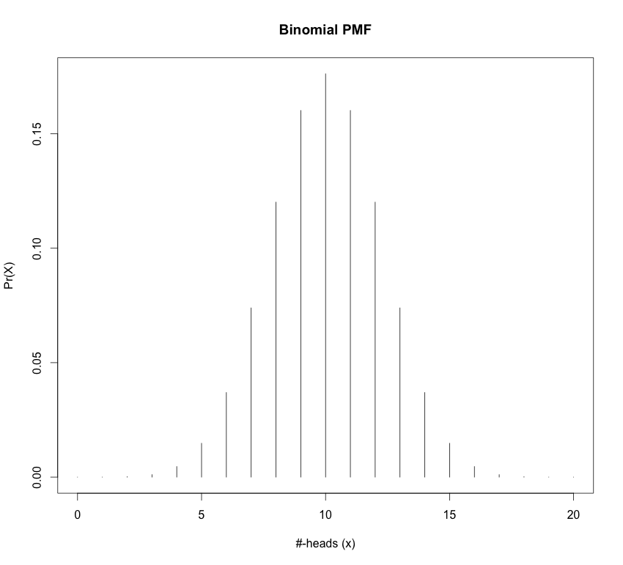
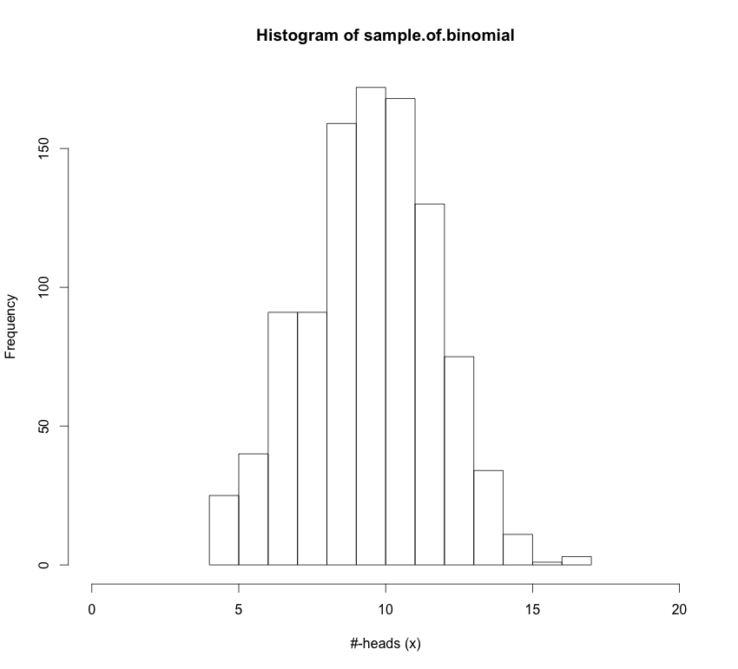
Binomial Distribution
Mean:
Variance:
n = 20
p = 0.5
Sample of 1000 from Pr(X)

Slide 20
Binomial Distribution
Cumulative distribution function (CDF):
Don’t worry. Just use this: pbinom(q = x, size = n, prob = p)
“p-functions” in R are the CDFs of the distribution
And while we’re at it:
dbinom “d-function” in R is the density (mass) of the distribution
pbinom “p-function” in R is the CDFs of the distribution
qbinom “q-function” in R give the quantiles of the distribution (x-values) for a given cumulative probability (p-value)
rbinom “r-functions” in R gives a random sample from the distribution
*NOTE: “p-functions” and “q-functions” are inverses of each other

Slide 21
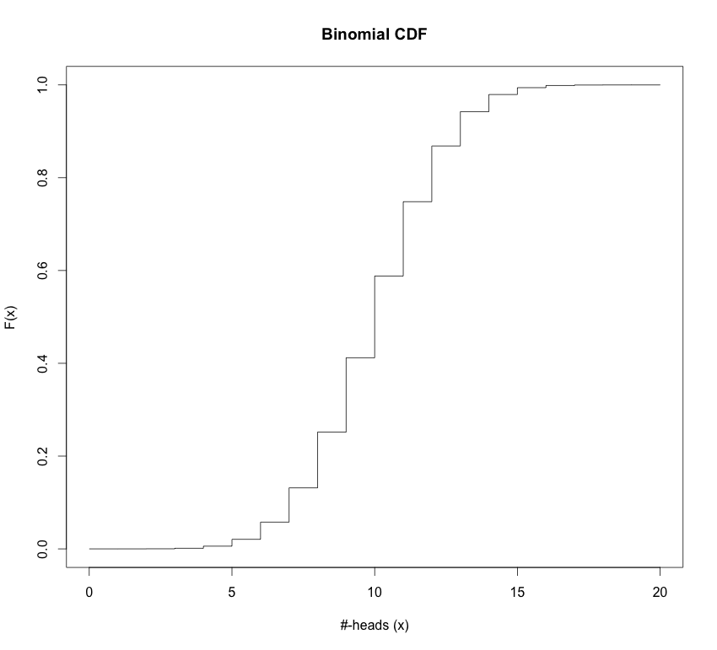
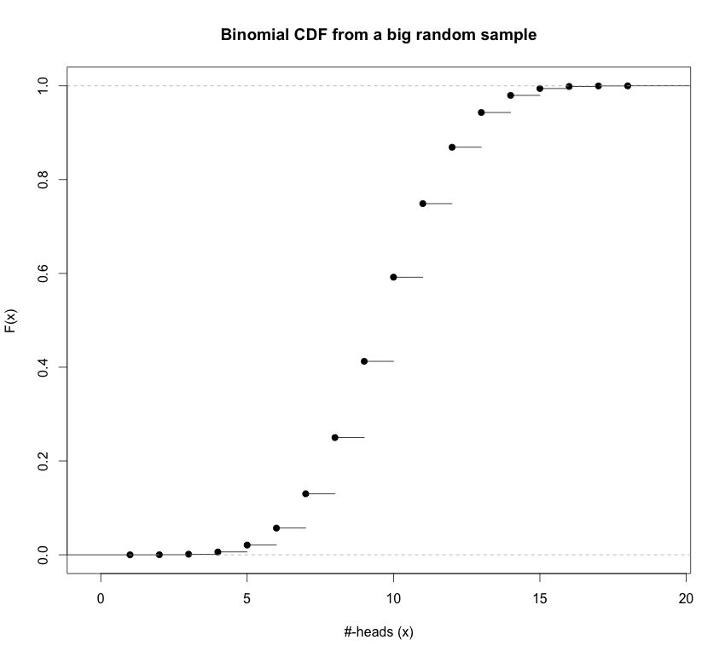
Binomial Distribution
Cumulative distribution function (CDF):
# Plot the Cumulative Distribution Function:
binomial.cdf <- pbinom(q = 0:20, size = n, prob = p)
plot(0:20, binomial.cdf, typ="s", main="Binomial CDF", xlab="#-heads (x)",ylab="F(x)")
# Make a prettier CDF plot by getting a big random sample
# and plotting the empirical CDF for it:
sample.of.binomial <- rbinom(100000, size = n, prob = p)
plot(ecdf(sample.of.binomial), main="Binomial CDF from a big random sample", xlab="#-heads (x)",
ylab="F(x)")

Slide 22
Example
Using data collected by Besson, Taroni et al. suggest that about 36% of bills in general circulation in Europe contain traces of cocaine.
What is the distribution of the number of European bills that contain traces of cocaine in a stack of 50?
What is approximate uncertainty in the count?
How many contaminated bills do you expect to find?
What is the probability of finding between 10 and 20 bills contaminated with cocaine?

Slide 23
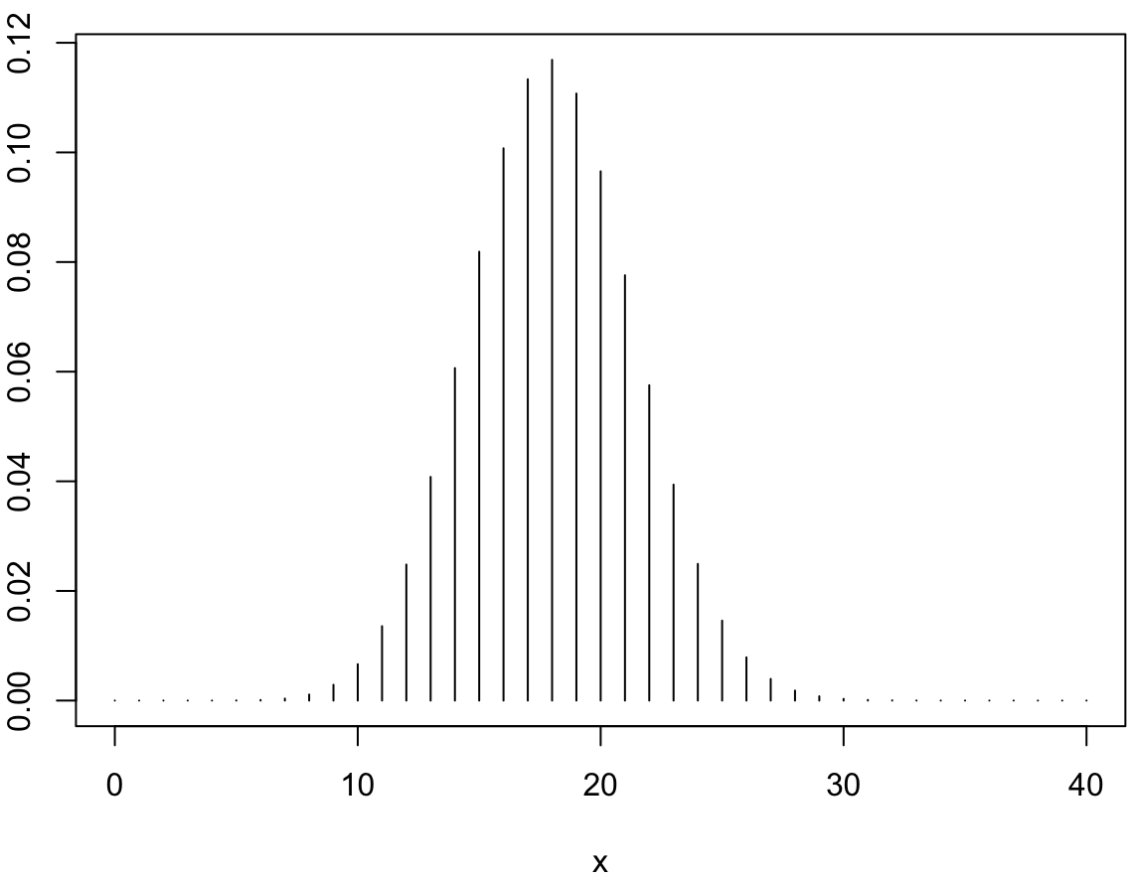
p <- 0.36
n <- 50
# a.
x <- seq(from=0, to=40)
pmf <- dbinom(x, size = n, prob = p)
plot(x, pmf, typ = "h")
# b.
sigma <- sqrt(n*p*(1-p))
sigma
# c.
mu <- n*p
mu
# d.
pbinom(20, size = n, prob = p) - pbinom(10, size = n, prob = p)

Slide 24
Poisson Distribution
Poisson PMF: You don’t know how many times you are going to “flip the coin” but you do know on average how many “heads” you get λ
λ is the mean rate for occurrence of an “event”, “success” or “head”.
Say on average you get 100 texts in a day. Then λ = 100.
Number of “events”, “successes”, “heads” (etc.) is x
*NOTE: The is no upper limit on “events” that can occur in an experiment, unlike for the binomial, where the upper limit of “successes” (“events”) is n.

Slide 25
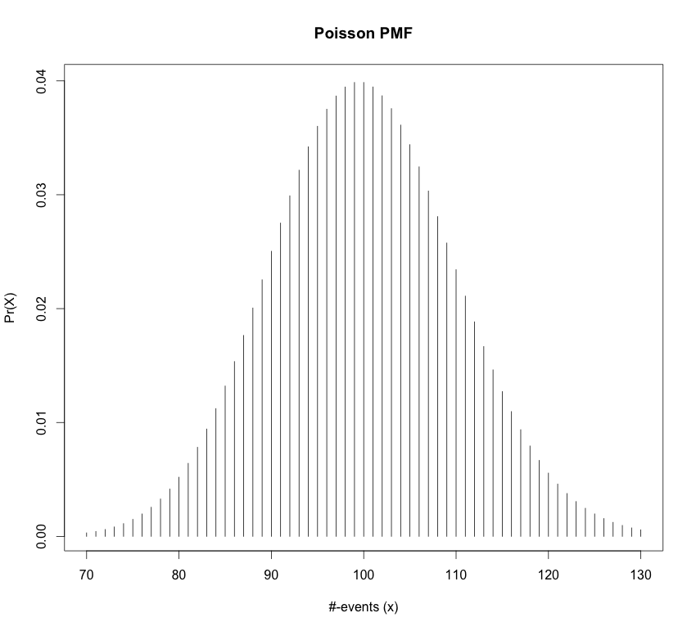
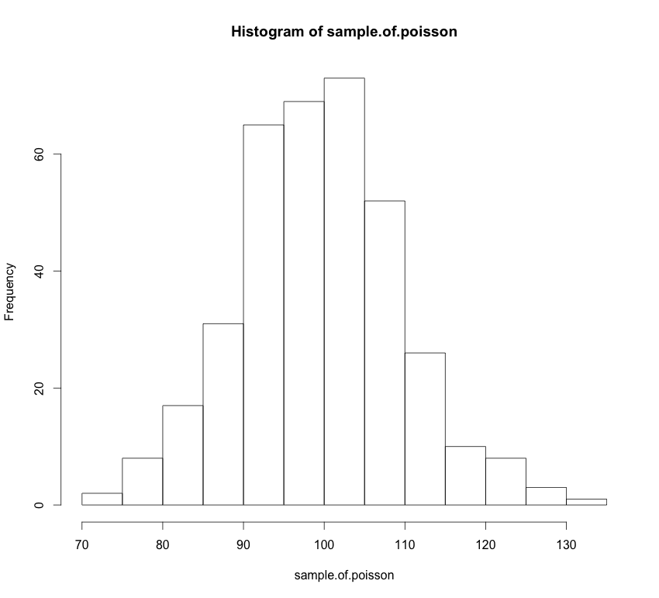
Poisson Distribution
Mean:
Variance:
= 100
Sample of 365 from Pr(X)

Slide 26
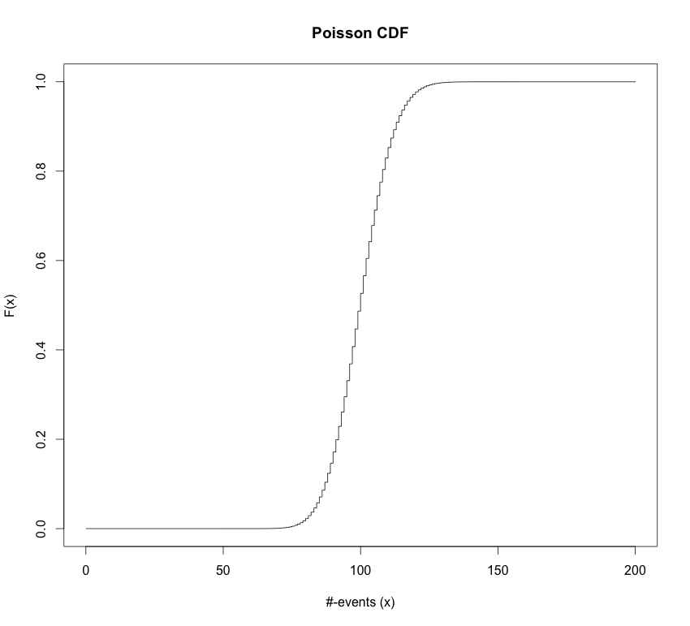
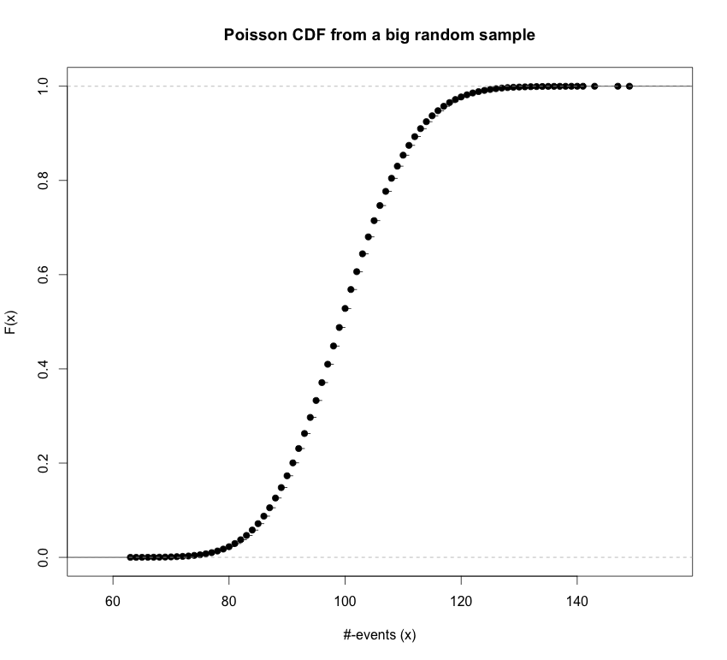
Poisson Distribution
Cumulative distribution function (CDF):
ppois(q = x, lambda = lam)

Slide 27
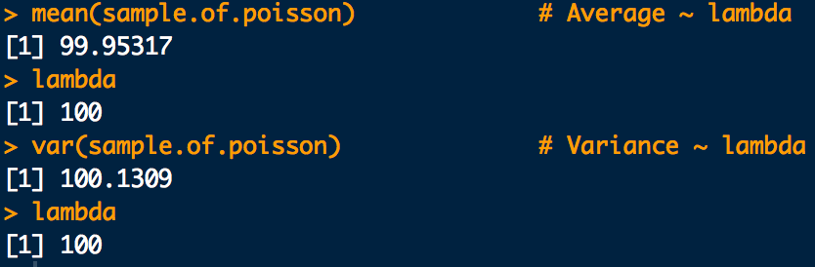
Poisson Distribution
Code for Poisson figures:
# On average we get 100 "texts" per day (lambda, units: events/interval)
lambda <- 100
#Poisson PMF. Gives probabilities for recieving between 70-130 "texts" per day
poisson.pmf <- dpois(x = 70:130, lambda = lambda)
plot(70:130,poisson.pmf, typ="h", main="Poisson PMF",xlab="#-events (x)",ylab="Pr(X)")
# A sample of 365 "days" (intervals). Each "day" we count
#the number of "texts" (events) we get:
sample.of.poisson <- rpois(365, lambda=lambda)
hist(sample.of.poisson)
mean(sample.of.poisson) # Average ~ lambda
var(sample.of.poisson) # Variance ~ lambda
# Plot the Cumulative Distribution Function:
poisson.cdf <- ppois(q = 0:200, lambda = lambda)
plot(0:200, poisson.cdf, typ="s", main="Poisson CDF", xlab="#-events (x)",ylab="F(x)")
# Make a prettier CDF plot by getting a big random sample
# and plotting the empirical CDF for it:
sample.of.poisson <- rpois(100000, lambda = lambda)
plot(ecdf(sample.of.poisson), main="Poisson CDF from a big random sample", xlab="#-events (x)",ylab="F(x)”)

Slide 28
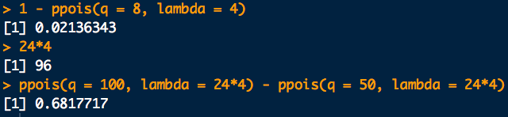
Example
A certain “user” of a social media site (may be a bot) posts at an average rate of about 4 per hour.
What is the probability that more than 8 posts will be put up in the next hour?
About how many posts can be expected in 24 hours?
What is the probability of between 50 and 100 posts appearing in 24 hours?
# a.
1 - ppois(q = 8, lambda = 4)
# b. mean poisson with new rate = 24*old rate:
24*4
# c.
ppois(q = 100, lambda = 24*4) - ppois(q = 50, lambda = 24*4)

Slide 29
Multinomial Distribution
Multinomial PMF:
multinomial coefficient
Means: the probability category 1 occurs x_{i} times
Assumes “occurrences” in a category happen independently
NOTE: each X_{i} is “marginally” (alone as a subset) distributed as:
Means: “is distributed as”

Slide 30
Multinomial Distribution
Multinomial PMF:
Mean for each category:
Variance for each category:
Since there are many categories, the X_{k} can “vary” with each other:
i.e. the X_{k} can “co-vary”
Covariance between occurrences in category i and category j:
Covariance can also be given on a standard scale for -1 to 1 called correlation:
Correlation between occurrences in category i and category j:
Cor(X_{i}, X_{i}) = 1

Slide 31
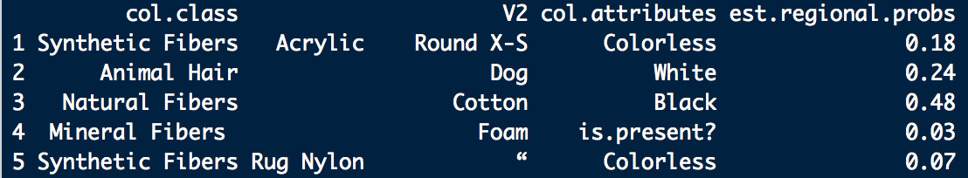
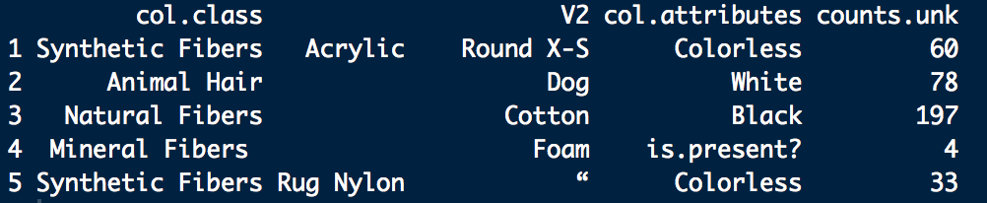
Example: Multinomial Distribution
In a certain apartment several dust bunnies are found and their constituents assessed. Using this data a dust bunny from the apartment has estimated composition of constituents:
A victim is found rolled up and stuffed in a closet in a neighboring apartment. A dust bunny is recovered with the victim. The constituents are the same and have the following counts:

Slide 32
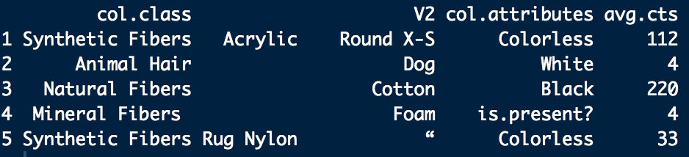
Example: Multinomial Distribution
Two small dust bunnies are found in the residence. A mass is selected from each. The first 372 items fitting into the categories of the unknown are counted. The fibers are returned to the main mass and mixed in. The process is repeated several times. The average counts for each category are found to be:
a. How do the probabilities of each configuration compare under the assumption that the dust bunnies are all from apartment 1?
b. What are some criticisms of this experiment and the probability model applied to it?

Slide 33
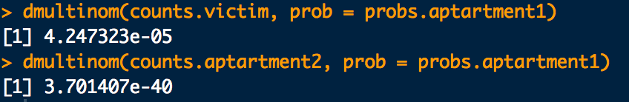
Example: Multinomial Distribution
probs.apartment1 <- c(0.16, 0.21, 0.53, 0.01, 0.09)
counts.victim <- c(60, 78, 197, 4, 33)
counts.apartment2 <- c(112, 4, 220, 4, 33)
dmultinom(x = counts.victim, prob = probs.apartment1)
dmultinom(x = counts.apartment2, prob = probs.apartment1)

Slide 34
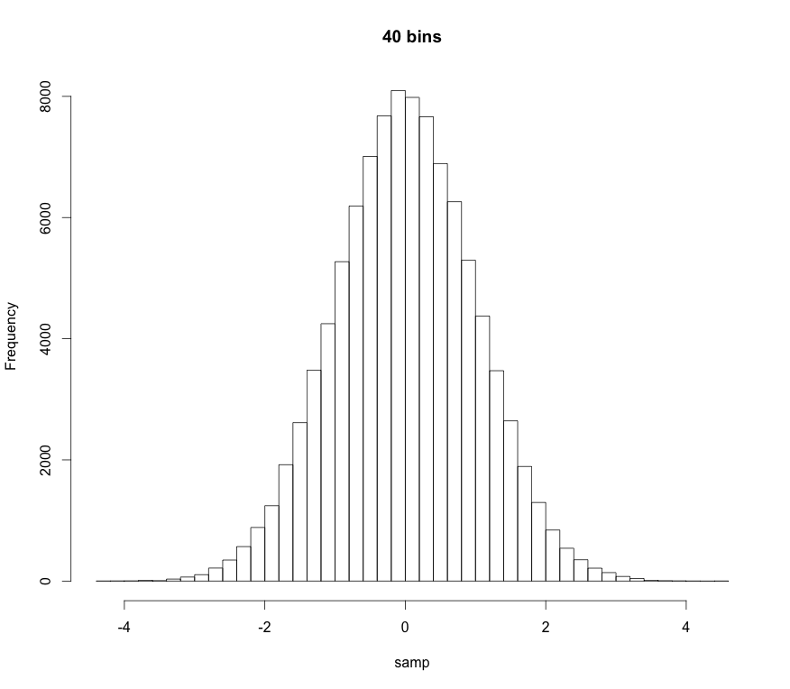
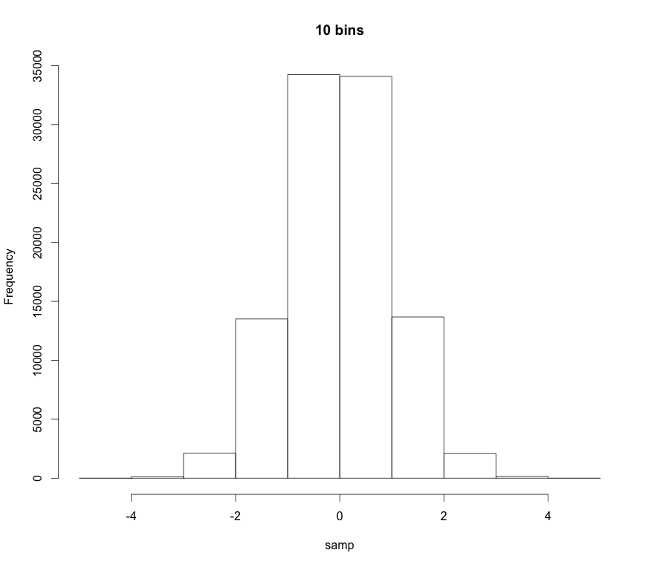
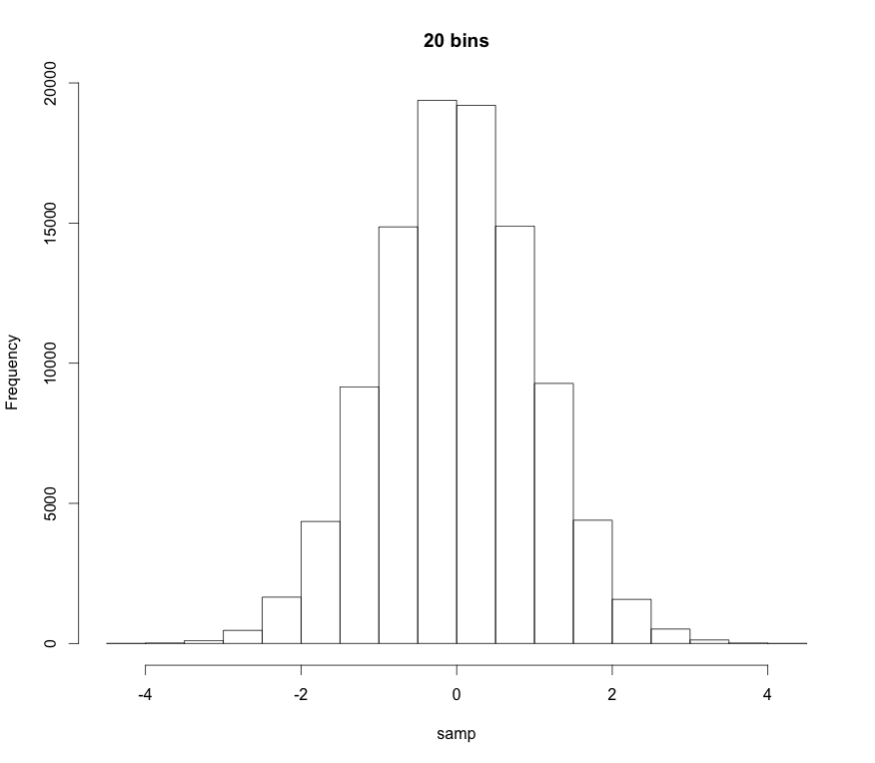
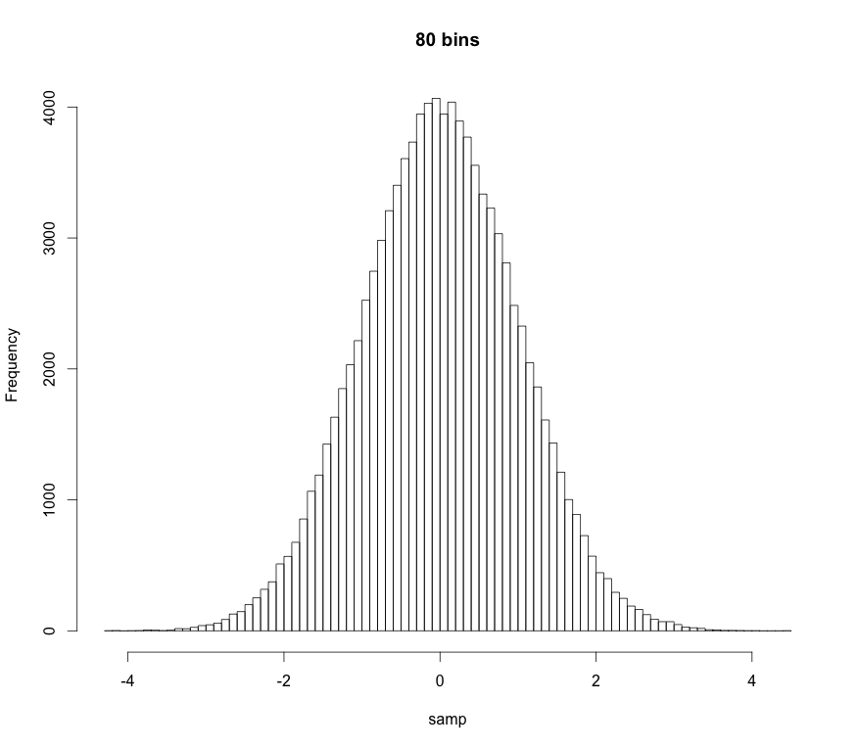
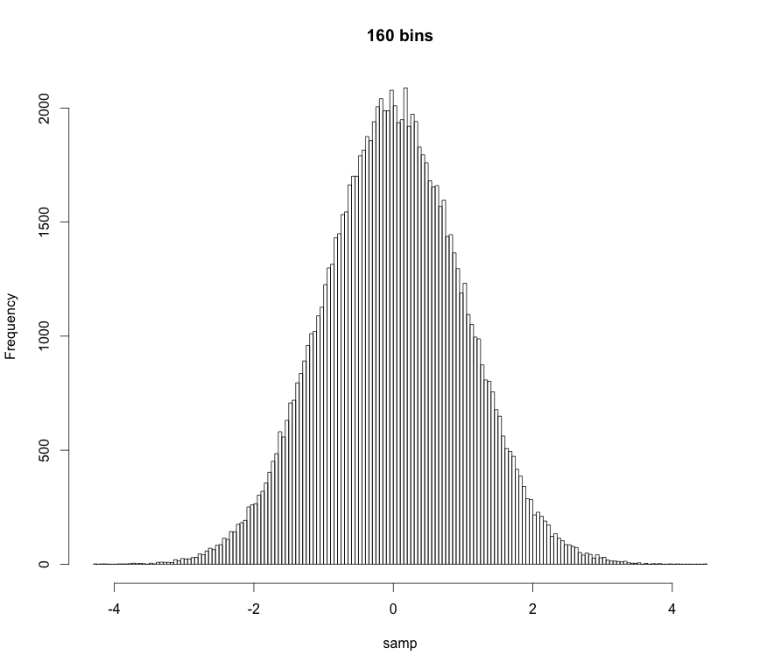
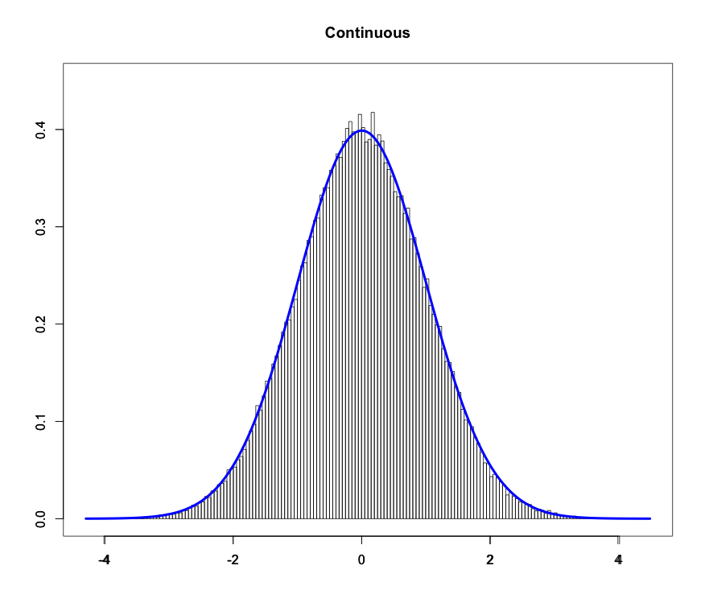
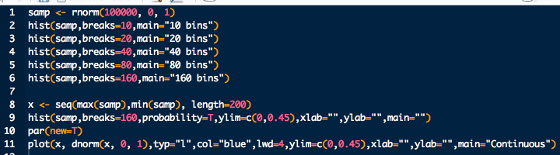
Probability Density Function
As we increase the number of “bins” in a histogram the “bars” get thinner and thinner
If there are an infinite number of bins the bars get infinitesimally thin:

Slide 35
Probability Density Function
Technical definition:
A random variate X is continuous if:
The probability that X lies between a and b
p(x): probability density function (pdf)
Note:
Proper pdfs should be normalized
“All space” for an r.v. is it’s domain. Also called its support
“All space” for us is usually 0 to ∞ or -∞ to ∞

Slide 36
Probability Density Function
Technical definition:
A random variate X is continuous if:
The probability that X lies between a and b
p(x): probability density function (pdf)
Note also:
The probability of obtaining a particular r.v. is 0
p(x) ≥ 0
The pdf is always greater than or equal to 0

Slide 37
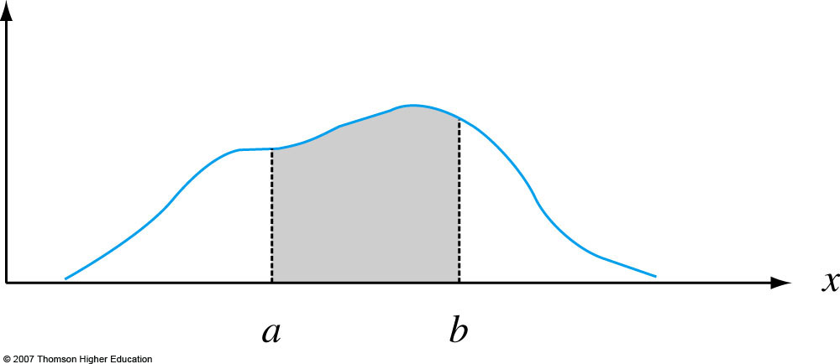
Probability Density Function
Graphically:
p(x)
Notes:
Figure 4.2
P (a ≤ X ≤ b) = the area under the density curve between a and b.

Slide 38
Moments and Expectation Values
Moments are numerical values that control a PDF’s location and shape properties.
m^{th}-order moments are found by taking the expectation value or average-value of an RV raised to the m^{th}-power:
Most of the time we only care about first-order and second-order-central moments.

Slide 39
Moments and Expectation Values
1st-order moment for X, i.e. the expectation value of X:
location descriptor
mean

Slide 40
Moments and Expectation Values
Important 2nd-order moments:
Second order central moment.
It can be shown that
Population standard deviation
spread descriptor

Slide 41
Uniform Distribution
Uniform PDF: Same “likelihood” for all x
Parameters:
a left bound
b right bound

Slide 42
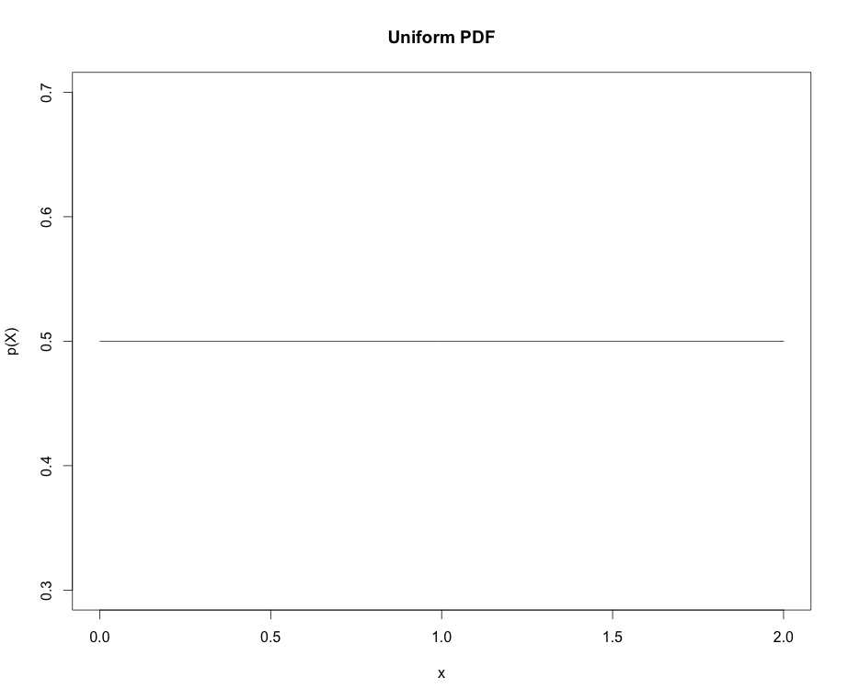
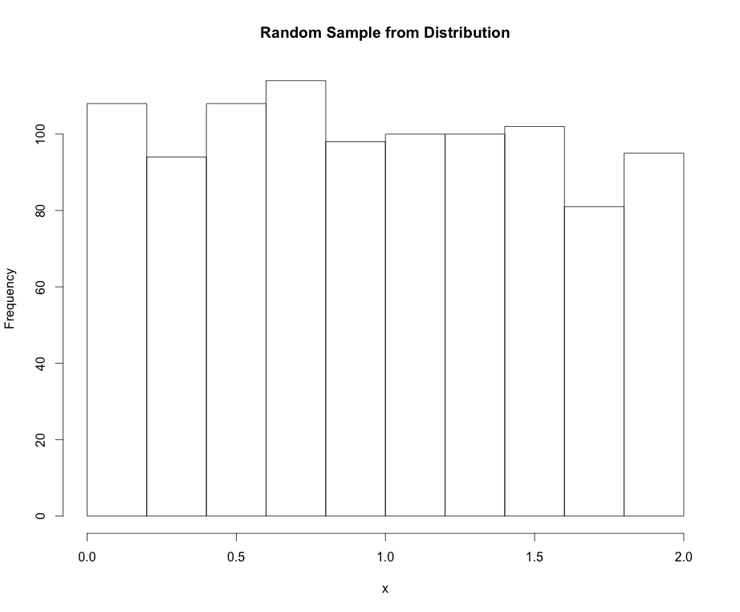
Uniform Distribution
Mean:
Variance:

Slide 43
Normal Distribution
Normal PDF: The “bell cure”. Also called Gaussian dist.
Parameters:
μ mean
σ standard deviation

Slide 44
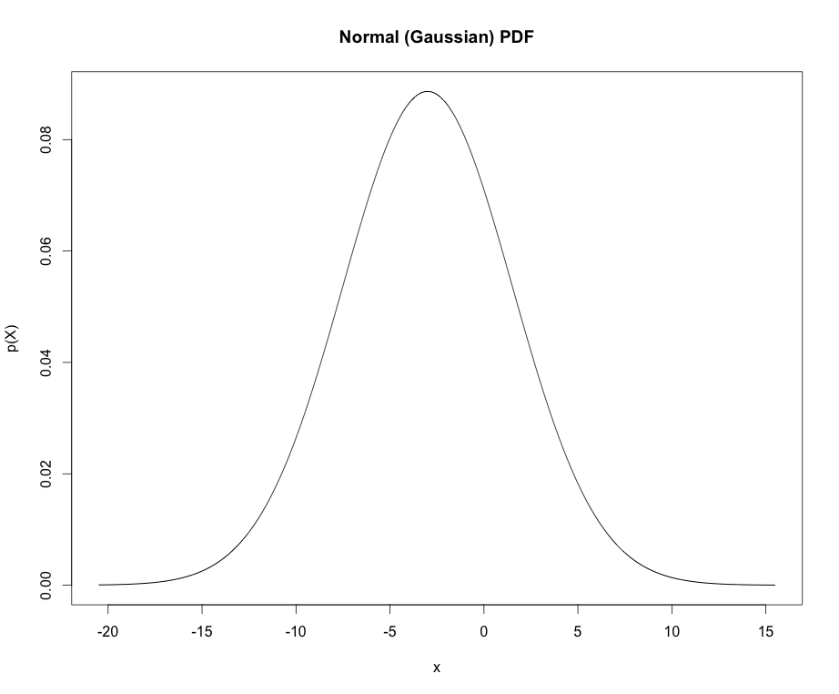
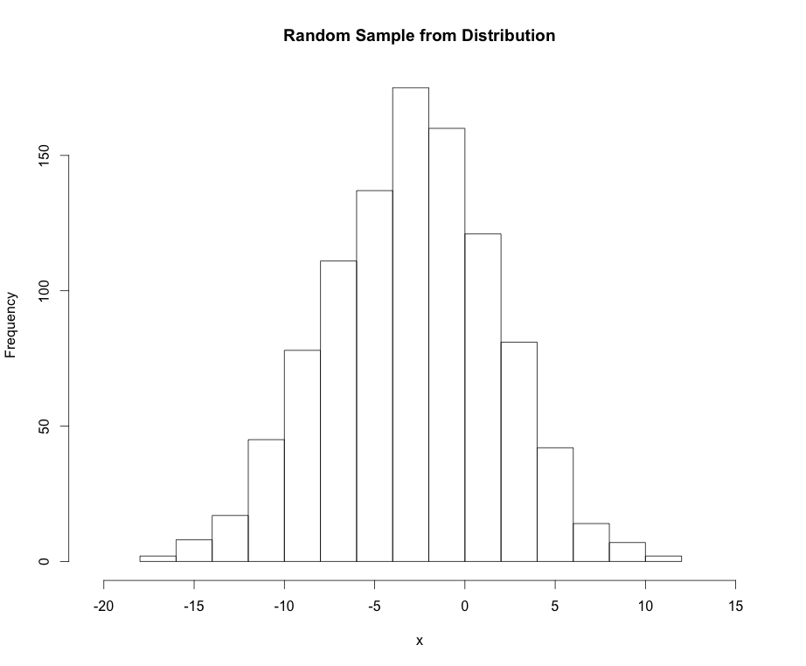
Normal Distribution
Mean: μ_{X} = μ
Variance: σ²_{X} = σ²

Slide 45
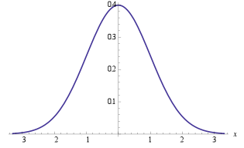
Normal Distribution
Points of interest for the Normal distribution:
If X ~ N(μ, σ) we can “standardize” (transform) to the z-scale:
Standard normal distribution
Handy equation
~ 68%
±1σ
~ 95%
±2σ
~ 99%
±3σ

Slide 46
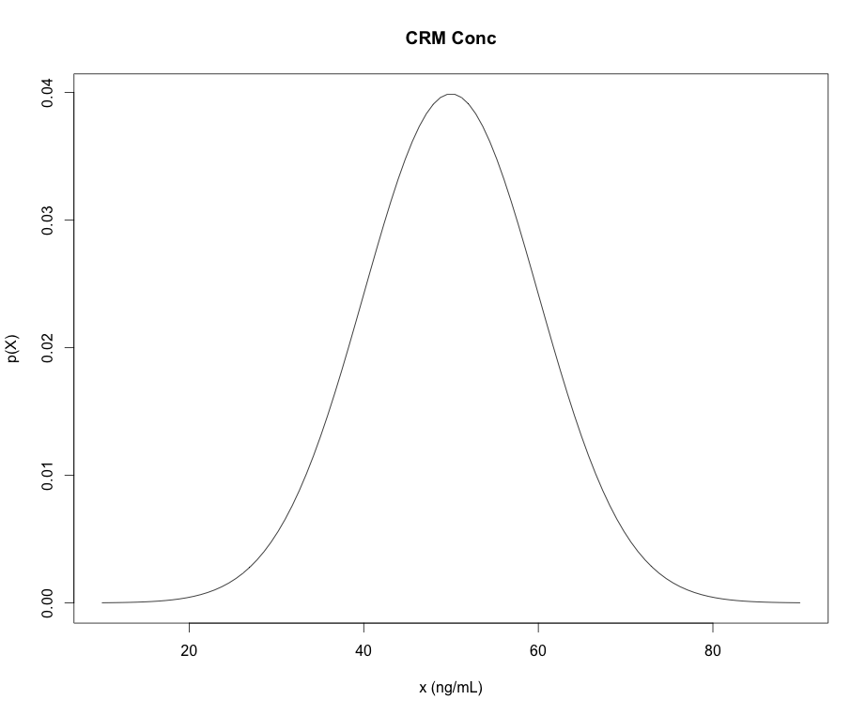
Some R Commands for PDFs
dnorm “d-function” in R is the density (mass) of the distribution
pnorm “p-function” in R is the CDFs of the distribution
qnorm “q-function” in R give the quantiles of the distribution (x-values) for a given cumulative probability (p-value)
rnorm “r-functions” in R gives a random sample from the distribution
*NOTE: “p-functions” and “q-functions” are inverses of each other
pnorm(q=47,mean=50,sd=10)=
0.42
0.42
“input quantity”
qnorm(p=0.42,mean=50,sd=10)=
47
47

Slide 47
Example: quantiles/percentiles
A sample of methamphetamine in blood certified reference material (CRM) is obtained as a standard for calibration of methodology in a tox lab.
The concentration of the CRM is certified to follow a normal distribution with mean concentration of 50 ng/mL and standard deviation of 10 ng/mL.
What maximum concentration can we expect for 90% of the samples we may measure?

Slide 48
Example: quantiles/percentiles
Another way to phrase: What measured sample concentration (quantile) should correspond to the 90th percentile with respect to the CRM?
0.9
?

Slide 49

Example: quantiles/percentiles
Another way to phrase: What measured sample concentration (quantile) should correspond to the 90th percentile with respect to the CRM?
# Parameters:
mu <- 50
sigma <- 10
# Quantile for the 90th percentile:
qnorm(0.9, mean=mu, sd=sigma)

Slide 50
Example: quantiles/percentiles
What is the probability of that the CRM’s concentration will be measured to be between 30 ng/mL and 70 ng/mL?
30 ng/mL
70 ng/mL
What would the code look like if we wanted Pr(X > 70ng/mL)?
# The “measurands” (parameters):
mu <- 50
sigma <- 10
# Pr(30 < X < 70):
pnorm(70, mean=mu, sd=sigma) – pnorm(30, mean=mu, sd=sigma)

Slide 51
Other Distributions We’ll Encounter
Student-t: Like Normal distribution but fatter tails. Can be a handy prior for means.
dt, qt, pt, rt
Parameters:
df: degrees of freedom
Chi-squared (χ²): Handy especially for comparing raw set of counts. Also, it’s proportional to the likelihood of sample variance for IID data.
dchisq, qchisq, pchisq, rchisq
Parameters:
df: degrees of freedom

Slide 52
Other Distributions We’ll Encounter
Beta: Handy to represent beliefs about a proportion or a probability
Parameters:
dbeta, qbeta, pbeta, rbeta
shape1: α
shape2: β
Dirichlet: Handy to represent beliefs about many probabilities that sum to 1.
Parameters:
α: shape parameters.

Slide 53
Other Distributions We’ll Encounter
Cauchy, Half-Cauchy : Bell/half-bell shaped but pretty fat tailed. Handy as weakly informative priors for means and standard deviations.
Parameters:
Shape, scale
Look around at other people’s applications. Some of their ideas may work for you.

