Slide 1

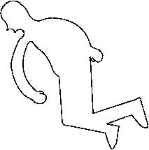
Overview of Bayesian Methodology

Slide 2
Outline
Bayes’ Rule
Bayesian Statistics (Briefly!)
Conjugates
General parametric using BUGS/MC software
Bayesian Networks (Just briefly. Take another course on this.)
Bayesian Hypothesis Testing/Model Checking

Slide 3
A little about conditional probability
Bayes’ Rule:

Slide 4
Probability
Frequency: ratio of the number of observations of interest (n_{i}) to the total number of observations (N)
It is EMPIRICAL!
Probability (frequentist): frequency of observation i in the limit of a very large number of observations

Slide 5
Probability
Belief: A “Bayesian’s” interpretation of probability.
An observation (outcome, event) is a “measure of the state of knowlege”^{Jaynes}.
Bayesian-probabilities reflect degree of belief and can be assigned to any statement
Beliefs (probabilities) can be updated in light of new evidence (data) via Bayes theorem.

Slide 6
Bayesian Statistics
The basic Bayesian philosophy:
Prior Knowledge × Data =
Updated Knowledge
A better understanding of the world
Prior × Data = Posterior

Slide 7
Bayesian Statistics
Bayesian-ism can be a lot like a religion
Different “sects” of (dogmatic) Bayesians don’t believe other “sects” are “true Bayesians”
Bayes Nets
Graphical Models
Steffan Lauritzen (Oxford)
Judea Pearl (UCLA)
Parametric
BUGS (Bayesian Using Gibbs Sampling)
MCMC (Markov-Chain Monte Carlo)
Andrew Gelman (Columbia)
David Speigelhalter (Cambridge)
The major Bayesian “churches”
Empirical Bayes
Data-driven
Brad Efron (Stanford)

Slide 8
Bayesian Statistics
What’s a Bayesian…??
Someone who adheres ONLY to belief interpretation of probability?
Someone who uses Bayesian methods?
Only uses Bayesian methods?
Usually likes to beat-up on frequentist methodology…

Slide 9


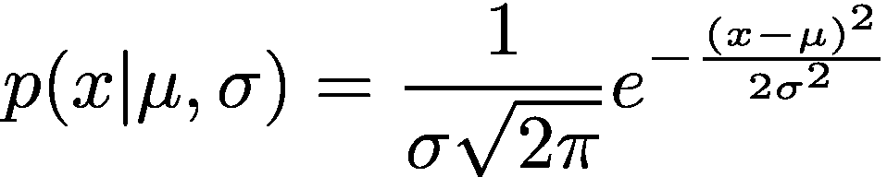
Bayesian Statistics
Actually DOING Bayesian statistics is hard!
We will up-date this prior belief later
Why?
Parametric Bayesian Methods
All probability functions are “parameterized”
For example:

Slide 10
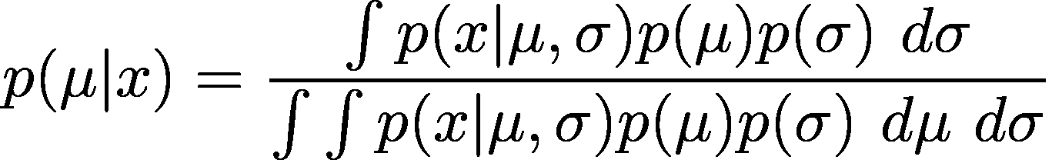
Bayesian Statistics
Say we have a prior “belief” for the value of the mean μ and sd σ
Next, we observe some data
What can we say specifically about the mean now?
We need Bayes’ rule:
YUK!
And this is for an “easy” problem

Slide 11
Bayesian Statistics
So what can we do????
Until ~ 1990, get lucky…..
Sometimes we can work out the integrals by hand
Sometimes you get posteriors that are the same form as the priors (Conjugacy)^{Raiffa and} ^{Schlaifer 1961}
Conjugacy was how Bayesian statistics was basically done until ~ 1990
Howard Raiffa is Professor Shenkin’s cousin!
Now there is software to evaluate the integrals.
Some free stuff:
MCMC: WinBUGS, OpenBUGS, JAGS
HMC: Stan

Slide 12
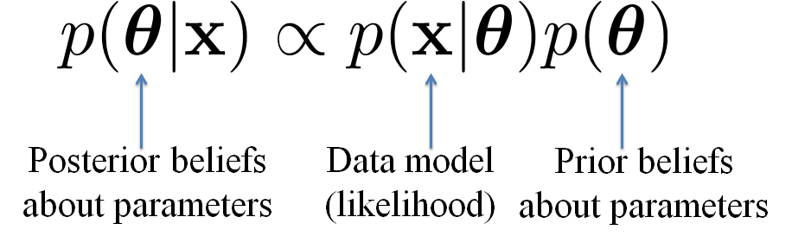
Bayesian Statistics
Basic set-up we will follow:

Slide 13
Bayesian Statistics
For the YUK problem this would be:
More specifically, we could go with:

Slide 14
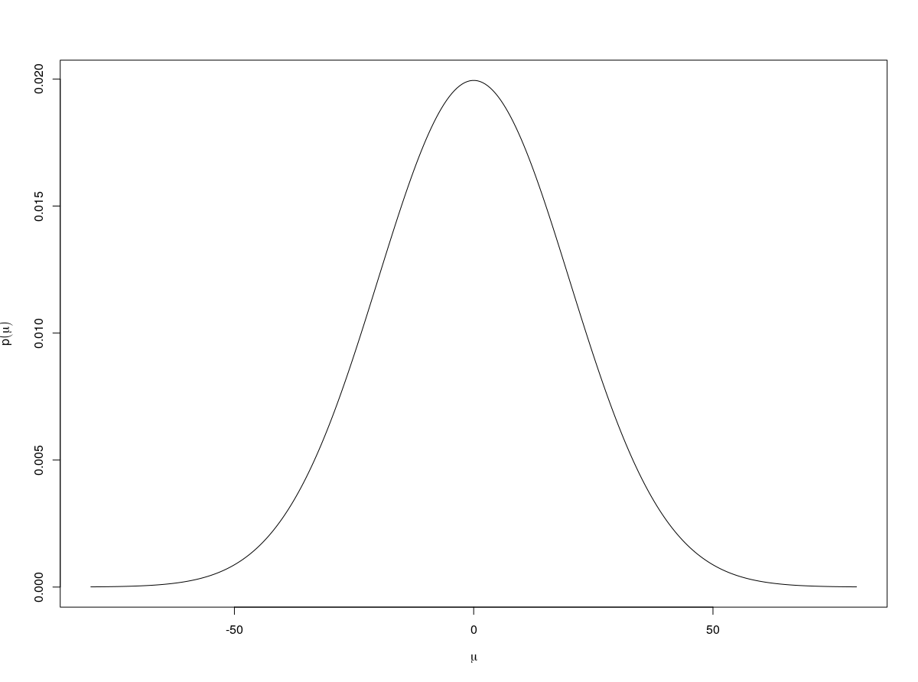
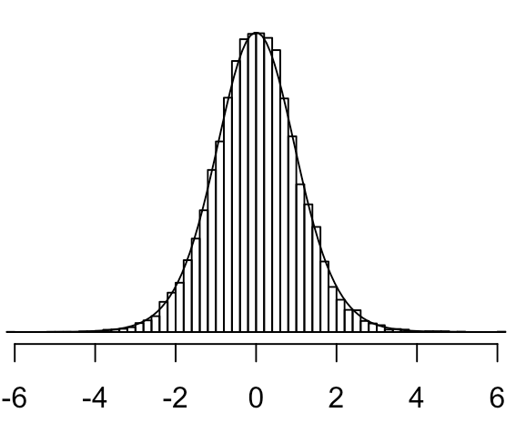
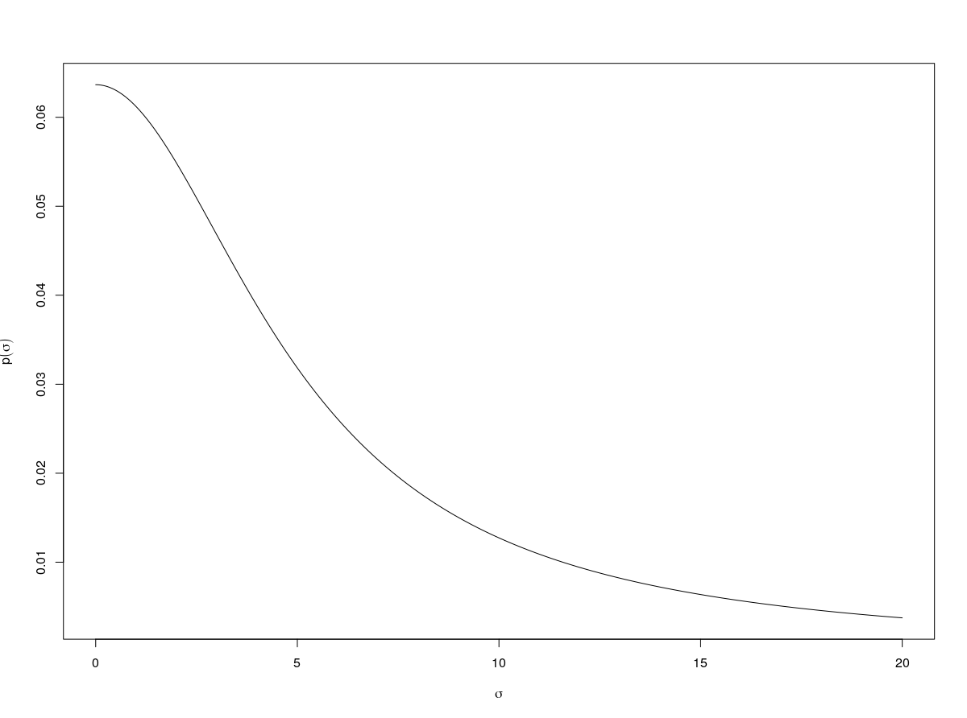
Bayesian Statistics
p(μ)
Posterior
p(μ|x)
Priors
p(σ)

Slide 15
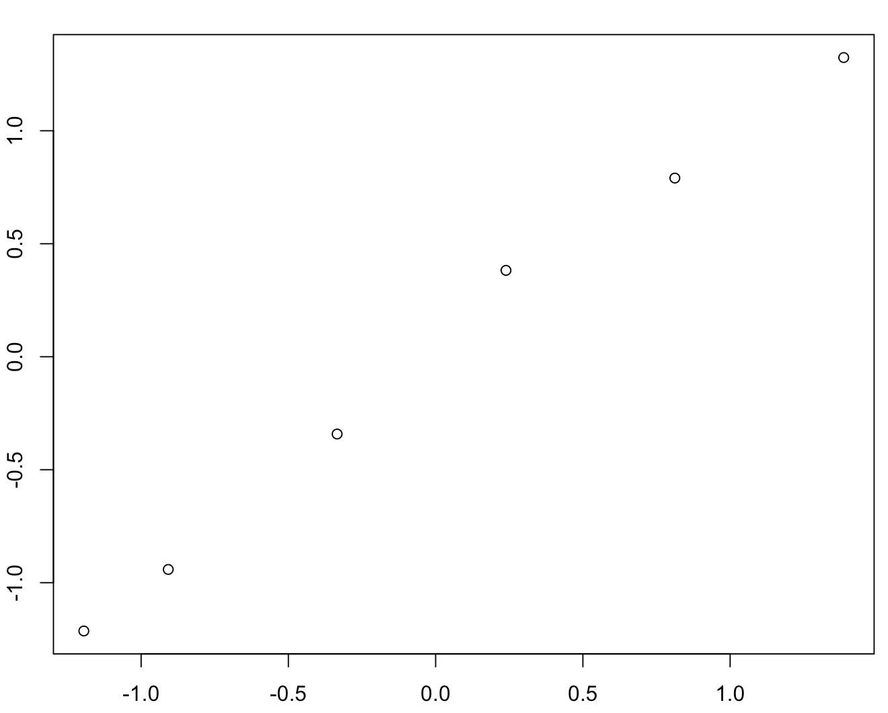
Major Application of Bayesian Statistics: Regression
GC-Ethanol: Azevedo
Peak Area Ratio (standardized)
Concentration (standardized)

Slide 16

Major Application of Bayesian Statistics: Regression
GC-Ethanol: Azevedo
Regression parameters which we may have some prior beliefs about
Peak Area Ratio (standardized)
Observe some data and “update” your beliefs about the parameters
Concentration (standardized)

Slide 17
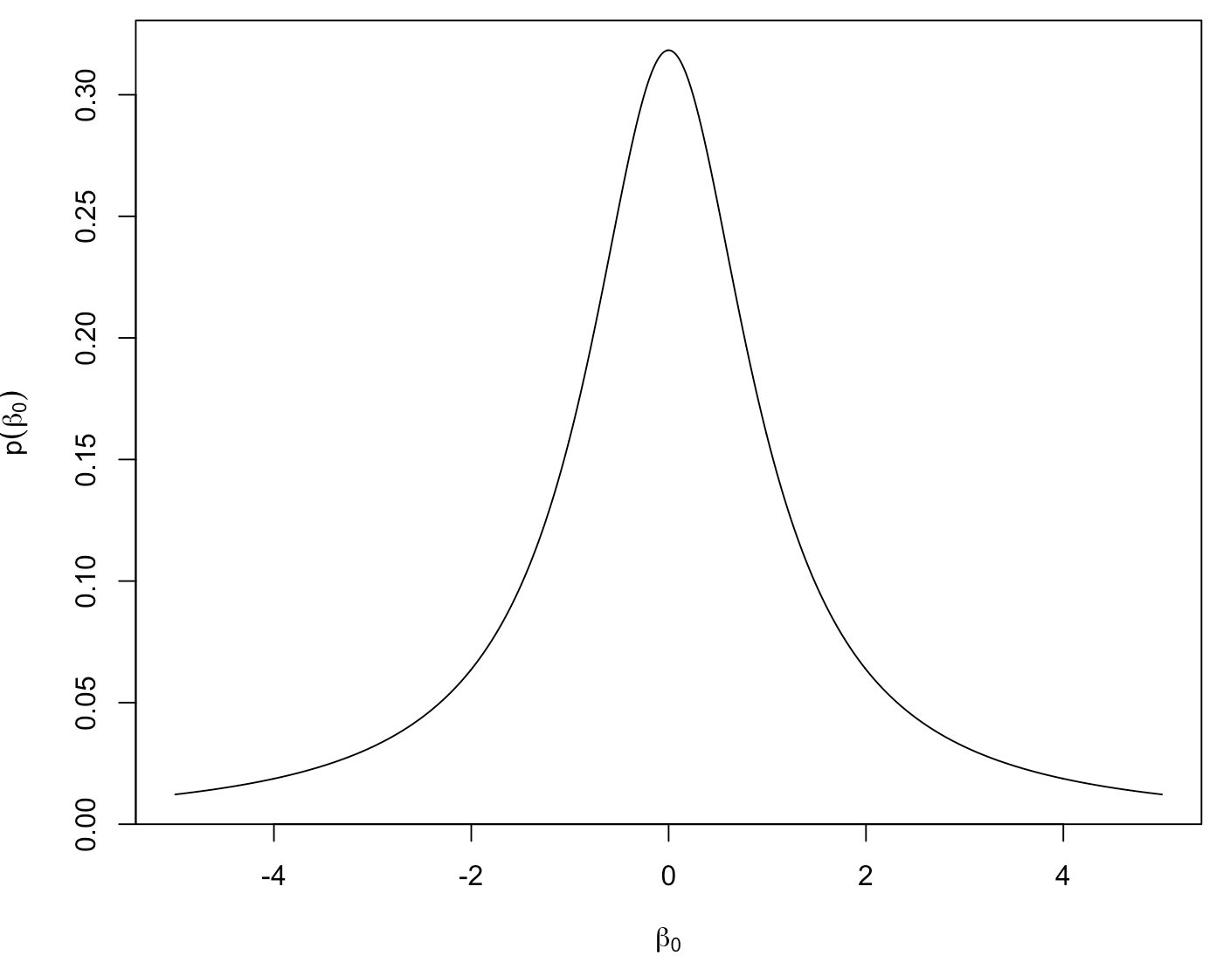
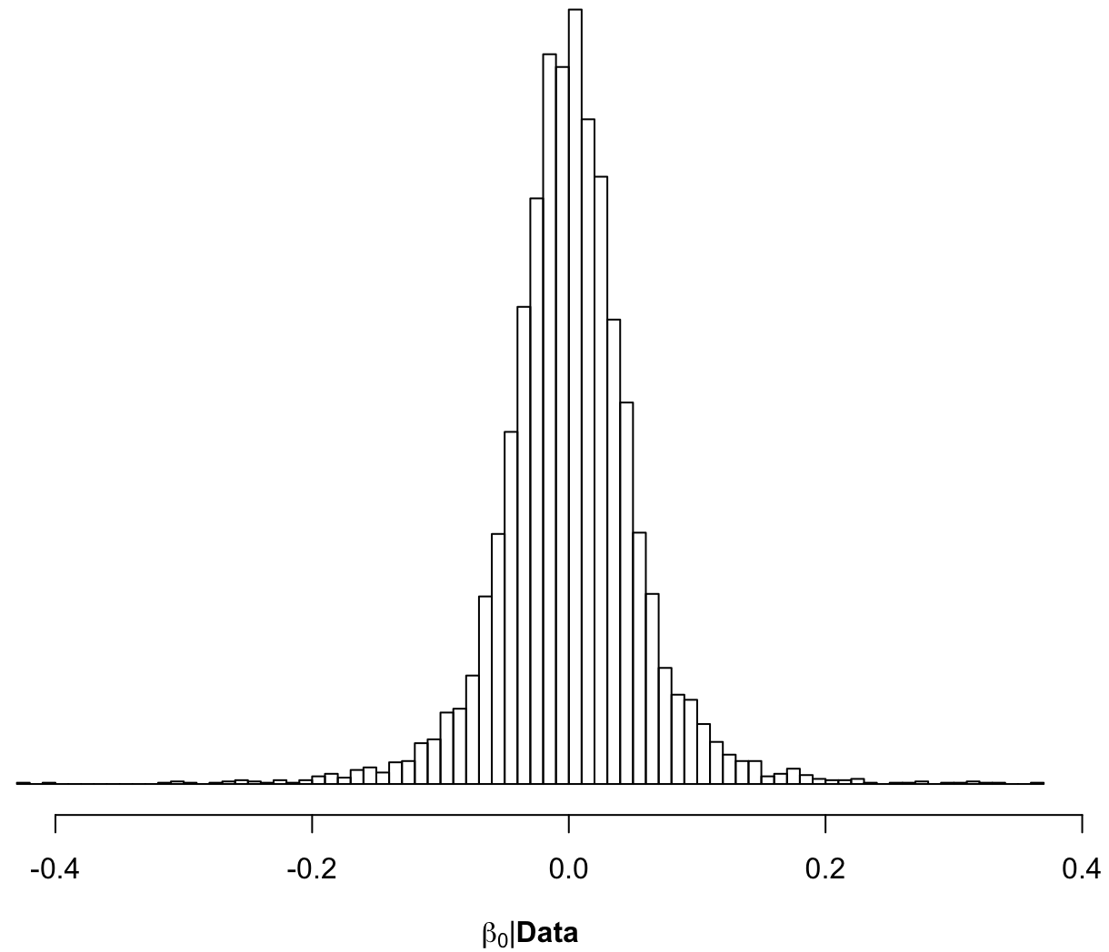
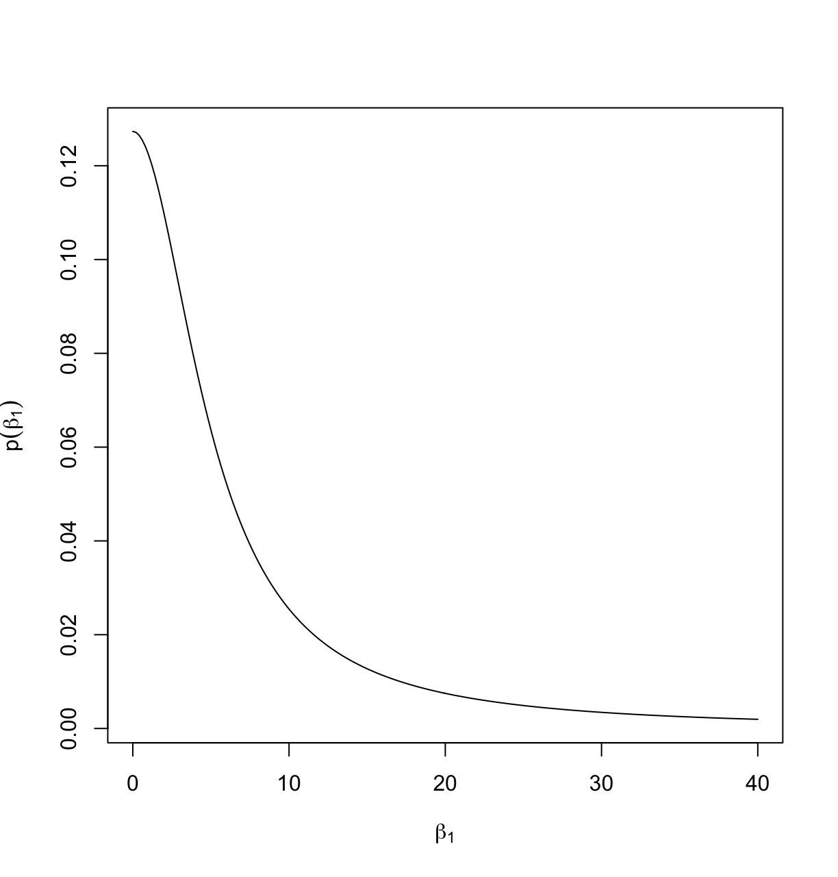
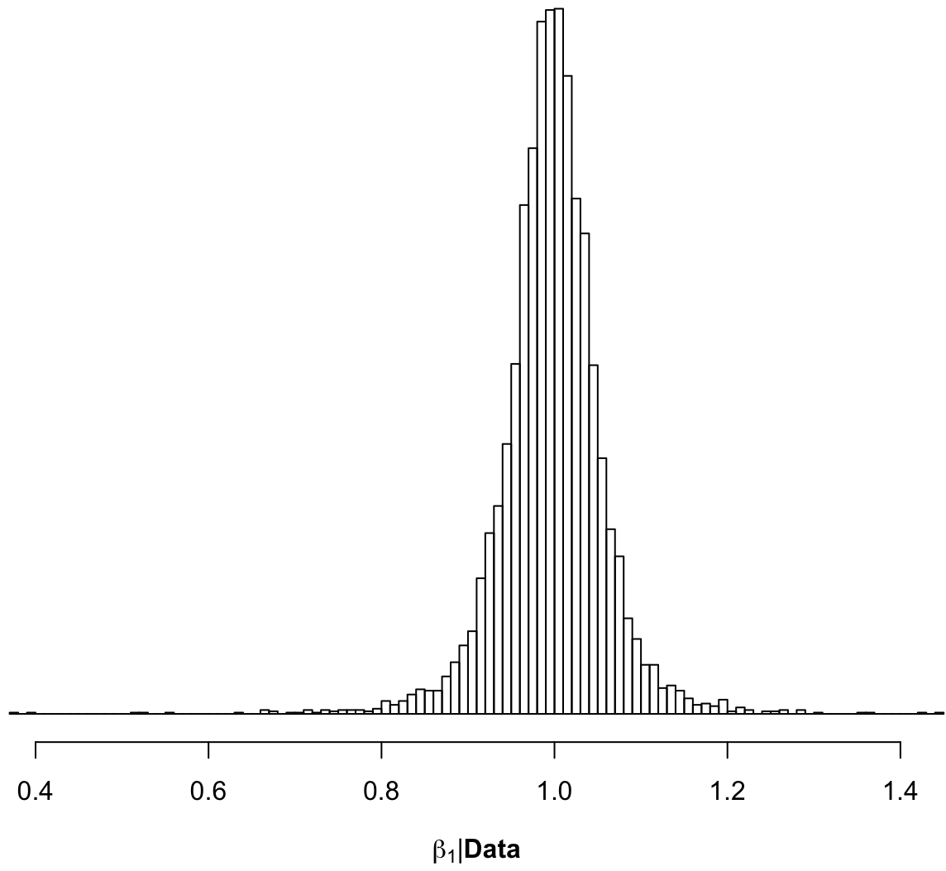
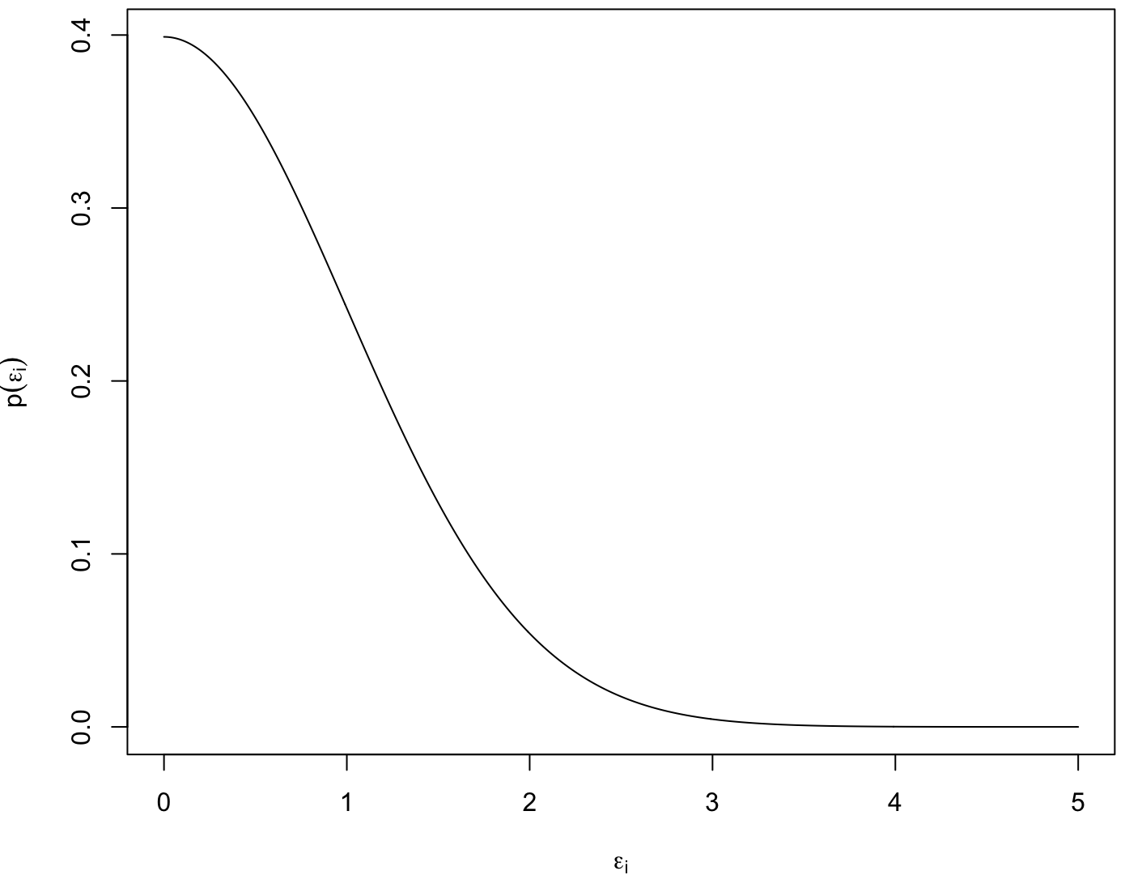
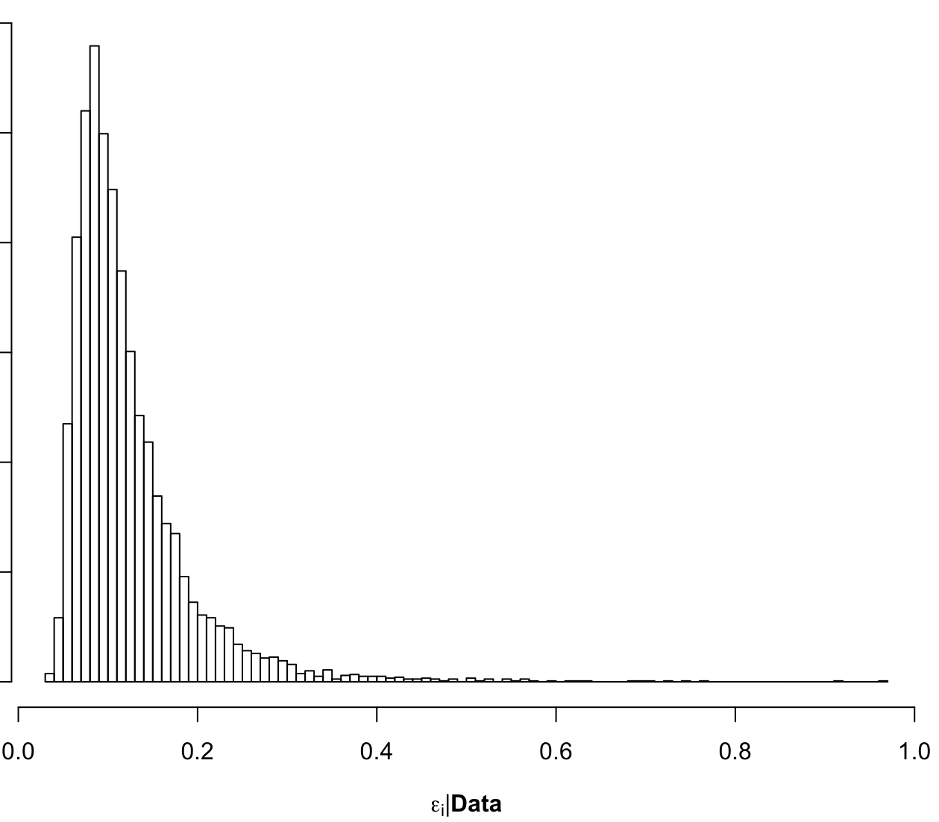
Major Application of Bayesian Statistics: Regression
p(β₀)
p(β₀|Data)
p(β₁)
p(β₁|Data)
Priors
Posteriors
p(ε_{i})
p(ε_{i}|Data)

Slide 18
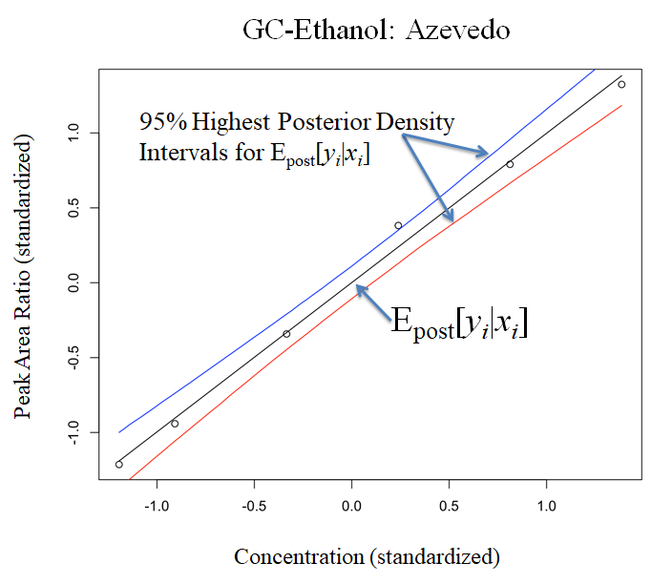

Slide 19
Another world altogether:
Bayesian Networks
A “scenario” is represented by a joint probability function
Contains variables relevant to a situation which represent uncertain information
Contain “dependencies” between variables that describe how they influence each other.
A graphical way to represent the joint probability function is with nodes and directed lines
Called a Bayesian Network^{Pearl}

Slide 20
Bayesian Networks
(A Very!!) Simple example^{Wiki}:
What is the probability the Grass is Wet?
Influenced by the possibility of Rain
Influenced by the possibility of Sprinkler action
Sprinkler action influenced by possibility of Rain
Construct joint probability function to answer questions about this scenario:
Pr(Grass Wet, Rain, Sprinkler)

Slide 21
Bayesian Networks
Pr(Sprinkler | Rain)
 | Rain: | yes | no
Sprinkler: | was on | 40% | 1%
 | was off | 60% | 99%
Pr(Rain)
Rain: | yes | 20%
 | no | 80%
Pr(Grass Wet | Rain, Sprinkler)
 | Sprinkler: | was on | was on | was off | was off
 | Rain: | yes | no | yes | no
Grass Wet: | yes | 99% | 90% | 80% | 0%
 | no | 1% | 10% | 20% | 100%

Slide 22
Bayesian Networks
Pr(Sprinkler)
Pr(Rain)
Other probabilities
are adjusted given
the observation
You observe
grass is wet.
Pr(Grass Wet)

Slide 23
Bayesian Networks
Areas where Bayesian Networks are used
Medical recommendation/diagnosis
IBM/Watson, Massachusetts General Hospital/DXplain
Image processing
Business decision support
Boeing, Intel, United Technologies, Oracle, Philips
Information search algorithms and on-line recommendation engines
Space vehicle diagnostics
NASA
Search and rescue planning
US Military
Requires software. Some free stuff:
GeNIe (University of Pittsburgh)^{G},
SamIam (UCLA)^{S}
Hugin (Free only for a few nodes)^{H}
gR R-packagesgR

Slide 24
Bayesian Statistics
Bayesian network for the provenance of a painting given trace evidence found on that painting

Slide 25
Bayesian Model Checking
Frequentist hypothesis testing:
Assume/derive a “null” probability model for a statistic
E.g.: Sample averages follow a Gaussian curve
Say sample statistic falls here
“Wow”! That’s an unlikely
value under the null hypothesis
(small p-value)

Slide 26
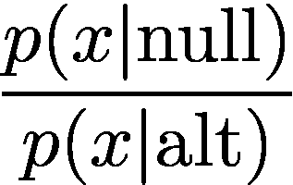
Bayesian Model Checking
Bayesian hypothesis testing:
Assume/derive a “null” probability model for a statistic
Assume an “alternative” probability model
Bayes factor or
likelihood ratio
depending on how it is computed…
p(x|null)
p(x|alt)
Say sample statistic falls here

Slide 27
Actually Computing Bayes Factors
and Likelihood Ratios…
Until recently (~2004??) BFs are almost all impossible to compute for realistic models of practical interest
This is probably the real reason why they are unpopular^{(whisper…)} in the applied Bayesian community
LRs are typically easier to compute than BFs but are far more arbitrary for assorted reasons…
Regardless of your philosophies about BFs/LRs:
…try to compute and work with them for practical situations of interest.
Do they deliver any value to you; helping to get closer to the “truth” or discern a clearer “scientific story”?
Note: Always be cognizant and “up-front” about the assumptions, strengths and weaknesses of your calculations.

Slide 28
Actually Computing Bayes Factors
and Likelihood Ratios…
This is a practical/applied Bayes methods course, so we’ll try to avoid Bayes Factors (for the most part), but a few last words
BFs (and LRs for that matter) are used for “model comparison”
Thinking of evidence E as data D, we aught to be able to compare any two arbitrary “models” (hypotheses) attorneys may want to compare:
“Weight of the evidence” = BF

Slide 29
Aside: The “Bayesian Framework” in Forensic Science
Bayes’ Rule^{Aitken, Taroni}:
H_{p} = the prosecution’s hypothesis
H_{d} = the defences’ hypothesis
E = any evidence
I = any background information

Slide 30
Aside: The “Bayesian Framework” in Forensic Science
Odd’s form of Bayes’ Rule:
{
{
{
Posterior odds in favour of
prosecution’s hypothesis
Likelihood Ratio
Prior odds in favour of
prosecution’s hypothesis
Posterior Odds = Likelihood Ratio × Prior Odds

Slide 31
Aside: The “Bayesian Framework” in Forensic Science
The likelihood ratio has largely come to be the main quantity of interest in their literature:
A measure of how much “weight” or “support” the “evidence” gives to one hypothesis relative to the other
Here, H_{p} relative to H_{d}
Major Players: Evett, Aitken, Taroni, Champod
Influenced by Dennis Lindley

Slide 32
Aside: The “Bayesian Framework” in Forensic Science
Likelihood ratio ranges from 0 to infinity
Points of interest on the LR scale:
LR = 0 means evidence TOTALLY DOES NOT SUPPORT H_{p} in favour of H_{d}
LR = 1 means evidence does not support either hypothesis more strongly
LR = ∞ means evidence TOTALLY SUPPORTS H_{p} in favour of H_{d}

Slide 33
Aside: The “Bayesian Framework” in Forensic Science
A standard verbal scale of LR “weight of evidence” IS IN NO WAY, SHAPE OR FORM, SETTLED IN THE STATISTICS LITERATURE!
A popular verbal scale is due to Jefferys but there are others
READ British R v. T footwear case!

Slide 34
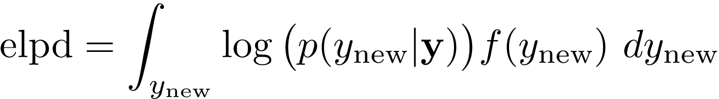
Back to Bayesian Model Checking
More heuristic, but far more practical is to consider how well the posterior predicts “future” data
i.e. data not used to obtain the posterior
A general performance measure which we pay attention to is the expected log posterior density:
Expresses how “close” the posterior predictive distribution is to the data’s true distribution f(y_{new}).

Slide 35
Back to Bayesian Model Checking
f(y_{new}), besides being all possible data’s true density, is also the all possible data’s marginal likelihood.
Only the gods know it
Luckily we can approximate elpd even though we don’t have f(y_{new})
We’ll do it after we learn how to fit models
elpd is also (much) easier to estimate than Bayes factors or their constituent marginal likelihoods

