Slide 1
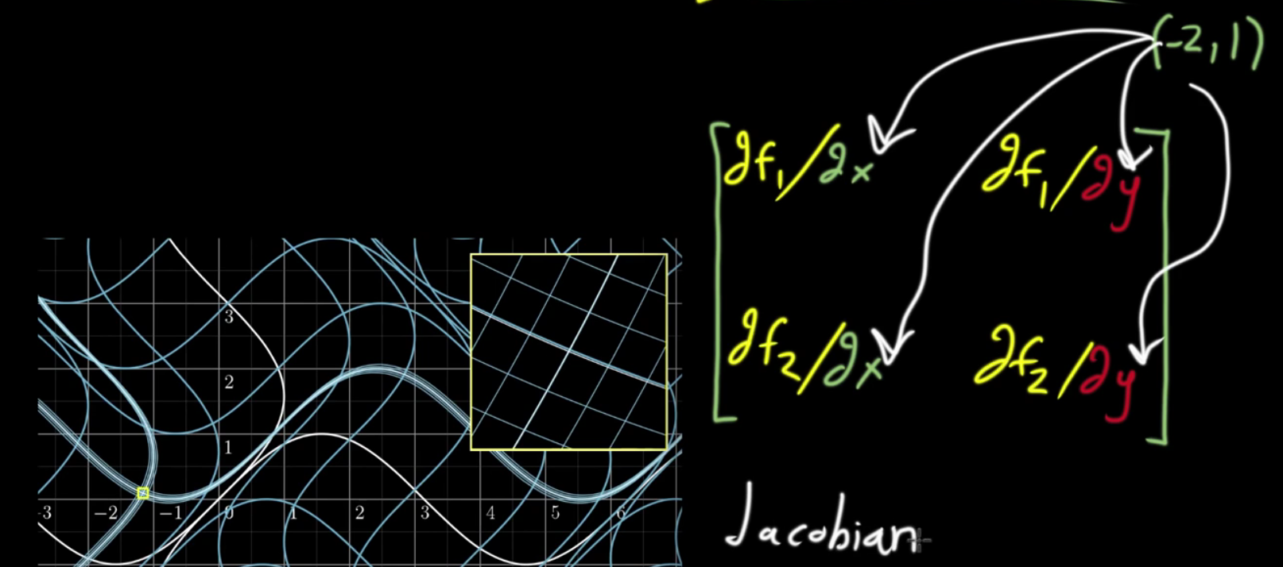
Reasons for and appearance of Jacobians in Bayesian Applications
Khan Academy

Slide 2
Re-parameterization
We are interested in probabilities. Usually though we don’t work directly with them…
Usually we work directly with probability density
Think of probability as mass, m. Physically, density ρ is mass over volume, V:
We can think of volume V, as parameter space θ:

Slide 3
Re-parameterization
Taking the physical analogy a little further, (probability) mass is:
A little bit (differential) of probability mass is:
It will be convenient to remember that probability density is a function of its parameter(s)

Slide 4
Re-parameterization
So a little bit of “probability mass” is:
Let’s say that it is not fruitful to work with the density in terms of θ.
We want to write this in terms of another parameter (related to θ) but not change the density or dm.
We want to re-parameterize ρ and persevere probability mass.

Slide 5
Re-parameterization
Say we choose to re-parameterize in terms of α with relationship to θ given as:
Substituting for θ from the above:
unchanged
unchanged
…but what is this?

Slide 6
Re-parameterization
Since θ and α are related, we can take derivatives:
Which implies

Slide 7
Re-parameterization
So substituting for d(f ⁻¹(α)):
θ
dθ
We have re-parameterized density and preserved the probability mass!
This is really just the (reverse) u-substitution trick from calculus

Slide 8
Re-parameterization
is called the (univariate) Jacobian
Take absolute value to ensure ρ ≥ 0, and a few other technical reasons
This generalizes to a determinant for more than two parameters
Usually we don’t need this because our component probability densities in a model are typically a function of only one parameter.
Take home message: To preserve (posterior) probability under re-parameterization, we need to:
multiply ρ by the Jacobian
-or- (in Stan) add the log-Jacobian to log-ρ.

Slide 9
Summary: To preserve (posterior) probability under re-parameterization, we need to multiply ρ by the Jacobian
dPr if you prefer…
Spiegelhalter et al.
Carpenter
Some more identities:
Carpenter

Slide 10
Example
For example, consider a large financial institution with hundreds of thousands of electronic storage devices (hard drives, memory sticks, etc.) to monitor for inappropriate or stolen material. Such material exposes the company to assorted risks and liabilities. Executives are worried and wish to know the the proportion, p, of compromised devices throughout the company.
A reasonable data model for this problem is to assume n device examinations follow a Bernoulli distribution:
likelihood
Analysts initially have no idea no idea what the proportion of compromised devices may be, so they represent their prior beliefs on p as:
prior
Example adapted from Carpenter: http://mc-stan.org/users/documentation/case-studies/mle-params.html

Slide 11
Example
100 devices are sampled and it is found:
1, 0, 0, 0, 0, 0, 0, 0, 0, 0, 1, 0, 0, 0, 1, 0, 0, 0, 0, 0, 0, 0, 1, 1, 0, 0, 1, 0, 0, 1, 0, 0, 1, 1,
0, 0, 0, 0, 0, 0, 0, 0, 0, 0, 0, 0, 0, 0, 0, 1, 0, 0, 0, 0, 0, 0, 0, 0, 0, 0, 0, 1, 0, 1, 0, 0, 0, 0,
0, 0, 1, 0, 0, 0, 1, 0, 0, 0, 1, 0, 0, 0, 0, 0, 0, 0, 0, 0, 1, 0, 0, 0, 0, 0, 0, 0, 0, 0, 0, 0
0=clean, 1=compromised
The posterior density for this model is:
We’ll use the exact posterior for comparison

Slide 12
Example
Let’s say that we chose to parameterize this problem in terms of to log-odds instead:
Re-parameterization in terms of α
But, we want to preserve our prior belief that:
i.e. represent the problem this way:
function on the left of a sampling statement, so we need the Jacobian of the function

Slide 13
Example
Find the Jacobian of the function:
So, to the log posterior we need to add:

Slide 14
Example
data {
int<lower=0> N;
int<lower=0, upper=1> y[N];
}
parameters {
real alpha;
}
transformed parameters {
real <lower=0, upper=1> ppi;
ppi = exp(alpha)/(1+exp(alpha));
}
model {
exp(alpha)/(1+exp(alpha)) ~ uniform(0,1);
y ~ bernoulli(ppi);
// Add in the log-Jacobian
target += alpha - 2*log(1+exp(alpha));
}

Slide 15
Example
library(rstan)
# Note the "true" p was 15.2%:
flip.samp <- c(
1, 0, 0, 0, 0, 0, 0, 0, 0, 0, 1, 0, 0, 0, 1, 0, 0, 0, 0, 0, 0, 0, 1, 1, 0, 0, 1,
0, 0, 1, 0, 0, 1, 1, 0, 0, 0, 0, 0, 0, 0, 0, 0, 0, 0, 0, 0, 0, 0, 1, 0, 0, 0, 0,
0, 0, 0, 0, 0, 0, 0, 1, 0, 1, 0, 0, 0, 0, 0, 0, 1, 0, 0, 0, 1, 0, 0, 0, 1, 0, 0,
0, 0, 0, 0, 0, 0, 0, 1, 0, 0, 0, 0, 0, 0, 0, 0, 0, 0, 0
)
# Data and fixed parameters:
n <- length(flip.samp)
dat<-list(y=flip.samp,N=n)
stan.code<-paste(readLines(”PATH/Jacobian_log_odds.R"),collapse='\n')
model.c <- stanc(model_code = stan.code, model_name = 'model1')
# Compile the models:
sm <- stan_model(stanc_ret = model.c, verbose = T)
#Run the model
fit <- sampling(sm, data = dat, iter=2000, thin = 1, chains = 4)
print(fit)

Slide 16
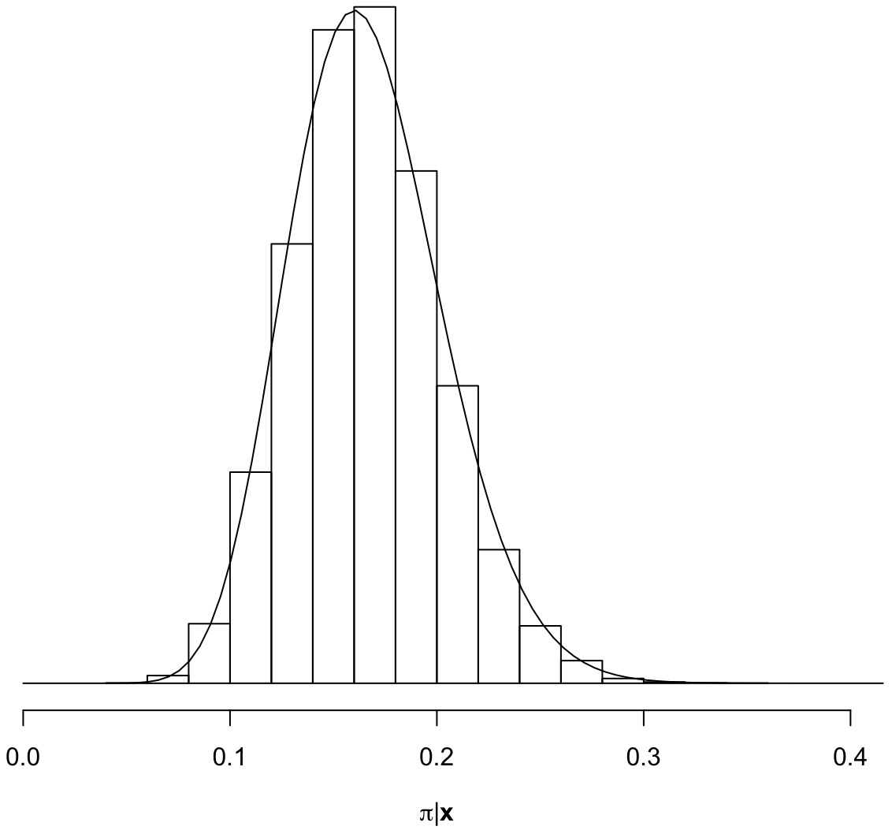
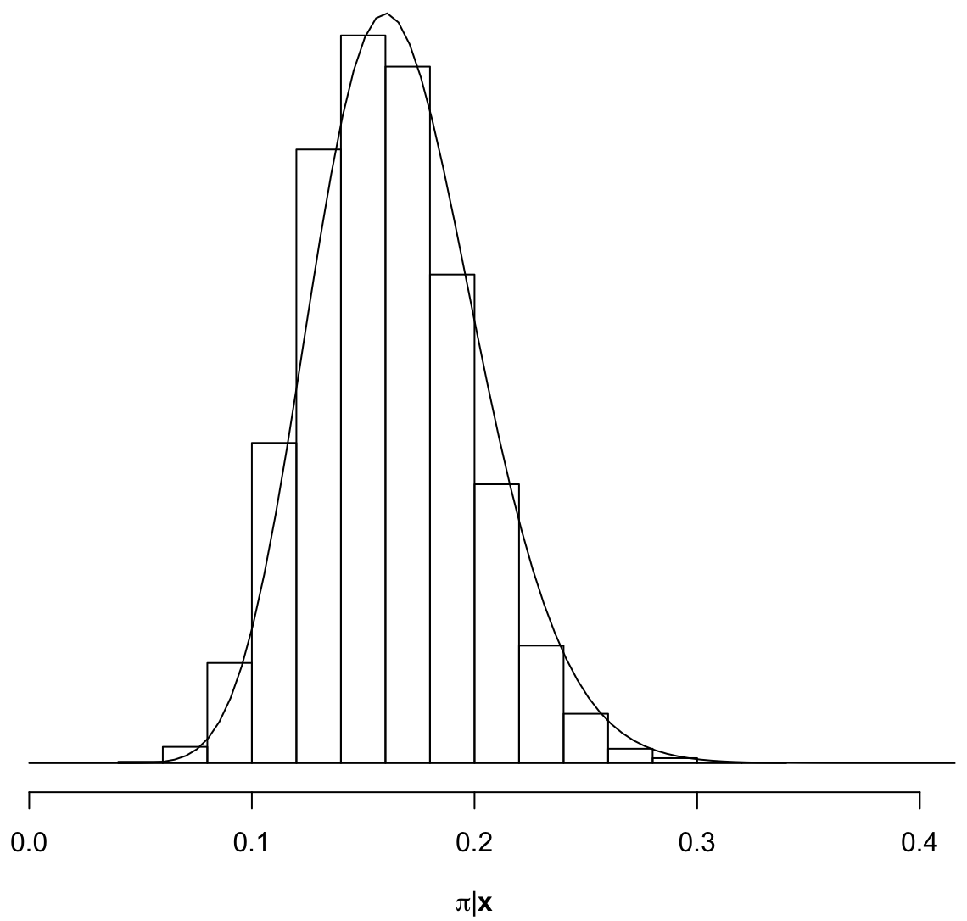
Example
# Examine the posterior for p
ppi <- extract(fit, "ppi")[[1]]
hist(ppi, main=NULL, xlab=expression(paste(pi, "|", bold("x"))), probability = T, xlim=c(0,1))
# Exact posterior is Beta(1+S, 1+n-S). Overlay:
S <- sum(flip.samp)
pi.ax <- seq(from=0, to=1, length.out = 200)
lines(pi.ax, dbeta(pi.ax, shape1 = 1+S, shape2 = 1+n-S))
Correct posterior w/ Jacobian
Wrong posterior
w/o Jacobian
Curve is the exact posterior

Slide 17
Example
You don’t always have to use a Jacobian however. For this problem, since
p ~ Uniform(0,1), it can be shown that α ~ Logistic(0,1)
p
Same problem, but this time NO function on the left of a sampling statement, so we DON’T need a Jacobian here
A transformation samples a parameter, then transforms it.
A change of variables transforms a parameter, then samples it.
Only the latter requires a Jacobian adjustment.
Gelman, Betancourt, Carpenter, et al….

Slide 18
Example
data {
int<lower=0> N;
int<lower=0, upper=1> y[N];
}
parameters {
real alpha;
}
model {
alpha ~ logistic(0,1);
y ~ bernoulli(exp(alpha)/(1+exp(alpha)));
}
generated quantities {
// So we don’t have to calc p in R”
real ppi;
ppi = exp(alpha)/(1+exp(alpha));
}

Slide 19

Example
Correct posterior, but now reformulated to NOT need a Jacobian
A transformation samples a parameter, then transforms it.
A change of variables transforms a parameter, then samples it.
Only the latter requires a Jacobian adjustment.
Gelman, Betancourt, Carpenter, et al….

