Slide 1

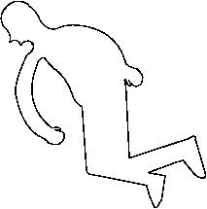
Bayesian Methods
Basic Parametric Bayesian Inference

Slide 2
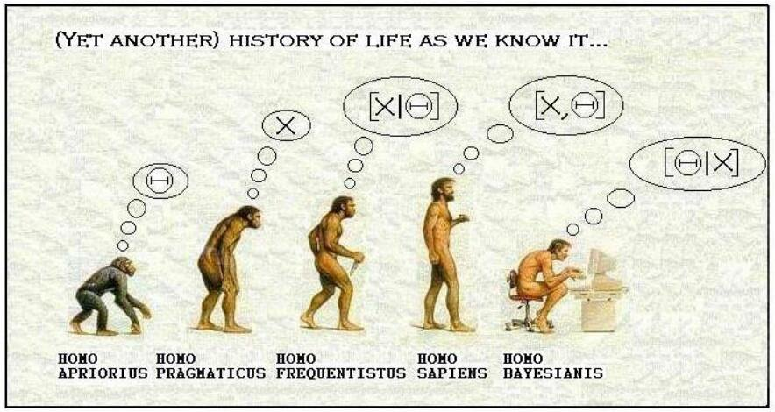
Bayesian Methods
This is probably a more apt meme for us:
Credit:unknown

Slide 3
Bayesian Statistics
The basic Bayesian philosophy:
Prior Knowledge × Data =
Updated Knowledge
A better understanding of the world
Prior × Data = Posterior

Slide 4
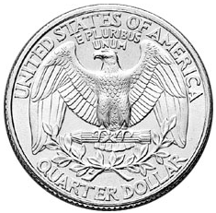
Is this a “fair coin”?

Slide 5
Is this a “fair coin”?
Before we gather any data on this coin’s flipping behavior, what do we believe about its probability to land on heads?
Represent your beliefs about a parameter before you’ve gathered data as a prior (a priori) density over it

Slide 6
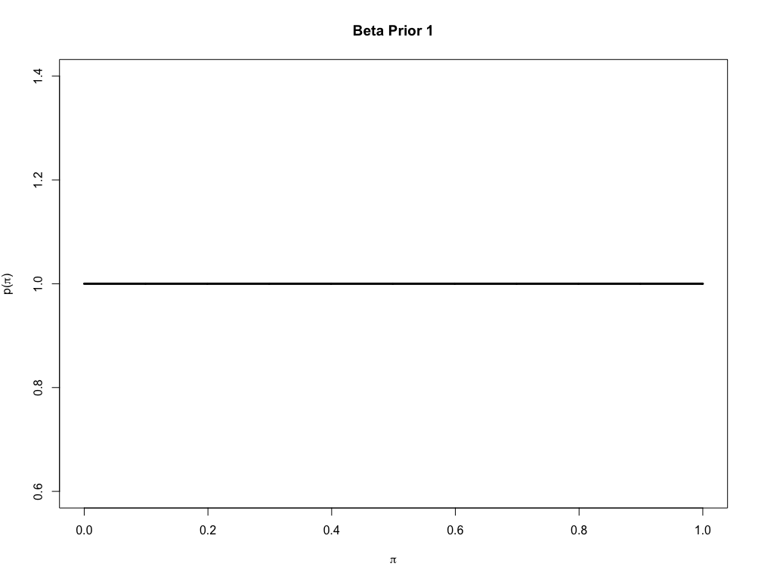
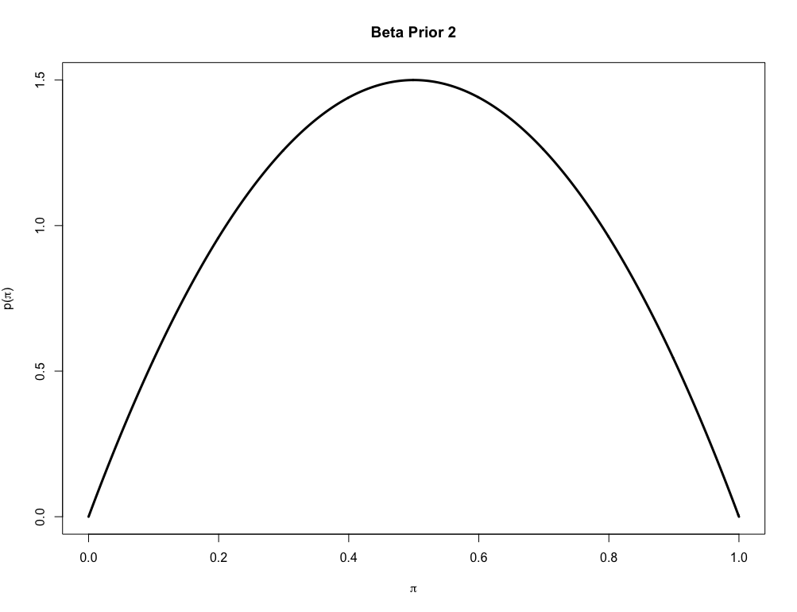
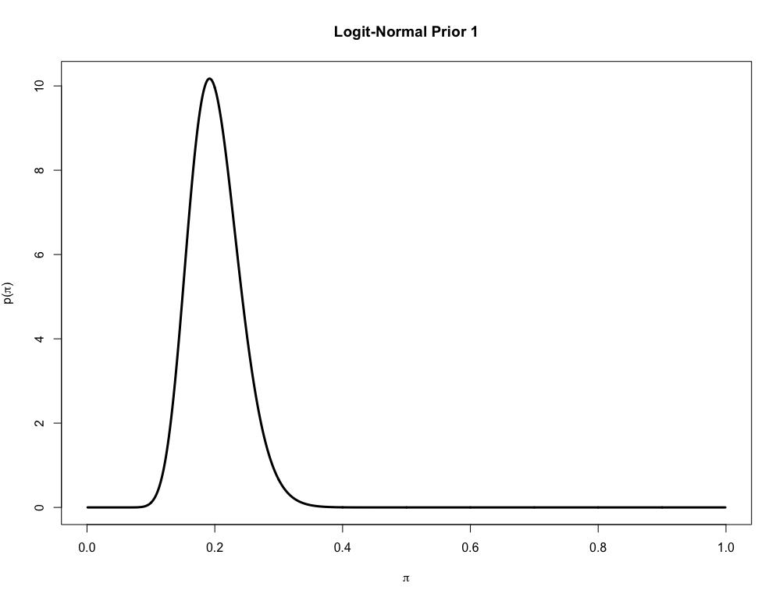
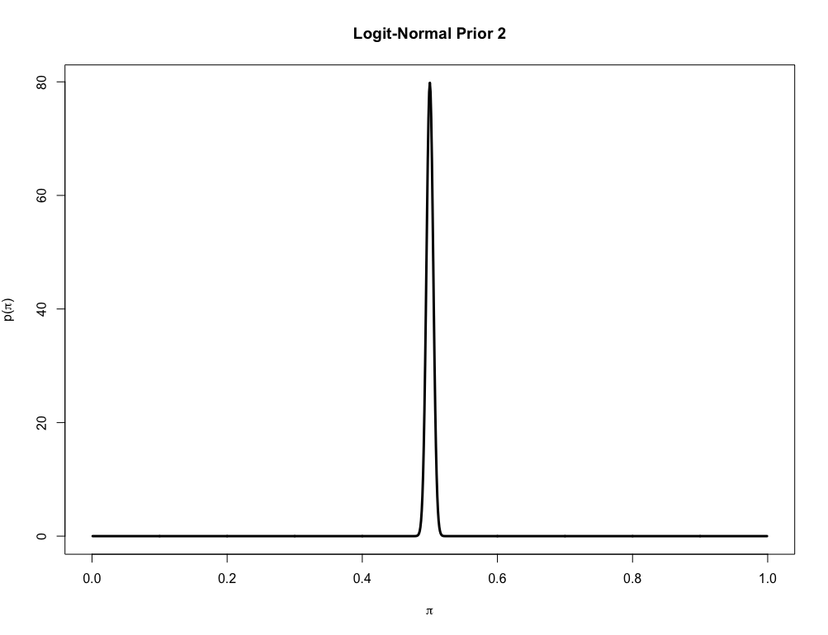
Some prior beliefs we may have about π_{Heads} for the coin

Slide 7
Is this a “fair coin”?
Now flip the coin and gather some data:
x = 1 1 0 0 0 0 0 1 1 0
1 = “Heads”, 0 = “Tails”
Based on this data and what we believed about π_{Heads} before, what can we say about it now?

Slide 8
Is this a “fair coin”?
The data (likelihood)
Our beliefs about π_{Heads} after we gathered the data (a posteriori probability)
Our beliefs about π_{Heads} before we gathered the data (a priori probability)

Slide 9
Is this a “fair coin”?
The likelihood of observing the data given π_{Heads} is the data model
Here, good models for the data are either the Bernoulli or Binomial likelihoods
or

Slide 10
Is this a “fair coin”?
The lets determine the posterior with a Beta(1,1) prior on π_{Heads} and a Binomial likelihood model for the data
Directed Acyclic Graph (DAG) representation: joint PDF

Slide 11
Is this a “fair coin”?
The model is simple enough that we can obtain an analytical solution for the posterior:

Slide 12
Is this a “fair coin”?
The model is simple enough that we can obtain an analytical solution for the posterior:
Conjugate model: When the posterior is the same form as the prior.
Many of these models were derived by Prof. Shenkin’s cousin: Howard Raiffa! Wow!
Cf. Raiffa, H. and Schlaiffer, R. (1961). Applied Statistical Decision Theory.

Slide 13
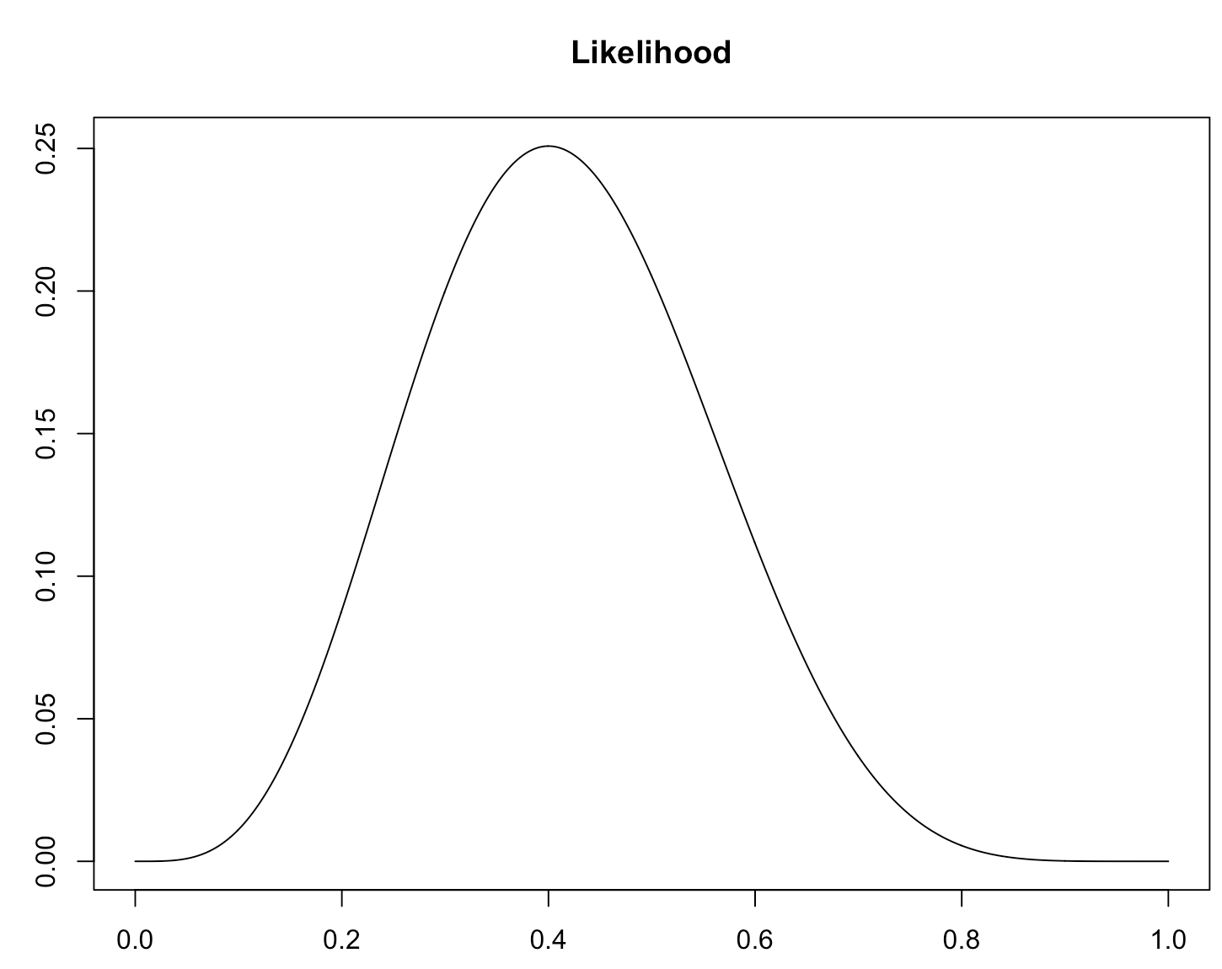
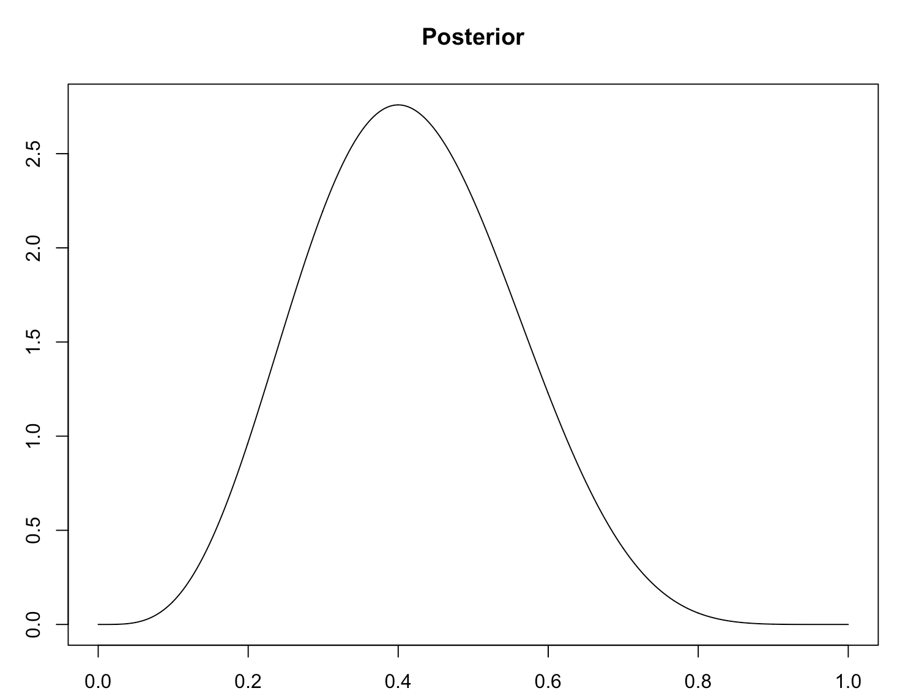
Side note: the MLE for π
Given this model, why does the posterior look like “the data”?
At this point, what would you bet on, H or T?

Slide 14
Is this a “fair coin”?
Most of the posteriors we will model will not have an analytical form.
Picking picking any prior in general leads to an analytically intractable posterior

Slide 15
Is this a “fair coin”?
Most of the posteriors we will model will not have an analytical form.
For example:
From the law of total probability.
Can’t do this integral analytically...

Slide 16
Is this a “fair coin”?
But, we can (often) get these posteriors numerically:
General trick: Markov Chain Monte Carlo: MCMC

Slide 17
MCMC in a Nutshell
But, we can (often) get these posteriors numerically:
By specifying these
MCMC allows us to sample proportionally from this
We avoid having to explicitly evaluate any nasty integrals
A nice explanation of basic Metropolis-Hastings MCMC by STATA:
https://www.youtube.com/watch?v=OTO1DygELpY

Slide 18
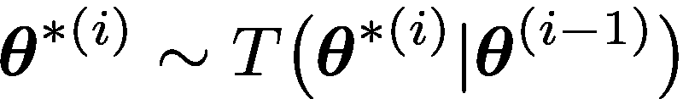
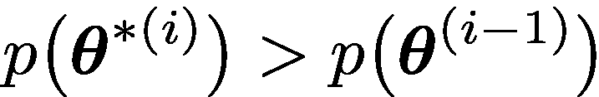

Metropolis-Hastings Algorithm
Markov Chain Monte Carlo (MCMC), Metropolis algorithm
Randomly moves around parameter space trying to sample from the posterior p(θ )
Works like “hill-climbing” with a reverse gear that kicks in some times
Algorithm outline:
Initialize a θ → θ ⁽⁰⁾
Start a counter i at 1 and go to N:
Draw a new θ ^{∗(i)} from a proposal (jumping, transition) distribution:
Accept θ ^{∗(i)} into a growing posterior sample and go back to a. if
(hill-climb)
If the opposite of b. is true, accept θ ^{∗(i)} with a random probability p_{accept}
(reverse gear if you win this bet)

Slide 19
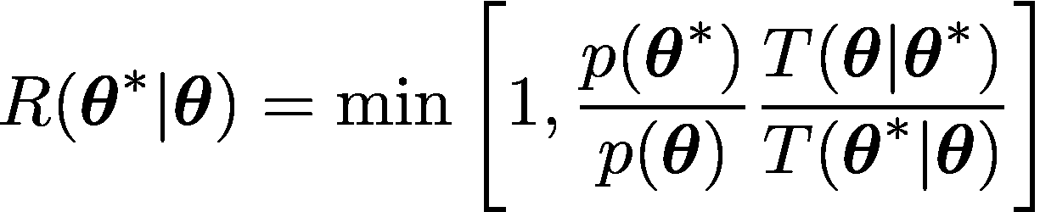
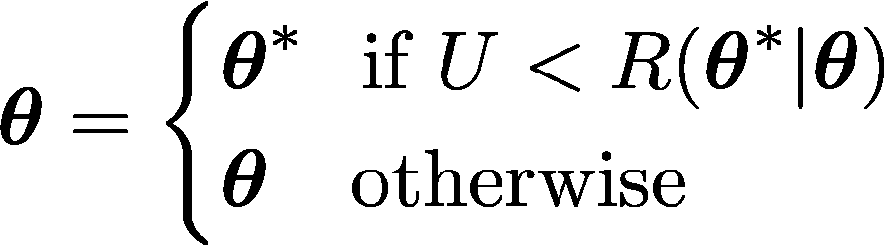
Metropolis-Hastings Algorithm
Slightly more formally, the basic Metropolis(-Hastings) MCMC algorithm isCalderhead: http://events.csml.ucl.ac.uk/userdata/lunch_talks/2012_11_23_bc.pdf
Given current state θ draw proposed state θ * from the transition density (TD) T(θ * | θ )
Note: if TD is symmetric: T(θ * | θ ) = T(θ | θ *)
Calculate the acceptance ratio:
if TD is not symmetric this appears and alg called Metropolis-Hastings
Draw U ~ Uniform(0,1)
Let:

Slide 20
Metropolis-Hastings Algorithm
In R this could look something like:
# A port from the nice pedagogical python code by T Wiecki at
# https://twiecki.io/blog/2015/11/10/mcmc-sampling/
# next step proposal:
proposal <- function(mu.curr, proposal.wid){rnorm(n = 1, mean = mu.curr, sd = proposal.wid)}
# likelihood part of ansatz
likelihood <- function(a.mu, dats){ prod(dnorm(dats, mean = a.mu, sd = 1)) }
# prior part of ansatz
prior <- function(a.mu, mu.hyp, sd.hyp){dnorm(x = a.mu, mean = mu.hyp, sd = sd.hyp)}
# ansatz (un-normalized posterior "d-function")
ansatz <- function(a.mu, mu.hyp, sd.hyp, dats){likelihood(a.mu, dats) *
prior(a.mu, mu.hyp, sd.hyp)}
# Metropolis (only, not -Hastings) ratio
r.metrop <- function(mu.curr, mu.prop, mu.hyp, sd.hyp, dats){
ansatz(mu.prop, mu.hyp, sd.hyp, dats) / ansatz(mu.curr, mu.hyp, sd.hyp, dats)
}

Slide 21
# MCMC routine:
sampler <- function(datav, num.iter=100, mu.init=.5,
proposal.width=.5, mu.prior.mu=0, mu.prior.sd=1){
mu.current <- mu.init
posterior.sample <- array(NA,num.iter)
posterior.sample[1] <- mu.current
for(i in 2:num.iter){
# suggest new position
mu.proposal <- proposal(mu.curr = mu.current, proposal.wid = proposal.width)
# Accept proposal?
accept.ratio <- r.metrop(
mu.curr = mu.current,
mu.prop = mu.proposal,
mu.hyp = mu.prior.mu,
sd.hyp = mu.prior.sd,
dats = datav)
acceptQ <- runif(1) < accept.ratio
if(acceptQ) {
# Update position
mu.current <- mu.proposal
}
posterior.sample[i] <- mu.current
}
return(posterior.sample)
}

Slide 22
Metropolis-Hastings Algorithm
Demo:

Slide 23
Gibbs Sampling

Slide 25
MCMC Fails…

Slide 26
Back to: Is this a “fair coin”?
data{
int n;
int s;
real mu;
real <lower=0> sigma;
}
parameters{
real Z;
}
model{
Z ~ normal(mu,sigma);
s ~ binomial_logit(n,Z);
}
generated quantities{
real pi;
pi = inv_logit(Z);
}
model{
# Likelihood:
s ~ dbinom(n, ppi)
# Prior:
Z ~ dnorm(0, 1/(1.25^2))
ppi <- ilogit(Z)
}
Stan language
(B)ayesian Inference (U)sing (G)ibbs (S)ampling
BUGS language
JAGS Dialect

Slide 27
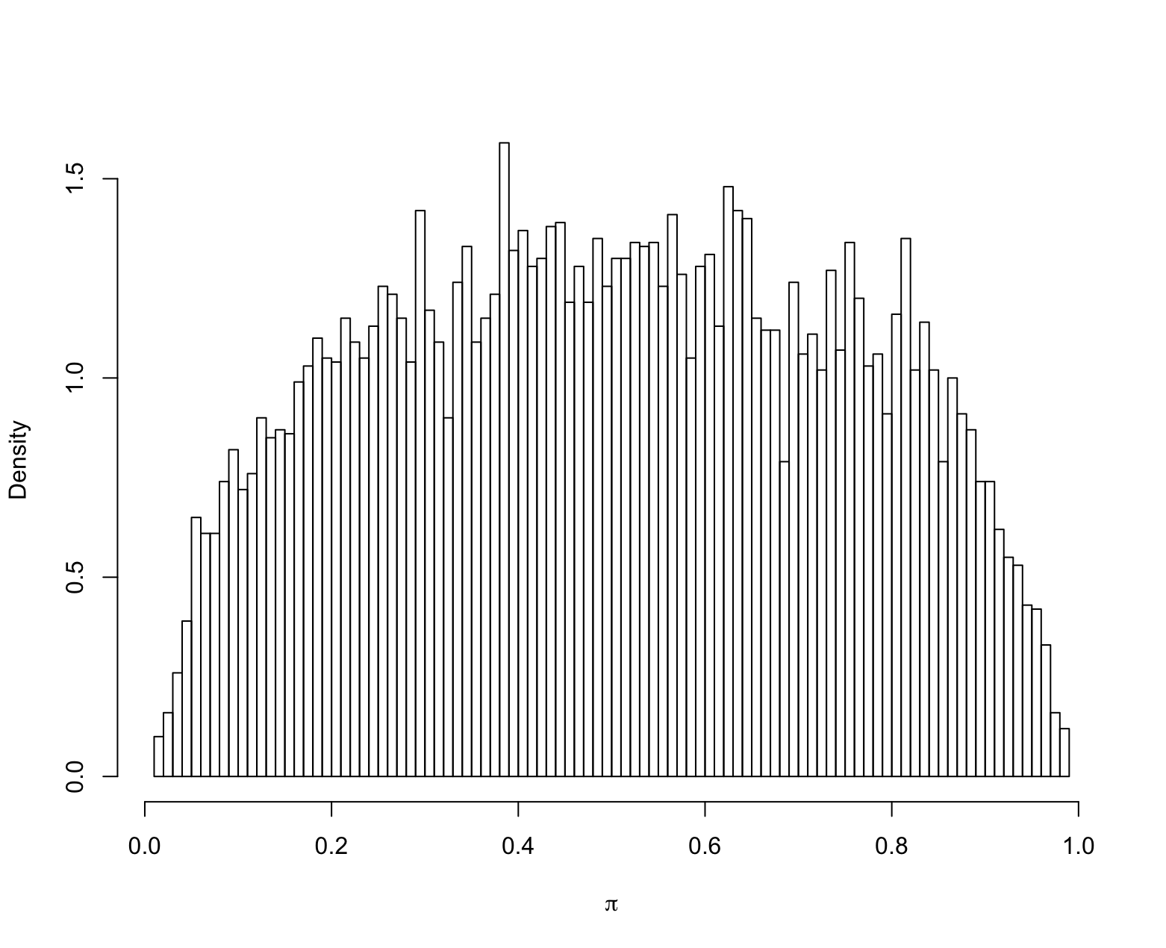
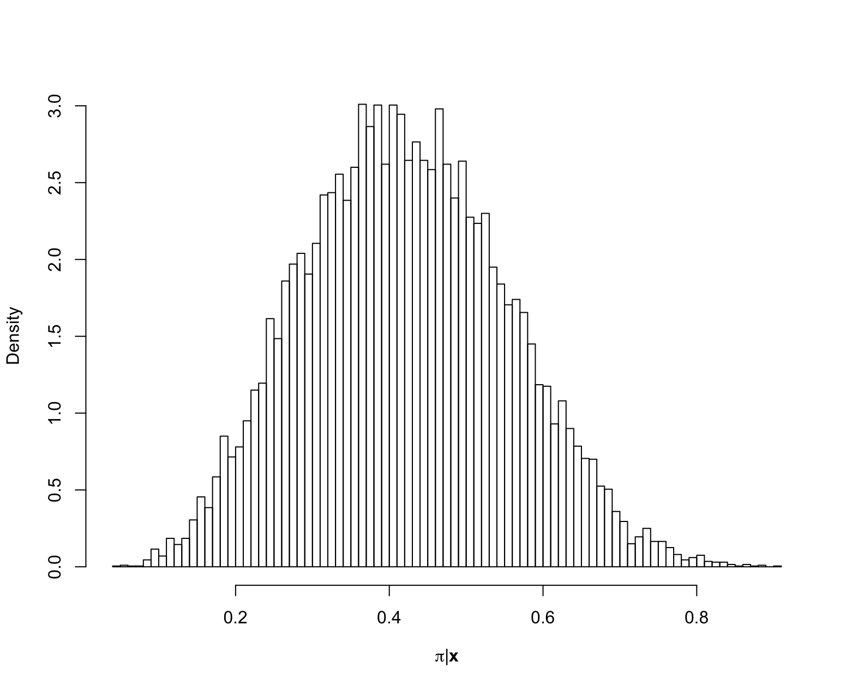
Back to: Is this a “fair coin”?
Prior
Posterior
So do you believe the coin is fair after observing data?

Slide 28
A Glimpse Into Regression
It’s easy to expand into many other statistical methods within the Bayesian framework
Key: all parameters of a model have distributions (Bayesian), instead of being unknown but fixed (frequentist).
These are given a priori distributions which are updated in light of the data x_{i} and y_{i}
response variable
error
explanatory or predictor
variable
intercept
regression coefficients

Slide 29
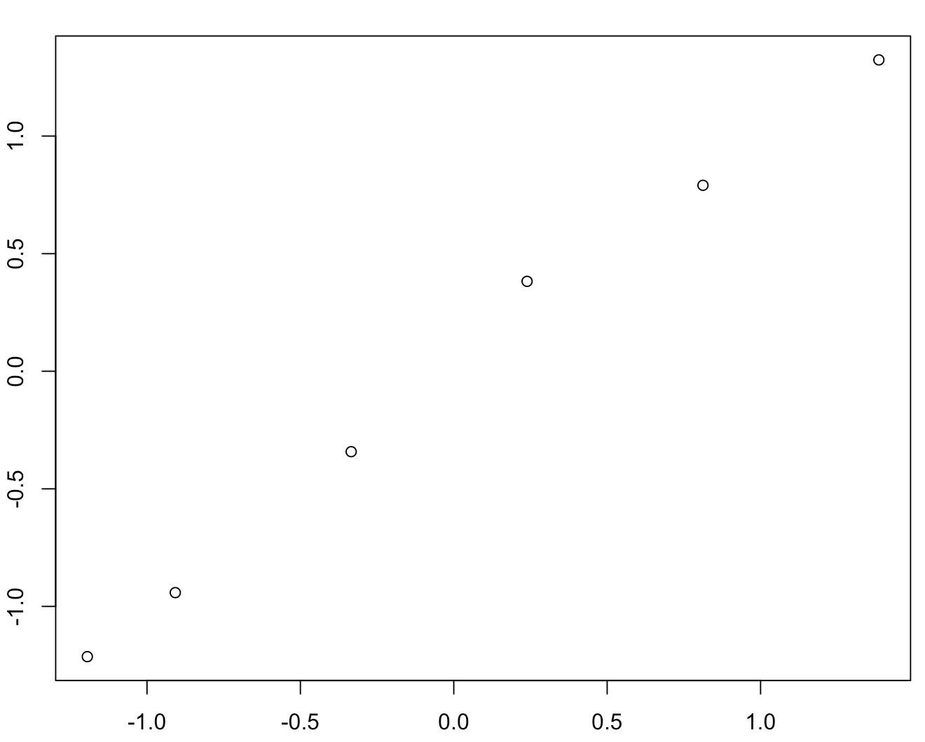
A Glimpse Into Regression
GC-Ethanol: Azevedo
Peak Area Ratio (standardized)
Concentration (standardized)

Slide 30
A Glimpse Into Regression
GC-Ethanol: Azevedo
Best fit line: Simple linear regression
Priors:
Fairly uninformative, but realistic^{Gelman}
Vaguely informative, but realistic^{Gelman}
A standard realistic choice
Likelihood (Data model):

Slide 31
A Glimpse Into Regression
data {
int<lower=0> N;
vector[N] x;
vector[N] y;
}
parameters {
real beta0; // Intercept
real <lower=0> beta1; // Slope
real<lower=0> epsilon; // Residuals (noise)
}
model {
// Priors on regression coef, intercept and noise
beta0 ~ cauchy(0,1);
beta1 ~ cauchy(0,5);
epsilon ~ normal(0,1);
// Likelihood ("vectorized" form)
y ~ normal(beta0 + beta1 * x, epsilon);
}
Stan language simple linear regression

Slide 32
A Glimpse Into Regression
model {
# Priors on regression coef, intercept and noise
# No Cauchy in JAGS, so lets use wide Normals instead
beta0 ~ dnorm(0,0.0001)
beta1 ~ dnorm(0,0.0001) T(1.0E-8,1.0E12)
epsilon ~ dnorm(0,1) T(1.0E-8,1.0E12)
tau <- 1/pow(epsilon,2) # Need precision for BUGS/JAGS
# Likelihood
for(i in 1:N) {
mu[i] <- beta0 + beta1*x[i]
y[i] ~ dnorm(mu[i], tau)
}
}
JAGS language simple linear regression

Slide 33
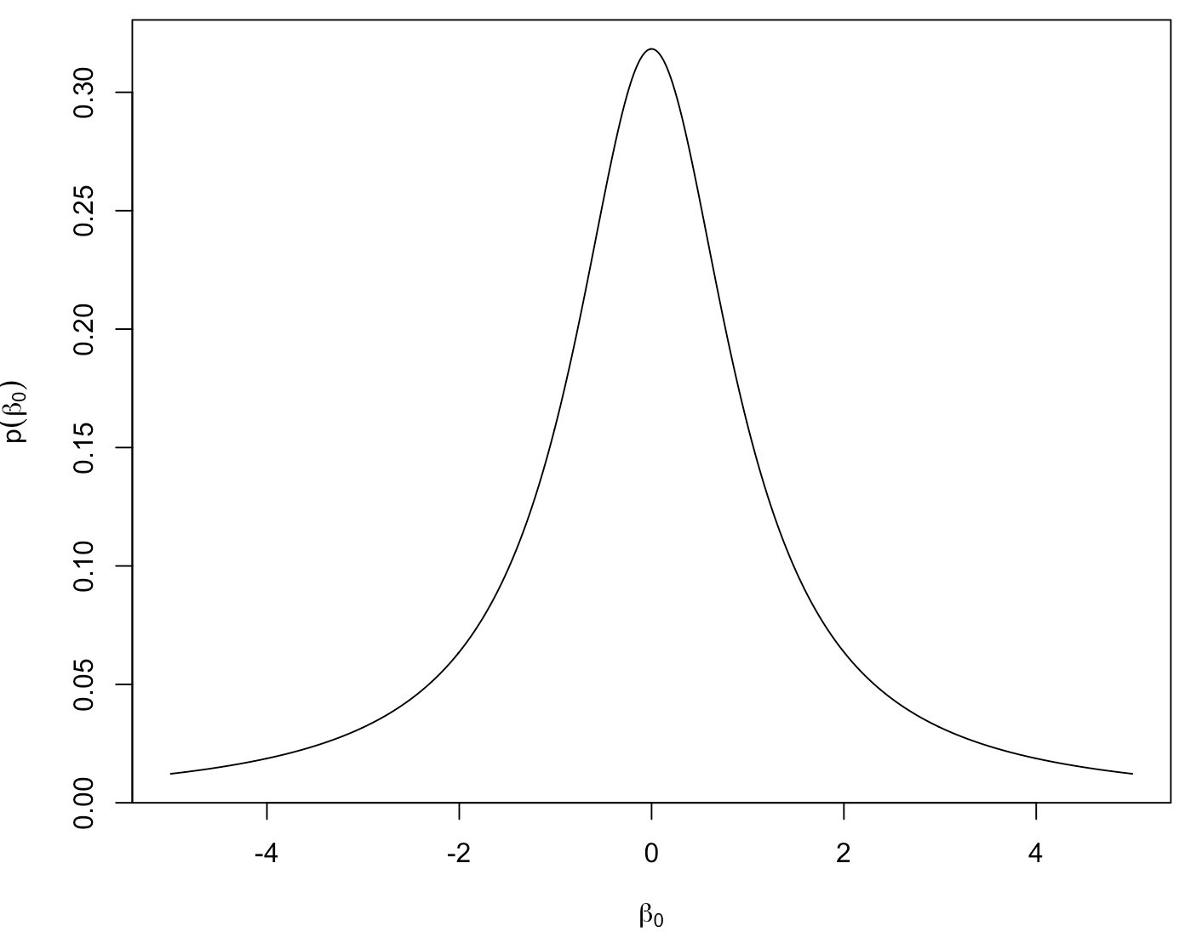
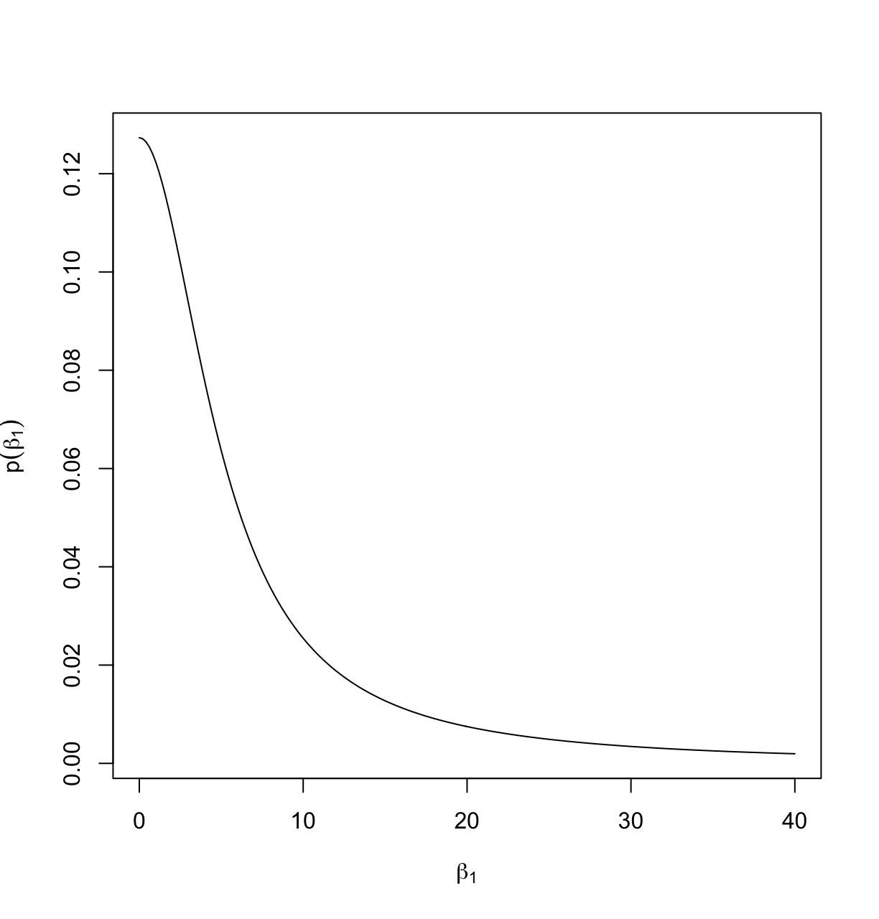
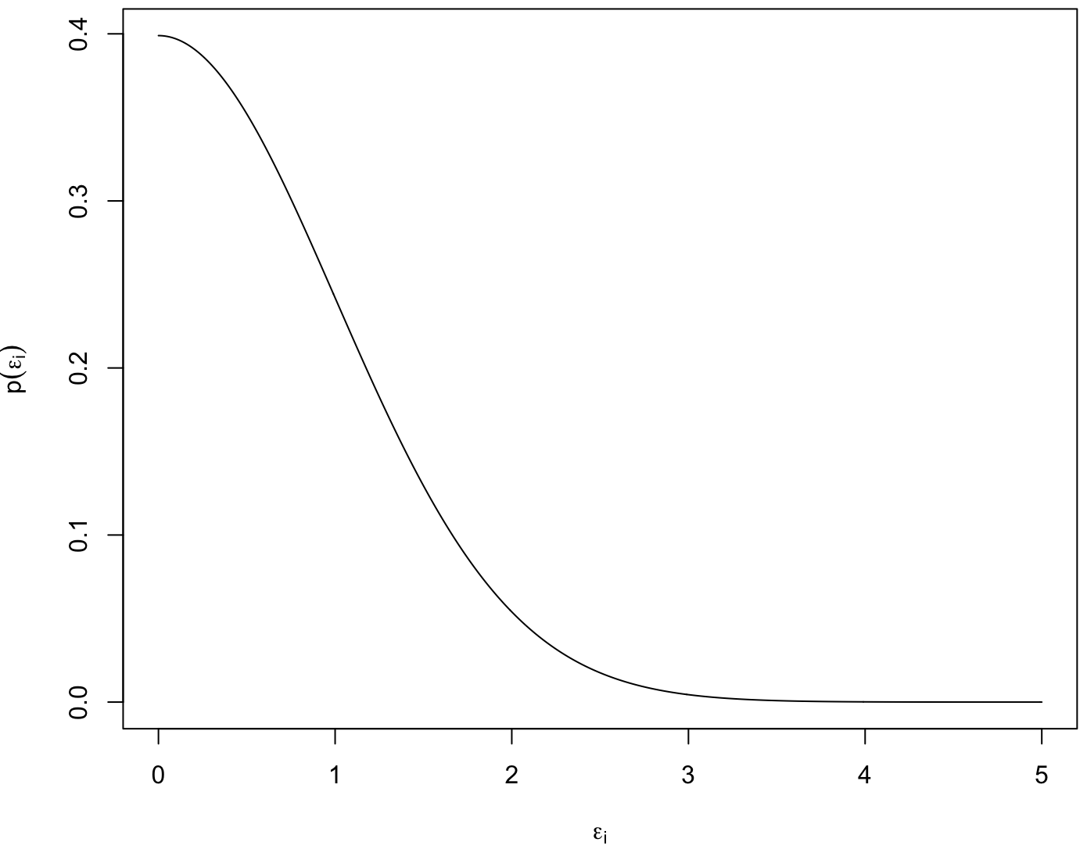
Priors

Slide 34
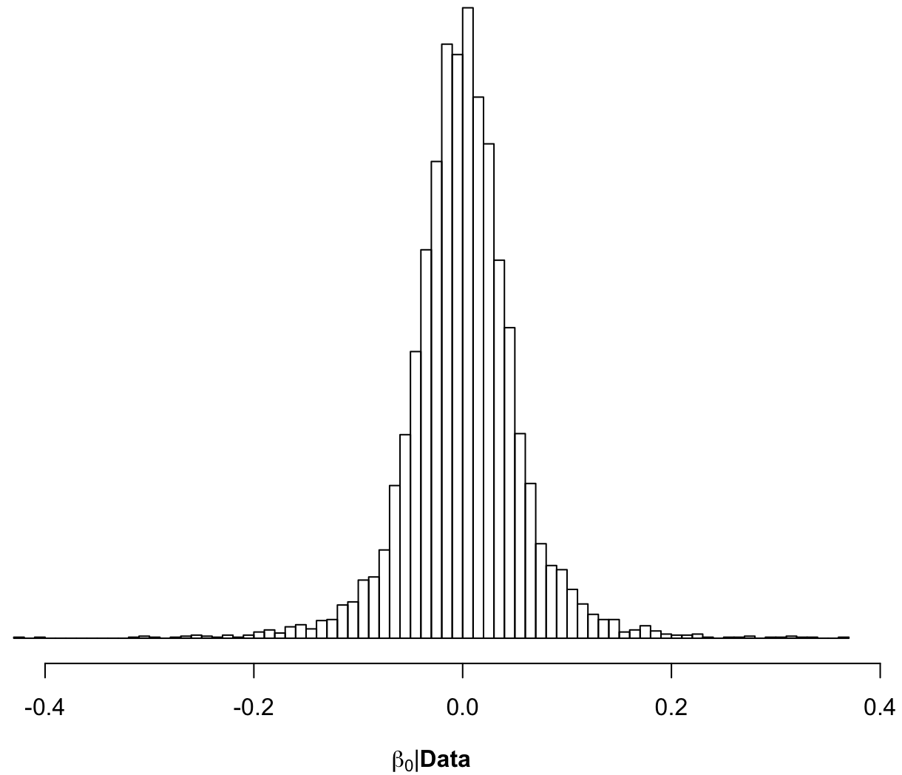
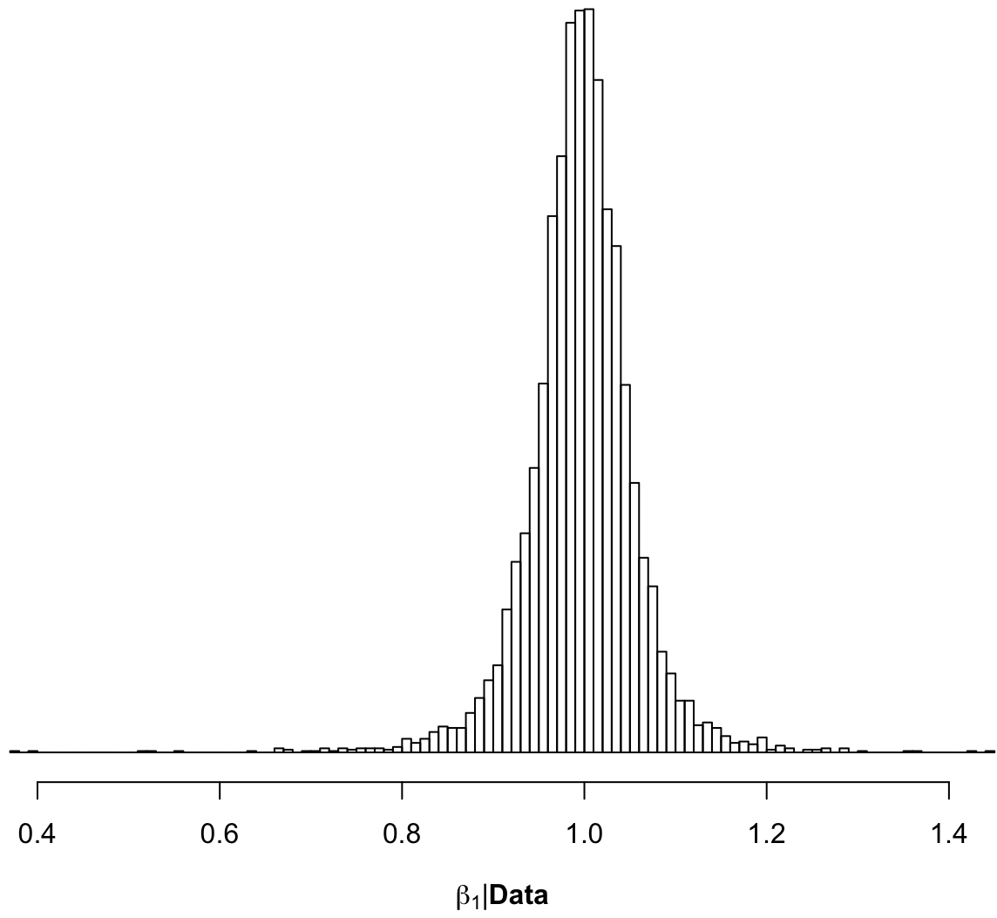
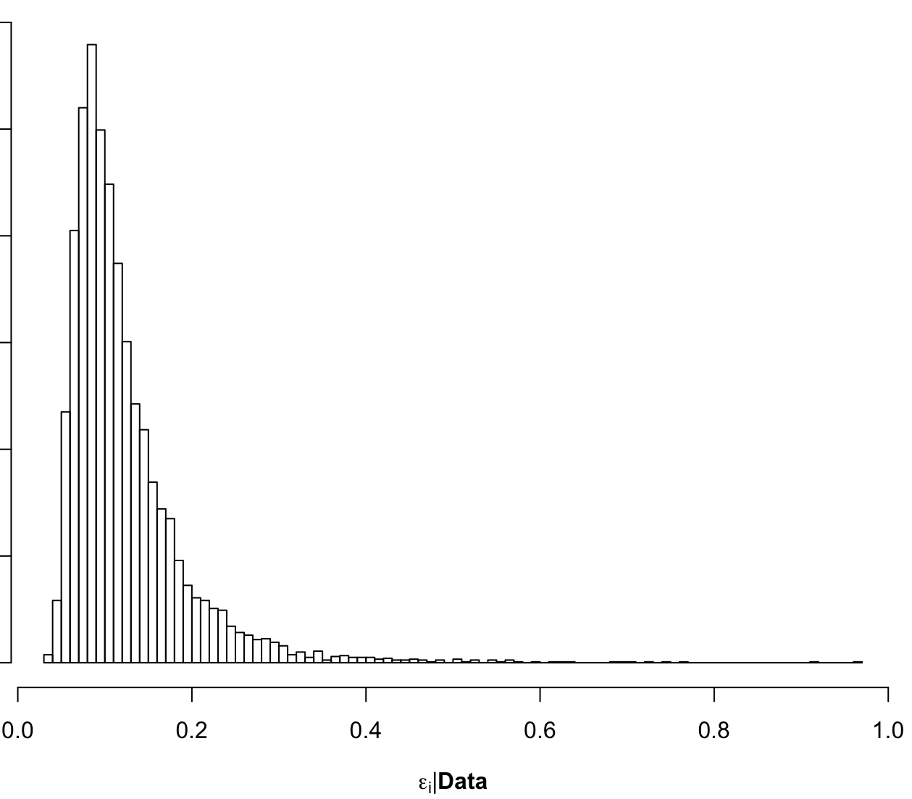
Posteriors
p(β₀|Data)
p(β₁|Data)
p(ε_{i}|Data)

Slide 35
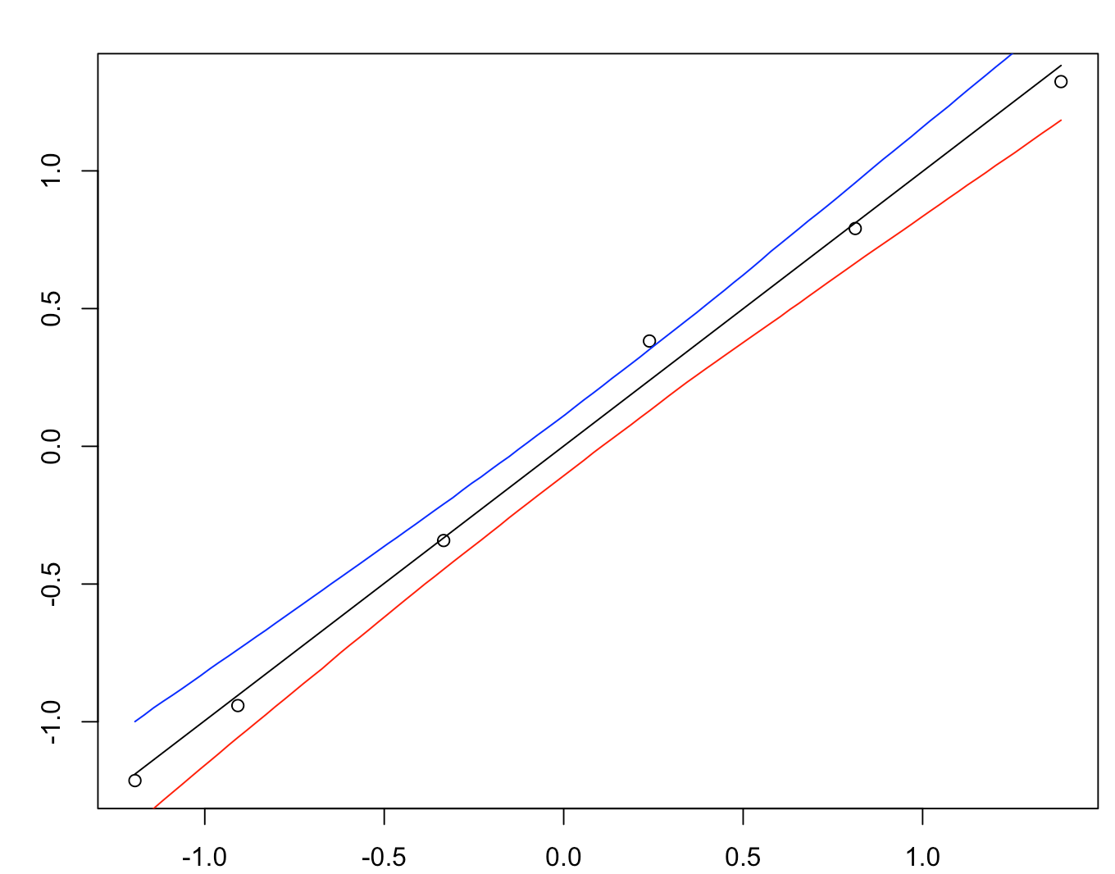
Lines From the Posterior
GC-Ethanol: Azevedo
95% Highest Posterior Density Intervals for E_{post}[y_{i}|x_{i}]
Peak Area Ratio (standardized)
E_{post}[y_{i}|x_{i}]
Concentration (standardized)

Slide 36
Some First Cautions
Bayesians will tell you the answer to your question, but you need a frequentist to tell you if they’re right^{Saunders}
That said, there are many practical ways out there to “check” (“stress-test”) your Bayesian models and assumptions:
Try multiple priors, Sensitivity analysis (tedious, but good)
Posterior predictive checking (my favorite)
Frequentist properties (See Efron)

Slide 37
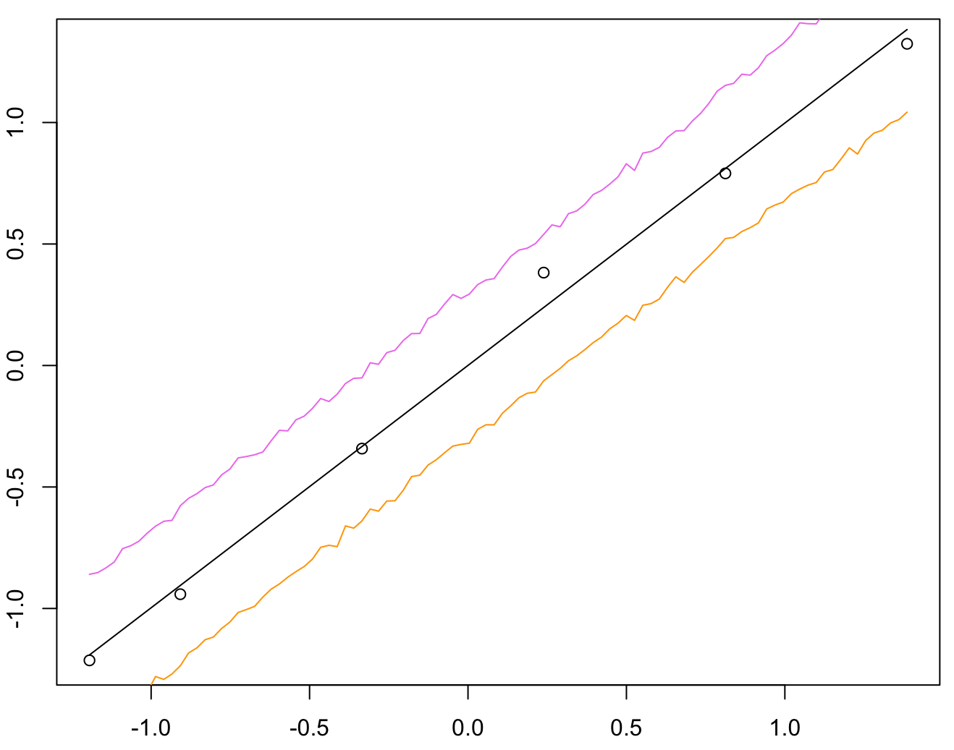
Posterior Predictive Bands
GC-Ethanol: Azevedo
95% Highest Predictive Posterior Density Intervals for y_{i}(x_{i})
Peak Area Ratio (standardized)
E_{post}[y_{i}|x_{i}]
Concentration (standardized)

Slide 38
A Glimpse at Bayesian Evidence
Another way to examine your model’s “goodness-of-fit” is to compute the likelihood of observing the data you got under the model you are assuming: Bayesian evidence
Bayesian evidence is the marginal likelihood of the data
VERY challenging to calculate in general, … but we’ll try.

Slide 39
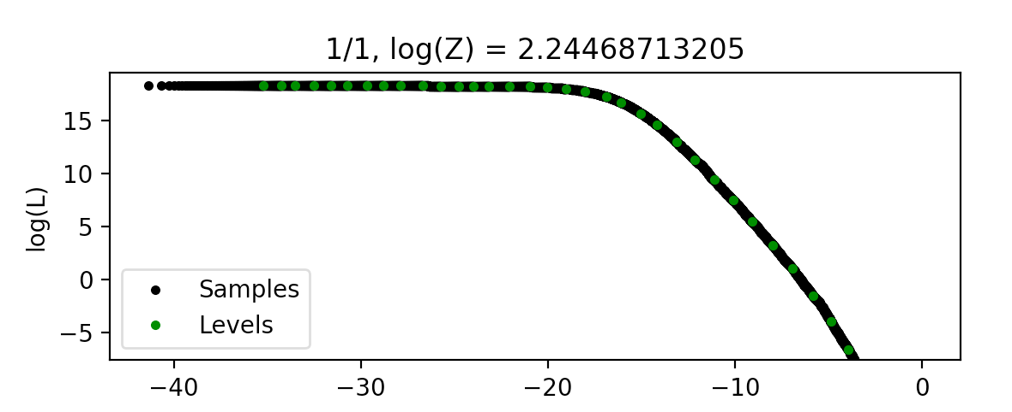
A Glimpse at Bayesian Evidence
GC-Ethanol: Azevedo
Using DNest4:
The “evidence”: likelihood of this data given the model:
Z ≈ e^{2.2}
log(X)

