Slide 1
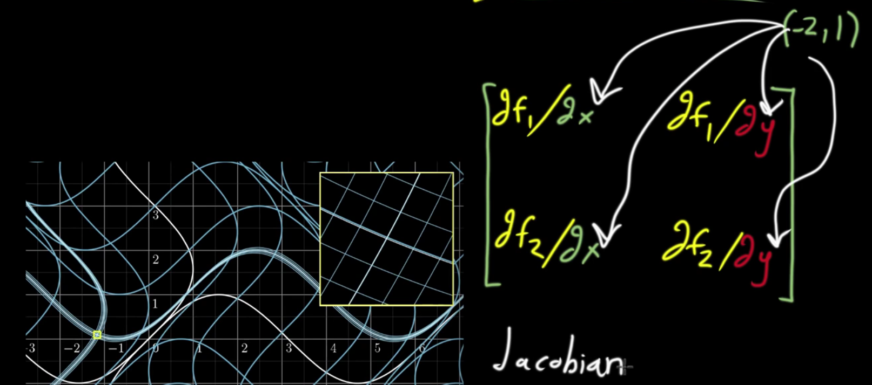
Reasons for and appearance of Jacobians in Bayesian Applications
Khan Academy
Change-of-Variables

Slide 2
Change-of-Variables
Motivating example: Say we want to learn about the variance (σ ²) in gunshot pellet spread dataª:
Area of rectangle enclosing pellet pattern produced from shot at 10 ft
2.60, 3.35, 3.33, 3.06, 3.38, 3.85
Assuming the data is gaussian, the likelihood of the sample variance s², can be expressed as a chi-square distribution:
This sampling statement is a function of the parameter we’re interested in and data 🤔…
ªRowe, W.F. and Hanson, S.R. (1985) Range-of-fire estimates from regression analysis applied to the spreads of shotgun pellet patterns: Results of a blind study, Forensic Science International, 28(3-4): 239-250.

Slide 3
Change-of-Variables
Generally, if we are interested in working with the distribution of x (could be data, could be a parameter), but it is much easier or convenient to work with the distribution for a function of x, f(x) = y, we’d want to know:
What is the pdf of x in terms of the pdf of y?
In other words: if the (convenient) pdf of y is :
and the pdf of x is:
what is
in terms of
?

Slide 4
Change-of-Variables
We can get the relationship from the change-of-variables theorem from calculus:
With:
Jacobian
They get more complicated for more than one variable but this 1D version is all we’ll need.

Slide 5
Change-of-Variables
Back to the gunshot pellet spread:
Is there a lot of variability (σ ²) in the areas?
0
1
A possible DAG for s²/σ ² :
σ²
n=6
s²

Slide 6
Change-of-Variables
We’re interested in the likelihood p(s² | σ ²) but we’ve got p(x) = χ²(x | n-1)
Use change-of-variables:
In general:
Here:
In general:
Here:

Slide 7
Stan code:
data {
int<lower=0> n;
real<lower=0> s_sq;
real<lower=0> loc;
real<lower=0> scale;
}
parameters {
real<lower=0> sigma_sq;
}
transformed parameters {
real<lower=0> x;
x = (n-1)*s_sq/sigma_sq; // This is distributed as chi-sq(n-1)
}
model {
//Prior
//sigma_sq ~ cauchy(loc, scale);
target += cauchy_lpdf(sigma_sq | loc, scale);
//likelihood
target += chi_square_lpdf(x | n-1) + log(n-1) - 2*log(sigma_sq);
}
generated quantities {
real<lower=0> sigma;
sigma = sqrt(sigma_sq);
}
Stan works on the log-scale. Add in the log Jacobian with target += syntax

Slide 8
Run Stan code:
library(bayesutils) # Should load everything we need
# Extra options to set for Stan:
options(mc.cores = 1)
rstan_options(auto_write = TRUE)
# Load a Stan model:
stan.code <- paste(readLines(system.file("stan/chisq_jacobian-cauchy.stan", package = "bayesutils")),collapse='\n')
# Translate Stan code into C++
model.c <- stanc(model_code = stan.code, model_name = 'model', verbose=T)
# Compile the Stan C++ model:
sm <- stan_model(stanc_ret = model.c, verbose = T)
a <- c(2.60, 3.35, 3.33, 3.06, 3.38, 3.85) # Area of rectangle enclosing pellet pattern produced from shot at 10 ft
dat <- list(
"n" = length(a),
"s_sq" = var(a),
"loc" = 0,
"scale" = 1
)
# Run the model:
fit <- sampling(sm, data = dat, iter=5000, thin = 1, chains = 4)
print(fit)
params.chains <- extract.params(fit, by.chainQ = T)
#mcmc_trace(params.chains, pars =c("sigma_sq", "sigma", "x"))
mcmc_pairs(params.chains, pars = c("sigma_sq", "sigma", "x"))
# Examine posteriors:
params.mat <- extract.params(fit, as.matrixQ = T)
mcmc_areas(params.mat, prob = 0.95)
parameter.intervals(params.mat$sigma_sq, plotQ = T)
mean(params.mat$sigma_sq)
median(params.mat$sigma_sq)
var(a)
parameter.intervals(params.mat$sigma, plotQ = T)
mean(params.mat$sigma)
median(params.mat$sigma)
sd(a)

Slide 9
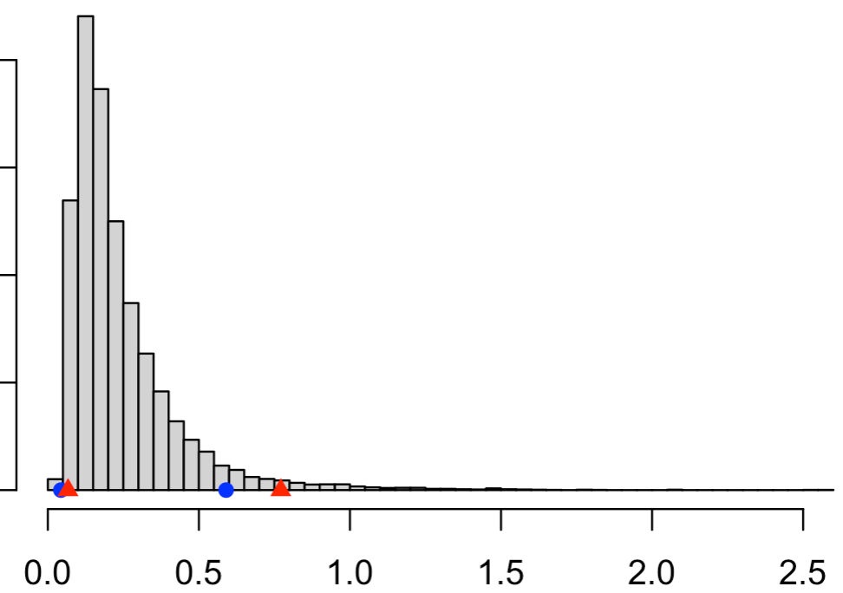
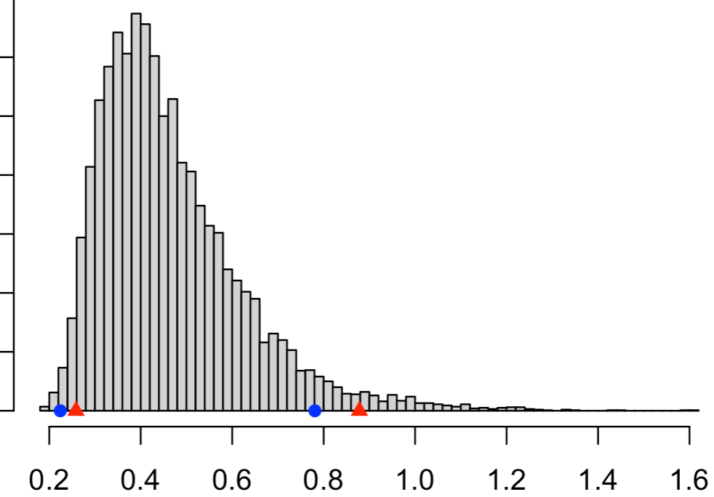
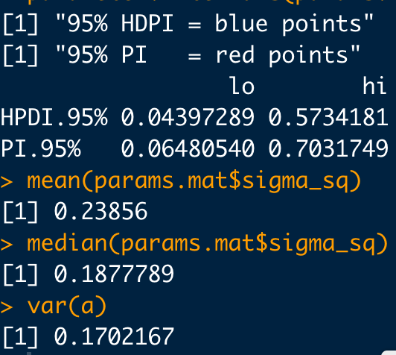
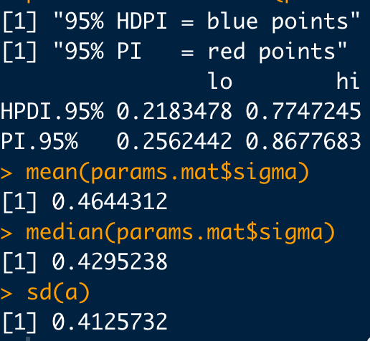
Correct: With Jacobian
p( σ ² | s² )
p( σ | s² )

Slide 10
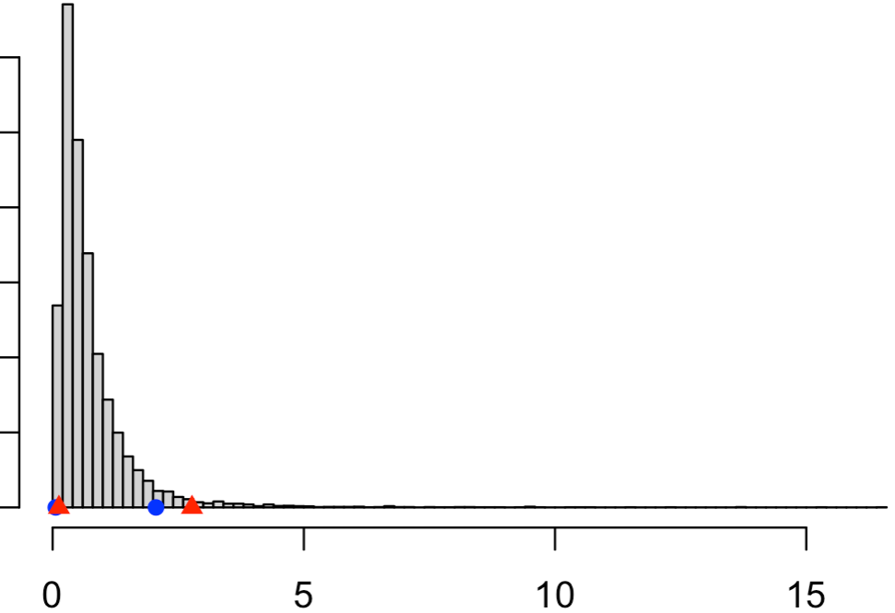
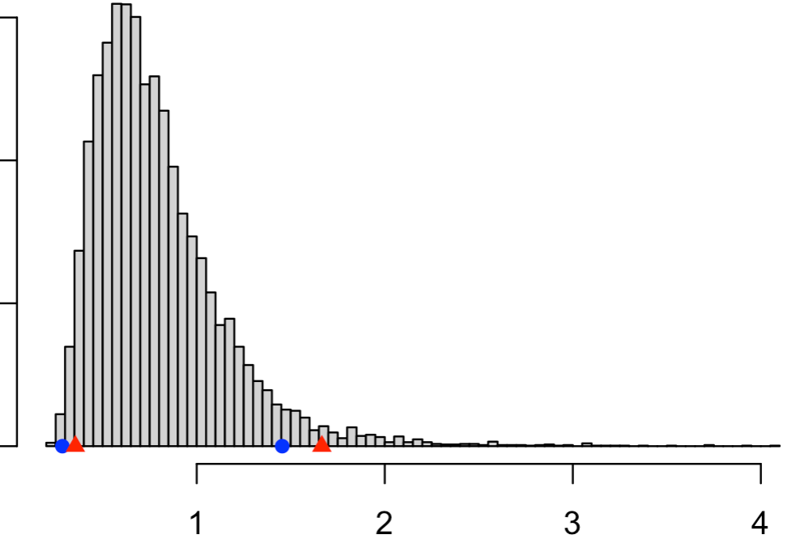
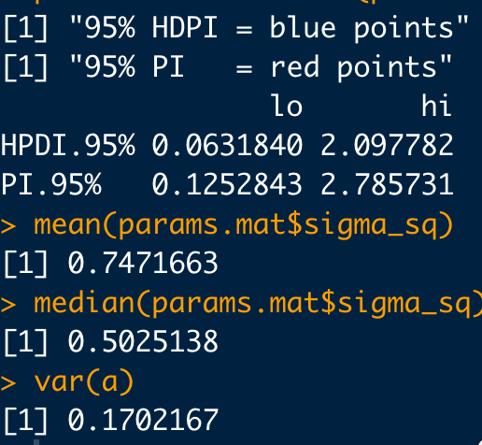
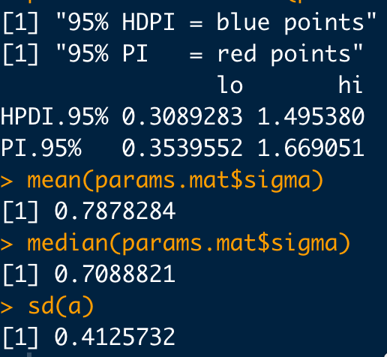
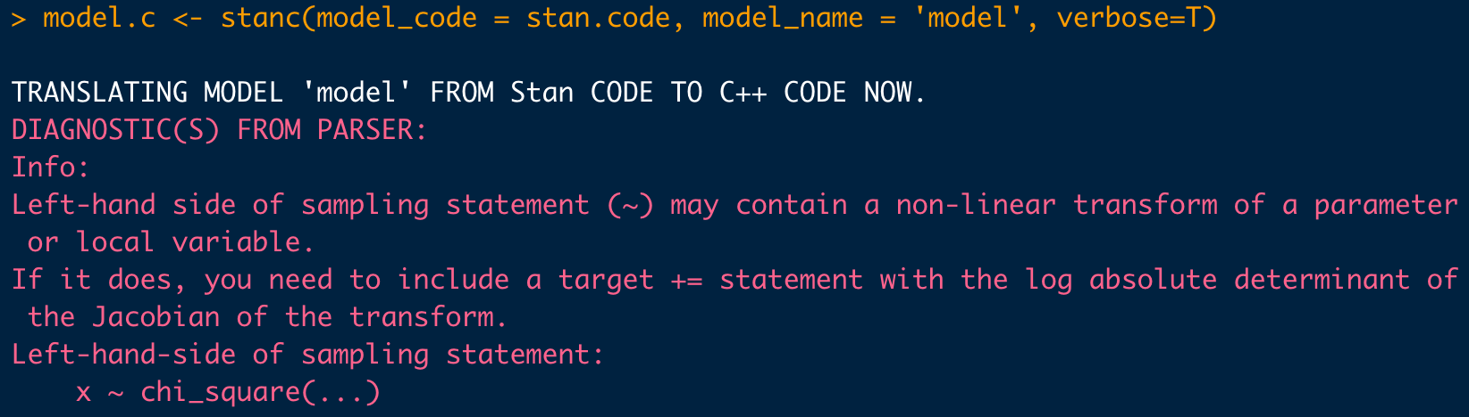
Wrong: Without Jacobian
p( σ ² | s² )
p( σ | s² )
Stan may try to warn you if it thinks you forgot a Jacobian

Slide 11
We can’t easily modify a distribution in JAGS (😖), so we need another formulation that avoids a Jacobian…
0
1
Another possible DAG to learn about σ ². Indirect, but this avoids a Jacobian:
σ²
X
X_{i}
JAGS Specific parameterization
i=1:6

Slide 12
JAGS code:
model{
# Prior
sigma_sq ~ dt(loc, 1/(scale^2), 1)T(0.0,) # cauchy is student-T with k=1
# Likelihood
for(i in 1:n){
x[i] ~ dnorm(xbar, 1/sigma_sq)T(0.0,)
}
sigma <- sqrt(sigma_sq)
}
Get Cauchy in JAGS using student-T with 1 degree of freedom

Slide 13
Run JAGS code:
library(bayesutils) # Should load everything we need
a <- c(2.60, 3.35, 3.33, 3.06, 3.38, 3.85) # Area of rectangle enclosing pellet pattern produced from shot at 10 ft
dat <- list(
"n" = length(a),
"s_sq" = var(a),
"loc" = 0,
"scale" = 1
)
inits <- function (){
list(sigma_sq=runif(1))
}
#Run the model:
fit <- jags(data=dat,
inits=inits,
parameters.to.save = c("sigma_sq", "sigma"),
n.iter=20000, n.burnin = 500, n.thin = 10,
n.chains=4,
model.file = system.file("jags/trunc-norm-half-cauchy.bug.R", package = "bayesutils"))
fit
params.chains <- extract.params(fit, by.chainQ = T)
#mcmc_trace(params.chains, pars =c("sigma_sq", "sigma"))
mcmc_pairs(params.chains, pars = c("sigma_sq", "sigma"))
# Examine posteriors:
params.mat <- extract.params(fit, as.matrixQ = T)
mcmc_areas(params.mat, prob = 0.95)
parameter.intervals(params.mat$sigma_sq, plotQ = T)
mean(params.mat$sigma_sq)
median(params.mat$sigma_sq)
var(a)
parameter.intervals(params.mat$sigma, plotQ = T)
mean(params.mat$sigma)
median(params.mat$sigma)
sd(a)

Slide 14
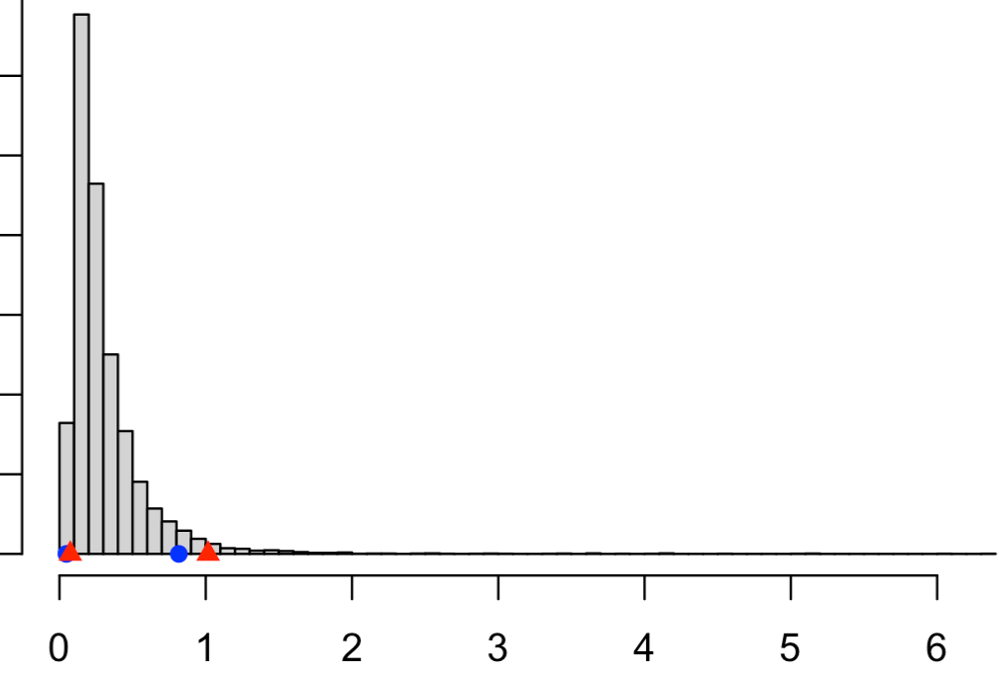
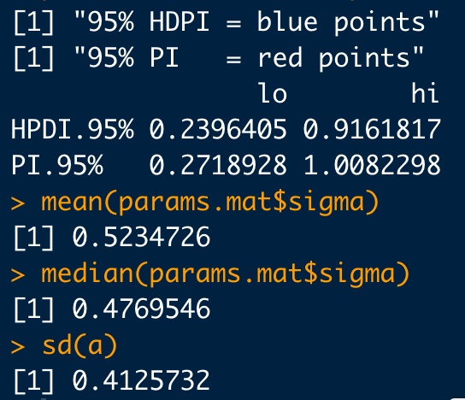
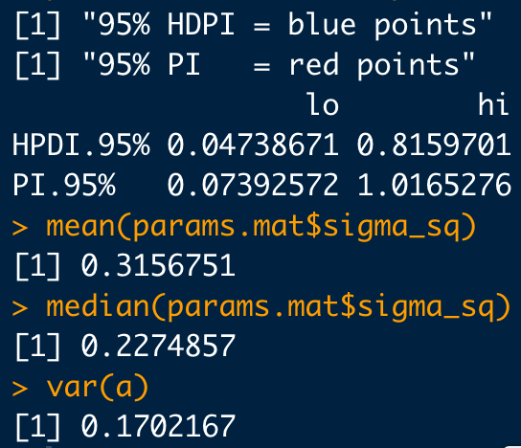
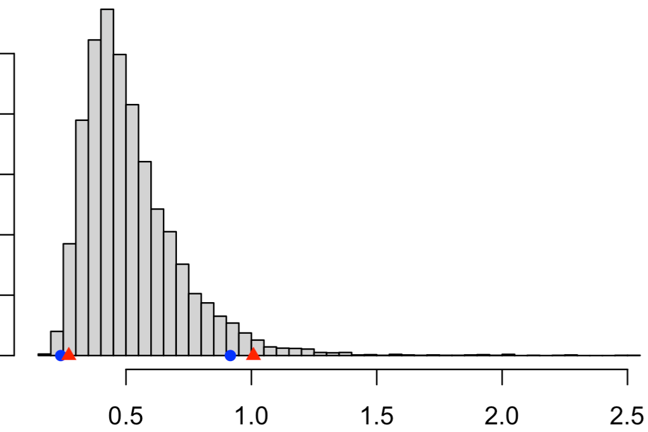
Compare: Stan vs. JAGS formulation
p( σ ² | s² )
p( σ | s² )
JAGS Result
Stan Result

Slide 15
Another Example: Compromise Risk
Consider a large financial institution with hundreds of thousands of electronic storage devices to monitor for inappropriate or stolen material (hard drives, memory sticks, etc.). Such material exposes the company to assorted risks and liabilities. Executives are worried and wish to know the the proportion, π, of compromised devices throughout the company.
100 devices are sampled, and it’s found:
1, 0, 0, 0, 0, 0, 0, 0, 0, 0, 1, 0, 0, 0, 1, 0, 0, 0, 0, 0, 0, 0, 1, 1, 0, 0, 1, 0, 0, 1, 0, 0, 1, 1,
0, 0, 0, 0, 0, 0, 0, 0, 0, 0, 0, 0, 0, 0, 0, 1, 0, 0, 0, 0, 0, 0, 0, 0, 0, 0, 0, 1, 0, 1, 0, 0, 0, 0,
0, 0, 1, 0, 0, 0, 1, 0, 0, 0, 1, 0, 0, 0, 0, 0, 0, 0, 0, 0, 1, 0, 0, 0, 0, 0, 0, 0, 0, 0, 0, 0
0=clean, 1=compromised
Example adapted from Carpenter: http://mc-stan.org/users/documentation/case-studies/mle-params.html

Slide 16
Another Example: Compromise Risk
Log-odds, α, are defined as:
The log-odds scale “stretches out” probability from [0,1] to a score between (-∞, ∞)
Inversely:
Change of variables from α to π

Slide 17
Another Example: Compromise Risk
Let’s parameterize in terms of α but let’s assign a uniform prior to π:
Use change-of-variables:
In general:
Here:
In general:
Here:

Slide 18
Another Example: Compromise Risk
0
1
DAG for this model with:
α
y_{i}
i=1:100

Slide 19
Stan code:
data {
int<lower=0> n;
int<lower=0> y[n];
}
parameters {
real alpha; // log odds
}
transformed parameters {
real <lower=0, upper=1> ppi;
ppi = exp(alpha)/(1+exp(alpha));
}
model {
// Prior (includes log jacobian for transform, log(dppi/dalpha) )
target += uniform_lpdf(ppi | 0, 1) + alpha - 2*log(1+exp(alpha));
// Likelihood
target += bernoulli_lpmf(y | ppi);
}
log Jacobian

Slide 20
Run Stan code:
library(bayesutils)
# Extra options to set for Stan:
#options(mc.cores = 4)
rstan_options(auto_write = TRUE)
# Load a Stan model:
stan.code <- paste(readLines(system.file("stan/bern-uniform-jacobian.stan", package = "bayesutils")), collapse='\n')
# Translate Stan code into C++
model.c <- stanc(model_code = stan.code, model_name = 'model', verbose=T)
# Compile the Stan C++ model:
sm <- stan_model(stanc_ret = model.c, verbose = T)
y <- c(
1, 0, 0, 0, 0, 0, 0, 0, 0, 0, 1, 0, 0, 0, 1, 0, 0, 0, 0, 0, 0, 0, 1, 1, 0, 0, 1, 0, 0, 1, 0, 0, 1, 1,
0, 0, 0, 0, 0, 0, 0, 0, 0, 0, 0, 0, 0, 0, 0, 1, 0, 0, 0, 0, 0, 0, 0, 0, 0, 0, 0, 1, 0, 1, 0, 0, 0, 0,
0, 0, 1, 0, 0, 0, 1, 0, 0, 0, 1, 0, 0, 0, 0, 0, 0, 0, 0, 0, 1, 0, 0, 0, 0, 0, 0, 0, 0, 0, 0, 0
)
dat <- list(
"n" = length(y),
"y" = y
)
# Run the model:
fit <- sampling(sm, data = dat, iter=5000, thin = 1, chains = 4)
print(fit)
params.chains <- extract.params(fit, by.chainQ = T)
#mcmc_trace(params.chains, pars = c("alpha", "ppi"))
mcmc_pairs(params.chains, pars = c("alpha", "ppi"))
# Examine posteriors:
params.mat <- extract.params(fit, as.matrixQ = T)
mcmc_areas(params.mat, prob = 0.95)
parameter.intervals(params.mat$ppi, plotQ = T)
mean(params.mat$ppi)
median(params.mat$ppi)
sum(y)/length(y)

Slide 21
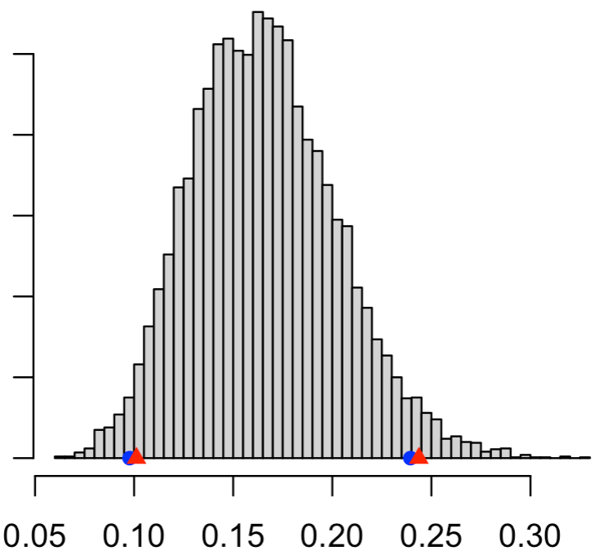
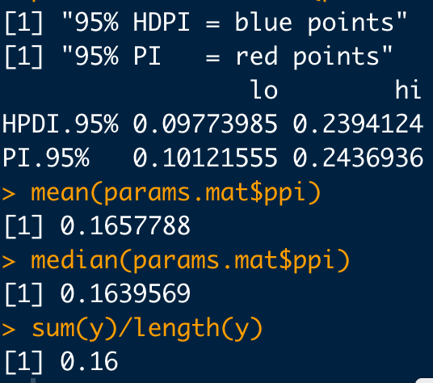
Another Example: Compromise Risk
p(π | y)

Slide 22
Again, we can’t easily include a Jacobian in JAGS (🤮), so we need another formulation that avoids it…
0
1
α
Another possible DAG to learn about π. Avoids a Jacobian and is also equivalent to the previous model:
y_{i}
i=1:100

Slide 23
JAGS code:
model {
# Prior
alpha ~ dlogis(0,1)
# Likelihood
for(i in 1:n){
y[i] ~ dbern( exp(alpha)/(1+exp(alpha)) )
}
# Save some time and make JAGS generate ppi from sampled alpha
ppi <- exp(alpha)/(1+exp(alpha))
}

Slide 24
Run JAGS code:
library(bayesutils)
y <- c(
1, 0, 0, 0, 0, 0, 0, 0, 0, 0, 1, 0, 0, 0, 1, 0, 0, 0, 0, 0, 0, 0, 1, 1, 0, 0, 1, 0, 0, 1, 0, 0, 1, 1,
0, 0, 0, 0, 0, 0, 0, 0, 0, 0, 0, 0, 0, 0, 0, 1, 0, 0, 0, 0, 0, 0, 0, 0, 0, 0, 0, 1, 0, 1, 0, 0, 0, 0,
0, 0, 1, 0, 0, 0, 1, 0, 0, 0, 1, 0, 0, 0, 0, 0, 0, 0, 0, 0, 1, 0, 0, 0, 0, 0, 0, 0, 0, 0, 0, 0
)
dat <- list(
"n" = length(y),
"y" = y
)
inits <- function (){
list(alpha=runif(1))
}
#Run the model:
fit <- jags(data=dat,
inits=inits,
parameters.to.save = c("ppi", "alpha"),
n.iter=20000, n.burnin = 500, n.thin = 10,
n.chains=4,
model.file = system.file("jags/bern-logistic.bug.R", package = "bayesutils"))
fit
params.chains <- extract.params(fit, by.chainQ = T)
#mcmc_trace(params.chains, pars = c("alpha", "ppi"))
mcmc_pairs(params.chains, pars = c("alpha", "ppi"))
# Examine posteriors:
params.mat <- extract.params(fit, as.matrixQ = T)
mcmc_areas(params.mat, prob = 0.95)
parameter.intervals(params.mat$ppi, plotQ = T)
mean(params.mat$ppi)
median(params.mat$ppi)
sum(y)/length(y)

Slide 25
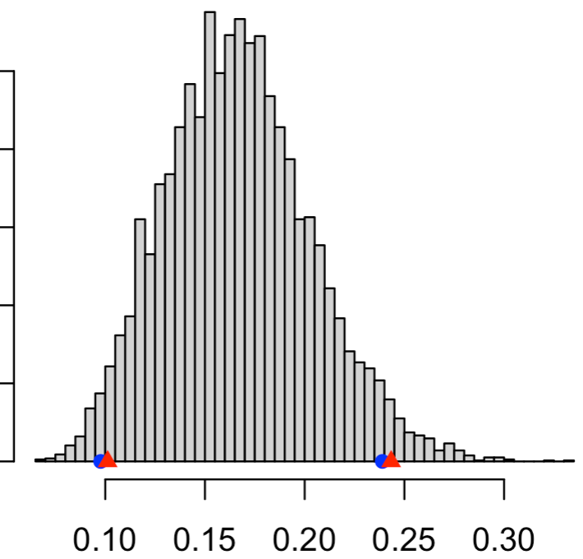
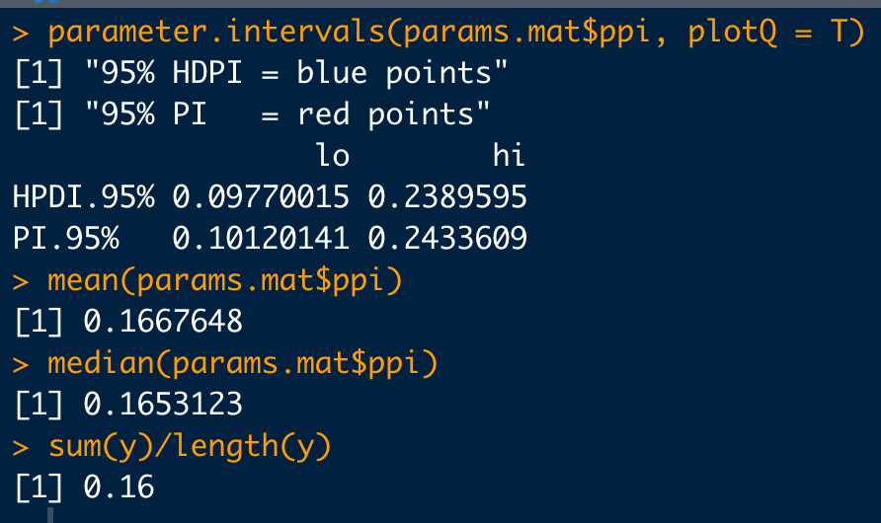
Another Example: Compromise Risk
Results equivalent to the Stan formulation with the Jacobian
p(π | y)
π

Slide 26
Synopsis: Change-of-Variables
In general, if you want to sample from a function of a variable of interest (usually a parameter):
…this is equivalent to:
In Stan this must be added to target as:
In JAGS, find another formulation that avoids a Jacobian 😢

Slide 27
Synopsis: Change-of-Variables
BUT, if you have already sampled from a variable of interest (usually a parameter):
and later after sampling want to transform it:
No Jacobian required in this case
Also, no need to include a Jacobian if all transformed terms are constants

