Slide 1

Regression

Slide 2
Basic Linear Regression
Remember the equation of a line:
As scientists, we find it an irresistible temptation to put a straight line though something that looks like it needs one…
How do we do this in a principled, systematic way??

Slide 3
Basic Linear Regression
Review: simple univariate linear model (LM):
response variable
error
explanatory or predictor
variable
intercept
regression coefficients
In simple linear regression, error is assumed to be normally distributed with mean 0 and sd σ
Estimated from the data

Slide 4
Basic Linear Regression
y
x

Slide 5
Basic Bayesian Linear Regression
Frequentist formulation
A Bayesian formulation
LM Likelihood:
response is normally distributed
Data model
….or whatever is appropriate for the problem
Priors

Slide 6
Example: Basic Bayesian Linear Regression
Headspace gas chromatography is often used in Tox labs to measure ethanol concentration in biological tissues or fluids. To quantitate a calibration curve is constructed for a series of ethanol/internal standardsª:
EtOH Concentration (x):
0.05, 0.1, 0.2, 0.3, 0.4, 0.5
Peak Area Ratio (y):
0.1716393, 0.2905149, 0.5521852, 0.8684159, 1.046752, 1.279638
Do a quick classic linear regression on the dataset for reference
“Standardize” the data to put it on the “unit scale”. (Why bother doing this?)
Obtain posteriors for regression coefficients of x vs. y
Plot posterior parameters and posterior lines
Compute predicted concentration with 95% probability bands for a peak area ratio = 0.7
ªActual data collected by Daniel A. Thanks Daniel.

Slide 7
Example: Basic Bayesian Linear Regression
DAG for model:
α
β
x_{i}
μ_{i} = α + x_{i}β
σ
y_{i}
i = 1:5

Slide 8
Example: Basic Bayesian Linear Regression
# Data: GC-Ethanol from Daniel Azevedo
AreaRatio <- c(0.1716393,0.2905149,0.5521852,0.8684159,1.046752,1.279638)
Concentration <- c(0.05,0.1,0.2,0.3,0.4,0.5)
# Scatter plot:
plot(Concentration, AreaRatio)
# Scale data and re-plot:
As <- (AreaRatio - mean(AreaRatio))/sd(AreaRatio)
Cs <- (Concentration - mean(Concentration))/sd(Concentration)
plot(As,Cs)
# Best fit line:
fit <- lm(AreaRatio ~ Concentration)
fits <- lm(As ~ Cs)
summary(fit)
summary(fits)
# Plot the line on the scatter plot:
plot(Concentration, AreaRatio)
abline(fit)
plot(As,Cs)
abline(fits)
# Residuals (sigma)
hist(residuals(fit))
hist(residuals(fits))
qqnorm(residuals(fit))
qqline(residuals(fit))
qqnorm(residuals(fits))
qqline(residuals(fits))
Classic frequentist linear regression version
ex1_daniel-gc_freq.R

Slide 9
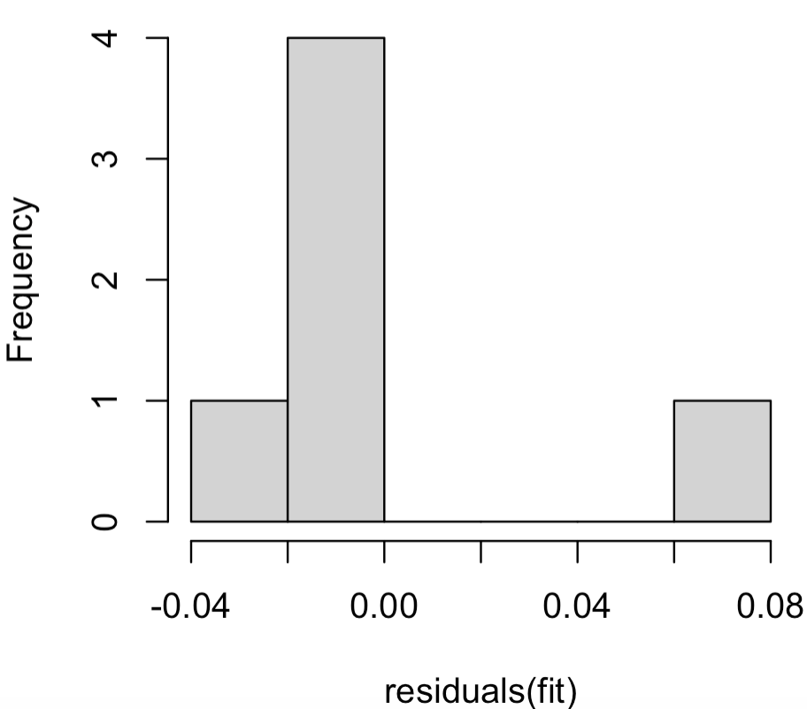
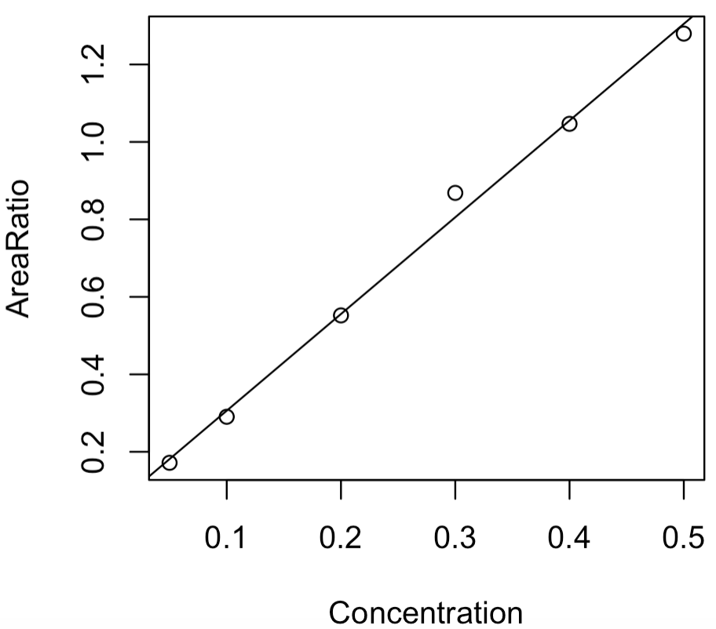
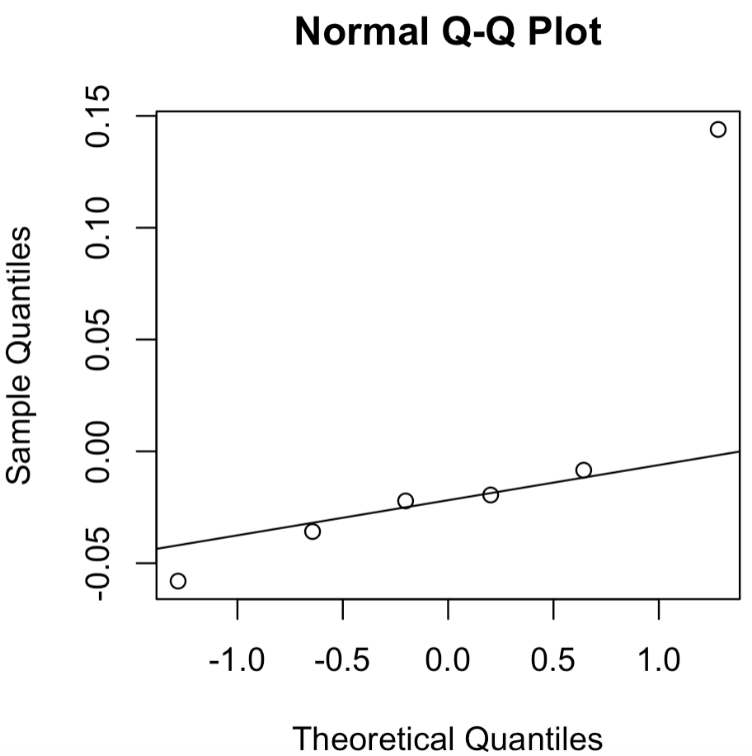
Classic ”best fit line”

Slide 10
Example: Basic Bayesian Linear Regression
Stan model
data{
int<lower=0> n;
real x[n];
real y[n];
int<lower=1> nu_alpha;
real mu_alpha;
real<lower=0> sig_alpha;
int<lower=1> nu_beta;
real mu_beta;
real<lower=0> sig_beta;
real mu_sigma;
real<lower=0> sig_sigma;
}
parameters{
real alpha;
real beta;
real<lower=0> sigma;
}
model{
//Priors
target += student_t_lpdf(alpha | nu_alpha, mu_alpha, sig_alpha);
target += student_t_lpdf(beta | nu_beta, mu_beta, sig_beta);
target += normal_lpdf(sigma | mu_sigma, sig_sigma);
//Likelihood
for(i in 1:n) {
target += normal_lpdf(y[i] | alpha + beta * x[i], sigma);
}
}
generated quantities{
real mu[n];
for(i in 1:n){
mu[i] = alpha + beta * x[i];
}
}
JAGS model
model{
# Priors
alpha ~ dt(mu_alpha, 1/sig_alpha^2, nu_alpha)
beta ~ dt(mu_beta, 1/sig_beta^2, nu_beta)
sigma ~ dnorm(mu_sigma, 1/sig_sigma^2)T(0.0,)
# Likelihood
for(i in 1:n){
mu[i] <- alpha + beta * x[i]
y[i] ~ dnorm(mu[i], 1/sigma^2)
}
}
univariate_linear_regression.bug
univariate_linear_regression.stan

Slide 11
Run Stan code:
library(bayesutils)
# Extra options to set for Stan:
options(mc.cores = 1)
rstan_options(auto_write = TRUE)
# Load a Stan model:
stan.code <- paste(readLines(system.file("stan/univariate_linear_regression.stan", package = "bayesutils")),collapse='\n')
# Translate Stan code into C++
model.c <- stanc(model_code = stan.code, model_name = 'model', verbose=T)
# Compile the Stan C++ model:
sm <- stan_model(stanc_ret = model.c, verbose = T)
# Data: GC-Ethanol from Daniel A
AreaRatio <- c(0.1716393,0.2905149,0.5521852,0.8684159,1.046752,1.279638)
Concentration <- c(0.05,0.1,0.2,0.3,0.4,0.5)
# Standardize:
xstd.info <- standardize(AreaRatio)
ystd.info <- standardize(Concentration)
As <- xstd.info$datvec
Cs <- ystd.info$datvec
dat <- list(
"n" = length(As),
"x" = As,
"y" = Cs,
#
"nu_alpha" = 3,
"mu_alpha" = 0,
"sig_alpha" = 1,
#
"nu_beta" = 3,
"mu_beta" = 0,
"sig_beta" = 5,
#
"mu_sigma" = 0,
"sig_sigma" = 1
)
# Run the model:
fit <- sampling(sm, data = dat, iter=5000, thin = 1, chains = 4)
fit
ex1_daniel-gc_STAN.R

Slide 12
Run JAGS code:
library(bayesutils)
# Data: GC-Ethanol from Daniel A
AreaRatio <- c(0.1716393,0.2905149,0.5521852,0.8684159,1.046752,1.279638)
Concentration <- c(0.05,0.1,0.2,0.3,0.4,0.5)
# Standardize:
xstd.info <- standardize(AreaRatio)
ystd.info <- standardize(Concentration)
As <- xstd.info$datvec
Cs <- ystd.info$datvec
dat <- list(
"n" = length(As),
"x" = As,
"y" = Cs,
#
"nu_alpha" = 3,
"mu_alpha" = 0,
"sig_alpha" = 1,
#
"nu_beta" = 3,
"mu_beta" = 0,
"sig_beta" = 5,
#
"mu_sigma" = 0,
"sig_sigma" = 1
)
inits <- function (){
list(alpha=rnorm(1), beta=rnorm(1), sigma=runif(1))
}
#Run the model:
fit <- jags(data=dat,
inits=inits,
parameters.to.save = c("alpha", "beta", "sigma", "mu"),
n.iter=20000, n.burnin = 500, n.thin = 10,
n.chains=4,
model.file = system.file("jags/univariate_linear_regression.bug.R", package = "bayesutils"))
fit
ex1_daniel-gc_JAGS.R

Slide 13
Analysis:
params.chains <- extract.params(fit, by.chainQ = T)
mcmc_pairs(params.chains, pars = c("alpha", "beta", "sigma"))
# Examine posteriors:
params.mat <- extract.params(fit, as.matrixQ = T)
mcmc_areas(params.mat, prob = 0.95)
alpha <- params.mat$alpha
beta <- params.mat$beta
sigma <- params.mat$sigma
# Plot posterior lines on standardized scale:
plot(As,Cs)
abline(a=alpha[1], b=beta[1])
outj <- sapply(1:nrow(params.mat), function(xx){abline(a=alpha[xx], b=beta[xx])})
# Prediction
x <- 0.7
xs <- (x-xb)/sx
ys <- rnorm(length(alpha), mean = beta*xs + alpha, sd = sigma)
y <- ys*sy + yb
intervl <- parameter.intervals(y, prob=0.95, plotQ=T)
plot(AreaRatio,Concentration)
points(x,median(y), pch=16, col="blue") # posterior mean
points(x,mean(y), pch=16, col="orange") # posterior median
points(c(x,x), c(intervl[1,1], intervl[1,2]), pch=16, col="red") # HDPI
points(c(x,x), c(intervl[2,1], intervl[2,2]), pch=16, col="green") # PI
# Plot posterior lines on original scale:
xb <- xstd.info$center
sx <- xstd.info$scale
yb <- ystd.info$center
sy <- ystd.info$scale
a <- sy*alpha + yb - (sy/sx)*beta*xb # convert intercept back to original scale
b <- (sy/sx)*beta # convert slope back to original scale
plot(AreaRatio,Concentration)
abline(a=a[1], b=b[1])
outj <- sapply(1:nrow(params.mat), function(xx){abline(a=a[xx], b=b[xx])})

Slide 14
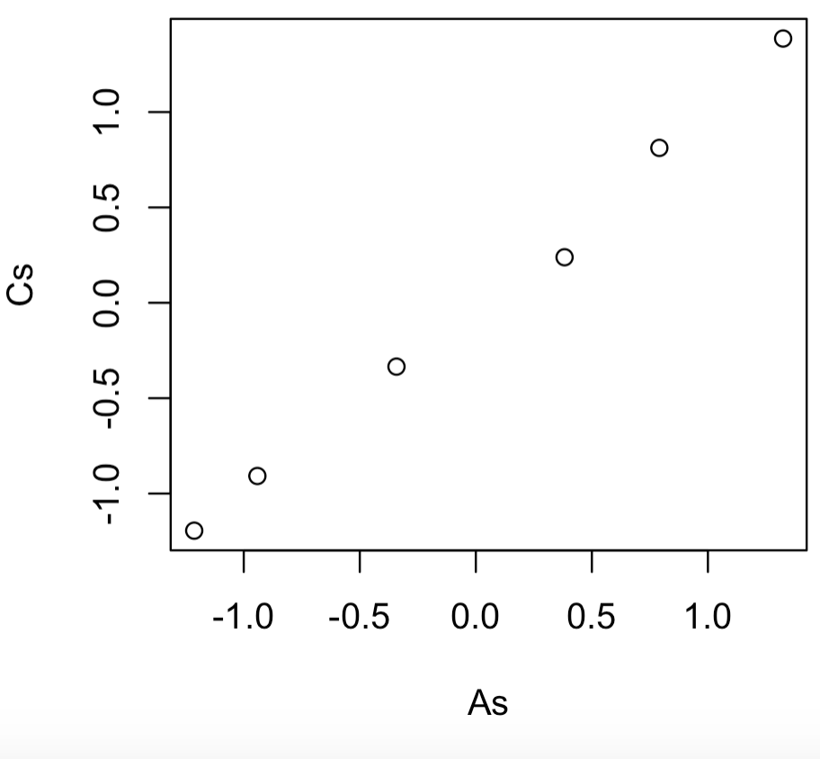
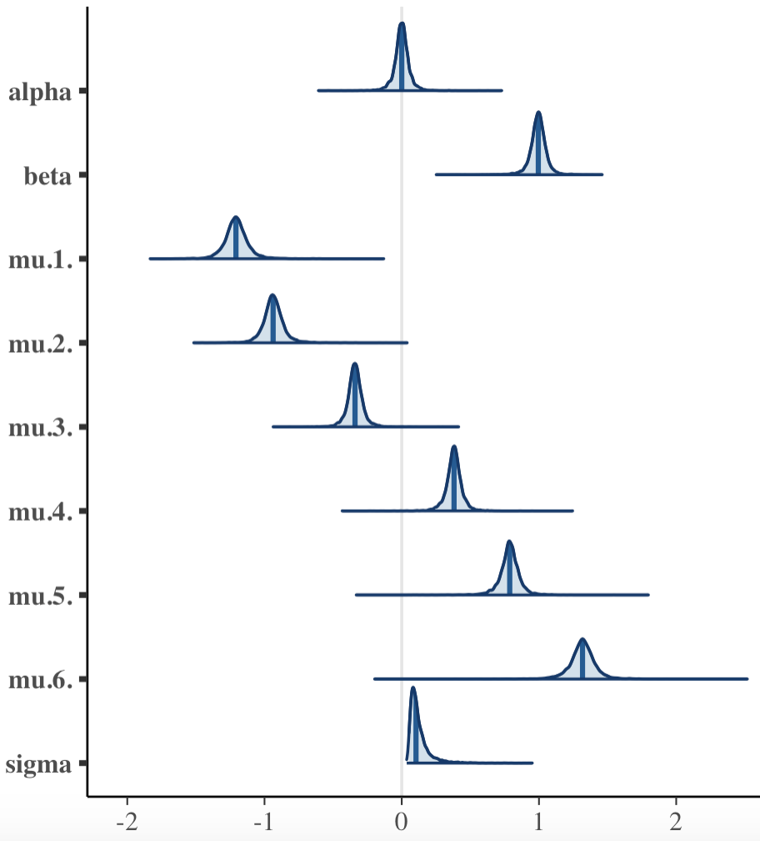
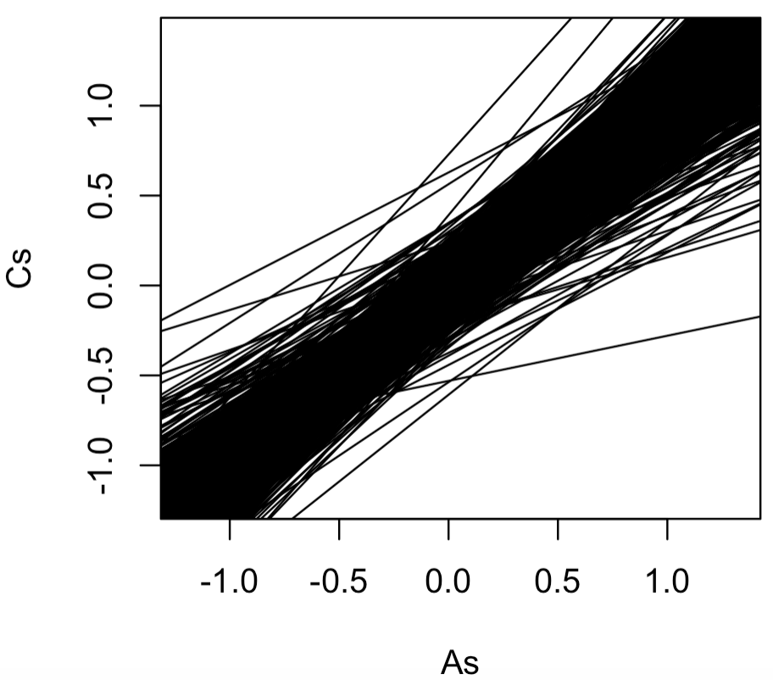
Data on standardized scale:
Posterior parameters:
Note where they all fall wrt 0
Posterior lines:

Slide 15
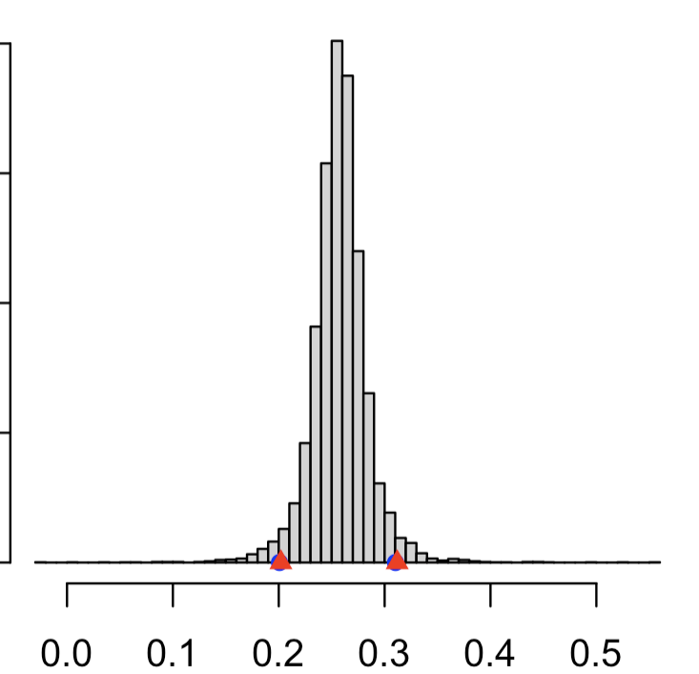
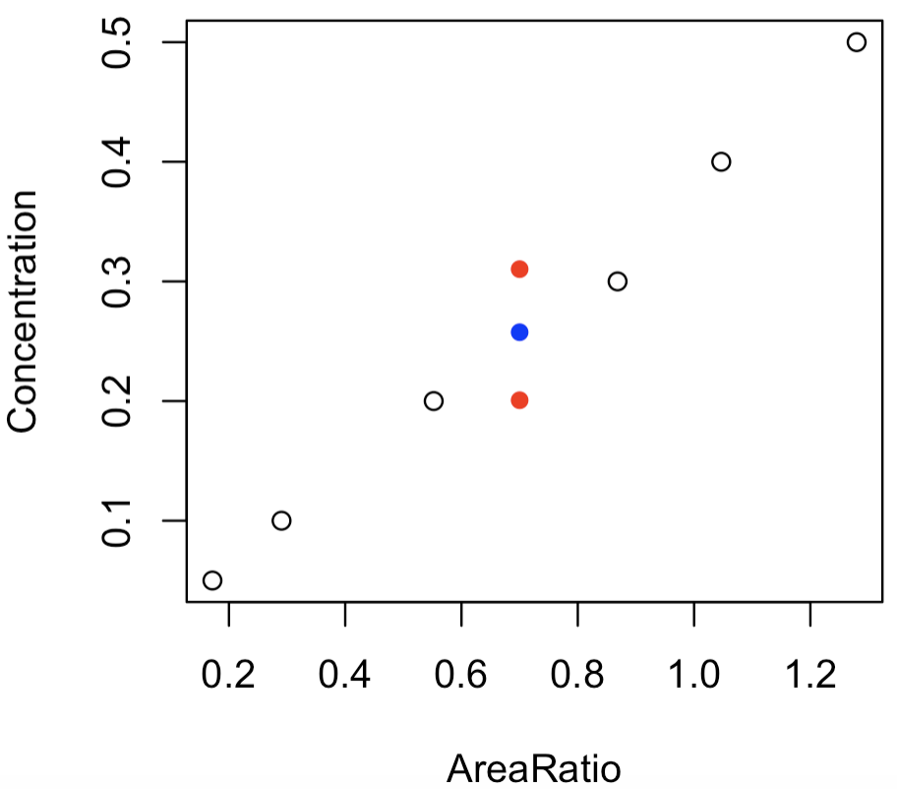
Posterior concentration for peak area ratio of 0.7

Slide 16
Bayesian Multiple Linear Regression
Multiple linear regression works the same way, just with more variables
Likelihood
Data model
….or whatever is appropriate for the problem
Priors

Slide 17
Example: Bayesian Multiple Linear Regression
Gustafson presented an early method for the prediction of age at time of death from various dental features. Gustafson’s data is available in Curran’s R library dafs.
Gustafson used multiple regression on 6 dental features collected from 41 teeth Age.
Preform a quick classical multiple linear regression for the dataset
Compute, graph and discuss posterior parameters for the model
Construct a simple code to use posterior parameters and a dental feature vector to predict Age with associated prediction uncertainty.

Slide 18
Example: Basic Bayesian Linear Regression
DAG for model:
α
β
x_{i}
μ_{i} = α + x_{i}β
σ
y_{i}
i = 1:41

Slide 19
Example: Basic Bayesian Linear Regression
Stan model
data{
int<lower=1> n;
int<lower=1> p;
matrix[n,p] X;
real y[n];
int<lower=1> nu_alpha;
real mu_alpha;
real<lower=0> sig_alpha;
int<lower=1> nu_beta;
real mu_beta;
real<lower=0> sig_beta;
real mu_sigma;
real<lower=0> sig_sigma;
}
parameters{
real alpha;
vector[p] beta;
real<lower=0> sigma;
}
model{
//Priors
target += student_t_lpdf(alpha | nu_alpha, mu_alpha, sig_alpha);
for(i in 1:p) {
target += student_t_lpdf(beta[i] | nu_beta, mu_beta,
sig_beta);
}
target += normal_lpdf(sigma | mu_sigma, sig_sigma);
//Likelihood
for(i in 1:n) {
target += normal_lpdf(y[i] | alpha + dot_product(beta, X[i,]),
sigma);
}
}
JAGS model
model{
# Priors
alpha ~ dt(mu_alpha, 1/sig_alpha^2, nu_alpha)
for(i in 1:p) {
beta[i] ~ dt(mu_beta, 1/sig_beta^2, nu_beta)
}
sigma ~ dnorm(mu_sigma, 1/sig_sigma^2)T(0.0,)
# Likelihood
for(i in 1:n) {
y[i] ~ dnorm(alpha + inprod(beta, X[i,]), 1/sigma^2);
}
}
multivariate_linear_regression.bug
multivariate_linear_regression.stan

Slide 20
Classical Frequentists Regression:
library(dafs)
data(gustafson.df)
Age <- gustafson.df$Age
A <- gustafson.df$A
S <- gustafson.df$S
P <- gustafson.df$P
C <- gustafson.df$C
TT <- gustafson.df$T
R <- gustafson.df$R
fit <- lm(Age ~ A + S + P + C + TT + R)
summary(fit)
ex2_gus-teeth_freq.R

Slide 21
Run Stan code:
library(bayesutils)
library(dafs)
# Extra options to set for Stan:
options(mc.cores = 1)
rstan_options(auto_write = TRUE)
# Load a Stan model:
stan.code <- paste(readLines(system.file("stan/multivariate_linear_regression.stan", package =
"bayesutils")),collapse='\n')
# Translate Stan code into C++
model.c <- stanc(model_code = stan.code, model_name = 'model', verbose=T)
# Compile the Stan C++ model:
sm <- stan_model(stanc_ret = model.c, verbose = T)
# Data
data("gustafson.df")
Age <- gustafson.df$Age
A <- gustafson.df$A
S <- gustafson.df$S
P <- gustafson.df$P
C <- gustafson.df$C
TT <- gustafson.df$T
R <- gustafson.df$R
X <- cbind(A,S,P,C,TT,R)
dat <- list(
"n" = nrow(X),
"p" = ncol(X),
"X" = X,
"y" = Age,
#
"nu_alpha" = 3,
"mu_alpha" = 0,
"sig_alpha" = 1,
#
"nu_beta" = 3,
"mu_beta" = 0,
"sig_beta" = 1,
#
"mu_sigma" = 0,
"sig_sigma" = 1
)
# Run the model:
fit <- sampling(sm, data = dat, iter=5000, thin = 1, chains = 4); fit
ex2_gus-teeth_STAN.R

Slide 22
Run JAGS code:
library(bayesutils)
library(dafs)
# Data
data("gustafson.df")
Age <- gustafson.df$Age
A <- gustafson.df$A
S <- gustafson.df$S
P <- gustafson.df$P
C <- gustafson.df$C
TT <- gustafson.df$T
R <- gustafson.df$R
X <- cbind(A,S,P,C,TT,R)
dat <- list(
"n" = nrow(X),
"p" = ncol(X),
"X" = X,
"y" = Age,
#
"nu_alpha" = 3,
"mu_alpha" = 0,
"sig_alpha" = 1,
#
"nu_beta" = 3,
"mu_beta" = 0,
"sig_beta" = 1,
#
"mu_sigma" = 0,
"sig_sigma" = 1
)
inits <- function (){
list(alpha=rnorm(1), beta=rnorm(ncol(X)), sigma=runif(1))
}
#Run the model:
fit <- jags(data=dat,
inits=inits,
parameters.to.save = c("alpha", "beta", "sigma", "mu"),
n.iter=20000, n.burnin = 500, n.thin = 10,
n.chains=4,
model.file = system.file("jags/multivariate_linear_regression.bug.R", package = "bayesutils"))
fit
ex2_gus-teeth_JAGS.R

Slide 23
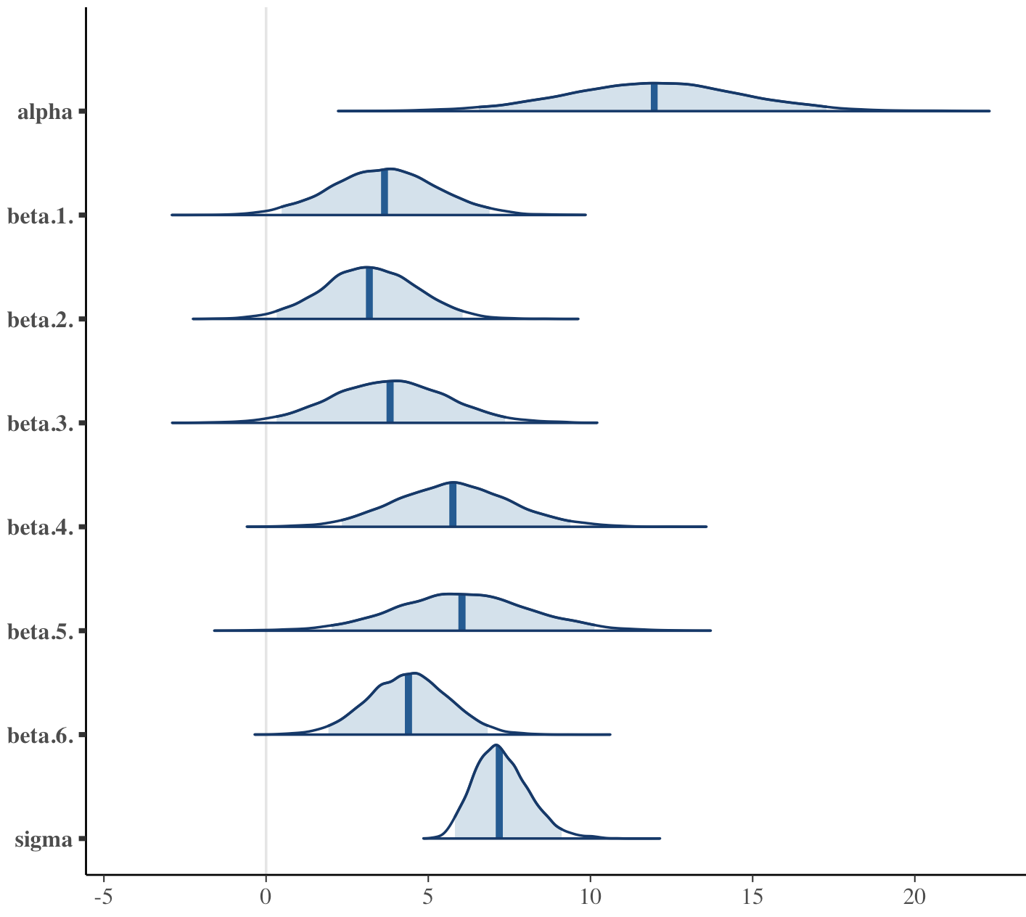
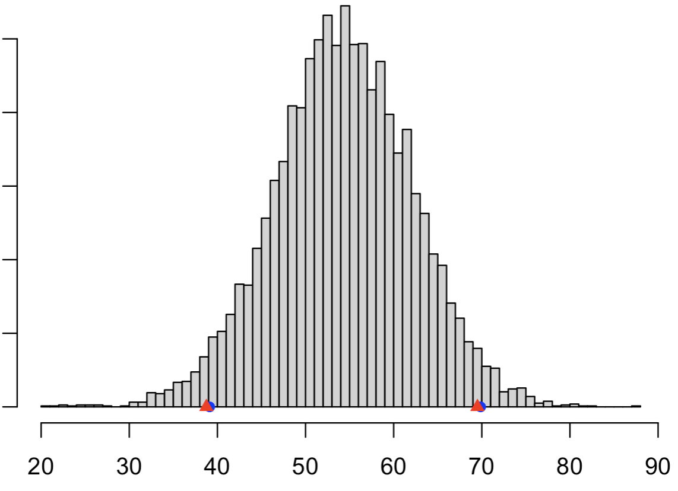
Analysis:
params.chains <- extract.params(fit, by.chainQ = T)
#mcmc_trace(params.chains, pars = c("alpha", "beta", "sigma"))
#mcmc_pairs(params.chains, pars = c("alpha",
# "beta[1]","beta[2]","beta[3]","beta[5]","beta[4]","beta[6]",
# "sigma"))
# Examine posteriors:
params.mat <- extract.params(fit, as.matrixQ = T)
mcmc_areas(params.mat, prob = 0.95)
# Predict Age using model
colnames(params.mat)
alpha <- params.mat$alpha
beta <- params.mat[,2:7]
sigma <- params.mat$sigma
num.sim <- length(alpha)
xidx <- 35 # Choose a dental feature vector or make one up
X[xidx,]
mux <- sapply(1:num.sim, function(xx){sum(X[xidx,] * beta[xx,]) + alpha[xx]})
Age.predx <- rnorm(num.sim, mean = mux, sd=sigma)
mean(Age.predx)
median(Age.predx)
Age[xidx]
parameter.intervals(Age.predx, prob=0.95, plotQ=T)
True age = 55

Slide 24
Bayesian Generalized Linear Regression
Generalized linear model (GLM)
Response (y_{i}) is distributed as anything in the exponential family, i.e. bernoulli, binomial, poisson, normal, etc…
A function of the mean response is linear:
Compactly:
Even more compactly:

Slide 25
Bayesian Logistic Regression
Logistic regression:
Carry out n Bernoulli trials with outcomes {1 (success), 0 (fail)}:
The mean, μ_{i}, is probability of a “success” π_{i}, i.e. μ_{i} = π_{i}
Transform π_{i} to log-odds (“logits”) and equate to a linear function of inputs x_{j,i}:

Slide 26
Bayesian Logistic Regression
α
β
x_{i}
η_{i} = α + x_{i}β
DAG for generic-ish logistic regression
y_{i}
i = 1:n

Slide 27
Example: Bayesian Logistic Regression
The amount of DNA collected for a locus can give insight about the dropout rate at that locus. Tvedebrinkª et al. note the quantity H derived from locus allele peak heights, can be used as a proxy for amount of DNA in a sample. Using log(H) and dropout data for the D8 locus in dropout.info:
Preform a quick classical logistic regression for dropout as a function of logH
Compute, graph and discuss posterior parameters for the model
Construct a logistic curve to predict the median drop out rate as a function of log(H).
ªTvedebrink, Eriksen, Asplund, Mogensen, Morling. Allelic drop-out probabilities estimated by logistic regression—Further considerations and practical implementation. Forensic Science International: Genetics 6 (2012) 263–267.

Slide 28
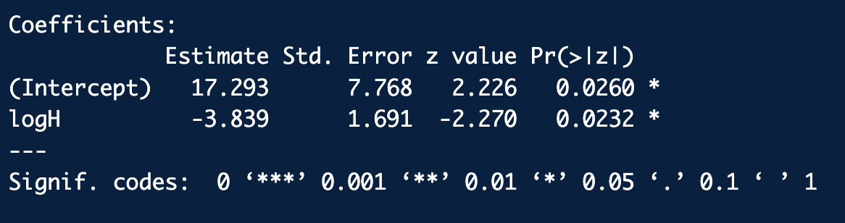
Example: Bayesian Logistic Regression
Frequentist Logistic Regression
library(bayesutils)
logH <- as.numeric(dropout.info$D8[,"logH"])
dropout <- as.numeric(dropout.info$D8[,"dropout"])
fit <- glm(dropout ~ logH, family=binomial)
summary(fit)
ex3_dropout_freq.R

Slide 29
Example: Bayesian Logistic Regression
Stan model
data{
int<lower=1> n;
int<lower=1> p;
matrix[n,p] X;
real y[n];
int<lower=1> nu_alpha;
real mu_alpha;
real<lower=0> sig_alpha;
int<lower=1> nu_beta;
real mu_beta;
real<lower=0> sig_beta;
}
parameters{
real alpha;
vector[p] beta;
}
model{
//Priors
target += student_t_lpdf(alpha | nu_alpha, mu_alpha, sig_alpha);
for(i in 1:p) {
target += student_t_lpdf(beta[i] | nu_beta, mu_beta, sig_beta);
}
//Likelihood
for(i in 1:n) {
target += bernoulli_logit_lpmf(y[i] | alpha + dot_product(beta, X[i,]) );
}
}
logistic_regression.stan

Slide 30
Example: Bayesian Logistic Regression
JAGS model
model{
# Priors
alpha ~ dt(mu_alpha, 1/sig_alpha^2, nu_alpha)
for(i in 1:p) {
beta[i] ~ dt(mu_beta, 1/sig_beta^2, nu_beta)
}
# Likelihood
for(i in 1:n) {
logit(ppi[i]) <- alpha + inprod(beta, X[i,])
y[i] ~ dbin(ppi[i], 1)
}
}
logistic_regression.bug

Slide 31
Run Stan code:
library(bayesutils)
# Extra options to set for Stan:
options(mc.cores = 4)
rstan_options(auto_write = TRUE)
# Load a Stan model:
stan.code <- paste(readLines(system.file("stan/logistic_regression.stan", package =
"bayesutils")),collapse='\n')
# Translate Stan code into C++
model.c <- stanc(model_code = stan.code, model_name = 'model', verbose=T)
# Compile the Stan C++ model:
sm <- stan_model(stanc_ret = model.c, verbose = T)
# Data
X <- as.matrix(dropout.info$D8[,"logH"])
dropout <- dropout.info$D8[,"dropout"]
dat <- list(
"n" = nrow(X),
"p" = ncol(X),
"X" = X,
"y" = dropout,
#
"nu_alpha" = 3,
"mu_alpha" = 0,
"sig_alpha" = 10,
#
"nu_beta" = 3,
"mu_beta" = 0,
"sig_beta" = 10
)
# Run the model:
fit <- sampling(sm, data = dat, iter=50000, thin = 10, chains = 4)
fit
ex3_dropout_STAN.R

Slide 32
Run JAGS code:
library(bayesutils)
# Data
X <- as.matrix(dropout.info$D8[,"logH"])
dropout <- dropout.info$D8[,"dropout"]
dat <- list(
"n" = nrow(X),
"p" = ncol(X),
"X" = X,
"y" = dropout,
#
"nu_alpha" = 3,
"mu_alpha" = 0,
"sig_alpha" = 10,
#
"nu_beta" = 3,
"mu_beta" = 0,
"sig_beta" = 10
)
inits <- function (){
list(alpha=rnorm(1), beta=rnorm(ncol(X)))
}
#Run the model:
fit <- jags(data=dat,
inits=inits,
parameters.to.save = c("alpha", "beta", "ppi"),
n.iter=20000, n.burnin = 500, n.thin = 10,
n.chains=4,
model.file = system.file("jags/logistic_regression.bug.R",
package = "bayesutils"))
fit
ex3_dropout_JAGS.R

Slide 33
Analysis:
params.chains <- extract.params(fit, by.chainQ = T)
#mcmc_trace(params.chains, pars = c("alpha", "beta", "sigma"))
mcmc_pairs(params.chains, regex_pars = c("alpha", "beta"))
# Examine posteriors:
params.mat <- extract.params(fit, as.matrixQ = T)
mcmc_areas(params.mat, prob = 0.95, regex_pars = c("alpha", "beta"))
# Plot the logistic curve
colnames(params.mat)
alpha <- params.mat$alpha
beta <- params.mat$beta.1. # For Stan
#beta <- params.mat$beta # For JAGS
num.sim <- length(alpha)
H <- seq(from=1, to=6000, length.out=1000)
eta <- sapply(1:num.sim, function(xx){ alpha[xx] + beta[xx]*log(H) })
dim(eta)
eta.med <- apply(eta, MARGIN = 1, FUN = median)
ppi.med <- exp(eta.med)/(1+exp(eta.med))
plot(log(H), eta.med, main="Log Odds")
plot(log(H), ppi.med, main="Logistic Curve", ylab="Pr(dropout)", typ="l")
plot(H, ppi.med)

Slide 34
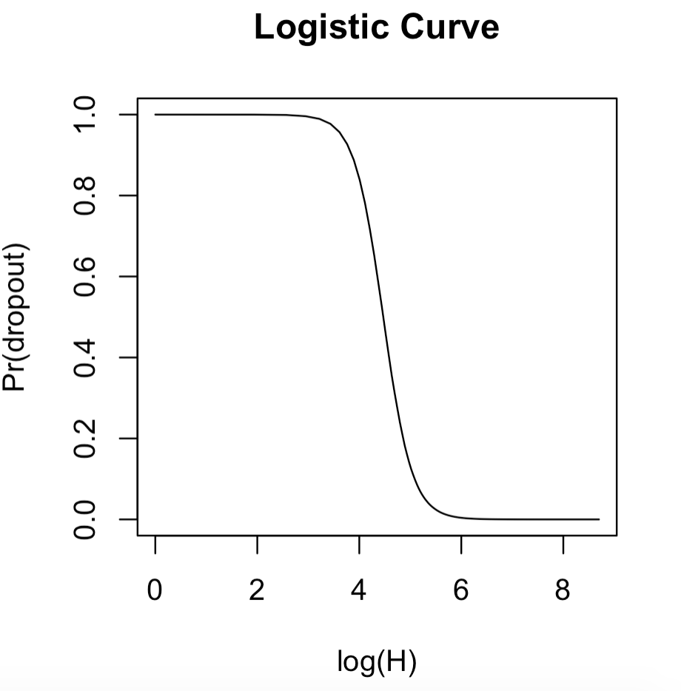
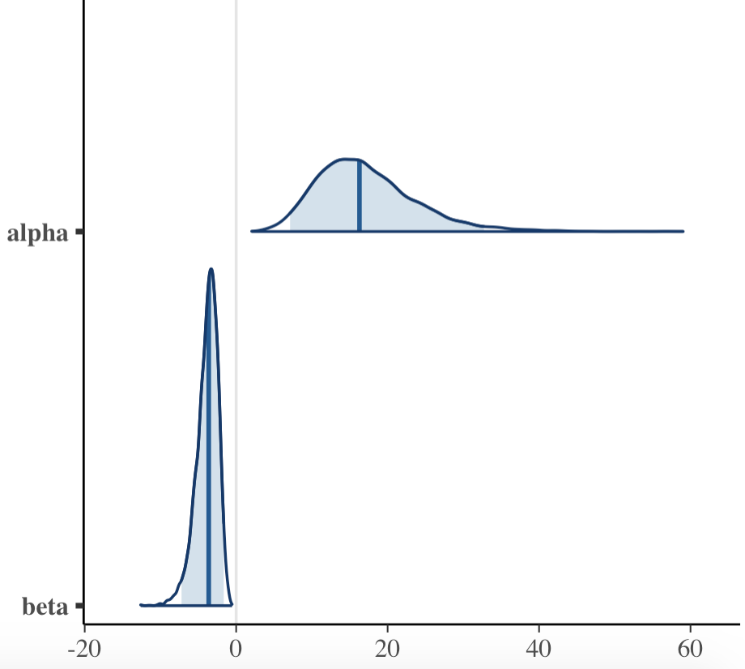
Example: Bayesian Logistic Regression

Slide 35
Bayesian Poisson Regression
Poisson regression:
Model count data with no upper limit on the number of trials
The mean, μ_{i}, is the rate of “success” λ_{i}, in a series of Bernoulli trials i.e. μ_{i} = λ_{i}
Log transform λ_{i} and equate to a linear function of inputs x_{j,i}: and a possible constant “offset” (log base rate).

Slide 36
Bayesian Poisson Regression
β
offset_{i}
x_{i}
DAG for generic-ish poisson regression
log(λ_{i})= offset_{i}+ x_{i}β
y_{i}
i = 1:n

Slide 37
Example: Bayesian Poisson Regression
In 2007 Gelman et al. published a sophisticated analysis of data on pedestrian stops by local law enforcement over a sample period of 15 monthsª. A modified/obscured portion of this data is contained in the frisk dataset^{b}.
Preform a quick classical poisson regression for the mean stop rate as a function of ethnicity and precinct. Use log number of prior arrests per precinct as the offset.
Compute posterior rates for each ethnicity/precinct combinations using an initial Bayesian poission regression
Plot posterior median rates for each ethnicity/precinct combination.
ªhttp://www.stat.columbia.edu/~gelman/research/published/frisk9.pdf
^{b}http://www.stat.columbia.edu/~gelman/arm/examples/police/frisk_with_noise.dat

Slide 38
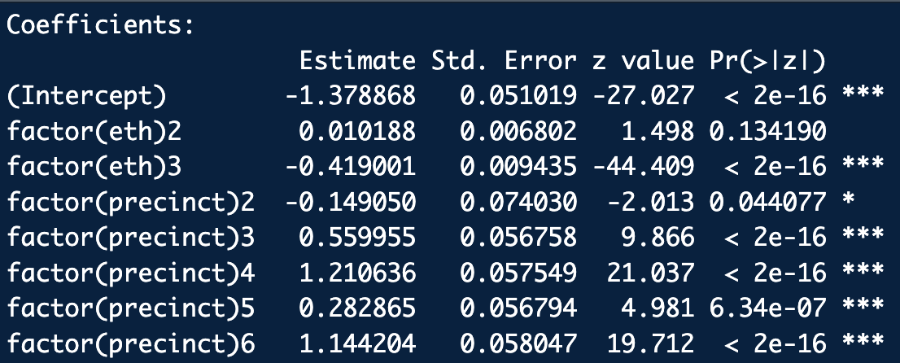
Example: Bayesian Poisson Regression
Frequentist Poisson Regression
library(bayesutils)
# Data
stops.dat <- aggregate(cbind(stops, past.arrests) ~ eth + precinct, data=frisk, sum)
stops <- stops.dat$stops
eth <- stops.dat$eth
precinct <- stops.dat$precinct
offset <- log(stops.dat$past.arrests)
fit <- glm(formula = stops ~ factor(eth) + factor(precinct), offset=offset,
family=poisson)
summary(fit)
ex4_frisk_freq.R

Slide 39
Example: Bayesian Poisson Regression
Stan model
data{
int<lower=1> n;
int<lower=1> p;
matrix[n,p] X;
int y[n];
vector[n] offset;
real nu_beta;
real mu_beta;
real sig_beta;
}
parameters{
vector[p] beta;
}
model{
//Priors
for(i in 1:p) {
target += student_t_lpdf(beta[i] | nu_beta, mu_beta, sig_beta);
}
// Likelihood (computationally efficient form)
target += poisson_log_glm_lpmf(y | X, offset, beta);
}
poisson_regression.stan

Slide 40
Example: Bayesian Poisson Regression
JAGS model
model{
# Priors
for(i in 1:p) {
beta[i] ~ dt(mu_beta, 1/sig_beta^2, nu_beta)
}
# Likelihood
for(i in 1:n) {
log(lambda[i]) <- offset[i] + inprod(beta, X[i,])
y[i] ~ dpois(lambda[i])
}
}
poisson_regression.bug

Slide 41
Run Stan code (CAUTION-slowish):
library(bayesutils)
# Extra options to set for Stan:
options(mc.cores = 4)
rstan_options(auto_write = TRUE)
# Load a Stan model:
stan.code <- paste(readLines(system.file("stan/poisson_regression.stan", package =
"bayesutils")),collapse='\n')
# Translate Stan code into C++
model.c <- stanc(model_code = stan.code, model_name = 'model', verbose=T)
# Compile the Stan C++ model:
sm <- stan_model(stanc_ret = model.c, verbose = T)
# Data
stops.dat <- aggregate(cbind(stops, past.arrests) ~ eth + precinct, data=frisk, sum)
stops <- stops.dat$stops
eth <- stops.dat$eth
precinct <- stops.dat$precinct
offset <- log(stops.dat$past.arrests)
X <- model.matrix(~ factor(eth) + factor(precinct))
dim(X)
dat <- list(
"n" = nrow(X),
"p" = ncol(X),
"X" = X,
"y" = stops,
"offset" = offset,
"nu_beta" = 30,
"mu_beta" = 0,
"sig_beta" = 10
)
fit <- sampling(sm, data = dat, iter=100000, thin = 10, chains = 4)
fit
ex4_frisk_STAN.R

Slide 42
Run JAGS code (CAUTION-very slow):
library(bayesutils)
# Data
stops.dat <- aggregate(cbind(stops, past.arrests) ~ eth + precinct, data=frisk, sum)
stops <- stops.dat$stops
eth <- stops.dat$eth
precinct <- stops.dat$precinct
offset <- log(stops.dat$past.arrests)
X <- model.matrix(~ factor(eth) + factor(precinct))
dim(X)
dat <- list(
"n" = nrow(X),
"p" = ncol(X),
"X" = X,
"y" = stops,
"offset" = offset,
"nu_beta" = 30,
"mu_beta" = 0,
"sig_beta" = 10
)
inits <- function (){
list(beta=rnorm(ncol(X)))
}
#Run the model:
fit <- jags(data=dat,
inits=inits,
parameters.to.save = c("beta", "lambda"),
n.iter=100000, n.burnin = 500, n.thin = 20,
n.chains=4,
model.file = system.file("jags/poisson_regression.bug.R", package = "bayesutils"))
fit
ex4_frisk_JAGS.R

Slide 43
Analysis:
#params.chains <- extract.params(fit, by.chainQ = T)
#mcmc_trace(params.chains, pars = c("beta"))
#mcmc_pairs(params.chains, regex_pars = c("beta"))
# Examine beta posteriors:
params.mat <- extract.params(fit, as.matrixQ = T)
mcmc_areas(params.mat, prob = 0.95, regex_pars = c("beta"))
# Compute posterior median rates
colnames(params.mat)
beta.sims <- params.mat[,1:77]
beta.med <- apply(beta.sims, MARGIN = 2, FUN = median)
lambda.med <- exp(offset + X %*% beta.med)
plot(lambda.med, typ="h", col=rep(c("red", "green", "blue"), 75))

Slide 44
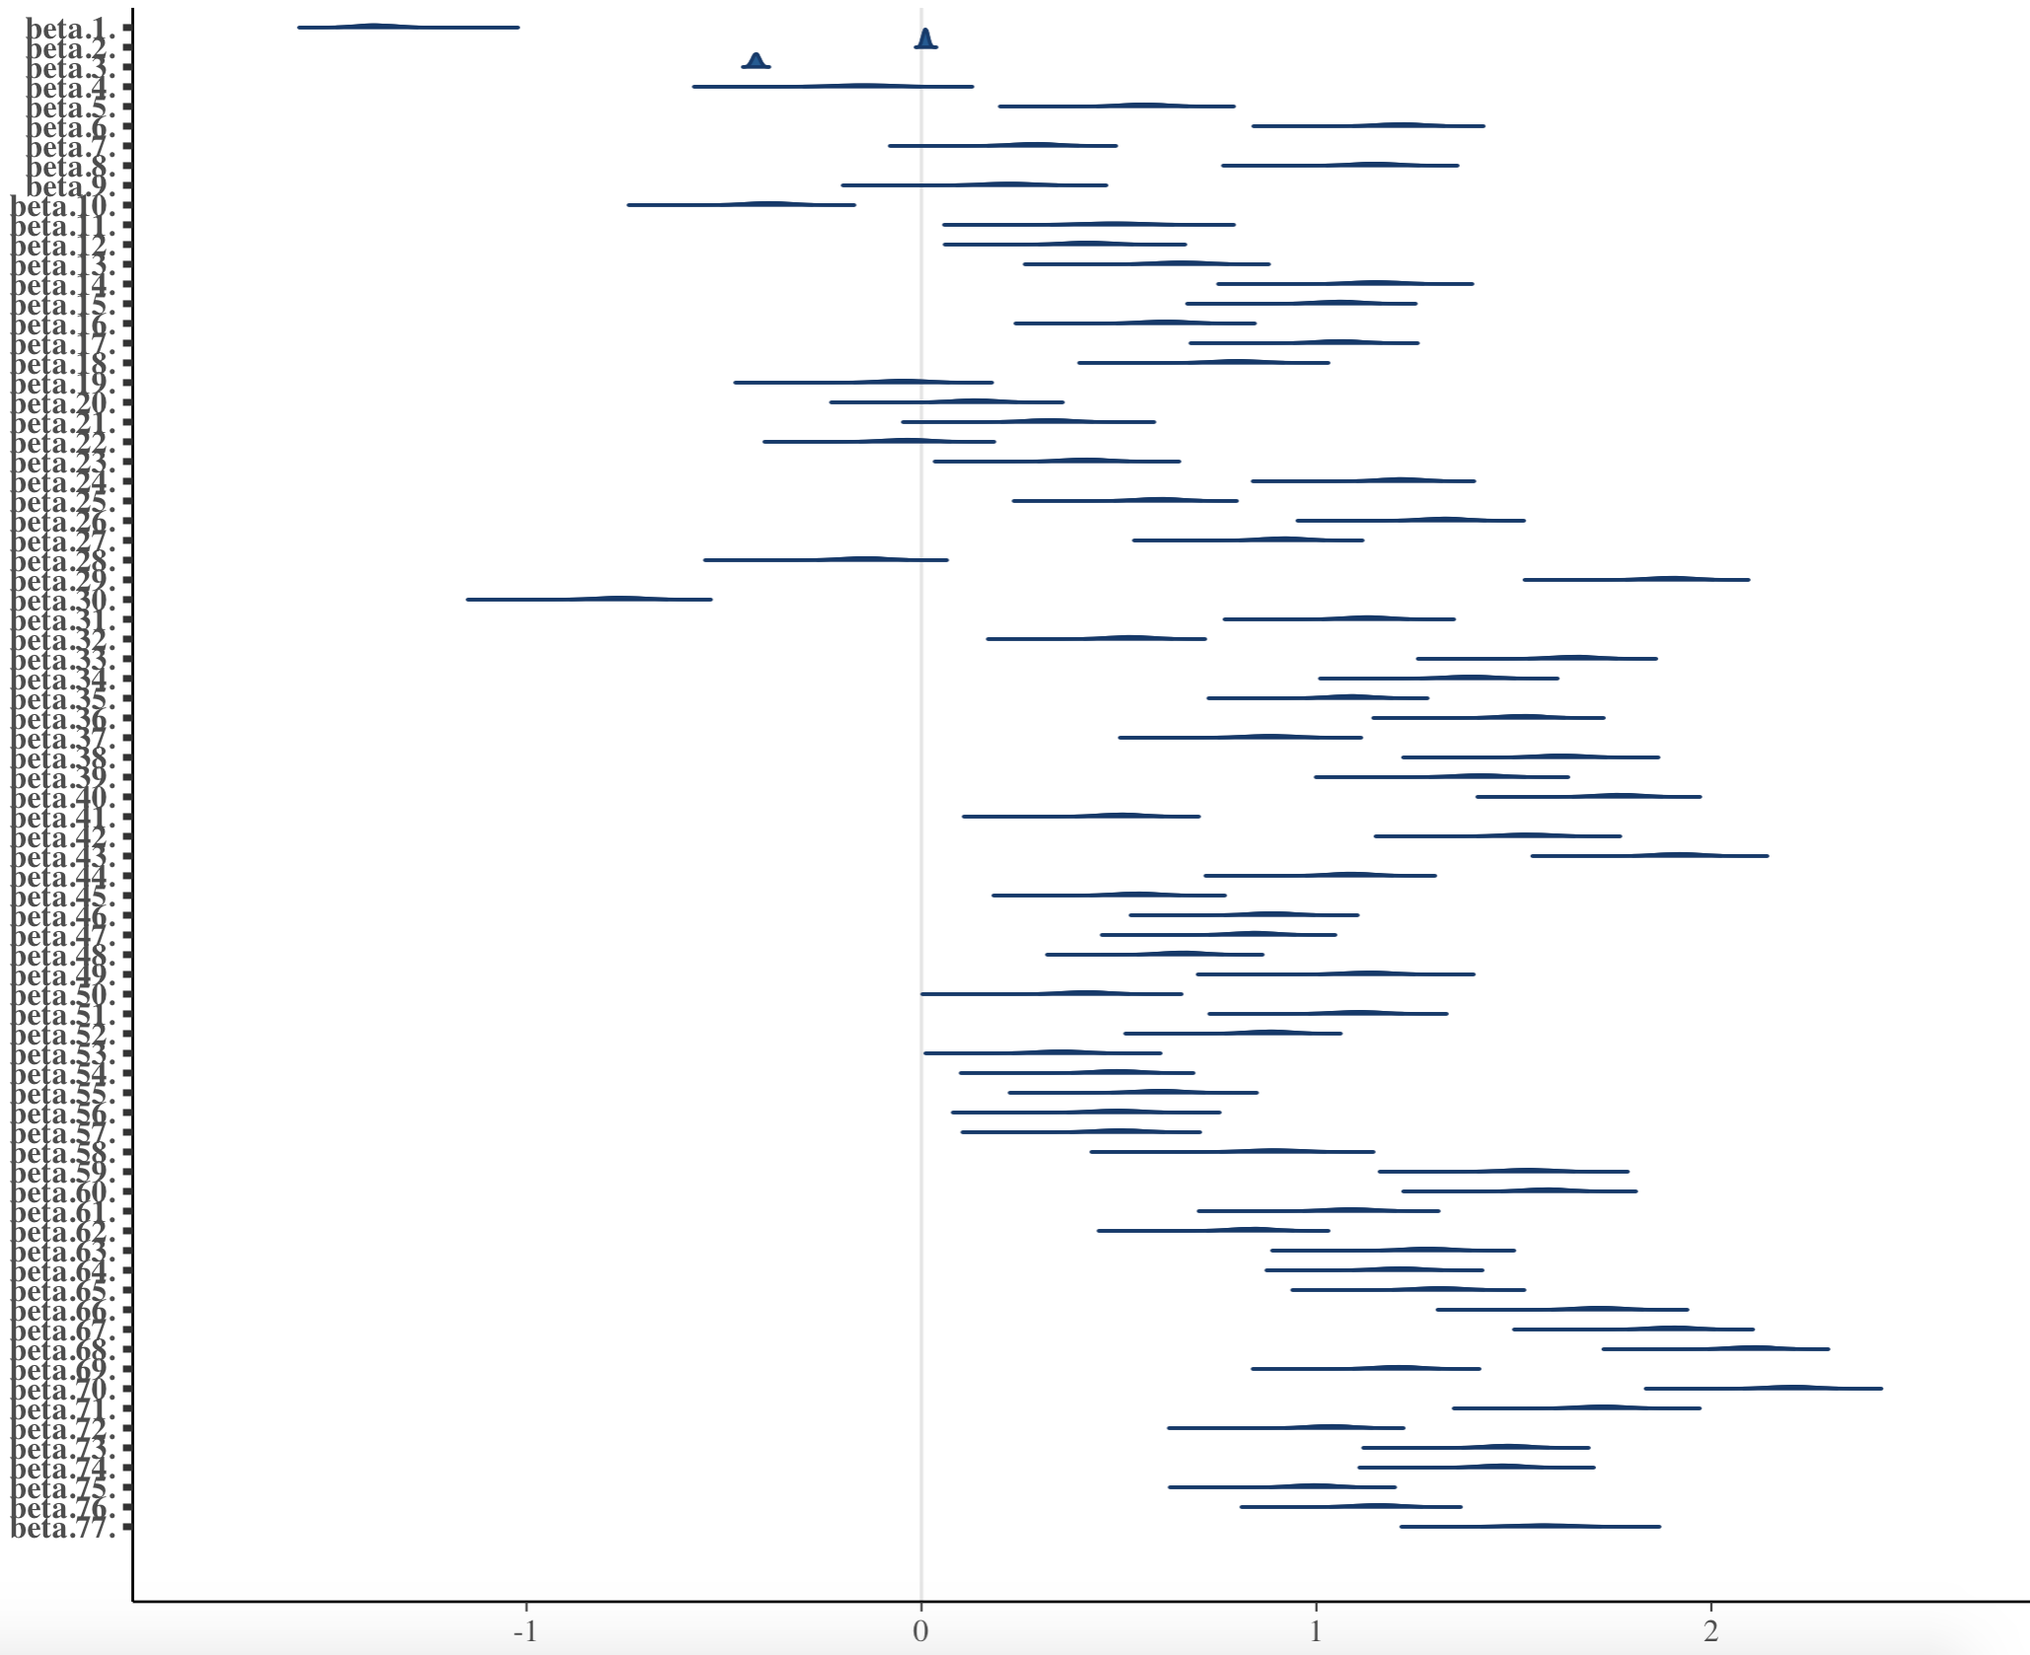
Example: Bayesian Poisson Regression
p(β_{j} | X)

Slide 45
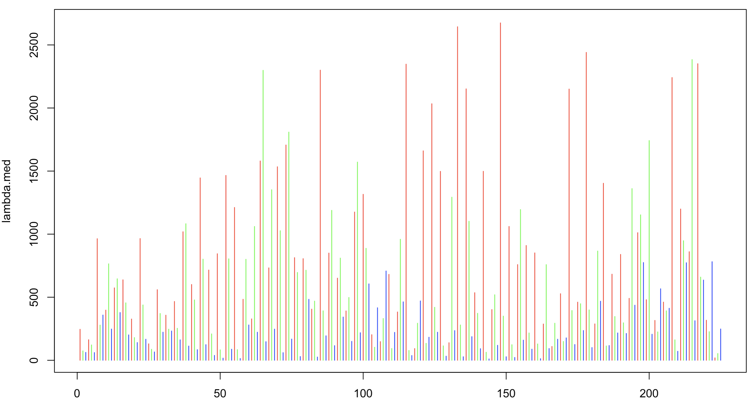
Example: Bayesian Poisson Regression
λ_{i} | X

