Slide 1

Basic Graphing
Osborn

Slide 2
First Thing: Look at your Data
Some Handy Graphics

Slide 3
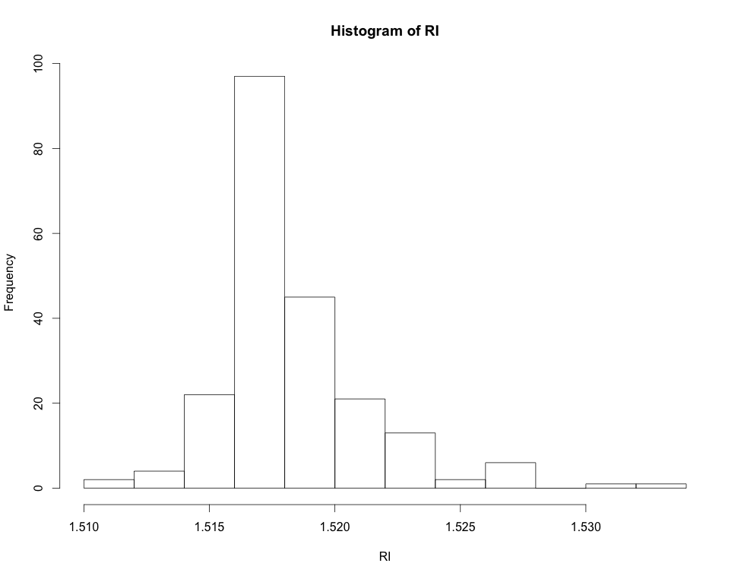
First Thing: Look at your Data
Histograms: “bin” a variable and plot frequencies

Slide 4
First Thing: Look at your Data
Histograms:
library(mlbench) # Load a library containing some data
data(Glass) # Load Glass data set
Glass # Take a look at Glass
head(Glass) # Just look at the top of Glass
RI <- Glass[,1] # Pull out the RIs. They are in column 1
hist(RI) # Make a histogram for the RIs
In R:
Notes:
Go over to Rstudio and demo install.packages
If you can’t get to work make up some fake data with rnorm

Slide 5
First Thing: Look at your Data
Histograms: “bin” a variable and plot frequencies
Each bar is a “bin” that contains a number of data points: counts

Slide 6
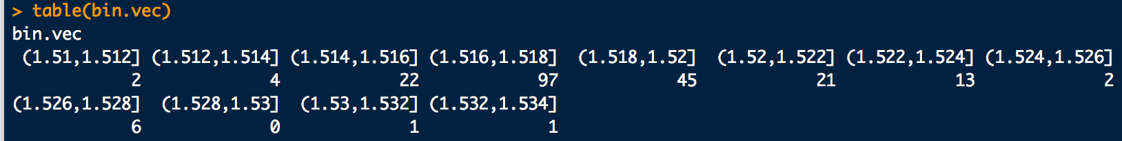
First Thing: Look at your Data
Histograms: counts in each bin:
# Get histogram counts if you’d like them…
library(mlbench)
data(Glass)
RI <- Glass[,1]
hist(RI)
bin.vec <- cut(RI, hist(RI, plot=F)$breaks)
table(bin.vec)
In R:
Result:

Slide 7
First Thing: Look at your Data
Box and Whiskers plots:
range
possible
outliers
possible
outliers
25th-%tile
1st-quartile
median
50th-%tile
75th-%tile
3rd-quartile
RI

Slide 8
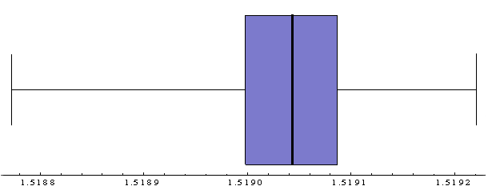
Visualizing Data
Note the relationship:

Slide 9
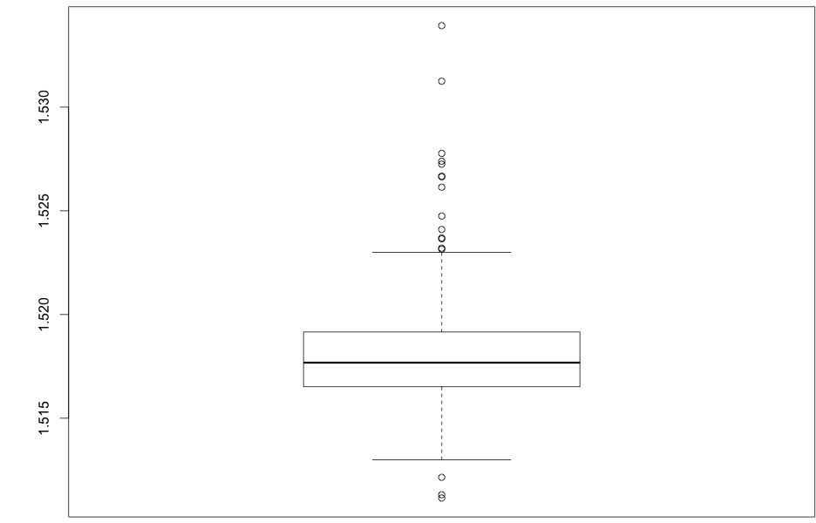
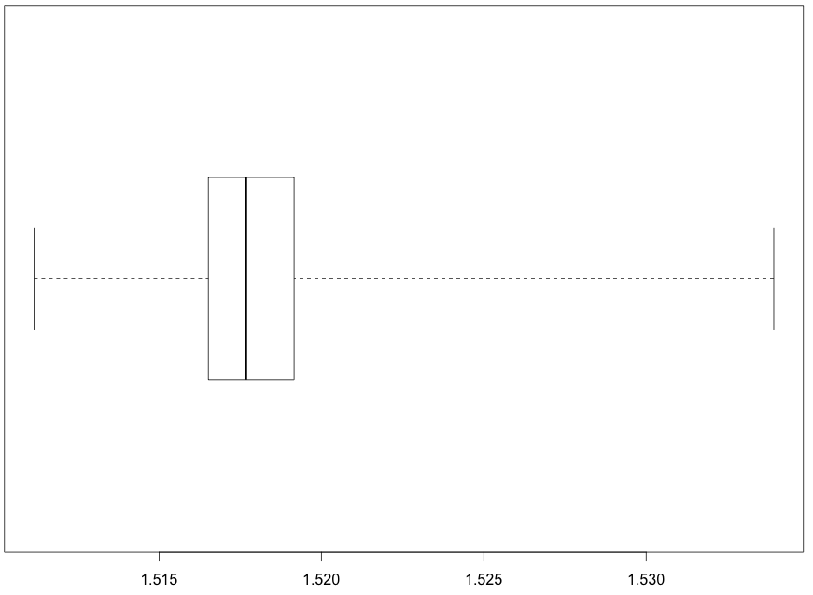
First Thing: Look at your Data
Box-and-whiskers:
# Box and whiskers plots
boxplot(RI)
boxplot(RI, horizontal = T, range = 0)
In R:
Result:

Slide 10
First Thing: Look at your Data
Scatter plots: plot any two variables against each other

Slide 11
First Thing: Look at your Data
Pairs plots: do many scatter plots at once

Slide 12
First Thing: Look at your Data
Gasoline data:

Slide 13
R commands not to forget so far
<- (assignment or “gets”)
? (to get help with a command)
c (“collect”)
: (range operator)
seq (generate a sequence)
plot
hist
boxplot

