Slide 1

Summarizing Data 1:
Mean, Median and Mode
Osborn

Slide 2
Measures of Central Tendency
Given a sample from some population:
What is a good “summary” value which well describes the sample?
We will look at:
Average (arithmetic mean)
Median
Mode
For reference see (available on-line):
“The Dynamic Character of Disguised Behaviour for Text-based, Mixed and Stylized Signatures”
LA Mohammed, B Found, M Caligiuri and D Rogers
J Forensic Sci 56(1),S136-S141 (2011)

Slide 3
Histogram Points of Interest
Velocity for the first segment of genuine signatures in (soon to be classic) Mohammed et al. study.
What is a good summary number?
“Central Tendency”
How spread out is the data?

Slide 4
Measures of Central Tendency
Arithmetic sample mean (average):
The sum of data divided by number of observations:
intuitive formula
fancy formula

Slide 5

Measures of Central Tendency
Example from L.A.M. study:
Compute the average absolute size of segment 1 for the genuine signature of subject 2:
Subj. 2; Gen; Seg. 1 | Absolute Size (cm)
1 | 0.0548
2 | 0.2951
3 | 0.1026
4 | 0.1005
5 | 0.2491
6 | 0.1287
7 | 0.0496
8 | 0.2299
9 | 0.256
10 | 0.0538
x <- c(0.0548,0.2951,0.1026,0.1005,0.2491,
0.1287,0.0496,0.2299,0.256,0.0538)
mean(x)

Slide 6
Measures of Central Tendency
Example:
More useful: Consider again Absolute Average Velocity for Genuine Signatures across all writers in the LAM study:
92 subjects × 10 measurements/subject = 920 velocity measurements
Average Absolute Average Velocity:

Slide 7
Measures of Central Tendency
Sample median:
Ordering the n pieces of data from smallest value to largest value, the median is the “middle value”:
If n is odd, median is largest data point.
If n is even, median is average of and largest data points.

Slide 8

Measures of Central Tendency
Example from L.A.M. study:
Compute the median absolute size of segment 1 for the genuine signature of subject 2:
Subj. 2; Gen; Seg. 1 | Absolute Size (cm)
1 | 0.0548
2 | 0.2951
3 | 0.1026
4 | 0.1005
5 | 0.2491
6 | 0.1287
7 | 0.0496
8 | 0.2299
9 | 0.256
10 | 0.0538
Ordered
0.0496 0.0538 0.0548 0.1005 0.1026 0.1287 0.2299 0.2491 0.2560 0.2951

Slide 9
Measures of Central Tendency
Example:
Median of Average Absolute Velocity for Genuine Signatures, LAM:
Avg

Slide 10


Measures of Central Tendency
Sample mode:
Needs careful definition but basically:
The data value that occurs the most
Tabulate the data and see which value(s) occur the most:
Sample:
mode

Slide 11
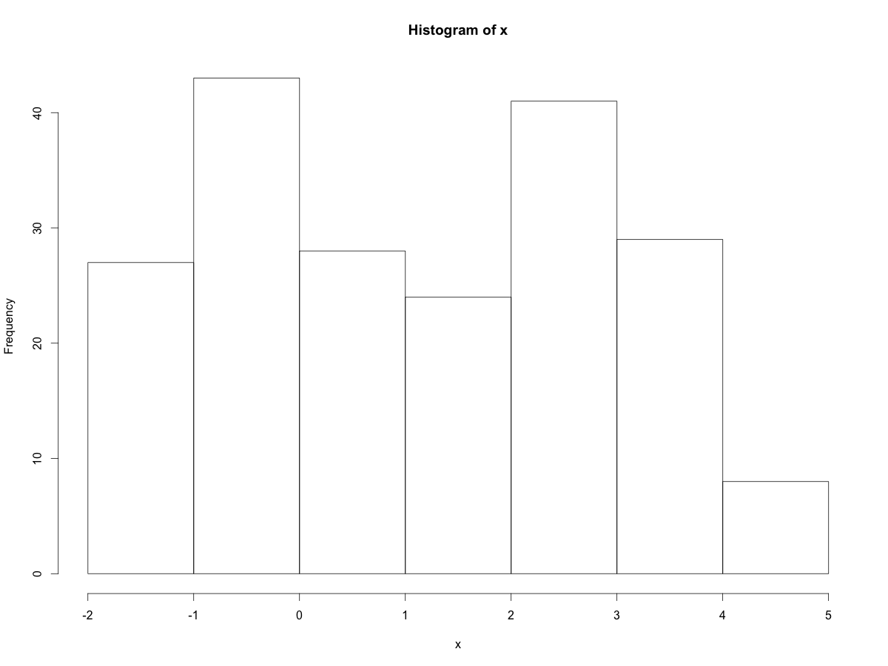
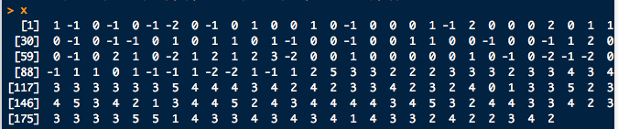

Measures of Central Tendency
Sample mode:
Computing modes can get tricky if there are more than one (multi-modal)
Sample:
modes…

Slide 12
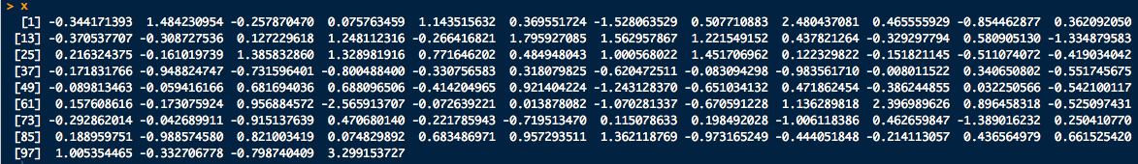
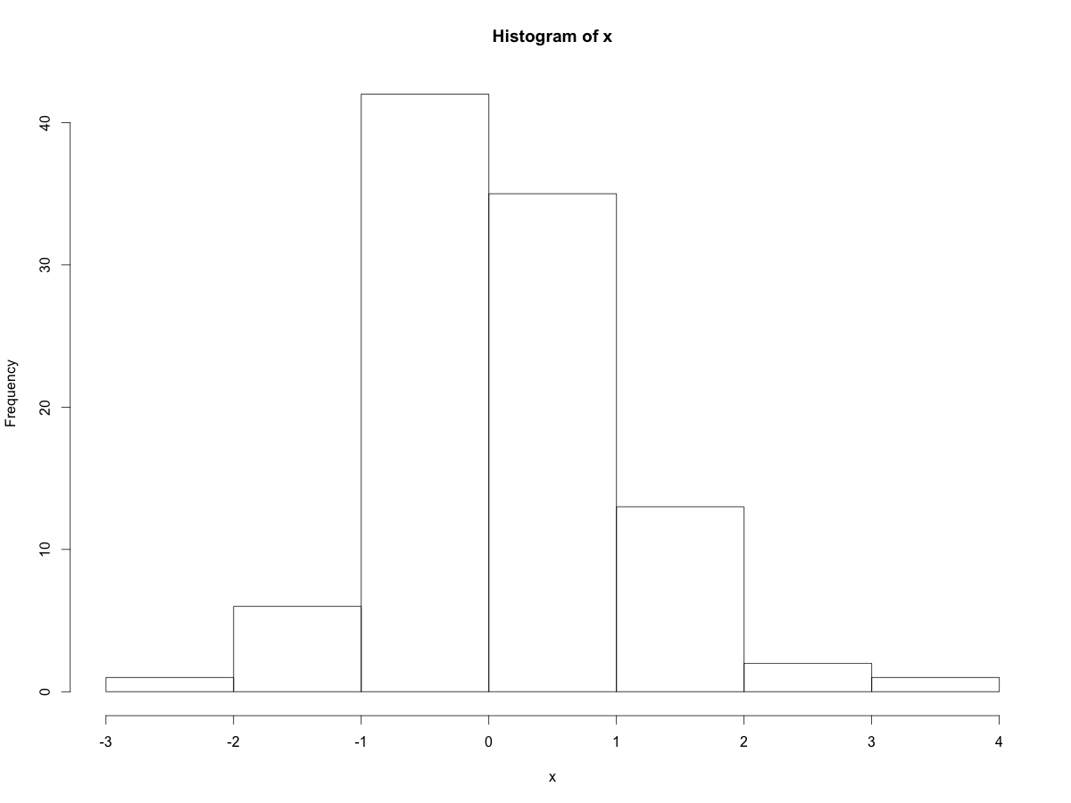
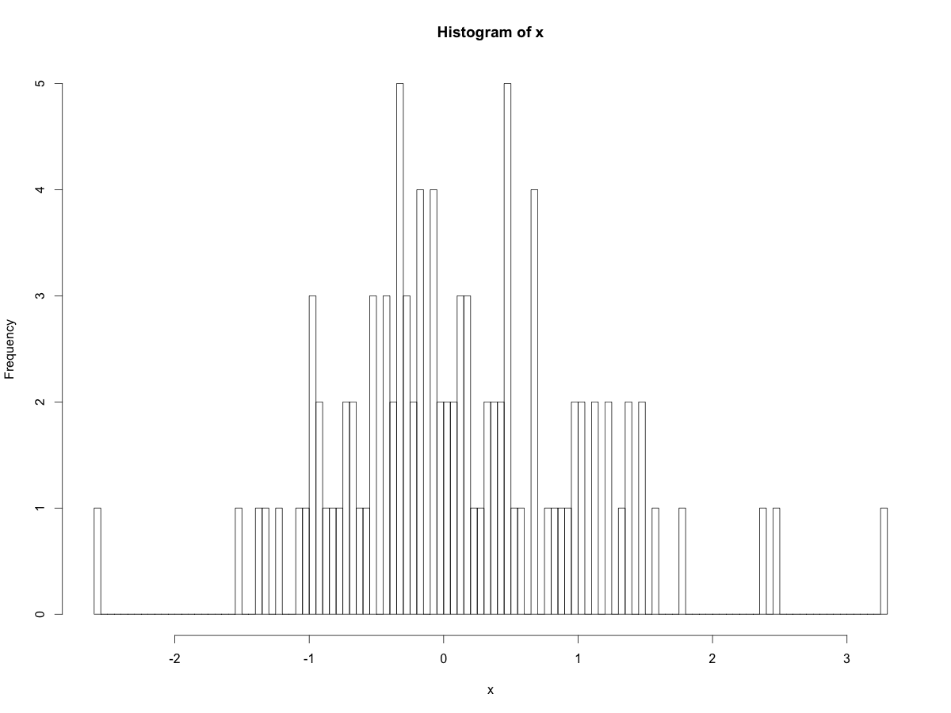
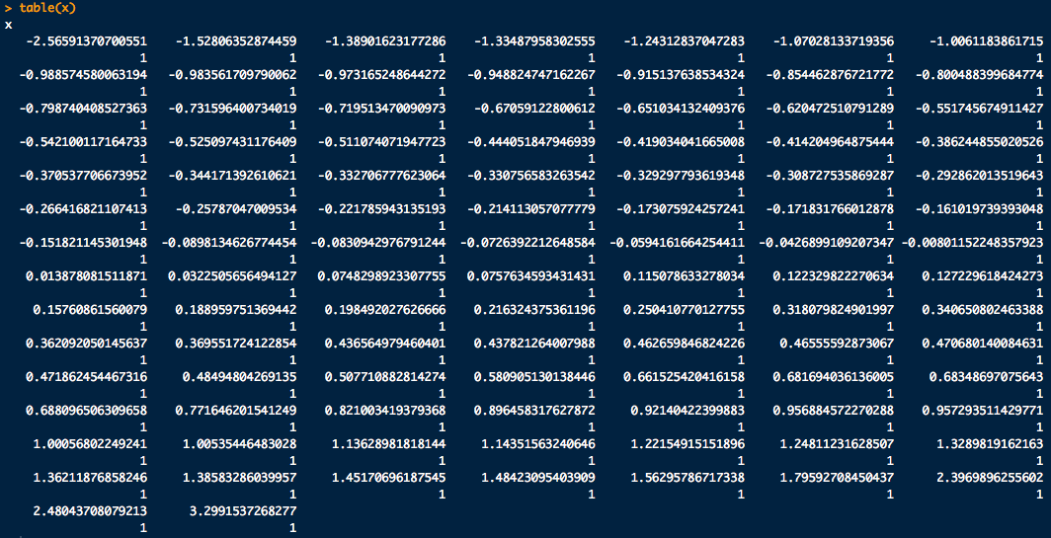
Measures of Central Tendency
Sample mode:
What’s the mode here?
Sample:

Slide 13
Measures of Central Tendency
Sample mode:
Mode of Average Absolute Velocity for Genuine Signatures, LAM:
mode = 9.2541
Med
Avg

Slide 14
Measures of Central Tendency
Some trivia:
Modes
Mean
Nice and symmetric:
Mean = Median = Mode

